Slide 1

CUSTOMER PREDITION
.

Slide 2
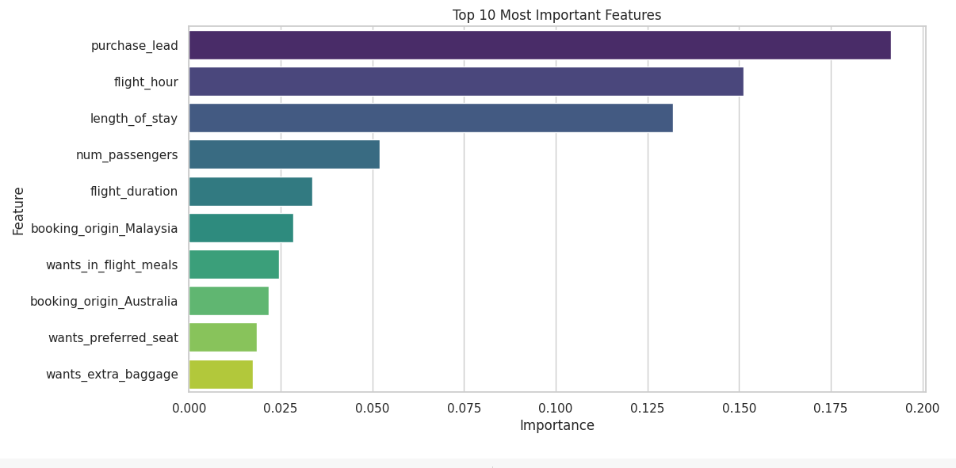
Evaluation
• The most important variable in the model was purchase_lead, that is the time between purchase and departure.
• Information about the flight, e.g. flight time and duration was also significant, however booking origin of the customer was not important.
• The accuracy of the model was approximately 0.7 (Precision) and 0.003 (Recall), showing that this model requires more improvement. I suggest adding more customer-centric features into the model.

