Slide 1
AI AGENT FOR DIGITAL FINANCIAL LITERACY
IBM HACHKATHON PROJECT
Presented By: VARUN B
Roll Number: 20221CIT0150
College Name: Presidency University
Department: CSE

Slide 2
OUTLINE
Problem Statement
Proposed System/Solution
Technologies
IBM Cloud Services
Wow Factor
End Users
API Reference After Deployment
Deployments And Preview
Results
Conclusion
Future Scope
Git Hub Link
IBM Certifications

Slide 3
Problem Statement
AI AGENT FOR DIGITAL FINANCIAL LITERACY: FINANCE_ADVISOR
The Challenge – An AI Agent for Digital Financial Literacy, powered by RAG (Retrieval-Augmented Generation), helps users understand and navigate essential financial tools and practices. It retrieves reliable content on using UPI, avoiding online scams, understanding interest rates, budgeting, and personal finance management from government portals, banking websites, and educational platforms. With multilingual support, users from diverse backgrounds can interact in their preferred language and ask questions like “How do I send money via UPI?” or “What is a safe interest rate for a loan?” The agent ensures financial literacy is accessible, personalized, and culturally inclusive. This AI-driven assistant empowers users with knowledge, protects them from fraud, and builds confidence in digital finance.

Slide 4
TECHNOLOGIES USED:
IBM Cloud Object Storage
Custom Agent Instructions
AI Foundation Model : watsonx.ai
Cloud Platform : IBM Cloud
Large Language Models (LLM’s)
IBM App Connect
IBM Granite Model
IBM Cloud Lite Services
Natural Language Processing
Watsonx.ai Associative Service
Authentication : IBM App ID

Slide 5
IBM CLOUD SERVICES USED:
IBM Cloud Object Storage
AI Foundation Model : watsonx.ai
Cloud Platform : IBM Cloud
IBM App Connect
IBM Granite Model
IBM Cloud Lite Services
Watsonx.ai Associative Service
Authentication : IBM App ID
IBM AI Tools
IBM Cloud watsonx.ai Runtime

Slide 6
WOW FACTORS:
Cognitive AI That Understands Money
Grounded in Real Financial Intelligence (RAG Power)
Talks Like ChatGPT, Thinks Like Warren Buffett
Built Entirely on Enterprise-Grade IBM Cloud Stack
Hyper-Personalized Financial Guidance
Bridges Knowledge Gaps With Smart Questions
Ethical AI With Boundaries
Transforms Passive Learning into Active Financial Mastery
Fuses Finance, Psychology, and AI into a Single Intelligent Ecosystem
Built to Scale from Student Projects to Real-World Fintech

Slide 7
END USERS OF FINANCE_ADVISOR:
College Students & Young Professionals
Working-Class Individuals
Non-Finance Background Learners
Retail Investors & Stock Market Enthusiasts
Small Business Owners / Entrepreneurs
Aspiring Finance Professionals / MBA Students
General Public Seeking Financial Literacy
Retired Individuals & Senior Citizens
Freelancers & Gig Workers
Educators & Financial Literacy Trainers

Slide 8
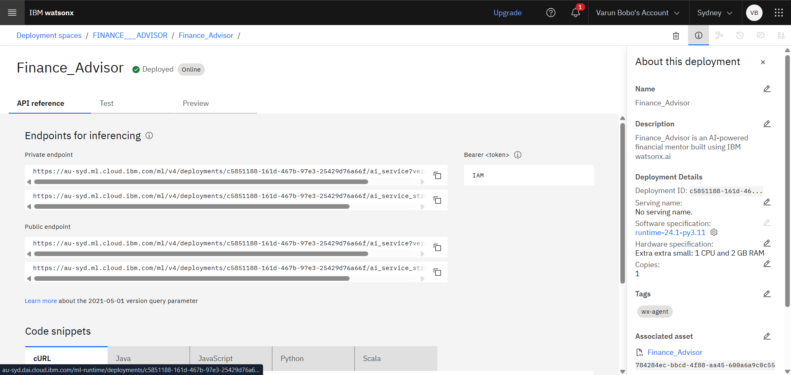
API REFERENCE AFTER DEPLOYMENT:

Slide 9
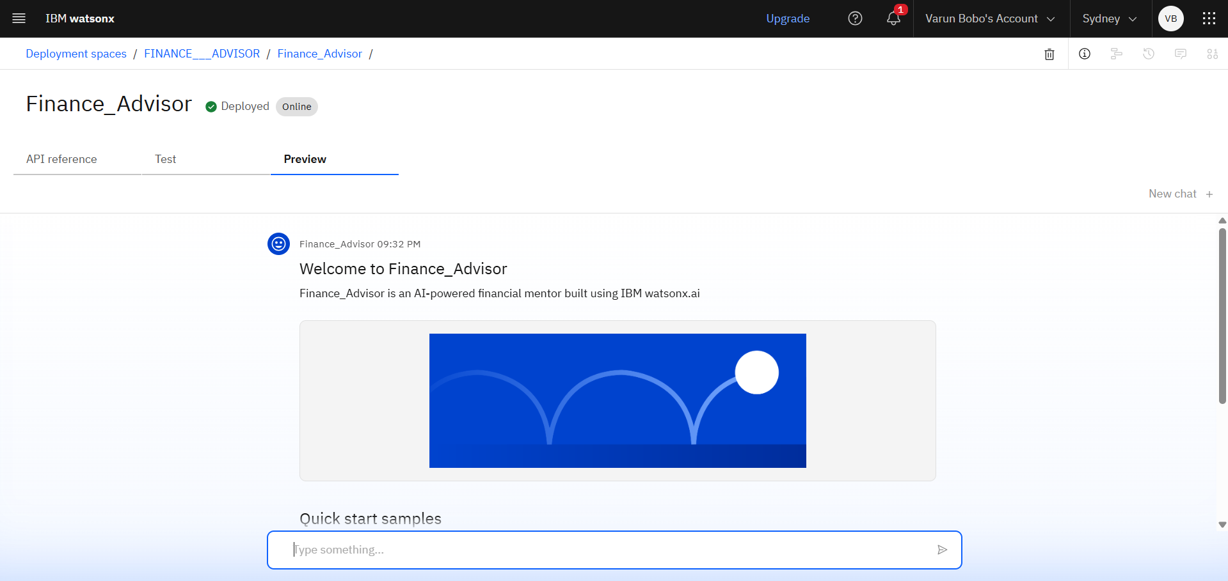
DEPLOYMENT AND PREVIEW:

Slide 10
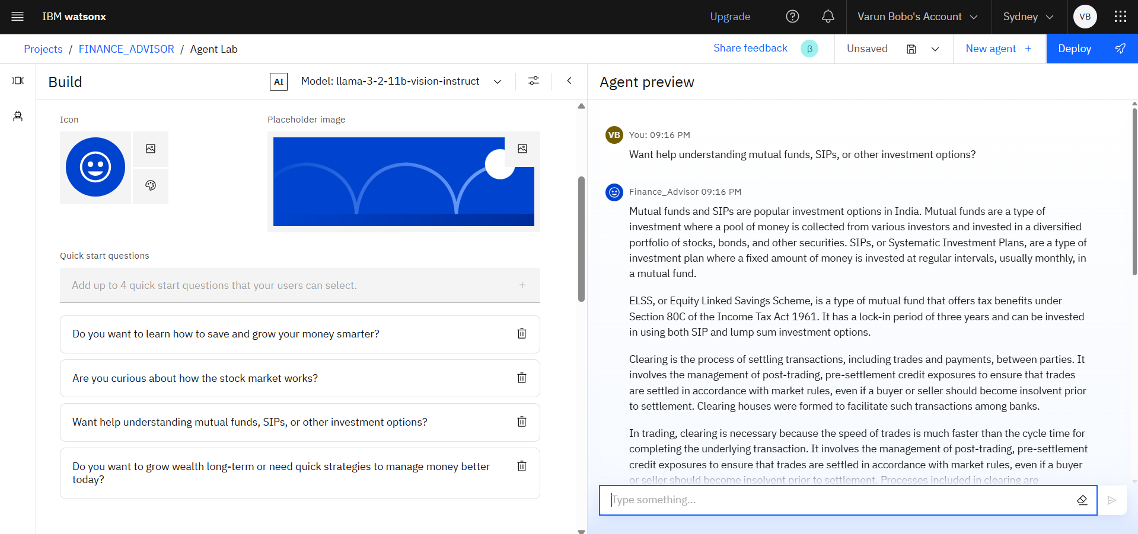
Results:

Slide 11
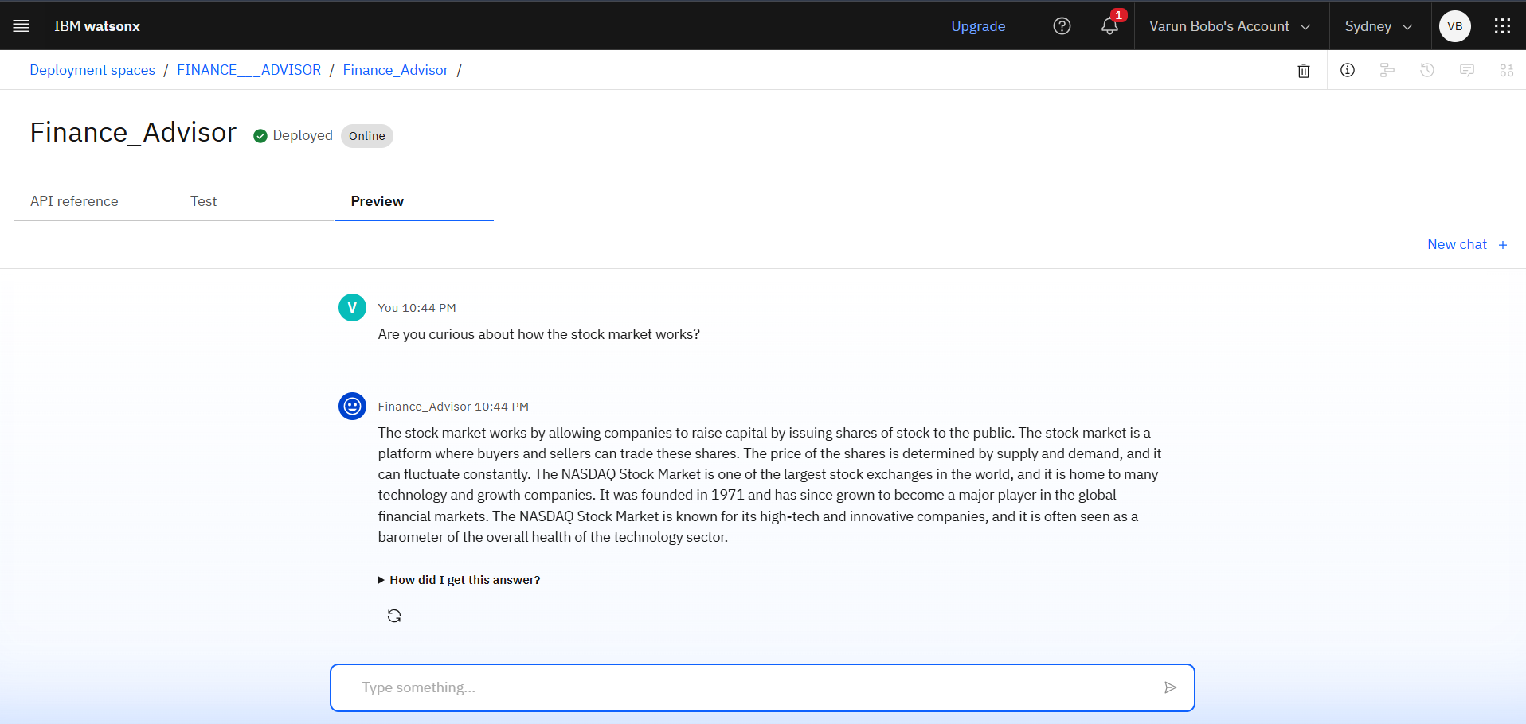
RESULTS:

Slide 12
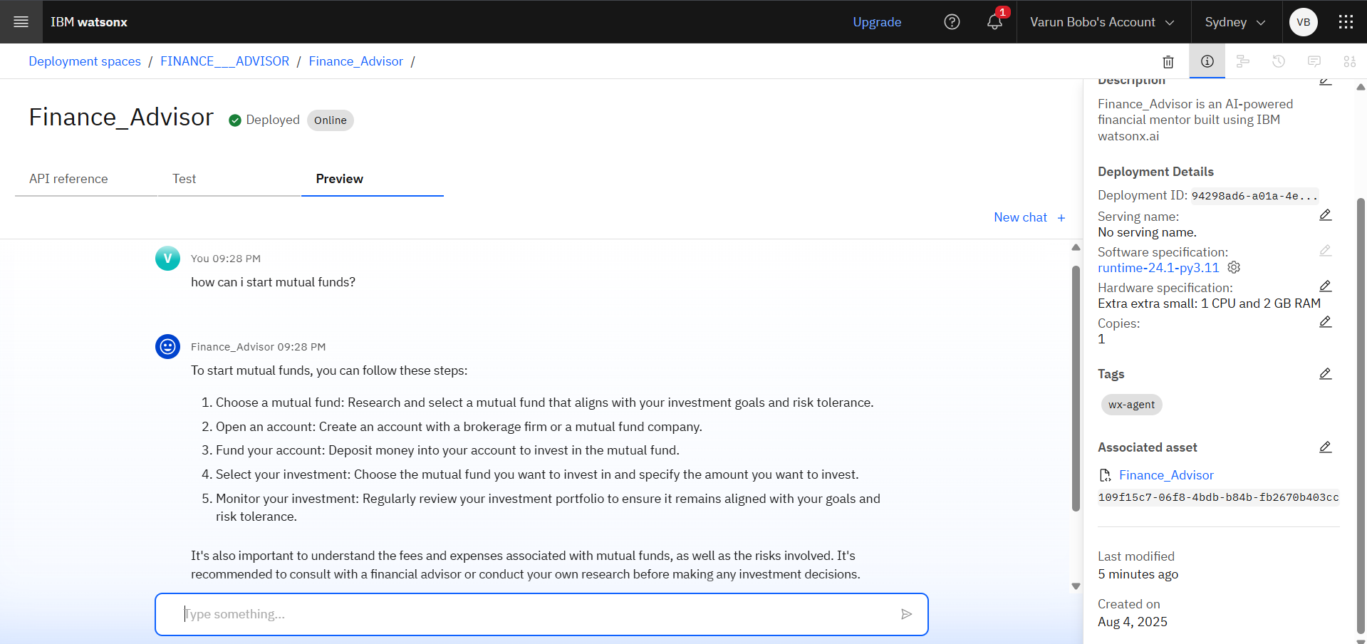
Results:

Slide 13
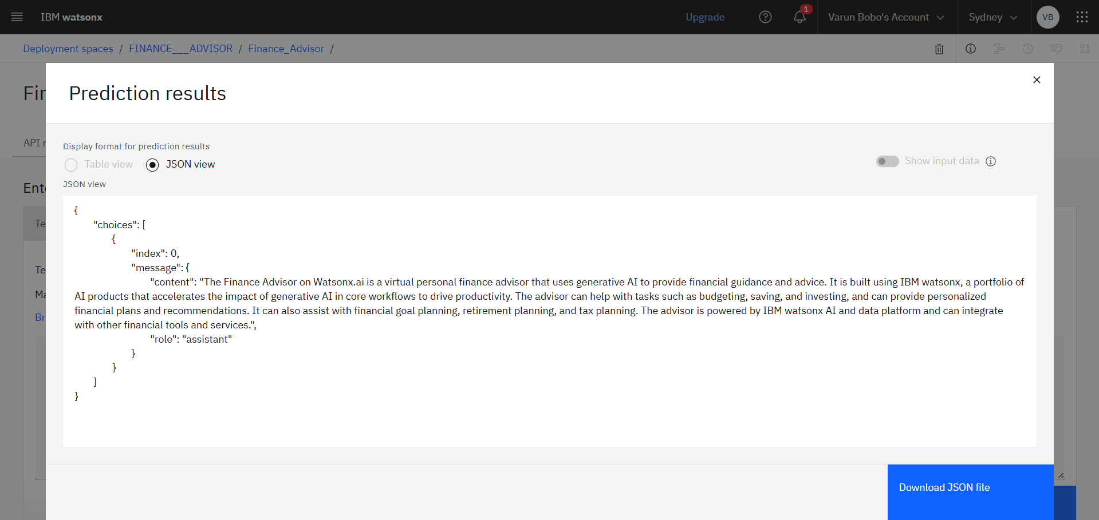
Results:

Slide 14
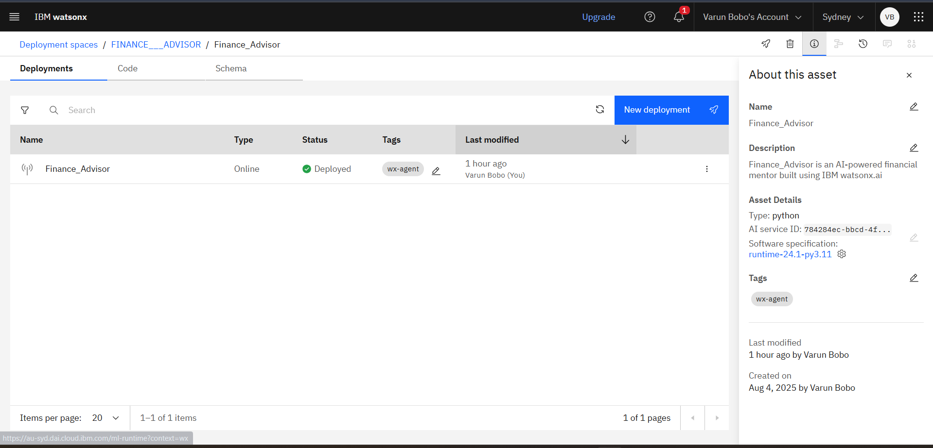
Results:

Slide 15
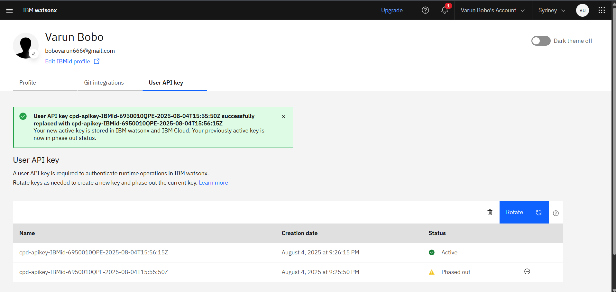
Results:

Slide 16
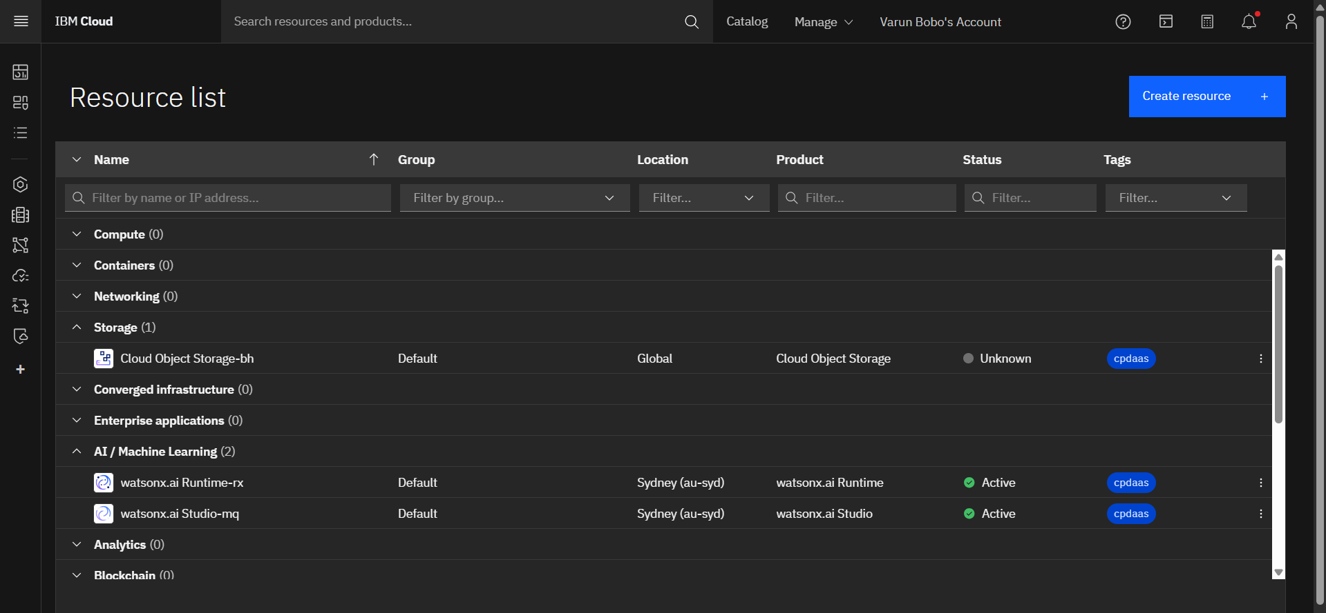
Results:

Slide 17
future scope:
Integration with Real-Time Financial Data Sources
Multilingual and Voice-Based Interaction
Personalized Financial Roadmaps
Regulatory and Taxation Intelligence
Mobile App Deployment & Cross-Platform Accessibility
Gamified Financial Education Modules
Enterprise Use Cases: Fintech & EdTech Integration
Predictive Financial Analytics
Blockchain and Digital Asset Advisory
Continuous Learning through Feedback Loops

Slide 18
conclusion:
The Finance Advisor project is a strategic fusion of AI, financial intelligence, and user-centric design — built on IBM Cloud with watsonx.ai at its core. It delivers precise, grounded, and interactive financial insights, transforming complex market knowledge into simple, actionable guidance for users of all levels. This solution not only addresses the rising demand for accessible financial literacy but also showcases real-world application of GenAI, retrieval-based learning, and intelligent dialogue systems. It’s not just a chatbot — it’s a scalable, intelligent financial companion with the potential to redefine digital finance advisory.

Slide 19
References
1. IBM Cloud & watsonx.ai Documentation https://www.ibm.com/docs/en
2. IBM SkillsBuild Virtual Internship Program
3. Books & Thought Leaders in Finance
The Intelligent Investor – Benjamin Graham
The Psychology of Money – Morgan Housel
4. National Stock Exchange (NSE) & SEBI Resources https://www.nseindia.com
5. Mentorship Support I sincerely thank my mentor, whose guidance during the IBM SkillsBuild VirtualInternship Program was
instrumental in enhancing my technical clarity, thought process, and project execution.

Slide 20
GIT HUB LINK:

Slide 21
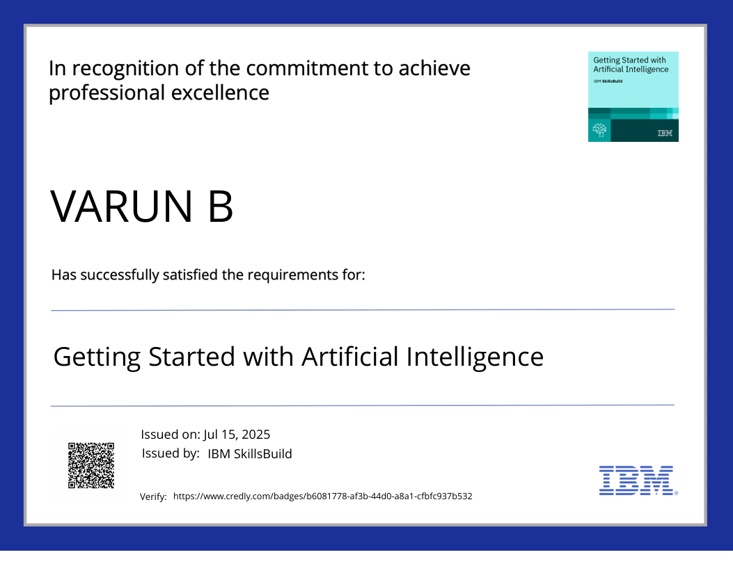
IBM Certifications

Slide 22

IBM Certifications

Slide 23
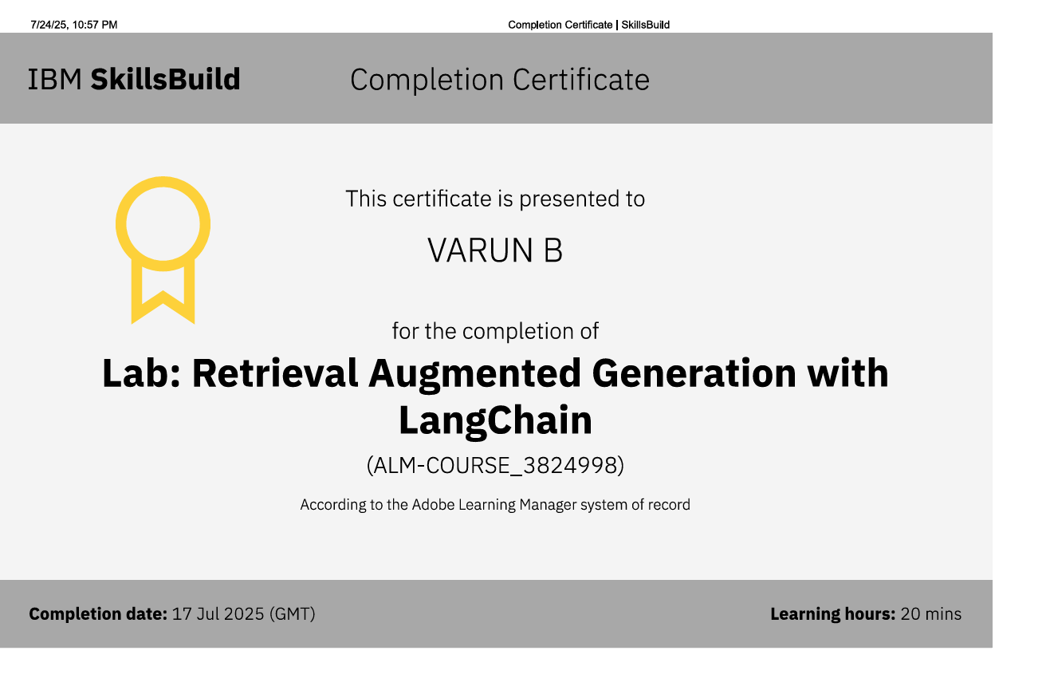
IBM Certifications

Slide 24
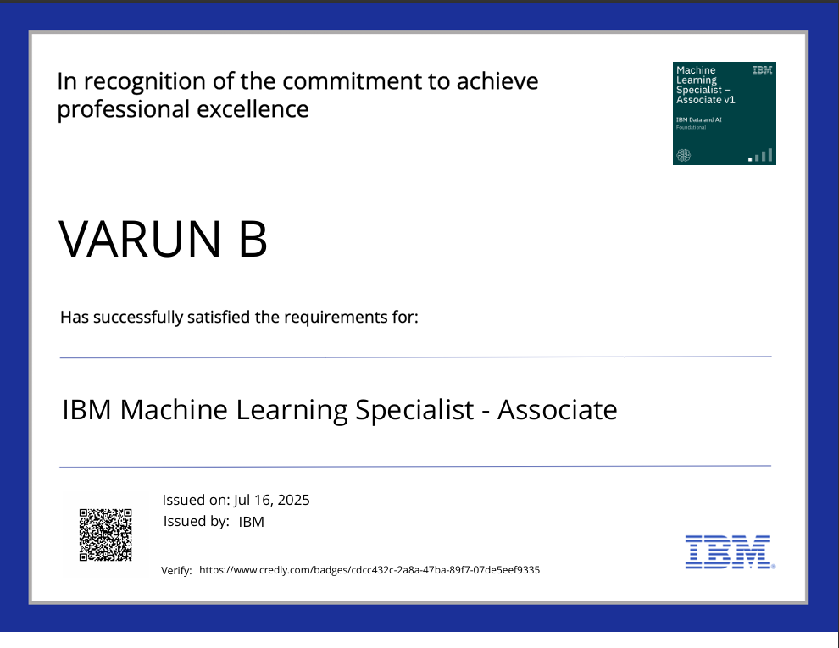
IBM Certifications

Slide 25

IBM Certifications

Slide 26
THANK YOU

