Slide 1
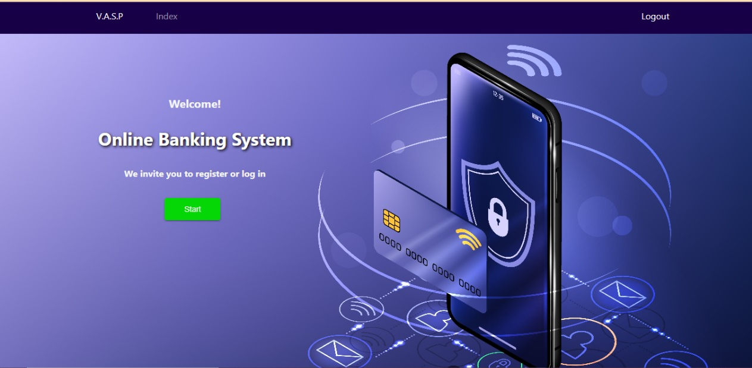
Online Banking System

Slide 2

Team members:
Presented by:
Varun Dabhare
Aastha Topwal
Ankithraddi .
Prathik T P Sarita Negi
Vijayalakshmi M

Slide 3
Introduction:
Online Banking System is a web application developed using Java programming. In this website there will be three major accounts namely-
Admin Account, Employee Account and Client Account
This web application has functionalities like creating a new account, adding employees, currency exchange, transfer of amount, credits, deposits and password change.
All the models which are implemented in this web app is interrelated and plays a key role throughout the application.
Some of the functionalities were created using reusable codes which are taken from online resources.

Slide 4
Requirements:
Windows version 7+
Frontend Software: Html, CSS , Typescript, Angular.
Backend software: Java, Spring Boot, Spring Data JPA, Database(Oracle).

Slide 5


Used Tools and technologies:
Frontend: Html , CSS, Typescript and Angular.
Back end: Spring tool suite
Database(Oracle).
Eclipse IDE
VS Code

Slide 6
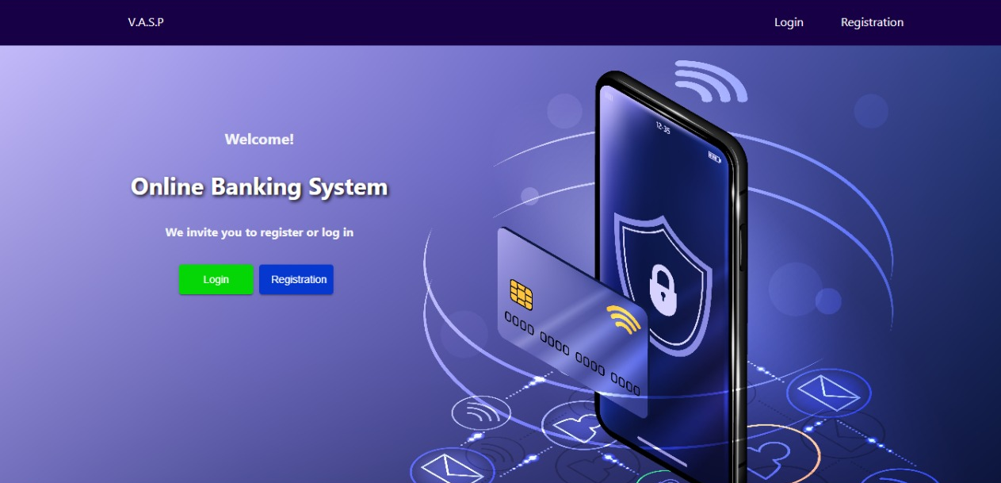
Home page

Slide 7
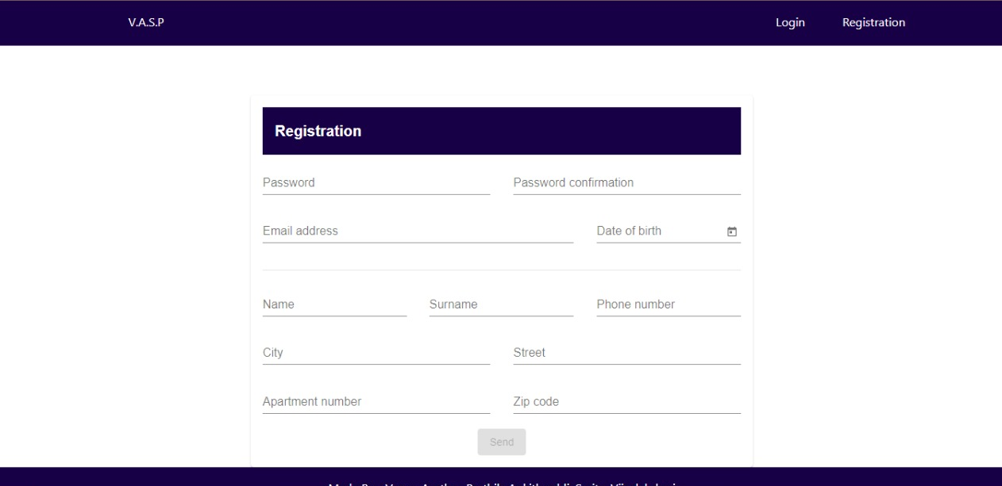
Registration page

Slide 8
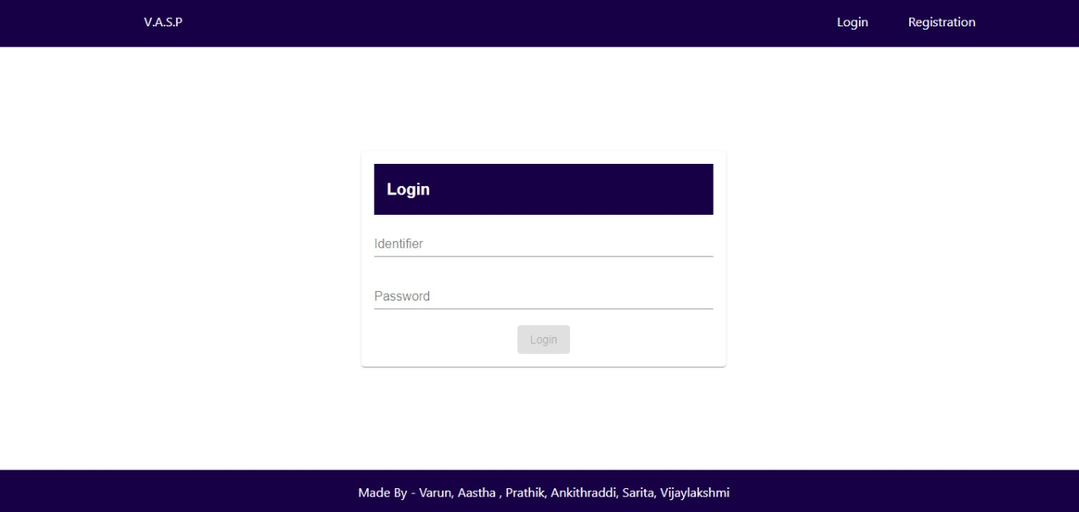
Login page

Slide 9
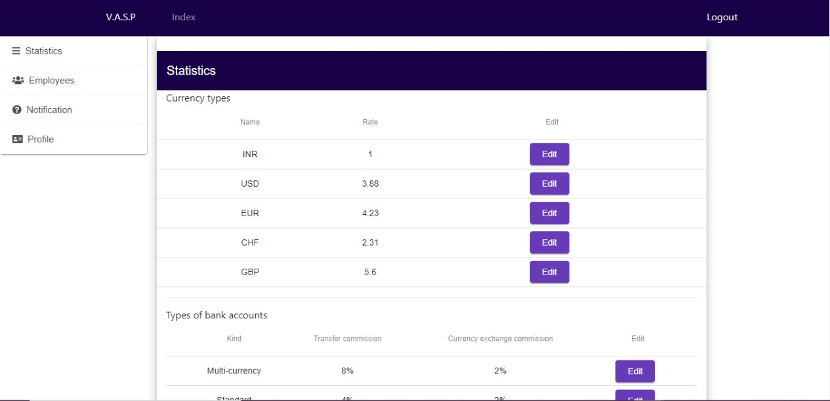
Admin account

Slide 10
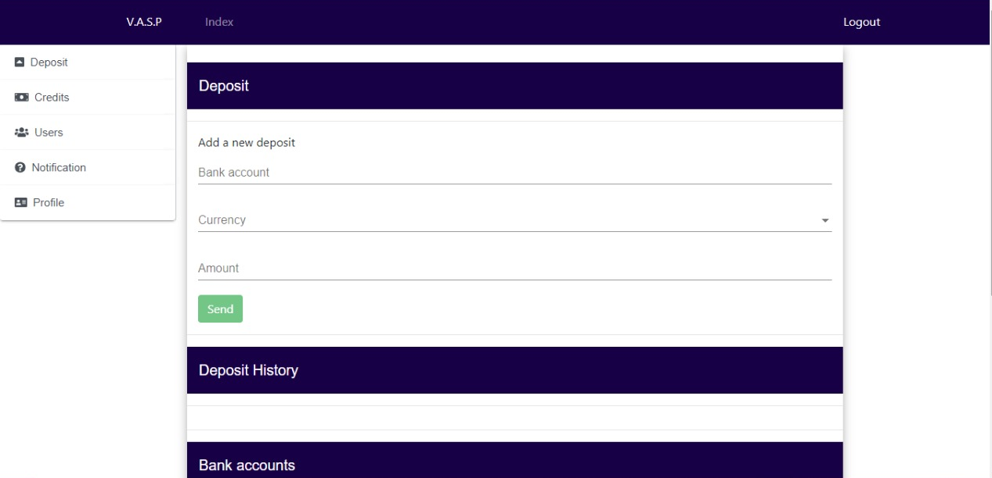
Employee Account

Slide 11
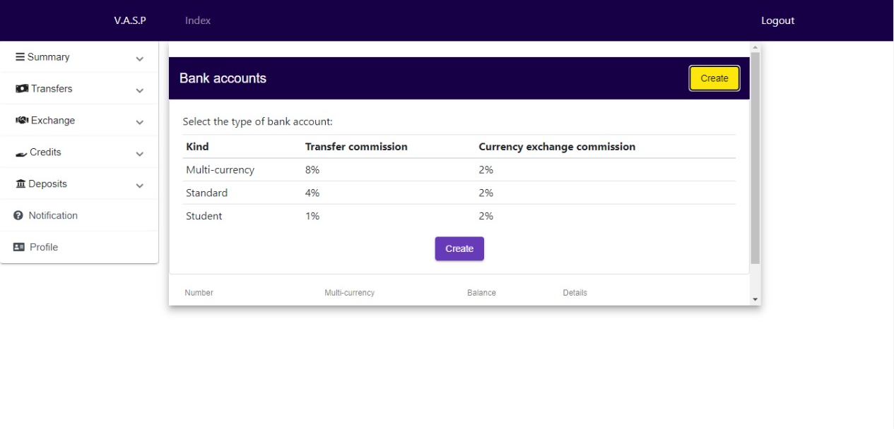
Client account

Slide 12
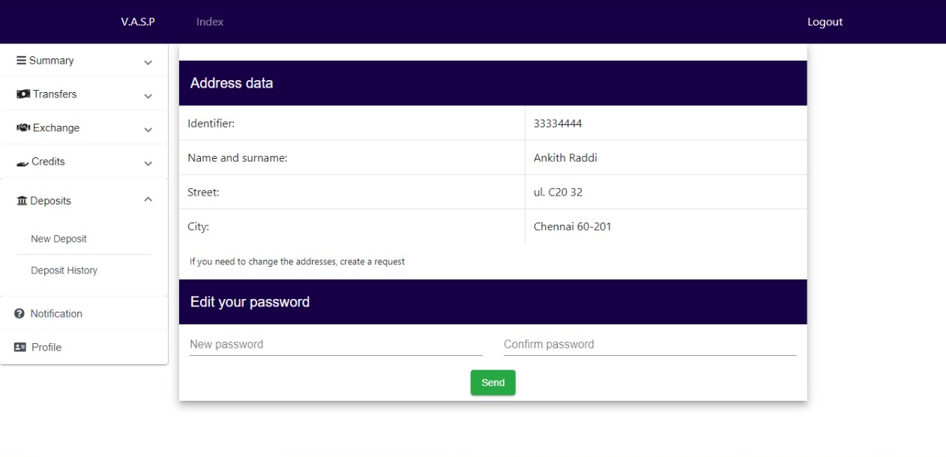
Profile page

Slide 13
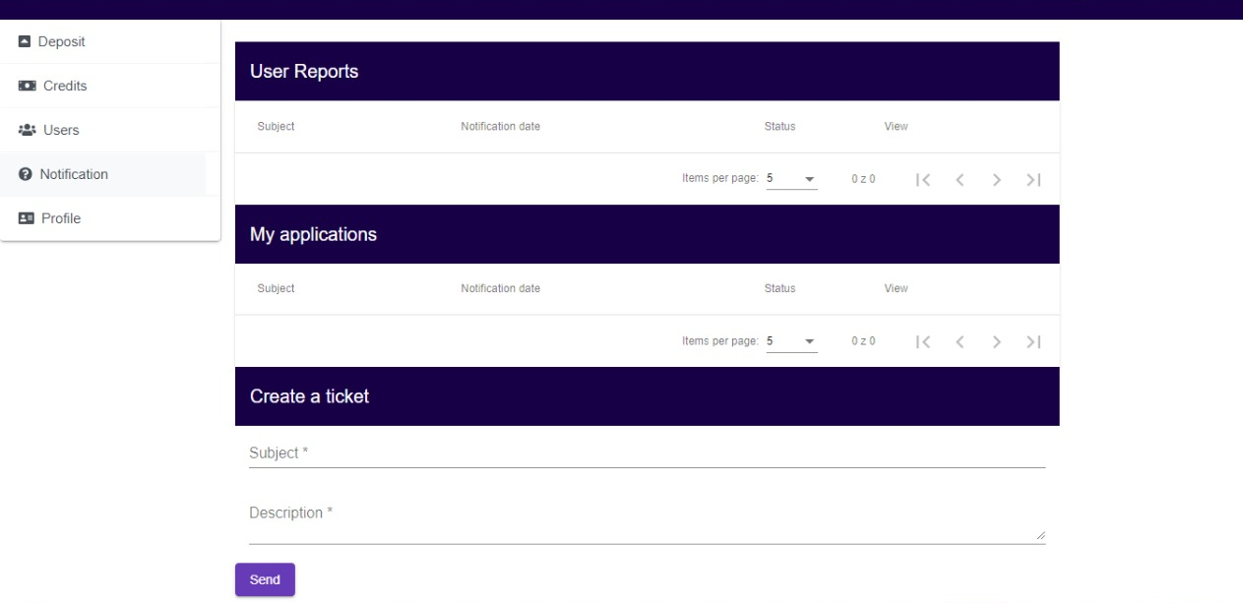
Notification panel

Slide 14


