Slide 1



ENGINEERING PROJECT SHOWCASE
AI-Powered Docker
Natural Language Dashboard
Smart Container Monitoring and Management using AI and Docker
TEAM TECHNOVA
Varun Kumar M
Akash K
Salman Khan S
Yogesh S
React + TS
Express
Ollama AI
Docker Engine
TechNova | AI Docker NL Dashboard
01

Slide 2


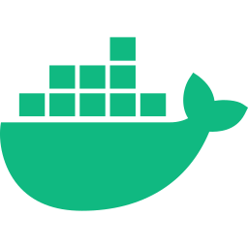

Team TechNova
Contribution Board — Roles & Connections
Varun Kumar M
Akash K
Salman Khan S
Yogesh S
Backend & Agent Orchestration
AI / LLM Integration
Docker Execution Layer
Frontend & Dashboard UX
AgentController, execution pipeline, system integration
LLMService, Ollama prompt design, intent translation
DockerExecutor, container actions, engine communication
React + Tailwind dashboard, API integration, visualization
All roles connect through one execution pipeline: Dashboard -> Backend -> AI -> Docker Engine
TechNova | AI Docker NL Dashboard
02

Slide 3



The Problem
Why Docker monitoring is harder than it should be
Developer
Commands
Complexity
Needs to monitor & manage running containers daily
Must recall and type many docker CLI commands correctly
Logs, stats, health checks scattered across multiple terminal windows
Core Pain Points
Manual commands slow down debugging during incidents
Switching between multiple terminal tabs breaks focus
New developers face a steep Docker CLI learning curve
No unified, real-time view of container health & resource usage
TechNova | AI Docker NL Dashboard
03

Slide 4







Our Solution
AI-Powered Docker Dashboard — Simplifying DevOps through Natural Language
Natural Language Interaction
How It Works
Type plain English — AI translates intent to Docker commands automatically
User Prompt
Easy Container Management
Start, stop, restart and inspect containers with a single prompt
AI Intent
Real-Time Health Monitoring
Live CPU, memory and health status displayed on one unified dashboard
Docker Action
User-Friendly Interface
Dashboard
React + Tailwind UI with no CLI knowledge required to operate
Prompt-Based Deployment
DevOps Simplification
Trigger container lifecycle actions just by describing what you need
No CLI memorisation required for container ops
Simplifies DevOps Operations
One dashboard replaces multiple terminal windows
Reduces manual overhead, speeds up incident response and lowers skill barriers
AI-driven actions cut incident response time
TechNova | AI Docker NL Dashboard
04

Slide 5




Docker Fundamentals
Core concepts powering the project
Engine
Images
Containers
Lifecycle
Runtime that builds, runs, and manages containers on the host OS
Read-only templates packaging app code, dependencies & config
Lightweight, isolated running instances created from images
Create -> Start -> Stop -> Restart -> Remove, managed via the engine
Container vs Virtual Machine
Containers (Docker)
Virtual Machines
Share host OS kernel - lightweight
Each VM runs its own full guest OS
Start in seconds, minimal overhead
Slower to boot, heavier resource use
Higher density per host machine
Lower density, more overhead per app
Ideal for microservices & rapid scaling
Stronger isolation, higher cost per workload
TechNova | AI Docker NL Dashboard
05

Slide 6






Why Docker is Chosen Globally
Key advantages that make Docker the industry standard for containerisation
Lightweight
Fast Deployment
Portability
Scalability
Shares host OS kernel — no full guest OS per app. Runs with minimal memory and CPU overhead.
Containers start in seconds. Ship code from dev to production with a single command.
Build once, run anywhere — laptop, server, or cloud. Same image, identical behaviour.
Spin up multiple container instances effortlessly to handle growing workloads.
Isolation
Efficient Resources
Industry Demand
Each container runs independently with its own filesystem and network namespace.
Higher app density per server than VMs. Cuts infrastructure cost significantly.
Used by Netflix, Google, Meta and thousands of enterprises for production workloads.
Real-World Use Cases:
Netflix — streaming microservices
Spotify — CI/CD pipelines
Airbnb — dev environment parity
NASA — scientific data processing
TechNova | AI Docker NL Dashboard
06

Slide 7


Frontend Architecture
React + TypeScript + Vite + Tailwind
Dashboard Component Flow
API Communication
PromptInput
Sends prompts via REST calls to Express backend
Captures user's natural language command
Receives structured JSON: intent, action, result
Async fetch with loading & error states
AgentStatusPanel
Live UI updates after each execution cycle
Shows AI processing & execution state
Tech Stack
ContainerMonitor
React
Displays live container stats & health
TypeScript
LogsViewer
Vite
Streams logs and execution output
Tailwind CSS
View Live Application
TechNova | AI Docker NL Dashboard
07

Slide 8
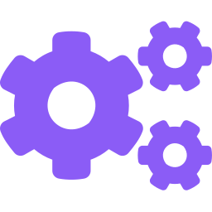
Backend Architecture
Express + TypeScript — Layered request processing
Request Layer
Express routes receive dashboard API calls (prompt, action requests)
Execution Layer
AgentController -> LLMService -> DockerExecutor pipeline runs the task
Response Layer
Formatted JSON result returned to the React dashboard
TechNova | AI Docker NL Dashboard
Request -> Execution -> Response
08

Slide 9

End-to-End Workflow
From a natural language prompt to a live dashboard update
1
2
3
4
5
6
Prompt
Intent
Backend
Docker
Monitor
Dashboard
User types a natural language command
LLMService.translate() interprets meaning via Ollama
AgentController.runAgent() coordinates execution
DockerExecutor runs the action via executeAction()
Container stats, logs & health captured
Results rendered back to the user in real time
Prompt -> Intent -> Backend -> Docker -> Monitor -> Dashboard
TechNova | AI Docker NL Dashboard
09

Slide 10

Internal Working — One Complete Execution Cycle
Sequence diagram of a single natural language request
User
Backend
AgentController
LLMService
DockerExecutor
Docker Engine
Formatter
Dashboard
Types prompt
Receives API request
runAgent() starts cycle
translate() via Ollama
executeAction() runs op
Performs container action
Formats result payload
Displays final response
Request
AI Processing
Docker Execution
Output
Execution Cycle Explained
User enters a request (e.g. "restart unhealthy containers") on the dashboard.
Backend forwards it to AgentController.runAgent(), which drives the whole cycle.
LLMService.translate() asks Ollama to convert the prompt into a structured intent.
DockerExecutor.executeAction() runs the corresponding Docker Engine command.
The result is formatted and pushed back to the dashboard for the user to see.
TechNova | AI Docker NL Dashboard
10

Slide 11


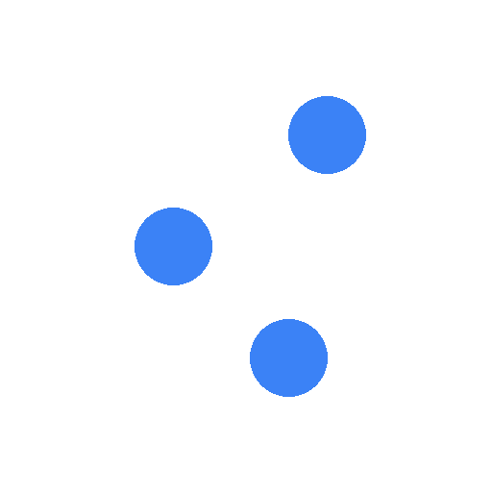





Key Features
★ STAR FEATURE
🌐 Globally Deployed Live Demo — Connect Any Docker Device Instantly
Visit the hosted website → connect your Docker → copy ONE command → paste in terminal → your containers appear live. Works on any OS, any device, anywhere in the world.
AI Command Execution
Real-Time Monitoring
Container Controls
Health Tracking
Natural language → Docker action in milliseconds
WebSocket updates every 3 seconds, no refresh needed
Start, Stop, Restart containers from the UI
CPU, Memory, Uptime, Health status per container
Live Log Viewer
Error Detection
Markdown Reports
Token Auth Security
Real-time stdout/stderr log streaming per container
AI identifies crashes and suggests fixes automatically
AI generates colored, formatted diagnostic reports
Dashboard token protects write operations in production
TechNova | AI Docker NL Dashboard
11

Slide 12
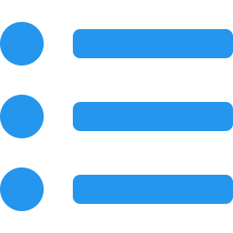
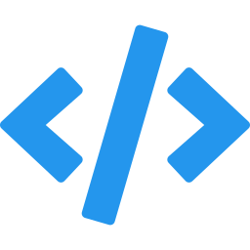



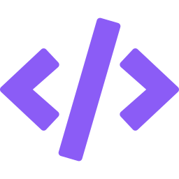

Markdown Integration
Lightweight, readable documentation powering the project's technical content
What is Markdown?
Easy Documentation
Markdown is a lightweight plain-text formatting language that converts to styled HTML with minimal syntax — making documentation fast to write and easy to read on any platform.
Write structured docs using simple #, *, **, [] syntax
Readability
Plain text is human-readable even before rendering
Why Markdown is Used
Lightweight Format
Renders natively on GitHub, GitLab and most dev platforms
No bloated editors — just .md files in the repo
No special editor needed — any text editor works
Version control friendly — diffs are human-readable
Tech Doc Support
Code blocks, tables, links and headers all natively supported
How Markdown Helps Users & Developers
Developer Friendly
Users: README files explain how to run the dashboard without navigating code
Widely used in open-source — README.md is universal
Developers: API docs, setup guides and changelogs stay inside the repo
Platform Agnostic
Reviewers: Clean, structured documentation speeds up project evaluation
Renders on GitHub, Notion, VS Code, Confluence and more
TechNova | AI Docker NL Dashboard
12

Slide 13



Who Is This For
Target users of the AI Docker Dashboard
Developer
DevOps Engineer
Student
Startup Team
Monitor and manage containers without leaving the dashboard during development
Quickly check container health & resource usage using natural language
Learn Docker concepts interactively without memorizing CLI commands
Lightweight container oversight without setting up complex tooling
TechNova | AI Docker NL Dashboard
13

Slide 14

Unique Value Proposition
Traditional commands vs Prompt + Dashboard experience
Traditional Commands
Prompt + Dashboard
Type exact docker CLI syntax
Describe what you want in plain English
Memorize flags and subcommands
AI (Ollama) translates intent automatically
Switch between many terminal windows
AgentController + DockerExecutor act for you
No visual feedback - text output only
Real-time visual results on one screen
Slower for non-experts and beginners
Accessible to developers of all skill levels
TechNova | AI Docker NL Dashboard
14

Slide 15
Challenges & Solutions
Problems faced during implementation and how we solved them
Problem
Problem
Translating varied natural language phrasing into precise Docker actions
Ensuring DockerExecutor only runs safe, valid container operations
Solution
Solution
Designed structured prompt templates for LLMService.translate() to constrain Ollama output
AgentController validates intent before DockerExecutor.executeAction() runs
Problem
Problem
Keeping the dashboard responsive during long-running Docker operations
Handling inconsistent or partial Docker Engine responses
Solution
Solution
Async execution with clear loading and status states in the React UI
Centralized response formatting before sending data to the dashboard
TechNova | AI Docker NL Dashboard
15

Slide 16





Future Roadmap
Planned enhancements beyond the current implementation
Kubernetes Support
Cloud Deployment
Voice Commands
Mobile App
Smart Recommendations
Extend orchestration beyond single-host Docker Engine
Host the dashboard and agent on cloud infrastructure
Voice-driven prompts for hands-free container management
Companion mobile app for monitoring on the go
AI-suggested optimizations based on usage patterns
TechNova | AI Docker NL Dashboard
16

Slide 17


Project Impact
Measurable improvements over traditional Docker workflows
Reduced
Faster
Simpler
Manual Effort
Monitoring
Interaction
Natural language replaces multi-step CLI sequences for common tasks
Live container stats, logs and health in a single unified view
Prompt-driven actions accessible to users of any experience level
Outcome: a streamlined, AI-assisted Docker monitoring and execution experience built on a fully working pipeline.
Launch Dashboard
TechNova | AI Docker NL Dashboard
17

Slide 18


Conclusion
From problem to working AI-powered Docker management system
Problem
Architecture
Execution
Outcome
Docker management was manual, command-heavy and error-prone
React dashboard, Express backend, Ollama AI and Docker Engine integrated end to end
AgentController, LLMService and DockerExecutor form one reliable pipeline
A working AI-powered dashboard for natural language Docker monitoring & control
TechNova — Simplifying Docker Management using AI
TechNova | AI Docker NL Dashboard
18

Slide 19
Thank You
Questions & Discussion
Varun Kumar M
Akash K
Salman Khan S
Yogesh S
Team TechNova | AI-Powered Docker Natural Language Dashboard
19

