Slide 1
School of Computer Science & Engineering
AI Application Development – IA1
Ayu Sutra
“A Smart HealthCare Assistant”

Slide 2
Team members & roles
Team member name | Role
B Nishitha Mani-R23EF044 | Team Lead and Development Lead
A Shruthi-R23EF003 | Developer
Varshata-R23EF299 | DevOps / GitHub / Product Build / Documents
Nihal Prakash Nayak-R23EF154 | Test Lead
Amulya K-R23EF020 | Customer Contact Lead
Notes:
Talk about how they are managing their documents, how google docs does automatic versioning
As them what they know about Android and IoS versions

Slide 3
Problem Statement
In critical moments, delayed or wrong healthcare decisions can cost lives due to lack of proper guidance. A smart system is needed to instantly connect users to the right medical services based on their symptoms and location.
Notes:
Talk about how they are managing their documents, how google docs does automatic versioning
As them what they know about Android and IoS versions

Slide 4
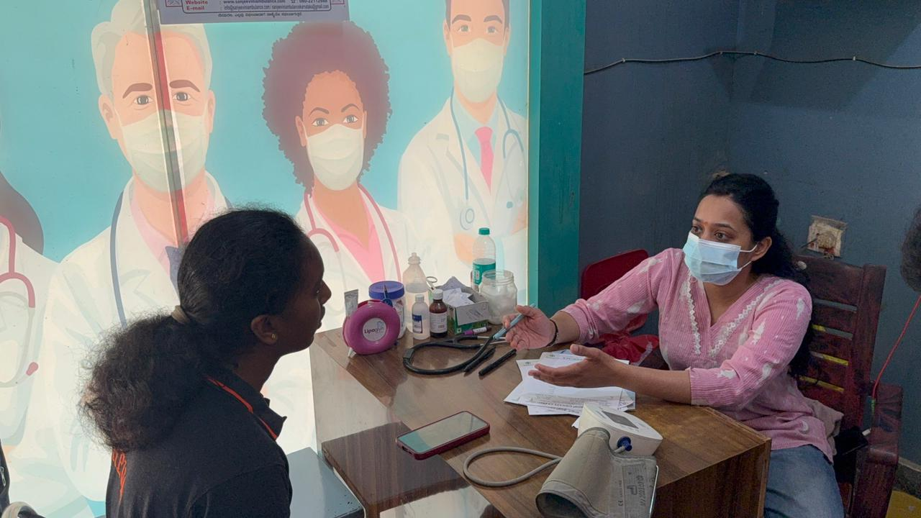
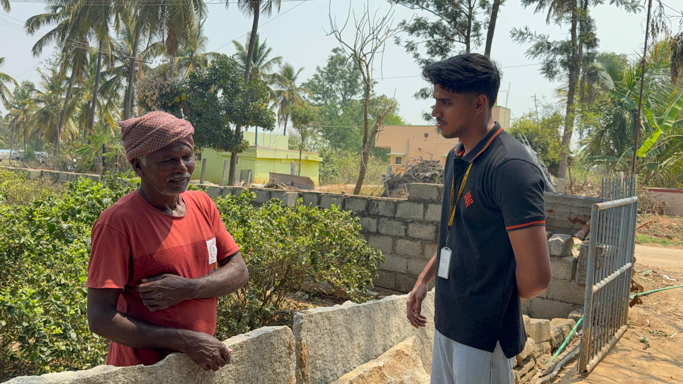
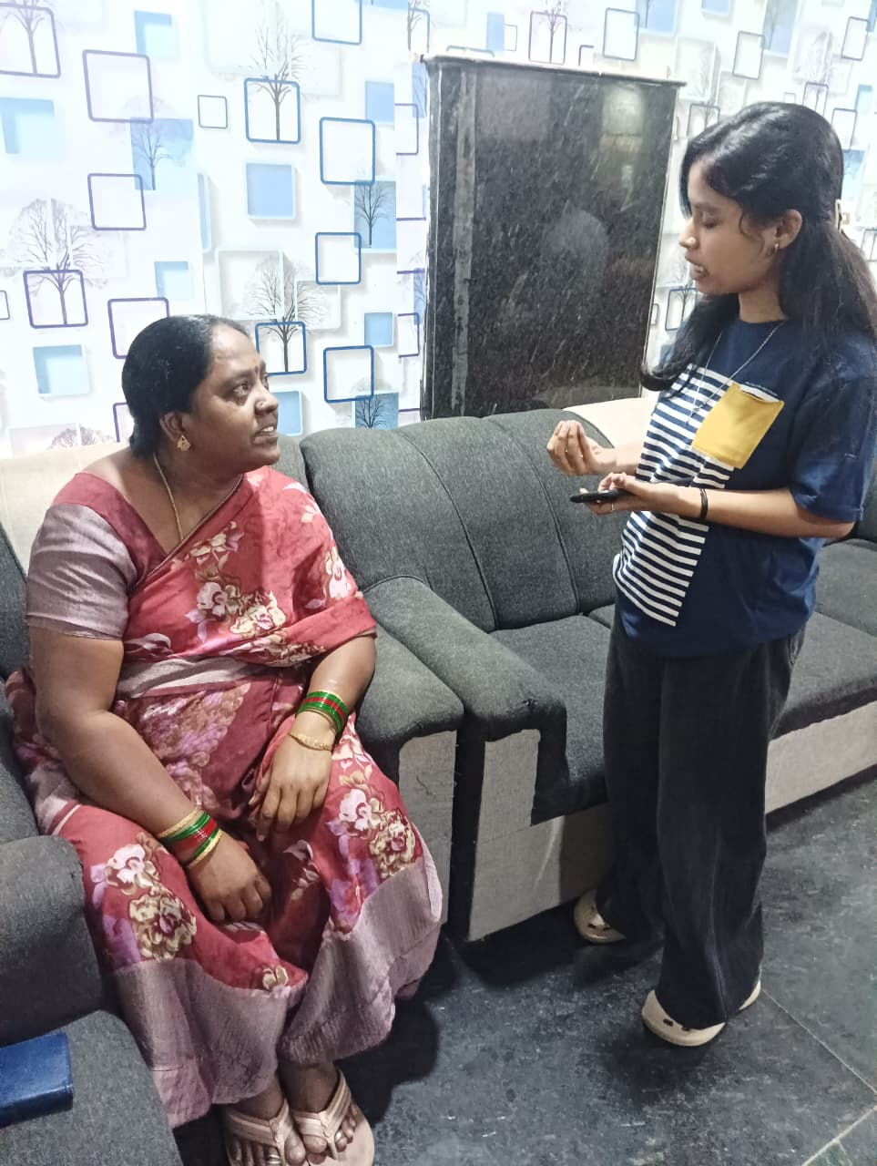
User/ Customer Understanding
Survey form
https://forms.gle/dMSd729nJ6ZcadCS9
Customer Interaction Link:
https://drive.google.com/drive/folders/1vEstfkfZbUiPg5BQRh5lmQjovcD_g9i6?usp=sharing
Notes:
Talk about how they are managing their documents, how google docs does automatic versioning
As them what they know about Android and IoS versions

Slide 5
Ideal Customer Profile (ICP)
Our Ideal Customer:
Demographic Profile
Age: 18 – 60 years
Location: Rural and Semi-Urban areas ,Urban areas
Occupation: Farmers, daily wage workers, small business owners, homemakers
Device Usage: Basic smartphone users with limited but active internet access
Psychographic Profile
Feels uncertain and dependent when health issues occur.
Prefers simple and clear guidance rather than complex information .
Has limited awareness of nearby healthcare facilities .
Values trust, affordability, and accessibility .
Gets stressed during emergencies due to lack of quick support.
Notes:
Only stress on the 1st sentence – the definition
Come back to the 2nd sentence in the end as part of revision

Slide 6
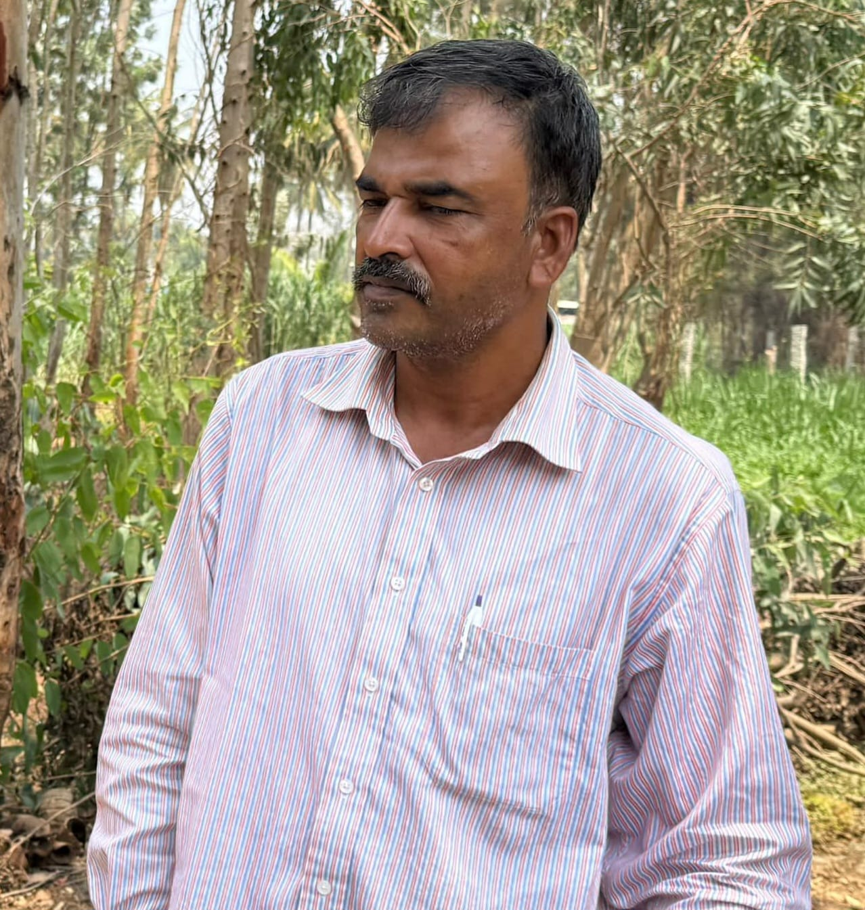
Customer Persona (CP)
BIO:
Kailash is a 45-year-old mechanic living in a semi-urban area of Yadgir, Karnataka. When his daughter fell seriously ill, the doctor recommended a CT scan, but he struggled to find a nearby diagnostic center. After diagnosis, she was found to have a kidney infection and was referred to a city hospital. Krishna was confused about which hospital to visit, which department to approach, and how to proceed, causing delays in treatment.
He needs a simple, unified healthcare solution that can help him understand medical conditions, guide him step-by-step, recommend the right hospitals and services, and support him in his local language.
Kailash
Goals:
Get the right treatment quickly for his family.
Understand medical conditions and next steps clearly.
Find reliable hospitals and diagnostic centers nearby.
Frustrations
Difficulty in finding nearby diagnostic centers .
Lack of awareness about hospitals and departments.
Confusion due to complex medical terms.
Delay in treatment due to lack of guidance.
Notes:
Only stress on the 1st sentence – the definition
Come back to the 2nd sentence in the end as part of revision

Slide 7
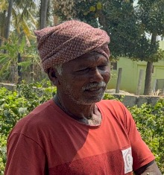
Customer Persona (CP)
BIO:
Ramesh is a 52-year-old farmer from a rural area near Bengaluru Rural, Karnataka. One day, his wife suddenly fell very weak, and the doctor advised immediate blood transfusion and hospital care. Ramesh felt helpless as he did not know where to find a blood bank or how to arrange an ambulance quickly.
He asked people around him, but got different suggestions, which caused confusion and delay. This experience made him realize the need for a simple system that can guide him during emergencies, help find blood banks, ambulance services, and provide clear steps in his local language.
Ramesh
Goals:
Get quick help during emergencies.
Find blood banks and ambulance services easily.
Frustrations:
Confusion and panic during emergencies.
Lack of information about nearby services.
Delay due to dependence on others.
Notes:
Only stress on the 1st sentence – the definition
Come back to the 2nd sentence in the end as part of revision

Slide 8
Product USP
AI-driven symptom analysis that provides personalized healthcare recommendations, not just general search results.
All-in-one healthcare platform combining hospital, diagnostic center, ambulance, and blood bank services.
Location-aware and real-time guidance for quick decision-making, especially during emergencies.
Simple, local-language supported interface designed for rural and semi-urban users.
Notes:
Only stress on the 1st sentence – the definition
Come back to the 2nd sentence in the end as part of revision

Slide 9
Use Cases & High level Requirements
1.Symptom-Based Hospital Recommendation
Input: User enters symptoms (e.g., fever, pain)
Output: Suggested condition + list of suitable hospitals & specialists
2.Diagnostic Center Finder
Input: Test required (e.g., CT scan) + location
Output: Nearest diagnostic centers with details (distance, services)
3.Emergency Ambulance Locator
Input: Current location
Output: Nearest available ambulance services with contact details
4. Blood Bank Search
Input: Blood group + location
Output: Nearby blood banks with availability & contact info
5. Medical Guidance & History
Input: User medical data / previous reports
Output: Stored history + guidance on next steps
Notes:
Only stress on the 1st sentence – the definition
Come back to the 2nd sentence in the end as part of revision

Slide 10
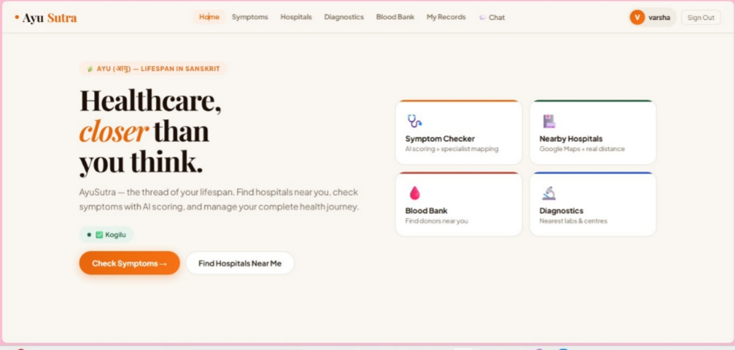
Proof of Concept (PoC) / Prototype Demo Ayu Sutra Prototype demo
Demo Link:
https://drive.google.com/file/d/1lHmNaw0wxxtn8JQcVMCPQRw4NCW-tlWL/view?usp=sharing
Notes:
Only stress on the 1st sentence – the definition
Come back to the 2nd sentence in the end as part of revision

Slide 11
THANK YOU

