Slide 1
Network Routing – SPT Optimization in Link State Routing
Name: Vasu Dobariya
Roll No: 22BCE083
Course: Design and Analysis of Algorithms
Innovative Assignment Presentation

Slide 2
Problem Statement
Optimizing Link State Routing in networks to ensure efficient data transmission through shortest path trees (SPT), using OSPF (Open Shortest Path First) Protocol.
Objective: To develop a simulator that visualizes the shortest path in a network and handles router failure scenarios.

Slide 3
Methodology
Users can configure network routers and links.
Routers can be marked as failed to simulate network failures.
Dijkstra’s Algorithm is used to calculate shortest paths.
The UI displays routing tables and paths from source to destination.

Slide 4
Steps Include in Link State Routing
Discover its neighbors and learn their network addresses.
Set the distance or cost metric to each of its neighbors.
Construct a packet telling all it has just learned.
Send this packet to and receive packets from all other routers.
Compute the shortest path to every other router.

Slide 5
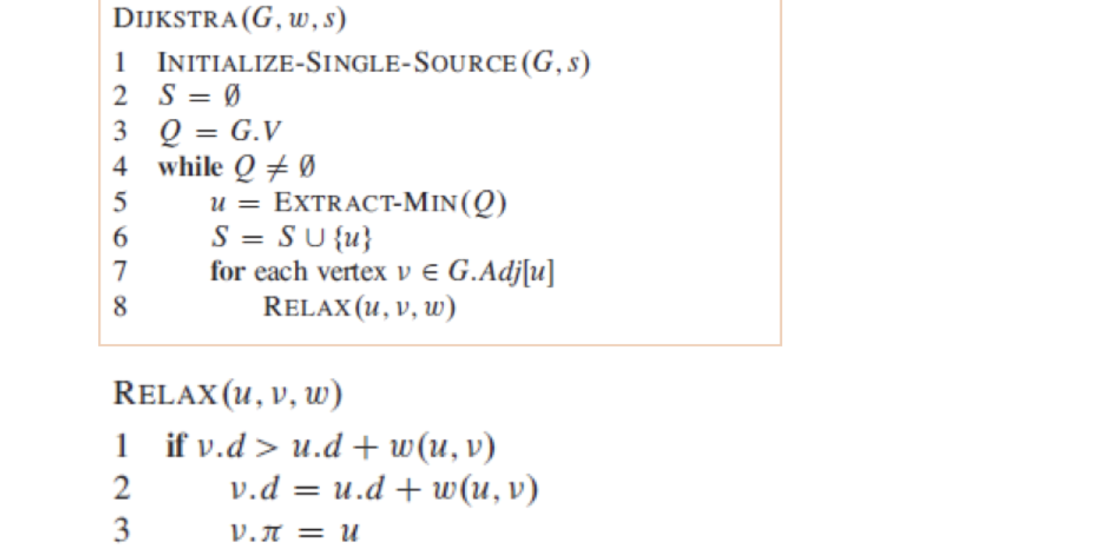
Algorithm Used
Dijkstra's Algorithm:
A well-known algorithm for finding
the shortest paths in a graph.
Modified to skip paths through failed
routers.
Helps calculate optimal routes and
display updated routing tables.

Slide 6
Time Complexity of Algorithm
Dijkstra's Algorithm has a time complexity of O((V + E) log V), where V is the number of vertices (routers) and E is the number of edges (connections).
This complexity makes it efficient for moderately large networks but may have limitations in very large networks.

Slide 7
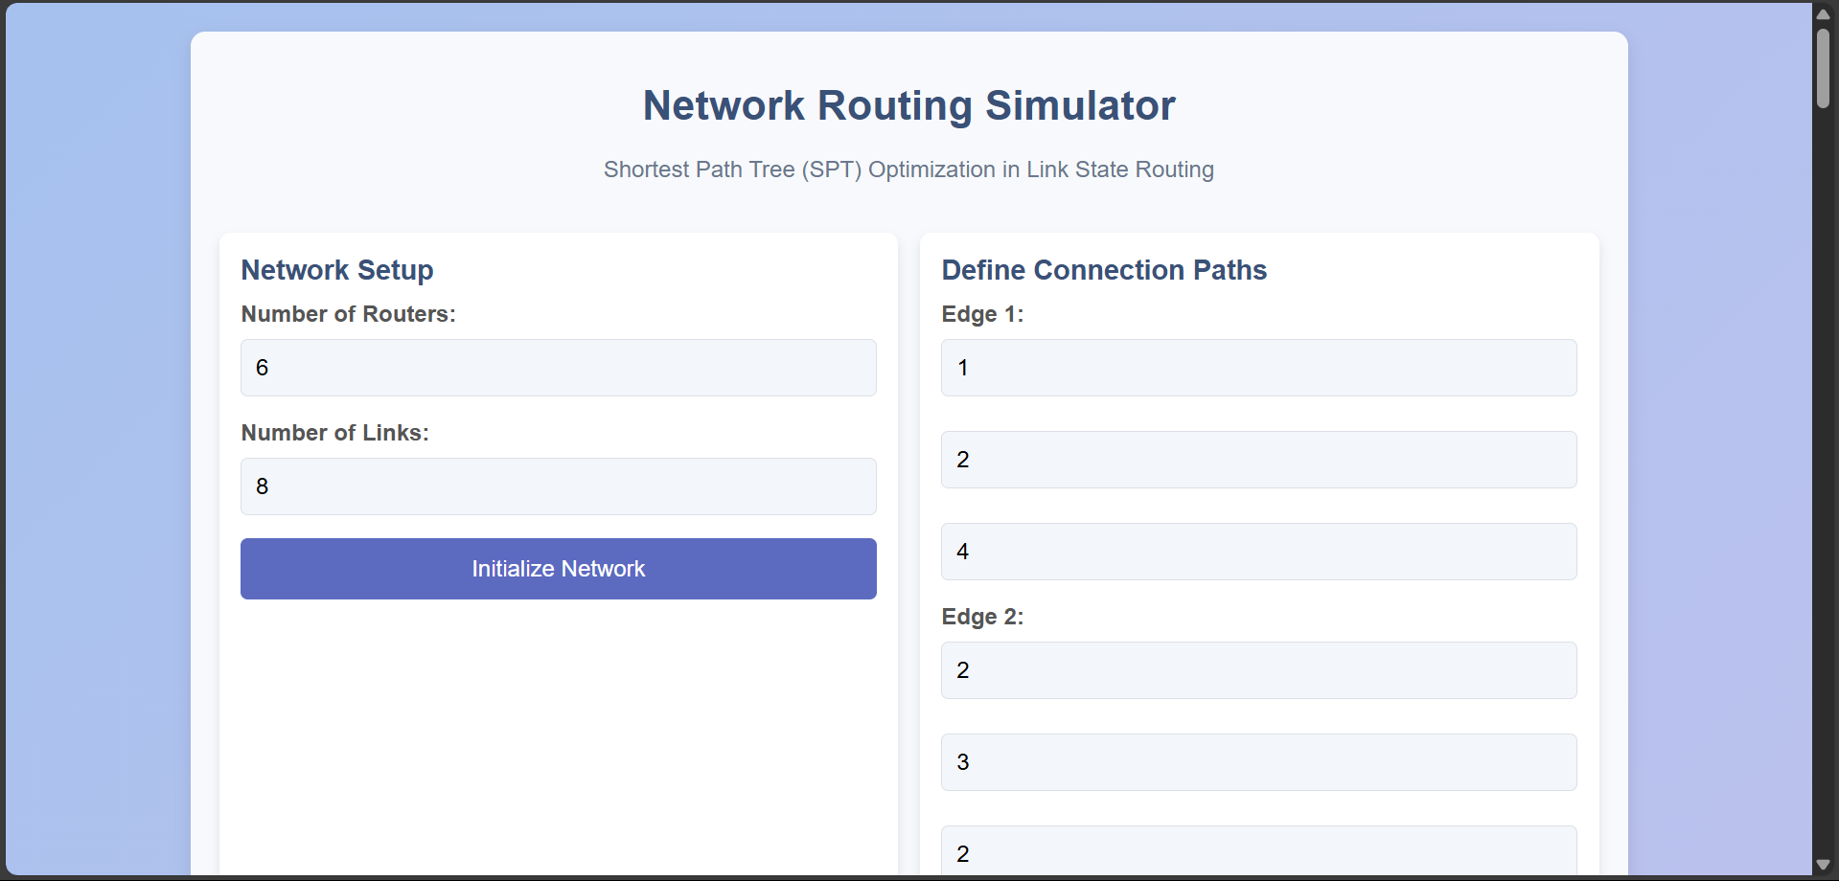
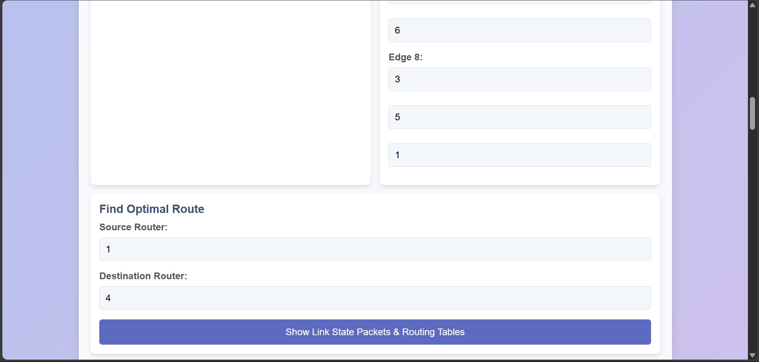
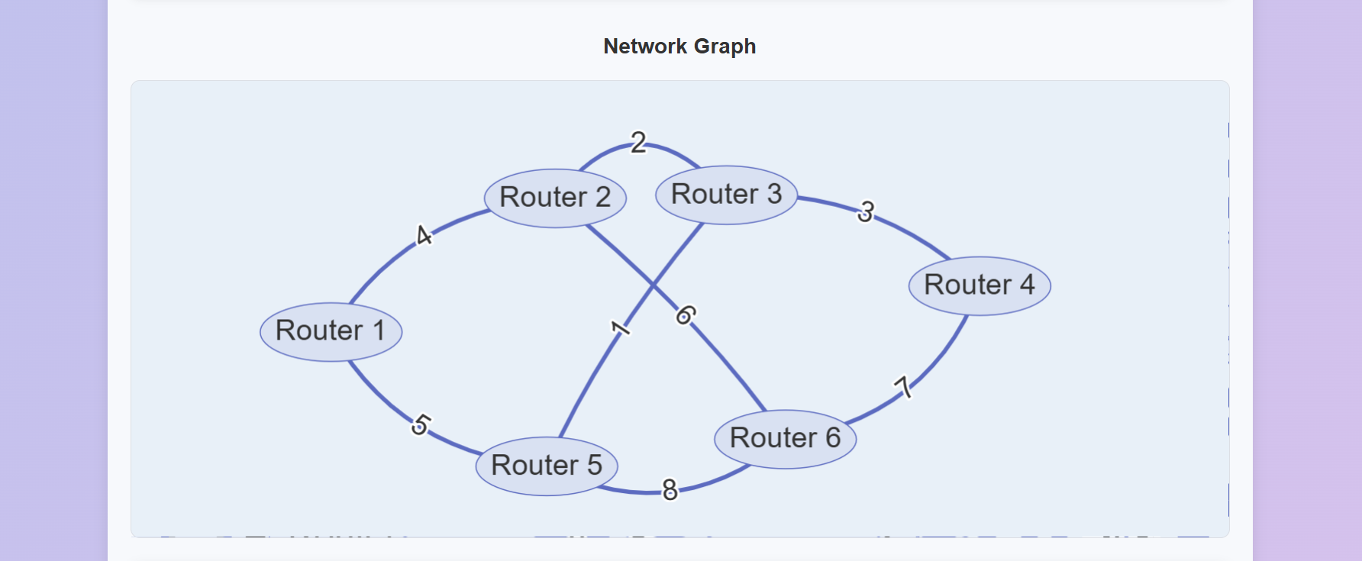
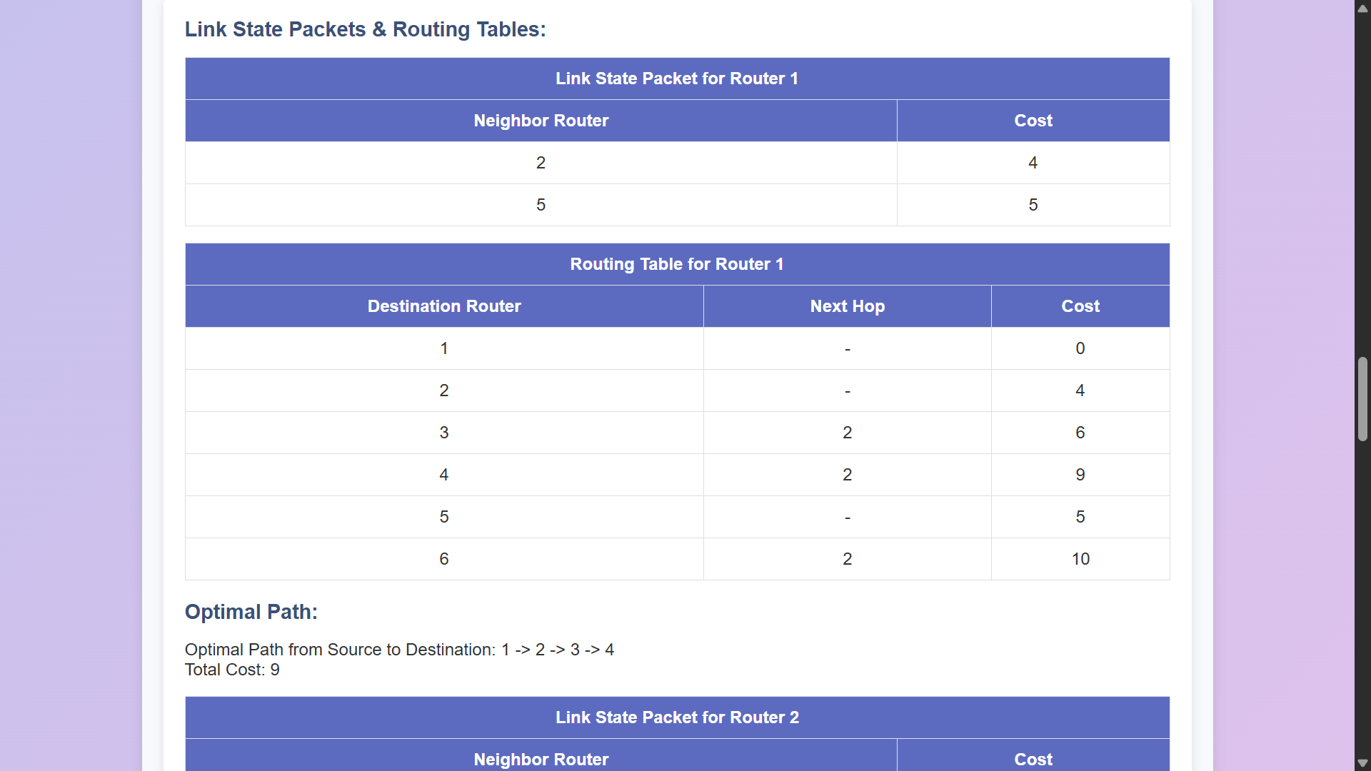
UI Screenshots

Slide 8
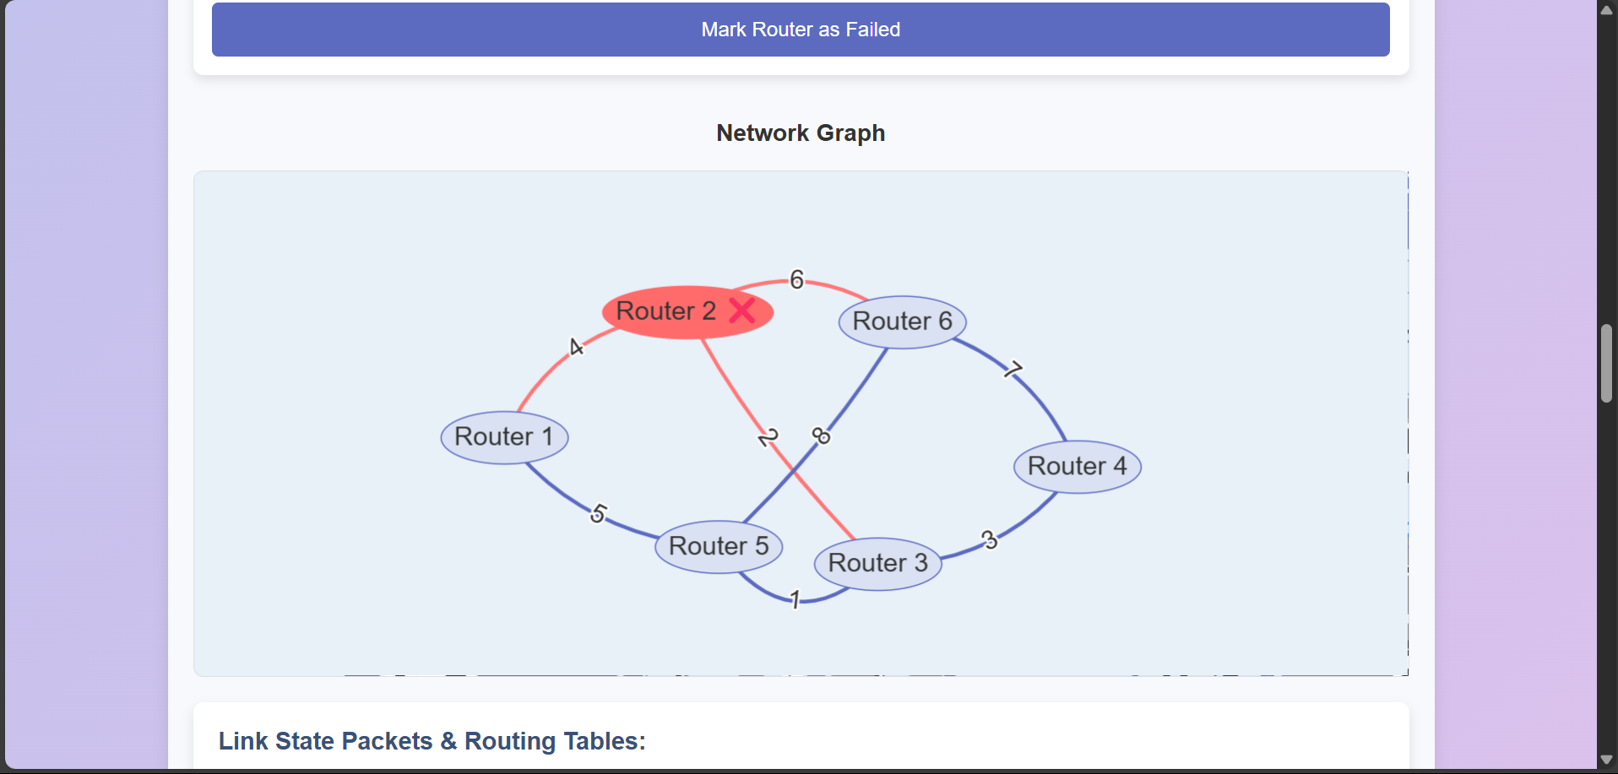
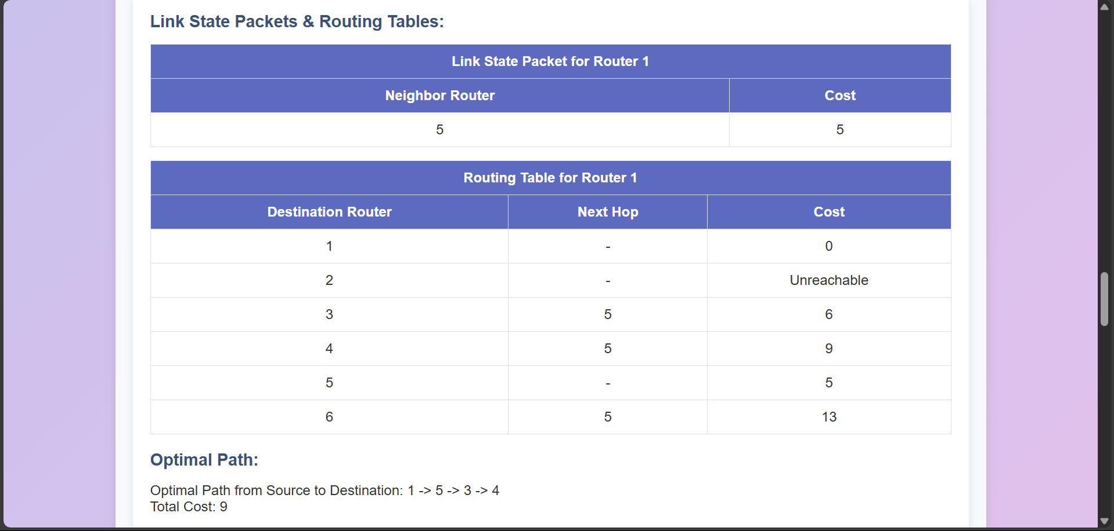
UI Screenshots – Router failure

Slide 9
Conclusion
The simulator effectively demonstrates network routing and resilience.
Potential for enhancement by adding support for additional network protocols, like BGP (Border Gateway Protocol), to simulate real-world ISP routing more closely.

