Slide 1
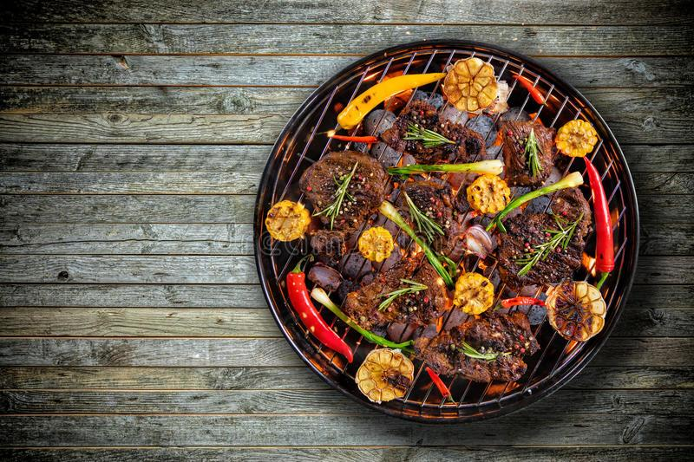
BBQReserver
BBQReserver
Team #1
Anjasmoro Adi Nugroho
Mario Loescher
Sofiia Yermolaieva

Slide 2
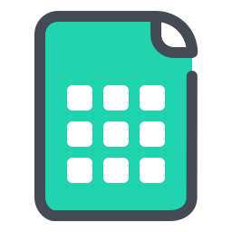

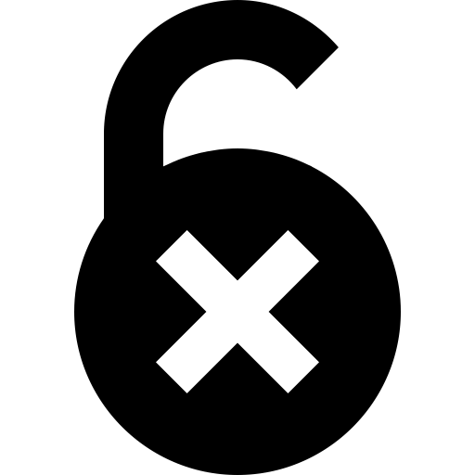
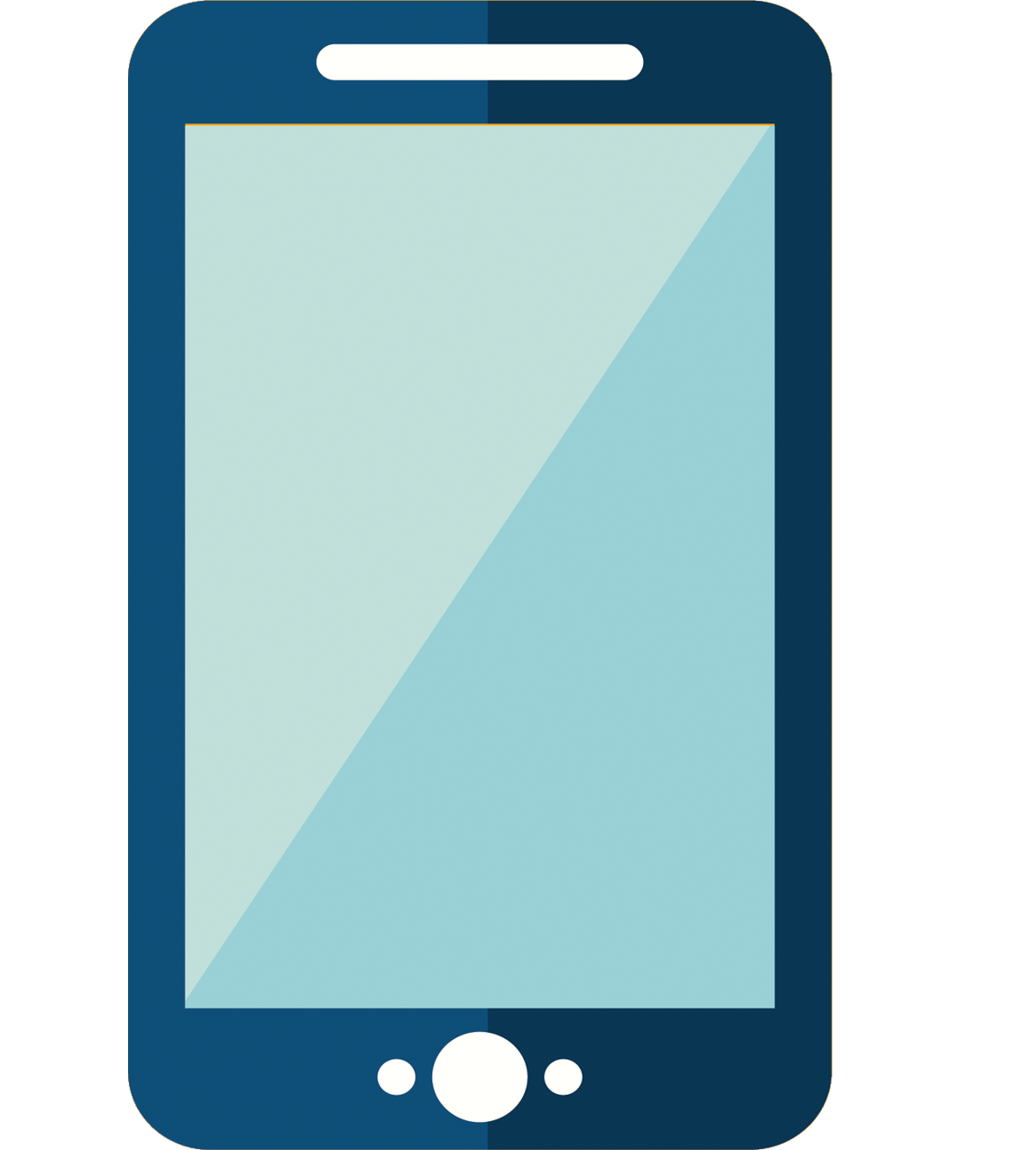
Motivation from the proposal
Currently booking is made in an ​online table​.
Records are not ordered => hard to find a free slot
Anyone can edit/delete anyone’s data
Spreadsheet is not adaptive for mobile devices

Slide 3

Features from the proposal
Check if the time slot is booked
View free time slots for selected date
View booked time slots for selected date
Create a booking for the selected time slot
Delete booking if your telegram alias matches alias that was mentioned in table

Slide 4
Quality of the interview transcript
Traceability was presented only in 1 out of 4 interviews
Potential end-users and the customer team was interviewed.

Slide 5
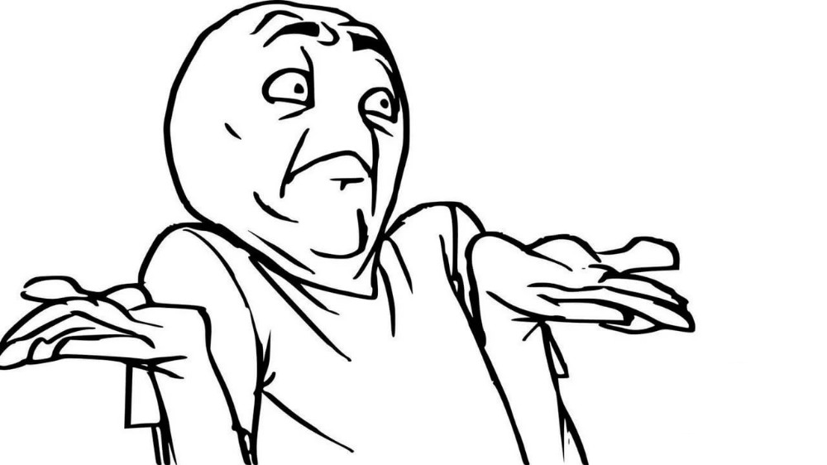
“Customer don’t want a telegram bot”
Interview Transcript vs Requirements
“System must be built on Telegram bot technologies.”
Interview transcript:
Use Case document:

Slide 6
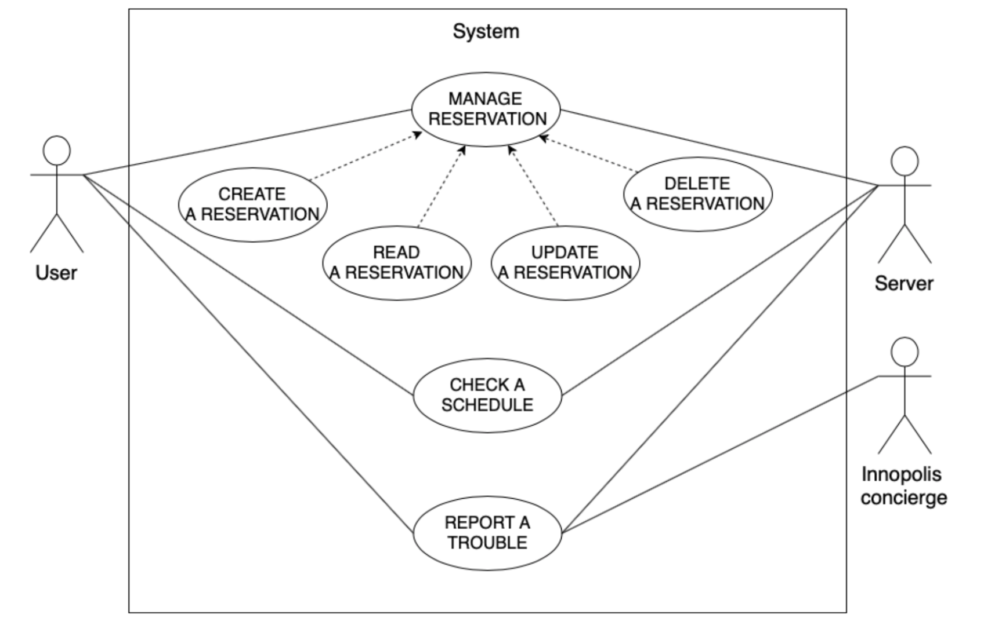
Initial Use Cases

Slide 7
Quality of the Interfaces
Interfaces were derived from the Use Cases and activity diagram
Interfaces were created for 4 Use Cases out of 7

Slide 8
Use Cases were shrinked after Interface development
Update reservation record
Create a new reservation
Delete a booking record
Checking a schedule
US001
US002
US003
US005

Slide 9
Quality of the MVP
There was no database.
System offers MVC (Model-View-Controller) structure, but it didn’t follow the MVC pattern.
There was no documentation about a specific .Net Version which we should use.
The bot only runs in .Net version 2.2

Slide 10
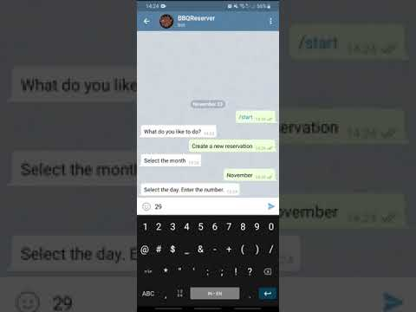
Software demo
US002 Create a new reservation

Slide 11
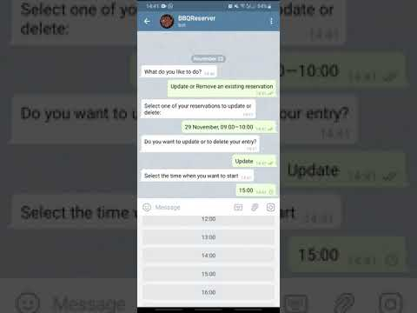
Software demo
US001 Update reservation record

Slide 12
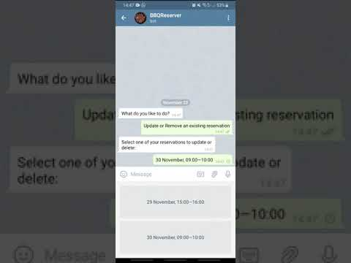
Software demo
US003 Delete a booking record

Slide 13
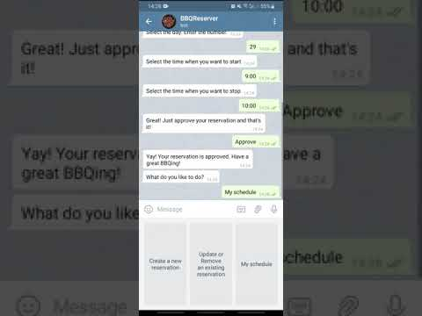
Software demo
US005 Checking a schedule

Slide 14
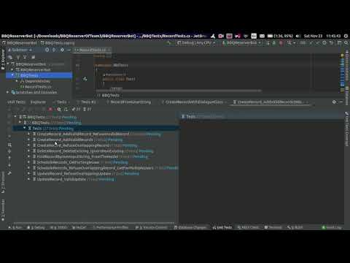
Unit Testing demo

Slide 15
Use Cases testing
Test Cases
Interaction Tests
Result
Passed
Warning
9/10
2
10
6

Slide 16
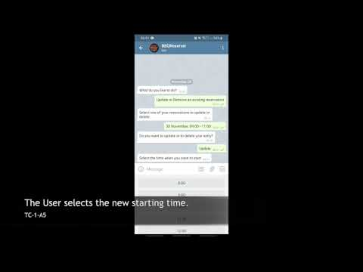
Use Cases testing. TC-1

Slide 17
Teamwork and Communication
with other teams
All customers were available for requirements refinement.
Team work always starts with the planning.
We did not have any communication problems inside or outside the team.

Slide 18
Lesson Learned
Proposal should be available to have continuous evaluation of the project with initial idea.
Use Cases should always be of the latest version. All updates should be done and submitted as soon as possible.
Requirements refinement is a continuous process which lasts till the end of the project.
Without traceability effective requirements refinement is not possible.

Slide 19
Strength and Weaknesses of the implementation
Strengths
It follows known design pattern (MVC) which is easy to understand.
Now you can book bbq zone via telegram bot.
Weaknesses
There is no automation test library to test the use cases in C#.

Slide 20
@BBQReserver_bot

Slide 21
Use Cases testing
Failed
F-1: A user can delete a reservation created by another user by entering a date and time of his reservation.
Warning
W-1: There is no “warning message” to inform the user about the creation status whether is created or not.
W-2: Infinite loop.

Slide 22
Use Cases Interaction matrix
 | Update reservation record | Create a new reservation | Delete a booking record | Checking a schedule
Update reservation record |  |  |  | RC-reservation record
Create a new reservation | RC-reservation record |  | RC-reservation record | RC-reservation record
Delete a booking record | RD-reservation record |  |  | RD-reservation record
Checking a schedule

Slide 23
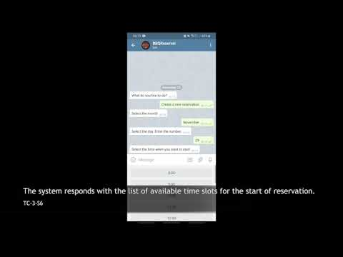
Use Cases testing. TC-3

Slide 24
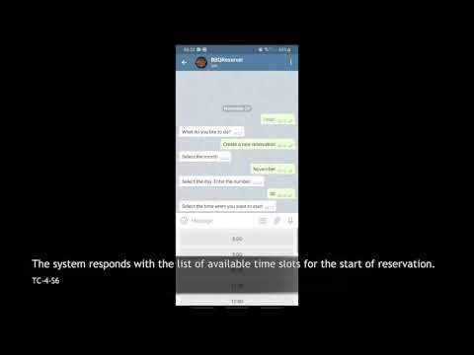
Use Cases testing. TC-4

