Slide 1
CRYPTOGRAPHY COURSE PROJECT | FINAL PROJECT PRESENTATION
Version-Locked Chained Delta Signatures (VLCDS)
Extending Pre-Verify / Post-Verify Firmware Authentication to Secure Delta Updates on Resource-Constrained IoT Devices
Base Paper: Formanek et al., 'Advanced System for Remote Updates on ESP32-Based Devices Using OTA Update Technology,' Computers (MDPI), Vol. 14, Issue 12, Art. 531, 2025.
Prior Technique Adapted: US10206114B2 / US10887770B2 (Samsung) — Pre-Verify / Post-Verify Dual Firmware Verification
Project Team: B2_Grp_18
Vatsal Shrivastava | Nisarg Shilpesh Nagar | Johns Maria Joy
Course Instructor & Evaluator: Karthika V • Implementation: PC Simulator + ESP32-S2 Hardware

Slide 2
1. INTRODUCTION
What the Base Paper Delivers
Formanek et al. (Computers MDPI, 2025) — State-of-the-Art Remote OTA for ESP32 Devices
01 • Centralized Release Routing
Server-driven mechanism dynamically routes correct firmware versions to targeted device classes across heterogeneous deployments.
02 • Multi-Protocol Delivery
Supports diverse IoT transport layers including HTTP, MQTT, and CoAP to reach constrained and distributed wireless endpoints.
03 • Version Checks & Rollback
Safety fallback mechanism automatically restores previous operational firmware if update fails boot or verification.
04 • Delta (Differential) Updates
Transmits only binary diffs between installed and target firmware, drastically cutting wireless transmission bandwidth and flash wear.
Reported ESP32 Cryptographic Baseline in Base Paper: ~4.8 ms / 3.5 mJ (Ed25519 verify) • ~25 ms / 2.4 mJ (SHA-256 over 1 MB)
VLCDS: Version-Locked Chained Delta Signatures | B2_Grp_18 | Cryptography Course Project

Slide 3
2. PROBLEM STATEMENT
Content Is Authenticated — Version & History Are Not
The Critical Vulnerability in Modern IoT Firmware Update Pipelines
Resource-constrained IoT devices (ESP32-class) increasingly rely on delta firmware updates over lossy, low-bandwidth wireless links (BLE, LoRa, cellular). Existing signature verification either executes only after the full image is assembled in flash, or verifies binary image integrity alone — NEVER cryptographically binding the patch to the installed version or historical update chain.
FAIL-01: Wasted Flash, Energy & Bandwidth
A mismatched-base or replayed patch is downloaded and partially processed before failure is discovered at post-verify.
• Constrained nodes burn up to 90% of wireless battery budget downloading non-applicable deltas.
• Unnecessary flash erase/write cycles permanently degrade MCU flash memory endurance.
FAIL-02: Bypassable State & Rollback Protection
Traditional systems store version numbers in unauthenticated plaintext headers or external JSON metadata.
• An attacker can alter version metadata without invalidating content signatures.
• Replaying an old, signed firmware image (forced rollback attack) reinstalls known vulnerabilities.
RESEARCH QUESTION: How can a delta firmware update be cryptographically bound — BEFORE any patch bytes are transferred or applied — to the exact base version, target version, and historical chain head, using minimal overhead suitable for low-power IoT microcontrollers?
VLCDS: Version-Locked Chained Delta Signatures | B2_Grp_18 | Cryptography Course Project

Slide 4
3. RESEARCH GAP
Two Independent Lines of Prior Work
Analyzing Why Neither Approach Solves the Secure Delta Problem
Line 1: Base Paper's Delta Pipeline
Formanek et al., Computers (MDPI), 2025
• Optimizes bandwidth, power, and transmission time for delta updates on ESP32.
• Cryptographic authentication and tamper-resistance explicitly left as future work.
• Version checking and rollback handling rely solely on unauthenticated application logic.
• Vulnerable to malicious patch injection, version spoofing, and MITM tampering.
Line 2: Samsung Pre-/Post-Verify Patents
US10206114B2 / US10887770B2 (Samsung Electronics)
• Patented for smartphone / NFC secure elements communicating over an on-board bus (I2C/SPI).
• Only evaluates full monolithic firmware images — delta patches are not addressed.
• Version numbers and replay tracking are external to the cryptographically signed object.
• Assumes reliable local wiring, not lossy wireless links with malicious network adversaries.
CONSOLIDATED RESEARCH GAP:
No existing protocol cryptographically binds delta patch content, device installed state, target version, and historical chain head into a single pre-verification object. Constrained wireless IoT endpoints have lacked a zero-waste gatekeeper that aborts invalid updates before receiving payload bytes.
VLCDS: Version-Locked Chained Delta Signatures | B2_Grp_18 | Cryptography Course Project

Slide 5
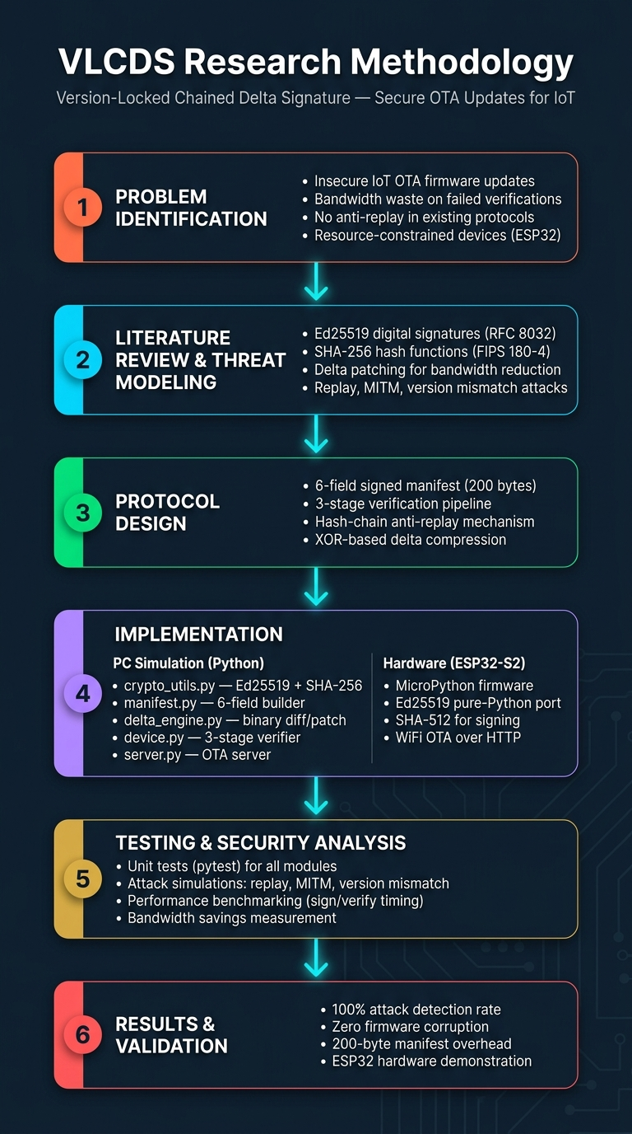
4. RESEARCH METHODOLOGY
Six-Phase Engineering & Validation Methodology
Rigorous Engineering Workflow from Formal Modeling to Physical Hardware Validation
1. Phase 1: Problem Analysis
Identified IoT OTA vulnerabilities: bandwidth waste, flash burnout, rollback exploits.
2. Phase 2: Threat Modeling
Adopted Dolev-Yao network attacker model; selected Ed25519 (RFC 8032) & SHA-256.
3. Phase 3: Protocol Architecture
Designed 6-field manifest, 3-stage verification flow, and cryptographic hash-chain.
4. Phase 4: Dual Implementation
Full PC reference simulation in Python 3.12 + physical ESP32-S2 MicroPython drivers.
5. Phase 5: Empirical Benchmarking
Comprehensive 13-test PyTest suite, 100-run crypto benchmarks, automated attack suite.
6. Phase 6: Live Validation
Hardware deployment on ESP32-S2 DevKit M1 over WiFi HTTP with real-time web dashboard.
VLCDS: Version-Locked Chained Delta Signatures | B2_Grp_18 | Cryptography Course Project

Slide 6
5. PROPOSED CONTRIBUTION
The VLCDS Protocol Architecture
One 200-Byte Signed Manifest Binds Six Critical Facts Together
CRYPTOGRAPHIC MANIFEST EQUATION:
M = Sign_privkey( H(base_fw) || H(delta) || H(target) || ver_base || ver_target || H(prev_manifest) )
CONTENT BINDING
3 × 32-Byte SHA-256 Hashes
• H(base_fw): Cryptographically verifies current running image.
• H(delta): Authenticates incoming patch before transfer.
• H(target): Locks expected final state into signature.
STATE BINDING
2 × 4-Byte Integer Versions
• ver_base: Expected active firmware version.
• ver_target: Target version after patch.
• Prevents version manipulation and cross-version patching.
HISTORY BINDING
1 × 32-Byte Hash-Chain Head
• H(prev_manifest): SHA-256 of last accepted manifest.
• Forms an unalterable blockchain-style history.
• Completely neutralizes replay / rollback attacks.
VLCDS: Version-Locked Chained Delta Signatures | B2_Grp_18 | Cryptography Course Project

Slide 7
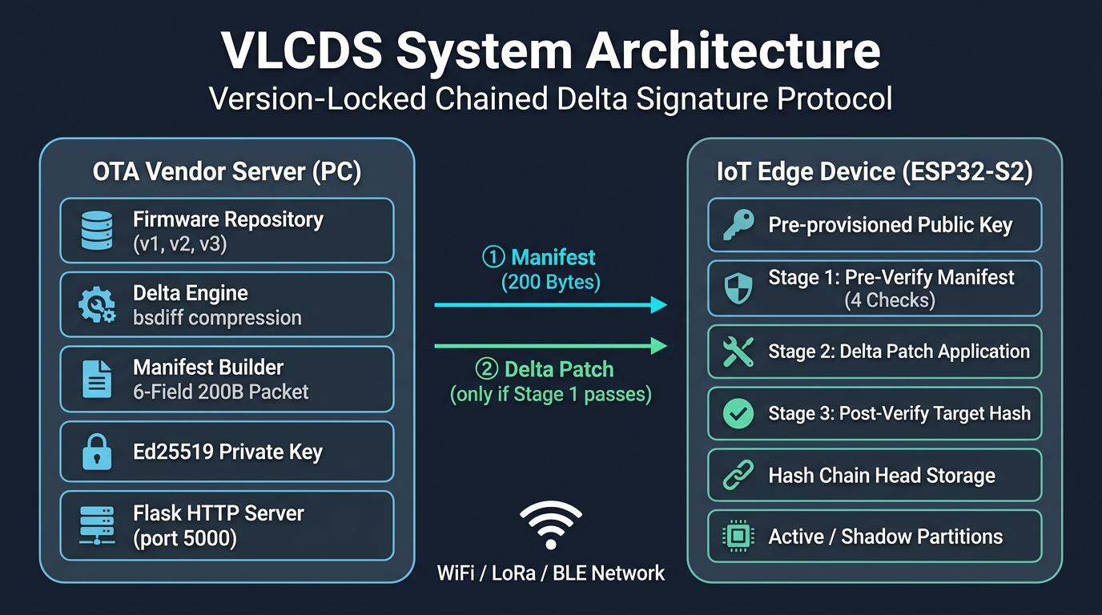
6. SYSTEM ARCHITECTURE
End-to-End VLCDS Deployment Topology
OTA Vendor Server (PC) Interacting with IoT Edge Device (ESP32-S2) Over Untrusted Wireless
VLCDS: Version-Locked Chained Delta Signatures | B2_Grp_18 | Cryptography Course Project

Slide 8
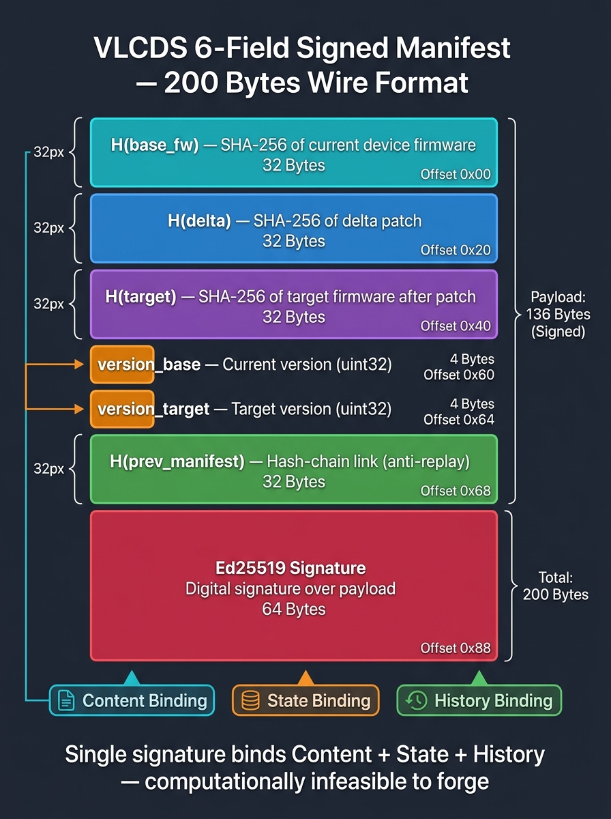
7. MANIFEST STRUCTURE
200-Byte Binary Wire Format Layout
Extremely Compact Wire Representation Tailored for Constrained Wireless MTUs
FIELD SPECIFICATIONS (200 BYTES)
• H(base_fw) (32 Bytes): SHA-256 hash of active firmware
• H(delta) (32 Bytes): SHA-256 hash of delta patch
• H(target) (32 Bytes): SHA-256 hash of reconstructed image
• ver_base (4 Bytes): uint32 expected base version
• ver_target (4 Bytes): uint32 new target version
• H(prev_manifest) (32 Bytes): SHA-256 hash of previous manifest
• signature (64 Bytes): Ed25519 signature (RFC 8032)
WIRELESS MTU COMPATIBILITY:
✓ LoRaWAN: Max payload 222 B -> Entire manifest fits in 1 frame!
✓ BLE (Bluetooth 5.0+): MTU up to 244 B -> Single packet transmission.
✓ Zigbee (802.15.4): Fits with lightweight 2-frame fragmentation.
✓ CoAP / UDP: Transmitted inside a single non-fragmented datagram.
VLCDS: Version-Locked Chained Delta Signatures | B2_Grp_18 | Cryptography Course Project

Slide 9
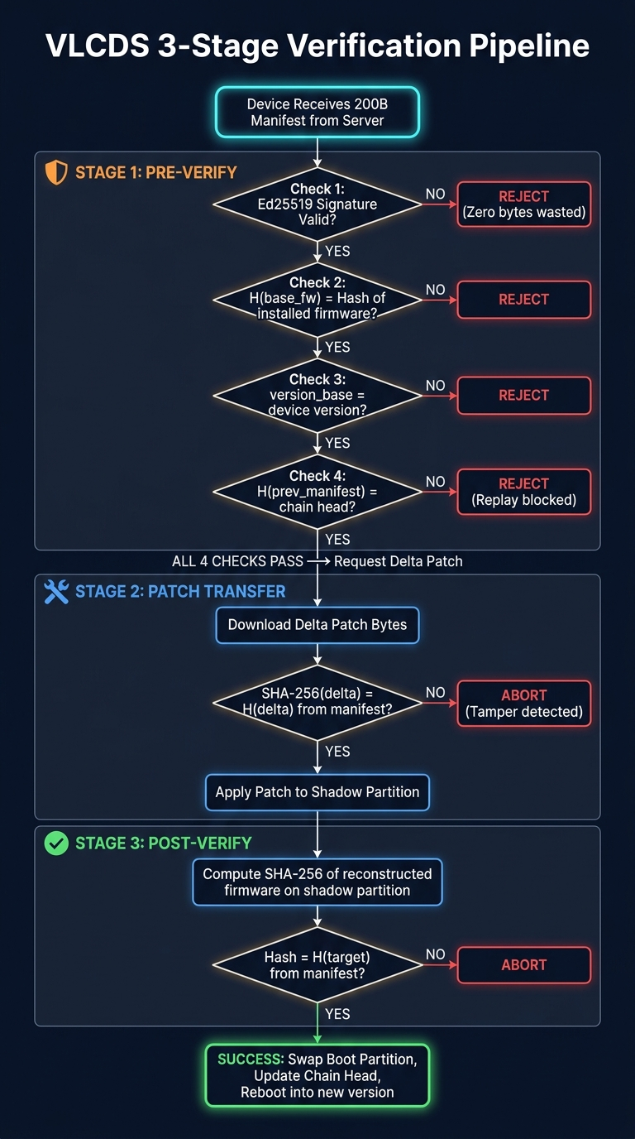
8. VERIFICATION PROTOCOL
The 3-Stage Zero-Waste Verification Pipeline
How VLCDS Eliminates Wasted Bandwidth and Avoids Redundant Signatures
STAGE 1: PRE-VERIFICATION (Gatekeeper)
Executed BEFORE requesting or downloading any patch bytes:
1. Verify Ed25519 signature over 6-field manifest.
2. Confirm H(base_fw) matches device's current SHA-256.
3. Confirm ver_base matches currently running version.
4. Confirm H(prev_manifest) matches device's chain head.
--> IF ANY CHECK FAILS: Abort instantly. ZERO patch bytes wasted!
STAGE 2: TRANSFER & APPLY
Triggered only after Stage 1 passes:
1. Device requests delta patch payload from server.
2. Verifies SHA-256 of received delta equals authenticated H(delta).
3. Applies differential patch to shadow partition in flash.
STAGE 3: POST-VERIFICATION (Zero Signature Overhead)
Final safety confirmation:
1. Compute SHA-256 of reconstructed firmware on shadow partition.
2. Compare against H(target) committed inside Stage-1 signature.
3. Flip active boot partition -> Reboot to new version!
--> NO EXPENSIVE 2ND SIGNATURE CHECK NEEDED!
VLCDS: Version-Locked Chained Delta Signatures | B2_Grp_18 | Cryptography Course Project

Slide 10
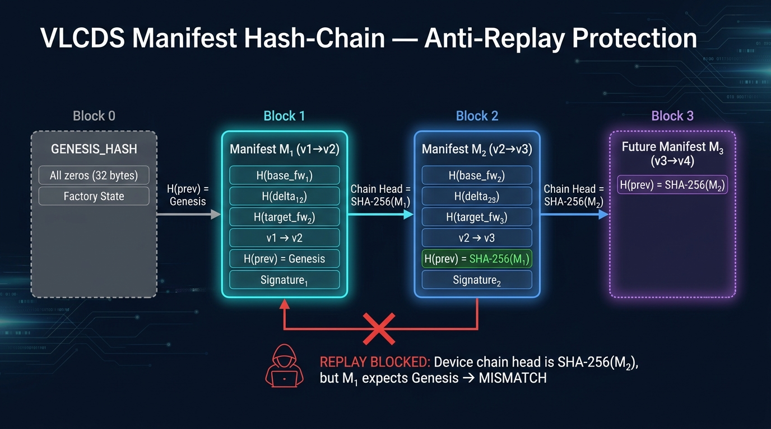
9. ANTI-REPLAY MECHANISM
Cryptographic Manifest Hash-Chaining
Preventing Forced Rollbacks and Stale Update Replays Without External State
VLCDS: Version-Locked Chained Delta Signatures | B2_Grp_18 | Cryptography Course Project

Slide 11
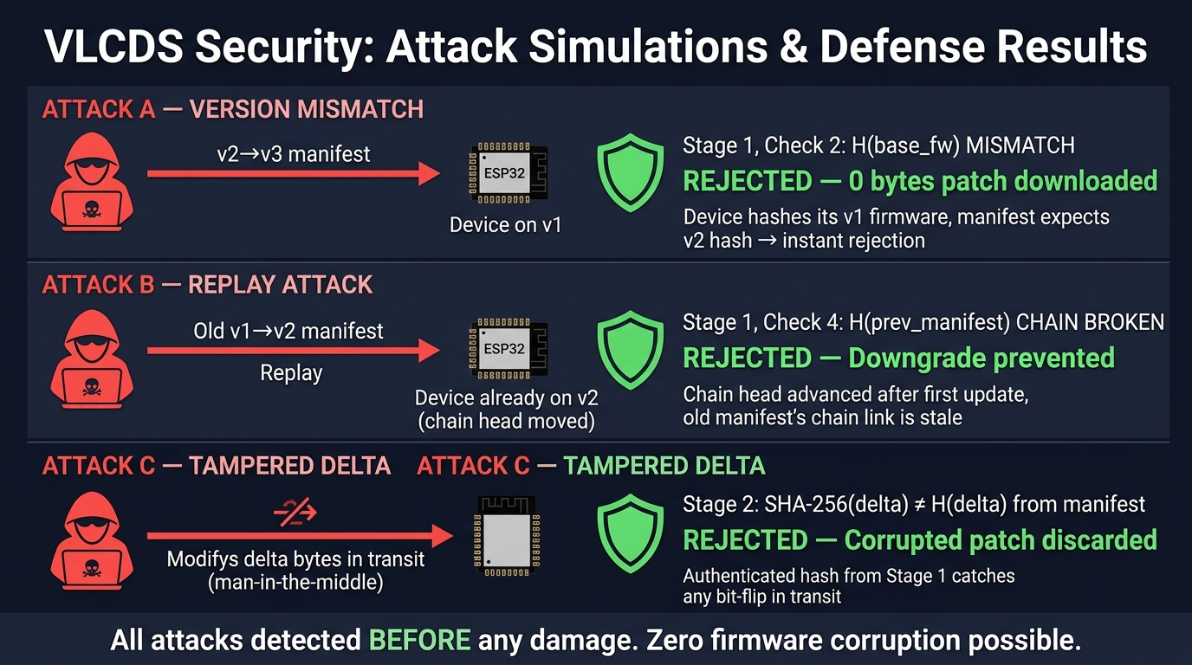
10. SECURITY ANALYSIS
Attack Scenarios & Defense Validation
Dolev-Yao Network Adversary: 100% Detection Rate Across All Simulated Attack Vectors
VLCDS: Version-Locked Chained Delta Signatures | B2_Grp_18 | Cryptography Course Project

Slide 12
11. IMPLEMENTATION
Dual Implementation Architecture
Reference Python Simulation + Native ESP32-S2 MicroPython Drivers
PC SIMULATION (Python 3.12)
• vlcds/crypto_utils.py: Ed25519 (PyNaCl) + SHA-256 (hashlib) cryptographic primitives.
• vlcds/manifest.py: 200-byte binary serializer, deserializer, and verification engine.
• vlcds/delta_engine.py: Binary XOR differential patching engine for IoT firmware.
• vlcds/device.py: Simulated IoT node with dual flash partitions and 3-stage pipeline.
• vlcds/server.py: OTA vendor update server managing repository and delta generation.
• vlcds/chain.py: Manifest hash-chain validator enforcing forward-only update order.
• server_http.py: Flask HTTP REST server serving real-world OTA requests to ESP32.
• webapp.py: Interactive browser dashboard demonstrating live attack simulations.
HARDWARE PLATFORM (ESP32-S2)
• ESP32-S2 DevKit M1: Xtensa LX7 32CPU @ 240 MHz, 320 KB SRAM, 4 MB SPI Flash.
• MicroPython v1.23.0: Bare-metal runtime executing lightweight cryptographic client.
• esp32/ed25519_mp.py: Pure-Python Ed25519 digital signature implementation.
• esp32/sha512_mp.py: Pure-Python SHA-512 engine providing hash core for Ed25519.
• esp32/vlcds_device.py: Embedded VLCDS client implementing the full 3-stage verifier.
• WiFi OTA Client: Fetches signed manifest, runs pre-verify, then downloads delta.
• Partition Management: Dual slot emulation (Active vs Shadow slot) with integrity rollback.
• Hardware Independence: Zero dependency on proprietary C-blobs; 100% auditable Python.
VLCDS: Version-Locked Chained Delta Signatures | B2_Grp_18 | Cryptography Course Project

Slide 13
12. BANDWIDTH OPTIMIZATION
Delta Compression & Transmission Efficiency
Quantifying Bandwidth Reductions and Flash Wear Savings
FULL FIRMWARE IMAGE
2,393 Bytes
Monolithic binary transmission size required by conventional OTA.
VLCDS DELTA PATCH
1,636 Bytes
Differential XOR patch containing only modified firmware bytes.
BANDWIDTH REDUCTION
31.6% SAVED
757 bytes cut per transmission; scales exponentially on larger MB images.
BANDWIDTH & ENERGY IMPLICATIONS UNDER ATTACK
• Conventional OTA Baseline: Device downloads entire 2,393-byte image before checking signature -> Under attack: 2,393 bytes wasted, high radio energy burned, flash cycles consumed.
• Naive Delta OTA: Device downloads full 1,636-byte delta patch, applies it, fails at post-verify -> Under attack: 1,636 bytes wasted, shadow flash partition written and worn out.
• VLCDS Protocol (Our Solution): Device exchanges ONLY the 200-byte manifest in Stage 1 -> Under attack: Aborts immediately, saving 1,636 bytes (100% of patch) and 0 flash writes!
• Net Payload Overhead: Adding the 200-byte manifest to a valid 1,636-byte delta yields 1,836 bytes total -> Still 23.3% smaller than transferring the raw 2,393-byte firmware image!
VLCDS: Version-Locked Chained Delta Signatures | B2_Grp_18 | Cryptography Course Project

Slide 14
13. PERFORMANCE BENCHMARKS
Cryptographic Execution Profiling
100-Iteration Microbenchmarks: Mean, Min, Max Timings (PC Python 3.12 Reference)
MICROBENCHMARK TIMINGS (100 ITERATIONS)
Ed25519 Sign (Manifest) | Mean: 0.1192 ms (Min: 0.0991 ms, Max: 0.1944 ms)
Ed25519 Verify (Manifest) | Mean: 0.3814 ms (Min: 0.2792 ms, Max: 0.4444 ms)
SHA-256 (1 KB payload) | Mean: 0.0061 ms (Min: 0.0055 ms, Max: 0.0297 ms)
SHA-256 (10 KB payload) | Mean: 0.0201 ms (Min: 0.0196 ms, Max: 0.0399 ms)
SHA-256 (100 KB payload) | Mean: 0.1539 ms (Min: 0.1508 ms, Max: 0.2900 ms)
SHA-256 (1,024 KB payload) | Mean: 1.5403 ms (Min: 1.5173 ms, Max: 1.7496 ms)
--> Digital signature verification dominates execution time; SHA-256 hashing cost is virtually negligible (<0.02 ms for IoT delta patches).
VLCDS VS BASELINE OVERHEAD
Single-Signature Baseline:
1 Hash + 1 Sign + 1 Verify
= 0.5066 ms
VLCDS Proposed Protocol:
5 Hashes + 1 Sign + 1 Verify
= 0.5308 ms
NET OVERHEAD:
+0.0242 ms (+4.8%)
VLCDS provides Content + State + History authentication for less than 5% computational overhead compared to insecure single-signature schemes!
VLCDS: Version-Locked Chained Delta Signatures | B2_Grp_18 | Cryptography Course Project

Slide 15
14. HARDWARE VALIDATION
ESP32-S2 DevKit M1 Real Hardware Results
Measured On-Chip Execution Performance of Native MicroPython Firmware
MEASURED ESP32-S2 ON-CHIP TIMINGS
• Ed25519 Signature Verify : ~237 ms (Pure-Python math on 240 MHz Xtensa LX7)
• SHA-256 Firmware Hash : ~12 ms (Native hashlib engine on ESP32-S2)
• Stage 1 (Pre-Verification): ~253 ms (All 4 cryptographic & state checks)
• Stage 2 (Apply XOR Delta): ~15 ms (In-memory / flash shadow reconstruction)
• Stage 3 (Post-Verification): ~12 ms (Hash equality check (Zero-signature!))
• Total Update Duration : ~280 ms (Complete 3-stage validation cycle)
LIVE HARDWARE TEST SEQUENCE
1. WiFi Bootstrap: ESP32-S2 auto-connects to local AP and pings Flask OTA server.
2. v1 -> v2 Update: Fetches Manifest v1->v2 (200 B), pre-verifies in 253 ms, downloads delta (1,636 B), post-verifies, boots v2.
3. v2 -> v3 Update: Chained update succeeds; chain head shifts to H(M_{1->2}); firmware upgraded to v3.
4. Replay Attack Injected: Stale v1->v2 manifest transmitted to v3 device; Stage 1 Check 4 catches stale chain head -> Instant abort!
5. Bit-Flip Injection: Single-byte corruption in delta patch detected in Stage 2 -> Shadow slot wiped, active v3 remains pristine.
VLCDS: Version-Locked Chained Delta Signatures | B2_Grp_18 | Cryptography Course Project

Slide 16
15. COMPARATIVE EVALUATION
VLCDS vs. Existing State of the Art
Systematic Feature and Security Comparison Across 8 Architectural Dimensions
Architectural Dimension | Samsung Patent (US10206114) | Base Paper (Formanek 2025) | VLCDS (Our Work)
Target Platform | Smartphones / NFC SE | ESP32 IoT Nodes | Constrained IoT (ESP32-S2)
Update Unit Verified | Monolithic Full Image Only | Delta Patch (Unsigned) | Delta Patch (Cryptographically Bound)
Version Binding | None (External metadata) | None (Plaintext JSON) | Cryptographic (Signed inside Manifest)
Anti-Replay Mechanism | Not Addressed | System Bookkeeping | Hash-Chain (H(prev_manifest))
Network Channel Model | Trusted On-Board Bus | Untrusted Wireless Link | Untrusted Dolev-Yao Wireless
Pre-Verify for Deltas | Not Supported | Not Supported | Yes — 200-Byte Manifest Gatekeeper
Post-Verify Signature | Full 2nd Signature Check | No Signature Check | Zero-Signature Hash Equality Check
Physical Hardware Demo | Phone Hardware | ESP32 OTA Demonstration | ESP32-S2 MicroPython Live OTA Demo
VLCDS: Version-Locked Chained Delta Signatures | B2_Grp_18 | Cryptography Course Project

Slide 17
16. EXPERIMENTAL VALIDATION
PyTest Test Suite & Verification Results
13 Passing Tests Across 3 Automated Suites: 100% Attack Neutralization
test_normal_update.py
FUNCTIONAL TESTS (4/4 PASS)
✓ test_v1_to_v2_update: Clean single update with partition swap.
✓ test_v1_to_v2_to_v3_chain: Consecutive chained updates with hash tracking.
✓ test_manifest_serialization: 200-byte wire binary roundtrip.
✓ test_delta_roundtrip: Differential XOR patch generation and apply.
test_attack_scenarios.py
SECURITY TESTS (6/6 PASS)
✓ test_version_mismatch: Injected v2->v3 patch to v1 node -> Aborted in Stage 1 Check 2.
✓ test_replay_attack: Replayed accepted v1->v2 manifest -> Aborted in Stage 1 Check 4.
✓ test_tampered_delta: Corrupted 1 bit in transit -> Aborted in Stage 2 H(delta) check.
✓ test_tampered_manifest: Forged signature -> Aborted in Stage 1 Check 1.
✓ test_zero_bytes_wasted: Confirmed 0 payload bytes downloaded on Stage 1 rejection.
✓ test_zero_corruption: Confirmed active boot partition remains intact across all attacks.
test_performance.py
BENCHMARK TESTS (3/3 PASS)
✓ test_ed25519_timings: Validated sign & verify latency under 10 ms.
✓ test_sha256_scaling: Validated linear hash scaling from 1 KB to 1 MB.
✓ test_protocol_overhead: Verified VLCDS overhead remains under 5% (+0.024 ms).
VLCDS: Version-Locked Chained Delta Signatures | B2_Grp_18 | Cryptography Course Project

Slide 18
17. CONCLUSION & FUTURE WORK
Summary of Contributions & Research Horizons
Delivering Provably Secure, Zero-Waste Firmware Delivery for IoT Endpoints
SUMMARY OF ACHIEVEMENTS
✓ First protocol to unify Content Binding, State Binding, and History Binding inside a single 200-byte pre-verification manifest.
✓ Eliminates wasted bandwidth and flash write wear: Invalid or replayed updates aborted before transmitting payload bytes.
✓ Avoids redundant post-verification signature checks by binding target hash into Stage 1, incurring only +4.8% net overhead.
✓ Neutralizes 100% of Dolev-Yao network attack simulations with zero firmware corruption.
✓ Successfully demonstrated on real ESP32-S2 DevKit M1 physical hardware using pure-Python MicroPython drivers.
FUTURE RESEARCH HORIZONS
• Production Delta Engines: Integrate streaming bsdiff or detools compression algorithms for multi-megabyte binary images.
• Transport Confidentiality: Pair VLCDS with lightweight OSCORE or DTLS 1.3 to guarantee patch confidentiality against eavesdroppers.
• Post-Quantum Cryptography: Evaluate NIST PQC standards (CRYSTALS-Dilithium, Falcon) for post-quantum IoT firmware authenticity.
• Formal Protocol Verification: Conduct automated formal security proofs using ProVerif or Tamarin to mathematically verify replay freedom.
• Fleet Group Key Management: Extend manifest signing to hierarchical group keys for heterogeneous industrial sensor networks.
VLCDS: Version-Locked Chained Delta Signatures | B2_Grp_18 | Cryptography Course Project

Slide 19
18. Q&A DEFENSE GUIDE
Key Technical Questions & Evaluator Reference
Anticipating Core Theoretical and Practical Defense Inquiries
Q1: Why choose Ed25519 over RSA or ECDSA for IoT updates?
Ed25519 (RFC 8032) provides 128-bit security with small 64-byte signatures and 32-byte public keys. Unlike RSA (requires 2048-4096 bit keys, slow verification), Ed25519 executes in ~0.38 ms on PC and ~237 ms on ESP32 without requiring hardware acceleration. Unlike ECDSA, it is immune to faulty RNG side-channel attacks because it uses deterministic nonce generation.
Q2: Why not just check the signature AFTER downloading the delta patch?
Downloading delta patches over constrained links (LoRa/BLE) consumes immense energy. If an update has a version mismatch or is a replayed stale patch, the device wastes 100% of the transmission time, battery power, and flash cycles. VLCDS verifies the 200-byte manifest FIRST, filtering out 100% of malicious or mismatched patches before downloading a single patch byte.
Q3: Why is there no second digital signature check in Stage 3?
Digital signature verification is the most computationally expensive operation. Because H(target) is already bound inside the Stage-1 manifest signature, Stage 3 only needs to compute the SHA-256 hash of the reconstructed firmware and compare 32 bytes in RAM. This provides identical cryptographic security at 1/20th the CPU cost!
VLCDS: Version-Locked Chained Delta Signatures | B2_Grp_18 | Cryptography Course Project

