Slide 1
Data Analysis For E-Learning
Parul Institute of Computer Applications
Semester 5 Project
2019-20
Team members
170510101092
170510101083
170510101084
Guided by:
Vijya Tulsani,
Assistant Professor

Slide 2
INDEX
Abstract
Comparison of New system with Existing system
Technology and HW, SW Requirement Specification
Modules and its short description
Activity diagram
System Flow Diagram
Development Phase -1 Screenshots(layout / form designing)
Development Phase -2 Screenshots(layout / form design with code)
Development Phase -3 Screenshots(layout / form design with validation)
Development Phase -4 Screenshots(System with Testing)
Limitations
Future Enhancement
References & Bibliography

Slide 3
Abstract
E-learning data consists of large volume of educational data and available with complex and hybrid data architecture. Capturing of student performances, student evaluation and student's interaction information are one of the challenges faced by the e-learning software users at the time of analysis.
Integrating student data along with educational data for analysis needs complex system design framework.
New innovations in e-learning also facilitates augmented learning, adaptive learning, web based learning, activity based learning, and project based learning.
Education technology interventions using learning management system, content management system, advanced distributed learning, sharable content object reference models and application program interfaces enhanced and extended the e-learning frameworks to a greater horizon.

Slide 4
Comparison of New system with Existing system
Comparison with Existing System
Filtered Data
Relevant Data
Visualization
Use Algorithm approach for analysis
Accuracy
Time saving

Slide 5
Technology and HW, SW Requirement Specification
System configuration:
1.Server configuration
2.Core i5(7th Gen processor operating at 3.50 GHz)
3.8gb ram
4.1TB Free space hard disk
Software Requirements
1.Anaconda
2.Python

Slide 6
Modules and its short description
1. Drop-out
Under this we are collecting data why student are drop-out from school and finding reason behind it to solve this problem. For data analysis the method is used is mathematical approach is average dropout ratio and percentage wise dropout list.
2. Resources
As we know that every student required basic resources in their school life. If we doesn’t provide or they didn’t get then how they will study. For example, in village there is no school then children have to travel lots of distance to go for schooling in that time the student which are motivated will go to school and other left it. So, according to me student should be given the resources which are they required and we are finding it to solve the problem.
3. Visualization
After the data analysis our task is to generate visual images to make better understanding of our work. Suppose, we have to show how many students are leaving school due to transportation and then the result will come according to the graph.

Slide 7
Activity diagram

Slide 8
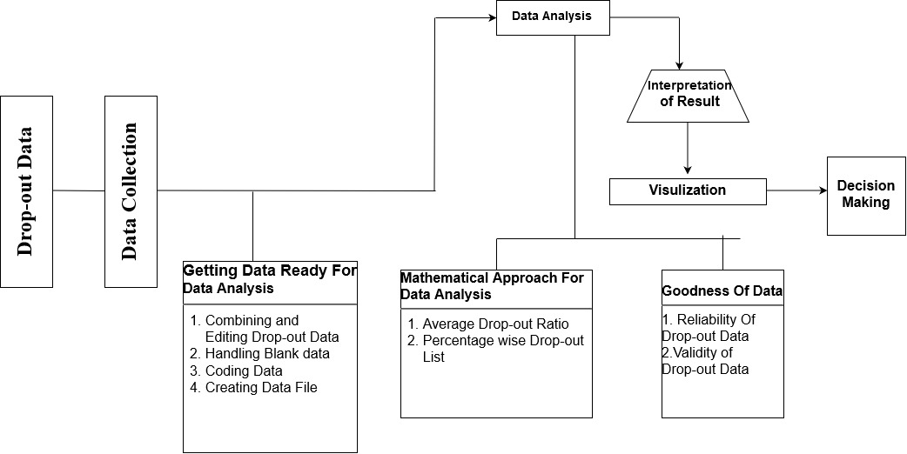
System Flow Diagram
1.Drop-Out

Slide 9
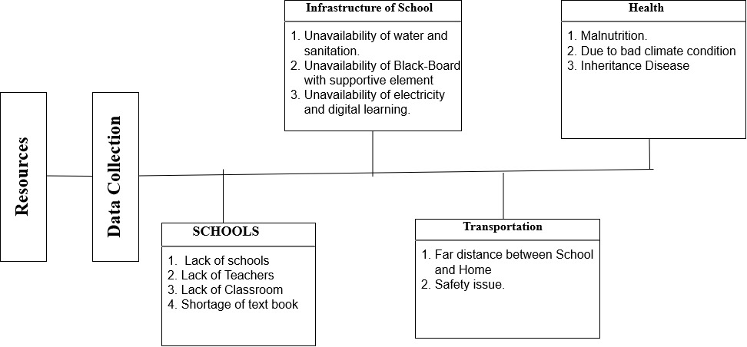
System Flow Diagram
2.Resources

Slide 10
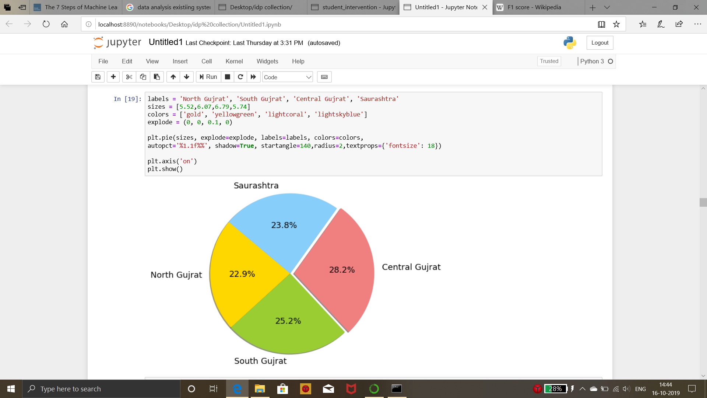
Screenshots 1

Slide 11
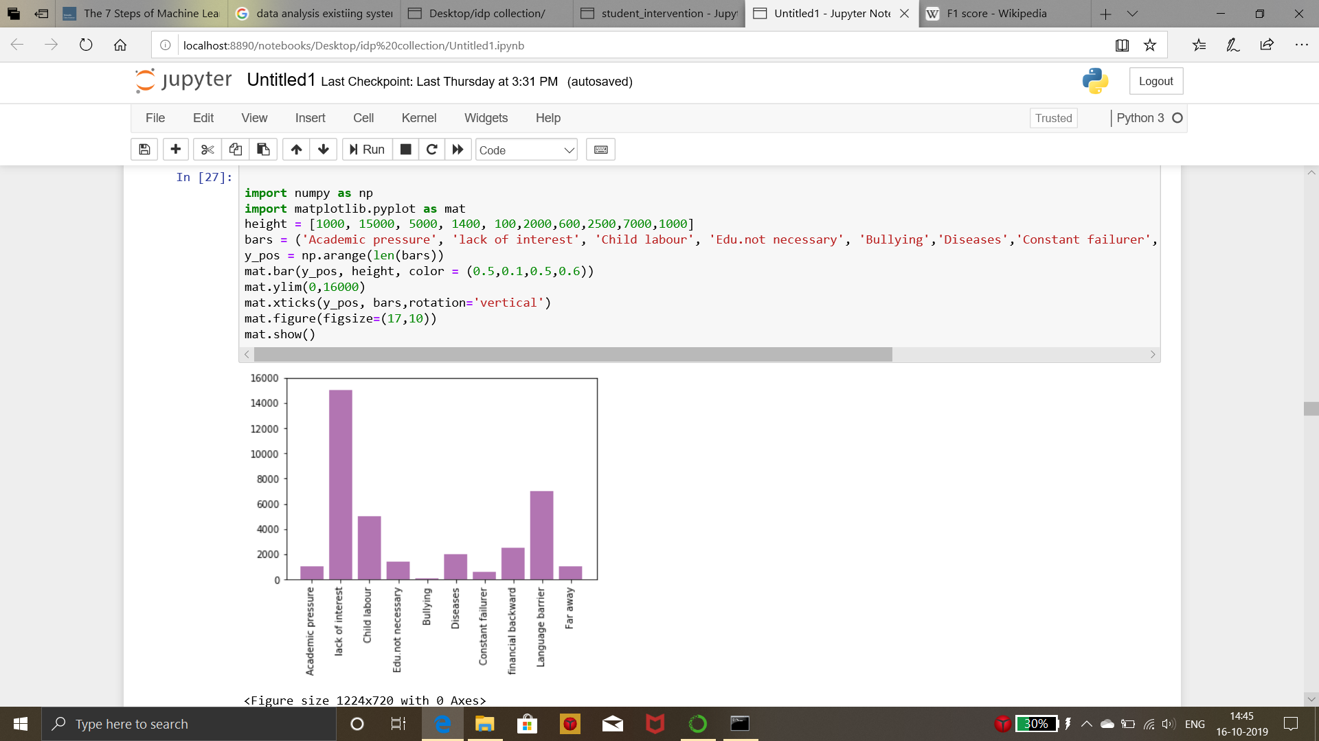
Screenshots 2

Slide 12
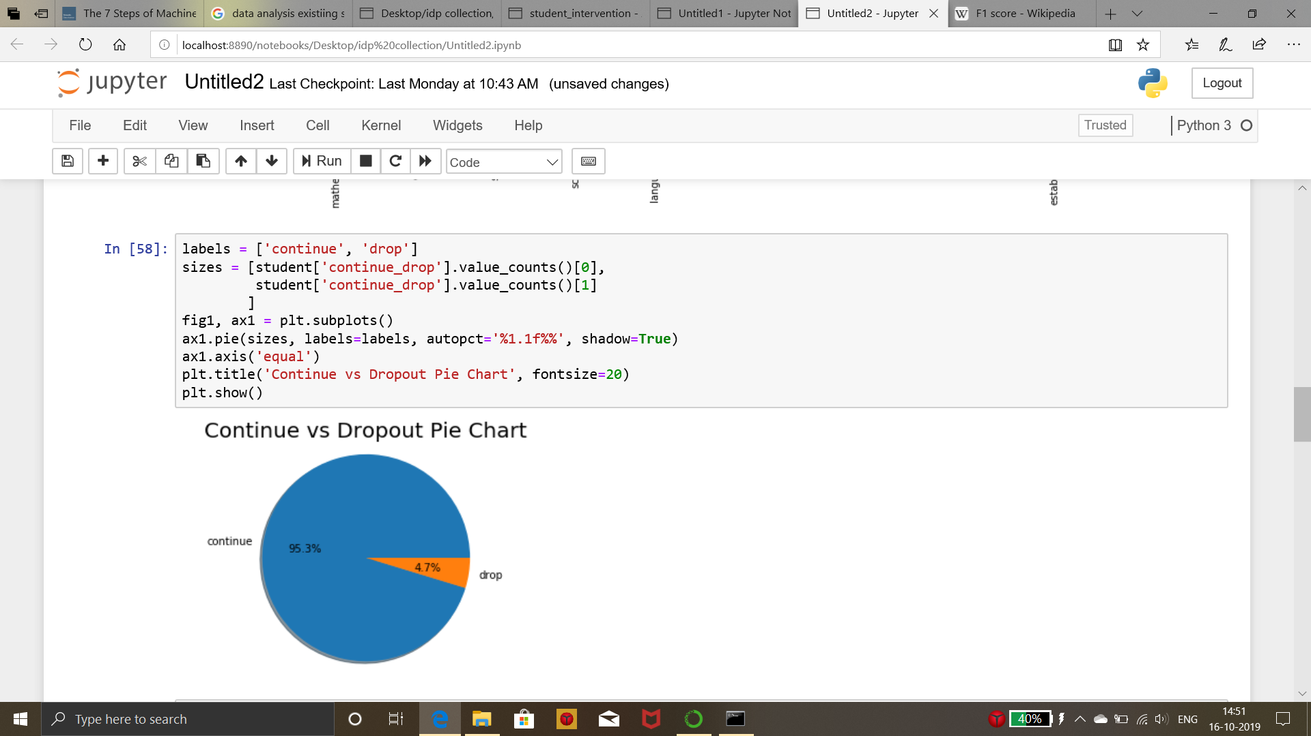
Screenshots 3

Slide 13
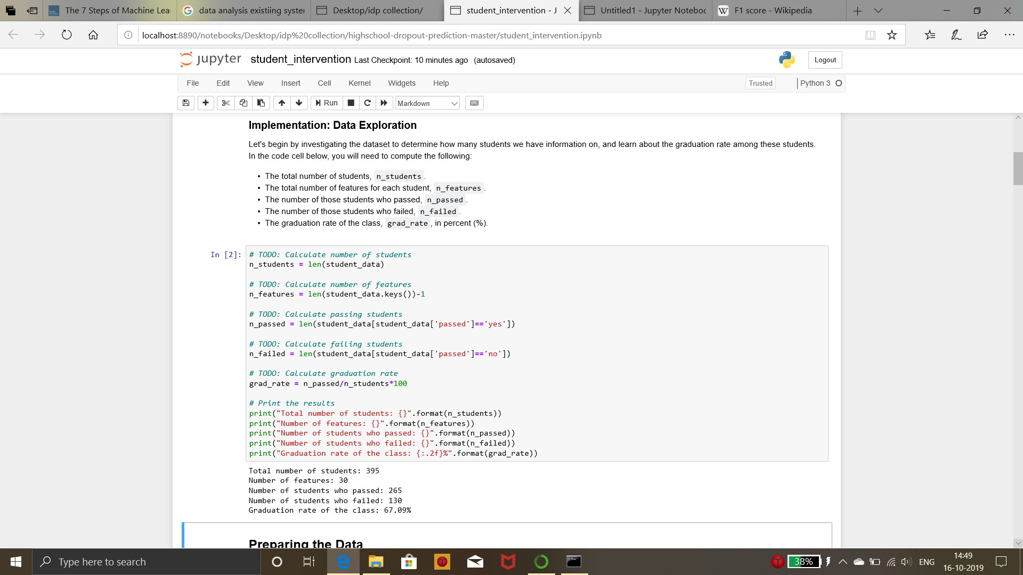
Screenshots 4

Slide 14
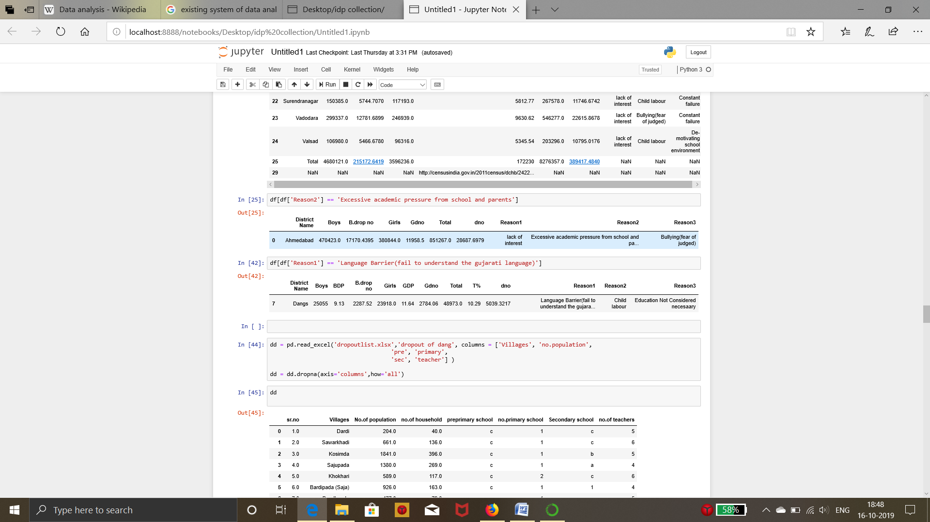
Screenshots 5

Slide 15
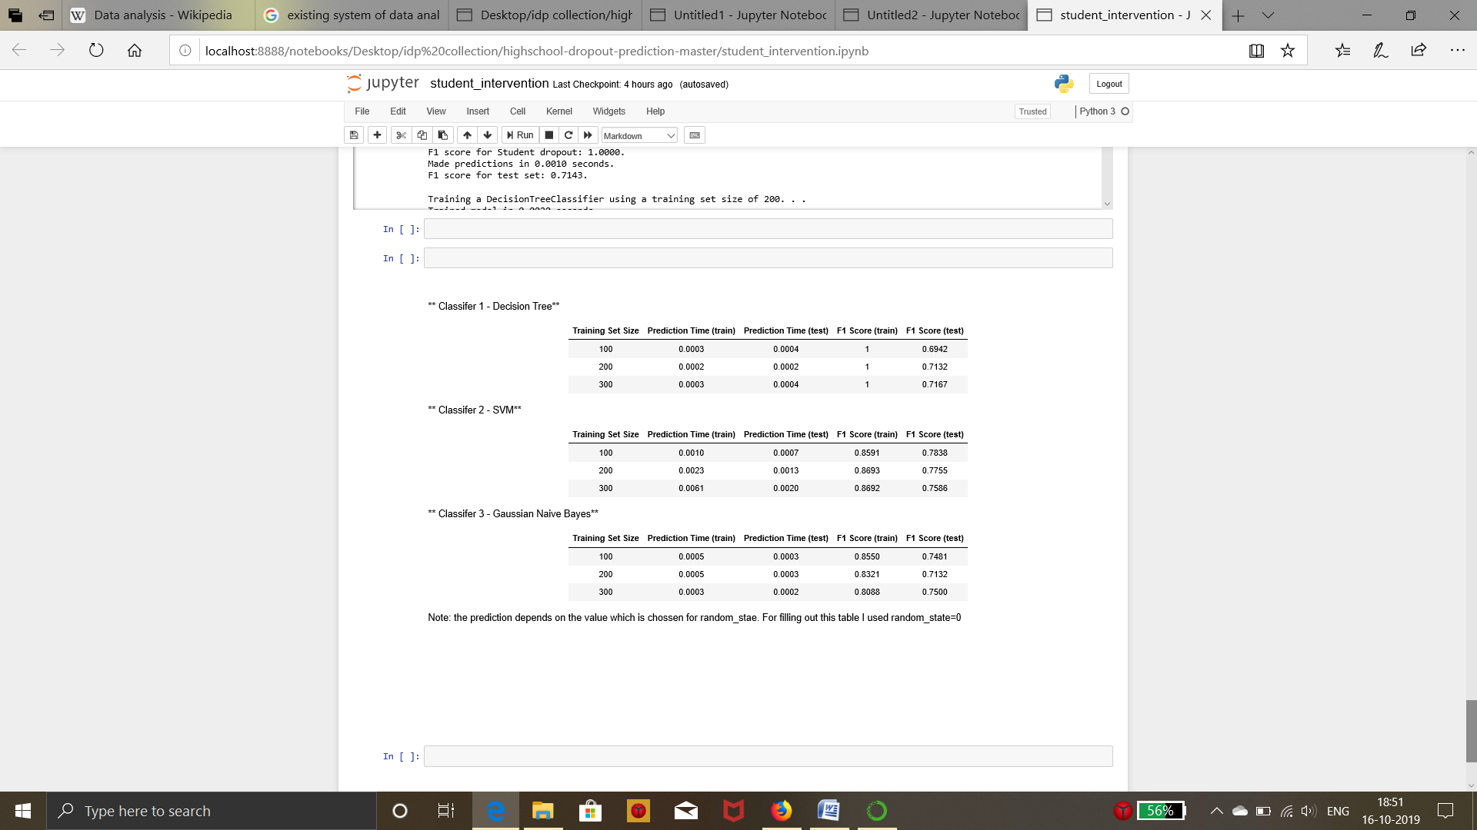
Screenshots 6

Slide 16
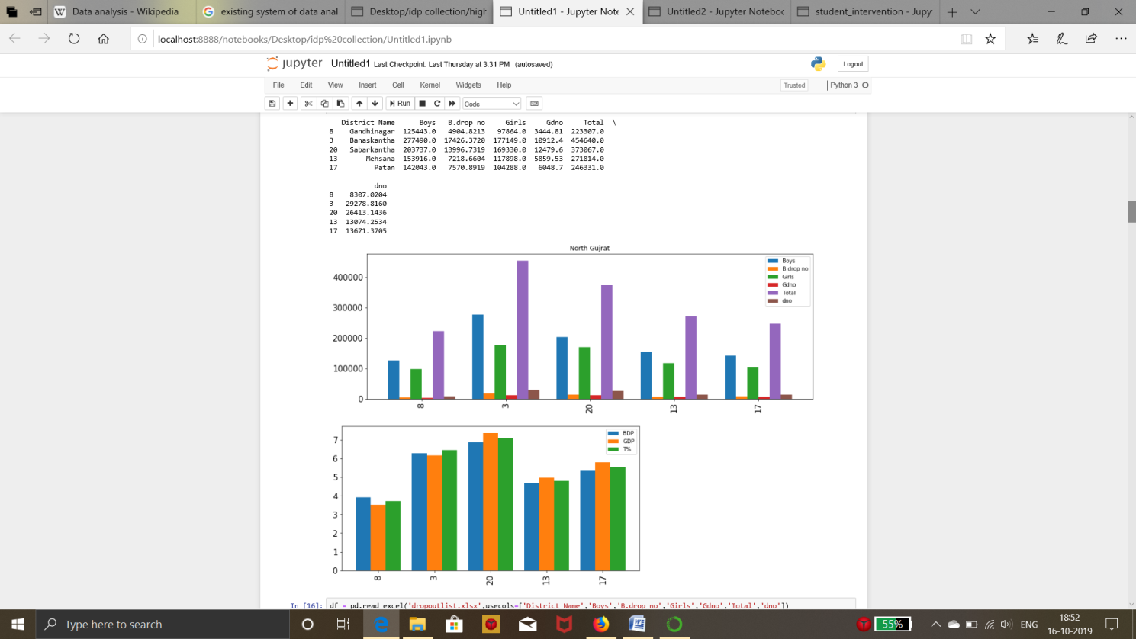
Screenshots 7

Slide 17
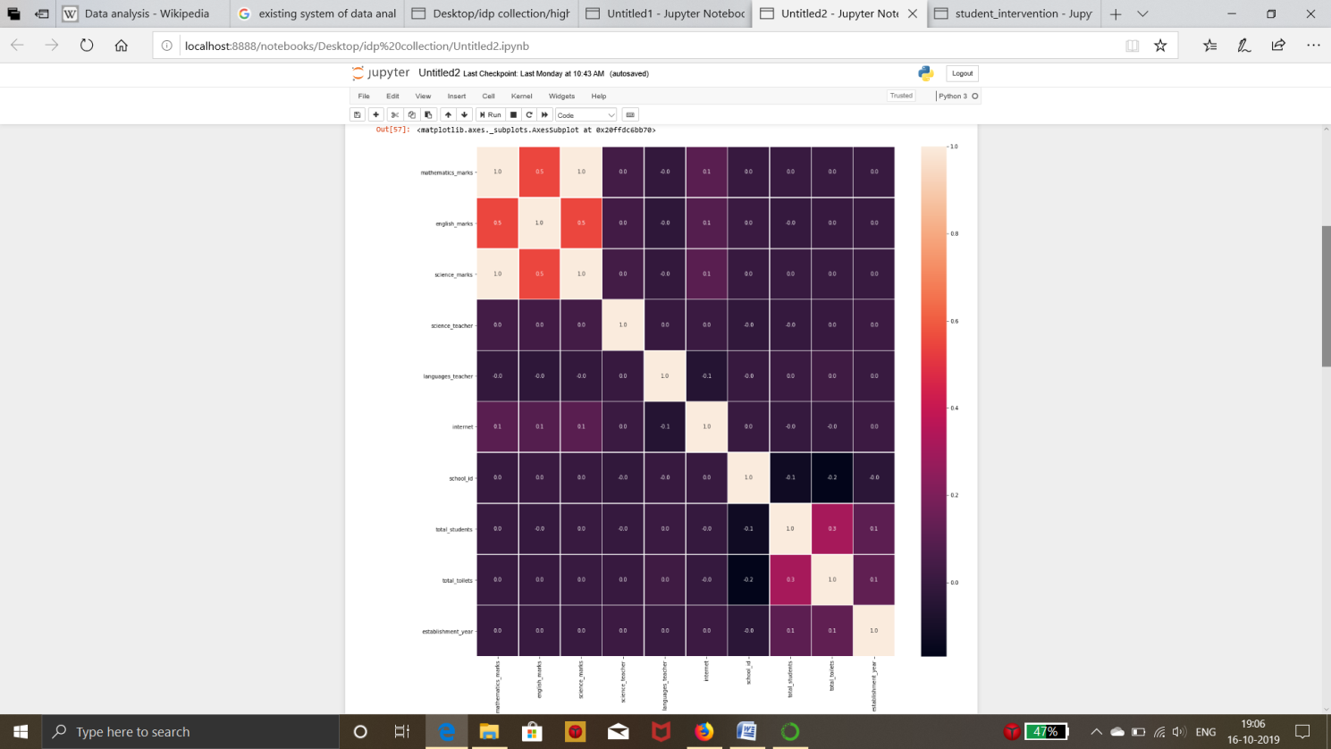
Screenshots 8

Slide 18
Limitations
Limitaioms
If we will get wrong information than our Data analysis get wrong report about that data.
Data collected from different sources can vary in quality and format.
The data could be incomplete. Missing values, even the lack of a section or a substantial part of the data, could limit its usability.
If you’re using data from surveys, keep in mind that people don’t always provide accurate information.

Slide 19
Future Enhancement
We collect more data in future according to new surveys and make our data analysis report more efficient.
we will use modern technologies such as AI and Deep Learning.
Real Time Data Collection will be done.

Slide 20
References & Bibliography
http://censusindia.gov.in/2011census/dchb/DCHB_A/24/2422_PART_A_DCHB_THE%20DANGS.pdf
https://www.in.undp.org/content/dam/india/docs/human-development/District%20HDRs/4.The%20Dangs_DHDR_July%202015.pdf

Slide 21
Thank you !!!

