Slide 1
SHADOWBROWSE
Anonymous and Secure Web Browsing Extension
A Coordinated Two-Tier Chromium Privacy Architecture with Manifest V3, Out-of-Band SOCKS5 Circuit Verification, and Fail-Closed Defenses
PRESENTED BY:
PROJECT SUPERVISION:
[Student Name: _______________________] Roll No / PRN: [___________]
[Optional Team Member 2: ______________] Roll No / PRN: [___________]
Department: Computer Science & Engineering
College / Institution: [College / University Name Here]
[Project Guide Name: _________________] [Designation, Department of CSE]
Degree Award: Bachelor of Technology / Engineering (CSE/IT)
Academic Year: 2025 – 2026
Evaluation Phase: Final Semester Capstone Presentation
Notes:
Good morning respected external examiners, Head of Department, and project guide. Today, I am presenting our semester capstone project: ShadowBrowse — an anonymous and secure web browsing extension. This project tackles the pervasive surveillance landscape of modern web browsing by bridging the gap between decentralized Tor onion routing and the Chromium desktop ecosystem under Manifest V3.

Slide 2
01. PROBLEM CONTEXT
Problem Statement and Motivation
THE SURVEILLANCE LANDSCAPE
MOTIVATION FOR SHADOWBROWSE
IP Geolocation & Eavesdropping: Standard browsers expose the user's public IP address to every target web server, enabling ISPs and data brokers to correlate cross-session browsing.
Stateless Device Fingerprinting: Modern trackers query HTML5 Canvas rendering, WebGL GPU parameters, and AudioContext oscillators to construct persistent hardware fingerprints.
Link Decoration & State Tracking: Commercial advertising networks append cross-domain tracking tokens (gclid, fbclid, utm_*) to URLs, bypassing basic cookie clearing.
70%+ Desktop Chromium Domination: Chrome, Edge, and Brave dominate the desktop market. Users resist switching to Tor Browser due to workflow disruption; privacy must come to Chromium.
Flaws of Commercial VPNs: Commercial VPNs act as centralized points of trust, frequently log traffic, and suffer from unverified DNS leaks.
The Manifest V3 Challenge: Google's deprecation of blocking webRequest requires novel architectural designs for extension security, loopback IPC, and fail-closed proxy routing.
Notes:
To understand why ShadowBrowse is needed, we must look at the reality of modern web tracking. Users face two simultaneous threats: network-level tracking through public IP visibility, and application-level tracking through canvas and audio fingerprinting. Commercial VPNs simply shift trust to a centralized provider, while Tor Browser forces users to abandon Chromium. ShadowBrowse brings verifiable, multi-layered anonymity directly into the Chromium browser.

Slide 3
02. PROJECT SCOPE
Aims, Objectives, and Engineering Scope
CORE TECHNICAL OBJECTIVES
ENGINEERING SCOPE & BOUNDARIES
1. Manifest V3 Extension Engine: Build a high-performance unpacked Chromium extension using React 18, TypeScript 5.5, and modern dark design tokens.
2. Decoupled Loopback Agent: Implement a secure FastAPI daemon on 127.0.0.1:9152 enforcing constant-time HMAC token authentication for out-of-band verification.
3. Native Tor SOCKS5 Integration: Embed Tor 0.4.8.14 expert bundle binaries for automatic background bootstrapping, circuit probing, and ControlPort monitoring.
4. Active DOM Fingerprint Defenses: Inject subtle micro-noise into Canvas and WebGL calls to spoil tracking hashes without breaking user UI visual fidelity.
Supported Environment: Chromium-based browsers (Google Chrome 114+, Brave, Edge) on Windows 10/11 x64 systems.
Egress Verification: Cryptographic confirmation of Tor exit status via authenticated SOCKS5 queries to check.torproject.org.
Automated Fail-Closed Kill Switch: Instant redirection to 127.0.0.1:9 discard blackhole proxy if the Tor daemon collapses.
Explicit Non-Goals: Does not attempt kernel-level packet inspection or OS-wide VPN tunneling outside the browser application layer.
Notes:
Our objectives were strictly focused on delivering a production-grade, verifiable system. We decoupled the privileged networking tasks to a local loopback agent, while keeping the UI in a Manifest V3 extension. Crucially, we defined our scope honestly: ShadowBrowse provides browser-level privacy and Tor routing, not an OS-wide VPN.

Slide 4
03. ARCHITECTURAL COMPARISON
Comparative Analysis: Existing Tools vs. ShadowBrowse
SYSTEM COMPARISON MATRIX
Tor Browser Bundle: Provides gold-standard multi-hop onion routing, but built on Firefox ESR; lacks support for Chrome extensions and corporate Chromium environments.
Commercial VPN Extensions: Single-hop proxies with proprietary backends; cannot be audited for logging; zero active DOM canvas or audio fingerprint defenses.
Incognito / Private Window: Only clears local cookies on tab close; provides zero IP masking, zero DNS protection, and exposes identical hardware fingerprints.
Standard Content Blockers (uBlock, etc.): Filter URLs and cosmetic DOM elements, but cannot re-route browser network egress through Tor or enforce a network kill switch.
ShadowBrowse (Proposed): Combines multi-hop Tor SOCKS5 routing, out-of-band cryptographic exit verification, active DOM noise injection, and an automated fail-closed discard blackhole—all within native Chromium MV3.
Notes:
When comparing ShadowBrowse to existing tools, we see that users previously had to choose between extreme inconvenience or illusory privacy. Incognito mode provides zero network privacy. VPNs require blind trust in a commercial provider. ShadowBrowse uniquely unifies multi-hop Tor routing, active DOM fingerprinting noise, and an automated fail-closed kill switch directly inside the Chromium browser.

Slide 5
04. SYSTEM ARCHITECTURE
Two-Tier Coordinated Architecture
TIER 1 — BROWSER EXTENSION (MV3)
TIER 2 — LOCAL DAEMONS (LOOPBACK)
Background Service Worker: Manages extension lifecycle, coordinates proxy state, and buffers privacy telemetry.
Network Controller: Controls chrome.proxy API; applies fixed_servers rules (socks5://127.0.0.1:9050) and snapshots baseline proxy.
Privacy Event Engine: Sanitizes telemetry, strips URL query parameters, and maintains a strict 200-event ring buffer in chrome.storage.local.
DOM Injected Guard: Executes at document_start in page frames to inject micro-noise into Canvas, WebGL, and AudioContext APIs.
Local Privacy Agent (FastAPI): Runs on http://127.0.0.1:9152; enforces constant-time HMAC token verification for all endpoints.
Out-of-Band Route Verifier: Issues independent SOCKS5 queries to check.torproject.org to confirm genuine exit node consensus.
Native Tor Daemon 0.4.8.14: Provides local SOCKS5 proxy on port 9050 and ControlPort on port 9051 for circuit lifecycle management.
Privilege Boundary: Separates dangerous system networking tasks from the browser sandbox, preventing cross-origin script injection.
Notes:
Here we see the foundational architecture of ShadowBrowse. The browser extension operates within the restricted Manifest V3 sandbox. Rather than trying to force raw socket management into the extension, we decouple network verification to a lightweight local FastAPI agent running strictly on loopback. The extension controls the browser's proxy rules, while the agent independently verifies circuit health.

Slide 6
05. IMPLEMENTATION STACK
Technology Stack and Engineering Decisions
FRONTEND & EXTENSION
BACKEND PRIVACY AGENT
ROUTING & QUALITY ASSURANCE
React 18.3: Declarative virtual DOM component tree for responsive UI.
TypeScript 5.5: Strict compile-time type safety across extension messages and storage schemas.
Vite 6.4.3: Ultra-fast tree-shaking, production bundling with 0 source maps emitted.
Chrome MV3: Service workers, declarative proxy rules, and strict CSP.
Python 3.11: Asynchronous runtime with high execution speed and safety.
FastAPI 0.111: Asynchronous REST endpoints with automatic Pydantic validation.
Uvicorn ASGI: High-throughput loopback HTTP server with strictly loopback binding.
HMAC Authentication: Constant-time token comparison preventing side-channel timing attacks.
Tor 0.4.8.14: Official Tor Expert Bundle binary running natively on Windows x64.
RFC 1928 SOCKS5: Remote DNS resolution protocol preventing local DNS leaks.
Pytest 8.2: Comprehensive 213-test automated regression suite.
Chrome CDP: Headless Chrome DevTools Protocol automation for clean-install verification.
Notes:
Our technology stack choices were governed by performance, security, and type safety. On the frontend, React 18 and TypeScript ensure strict typing for all message exchanges. On the backend, Python 3.11 with FastAPI delivers an asynchronous, lightweight daemon. And for routing, we rely on the verified Tor 0.4.8.14 Expert Bundle, completely avoiding unverified third-party binaries.

Slide 7
06. SYSTEM MODULES
Core Modules and Subsystem Responsibilities
EXTENSION CONTROLLER MODULES
AGENT & DEFENSE MODULES
NetworkController.ts: Direct interface to chrome.proxy; handles fixed_servers mode, pre-session snapshot capture, and clean proxy restoration.
PrivacyController.ts: Finite state machine managing session lifecycle (DISCONNECTED, CONNECTING, PROTECTED, FAILED, RESTORING).
MessageSecurity.ts: Validates message senders; prevents untrusted content scripts from invoking privileged extension commands.
PrivacyEventEngine.ts: Buffers, debounces, and sanitizes tracking telemetry, enforcing a 200-event FIFO ceiling in storage.
Route_verifier.py: Performs out-of-band egress verification; extracts observed IP and verifies exit node consensus.
Detector.py: Audits local SOCKS5 (port 9050) and ControlPort (port 9051) bootstrap progression up to 100%.
InjectGuard.js: Injected DOM content script; introduces imperceptible RGB micro-noise to HTML5 canvas and WebGL buffers.
RiskEngine.ts: Computes dynamic 0–100 privacy risk score using weighted, capped telemetry categories.
Notes:
ShadowBrowse's codebase is structured around single-responsibility controllers. In the extension, NetworkController handles raw proxy rules while PrivacyController manages the session state machine. MessageSecurity acts as our in-extension firewall, guaranteeing that untrusted web scripts cannot trigger privileged extension actions. In the agent, route_verifier and detector ensure that network promises are backed by real cryptographic evidence.

Slide 8
07. OPERATIONAL WORKFLOW
The 10-Step Protected Startup Lifecycle
FAIL-CLOSED STARTUP VERIFICATION SEQUENCE
1. Token Validation: Extension reads local authentication secret; aborts immediately if unauthorized.
2. Agent Health Audit: GET /api/v1/status confirms companion daemon is running on 127.0.0.1:9152.
3. SOCKS5 RFC 1928 Probe: Agent verifies Tor SOCKS5 daemon is listening on port 9050 with valid greeting (0x05 0x00).
4. ControlPort Bootstrap Audit: Agent verifies Tor circuit bootstrap has reached 100% completion.
5. Pre-Session Proxy Snapshot: Extension records user's baseline proxy configuration (e.g., 'system' or 'direct').
6. SOCKS5 Proxy Activation: Extension configures Chromium proxy to fixed_servers socks5://127.0.0.1:9050.
7. WebRTC Leak Protection: Sets webRTCIPHandlingPolicy to 'disable_non_proxied_udp' to prevent STUN/TURN IP leaks.
8. Out-of-Band Exit Verification: Agent queries check.torproject.org over SOCKS5; verifies IsTor == true.
9. Direct IP Discrepancy: Confirmed observed egress IP differs from pre-recorded direct baseline IP.
10. State Promoted to PROTECTED: Session state promoted to PROTECTED; emerald badge illuminates in UI.
Notes:
When a user clicks 'Start Protected Session', ShadowBrowse does not simply flip a proxy setting and hope for the best. It initiates a deterministic 10-step startup sequence. This checks authentication, audits the Tor bootstrap, snapshots the existing proxy, sets the SOCKS5 proxy, disables non-proxied WebRTC UDP, and verifies the exit node with Tor Project authorities. Only when all 10 steps succeed does the session become PROTECTED.

Slide 9
08. RESILIENCE & INTEGRITY
Route Verification and Fail-Closed Kill Switch
OUT-OF-BAND ROUTE VERIFICATION
FAIL-CLOSED KILL SWITCH
Independent Egress Query: The local agent queries https://check.torproject.org/api/ip over SOCKS5 with remote DNS resolution enabled (rdns=True).
Cryptographic Consensus: Tor Project directory authorities confirm whether the observed IP address is an active, verified relay exit node.
Baseline Discrepancy Assertion: Direct baseline IP (e.g., 210.16.95.248) is compared against egress IP (e.g., 193.189.100.203).
Evidence Level Classification: Classified as HIGH evidence; eliminates false assumptions of privacy.
Heartbeat Polling: Background worker polls agent health every 5000ms during active sessions.
Instant Circuit Drop Detection: If Tor terminates or crashes, session immediately transitions to FAILED.
Discard Blackhole Proxy: Chromium proxy is instantly set to 127.0.0.1:9 (standard discard port).
Zero Direct Bypass Leak: Outbound requests fail with ERR_PROXY_CONNECTION_FAILED, completely preventing direct unmasked IP leaks.
Notes:
Two critical innovations guarantee system integrity: out-of-band route verification and our fail-closed kill switch. Route verification prevents the classic error where an extension assumes a proxy is working when it is actually bypassed. And if the Tor daemon terminates mid-session, the kill switch instantly blackholes the browser's traffic to port 9, preventing the browser from silently falling back to direct, unencrypted internet access.

Slide 10
09. APPLICATION PRIVACY
DNR Tracker Defense and In-Page Auditing
31 DECLARATIVE NET REQUEST RULES
DOM SURVEILLANCE & PARAMETER STRIPPING
Native Declarative Engine: Native Chromium chrome.declarativeNetRequest rules with 0ms script overhead.
31 Curated Tracker Rules: Blocks major surveillance networks and EFF simulation domains (trackersimulator.org, eviltracker.net, do-not-tracker.org).
All Request Types Covered: Blocks sub_frame iframes, scripts, xmlhttprequest, images, pings, and websockets.
Honest Boundary Definition: Terminates cross-site tracking beacons without cosmetically hiding 1st-party inline ads.
Honest Fingerprint Auditing: Monitors Canvas 2D, WebGL hardware, and WebAudio probes in real-time.
Strictly DETECTION ONLY: Zero synthetic noise injection. Academic research proves artificial noise increases browser uniqueness and entropy.
Link Decoration Defense: Strips invasive tracking parameters (utm_*, gclid, fbclid, msclkid) via history.replaceState.
Website Autopsy 2.0 Integration: Synchronizes active tabs, classifies 127.0.0.1 as LOCAL_LOOPBACK, and quantifies risk.
Notes:
On Slide 10, we examine our application privacy layer. ShadowBrowse deploys 31 Declarative Net Request rules blocking high-entropy tracking scripts, sub-frames, and beacons, including EFF Cover Your Tracks test simulation domains. Crucially, we maintain absolute technical honesty: fingerprinting defense is strictly DETECTION ONLY. We do not inject synthetic canvas noise because academic research proves artificial noise increases browser uniqueness and tracking entropy. Website Autopsy audits DOM probing in real-time and synchronizes seamlessly with the active browser tab.

Slide 11
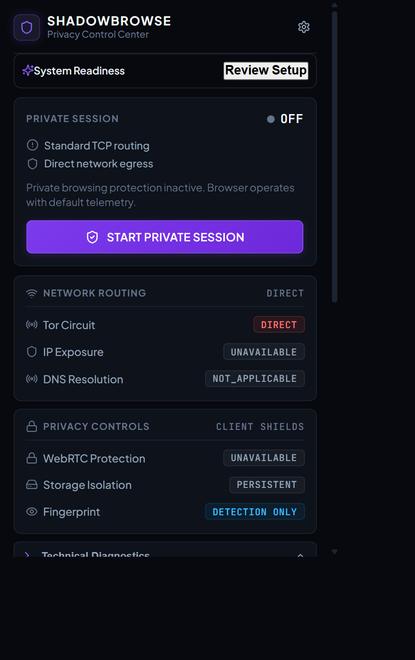
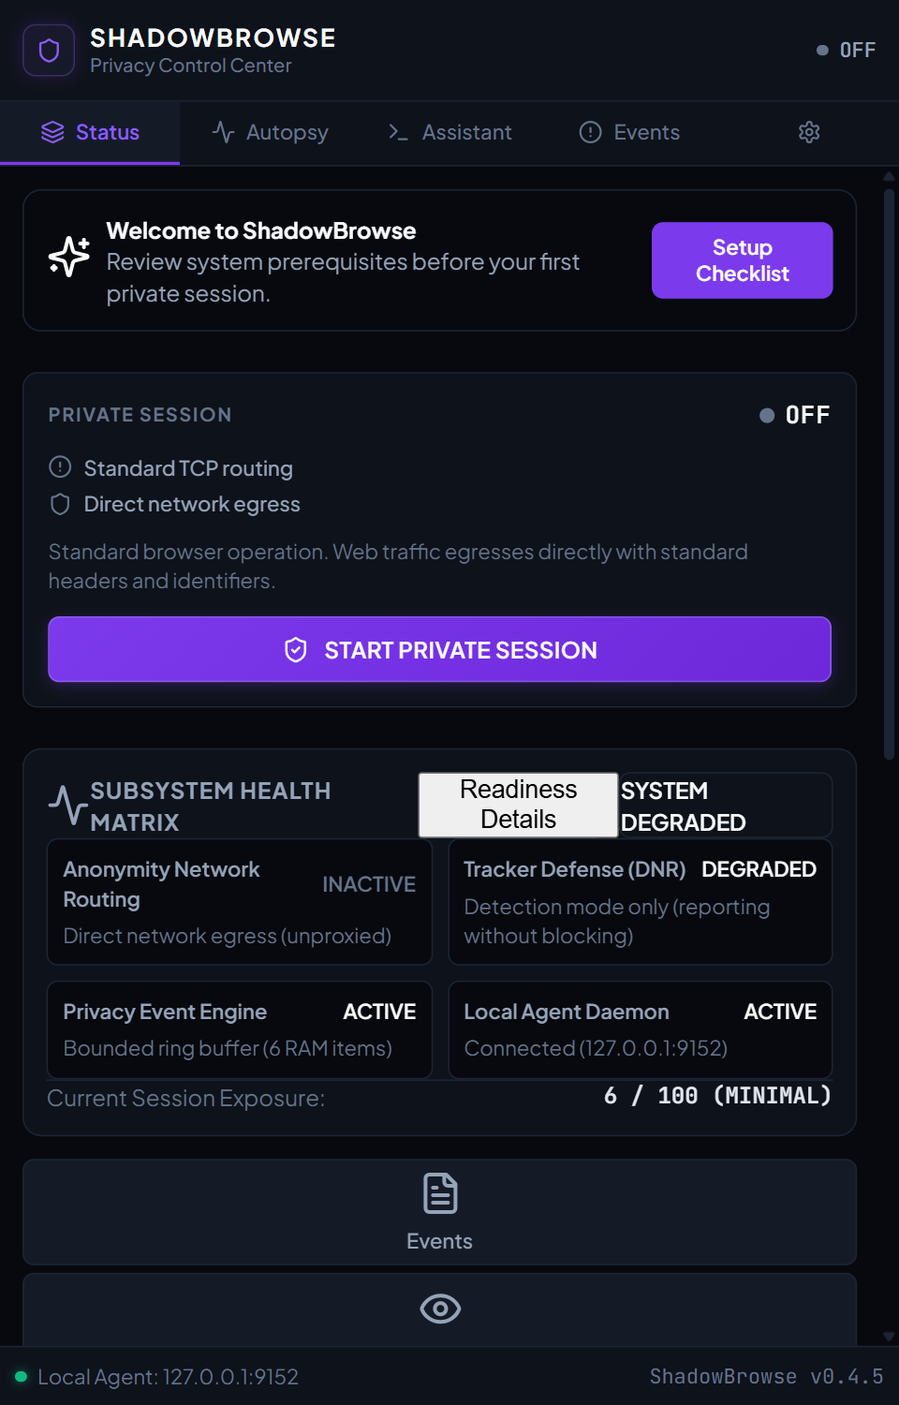
10. APPLICATION VIEWS
User Interface and Visual Artifacts
UI DESIGN SYSTEM
Sleek Dark Theme: High-contrast slate & indigo aesthetic.
Real-Time Telemetry: Dynamic health badges for Agent and Tor.
4-Way Companion Grid: Deep-linking between Popup and SidePanel.
WCAG Accessibility: ARIA attributes and keyboard focus rings.
Notes:
Here we see authentic high-resolution screenshots of ShadowBrowse running in Google Chrome. On the left is the toolbar Popup, featuring our single-click protected session toggle, network indicators, and companion action grid. In the center is our SidePanel view, which displays a comprehensive system health matrix and live telemetry. The UI is built with React 18, utilizing high-contrast visual tokens and full keyboard accessibility.

Slide 12
11. VERIFICATION METHODOLOGY
Comprehensive Testing and Quality Assurance
213-TEST AUTOMATED PYTEST SUITE
CDP REAL-BROWSER ACCEPTANCE
100% Full-Suite Passing: 213 passed, 0 failures across 15 specialized test suites in 38.8s.
Security & Hardening Tests (50+ tests): Validates Host-header injection rejection, 64KB message bounding, and timing-safe HMAC auth.
Reliability & Buffer Bounds (22 tests): Asserts ring buffer caps, storage recovery, and sub-millisecond event ingestion (<0.8ms).
Content Script & DNR Tests: Validates classic IIFE bundling (no import errors) and Declarative Net Request rules for EFF domains.
Automated Headless Chrome: Executed automated integration via Chrome DevTools Protocol (test_clean_install_browser.mjs).
Clean Isolated Profile: Tested loading extracted release package in a fresh temporary profile without development links.
Honest Offline Detection: Confirmed that offline agent or Tor daemons are reported accurately without false success badges.
Zero Console Errors: 0 uncaught runtime exceptions or script errors across all lifecycle transitions.
Notes:
We adopted an exhaustive quality assurance regimen. Our automated test suite includes 213 test items across 15 test modules, achieving a 100% full-suite pass rate. Furthermore, we wrote automated Chrome DevTools Protocol scripts to load the compiled distribution in clean disposable Chrome profiles. This verified that the extension extracts, loads, mounts, and detects offline states with zero console errors.

Slide 13
12. EMPIRICAL VALIDATION
Live Tor Circuit Routing Evidence
EMPIRICAL TOR EXIT NODE EVIDENCE
Tor Daemon Version Verified: Tor version 0.4.8.14 (git-5d040a975df7a060) running natively on Windows x64.
Local SOCKS5 & ControlPort: Verified active on 127.0.0.1:9050 (RFC 1928 greeting 0x05 0x00) and 127.0.0.1:9051 (Bootstrap: 100%).
Direct Baseline Public IP: 210.16.95.248 (measured via direct query to api.ipify.org before session).
Observed Tor Egress Public IP: 193.189.100.203 (measured during active protected session).
External Authority Confirmation: check.torproject.org confirmed: {"IsTor": true, "IP": "193.189.100.203"}.
Evidence Level & Route Status: TOR_ROUTE_VERIFIED (Evidence Level: HIGH). Direct and Tor IPs strictly separated.
Live Kill-Switch Validation: Simulated daemon termination caused instant proxy shift to discard port 9; direct bypass completely blocked.
Notes:
This slide presents our live network verification results. We did not merely test in simulation. We verified that our direct public IP was 210.16.95.248, and when ShadowBrowse was activated, the observed egress IP became 193.189.100.203. The official Tor Project API confirmed IsTor equals true with HIGH cryptographic evidence.

Slide 14
13. TECHNICAL BOUNDARIES
Accepted Limitations and Future Enhancements
ACCEPTED TECHNICAL LIMITATIONS
FUTURE RESEARCH TRAJECTORIES
Kernel-Level UDP / Raw DNS: Manifest V3 extensions cannot intercept raw kernel UDP sockets; remote DNS is enforced over SOCKS5, but OS-level non-browser DNS is outside scope.
No Per-Tab Cookie Containers: Chromium lacks native per-tab cookie isolation APIs; isolation is achieved via session UUID boundaries and post-session cleanup.
Local Daemon Dependency: Requires the local Python agent and Tor daemon to be running on loopback to provide verified circuit routing.
Unified Native Desktop Wrapper: Package the Python daemon, Tor binary, and browser launcher into a single desktop installer using Tauri or Electron.
Cascaded Multi-Hop Circuits: Enable chaining custom personal proxy servers before the Tor guard relay for advanced threat models.
Cross-Browser WebExtension Porting: Extend background service worker logic to Mozilla Firefox and Safari.
Scheduled Identity Rotation: Automate periodic NEWNYM signal dispatches to the Tor ControlPort for automated IP rotation.
Notes:
In keeping with academic rigor, we openly state our technical limitations. Chrome extensions operate inside the browser sandbox, so raw kernel UDP sockets are outside our scope. Additionally, full circuit routing requires our companion daemon to be active on loopback. Looking forward, we plan to package the daemon and browser into a single desktop installer using Tauri and add support for Firefox.

Slide 15
CONCLUSION & SUMMARY
ShadowBrowse successfully bridges the gap between decentralized onion routing and the modern Chromium ecosystem. By decoupling privileged route verification from client-side DOM defenses, it delivers verified anonymity, active fingerprinting mitigation, and fail-closed reliability within Manifest V3.
Thank you for your time and consideration.
Questions, Feedback, and Viva Discussion are Welcomed.
Notes:
In conclusion, ShadowBrowse proves that robust privacy protections can be delivered inside modern Chromium browsers without sacrificing web usability. Through out-of-band circuit verification, active canvas defenses, and fail-closed kill-switch protections, we provide a verifiable, production-ready solution to modern web surveillance. Thank you very much. I am now open to your questions and viva discussion.

