Slide 1
Open cover
Functional Test coverage Tool
Version: V2.3

Slide 2
content
Dev & QE Expectation
Functional Test Coverage
Why You Need Functional Test Coverage Over Code Coverage
Functional Test Coverage Tools & Why Open Cover
Open Cover & Report Generator
Open Cover & Report Generator - Prerequisite & Note
Demo On Open Cover
Additional info
Q&A

Slide 3
Dev & QE Expectation
DEV Should be able to host web application using Open Cover on developer box to generate report
QE Should be able to setup automated/manual test script execute against developer box

Slide 4
Functional Test Coverage
Test Coverage aims to measure the effectiveness of testing in a qualitative manner. It determines whether the test cases are covering entire functional requirements. You can think of it as a kind of black box testing, where test cases are not written based on code but based on user requirements or expected functionality.
Functional Coverage Tracks Your Test Plan.
Track the code coverage of a functional test, so that the test design and execution can be refined to reach an accurate, functional test goal.

Slide 5
Why You Need Functional test Coverage Over Code Coverage
Code Coverage cannot detect conditions that are not in the code
.NET Code Coverage on ASPX Files?
Please go thru below URL for more info
http://www.synthworks.com/blog/2013/04/20/why-you-need-functional-coverage/

Slide 6


Functional TEST Coverage Tools & Why Open Cover
 | Ncover | DotCover | Coverlet | Open Cover
License Type | Commerical | Commerical | Free/Open Source | Free/Open Source
.NET 4.0 or Above
.NET Core
Support IIS & IIS Express

Slide 7
Open Cover & Report generator – prerequisite & Note
Prerequisite:
CPU 2GHZ or above, RAM 8GB or above
.NET 4.5.2 Framework or above
Note:
Nuget support is also there for Open Cover. But it is recommended to use stand alone since we need to add package to projects

Slide 8
Open Cover & Report generator
Open Cover is a Code/Functional Test Coverage tool for .NET
https://github.com/OpenCover/opencover
Report generator
https://github.com/danielpalme/ReportGenerator
.NET 4.5.2 | https://github.com/OpenCover/opencover/releases/download/4.5.3427/opencover.4.5.3427.zip
.NET 4.7 | https://github.com/OpenCover/opencover/releases/download/4.7.922/opencover.4.7.922.zip
.NET 4.5.2 | https://github.com/danielpalme/ReportGenerator/releases/download/v3.1.2.0/ReportGenerator_3.1.2.0.zip
.NET 4.7 | https://github.com/danielpalme/ReportGenerator/releases/download/v4.2.5/ReportGenerator_4.2.5.zip

Slide 9
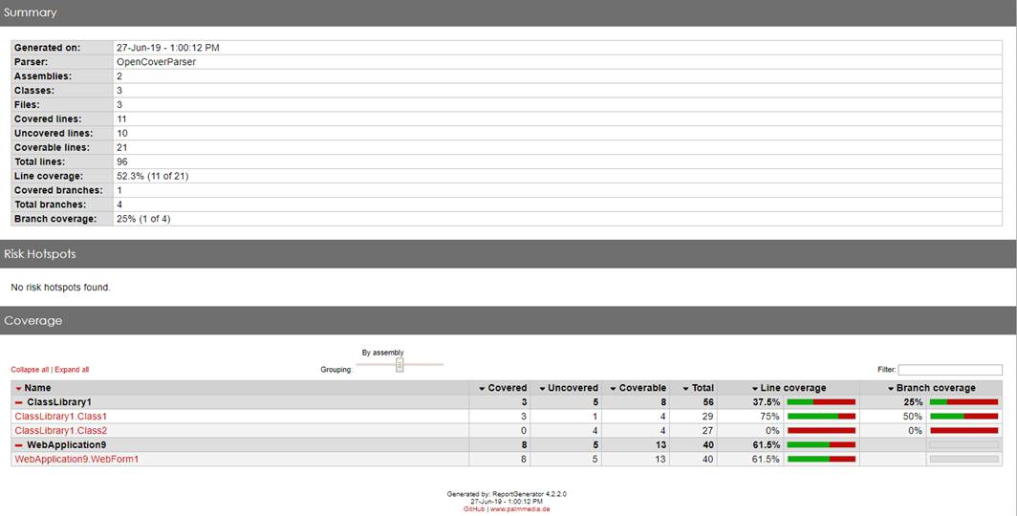
Demo

Slide 10
Additional info
Alt Cover Alternate to Open Cover
https://github.com/SteveGilham/altcover
https://www.hanselman.com/blog/AltCoverAndReportGeneratorGiveAmazingCodeCoverageOnNETCore.aspx
IIS Express Recommended for Open Cover Since IIS it tightly integrated with Windows OS and this needs to many configurations to changes
https://stackoverflow.com/questions/8389024/iis-express-vs-default-iis-that-comes-with-windows-7
It is recommended to stop IIS using below command. Since we use port 80 in applicationHost.config.
net start w3svc
net stop w3svc /y
Path IIS Express
32 Bit: C:\Program Files (x86)\IIS Express\iisexpress.exe
64 Bit: C:\Program Files\IIS Express\iisexpress.exe
Path IIS Express applicationHost.config: %userprofile%\documents\IISExpress\config
Sample IIS Express applicationHost.config

Slide 11
Additional info
Most Used Commands
OpenCover.Console.exe -target:"C:\Program Files\IIS Express\iisexpress.exe" -filter:+[*]* -register:user -targetdir:C:\Users\anand\source\repos\WebApplication9\WebApplication9\bin\Release\Publish\bin
ReportGenerator.exe -reports:"C:\OpenCover\opencover.4.7.922\results.xml" -targetdir:C:\OpenCover\Output\net47 -sourcedir:C:\Users\anand\source\repos\WebApplication9\WebApplication9\bin
Command to filter assemblies while generating reports
ReportGenerator.exe -reports:"C:\OpenCover\opencover.4.7.922\results.xml" -targetdir:C:\OpenCover\Output\net47 -sourcedir:C:\Users\anand\source\repos\WebApplication11\WebApplication11\bin\Release\Publish\bin "-assemblyfilters:+WebApplication11*;+ClassLibrary1*"

Slide 12
Additional info
Hosting Multiple Site And Capture Functional Test Coverage
OpenCover.Console.exe -target:"C:\Program Files\IIS Express\iisexpress.exe" -targetargs:"-config:C:\MyFolder\Demo\applicationhost_aspx.config" -filter:+[*]* -register:user "-searchdirs:C:\MyFolder\Demo\aspx\bin;C:\MyFolder\Demo\mvc\bin"
Report Option in Filters
ReportGenerator.exe -reports:"C:\OpenCover\opencover.4.7.922\results.xml" -targetdir:C:\MyFolder\Demo\zfunctionalCoverageReport "-sourcedirs:C:\MyFolder\Demo\aspx\bin;C:\MyFolder\Demo\mvc\bin" "-assemblyfilters:-Antlr3.Runtime* " "-classfilters:-__ASP.FastObjectFactory*;-*.BundleConfig;-*.FilterConfig;-*.RouteConfig;-*.MvcApplication;-ASP._Page_Views__ViewStart_cshtml"
ReportGenerator.exe -reports:"C:\OpenCover\opencover.4.7.922\results.xml" -targetdir:C:\MyFolder\Demo\zfunctionalCoverageReport "-sourcedirs:C:\MyFolder\Demo\aspx\bin;C:\MyFolder\Demo\mvc\bin" "-assemblyfilters:-Antlr3.Runtime*;-System.Web.UI.dll*" "-classfilters:-__ASP.FastObjectFactory*;-*.BundleConfig;-*.FilterConfig;-*.RouteConfig;-*.MvcApplication;-ASP._Page_Views__ViewStart_cshtml" "-filefilters:-C:\MyFolder\TFS\rmy\POC\OpenCover\aspx\*"
Note: This feature is supported with Open Cover 4.7.922 or above

Slide 13
Additional info
Console Application And Capture Functional Test Coverage
cd C:\OpenCover\opencover.4.7.922
OpenCover.Console.exe -target:"C:\MyFolder\Demo\ConsoleApp\ConsoleApp1.exe" -register:user
cd C:\OpenCover\ReportGenerator_4.2.2\net47
ReportGenerator.exe -reports:"C:\OpenCover\opencover.4.7.922\results.xml" -targetdir:C:\MyFolder\Demo\zfunctionalCoverageReport -sourcedir:C:\MyFolder\Demo\ConsoleApp\
Note: Above Path are POC paths please change as per your needs

Slide 14
Q&A

Slide 15
Thank You

