Slide 1
IBM SkillsBuild Winter Certification Program on Data Analytics: Turning Data into Decisions using Python
1. Name : S Varshitha
2. College Name : Sri Venkateswara College Of Engineering
3. State : Andhra Pradesh
4. Title of the Program : IBM SkillsBuild Winter Internship Program

Slide 2
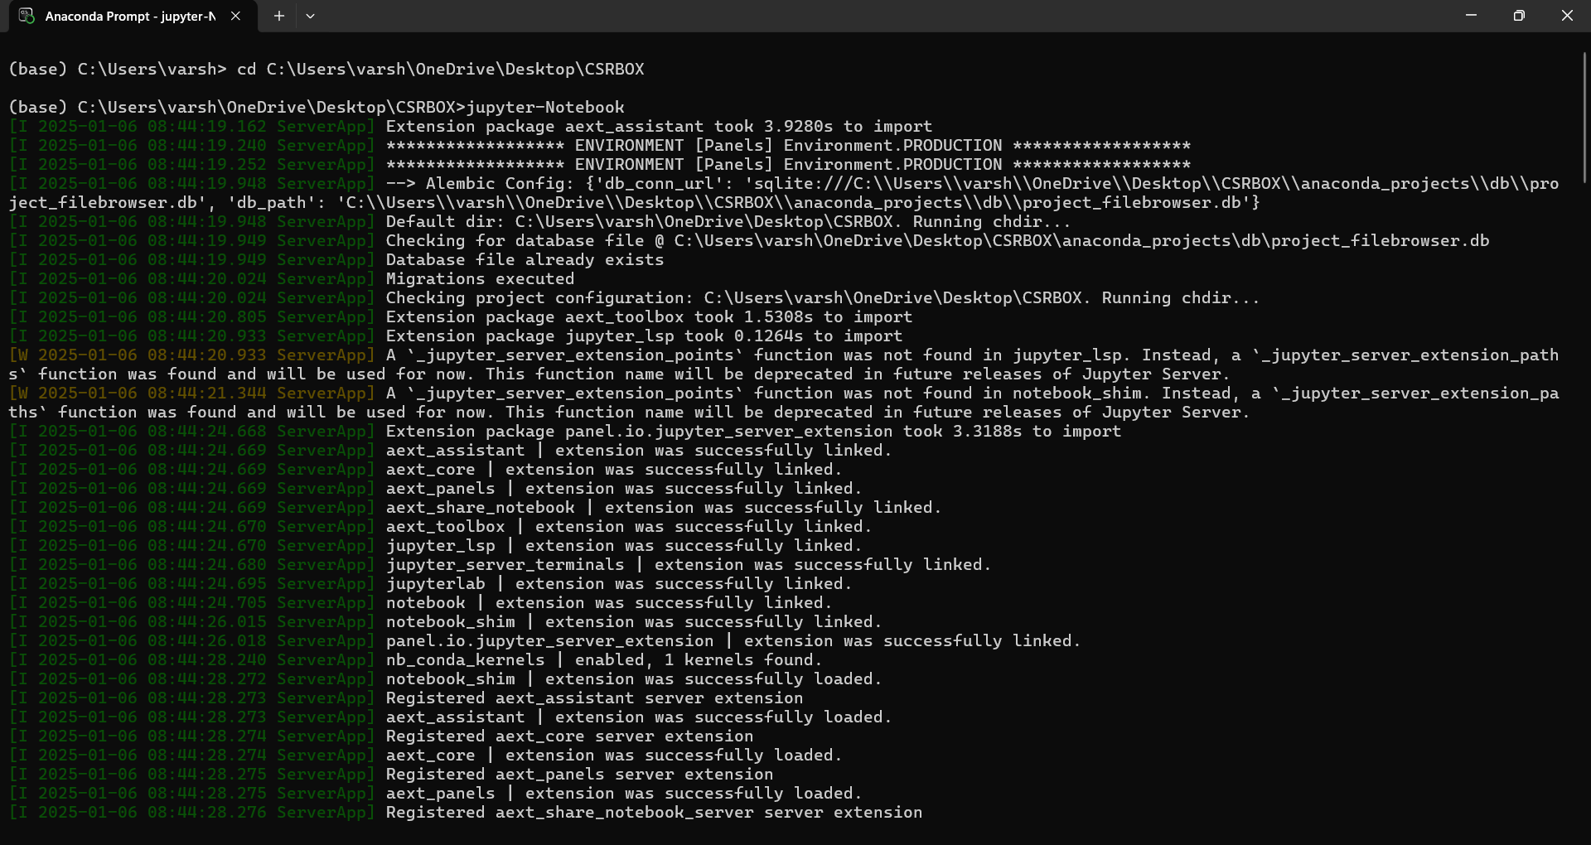
Assignment 1
Anaconda is an open-source distribution of Python and R, primarily used for scientific computing, data analysis, and machine learning. It comes with a package manager, Conda, which simplifies package installation, environment management, and deployment.

Slide 3
Assignment 2 : Data Analysis of "cars.csv" Dataset
Task 1
Load the Dataset:
Prompt: Load the "cars.csv" data file into Python using the pandas library.
Code Example:
import pandas as pd data = pd.read_csv('path_to_your_file/cars.csv')
Task 2
Display the Shape of the Dataset:
Prompt: Display the number of rows and columns in the dataset.
Code Example:
print(data.shape)

Slide 4
Task 3:Calculate Summary Statistics:
Prompt: Compute summary statistics such as Mean, Median, and Standard Deviation for numerical columns in the dataset.
Code Example:
summary_stats = data.describe() print(summary_stats)
Task 4: Interpretation of the 25th and 75th Percentiles
Step-by-Step Instructions:
Calculate the Summary Statistics:
First, load the dataset and use data.describe() to generate the summary statistics. This will provide the 25th and 75th percentiles.
import pandas as pd data = pd.read_csv('path_to_your_file/cars.csv’)
summary_stats = data.describe()
print(summary_stats)
2.Identify the 25th and 75th Percentiles:
In the summary statistics output, you will find rows labeled 25% and 75%. These represent the 25th and 75th percentiles for each numerical column in your dataset.

Slide 5
 | mpg | cylinders | horsepower | weight
count | 32.0 | 32.0 | 32.0 | 32.0
mean | 23.5 | 6.0 | 122.5 | 2800
25% | 17.0 | 4.0 | 90.0 | 2400
50% | 22.0 | 6.0 | 110.0 | 2800
75% | 29.0 | 8.0 | 140.0 | 3200
Interpretation:
25th Percentile (Q1): This is the value below which 25% of the data points lie. It indicates the lower boundary of the dataset and can be used to identify the lower range of values in a distribution.
Example interpretation: For the column mpg, the 25th percentile is 17.0, meaning that 25% of the cars in the dataset have a miles-per-gallon (mpg) value below 17.0.
75th Percentile (Q3): This is the value below which 75% of the data points lie. It indicates the upper boundary of the lower range of values.
Example interpretation: For the column mpg, the 75th percentile is 29.0, meaning that 75% of the cars in the dataset have an mpg value below 29.0

Slide 6
Assignment 3 (Data Visualization):
Types of Variables
Numerical Variables: Represent continuous data (e.g., height, weight, price).
Categorical Variables: Represent discrete categories (e.g., city, product type, gender).
Numerical: Suitable for Histograms and Boxplots.
Categorical: Best for Barplots.
Bivariate Analysis: Combines different variable types, such as Numerical vs. Numerical, Categorical vs. Categorical, and Numerical vs. Categorical.

Slide 7
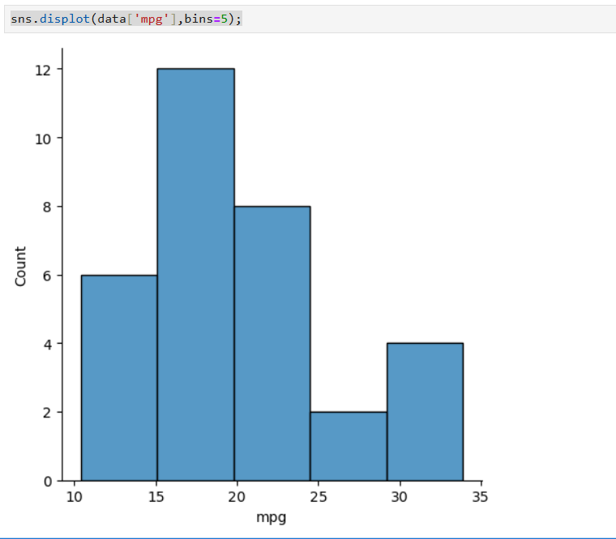
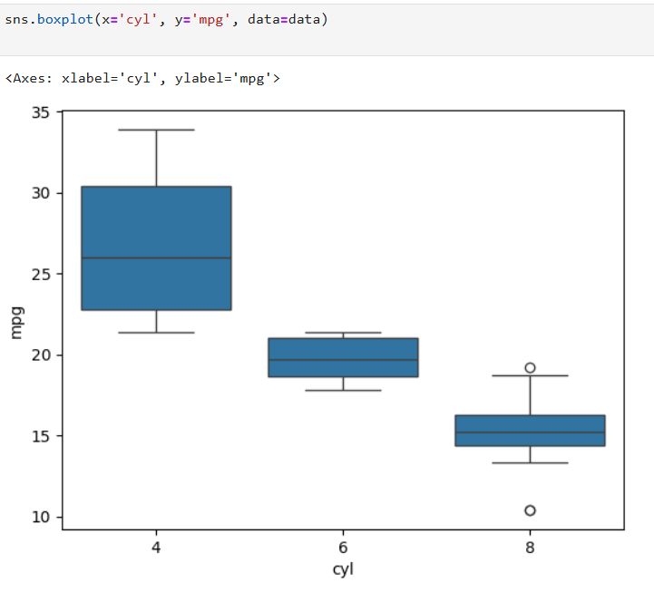
Using Numerical Variables for Histograms & Boxplots
Histogram:
Use for visualizing the distribution of a numerical variable.
Example: Visualizing the distribution of mpg (miles per gallon).
Boxplot:
Use for showing the spread of a numerical variable and detecting outliers.
Example: Comparing mpg across different categories of cyl (cylinders).
sns.displot(data['mpg'],bins=5);
sns.boxplot(x='cyl', y='mpg', data=data)

Slide 8
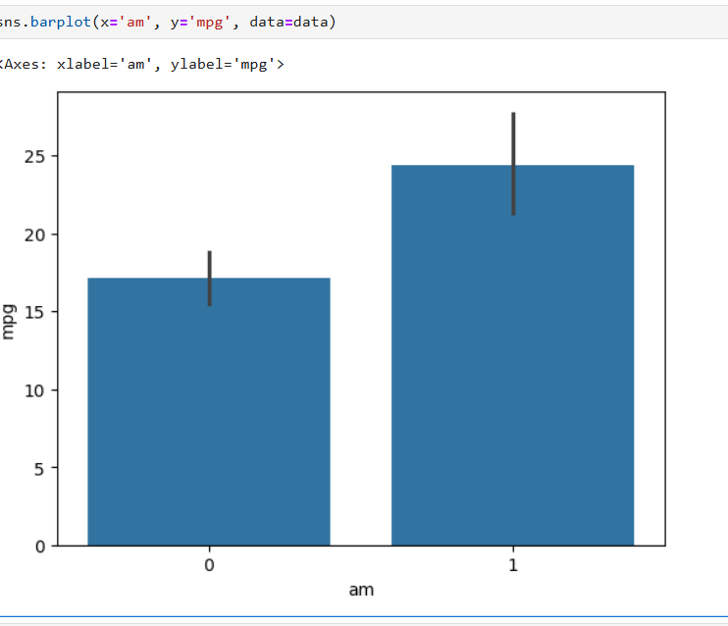
Using Categorical Variables for Barplots
Barplot:
Visualize the count or average of a numerical variable for each category.
Example: Show average mpg for each transmission type (am).
Code Example:
sns.barplot(x='am', y='mpg', data=data)

Slide 9
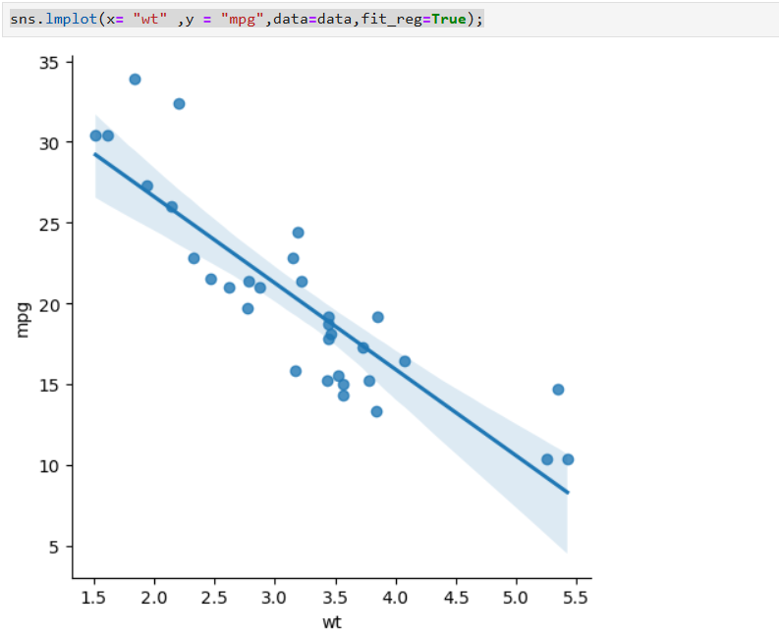
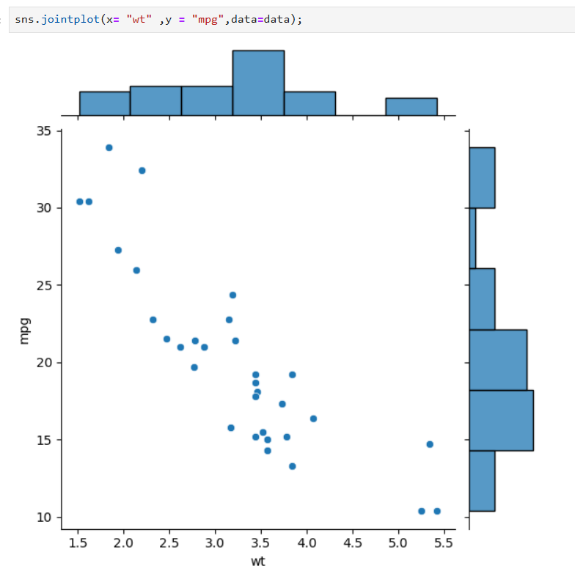
Bivariate Analysis: Numerical vs. Numerical
Scatterplot: Show the relationship between two numerical variables.
Example: wt (weight) vs. mpg (miles per gallon).
Code Example:
sns.scatterplot(x='wt', y='mpg', data=data)
sns.lmplot(x= "wt" ,y = "mpg",data=data,fit_reg=True);
Interpretation:
The scatterplot would reveal the relationship between weight (wt) and miles per gallon (mpg). A negative correlation might suggest that heavier cars tend to have lower miles per gallon
The plot reveals a negative correlation between car weight (wt) and miles per gallon (mpg), meaning as the weight of the car increases, its fuel efficiency (mpg) tends to decrease . The fitted regression line provides a visual representation of this trend, with a downward slope indicating that heavier cars are generally less fuel-efficient.

Slide 10
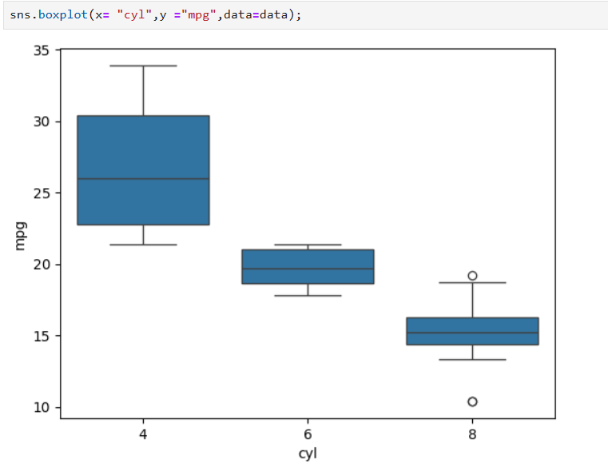
Bivariate Analysis: Numerical vs. Categorical
Boxplot: Use to compare the distribution of a numerical variable across different categories.
Example: mpg (miles per gallon) across different cyl (cylinders).
Code Example:
sns.boxplot(x='cyl', y='mpg', data=data)
Interpretation:
The boxplot would show how miles per gallon (mpg) is distributed across different cylinder categories (cyl). It highlights the median, quartiles, and outliers, helping to see if certain cylinders are more fuel-efficient.

Slide 11
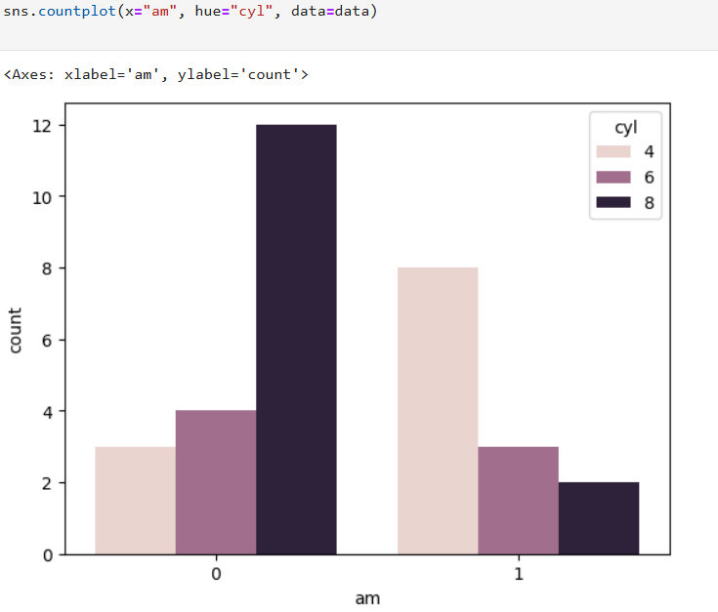
Bivariate Analysis: Categorical vs. Categorical
Countplot:
Compare the counts of different categories between two categorical variables.
Example: am (transmission) vs. cyl (cylinders).
Code Example:
sns.countplot(x='am', hue='cyl', data=data)
Interpretation:
This plot shows the distribution of the number of cylinders (cyl) with respect to the # transmission type (am). It helps to see if the distribution of cylinder types is different for automatic versus manual transmissions

Slide 12
Conclusion
Summary:
Assignment 1: Set up Anaconda and used Python for data analysis and visualization.
Assignment 2: Loaded cars.csv, calculated summary statistics (Mean, Median, Standard Deviation), and interpreted 25th and 75th percentiles.
Assignment 3: Visualized data using histograms, boxplots, and barplots for different variable types and conducted bivariate analysis.
Key Insights:
Analyzing and visualizing data aids in identifying trends and outliers.
Understanding correct plot types is essential for effective data interpretation.
Learnings:
Gained practical experience in data exploration, statistical analysis, and visualization.

