Slide 1
A Temporal Approach for
Large Scale Automatic
News Extraction
Valter & Luigi

Slide 2
Summary
Introduction
Features
  Stability
  Hypertexual Reference Dynamicity
Multi-Feature Approach
Multi-Phase Approach
  Exploration
  Exploitation
  #Links to Articles
Section-Driven Crawling
Experiments
  Stability
  HRD
  L2AC
Ongoing & Future Work
  Micro-Service Architecture
    Pre-analysis of costs
  Publication?
    Industrial Track
    Research Track

Slide 3
Glossary
News website: a website that bases its business on news
  E.g. http://www.nytimes.com, http://www.bbc.com, etc. etc.
Article: a page in which the main content is the news itself
  The page exists because the news itself exists
Section: a page in which the main content is a collection of links to Articles
  The page exists to help user navigate to articles
Other: a page which is not part of the two categories mentioned above
  E.g. contacts.html or aboutUs.html
Many border-cases… you know!

Slide 4

Problem Definition
Archive all the article pages from many news sources
  Input: entry points to news websites
  Output: article pages over time
At scale
Totally unsupervised
  System-wide parameters tuning is OK
  NO site-level parameter tuning allowed!

Slide 5
Temporal Approach
Main idea - The pages of the two main categories of pages in the news domain have well-known behaviors over time:
  Article: exists for a limited time at a certain depth
  Section: exists almost forever at a certain depth
  depth means crawling depth
Pick up some temporal signals about them automatically?
  Signal: means anything that can give us a hint about the nature of a page
We introduce the Stability of an URL
  To monitor a page over-time

Slide 6
Snapshot
A [crawling] snapshot is a set of pages from a site gathered at a certain time
  Periodic snapshots at fixed intervals of time
We have to gather evidence of the temporal behavior of pages from the snapshots
  too slow: evidence is lost because an article could appear&disappear before you see it
  too quick: consecutive snapshots identical, not providing any new information
    (and wasting resources)
They cost a lot… we cannot afford too many snapshots for every site

Slide 7



Unbiased Crawling
Unbiased crawler: doesn’t know anything about News domain
  Simple breadth-first crawler at max depth (2)
  Totally blind in this problem definition (>> design choice revisited later)
Loose control over the amount of downloaded pages
  Storage
  Time
Fixed interval between snapshots (about 1 hour)
...

Slide 8
What is Stability?
Degree of belief to find a certain URL at a certain depth in the next snapshot from a news source snapshot
  It is a frequency between 0 and 1:
    0 means that we'll not find the URL in the next sample, for sure
    1 means that we are sure we'll find the URL in the next sample
An example:
URL | Stability
http://A.html | 1.0
http://B.html | 1.0
http://C.html | 0.33
http://D.html | 0.5
http://E.html | 0.5
http://F.html | 0.33
http://A.html
http://B.html
http://C.html
http://D.html
http://A.html
http://B.html
http://E.html
http://D.html
http://A.html
http://B.html
http://E.html
http://F.html
Snapshot 1
Snapshot 2
Snapshot 3

Slide 9
Stability: Performance
Measures based on about 24 snapshots
  Daily coverage
    Easy to compare
    Easy to imagine
  for a bunch of websites:
    www.nytimes.com
    www.bbc.com
    www.lemonde.fr
    www.fr.de
    …
  ~ 4000k processed URLs per site
Classify pages in two main according according to a fixed threshold:
  Article: low stability
  Non-Article/Section: high stability
Manually crafted golden set to measure the quality of the classification
  Precision
  Recall
  F-measure

Slide 10
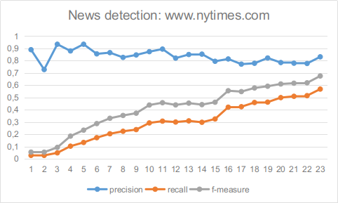
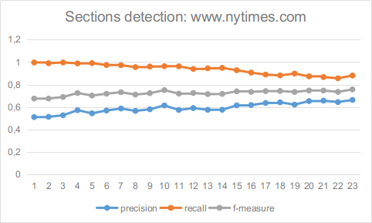
Experiments: www.nytimes.com
Articles
As we collect new snapshots
    Pages previously classified as Sections are progressively reclassified as Articles
    The recall (precision) of the Article detection grows (decreases) over time
    The precision (recall) of the Section detection grows (decreases) over time
Notice that Precision of Sections grows slower than the recall of Articles
  Due to noise inside the Section/Non-Article class >>

Slide 11
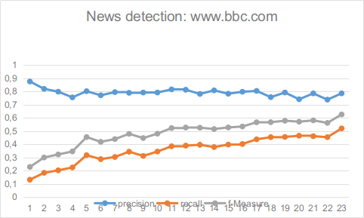
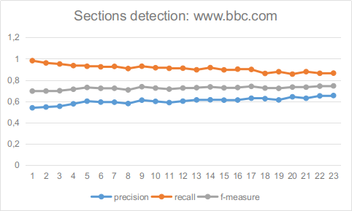
Experiments: www.bbc.com
Articles
The growth of the article precision is slightly slower
  numerous country-specific sections and articles belonging to several sections
  distinct country-specific sections behave differently

Slide 12
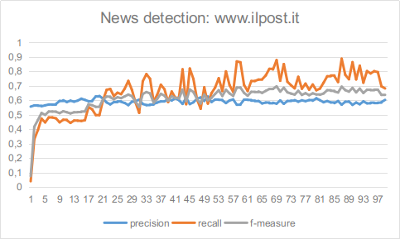
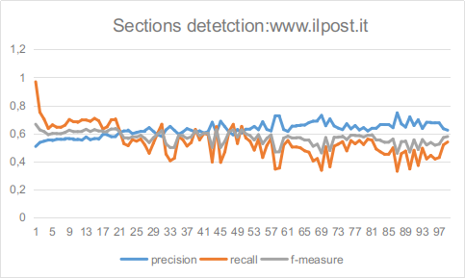
A Long Tail Example
Articles
Weird case: precision of Article detection stopped growing
Very steady: just a few updates per day...
  it is more like a blog than a news site
Misclassified to Section a 2011 Article (with stability=1.0) ...

Slide 13
Stability: Advantages
Tremendously simple
Quick&big hint about the nature of a page:
Article: after a transitory regime, will have a Low Stability
  This is due to the transient nature of a news Article
    Articles are not relevant forever
Non-Article/Section: after a transitory regime, will have a High Stability
  This is due to the stable nature of a Section
    Their main function is just indexing Articles to let user find them
      over time!

Slide 14
Stability: Limitations
Time needed to reach a regime unpredictable
  Strongly depends on frequency of updates
  Can be variable across different sections of the same site
    Especially for large sources with many sections, e.g., bbc.com
Brand new Sections will be treated as Article during the transient regime
Cannot distinguish between Section and Other pages
  That’s why it looked like the precision of Sections was never targeting 100%
Crawling depth drastically affects costs
  (and performance >>)

Slide 15
Link vs Link Occurrences
Beyond Pages Stability
  Sections were born to point to Articles
Interesting hints from Links
  Link: a link between two pages
  Link occurrence: a specific instance of that link
Several distinct outgoing link occurrences to the same page can exist, even from the same page

Slide 16
Link Collections
A Link collection is a group of link occurrences close to each other and homogeneous, both semantically and syntactically
Share common set of characteristics
  Presentation and layout
  Type of target pages
Can be found with simple yet effective heuristic methods
  We do not detail them here
  Site Cleaner already have a quite complex bunch of them
The dynamic of a link occurrence within his link collection may help to reveal the nature of the target page

Slide 17

Link Collections Example
yellow Link Collections
link occurrences in purple
Most often
  either list
  or menu

Slide 18





Link Occurrences Behavior
Behavior of link occurrences to articles over-time
Snapshot 1
Snapshot 2

Slide 19
Hypertextual References Dinamicity (HRD)
Link occurrences leading to Articles are quite dynamic, i.e., characterized by frequent movements across all the pages
  Articles have to be recent to be interesting
Link occurrences leading to Sections are relatively steady
  They are not supposed to change their position too often due to their inherent purpose:
  a stable and predictable reference to guide users’ navigation

Slide 20
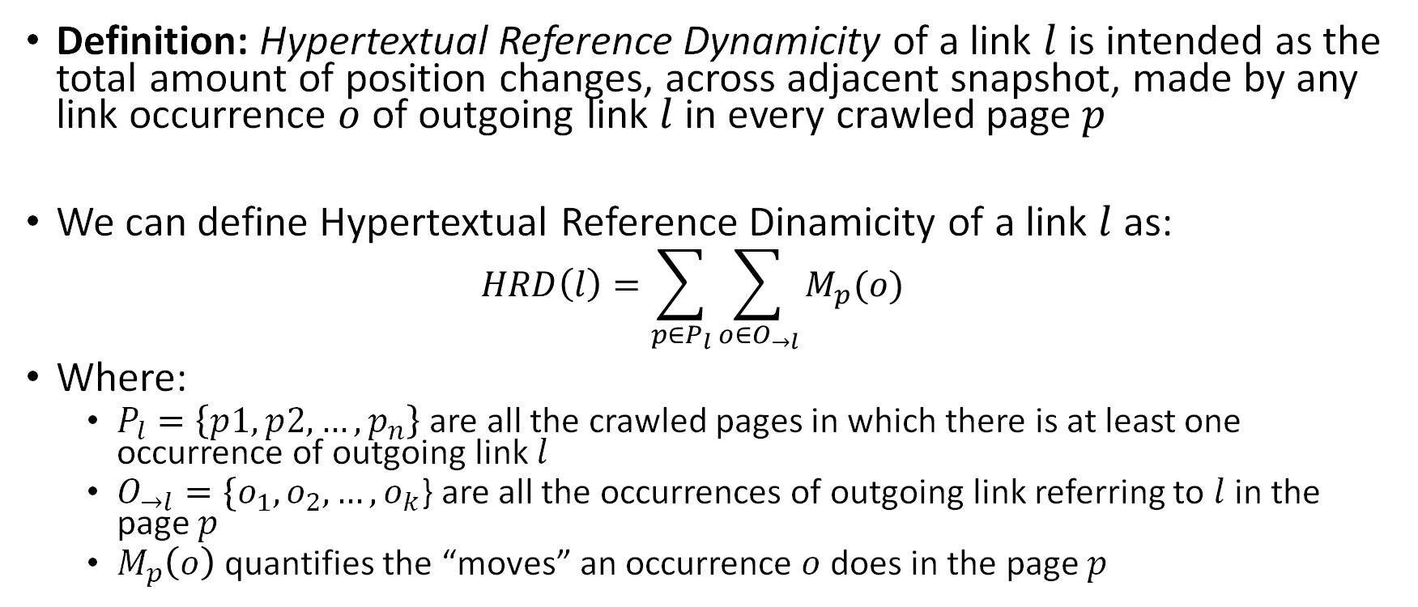
Hypertextual References Dynamicity of Links

Slide 21
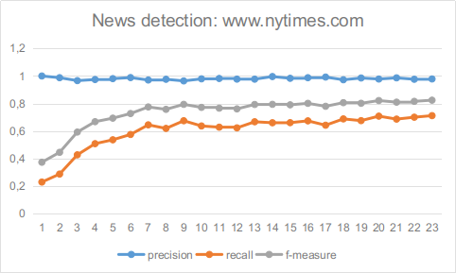
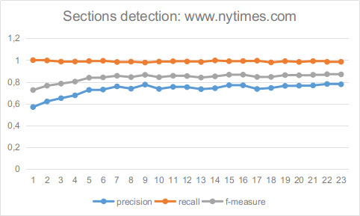
Experiments: www.nytimes.com
Articles
Updates are frequent: Article accuracy quickly increases
Slightly biased results because of crawling starting time
  An hour before lunchtime: exactly when many news sites do an update!
    Sudden spike of freshly published Articles

Slide 22
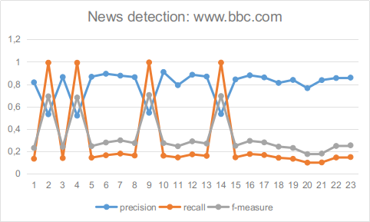

Experiments: www.bbc.com
Articles
Weird results with HRD (spikes)
Not that easy to track link occurrences
  Sections with links not that dynamic
  Others with links that don't last enough time

Slide 23
HRD: Conclusions
Catches leaps of hypertextual references to Articles
Again, there are limitations
  Cannot distinguish a Section from an Other
  Many Others are as steady as Sections
We can't focus only on a single feature

Slide 24
Multi-Feature Model
Let's combine Stability and Hypertextual References Dynamicity features
Classification based on both signals
  Vote for Article vs Non-Article
    Non-Articles:
      Either Sections
      Or Others
  Basic voting model:
    Stability counts +1
    HRD counts +1
  A decision tree to break ties
Boost to our performance in most cases
Can clearly distinguish between Articles and Non-Articles

Slide 25
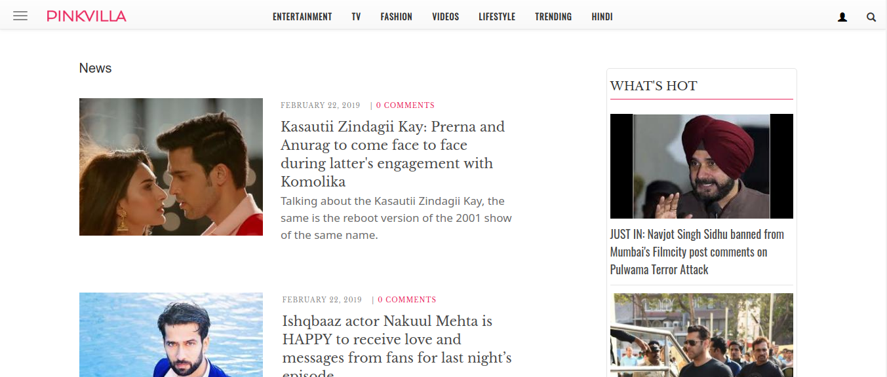
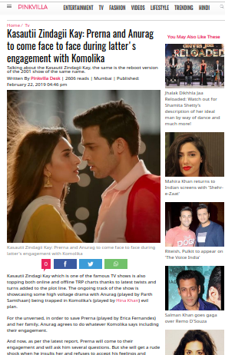
Multi-Feature Model: pinkvilla.com
Simple Sections and Articles
  Stability good enough to distinguish between Articles and Non-Articles
  Slow to converge for some Sections infrequently updated
Link occurrences of Articles are quite dynamic

Slide 26
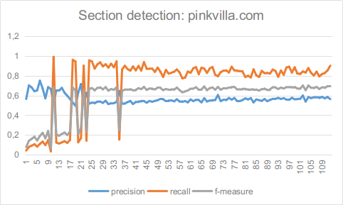
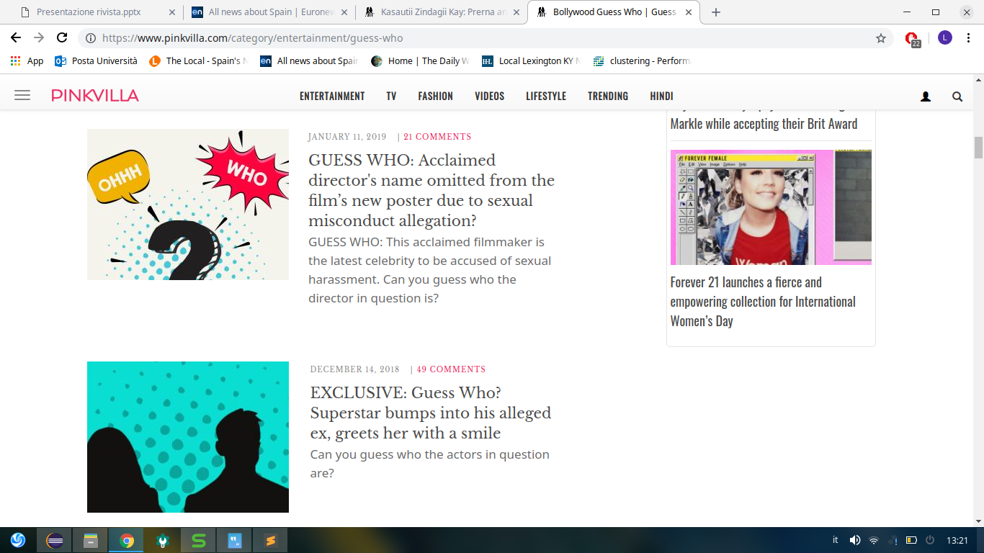
Stability
Non-articles
A bunch of Sections quite seldom updated
  Even after a month
Other Sections with a lot of Articles
  ~30 articles
  Easily to crawl at depth 1
  Articles take longer to disappear
Pages started to vanish after roughly ~40 snapshots
  An article stays in the first page of a section for about 2 days

Slide 27
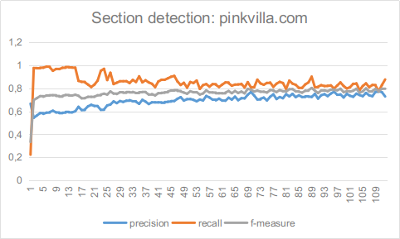
M-F Model: pinkvilla.com
Sections contain a lot(!) of Articles per page
  Therefore, an article takes a lot of time to disappear…
    Stability is slow to provide a clear hint
  But we can still catch link occurrences movement in the meanwhile
Using together Stability and HRD leads to an improvement
Section
Non-articles

Slide 28



irishtimes.com
Quite simple
Good dynamic
Peculiar Sections
  Not so many Articles per Section
  ...and an unexpected issue
    Every element of a link collection that
      contains a link to an Article
      also contains a link to the corresponding Section!
    Hypertextual References Dynamicity is misleading in this case

Slide 29
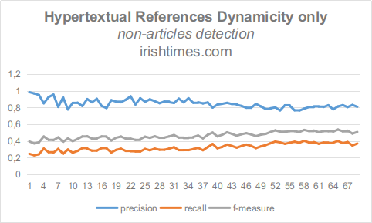
HRD Misleading on Irishtimes.com
Hypertextual References Dynamicity is misleading in this case
Articles and Sections end up having the same dynamicity

Slide 30
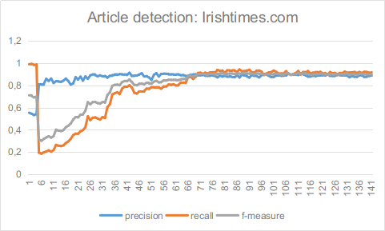
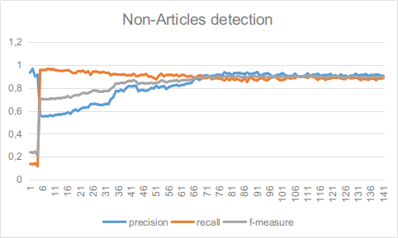
Multi-Feature Model: Irishtimes.com
Results combining both feature pretty good!
This way, a misleading feature doesn't negatively affect the classification

Slide 31
Multi-Feature Model: Preliminary Conclusions
As observed from previous examples, by using a multi-feature model:
  performance boost
  doesn't affect performance negatively in case of misleading features
  Stable classification
    Stronger signals have more importance than weak ones

Slide 32
Article vs Non-Articles Classification
Source | P | R | F | #Snapshots
www.repubblica.it | 0,853 | 0,937 | 0,893 | 152
www.huffingtonpost.it | 0,972 | 0,966 | 0,969 | 34
www.ansa.it | 0,839 | 0,937 | 0,885 | 84
www.fr.de | 0,830 | 0,883 | 0,856 | 100
www.wopular.com | 0,893 | 0,922 | 0,907 | 82
www.cbs58.com | 0,728 | 0,976 | 0,834 | 37
www.thereporter.com | 0,887 | 0,957 | 0,957 | 90
www.lemonde.fr | - | - | - | -
www.necn.com | 0,616 | 1,0 | 0,762 | 50
www.thelocal.es | - | - | - | -
www.news8000.com | 0.867 | 0.974 | 0.917 | 100

Slide 33
Problematic Sources
www.thelocal.es
  Some sections have very old "sub-sections" inside the page
  ~10 actual articles (aged max about 2 days)
  ~20 past year articles
  ~20 past 2 years articles
  “too stable to be articles” problem!
www.necn.com
  Unable to properly calculate Hypertextual References Dynamicity
  Most likely Link Collections we compute are totally wrong
    Need better heuristics for this collateral but important task
    Current heuristic too simple (not the same as in Site Cleaner)

Slide 34
A Pending Issue
Separating Sections from Others is a tough and ambiguous task...
Yet it is important for our induction:
  We need clean induction samples
    What are the consequences of a mis-classification Other and Section pages?
    Does it misguide the Smart Generator?
    Any cost model for these mistakes?

Slide 35
Multi-Phase Approach
S/O?→ S
Phase: Exploration
  First, blind crawling (depth=1/2) from the site entry point
  Use previous approach to classify its pages in two types
    Article vs Non-Article
  Then switch phase, by exploiting classifications produced so far
    Build the typed hypertextual graph of the site
      nodes are typed pages
      edges are link occurrences
    Classify non-Articles into Section vs Other by analyzing the topology of that typed graph
      Sections point to Articles
      Others do not point to Articles
Phase: Exploitation: Section-Driven Crawling
  Restart crawling the site, this time by pivoting from sections already identified (depth=1)
A
A
...
A
S/O?→ O
O
O
...
O

Slide 36
Exploration
Parameters:
  Entry points: www.genericnewssource.com
  Crawling depth = 1
  Features set: Stability, Hypertextual References Dynamicity
Steps for each snapshot:
  Crawl the website from its home page at depth 1
  Extract features
  Classify pages according to the features
  Re-estimate a few parameters
  Repeat until phase-switch condition

Slide 37
Exploration: Opportunities
With a smaller crawling depth we got
  Less pages to download and to store
  Simpler problem
    Less noise in data means → better results
Stability and HRD work well even at depth 1
  Consider that HRD is not strongly affected:
  If a page p is located at depth t, we can still observe the behavior of the link occurrences leading to it from pages at depth t-1

Slide 38
Exploration: Challenges
When to stop the exploration?
  Not that easy
  Currently we mock this step by using a threshold over F-measure
    Unfortunately, that is based on the availability of golden data
How often to snapshot?
  too fast = waste of resources
  too slow = possible loss of information
Parameters tuning could be driven by the average stability of the source

Slide 39
Section Driven Crawling: Exploitation
Parameters:
  Entry points:
    www.genericnewssource.com/politics
    www.genericnewssource.com/business
    www.genericnewssource.com/sport
    etc.
  Crawling depth = 1 >>
  Feature set:
    Stability
    Hypertextual References Dynamicity
    New feature! For Non-Article pages:
    Link-to-Article Count (L2AC):
    #links to Articles
Steps for each snapshot:
  Crawl the news source using sections as seeds
  Extract features
  Classify the pages
  Adapt site-level parameters
    Update with a more refined set of seed sections
  Repeat

Slide 40
Exploitation: Opportunities
We can finally distinguish between Section and Others!
  New feature! For Non-Article pages
    #links to Articles
  A Section has a larger #links to Articles w.r.t. Others
Exploitation crawling depth is 1 from Sections
  Actually a (subset of) depth 2 from Home...
  ...as we have depth 1 entry-points
Additionally
  We can classify Articles by the Section they’re coming from (politics, sport, economy...)

Slide 41
Exploitation: Challenges
Exploitation site-specific parameters should be tuned at runtime
  Wrong grain: should be Section-specific and not Source-specific
  e.g. frequency of snapshots
Should exploration be allowed again after we switch to exploration?
  Advantage: we can more easily discover new sections
  Drawback: we’re going to waste resources as new sections could be rare (especially on the end of the long tail)

Slide 42
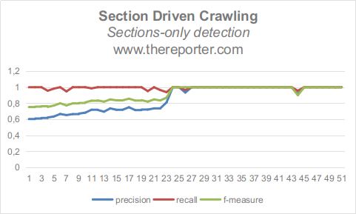
Section-Driven Crawling on www.thereporter.com
After ~25 snapshots
Performance boost due to
L2AC
Sections pivoting
In the red zone (snapshot 24) the phase-switch happened

Slide 43
Section-Driven Crawling on www.thereporter.com
Sections vs Others
now distinguishable
Sections → stable
  with a lot of articles
Others → stable
  fewer articles
In the red zone (snapshot 24) the phase-switch happened

Slide 44
System Parameters
The prototype relies on a few parameters
Let’s organize those related to the domain in a simple taxonomy
Two dimensions:
  Time:
    statically provided
    adapted dynamically at runtime
  Grain:
    Some are system-specific (OK!)
    Some are source/site-specific (KO!)
We cannot tune feature on source-basis
It does not scale to the long tail!

Slide 45
Source-Specific Parameters
Sample Frequency
  Source-wide
  Provided statically: should be computed and adapted dynamically
Crawling depth
  Source-wide
  Provided statically: should be computed and adapted dynamically
These parameters are currently specified by the system maintainer

Slide 46
Future Works
Unsupervised means Unsupervised!
  Including automatic parameters tuning
Other features only if really needed (not necessarily temporal?)
  Keep it Simple Principle!
A Wrapidity & Meltwater Publication
  OK, We’re not FB, Amazon, Google, MS
  But I’ve never seen so many a publications on data-extraction in the same room
  (There is added value to make it explicit IMHO!)
    Low-to-medium level venue for a research track (with small scale exps)
    Medium-to-high level venue for an industrial track (with large scale exps)
Define an micro-service architecture
  Evaluate costs >>
  Main components of current architecture

Slide 47
Costs
BTW: Induction should not run continuously for every source
Let's imagine to crawl www.genericnewssource.com
~100 snapshot
~ page size is 1 MB
~db row for a link occurrence is 5KB
~100 link occurrences per page
~50 distinct crawling frontier links per pages
Storage on Amazon S3 - S3 Standard Storage

Slide 48
Generic Crawling
Depth 0:
  1 home page (1MB) + 100 link occurrences (500KB=0.5MB)
  We can simplify 1 page = 1.5MB
Depth 1:
  50 pages = 75MB
Depth 2:
  2500 pages = 3750MB= 3,75GB
1 snapshot data = 3,82GB
Characteristics
Totally unbiased crawling
  depth 2
  100 snapshots
100 snapshots = 382,65GB

Slide 49
Section Driven Crawling
  Exploration
    Depth 0:
      1 page (1MB) + 100 link occurrences (500KB=0.5MB)
      We can simplify 1 page = 1.5MB
    Depth 1:
      50 pages ~ 75MB
    If this phase lasts for all the 100 snapshots, we'll have 7650MB ~ 7,65GB (worst case scenario)
  Exploitation
    Let's say Exploration phase lasts on average 50 snapshots
      76,5*50 = ~3,825GB
    Depth 0: sections are entry points (virtually is a depth 1)
      20 pages = 20*1.5 = 30MB
    Depth 1:
      1000 pages (1000 * 1.5MB = 1,5GB)
    For the remaining 50 snapshots =
    1,5GB * 50 = 75GB
    100 snapshot exploration + exploitation = 75GB + 3,825GB
Characteristics
Section Driven Crawler
2 phases
Exploration
Exploitation
Depth 2
100 snapshots
100 snapshots = ~80GB

Slide 50

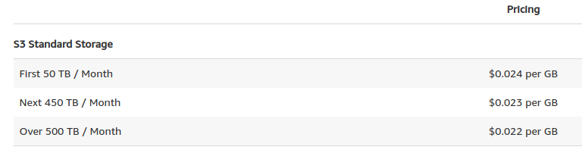
Costs Analysis
Amazon has a service for monthly calculation for every services it offers
  https://calculator.s3.amazonaws.com/index.html
  Storage is just one of the parameter!
Without optimization for a month
  100 snapshot - 1 news source = 382,65GB
  100 snapshot – 1000 news source = 382,65TB
  Monthly cost for 1000 news sources = 9969.59$
With Section Driven Crawling for a month
  100 snapshot – 1 news source = 80GB
  100 snapshot – 1000 news source = 80TB
  Monthly cost for 1000 news sources = 737.16$
Almost ~93% in savings and better performance

Slide 51
Main Components
ORCHESTRATOR
coordinate main steps: crawl, extract, classify, parameters-estimation per site
CRAWLER
crawling service
FEATURE-EXTRACTOR
CLASSIFICATOR
Training and classification
PARAMETERS ESTIMATOR
STORAGE

