Slide 1
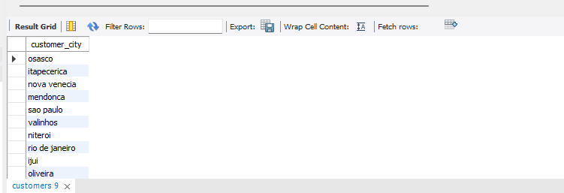
BASIC PROBLEMS
Objective : Extract fundamental insights from the dataset.
Q1 : List all unique cities where customers are located.
Input : SELECT DISTINCT customer_city
FROM customers;
Output :

Slide 2
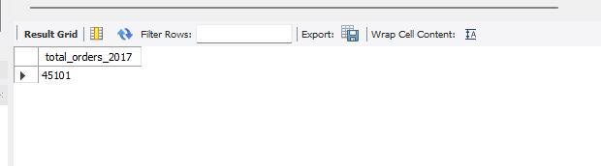
Q2 : Count the number of orders placed in 2017.
Input : SELECT COUNT(order_id) AS total_orders_2017
FROM orders
WHERE order_purchase_timestamp BETWEEN '2017-01-01 00:00:00' AND '2017-12-31 23:59:59';
Output :

Slide 3
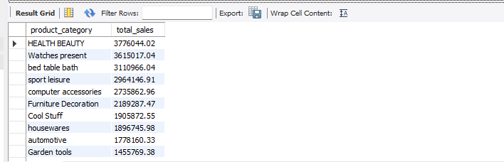
Q3 : Find the total sales per category.
Input : SELECT p.product_category, sum(oi.price) AS total_sales
FROM order_items oi
JOIN products p ON oi.product_id = p.product_id
GROUP BY p.product_category
ORDER BY total_sales DESC;
Output :

Slide 4
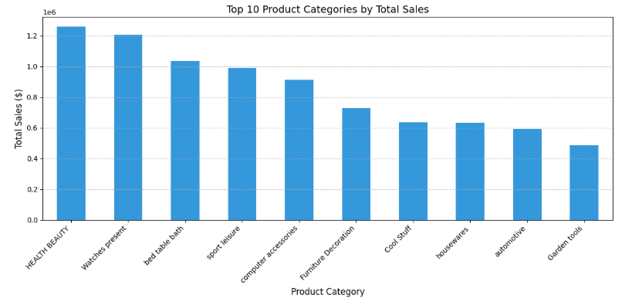
# Aggregate data
sales_per_cat = pd.merge(order_items, products, on='product_id')
cat_sales = sales_per_cat.groupby('product category')['price'].sum().sort_values(ascending=False).head(10)
# Create Bar Chart
plt.figure(figsize=(12, 6))
cat_sales.plot(kind='bar', color='#3498db')
plt.title('Top 10 Product Categories by Total Sales', fontsize=14)
plt.ylabel('Total Sales ($)', fontsize=12)
plt.xlabel('Product Category', fontsize=12)
plt.xticks(rotation=45, ha='right')
plt.grid(axis='y', linestyle='--', alpha=0.7)
plt.tight_layout()
plt.show()
Output :

Slide 5
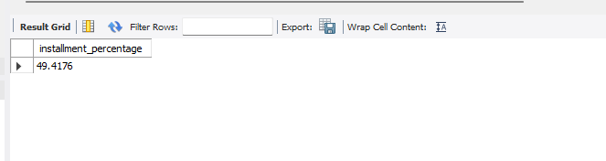
Q4 : Calculate the percentage of orders that were paid in instalments.
Input : SELECT
(COUNT(CASE WHEN payment_installments > 1 THEN 1 END) / COUNT(*)) * 100 AS
installment_percentage
FROM payments;
Output :

Slide 6
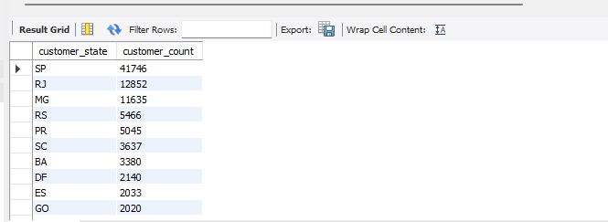
Q5 : Count the number of customers from each state.
Input : SELECT customer_state, COUNT(customer_id) AS customer_count
FROM customers
GROUP BY customer_state
ORDER BY customer_count DESC;
Output :

Slide 7
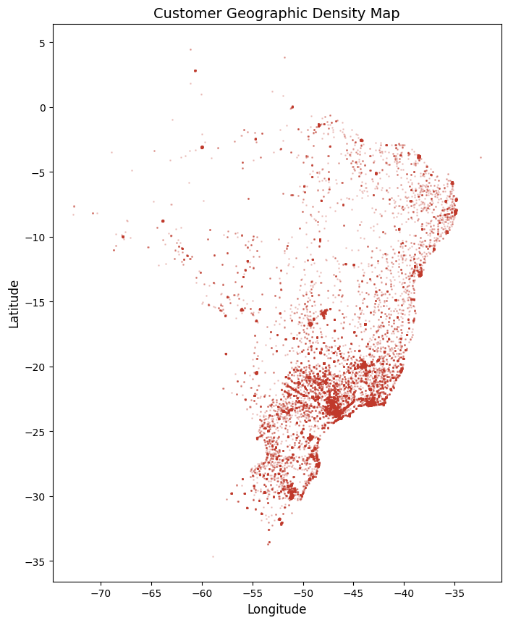
# Sample the data for performance (geolocation is very large)
geo_sample = geolocation.sample(n=50000, random_state=42)
# Create Density Map
plt.figure(figsize=(8, 10))
plt.scatter(geo_sample['geolocation_lng'], geo_sample['geolocation_lat'], s=1, alpha=0.2, color='#c0392b') plt.title('Customer Geographic Density Map', fontsize=14)
plt.xlabel('Longitude', fontsize=12)
plt.ylabel('Latitude', fontsize=12)
plt.show()
Output :

Slide 8
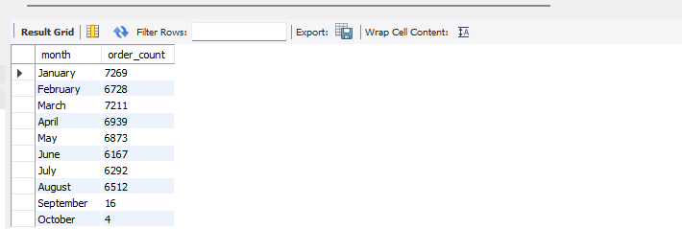
INTERMEDIATE PROBLEMS
Objective : Dive deeper into sales and order trends.
Q1 : Calculate the numbers of orders per month in 2018.
Input : SELECT MONTHNAME(order_purchase_timestamp) AS month, COUNT(order_id) AS order_count
FROM orders
WHERE YEAR(order_purchase_timestamp) = 2018
GROUP BY month
ORDER BY field(month, 'January', 'February', 'March', 'April', 'May', 'June', 'July', 'August', 'September', 'October', 'November', 'December');
Output :

Slide 9
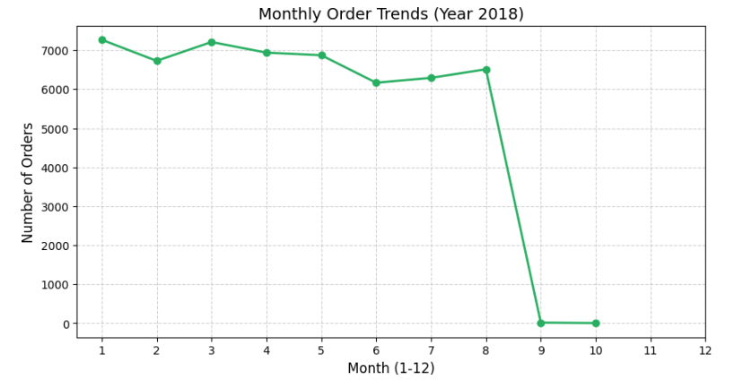
# Convert to datetime and filter for 2018
orders['order_purchase_timestamp'] = pd.to_datetime(orders['order_purchase_timestamp'])
orders_2018 = orders[orders['order_purchase_timestamp'].dt.year == 2018].copy()
orders_2018['month'] = orders_2018['order_purchase_timestamp'].dt.month
monthly_counts = orders_2018.groupby('month').size()
# Create Line Graph
plt.figure(figsize=(10, 5))
plt.plot(monthly_counts.index, monthly_counts.values, marker='o', linestyle='-', color='#27ae60', linewidth=2) plt.title('Monthly Order Trends (Year 2018)', fontsize=14)
plt.xlabel('Month (1-12)', fontsize=12)
plt.ylabel('Number of Orders', fontsize=12)
plt.xticks(range(1, 13))
plt.grid(True, linestyle='--', alpha=0.6)
plt.show()
Output :

Slide 10
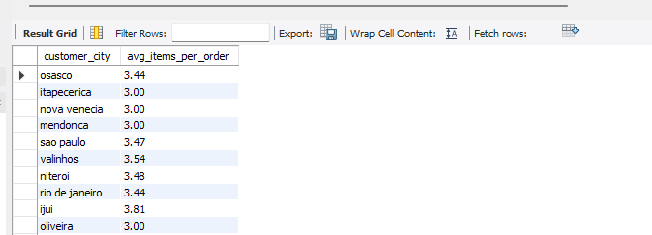
Q2 : Find the average number of products per order, grouped by customer city.
Input : WITH count_per_order AS (
SELECT orders.customer_id, order_items.order_id, count(order_items.order_item_id) AS item_count
FROM orders
JOIN order_items ON orders.order_id = order_items.order_id
GROUP BY orders.customer_id, order_items.order_id
)
SELECT c.customer_city, ROUND(AVG(cp.item_count), 2) AS avg_items_per_order
FROM customers c
JOIN count_per_order cp ON c.customer_id = cp.customer_id
GROUP BY c.customer_city;
Output :

Slide 11
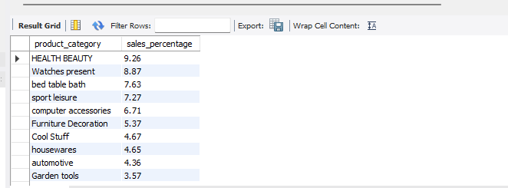
Q3 : Calculate the percentage of total revenue contributed by each product category.
Input : SELECT p.product_category,
ROUND((SUM(oi.price) / (SELECT SUM(price) FROM order_items) * 100), 2) AS sales_percentage
FROM order_items oi
JOIN products p ON oi.product_id = p.product_id
GROUP BY p.product_category
ORDER BY sales_percentage DESC;
Output :

Slide 12
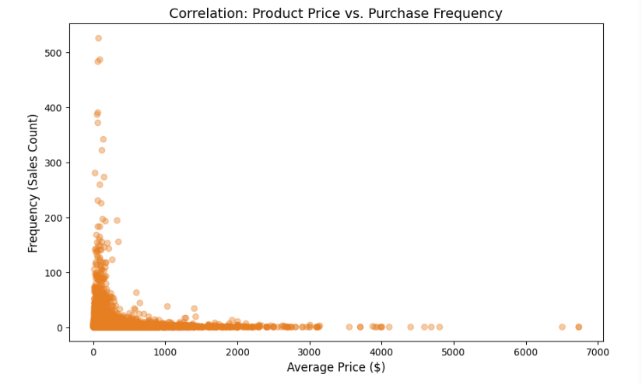
Q4 : Identify the correlation between product price and the number of times a product has been purchased.
Input : # Calculate stats per product
prod_stats = order_items.groupby('product_id').agg(
avg_price=('price', 'mean'),
purchase_count=('order_id', 'count')
)
# Create Scatter Plot
plt.figure(figsize=(10, 6))
plt.scatter(prod_stats['avg_price'], prod_stats['purchase_count'], alpha=0.4, color='#e67e22')
plt.title('Correlation: Product Price vs. Purchase Frequency', fontsize=14)
plt.xlabel('Average Price ($)', fontsize=12)
plt.ylabel('Frequency (Sales Count)', fontsize=12)
plt.show()
Output :

Slide 13
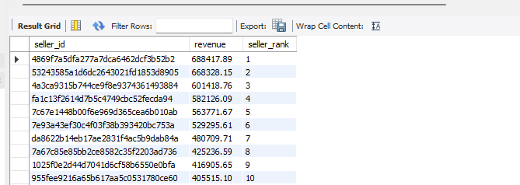
Q5 : Calculate the total revenue generated by each seller, and rank them by revenue.
Input : SELECT seller_id,
SUM(price) AS revenue,
RANK() OVER (ORDER BY SUM(price) DESC) AS seller_rank
FROM order_items
GROUP BY seller_id;
Output :

Slide 14
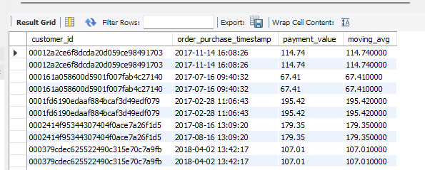
ADVANCED PROBLEMS
Objective : Generate strategic and customer-centric insights.
Q1 : Calculate the moving average of order values for each customer over their order history.
Input : SELECT
customer_id,
order_purchase_timestamp,
payment_value,
AVG(payment_value) OVER (
PARTITION BY customer_id
ORDER BY order_purchase_timestamp
ROWS BETWEEN 2 PRECEDING AND CURRENT ROW
) AS moving_avg
FROM (
SELECT o.customer_id, o.order_purchase_timestamp, p.payment_value
FROM orders o
JOIN payments p ON o.order_id = p.order_id
) AS subquery;
Output :

Slide 15
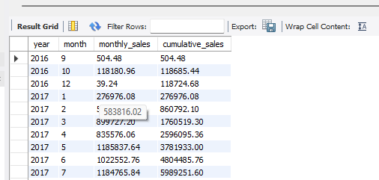
Q2 : Calculate the cumulative sales per month for each year.
Input : SELECT
year, month, monthly_sales,
SUM(monthly_sales) OVER (PARTITION BY year ORDER BY month) AS cumulative_sales
FROM (
SELECT
YEAR(o.order_purchase_timestamp) AS year,
MONTH(o.order_purchase_timestamp) AS month,
SUM(p.payment_value) AS monthly_sales
FROM orders o
JOIN payments p ON o.order_id = p.order_id
GROUP BY year, month
) AS t;
Output :

Slide 16
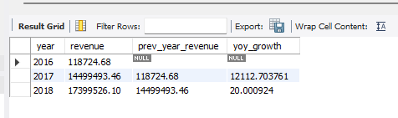
Q3 : Calculate the year-over-year growth rate of total sales.
Input : WITH yearly_sales AS (
SELECT YEAR(o.order_purchase_timestamp) AS year, SUM(p.payment_value) AS revenue
FROM orders o
JOIN payments p ON o.order_id = p.order_id
GROUP BY year
)
SELECT
year, revenue,
LAG(revenue) OVER (ORDER BY year) AS prev_year_revenue,
((revenue - LAG(revenue) OVER (ORDER BY year)) / LAG(revenue) OVER (ORDER BY year)) * 100 AS
yoy_growth
FROM yearly_sales;
Output :

Slide 17
Q4 : Calculate the retention rate of customers, defined as the percentage of customers who make another purchase within 6 months of their first purchase.
Input : WITH first_purchase AS (
SELECT customer_unique_id, MIN(order_purchase_timestamp) AS first_order
FROM orders o JOIN customers c ON o.customer_id = c.customer_id
GROUP BY customer_unique_id
),
retention AS (
SELECT f.customer_unique_id,
COUNT(o.order_id) AS second_purchase
FROM first_purchase f
LEFT JOIN customers c ON f.customer_unique_id = c.customer_unique_id
LEFT JOIN orders o ON c.customer_id = o.customer_id

Slide 18
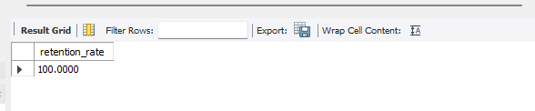
WHERE o.order_purchase_timestamp > f.first_order
AND o.order_purchase_timestamp <= DATE_ADD(f.first_order, INTERVAL 6 MONTH)
GROUP BY f.customer_unique_id
)
SELECT (COUNT(CASE WHEN second_purchase > 0 THEN 1 END) / COUNT(*)) * 100 AS retention_rate
FROM retention;
Output :

Slide 19
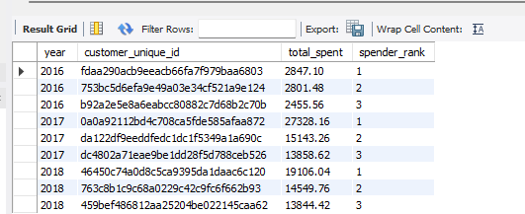
Q5 : Identify the top 3 customers who spent the most money in each year.
Input : SELECT year, customer_unique_id, total_spent, spender_rank
FROM (
SELECT
YEAR(o.order_purchase_timestamp) AS year,
c.customer_unique_id,
SUM(p.payment_value) AS total_spent,
DENSE_RANK() OVER (PARTITION BY YEAR(o.order_purchase_timestamp) ORDER BY SUM(p.payment_value) DESC) AS spender_rank
FROM orders o
JOIN customers c ON o.customer_id = c.customer_id
JOIN payments p ON o.order_id = p.order_id
GROUP BY year, c.customer_unique_id
) AS ranked_table
WHERE spender_rank <= 3;
Output :

