Slide 1

INTRODUCTION
DATA ANALYSIS
AND
VISUALIZATION
The purpose of the food delivery cost and profitability analysis is multifaceted. Primarily, it
aims to provide stakeholders, such as food delivery companies or restaurant owners, with a
comprehensive understanding of the financial dynamics involved in operating a food
delivery service.
The data is analyzed using Python libraries like NumPy, Pandas and Matplotlib.
It mainly focuses on :
Cost Analysis
Profitability Analysis
Strategic Decision Making
New Strategy For Profits
Project on
“
“
FOOD DELIVER COST
AND
PROFITABILITY ANALYSIS

Slide 2
DATA ANALYSIS
AND
VISUALIZATION
Project on
“
“
FOOD DELIVER COST
AND
PROFITABILITY ANALYSIS
PROCEDURE
INTRODUCTION
The purpose of the food delivery cost and profitability analysis is multifaceted. Primarily, it
aims to provide stakeholders, such as food delivery companies or restaurant owners, with a
comprehensive understanding of the financial dynamics involved in operating a food
delivery service.
The data is analyzed using Python libraries like NumPy, Pandas and Matplotlib.
It mainly focuses on :
Cost Analysis
Profitability Analysis
Strategic Decision Making
New Strategy For Profits

Slide 3
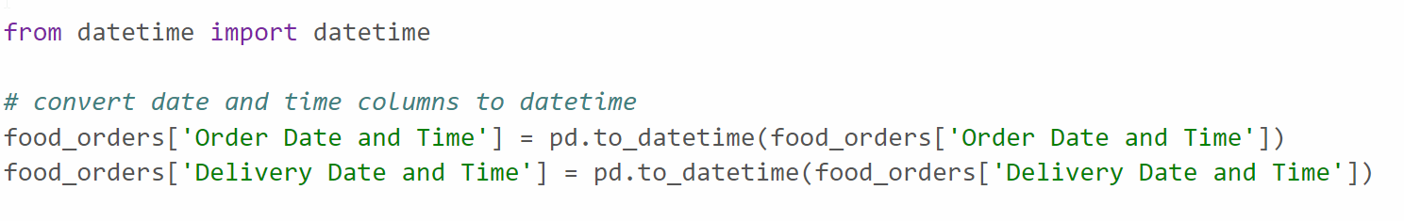
DATA ANALYSIS
AND
VISUALIZATION
Project on
“
“
FOOD DELIVER COST
AND
PROFITABILITY ANALYSIS
INTRODUCTION
PROCEDURE
Order by Date and Time using datetime Module:
2, Create Column for Discount Amount and Discount Percentage:
The purpose of the food delivery cost and profitability analysis is multifaceted. Primarily, it
aims to provide stakeholders, such as food delivery companies or restaurant owners, with a
comprehensive understanding of the financial dynamics involved in operating a food
delivery service.
The data is analyzed using Python libraries like NumPy, Pandas and Matplotlib.
It mainly focuses on :
Cost Analysis
Profitability Analysis
Strategic Decision Making
New Strategy For Profits

Slide 4
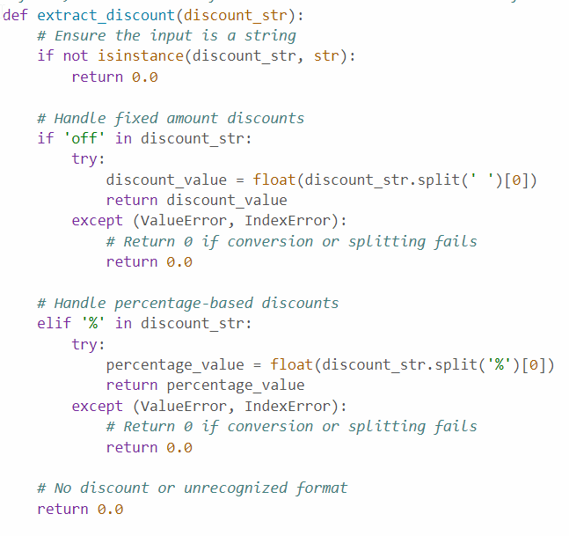
DATA ANALYSIS
AND
VISUALIZATION
Project on
“
“
FOOD DELIVER COST
AND
PROFITABILITY ANALYSIS
INTRODUCTION
PROCEDURE
2, Create Column for Discount Amount and Discount Percentage:
Order by Date and Time using datetime Module:
The purpose of the food delivery cost and profitability analysis is multifaceted. Primarily, it
aims to provide stakeholders, such as food delivery companies or restaurant owners, with a
comprehensive understanding of the financial dynamics involved in operating a food
delivery service.
The data is analyzed using Python libraries like NumPy, Pandas and Matplotlib.
It mainly focuses on :
Cost Analysis
Profitability Analysis
Strategic Decision Making
New Strategy For Profits

Slide 5
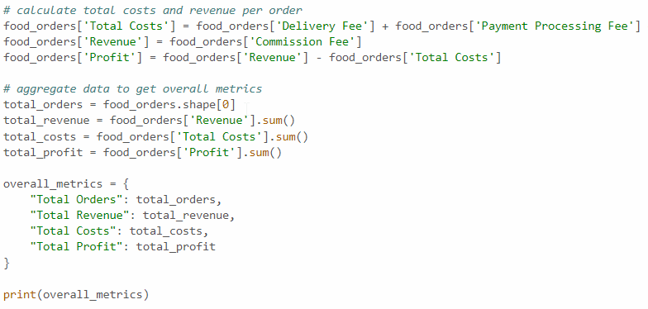
DATA ANALYSIS
AND
VISUALIZATION
Project on
“
“
FOOD DELIVER COST
AND
PROFITABILITY ANALYSIS
INTRODUCTION
PROCEDURE
3. Perform Cost and Profitability analysis:
Order by Date and Time using datetime Module:
Based on the analysis, here are the overall metrics for the food delivery operations:
Total Orders: 1,000
Total Revenue (from Commission Fees): 126,990 INR
Total Costs: 232,709.85 INR
Total Profit: -105,719.85 INR
The purpose of the food delivery cost and profitability analysis is multifaceted. Primarily, it
aims to provide stakeholders, such as food delivery companies or restaurant owners, with a
comprehensive understanding of the financial dynamics involved in operating a food
delivery service.
The data is analyzed using Python libraries like NumPy, Pandas and Matplotlib.
It mainly focuses on :
Cost Analysis
Profitability Analysis
Strategic Decision Making
New Strategy For Profits

Slide 6
DATA ANALYSIS
AND
VISUALIZATION
Project on
“
“
FOOD DELIVER COST
AND
PROFITABILITY ANALYSIS
INTRODUCTION
PROCEDURE
Order by Date and Time using datetime Module:
The analysis indicates that the total costs associated with the food delivery operations exceed the total revenue generated from commission fees, resulting in a net loss. It suggests that the current commission rates, delivery fees, and discount strategies might not be sustainable for profitability.
Based on the analysis, here are the overall metrics for the food delivery operations:
Total Orders: 1,000
Total Revenue (from Commission Fees): 126,990 INR
Total Costs: 232,709.85 INR
Total Profit: -105,719.85 INR
The purpose of the food delivery cost and profitability analysis is multifaceted. Primarily, it
aims to provide stakeholders, such as food delivery companies or restaurant owners, with a
comprehensive understanding of the financial dynamics involved in operating a food
delivery service.
The data is analyzed using Python libraries like NumPy, Pandas and Matplotlib.
It mainly focuses on :
Cost Analysis
Profitability Analysis
Strategic Decision Making
New Strategy For Profits

Slide 7
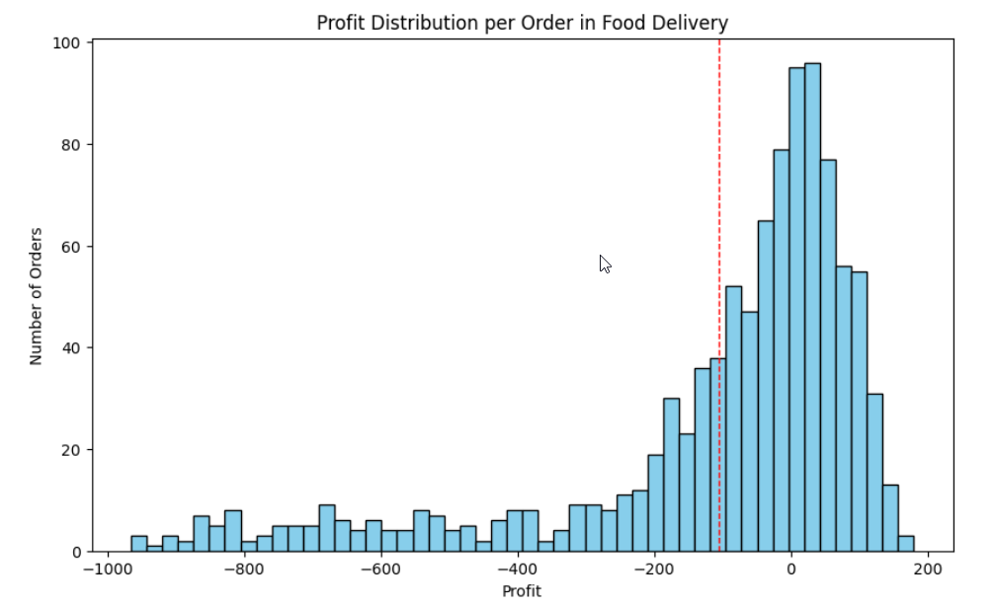
DATA ANALYSIS
AND
VISUALIZATION
Project on
“
“
FOOD DELIVER COST
AND
PROFITABILITY ANALYSIS
INTRODUCTION
PROCEDURE
Order by Date and Time using datetime Module:
Based on the analysis, here are the overall metrics for the food delivery operations:
Total Orders: 1,000
Total Revenue (from Commission Fees): 126,990 INR
Total Costs: 232,709.85 INR
Total Profit: -105,719.85 INR
The histogram shows a wide distribution of profit per order, with a noticeable number of orders resulting in a loss (profits below 0).
The red dashed line indicates the average profit, which is in the negative territory, highlighting the overall loss-making situation
The purpose of the food delivery cost and profitability analysis is multifaceted. Primarily, it
aims to provide stakeholders, such as food delivery companies or restaurant owners, with a
comprehensive understanding of the financial dynamics involved in operating a food
delivery service.
The data is analyzed using Python libraries like NumPy, Pandas and Matplotlib.
It mainly focuses on :
Cost Analysis
Profitability Analysis
Strategic Decision Making
New Strategy For Profits

Slide 8
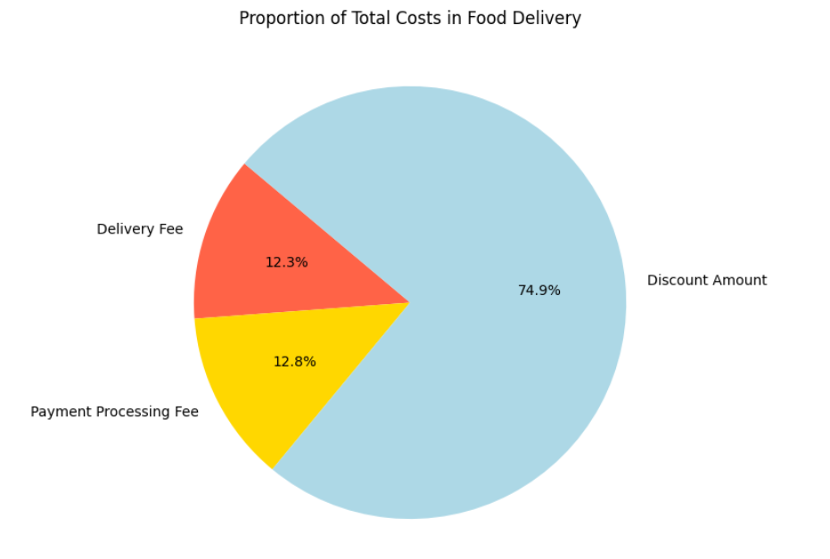
DATA ANALYSIS
AND
VISUALIZATION
Project on
“
“
FOOD DELIVER COST
AND
PROFITABILITY ANALYSIS
INTRODUCTION
PROCEDURE
Order by Date and Time using datetime Module:
Based on the analysis, here are the overall metrics for the food delivery operations:
Total Orders: 1,000
Total Revenue (from Commission Fees): 126,990 INR
Total Costs: 232,709.85 INR
Total Profit: -105,719.85 INR
The pie chart illustrates the breakdown of total costs into delivery fees, payment processing fees, and discount amounts.
Discounts constitute a significant portion of the costs, suggesting that promotional strategies might be heavily impacting overall profitability.
The purpose of the food delivery cost and profitability analysis is multifaceted. Primarily, it
aims to provide stakeholders, such as food delivery companies or restaurant owners, with a
comprehensive understanding of the financial dynamics involved in operating a food
delivery service.
The data is analyzed using Python libraries like NumPy, Pandas and Matplotlib.
It mainly focuses on :
Cost Analysis
Profitability Analysis
Strategic Decision Making
New Strategy For Profits

Slide 9
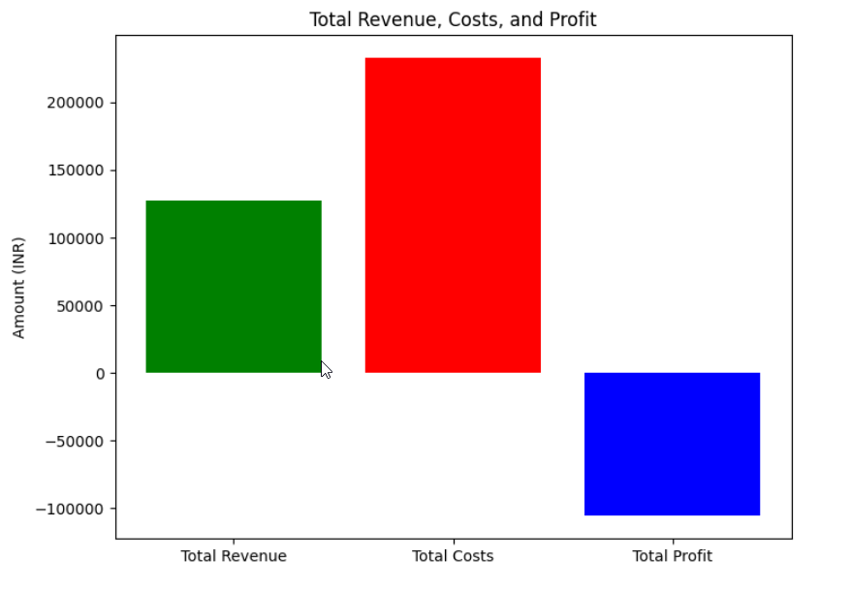
DATA ANALYSIS
AND
VISUALIZATION
Project on
“
“
FOOD DELIVER COST
AND
PROFITABILITY ANALYSIS
INTRODUCTION
PROCEDURE
Order by Date and Time using datetime Module:
Based on the analysis, here are the overall metrics for the food delivery operations:
Total Orders: 1,000
Total Revenue (from Commission Fees): 126,990 INR
Total Costs: 232,709.85 INR
Total Profit: -105,719.85 INR
The bar chart compares total revenue, total costs, and total profit.
It visually represents the gap between revenue and costs, clearly showing that the costs surpass the revenue, leading to a total loss.
The purpose of the food delivery cost and profitability analysis is multifaceted. Primarily, it
aims to provide stakeholders, such as food delivery companies or restaurant owners, with a
comprehensive understanding of the financial dynamics involved in operating a food
delivery service.
The data is analyzed using Python libraries like NumPy, Pandas and Matplotlib.
It mainly focuses on :
Cost Analysis
Profitability Analysis
Strategic Decision Making
New Strategy For Profits

Slide 10
DATA ANALYSIS
AND
VISUALIZATION
Project on
“
“
FOOD DELIVER COST
AND
PROFITABILITY ANALYSIS
INTRODUCTION
New Strategy:
From the analysis so far we understood that the discounts on food orders are resulting in huge losses. Now, we need to find a new strategy for profitability. We need to find a sweet spot for offering discounts and charging commissions. To find a sweet spot for commission and discount percentages, we can analyze the characteristics of profitable orders more deeply.
Specifically, we need to look for:
A new average commission percentage based on profitable orders.
A new average discount percentage for profitable orders, that could serve as a guideline for what level of discount still allows for profitability.
Given these new averages, we can suggest adjustments that might not only make individual orders profitable but also apply broadly across all orders to improve overall profitability.
Let’s calculate:
The average commission percentage for profitable orders. The average discount percentage for profitable orders.
Order by Date and Time using datetime Module:
Based on the analysis, here are the overall metrics for the food delivery operations:
Total Orders: 1,000
Total Revenue (from Commission Fees): 126,990 INR
Total Costs: 232,709.85 INR
Total Profit: -105,719.85 INR
The purpose of the food delivery cost and profitability analysis is multifaceted. Primarily, it
aims to provide stakeholders, such as food delivery companies or restaurant owners, with a
comprehensive understanding of the financial dynamics involved in operating a food
delivery service.
The data is analyzed using Python libraries like NumPy, Pandas and Matplotlib.
It mainly focuses on :
Cost Analysis
Profitability Analysis
Strategic Decision Making
New Strategy For Profits

Slide 11
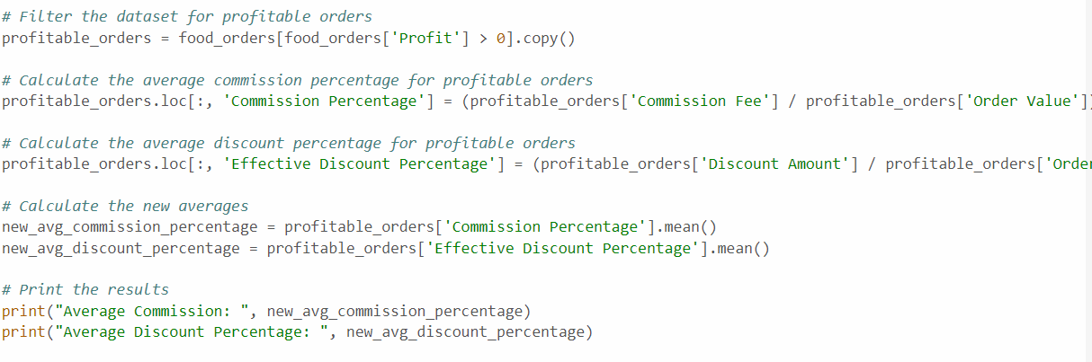
DATA ANALYSIS
AND
VISUALIZATION
Project on
“
“
FOOD DELIVER COST
AND
PROFITABILITY ANALYSIS
INTRODUCTION
Order by Date and Time using datetime Module:
Average Commission: 30.508436145149435
Average Discount Percentage: 5.8674698795
The average commission percentage for profitable orders is significantly higher than the overall average across all orders. It suggests that a higher commission rate on orders might be a key factor in achieving profitability. The average discount percentage for profitable orders is notably lower than the overall average, indicating that lower discounts might contribute to profitability without significantly deterring order volume.
Based on this analysis, a strategy that aims for a commission rate closer to 30% and a discount rate around 6% could potentially improve profitability across the board.
The purpose of the food delivery cost and profitability analysis is multifaceted. Primarily, it
aims to provide stakeholders, such as food delivery companies or restaurant owners, with a
comprehensive understanding of the financial dynamics involved in operating a food
delivery service.

Slide 12
THANK YOU !
PRESENTATION BY:-
160122737127 - S. Srujan Reddy
160122737132 – V. Ashish
160122737135 – Y. Arun Reddy
Based on the analysis, here are the overall metrics for the food delivery operations:
Total Orders: 1,000
Total Revenue (from Commission Fees): 126,990 INR
Total Costs: 232,709.85 INR
Total Profit: -105,719.85 INR

