Slide 1

Project Name- Netflix Data: Cleaning, Analysis and Visualization
Name-Vaibhav Ashok Barbate
Batch- August Python DA

Slide 2
Questions
Q1) What is the distribution of content types (TV Shows vs. Movies)?
Q2) How has the number of titles added to Netflix changed over the years?
Q3) What are the most common ratings for TV Shows and Movies?
Q4) What are the most popular genres on Netflix for TV Shows and Movies?
Q5) Who are the top 5 directors based on the number of titles they have on Netflix?
Q6) What is the monthly/yearly trend of content added to Netflix?
Q7) What is the distribution of durations having most content added?
Q8) How does the content distribution vary by country?
Q9) Which are the Top 5 Ratings on Netflix?

Slide 3
Data Extraction
#monthly data
df['month']=df['date_added'].dt.month
#yearly data
df['year']=df['date_added'].dt.year
#monthly_release_movies
monthly_added_movie=df[df['type']== 'Movie’]
Monthly_release_movies=monthly_added_movie.groupby('month').size().reset_index(name='count’)
print("monthly_added_movie")
print(Monthly_release_movies)
#monthly release Tv Show
monthly_release_Tv_show=df[df['type']=='TV Show’]
monthly_release_tv_show=monthly_release_Tv_show.groupby('month').size().reset_index(name='count’)
print("monthly_release_Tv_show")
print(monthly_release_tv_show)
#max_content_added_on_duration
top5_duration_added=df['duration'].value_counts().head(5)
top5_duration_added
#yearly Release TV shows and Movies
yearly_release_movies=df[df['type']=='Movie’]
movies_by_year = yearly_release_movies.groupby('year').size().reset_index(name='count’)
print("Yearly Added Movies")
print(movies_by_year)print("--------------------------------------------------------------------------------")
yearly_release_tv_show=df[df['type']=='TV Show’]
tv_shows_by_year= yearly_release_tv_show.groupby('year').size().reset_index(name='count’)
print("yearly_release_tv_show")
print(tv_shows_by_year)

Slide 4
#top 5 ratings
top_10_ratings=df['rating'].value_counts().head(10)
top_10_ratings
#top 10 countries
top_10_countries=df['country'].value_counts().head(10)
top_10_countries
#top 10 movie genres
top10_Movie_genres=df[df['type']=='Movie']['listed_in'].value_counts().head(10)
top10_Movie_genres
#top 10 tv genres
top10_tv_show_genres=df[df['type']=='TV Show']['listed_in'].value_counts().head(10)
top10_tv_show_genres

Slide 5
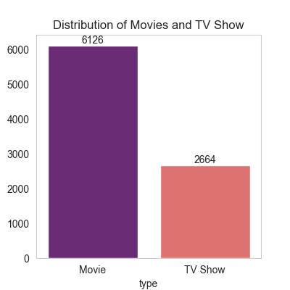
Q1) What is the distribution of content types (TV Shows vs. Movies)?
plt.figure(figsize=(4,4))
plt.title("Distribution of Movies and TV Show")
count_data=sns.countplot(x='type',data=df,hue='type',palette='magma’)
plt.grid(False)
for i in count_data.containers:
count_data.bar_label(i)
plt.savefig('Distribution_of_Movies_and_TV_Show.jpg’)
plt.show()

Slide 6
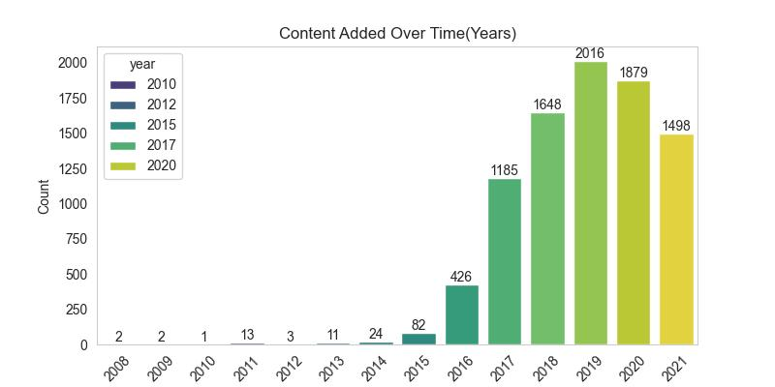
Q2) How has the number of titles added to Netflix changed over the years?
plt.figure(figsize=(8, 4))
cnt=sns.countplot(x='year',hue='year',data=df, palette='viridis’)
plt.title('Content Added Over Time(Years)’)
plt.xlabel('Year’)
plt.grid(False)
plt.ylabel('Count’)
plt.xticks(rotation=45)
for i in cnt.containers:
cnt.bar_label(i)
plt.show()

Slide 7
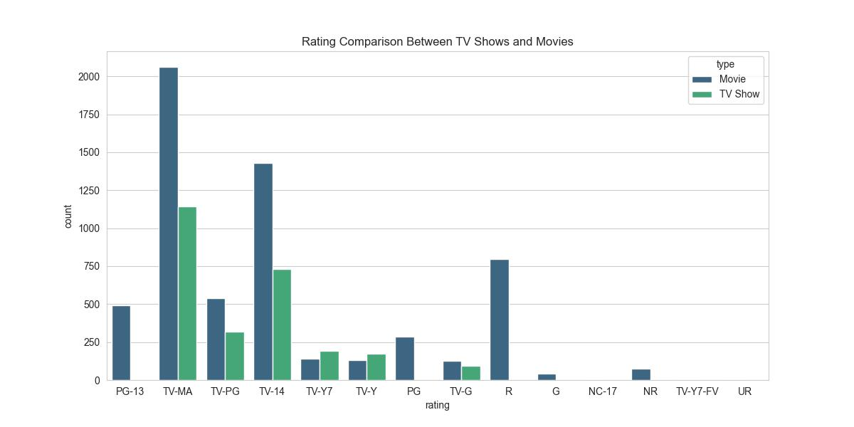
Q3) What are the most common ratings for TV Shows and Movies?
plt.figure(figsize=(12,6))
sns.countplot(x='rating',hue='type',data=df,palette='viridis’)
plt.title("Rating Comparison Between TV Shows and Movies")
plt.savefig('Rating_Comparison.jpg’)
plt.grid(False)
plt.show()

Slide 8
Q4) What are the most popular genres on Netflix for TV Shows and Movies?
plt.figure(figsize=(14,4))
plt.title("Top Genres of Movie")
sns.barplot(x=top10_Movie_genres.index , y=top10_Movie_genres.values , palette='magma’)
plt.xlabel("Top Movie Genres")
plt.xticks(rotation=45)
plt.grid(False)
plt.ylabel("Count")
plt.savefig('top_10_genre_movie.jpg’)
plt.show()
plt.figure(figsize=(14,4))
sns.barplot(x=top10_tv_show_genres.index , y=top10_tv_show_genres.values , palette='magma’)
plt.title("Top Genres of TV Show")
plt.xlabel("Top TV Show Genres")
plt.ylabel("Count")
plt.grid(False)plt.xticks(rotation=45)
plt.savefig('top_10_genre_TV.jpg’)
plt.show()

Slide 9
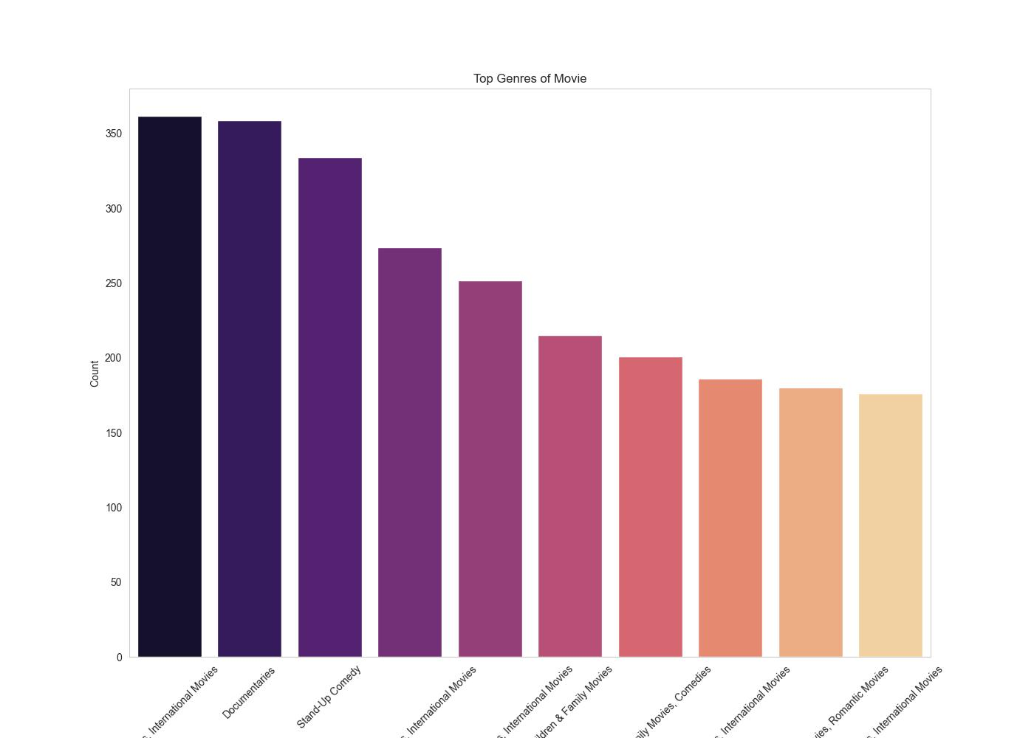

Slide 10
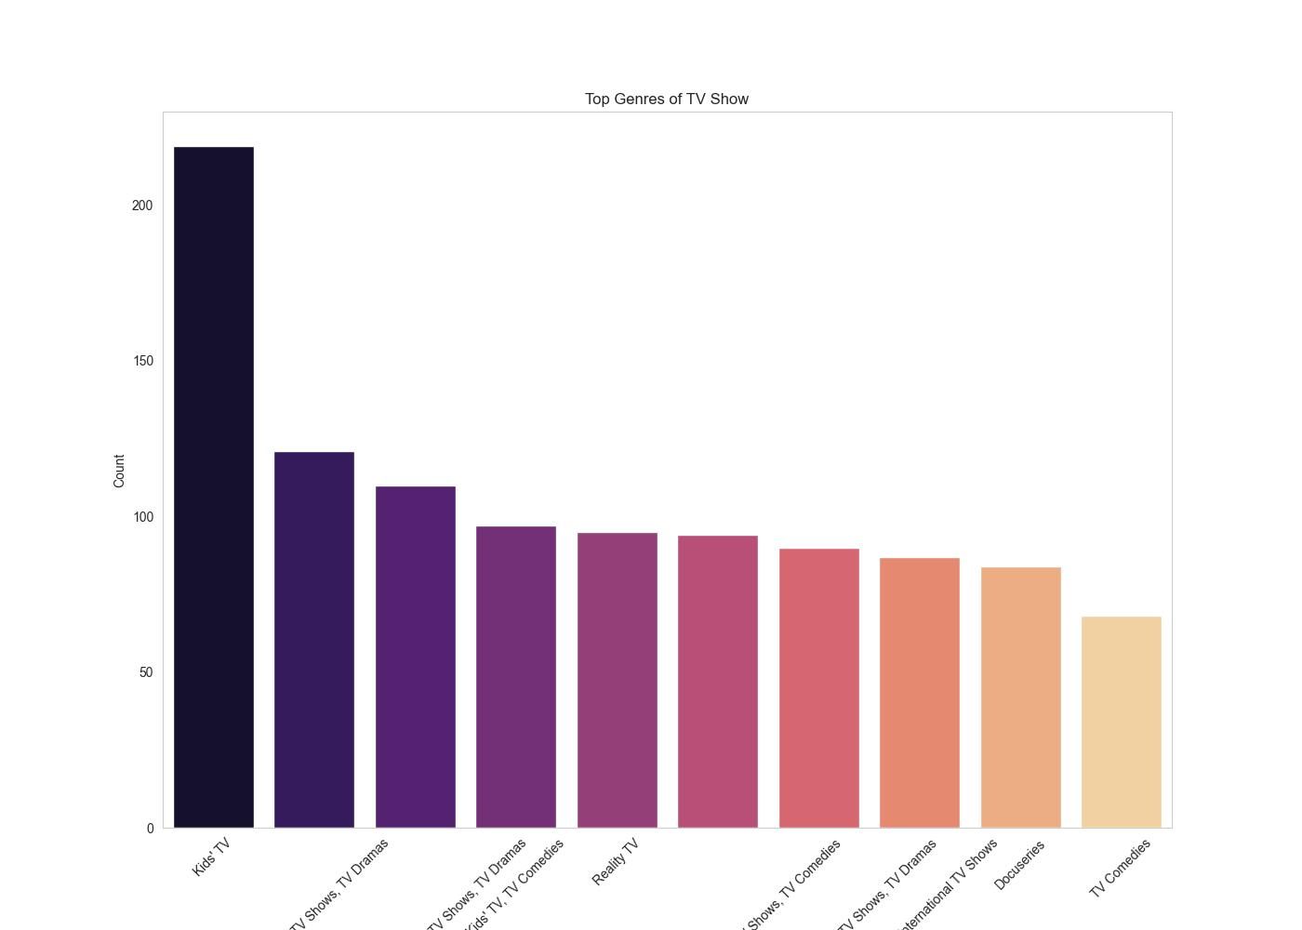

Slide 11
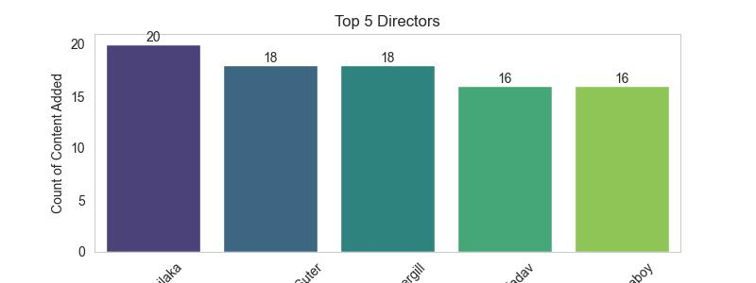
Q5) Who are the top 5 directors based on the number of titles they have on Netflix?
plt.figure(figsize=(6,3))
ax=sns.barplot(x=top_5_director.index , y=top_5_director.values palette='viridis’)
plt.xlabel('Directors’)
plt.ylabel('Count of Content Added’)
plt.title('Top 5 Directors’)
plt.xticks(rotation=45)
plt.grid(False)
for i in ax.containers:
ax.bar_label(i)
plt.savefig('Top_5_Director.jpg’)
plt.show()

Slide 12
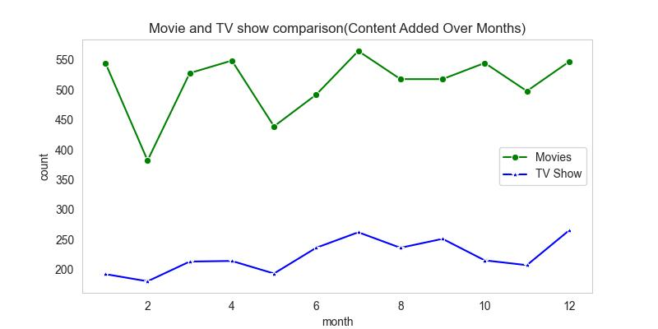
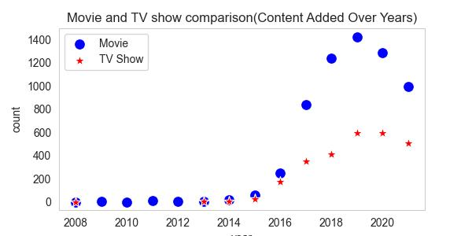
Q6) What is the monthly/yearly trend of content added to Netflix?
plt.figure(figsize=(8,4))
plt.title("Movie and TV show comparison(Content Added Over Months)")
sns.lineplot(x='month' , y='count' , data=Monthly_release_movies , marker='o',label='Movies' ,color='g’)
sns.lineplot(x='month' , y='count', data=monthly_release_tv_show, marker='*' , label='TV Show' , color='b’)
plt.grid(False)
plt.savefig('Movie_TV_Comparison_monthly.jpg’)
plt.show()
plt.figure(figsize=(6,3))
sns.scatterplot(x='year', y='count', data=movies_by_year, marker='o', color='b',s=100,label='Movie’)
sns.scatterplot(x='year' , y='count', data=tv_shows_by_year , marker='*' , color='r',s=100, label='TV Show’)
plt.title("Movie and TV show comparison(Content Added Over Years)")
plt.grid(False)
plt.savefig('Movie_TV_Comparison_yearly.jpg’)
plt.show()

Slide 13
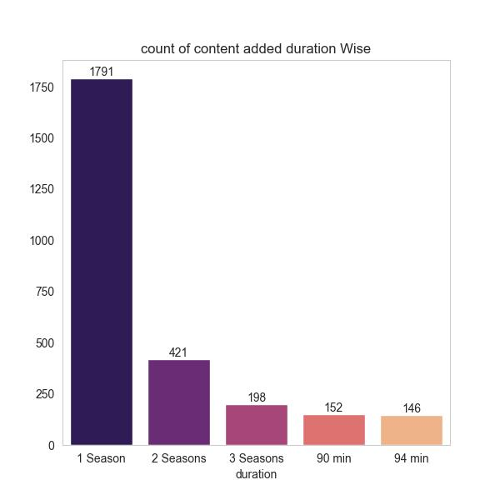
What is the distribution of durations having most content added?
plt.figure(figsize=(6,6))
plt.title("count of content added duration Wise")
cnt=sns.barplot(x=top5_duration_added.index , y=top5_duration_added.values , palette='magma’)
plt.grid(False)
for i in cnt.containers: cnt.bar_label(I)
plt.savefig('Duration.jpg’)
plt.show()

Slide 14
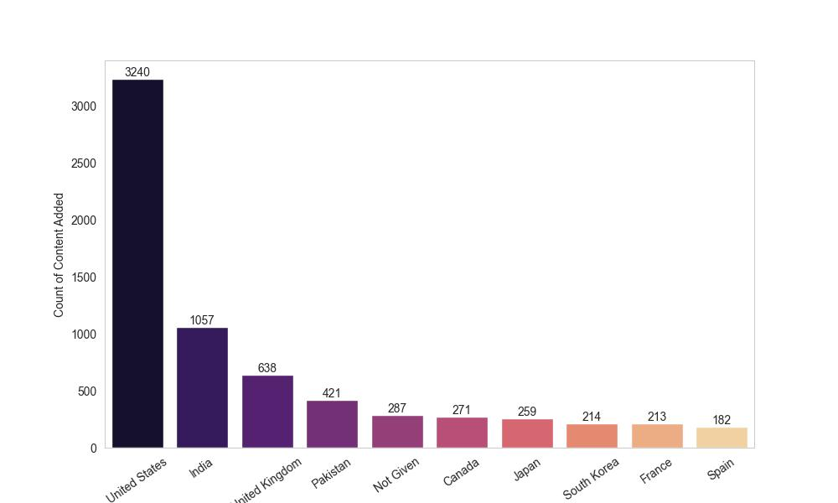
How does the content distribution vary by country?
plt.figure(figsize=(10,6))
country=sns.barplot(x=top_10_countries.index , y= top_10_countries.values, palette='magma’)
plt.xlabel("Country")
plt.ylabel("Count of Content Added")
plt.xticks(rotation=35)
plt.grid(False)
for i in country.containers:
country.bar_label(i)
plt.savefig('Top_10_Countries.jpg’)
plt.show()

Slide 15
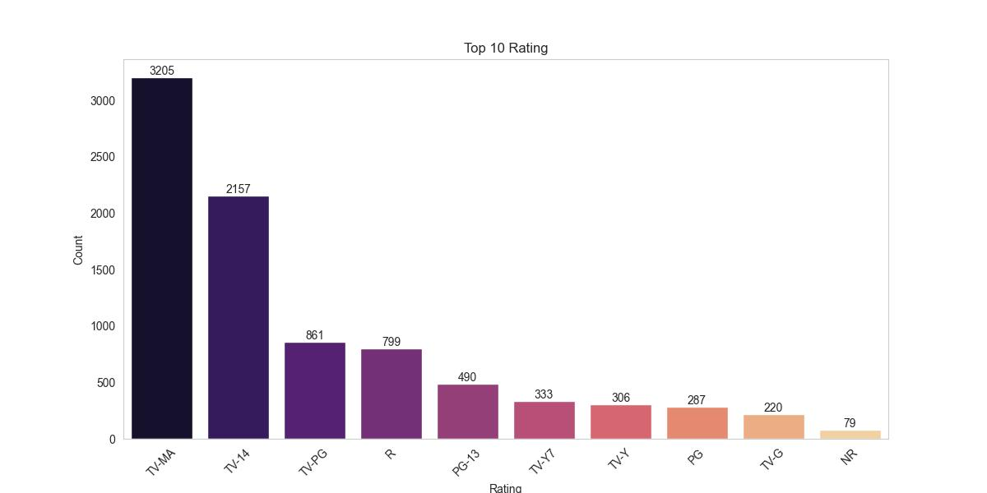
Q9) Which are the Top 10 Ratings on Netflix?
plt.figure(figsize=(12,6))
ax=sns.barplot(x=top_10_ratings.index , y=top_10_ratings.values , palette='magma’)
plt.xlabel("Rating")plt.ylabel("Count")
plt.title("Top 10 Rating")
plt.xticks(rotation=45)
plt.grid(False)
for i in ax.containers:
ax.bar_label(i)
plt.savefig('Top_10_Rating.jpg’)
plt.show

Slide 16
In this project we
Cleaned the data by handling missing values, removing duplicates, and converting data types.
*Used Feature Engineering for improved model performance
Explored the data through various visualizations such as bar plots , countplots , lineplot , scatterplot.
Analyzed content trends over time.
Identified popular genre
analyze top Cities which added most content over years
Identified top 5 dirctors
compared the Movies , TV Shows which added content over monthly, yearly.
compared ratings for movies and tv shows
Indentified most content added by duration wise

Slide 17

Insights
Netflix data analysis projects can uncover a wealth of insights that help understand viewer preferences, content performance, and strategic opportunities. Here are some key insights typically derived from such projects:
Content Analysis
Popular Genres: Identifying the most popular genres helps Netflix prioritize content acquisition and production.
Content Duration: Analyzing the duration of movies and TV shows to understand viewer preferences for shorter or longer content.
Release Trends: Examining the release patterns of content to determine the best times to launch new title

Slide 18
Performance Metrics
Ratings and Reviews: Analyzing ratings and reviews to gauge viewer satisfaction and identify areas for improvement.

