Slide 1



Multi-Agent Systems for Disaster Management.
Decentralized AI coordination for real-time crisis detection, dynamic resource allocation, and automated response protocols.
Presented By
B Vishnu (192512410)

Slide 2

The Current Challenge
Data Silos: Centralized databases create severe informational bottlenecks during high-stress, rapidly unfolding events.
High Latency: Human-in-the-loop decision-making delays critical dispatch times, costing crucial minutes.
Static Protocols: Legacy response plans cannot dynamically adapt to multi-front disaster scenarios.
Vulnerability: Centralized command infrastructures are susceptible to localized physical damage.

Slide 3







Core Architecture Roles
SENSOR AGENTS
DECISION AGENTS
COMM. AGENTS
Deployed extensively at the edge. They gather real-time telemetry including seismic, thermal, and meteorological data, performing localized anomaly detection before transmission.
Equipped with predictive models to analyze incoming verified data. They assess risk severity, calculate probabilities, and formulate optimal, bias-free resource allocation strategies.
Acting as the connective tissue, these agents manage message queuing, ensure delivery protocols, and dynamically route critical packets around damaged physical infrastructure.

Slide 4


Agent Coordination Strategies
01
Decentralized Consensus
In highly volatile zones, agent clusters negotiate immediate resource allocation without central oversight. They utilize auction-based algorithms to rapidly prioritize tasks based on threat proximity.
02
Hierarchical Reporting
For macro-level strategic planning, lower-level agents aggregate and summarize granular data. They pass only high-confidence state assessments upward, filtering out noise for regional responses.

Slide 5
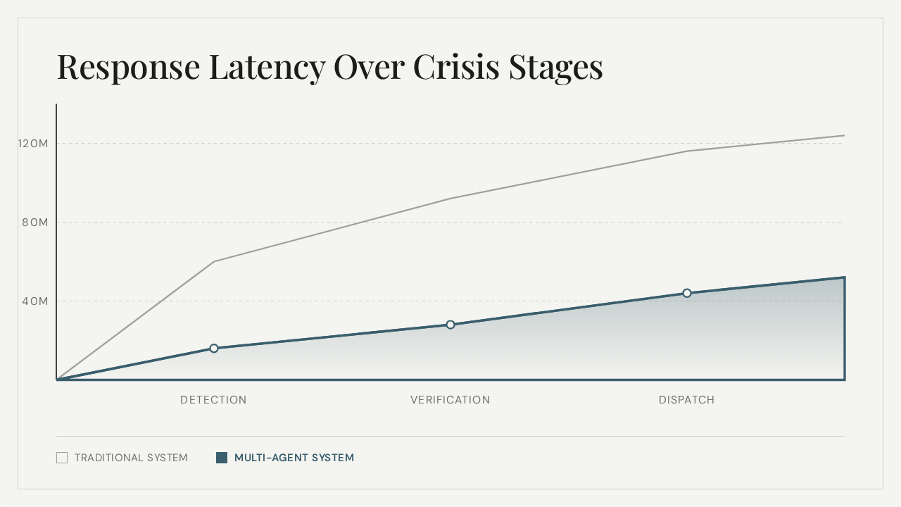

Slide 6
Paradigm Shift: Legacy vs. MAS
System Characteristic | Traditional Architecture | Multi-Agent System
Decision Making | Centralized Command Center | Distributed & Autonomous
Fault Tolerance | Low (Single point of failure) | High (Self-healing mesh)
Scalability | Limited by central bandwidth | Virtually Unlimited (P2P)
Adaptability | Static / Pre-programmed | Dynamic / ML-driven
Data Processing | Post-event batch processing | Real-time edge streaming

