Slide 1
Psst… Intro to Cryptography
Unit 4.1
Cybersecurity Boot Camp |

Slide 2
Intro to Encryption

Slide 3
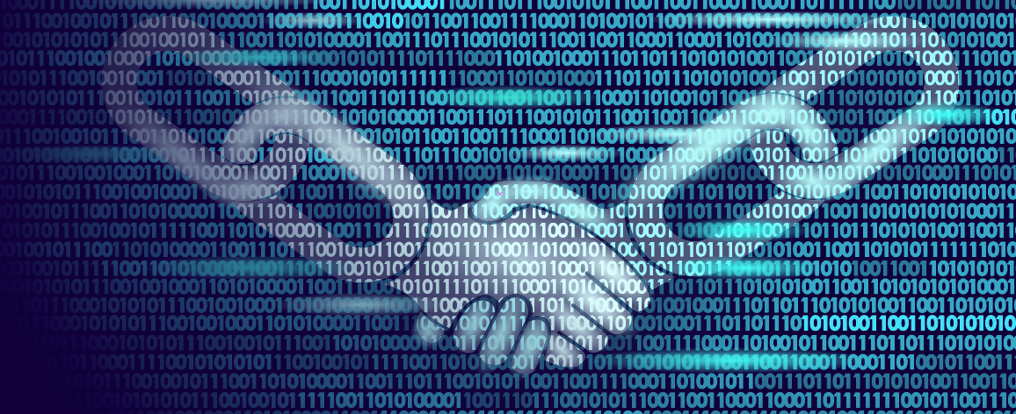
What is Cryptography and Encryption?
Cryptography is the practice and study of techniques for secure communication in the presence of third-party threat actors.
Historically, encryption has been a closely related concept – focused on the process of converting information from a readable state to an unreadable one.

Slide 4
Why Is It Relevant to Security Professionals?
Threat Actors
Sender
Receiver
Secured Channel with Data Exchange
Fundamentally, information is often the most prized asset of individuals and organizations alike.
Ensuring information can be stored, transmitted, and received securely (in avoidance of prying eyes) is often a key responsibility of the modern security professional.

Slide 5
How Does It Work Today?
Modern cryptography today is heavily based on complex mathematical theory that makes algorithm breaking infeasible by practical means.
As security professionals, there exist a variety of encryption standards like AES (Advanced Encryption Standard) and RSA (Rivest-Shamir-Adleman) which provide a recommended degree of security according to the NIST standard.
It is extremely rare (and unadvisable) for an everyday security professional to build their own encryption system.

Slide 6
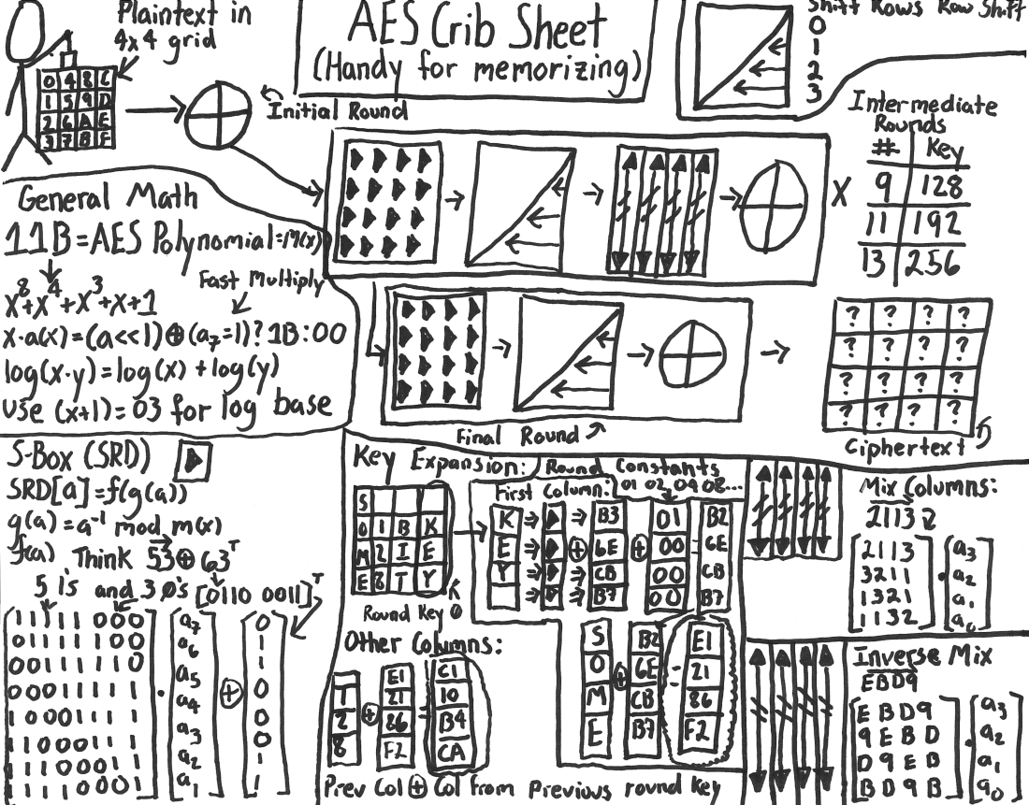
AES Implementation – A Stick Figure’s Guide (Don’t Try This At Home)
http://www.moserware.com/2009/09/stick-figure-guide-to-advanced.html

Slide 7
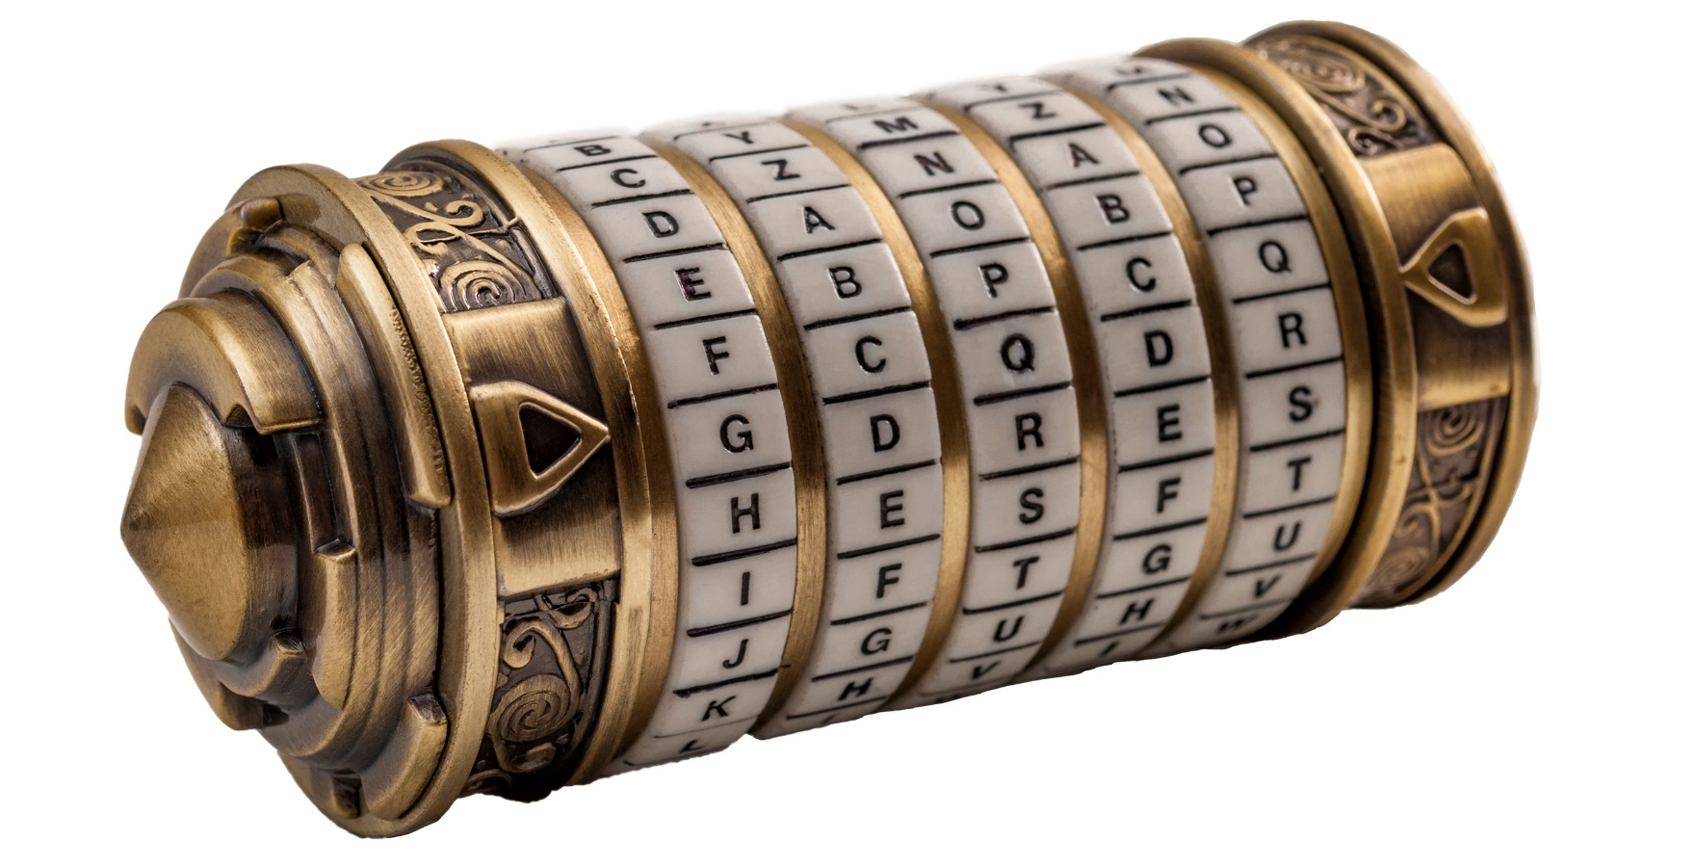
A Gentle Approach to Cryptography
While modern cryptographic methods are incredibly complex (and well, well beyond the scope of this class), there’s a value in understanding the fundamental principles that lay at the center of encryption, decryption, and code cracking.

Slide 8

The Key Concept in Cryptography
Plaintext
Ciphertext
Encryption
Readable
Message,
File, or Data
Encrypted Message, File, or Data
Key(s)
Decryption
At the center of any conversation on cryptography is the idea of a key, a piece of information or parameter that specifies how plaintext should be transformed into ciphertext and vice versa.

Slide 9
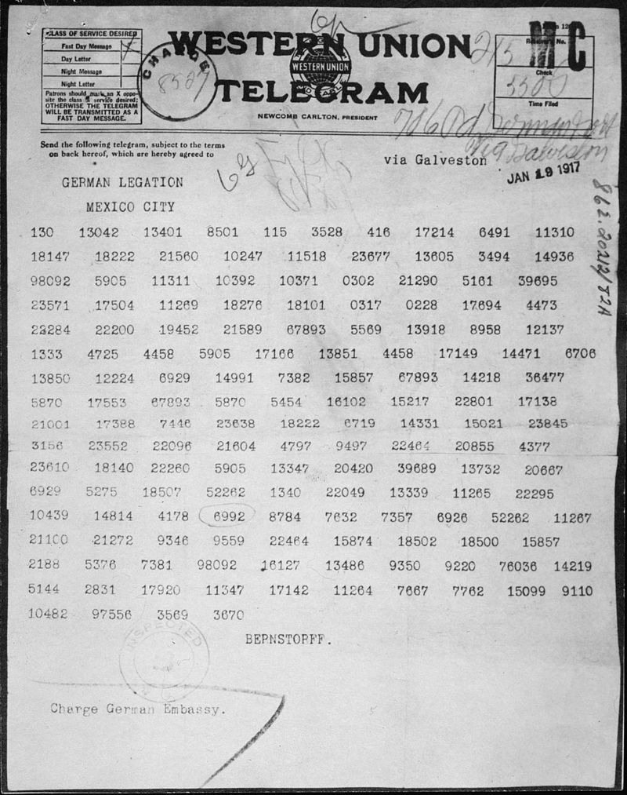
Ciphers Through History
Zimmerman Telegram, a secret diplomatic communication sent by Germany proposing a Mexico-Germany alliance. The cracking of the telegram is widely believed to have triggered the US entry into WWI.
This simple concept of a key being used to encrypt plaintext into ciphertext lays at the heart of important war and peace-time activities.

Slide 10
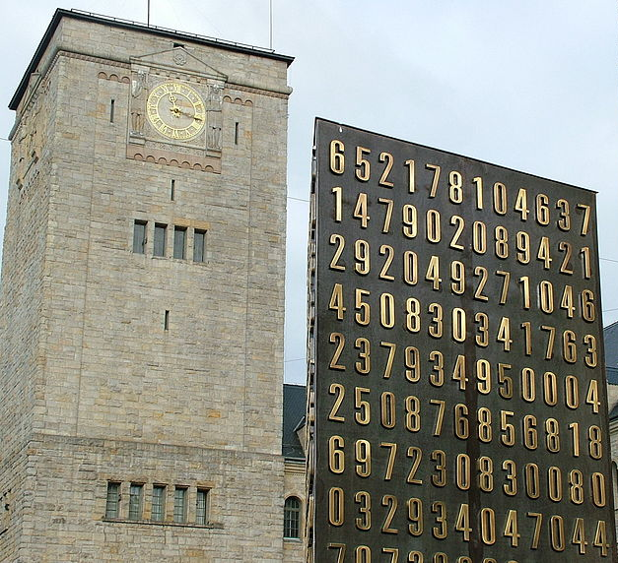
Ciphers Through History
Poznan monument celebrating the work of Polish Cryptologists whose breaking of Germany’s Enigma machine ciphers was pivotal in World War II.

Slide 11
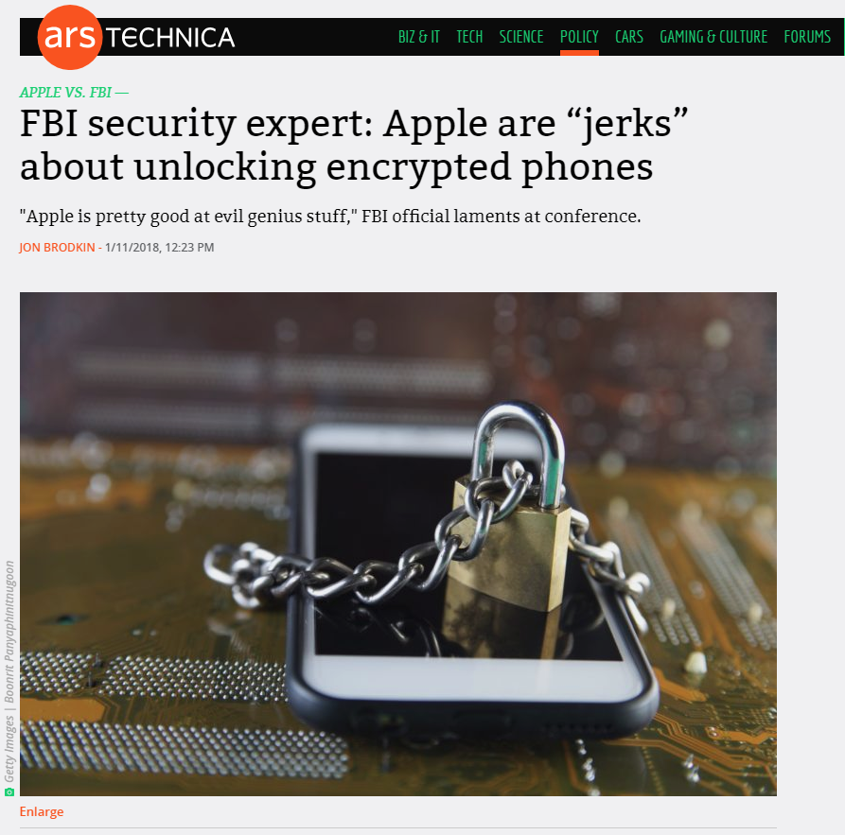
Ciphers Through History
Recent article on the back-and-forth legal battles between Apple and the FBI regarding “unencryptable” Apple phones.

Slide 12
Our Focus
This week, we’ll be:
Discussing some of the most well-known historic ciphers in the context of how they work and how they can be broken.
Implementing various ciphers using Python code.
And learning a few of the modern encryption concepts that underlie modern computing like Public Key Infrastructure (PKI) and Digital Signatures.

Slide 13
The Caesar Cipher

Slide 14
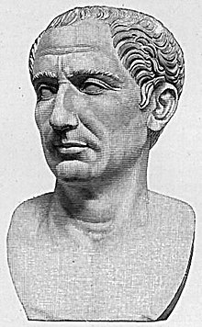
History of Caesar Cipher
They Shall Never Crack My Code!
The Caesar Cipher is one of the best known historic encryption techniques.
It is a simple “substitution cipher” in which messages are letter shifted according to a key.
It’s named after Julius Caesar who is said to have used a shift of three to protect military messages.
Despite it’s age and simplicity, it continues to appear as a blunt method of obfuscation.

Slide 15
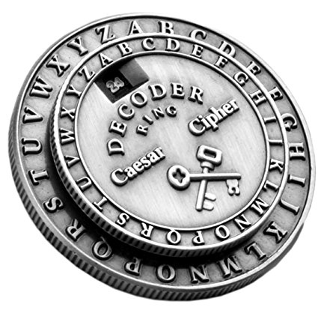
How the Caesar Cipher Works
Sender:
Writes Message
Selects Key
Encodes Message
Receiver:
Receives Message
Uses known key
Decodes Message
Message
Key
Senders select a shift-index (key) and use it to shift their messages (encryption).
Recipients then use the same key to retrieve the original message (decryption).

Slide 16
Caesar At Work (Message Encoding)
Key = 0
Original
A
B
C
D
E
F
G
H
I
J
A
B
C
D
E
F
G
H
I
J
Encoded
How it Works:
The Caesar Cipher works by shifting letters a set number of indices from their original position.
The number of letter shifts is determined by the key value.

Slide 17
Caesar At Work (Message Encoding)
Key = 0
Original
A
B
C
D
E
F
G
H
I
J
A
B
C
D
E
F
G
H
I
J
Encoded
Examples:
“I HID A CAB” → “I HID A CAB”
“A BAD DAD” → “A BAD DAD”

Slide 18
Caesar At Work (Message Encoding)
Key = 1
Original
A
B
C
D
E
F
G
H
I
J
A
B
C
D
E
F
G
H
I
J
Encoded
Examples:
“I HID A CAB” → “J IJE B DBC”
“A BAD DAD” → “B CBE EBE”

Slide 19
Caesar At Work (Message Encoding)
Key = 2
Original
A
B
C
D
E
F
G
H
I
J
A
B
C
D
E
F
G
H
I
J
Encoded
Examples:
“I HID A CAB” → “K JKF C ECD”
“A BAD DAD” → “C DCF FCF”

Slide 20
Quick Activity!
Just using paper and a pencil encode…
“I HID A CAB”
“A BAD DAD”
Using the Caesar Cipher with Key=5
(p.s. Don’t Cheat)

Slide 21
Quick Activity!
Just using paper and a pencil encode…
“I HID A CAB” → “N MNI F HFG”
“A BAD DAD” → “F GFI IFI”
Using the Caesar Cipher with Key=5
(p.s. Don’t Cheat)

Slide 22
Caesar At Work (Message Encoding)
Key = 5
Original
A
B
C
D
E
F
G
H
I
J
K
L
M
N
O
F
G
H
I
J
K
L
M
N
O
P
Q
R
S
T
Encoded
Examples:
“I HID A CAB” → “N MNI F HFG”
“A BAD DAD” → “F GFI IFI”

Slide 23
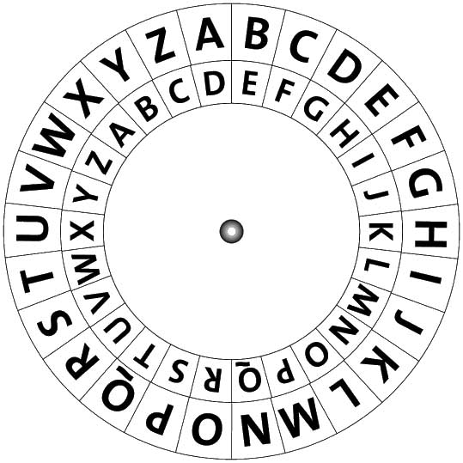
Quick Activity!
Question #1:
The Caesar Cipher is traditionally drawn as two concentric wheels.
Why is this the case?

Slide 24
Quick Activity!
Question #1:
The Caesar Cipher is traditionally drawn as two concentric wheels.
Why is this the case?
Answer:
The wheels allow us to handle letters that need to “back-shift” to the beginning of the alphabet.

Slide 25
Quick Activity!
Question #2:
In this example of the Caesar Cipher, what is the key value being used?

Slide 26
Quick Activity!
Question #2:
In this example of the Caesar Cipher, what is the key value being used?
Answer:
Key = 3
A->D
B->E
C->F
...

Slide 27
Activity: Caesar’s Minions (10 Mins)
Activity:
Take a few moments to do the following:
Explain to your neighbor in 2-3 sentences how the Caesar Cipher works.
Next write a one sentence message (hidden from your partner).
Specify a shift-key and use it to encode the message.
Then provide your partner the encoded message and key.
Have your partner use the key to decode the intended message. Confirm that they were correct.
Notes:
Use only this link http://inventwithpython.com/cipherwheel/ to do your encoding / decoding.

Slide 28
Caesar Cipher… In Code

Slide 29
Now it’s time to kick up the challenge.

Slide 30

Building Caesar.py
Caesar Cipher
Python
In this section of class, we’ll be implementing the Caesar Cipher using Python code.

Slide 31
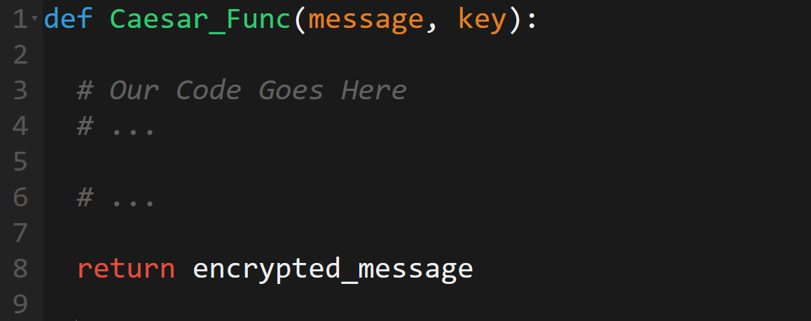
Building Caesar.py
Specifically, we’ll be building a Python function that take in a string and key
and outputs encoded text.

Slide 32
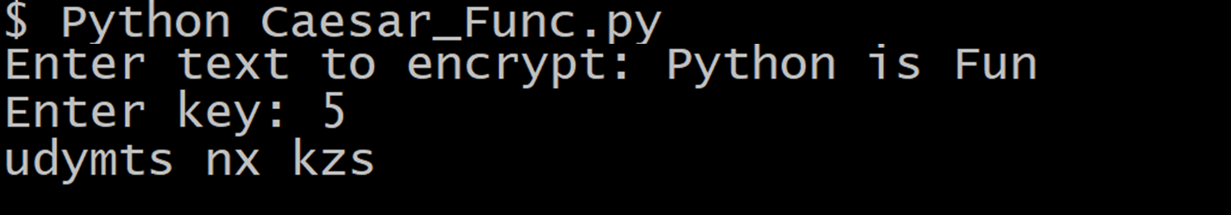
Building Caesar.py
Final Python Application:

Slide 33
Building Caesar.py
While this will be a challenging exercise, it’s a great way to deepen your Python skills and gain an understanding of how algorithm implementation works.

Slide 34
Activity: Planning Caesar’s Attack (7 mins)
Activity:
Take the next few moments to pseudocode an approach to building Caesar.py with your neighbor.
Specifically, try to break down the problem into 3-5 steps.
Be thinking of concepts you’ve used in Python (for-loops, functions, variables) in selecting your steps.
Be prepared to share!

Slide 35
Caesar.py Basic Approach
Step 1: Take in User Inputs
Message
Key
Step 2: Pass User Inputs into Function
Inputs (Arguments)
Outputs (Return)
Message
Key
Encrypted Message
Caesar Function (Python)
Step 3: Break Message Into Individual Letters
0
1
2
3
4
5
6
7
8
M
Y
S
E
C
R
E
T

Slide 36
Caesar.py Basic Approach
Step 4: Loop Through Each Letter of the String
M
Y
S
E
C
R
E
T
Step 5: Use the Key to Convert Each Letter According to the Shift
M
Y
S
E
C
R
E
T
Key = 4
Q
C
W
E
C
R
E
T

Slide 37
Caesar.py Basic Approach
Step 4: Loop Through Each Letter of the String
M
Y
S
E
C
R
E
T
Step 5: Use the Key to Convert Each Letter According to the Shift
M
Y
S
E
C
R
E
T
Key = 4
Q
C
W
E
C
R
E
T
Pro-Tip
There are plenty of additional details, but by keeping laser focused on the “key steps”, we have a starting point.
We’ll discover nuances as we start coding.

Slide 38
Let’s get coding!

Slide 39
Caesar’s Vulnerabilities?

Slide 40
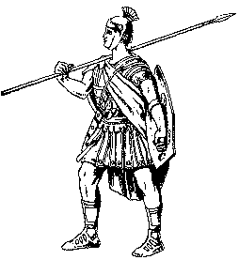

Secure Messaging?
Sender
Receiver:
Caesar Cipher
Key
Message
Key
Message
Thus far, we’ve talked about encryption and decryption in the context of receivers intended to receive the message…

Slide 41
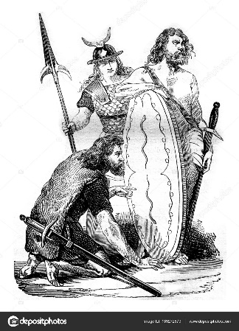
…But what happens when a malicious intruder enters the picture?

Slide 42
Secure Messaging?
Malicious Intruder
Sender
Receiver
Message
Key
Message
Key
Message
Let’s say an intruder has secured our encrypted message but failed to obtain our cipher’s key.

Slide 43
Secure Messaging?
Malicious Intruder
Sender
Receiver
Message
Key
Message
Key
Message
Should we be concerned?

Slide 44
Activity: The Barbarians Got Mail (15 Minutes)
Activity:
Work with your neighbor to play out each of the following:
Red Team – You Are the Barbarians:
You’ve successfully (and bloodily) secured one of Caesar’s messages.
However, it reads like gibberish. In fact it says: “olhklk av aol ypcly mvy h zvsv chjhf. zll fvb shaly!”. Figure out a way to determine it’s meaning.
Be ready to share your approach with the general.
Blue Team – You Are Caesar:
The Barbarians have successfully obtained Caesar’s most recent (encrypted) message! Outline a series of steps to assess the risk and prevent future impact.
Specifically come up with at least 5 assessment questions to ask and 5 proposals.
Be ready to share your approach with Caesar!

Slide 45
Time to Share!

Slide 46
The Barbarians Got Mail (Red Team - Review)
Option 1: nkgjkj zu znk xobkx lux g yuru bgige. ykk eua rgzkx!
Option 2: mjfiji yt ymj wnajw ktw f xtqt afhfd. xjj dtz qfyjw!
Option 3: liehih xs xli vmziv jsv e wsps zegec. wii csy pexiv!
Option 4: khdghg wr wkh ulyhu iru d vror ydfdb. vhh brx odwhu!
Option 5: jgcfgf vq vjg tkxgt hqt c uqnq xceca. ugg aqw ncvgt!
Option 6: ifbefe up uif sjwfs gps b tpmp wbdbz. tff zpv mbufs!
Option 7: headed to the river for a solo vacay. see you later!
Option 8: gdzcdc sn sgd qhudq enq z rnkn uzbzx. rdd xnt kzsdq!
Option 9: fcybcb rm rfc pgtcp dmp y qmjm tyayw. qcc wms jyrcp!
One of the principle weaknesses of the Caesar cipher is it’s penetrability to brute force cracking attempts.
A persistent intruder needs only to try each of the 25 different options (n-1 for each letter of the alphabet) to obtain the decrypted message.

Slide 47
The Barbarians Got Mail (Red Team - Review)
Option 1: nkgjkj zu znk xobkx lux g yuru bgige. ykk eua rgzkx!
Option 2: mjfiji yt ymj wnajw ktw f xtqt afhfd. xjj dtz qfyjw!
Option 3: liehih xs xli vmziv jsv e wsps zegec. wii csy pexiv!
Option 4: khdghg wr wkh ulyhu iru d vror ydfdb. vhh brx odwhu!
Option 5: jgcfgf vq vjg tkxgt hqt c uqnq xceca. ugg aqw ncvgt!
Option 6: ifbefe up uif sjwfs gps b tpmp wbdbz. tff zpv mbufs!
Option 7: headed to the river for a solo vacay. see you later!
Option 8: gdzcdc sn sgd qhudq enq z rnkn uzbzx. rdd xnt kzsdq!
Option 9: fcybcb rm rfc pgtcp dmp y qmjm tyayw. qcc wms jyrcp!
Worse yet… once decrypted, the intruder will have successfully obtained the key.
This means that the intruder can easily decrypt future messages as well.

Slide 48
The Barbarians Got Mail (Blue Team - Review)
Risk Assessment:
Are the intruders truly malicious?
If No… Consider the risk to be slightly reduced.
If Yes… Immediately elevate defenses.
Is the message of material consequence?
If No… Consider risk to be slightly reduced.
If Yes… Consider changing plans or elevating defenses.
Is this an ongoing threat? (Can the intruders obtain our messages again?)
If No… Consider this to be a one-time anomaly.
If Yes… Consider elevating defenses against repeat occurrences.
Are there many Romans currently using the Caesar cipher and/or this key?
If No… Consider the scope to be more limited.
If Yes… Consider the need for widespread education.
Is there a more secure Cipher available to us?
If No… Recognize the risk and avoid messaging when possible.
If Yes… Consider swapping ciphers.

Slide 49
The Barbarians Got Mail (Blue Team - Review)
Future Proofing:
Immediately change all cipher keys to a new cipher. While this will not prevent future brute force attacks, it will slow down the process by which intruders can decrypt our messages.
Invest in a more sophisticated cipher. (Perhaps try Vigenere or Affine ☺).
Send messages along safer transit lines. (Avoid giving Barbarians access to our messaging routes).
Reduce the amount of long-distance communication all-together. (Only use courier messaging when necessary).
Communicate the risk of cipher breakage to all parties using the Caesar cipher (instill safer communication practices).

Slide 50
Keeping It Simple
The point is:
The Caesar Cipher is not a secure method of cryptography.
While it is incredible convenient, it is easily subject to being “cracked” by non-intended message recipients.
We’ll find that cryptographers are constantly at battle looking for ways to ensure this fate can be avoided.

Slide 51
In Closing…

Slide 52
Lesson Recap
Consider yourself successful today if…
You can clearly define the word “Cryptography”.
You can explain how the “Caesar Cipher” works.
You feel a bit more confident in Python and can understand, at a high-level, how the Caesar Cipher implementation works.
You understand fundamentally how ciphers can be cracked and can specifically explain how the Caesar Cipher is vulnerable to brute force attacks.

Slide 53
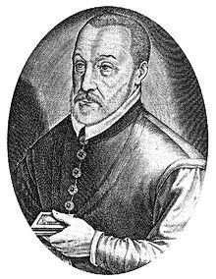
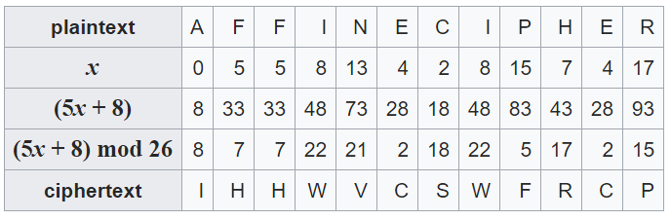
Our Next Set of Ciphers…
Vigenere Cipher
Affine Cipher
In the next class, we’ll be diving deeper into the idea of “cracking ciphers” and learning about a number of other ciphers that attempt to solve the vulnerabilities of the Caesar Cipher.

