Slide 1

Operating Room Scheduling
Making Hospitals Run Smoothly
15.071x – The Analytics Edge
Notes:
http://commons.wikimedia.org/wiki/File%3AFlag_of_the_Red_Cross.svg

Slide 2
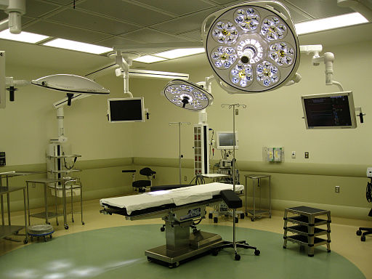
Operating Room Schedules
Hospitals have a limited number of ORs.
Operating room managers must determine a weekly schedule assigning ORs to different departments in the hospital.
Notes:
http://commons.wikimedia.org/wiki/File%3ACardiac_operating_room.jpg

Slide 3
Difficulties
Creating an acceptable schedule is a highly political process within the hospital.
Surgeons are frequently paid on a fee-for-service basis, so changing allocated OR hours directly affects their income.
The operating room manager’s proposed schedule must strike a delicate balance between all the surgical departments in the hospital.
Notes:
Target allocation may not be integer!!

Slide 4
Logistical Issues
Operating rooms are staffed in 8 hour blocks.
Each department sets their own target number of allocation hours, which may not be integer.
Departments may have daily and weekly requirements:
Ex) Gynecology needs at least 1 OR per day
Ex) Ophthalmology needs at least 2 ORs per week
Ex) The oral surgeon is only present on Tuesdays and Thursdays.
Notes:
Target allocation may not be integer!!

Slide 5
Case study: Mount Sinai Hospital
Has 10 ORs which are staffed Monday – Friday
10 ORs × 5 days × 8 hours/day = 400 hours to assign
Must divide these 400 hours between 5 departments:
Department | Weekly Target Allocation Hours
Ophthalmology | 39.4
Gynecology | 117.4
Oral Surgery | 19.9
Otolaryngology | 26.3
General Surgery | 189.0

Slide 6
Problem Data
Number of surgery teams from each department available each day:
Maximum number of ORs required by each department each day:
 | M | T | W | R | F
Ophthalmology | 4 | 4 | 4 | 4 | 4
Gynecology | 8 | 8 | 8 | 8 | 8
Oral Surgery | 3 | 3 | 3 | 3 | 3
Otolaryngology | 1 | 1 | 1 | 1 | 1
General Surgery | 5 | 5 | 5 | 5 | 5
 | M | T | W | R | F
Ophthalmology | 5 | 4 | 4 | 4 | 4
Gynecology | 2 | 8 | 8 | 8 | 8
Oral Surgery | 2 | 3 | 3 | 3 | 3
Otolaryngology | 3 | 1 | 1 | 1 | 1
General Surgery | 5 | 5 | 5 | 5 | 5

Slide 7
Additional Problem Data
Weekly requirement on number of ORs each department requires:
 | Minimum | Maximum
Ophthalmology | 3 | 8
Gynecology | 8 | 15
Oral Surgery | 2 | 2
Otolaryngology | 2 | 4
General Surgery | 18 | 24

Slide 8
The Traditional Way
Before the integer optimization method was implemented at Mount Sinai in 1999, the OR manager used graph paper and a large eraser to try to assign the OR blocks.
Any changes were incorporated by trial and error.
Draft schedule was circulated to all surgical groups.
Incorporating feedback from one department usually meant altering another group’s schedule, leading to many iterations of this process.
Notes:
Info from http://www.cmu.edu/cmnews/extra/050404_trick.html

Slide 9
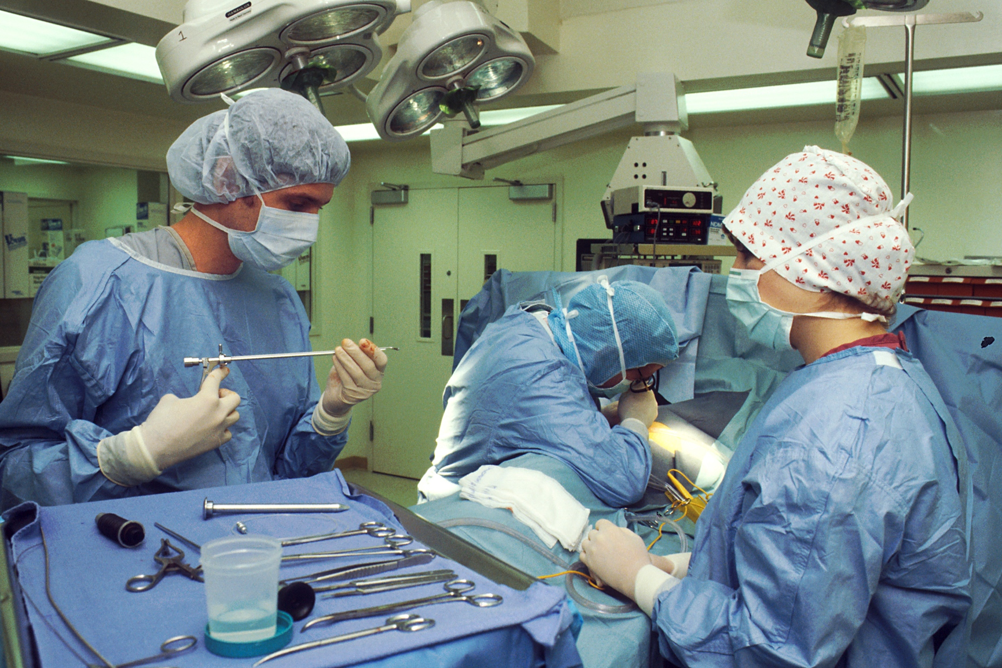
Optimization Problem
Decisions
How many ORs to assign each department on each day.
Integer decision variables x_{jk} represent the number of operating rooms department j is allocated on day k.
Notes:
http://commons.wikimedia.org/wiki/File%3AOperating_room.jpg

Slide 10
Objective
Maximize % of target allocation hours that each department is actually allocated.
If target allocation hours are t_{j} for department j, then we want to maximize the sum of (8 × x_{jk}) ÷ t_{j} over all departments and days of the week.
Ex) If otolaryngology has a target of 37.3 hours per week and we allocate them 4 ORs then their % of target allocation hours = (8 × 4) ÷ 37.3 = 85.8%

Slide 11
Constraints
At most 10 ORs are assigned every day
The number of ORs allocated to a department on a given day cannot exceed the number of surgery teams that department has available that day
Meet department daily minimums and maximums
Meet department weekly minimums and maximums
Ophthalmology | OP
Gynecology | GY
Oral Surgery | OS
Otolaryngology | OT
General Surgery | GS

Slide 12
Constraints
x_{OP, M}+ x_{GY, M}+ x_{OS, M}+ x_{OT, M}+ x_{GS, M} ≤ 10
The number of ORs allocated to a department on a given day cannot exceed the number of surgery teams that department has available that day
Meet department daily minimums and maximums
Meet department weekly minimums and maximums
Ophthalmology | OP
Gynecology | GY
Oral Surgery | OS
Otolaryngology | OT
General Surgery | GS

Slide 13
Constraints
x_{OP, M}+ x_{GY, M}+ x_{OS, M}+ x_{OT, M}+ x_{GS, M} ≤ 10
0 ≤ x_{OS, W} ≤ 3
0 ≤ x_{GY, F} ≤ 0
Meet department daily minimums and maximums
Meet department weekly minimums and maximums
Ophthalmology | OP
Gynecology | GY
Oral Surgery | OS
Otolaryngology | OT
General Surgery | GS

Slide 14
Constraints
x_{OP, M}+ x_{GY, M}+ x_{OS, M}+ x_{OT, M}+ x_{GS, M} ≤ 10
0 ≤ x_{OS, W} ≤ 3
0 ≤ x_{GY, F} ≤ 0
0 ≤ x_{GS, T} ≤ 8
Meet department weekly minimums and maximums
Ophthalmology | OP
Gynecology | GY
Oral Surgery | OS
Otolaryngology | OT
General Surgery | GS

Slide 15
Constraints
x_{OP, M}+ x_{GY, M}+ x_{OS, M}+ x_{OT, M}+ x_{GS, M} ≤ 10
0 ≤ x_{OS, W} ≤ 3
0 ≤ x_{GY, F} ≤ 0
0 ≤ x_{GS, T} ≤ 8
2 ≤ x_{OP, M}+ x_{OP, T}+ x_{OP, W} + x_{OP, R}+ x_{OP, F} ≤ 2
Ophthalmology | OP
Gynecology | GY
Oral Surgery | OS
Otolaryngology | OT
General Surgery | GS

