Slide 1

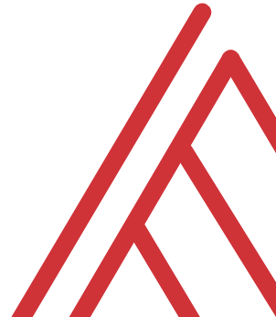
Excel Statistics for Business Analytics

Slide 2
Objectives for today
Explore a dataset for research questions
Check assumptions and build hypotheses
Test formally for difference in means between two groups
Make compelling business recommendations using inferential statistics

Slide 3
Exploratory data analysis in Excel

Slide 4
What is a variable and how do you measure it?

Slide 5

DRILLS
How many columns are in Managers?
How many of these columns are of type INTEGER?
How many rows does Managers have?

Slide 6
Questions?

Slide 7
The grammar of sql
Term | What it does | Example
Identifier | Identifies an object (i.e. table, field) | Master
Operator | Takes some action (perform calculation,, rename something) | +, AS
Expression | Applies criteria to data | birthYear > 1960

Slide 8
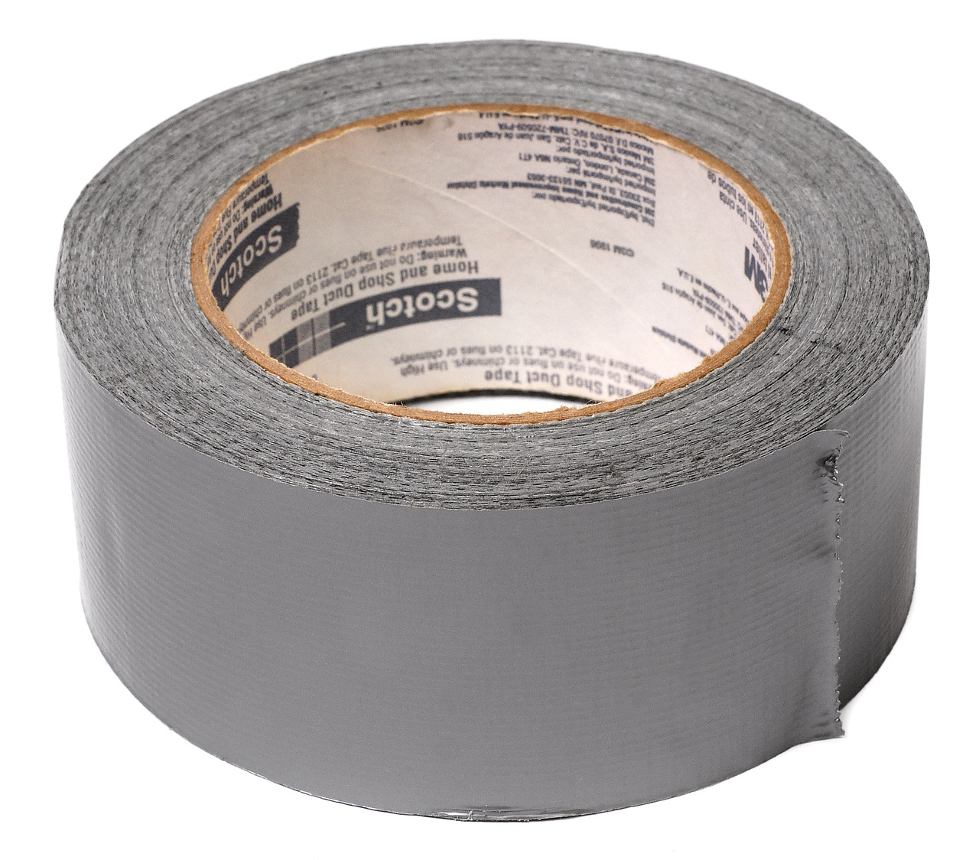

FROM VLOOKUP() DUCT TAPE TO JOIN() BLOWTORCH

Slide 9
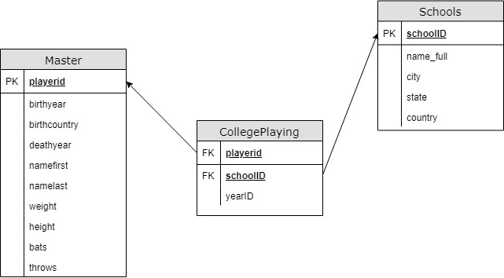
Introducing schemas

