Slide 1
SMART NAVIGATION ASSISTANT FOR PGRKAM PORTAL
CSE7101- Capstone Project
Review-1
Batch Number:CSE_62
Under the Supervision of,
Ms. Rama Bai V
Assistant Professor
School of Computer Science and Engineering
Presidency University
Roll Number | Student Name
20221CSE0727 | V BALAJI
20221CSE0698 | NITHIN REDDY
20221CSE0720 | SHREYA A
Name of the Program: Computer Science and Engineering
Name of the HoD: Dr. Asif Mohammed
Name of the Program Project Coordinator: Dr. Jayavadivel Ravi
Name of the School Project Coordinators: Dr. Sampath A K , Dr. Geetha A

Slide 2
Problem Statement Number:
Organization: Department of Employment ,Government of Punjab
Category :Software
Problem Description:
The Employment Department at present has a digital platform www.pgrkam.com and its mobile application to provide almost all services offered to job seekers and employers through digital means. The portal has multiple modules like private sector jobs, government jobs, self-employment avenues, foreign jobs, foreign study, counseling, guidance, induction into armed forces, job melas, etc. Currently, when a user visits the portal/app, there is no hand-holding mechanism to help the user get to the part of the digital platform which will resolve his queries. The user is required to navigate across multiple modules on the portal/ app to search for answers.

Slide 3
Content
Problem Statement
Objectives
Background and Related work for title Selection
Analysis of Problem Statement
Innovation or Novel Contributions
Git-hub Link
Timeline of the Project
References

Slide 4
Objective
Develop a multilingual smart chatbot leveraging Large Language Models (LLMs) such as GPT-3, to provide intelligent, context-aware assistance to users of the PGRKAM digital platform.
Enable both text and voice query handling in Punjabi, Hindi, and English, with a focus on domains including job search, skill development, and foreign counseling.
Incorporate personalized job recommendations by analyzing and utilizing each user’s historical interactions and stated preferences.
Enhance accessibility through the integration of a multilingual screen-reading module to support visually impaired users.
Ensure cross-platform compatibility, allowing users to chat, read, or listen to responses seamlessly on both smartphones and laptops, thereby reducing navigation time and effort.

Slide 5
Background and Related work
Large Language Models (LLMs) like GPT-3 have advanced conversational AI, enabling context-aware and human-like interactions.
AI chatbots are increasingly used in employment services to improve job search efficiency and provide personalized recommendations.
Multilingual conversational agents enhance accessibility for linguistically diverse populations and individuals with literacy challenges.
Existing government job portals in India do not integrate multilingual, voice-enabled AI assistants tailored for regional languages.
The identified gap supports the development of a PGRKAM Smart Chatbot to offer intelligent, accessible, and personalized employment assistance.

Slide 6
Analysis of Problem Statement
Technology Stack Components:
Frontend: HTML5, CSS3, JavaScript
Backend: Java (Spring Boot / Servlets)
Database: MySQL
Server: Apache Tomcat
Version Control: Git, GitHub
Tools: VS Code, Eclipse/IntelliJ
Build Tool: Maven

Slide 7
Innovation and Novel Contributions
Multilingual Conversational Interface: Supports Punjabi, Hindi, and English for wider regional accessibility.
Voice-Enabled Interaction: Facilitates both speech input and audio output for improved usability.
Personalized Recommendations: Utilizes user history and preferences to deliver targeted job and skill suggestions.
Accessibility Integration: Incorporates a screen-reading module to assist visually impaired users.
Seamless Platform Integration: Designed to work across both web and mobile versions of the PGRKAM platform.
Context-Aware Navigation: Directs users to the most relevant services without manual browsing.

Slide 8
Github Link
GithubLink: https://vbalaji2004-pu.github.io/PGRKAM_CapstoneProject_CSE_62/

Slide 9
Analysis of Problem Statement (contd...)
Software Requirements:
The current PGRKAM platform requires users to navigate multiple modules to locate relevant services or information.
This results in increased time consumption, reduced efficiency, and a suboptimal user experience.
The absence of an intelligent guidance mechanism limits accessibility for individuals with limited digital literacy or visual impairments.

Slide 10
Analysis of Problem Statement (contd...)
There is a clear requirement for an integrated, context-aware system to streamline user interaction with the platform.
A multilingual, voice-enabled AI chatbot with personalization capabilities can address these limitations effectively.

Slide 11
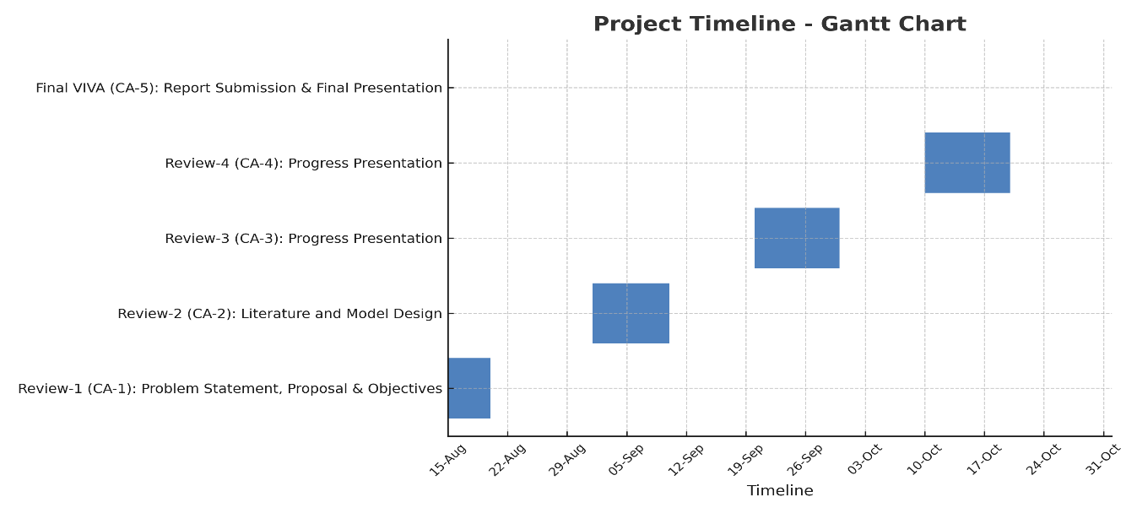
Timeline of the Project (Gantt Chart)

Slide 12
References (IEEE Paper format)
[1] T. B. Brown et al., “Language Models are Few-Shot Learners,” NeurIPS, 2020. https://proceedings.neurips.cc/paper/2020/file/1457c0d6bfcb4967418bfb8ac142f64a-Paper.pdfhttps://www.mdpi.com/1424-8220/21/24/8448https://proceedings.neurips.cc/paper/2020/file/1457c0d6bfcb4967418bfb8ac142f64a-Paper.pdf
[2] M. Allouch, A. Azaria, and R. Azoulay, “Conversational Agents: Goals, Technologies, Vision and Challenges,” Sensors, vol. 21, no. 24, art. 8448, 2021.
https://www.mdpi.com/1424-8220/21/24/8448

Slide 13
References (IEEE Paper format)
[3] S. Kusal et al., “AI-Based Conversational Agents: A Scoping Review From Technologies to Future Directions,” IEEE Access, 2022. https://doi.org/10.1109/ACCESS.2022.3201144
[4] N. M. Radziwill and M. C. Benton, “Evaluating Quality of Chatbots and Intelligent Conversational Agents,” arXiv preprint, 2017. https://arxiv.org/abs/1704.04579
[5] J. Gao, M. Galley, and L. Li, “Neural Approaches to Conversational AI,” arXiv preprint, 2018. https://arxiv.org/abs/1809.08267

Slide 14


