Slide 1
SMART NAVIGATION ASSISTANT FOR PGRKAM PORTAL
CSE7101- Capstone Project
Review-5
Batch Number:CSE_62
Under the Supervision of,
Ms. Rama Bai V
Assistant Professor
School of Computer Science and Engineering
Presidency University
Roll Number | Student Name
20221CSE0727 | V BALAJI
20221CSE0698 | NITHIN REDDY
20221CSE0720 | SHREYA A
Name of the Program: Computer Science and Engineering
Name of the HoD: Dr. Asif Mohammed
Name of the Program Project Coordinator: Dr. Jayavadivel Ravi
Name of the School Project Coordinators: Dr. Sampath A K , Dr. Geetha A

Slide 2
Content
Abstract
Literature Survey
Objective
Existing methods and drawbacks
Proposed methods and feasibility
Architecture Diagram
Module Description
Software Requirements
Timeline(Gantt Chart)
References
Project Output
Github

Slide 3
Problem Statement Number:17
Organization: Department of Employment ,Government of Punjab
Category :Software
Problem Description:
The Employment Department at present has a digital platform www.pgrkam.com and its mobile application to provide almost all services offered to job seekers and employers through digital means. The portal has multiple modules like private sector jobs, government jobs, self-employment avenues, foreign jobs, foreign study, counseling, guidance, induction into armed forces, job melas, etc. Currently, when a user visits the portal/app, there is no hand-holding mechanism to help the user get to the part of the digital platform which will resolve his queries. The user is required to navigate across multiple modules on the portal/ app to search for answers.

Slide 4
Abstract
This project presents a basic prototype of an intelligent chatbot integrated into the employment portal www.pgrkam.com and its mobile app. The chatbot aims to provide a user-friendly, guided experience, helping users navigate the platform efficiently and find relevant services or information quickly.

Slide 5
Objective
Develop a multilingual smart chatbot leveraging Large Language Models (LLMs) such as GPT-3, to provide intelligent, context-aware assistance to users of the PGRKAM digital platform.
Enable both text and voice query handling in Punjabi, Hindi, and English, with a focus on domains including job search, skill development, and foreign counseling.
Incorporate personalized job recommendations by analyzing and utilizing each user’s historical interactions and stated preferences.
Enhance accessibility through the integration of a multilingual screen-reading module to support visually impaired users.
Ensure cross-platform compatibility, allowing users to chat, read, or listen to responses seamlessly on both smartphones and laptops, thereby reducing navigation time and effort.

Slide 6
Literature Survey
Brown et al. (2020) – Language Models are Few-Shot Learners Paper Link → Introduces GPT-3, shows large LLMs can perform diverse NLP tasks with few shot learning.
Radziwill & Benton (2017) – Evaluating Quality of Chatbots and Intelligent Conversational Agents arXiv Link → Defines chatbot quality metrics: usability, reliability, conversational ability, accessibility.
Geyik et al. (LinkedIn, 2017) – Personalized Job Recommendation System https://engineering.linkedin.com/blog/2017/05/ai-powered-job-recommendations → Hybrid online/offline recommendation system for personalized job matching.

Slide 7
Literature Survey
IndicST (2025) – Speech-to-Text for Low-Resource Indian Languages GitHub Project → Improves speech recognition in Indic languages using multilingual corpora.
Popov et al. (2024) – Diffusion-based TTS for Low-Resource Languages https://arxiv.org/abs/2401.00386 → Uses diffusion models for high-quality text-to-speech in resource-scarce languages.
Reddy et al. (2023) – Inter-Bilingual Semantic Parsing for Indian Languages https://arxiv.org/abs/2303.13348 → Cross-lingual semantic parsing for multilingual dialogue systems.
Kaur & Sharma (2021) – Hybrid Summarization for Hindi & Punjabi Documents https://www.ijrte.org/wp-content/uploads/papers/v9i1/A4886059121.pdf → Hybrid extractive summarization method tailored for Indian languages.

Slide 8
Literature Survey
Kshetri (2022) – AI Chatbots in Indian Recruitment ResearchGate Link → Study on how Indian recruiters use chatbots, benefits & challenges.
Yadav et al. (2021) – AI-Based Job Portal with Chatbot Integration https://ijrpr.com/uploads/V2ISSUE3/IJRPR237.pdf → Prototype of a job portal with AI chatbot for faster job search & FAQs.
Sundar et al. (2020) – Accessibility Challenges in Multilingual Screen Readers https://dl.acm.org/doi/10.1145/3373625.3418306 → Shows how multilingual websites pose challenges for visually impaired users.

Slide 9
Existing Methods
Rule-based Chatbots
Predefined question–answer pairs.
Common in older government job portals and recruitment FAQs.
Menu-driven Navigation
Users select from dropdowns or menus to find jobs or services.
Widely used in current PGRKAM portal.
Generic Search Bars
Keyword search to retrieve results.
Often English-only and not optimized for regional languages.
Third-party Career Portals (e.g., Naukri, LinkedIn)
Provide AI-based job recommendations.
Focus mainly on English-speaking audience and private sector jobs.
Voice Assistants (Google Assistant, Alexa)
Can handle job-related questions but lack integration with regional government databases.

Slide 10
Drawbacks of Existing Methods
Limited Intelligence: → Rule-based chatbots fail when queries are outside predefined patterns.
Poor Multilingual Support: → Current systems mostly support English, little to no Punjabi/Hindi coverage.
High Navigation Effort: → Users must browse multiple modules manually (as in PGRKAM portal now).
Lack of Personalization: → No mechanism to remember candidate history, preferences, or past interactions.
Accessibility Gaps: → Screen-reader compatibility is low, making it difficult for visually impaired users.
Fragmented Experience: → No single assistant integrates job search, skill development, counseling, and foreign job/study options in one place.

Slide 11
Proposed Methods
Multilingual Conversational Interface: Supports Punjabi, Hindi, and English for wider regional accessibility.
Voice-Enabled Interaction: Facilitates both speech input and audio output for improved usability.
Personalized Recommendations: Utilizes user history and preferences to deliver targeted job and skill suggestions.
Accessibility Integration: Incorporates a screen-reading module to assist visually impaired users.
Seamless Platform Integration: Designed to work across both web and mobile versions of the PGRKAM platform.
Context-Aware Navigation: Directs users to the most relevant services without manual browsing.

Slide 12
Feasibility Study
Frontend: HTML5, CSS3, JavaScript
Backend: Java (Spring Boot / Servlets)
Database: MySQL
Server: Apache Tomcat
Version Control: Git, GitHub
Tools: VS Code, Eclipse/IntelliJ
Build Tool: Maven

Slide 13
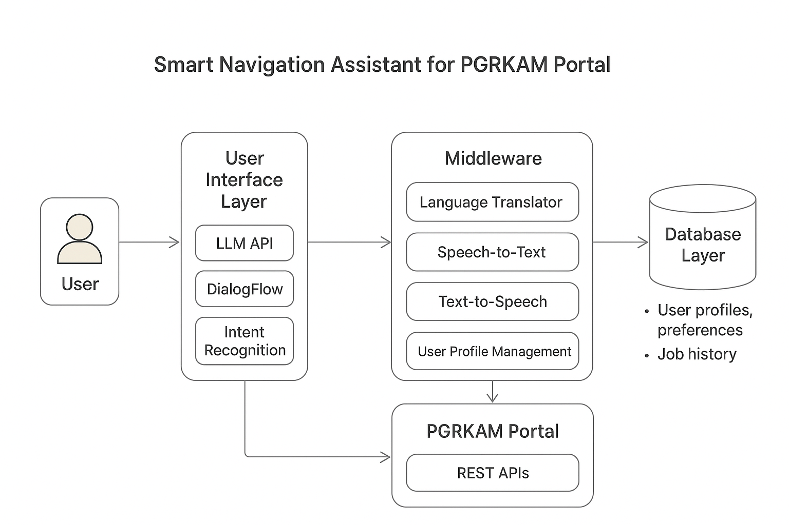
Architecture Diagram

Slide 14
Module Description
User Interaction Module
Web & mobile chatbot interface.
Supports text, voice input, and audio responses.
Language Processing Module
Multilingual (Punjabi/Hindi/English).
Speech-to-Text, Text-to-Speech, intent recognition via LLM.
Recommendation & Personalization Module
Profile & history-based filtering.
Suggests jobs, skills, and counseling options.
Integration & Middleware Module
Connects chatbot with PGRKAM APIs.
Maintains session context for smooth navigation.

Slide 15
Module Description
Database & Storage Module
User profiles & preferences (MySQL/Postgres).
Job listings + local cache for fast access.
Accessibility & Support Module
Screen reader compatibility & multilingual summaries.
Admin dashboard for monitoring & updates.

Slide 16
Software Requirements
The current PGRKAM platform requires users to navigate multiple modules to locate relevant services or information.
This results in increased time consumption, reduced efficiency, and a suboptimal user experience.
The absence of an intelligent guidance mechanism limits accessibility for individuals with limited digital literacy or visual impairments.

Slide 17
Software Requirements
There is a clear requirement for an integrated, context-aware system to streamline user interaction with the platform.
A multilingual, voice-enabled AI chatbot with personalization capabilities can address these limitations effectively.

Slide 18
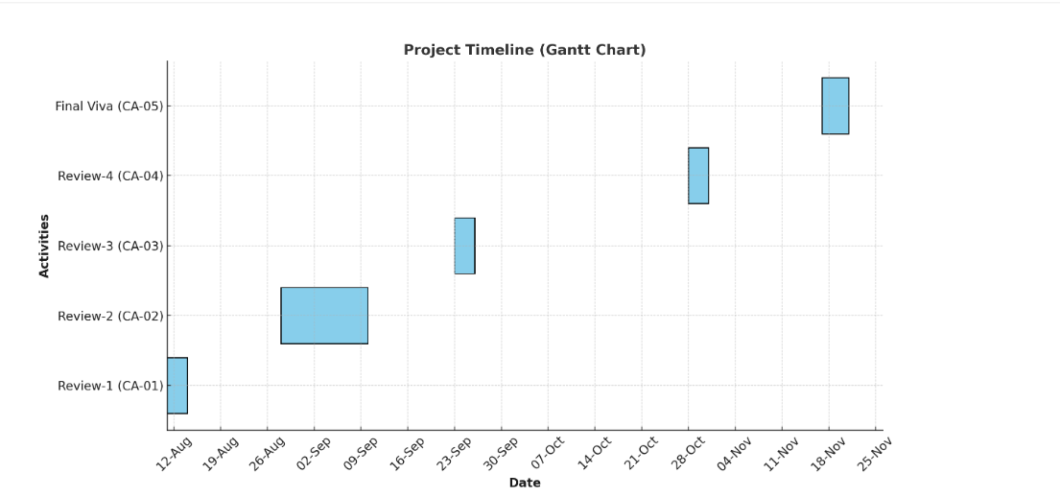
Timeline of the Project (Gantt Chart)

Slide 19
References (IEEE Paper format)
[1] T. B. Brown et al., “Language Models are Few-Shot Learners,” NeurIPS, 2020. https://proceedings.neurips.cc/paper/2020/file/1457c0d6bfcb4967418bfb8ac142f64a-Paper.pdfhttps://www.mdpi.com/1424-8220/21/24/8448https://proceedings.neurips.cc/paper/2020/file/1457c0d6bfcb4967418bfb8ac142f64a-Paper.pdf
[2] M. Allouch, A. Azaria, and R. Azoulay, “Conversational Agents: Goals, Technologies, Vision and Challenges,” Sensors, vol. 21, no. 24, art. 8448, 2021.
https://www.mdpi.com/1424-8220/21/24/8448

Slide 20
References (IEEE Paper format)
[3] S. Kusal et al., “AI-Based Conversational Agents: A Scoping Review From Technologies to Future Directions,” IEEE Access, 2022. https://doi.org/10.1109/ACCESS.2022.3201144
[4] N. M. Radziwill and M. C. Benton, “Evaluating Quality of Chatbots and Intelligent Conversational Agents,” arXiv preprint, 2017. https://arxiv.org/abs/1704.04579
[5] J. Gao, M. Galley, and L. Li, “Neural Approaches to Conversational AI,” arXiv preprint, 2018. https://arxiv.org/abs/1809.08267

Slide 21
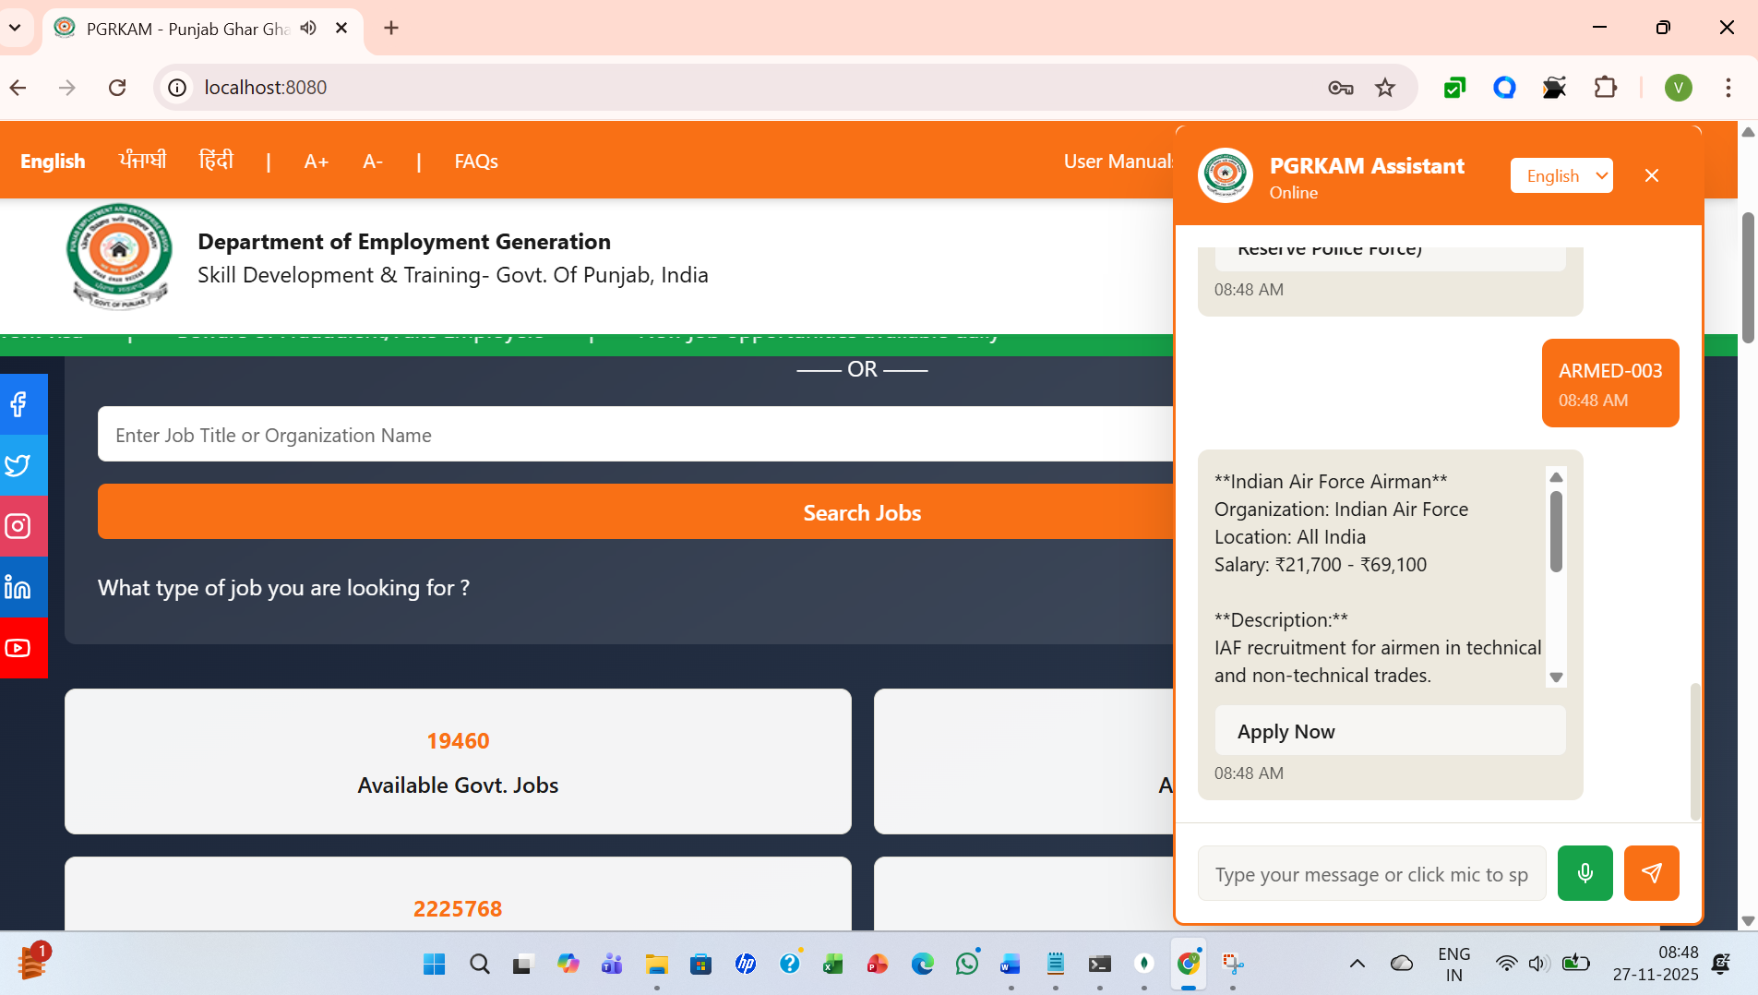
Project Output

Slide 22
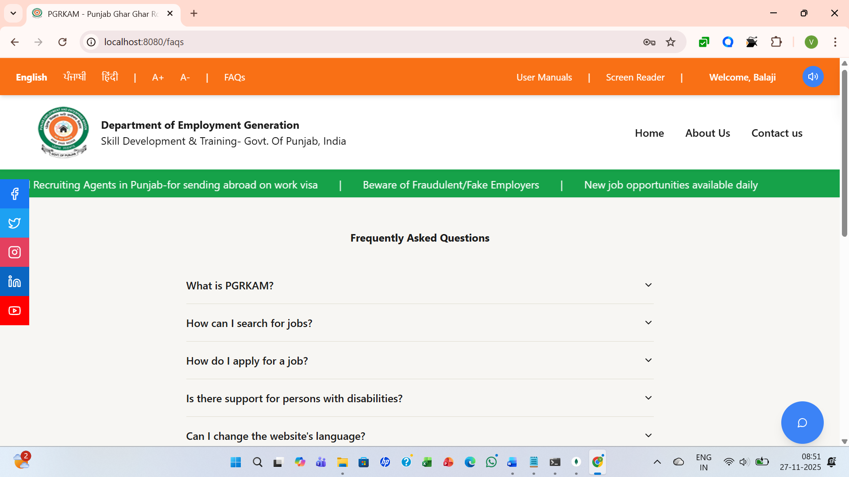
Project Output

Slide 23
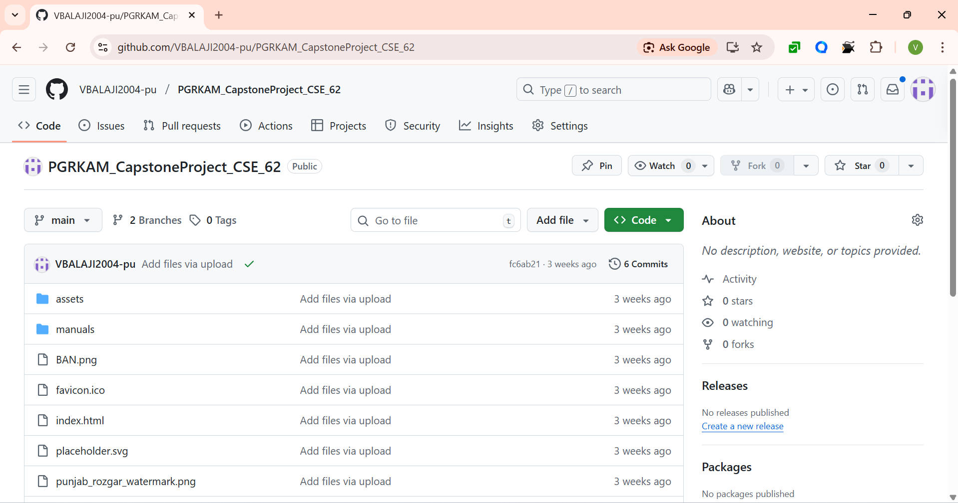
Github
Link:
https://github.com/VBALAJI2004-pu/PGRKAM_CapstoneProject_CSE_62

Slide 24


