Slide 1

LatticeForge
Pareto-Optimal Agent Capability Refactoring via Formal Concept Analysis
Smarter AI agents through mathematical capability reasoning — a new architecture that replaces guesswork with provable math.

Slide 2



Every AI Agent Eventually Breaks
Three scaling problems that silently erode agent reliability and maintainability:
Fuzzy Tool Retrieval
Vector similarity selects tools that are merely similar — not the ones that actually satisfy the task specification. Leads to wrong calls and missed capabilities.
Single-Strategy Blindness
One model, one prompt, one config for every task ignores multi-objective needs (latency, cost, accuracy). Suboptimal decisions at scale.
Tool Bloat
Engineers add tools faster than they prune them. Redundancy accumulates; nobody can prove which tools are unnecessary.

Slide 3

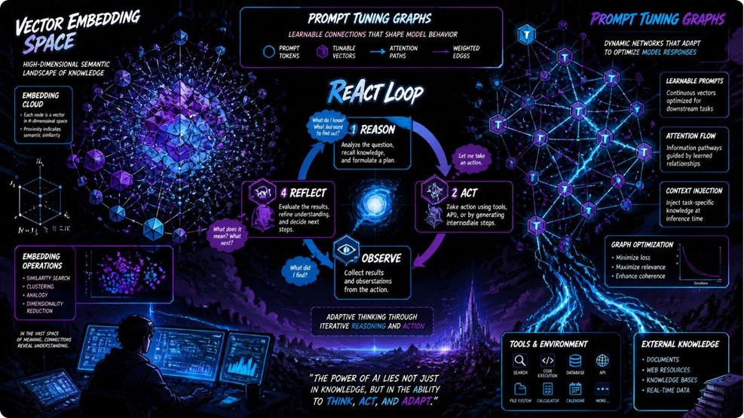
What Exists Today — And Why It's Not Enough
Tool
What it does
What it misses
LangChain / CrewAI
Tool-calling with vector retrieval
Fuzzy, not exact — no formal redundancy proofs
DSPy
Optimizes prompts for a single metric
No multi-objective trade-off handling
ReAct Agents
Reason-then-act loops for dynamic decision-making
Single strategy bias — no explicit cost/quality optimization
Bottom line: existing systems optimize specific pieces (retrieval, prompting, loop design) but do not combine exact capability matching with explicit multi-objective trade-offs.

Slide 4
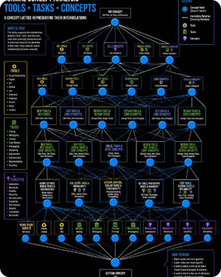
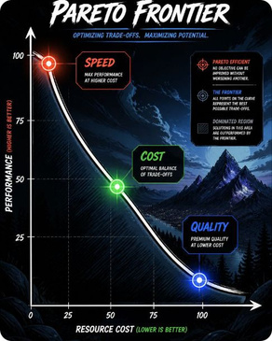
A Mathematical Foundation for Agent Capabilities
Formal Concept Analysis (FCA)
Pareto Frontier Optimization
Model tools and tasks as a concept lattice. For each task, compute the exact concept (intent + extent) that identifies the minimal set of tools required — provably sound selection, not heuristic similarity.
Maintain a Pareto surface of configurations (fast, cheap, accurate) for each concept. At runtime, select the Pareto-optimal configuration aligned to contextual constraints (latency budgets, SLAs, cost ceilings).

Slide 5

From Task to Execution — Mathematically Simple
Task Arrives
Extract Capabilities
Find Concept
Select Config
Caption: The pipeline enforces correctness at two points — exact capability matching via FCA, and context-aware config selection via Pareto optimization — producing reliable, efficient executions.

Slide 6


What LatticeForge Changes
From Approximate → Exact
From One Strategy → Optimal Strategy
From Manual Maintenance → Self-Aware Agents
Tool matching is provably correct: the lattice yields the exact set of capabilities required for a task, eliminating guesswork and false positives.
Multiple Pareto-optimal configurations are available for each concept; the system selects the one aligned to contextual objectives (latency, cost, accuracy).
The lattice exposes redundancy and gaps: engineers can prove which tools are redundant and which capabilities are missing, enabling principled pruning and targeted tool development.
"An agent that cannot reason about what it can do is not an agent. It is a script."
Design notes: Dark theme with electric blue/purple accents; use icons for lattice, Pareto, and execution when expanding the deck.

