Slide 1
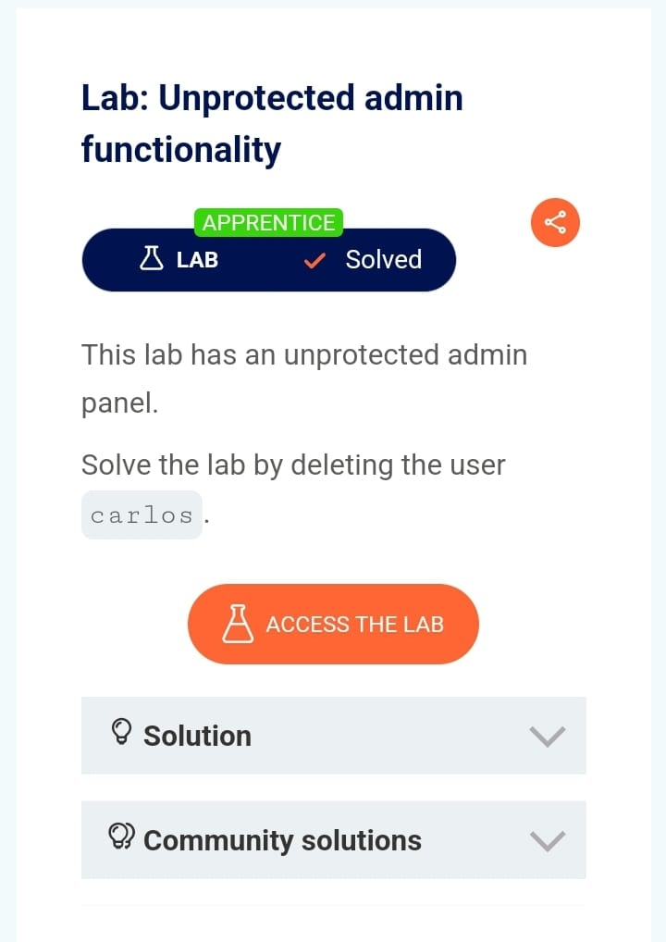

Slide 2
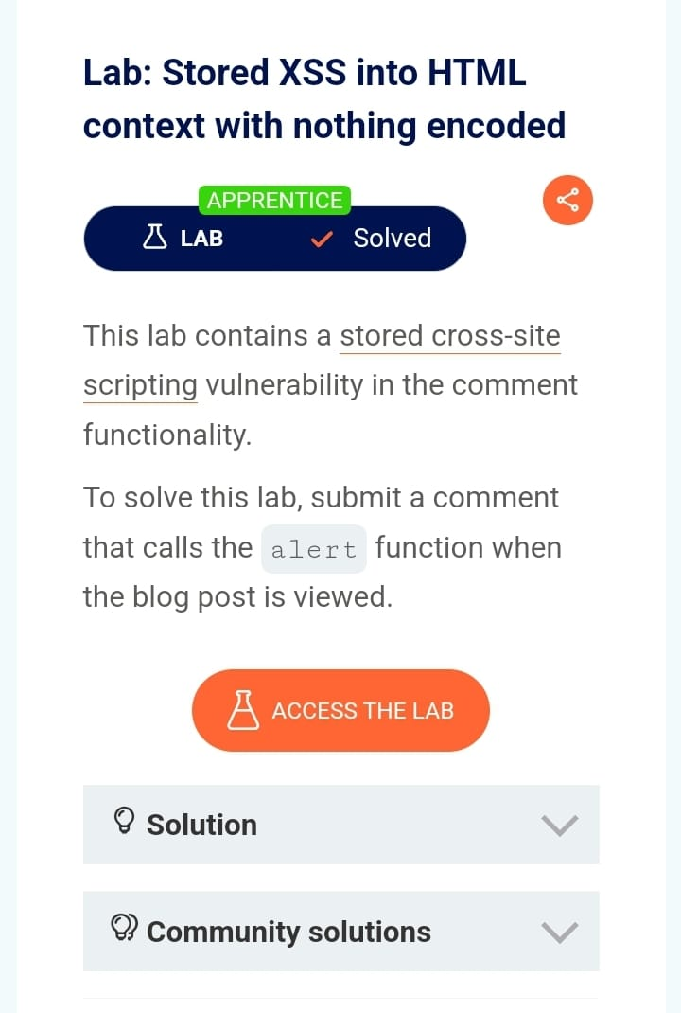

Slide 3
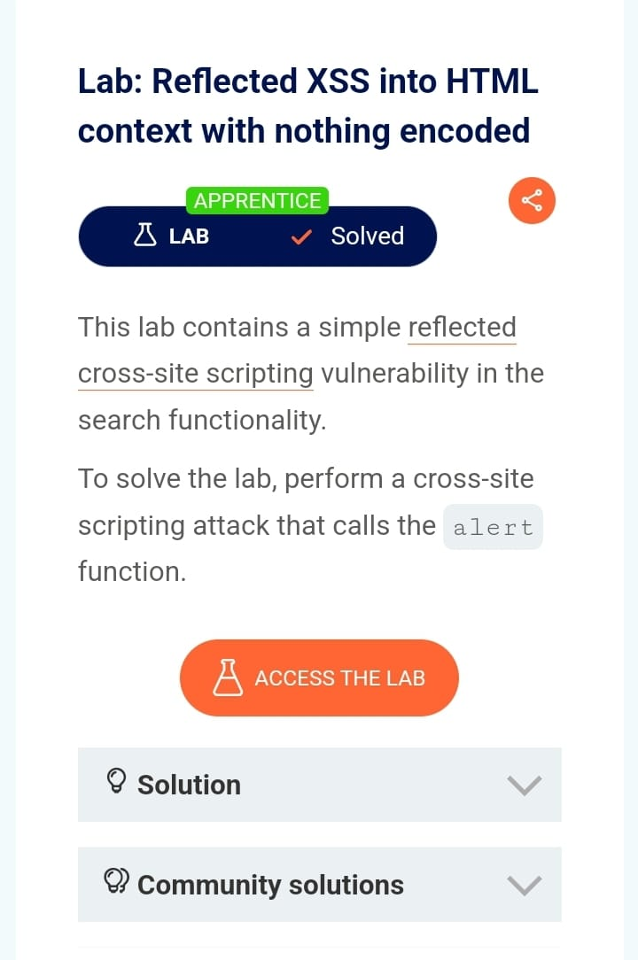

Slide 4
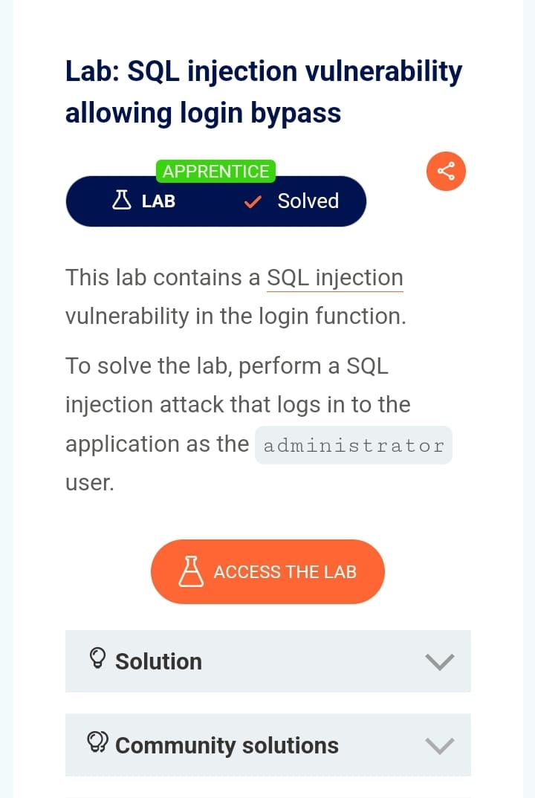

Slide 5
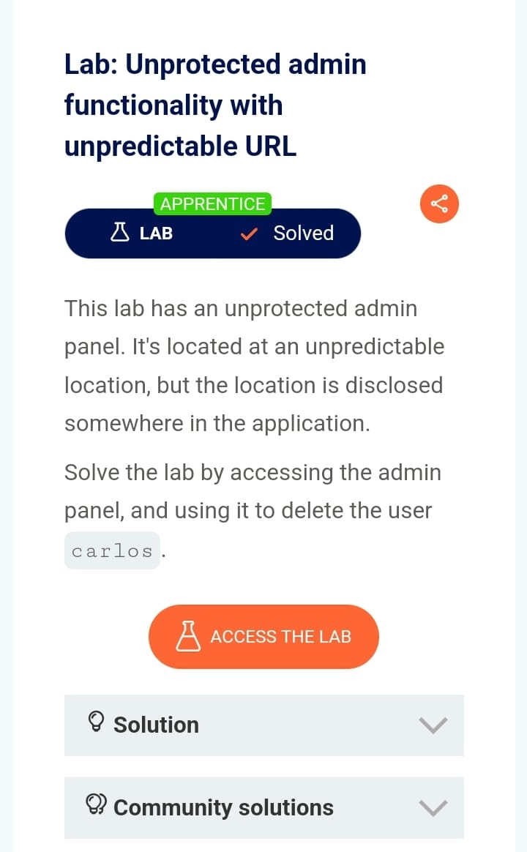

Slide 6
TITLE:HACKING
DOMAIN:ETHICAL HACKING.COM
SUBDOMAIN:AMAAS.DNSRECON.COM
STEPS FOR REPRODUCE:1.Reconnaissance: This is the preparation phase of the hack.
2.Scanning: In this phase, hackers use information gathered in the previous step.
3.Gaining Access: This is the ethical hacking phase of putting all the information to work and attempting to get into the network.
4.Maintaining Access: Once the hacker has gained access, they need to maintain it.
5.Covering Tracks/Providing a Vulnerability Report: The final step is to cover tracks and provide a report of the vulnerabilities found.
The above steps are not ethical hacking steps, but rather ways to cover tracks after a hack.

Slide 7
IMPACT USE:1.Testing and improving security measures proactively1.
2.Discovering vulnerabilities from an attacker’s point of view to fix weak points23.
3.Implementing secure networks to prevent security breaches2.
4.Defending national security by protecting data from terrorists2.
5.Gaining trust from customers and investors by ensuring product and data security2.
MITIGATION:1.Attack Mitigation in Ethical Hacking involves monitoring vulnerabilities within a system to prevent them from being exploited. It’s a best practice, but it shouldn’t be confused with security measures. Let me break it down for you:
2.Vulnerabilities: These are weaknesses or inadvertent errors in a system that allow unauthorized access by outsiders, such as hackers. When a hacking attempt breaks down security measures and causes damage or threatens an organization’s data and intellectual property, it’s considered an attack1.
Mitigation: This process aims to remove or block access from sources with malicious intent. It uses appropriate control systems to prevent future attacks. Think of it as proactive defense. Mitigation doesn’t just prevent potential attacks; it also prevents incidents by identifying vulnerabilities and mitigating risks1.
Steps of Mitigation:
3.Authentication: Determines whether someone is who they claim to be. It removes access from an attacker after detecting an attack using an IDS/IPS (Intrusion Detection System/Intrusion Prevention System). Access gained inappropriately is revoked, but sensitive data remains protected.
4.Authorization: Grants or denies specific privileges to users or devices. It prevents attackers from accessing sensitive data unless they follow specific behavior outlined in Access Control Lists (ACLs) and Role-Based Access Control (RBAC)1.

