Slide 1

P
ParkMaster

Slide 2
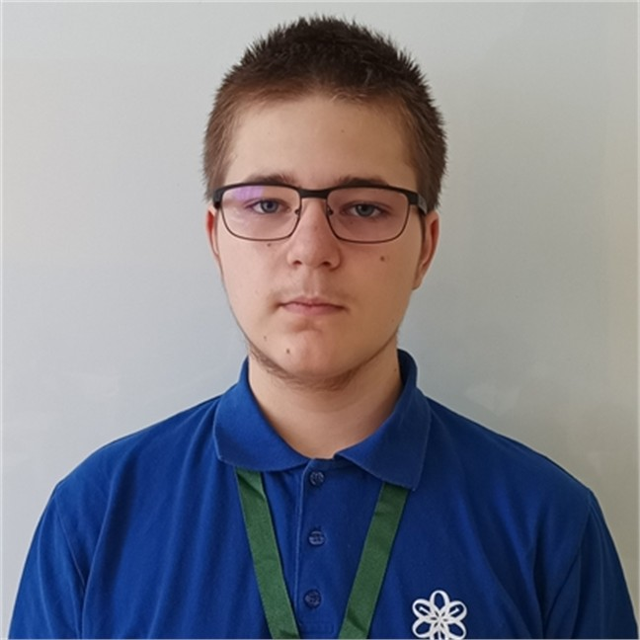
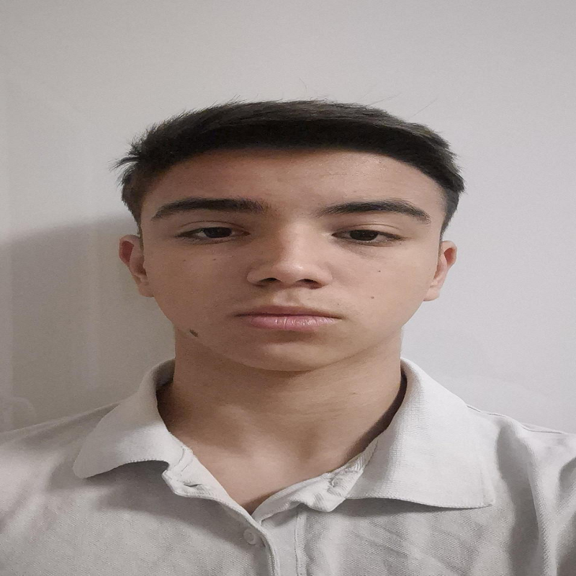

P
ParkMaster
Our Team
P
P
Martin Belchev
Alexander Georgiev
Veselin Boyanov

Slide 3


Our Idea
Our Team
P
P
P

Slide 4
Let’s go to the app!
Potential customers
Our Idea
Our app is designated for drivers of all ages

Slide 5
Let’s go to the app!
More Info

