Slide 1
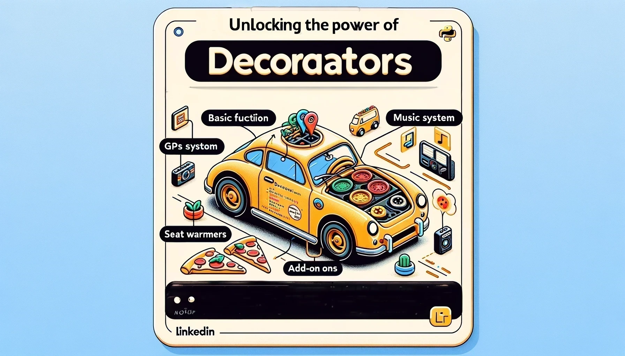

Slide 2
Unlocking the Power of Python Decorators
Introduction:
Python decorators are a powerful tool that allows you to modify the behavior of functions or methods.
They are often used to add functionality to existing code in a clean and readable way.

Slide 3
Understanding Decorators
Basic Function:
Think of a basic car (function) that performs a simple task like driving.
Example in Python:
def basic_function():
print("Driving a car")
Add-ons:
Just like a car can have add-ons such as a GPS system, music system, or seat warmers, a function can have added functionalities.
Example add-on: logging the time a function was called.

Slide 4
How Decorators Work
Defining a Decorator:
A decorator is a function that wraps another function to extend its behavior.
Example in Python:
def my_decorator(func):
def wrapper():
print("Something is happening before the function is called.")
func()
print("Something is happening after the function is called.")
return wrapper

Slide 5
Using a Decorator:
Applying the decorator to the basic function.
Example in Python:
@my_decorator
def basic_function():
print("Driving a car")
basic_function()

Slide 6
Practical Use Cases of Decorators
Logging:
- Track when a function is called.
- Example:
def log_decorator(func):
def wrapper(*args, **kwargs):
print(f"Function {func.__name__} was called")
return func(*args, **kwargs)
return wrapper
Authorization:
- Check if a user has permission to execute a function.
- Example:
def require_auth(func):
def wrapper(user, *args, **kwargs):
if user.is_authenticated:
return func(user, *args, **kwargs)
else:
print("Unauthorized")
return wrapper

Slide 7
Conclusion
- Python decorators enhance the readability and maintainability of your code by allowing you to add functionality to existing functions in a clean and efficient manner.
- By using decorators, you can keep your code DRY (Don't Repeat Yourself) and modular.
Call to Action:
- Try implementing decorators in your next Python project to see their benefits firsthand!

