Slide 1

EmoTag - Towards an Emotion-Based
Analysis of Emojis
Abu Awal Md Shoeb, Shahab Raji, and Gerard de Melo
Rutgers University
September 03, 2019, Varna, Bulgaria
Notes:
We want to quantify how emoji correspond to particular emotions
The japanese wordemoji means \picture + charac-ter", and has no semantical connection to english emo-tion as you might have thought. However, emojis in-deed very often carry the emotional state of the writer. That is why, no surprises that as a part of the digital text emojis were exploited in various NLP researches related to sentiment analysis or emotion classification.

Slide 2
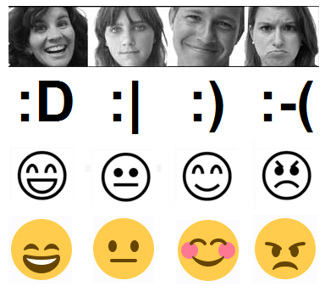

Emojis are Ubiquitous
A study found that half of social media text contains emojis (as of 2015)
The same parts of the brain are activated as when we look at a real human face
Oxford Dictionaries named “Face With Tears of Joy” its 2015 Word of the year
http://instagram-engineering.tumblr.com/post/117889701472/emojineering-part-1-machine-learning-for-emoji
Emoticons in mind: An event-related potential study by Churches O, Nicholls M, Thiessen M, Kohler M, Keage H (2014)
Notes:
social media data is typically rich in lexical variations, and hence, tend to contain a great deal of out-of-vocabulary words.
In the future, will all text contain emoji?
Then 10% of the Instagram text contained emoji in the first month.
emojitracker: realtime emoji use on twitter
When we look at a smiley face, the same parts of the brain are activated as when we look at a real human face.
Ref
https://instagram-engineering.com/emojineering-part-1-machine-learning-for-emoji-trendsmachine-learning-for-emoji-trends-7f5f9cb979ad
Img
http://minuum.com/exploring-emoji-the-quest-for-the-perfect-emoticon/

Slide 3
Goal: Emoji-based Lexical Resources
Problem:
Standard word embeddings are not interpretable
Capture relationships among words only
No relationships between emotion and words
What is missing:
Interpretable Word Vectors based on emojis
No lexicon for emoji-emotions yet
Our Approach:
Use emoji to derive features/emotions for arbitrary words
Emoji
Emotion
Text
Notes:
Research has shown that standard word embeddings are not adequate to represent relationships between emotion and words
What is missing: No lexicon for emoji-emotions yet!

Slide 4
EmoTag

Slide 5
Data Acquisition & Lexicons
Approach: Web Crawling
Collected ~20M tweets over a period of 1 year
100 tweets per day for each of 620 most frequently used emoji
Every single tweet contains at least one emoji
Data Cleansing
No more than 5 tweets from an individual user
Each tweet contains
tweet-id, text, username, date, retweets, favorites, geo-location, emoji, hashtags
Notes:
Why new corpus?

Slide 6
Vector Induction
Word2Vec on Tweets corpus
word₁
word₂
...
word_{n}
emoji₁
emoji₂
emoji₃
...
emoji₆₂₀
Emoji Vectors
emoji₁
emoji₂
emoji₃
...
emoji₆₂₀
word₁
Cosine_Similarity( word₂ , emoji₃ ) = 0.44
word₂
0.44
word₃
...
word_{n}
Notes:
3 steps.
Train w2v
Compute cos_sim
Create vectors

Slide 7
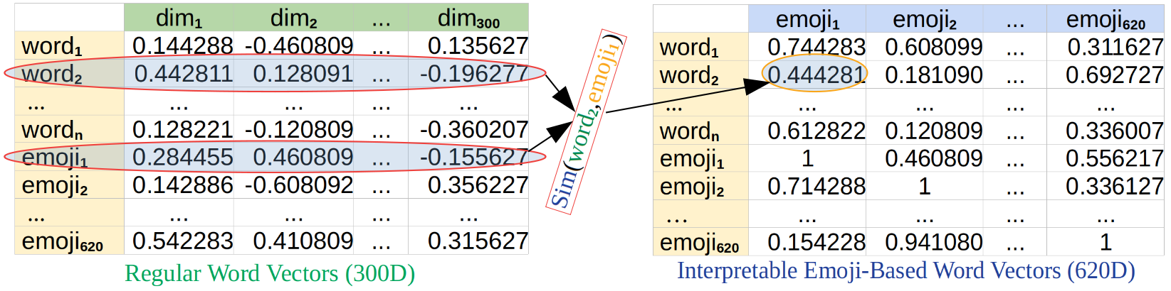
Emoji Vector Induction
Notes:
Why new corpus?

Slide 8
Evaluation of New Vectors

Slide 9
EmoInt – WASSA Shared Task
Task: given a tweet and an emotion X, determine the intensity or degree of emotion X felt by the speaker
Predicts the intensity of emotions in Tweets
Intensities are real valued scores in [0,1]
Emotions: classified as anger, fear, joy, sadness
Approach: Supervised Learning Method
Random Forest regressor with 800 trees
Combines many features including the output of a CNN-LSTM network that uses our Emoji Vectors as the word embedding
Notes:
it is often useful for applications to know the degree to which an emotion is expressed in text
Workshop on Computational Approaches to Subjectivity and Sentiment Analysis (WASSA)

Slide 10
EmoInt Results Including Other Baselines
 | Methods | Anger | Fear | Joy | Sadness | Average | Dim
Interpretable | Affective Tweets | 0.65 | 0.66 | 0.60 | 0.69 | 0.65 | n/a
 | EmoTag | 0.70 | 0.73 | 0.69 | 0.75 | 0.72 | 620
Non-Interpretable | Random Int. | 0.68 | 0.72 | 0.66 | 0.73 | 0.70 | 300
 | word2vec | 0.70 | 0.72 | 0.67 | 0.75 | 0.71 | 300
 | GloVe | 0.70 | 0.73 | 0.68 | 0.76 | 0.72 | 300
 | GloVe Twitter | 0.72 | 0.74 | 0.68 | 0.76 | 0.73 | 200
Pearson Correlations between Gold Score and Predicted Emotion Score for Tweets
Notes:
it is often useful for applications to know the degree to which an emotion is expressed in text

Slide 11
Evaluating Sentiment & Emotion Scores

Slide 12
Sentiment Score Generation
Evaluating Sentiment of Emojis
Prediction
NRC EmoLex is used to capture sentiment words from EmoTag
Find top K words (based on EmoTag Similarity Scores) for a given emoji
Aggregated similarity scores (K=3) are the final sentiment score for that emoji
Evaluation
we use Sentiment of Emojis by Novak et al. as ground truth
Notes:
it is often useful for applications to know the degree to which an emotion is expressed in text
Workshop on Computational Approaches to Subjectivity and Sentiment Analysis (WASSA)

Slide 13
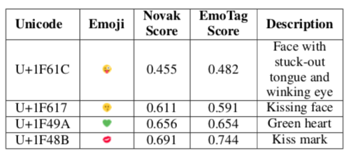
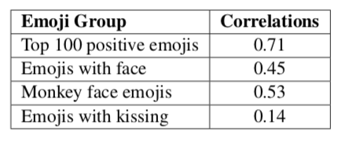
Sentiment Score Evaluation
Pearson Correlations of Our Sentiment Score and Novak’s Score
Comparison of Emoji Sentiment Score
Notes:
it is often useful for applications to know the degree to which an emotion is expressed in text
Workshop on Computational Approaches to Subjectivity and Sentiment Analysis (WASSA)

Slide 14
Emotion Score Generation
Evaluating Emotion of Emojis
Prediction
NRC EmoLex is used to capture emotion words from EmoTag
Rank top K words (based on EmoTag SImilarity Scores) for a given emoji
Weighted average scores (K=3) are the final emotion score for a given emoji
Evaluation 1
Affect Intensity Lexicon from NRC is used to reproduce their score using EmoTag
Rank top K emojis (based on EmoTag SImilarity Scores) for a given word
Arithmetic mean (K=10) is the final emotion scores for that word
Evaluation 2
Emoji2Emotion is used to predict Emotion Label for Emojis
Notes:
it is often useful for applications to know the degree to which an emotion is expressed in text
Workshop on Computational Approaches to Subjectivity and Sentiment Analysis (WASSA)

Slide 15
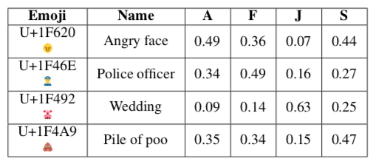

Emotion Score Evaluation 1
Snapshot of Proposed Emotion Score for Emojis
Pearson Correlations of Our Score &
Gold Score for Affect Intensity Lexicon
Notes:
it is often useful for applications to know the degree to which an emotion is expressed in text
Workshop on Computational Approaches to Subjectivity and Sentiment Analysis (WASSA)

Slide 16
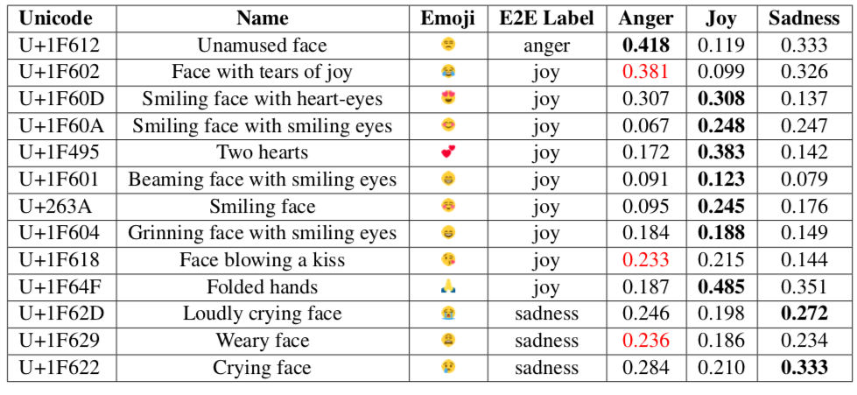
Emotion Score Evaluation 2
A comparison between Emoji2EMotion (E2E) and EmoTag
Notes:
it is often useful for applications to know the degree to which an emotion is expressed in text
Workshop on Computational Approaches to Subjectivity and Sentiment Analysis (WASSA)

Slide 17

Conclusion: EmoTag
Thank You!
It’s a huge and meaningful collection of Emoji centric Tweets
It shows how emojis and words co-occur in social media, including their connection to emotions
It provides a unique way to create interpretable word embedding with the help of emoji
Contact - abu.shoeb@rutgers.edu
All resources can be found at http://emoji.nlproc.org
Notes:
it is often useful for applications to know the degree to which an emotion is expressed in text
Workshop on Computational Approaches to Subjectivity and Sentiment Analysis (WASSA)

Slide 18
Backup

Slide 19
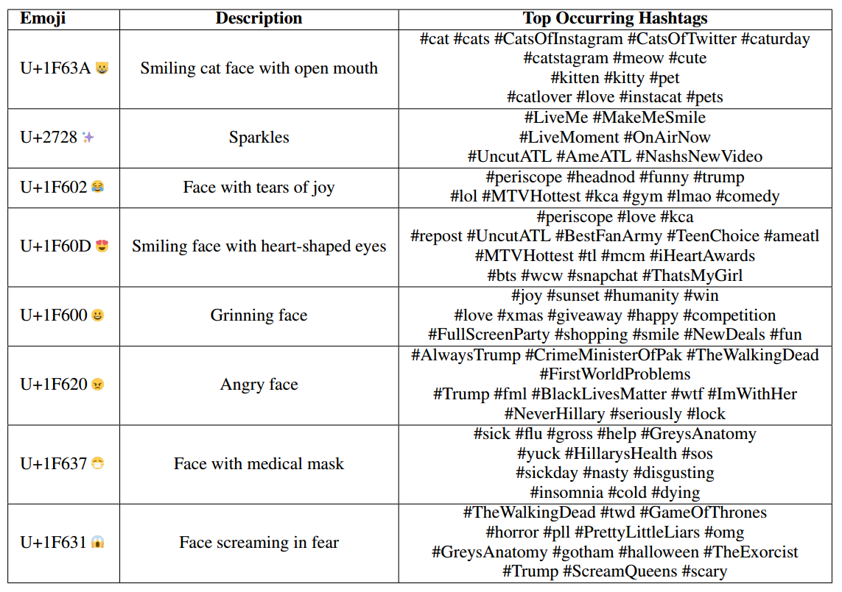
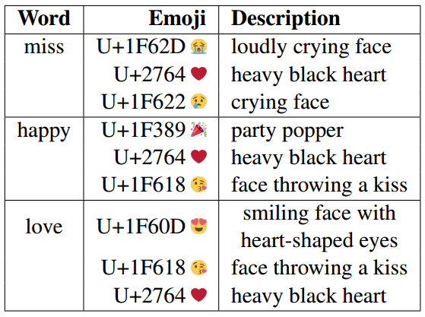
Co-Occurrences
Notes:
Why new corpus?

Slide 20


Formation of Lexicons - An Example
Tokens
same | 1 | 2
to | 1 | 2
you | 1 | 2
keep | 1 | 2
smiling | 1 | 2
happy | 1 | 2+2
hoidaze | 1 | 2
good | 0 | 2
morning | 0 | 2
thursday | 0 | 2
Notes:
Why new corpus?

Slide 21
Overview of Previously Released Dataset
Paper | Year | Lang. | Manual Annotation? | # of Emoji | Source/Size | Class/Output
Sentiment of Emojis | 2015 | 13 EUL | 83 Human Annotators | 751 | 1.6 M Tweets - only 4% has emoji | Sentiment Lexicon
Emoji2Vec | 2016 | English | No | 1661 | 6088 Emoji Descriptions | Pre-trained embeddings
EmoWordNet | 2018 | English | DepecheMood and crowd-sourced | X | 67K Terms from EWN | Emotion Lexicon
Emoji2Emotion | 2018 | English | 500 Human annotated tweets | 31+50 | 84777 tweets | Emoji Emotion Mapping Tech.
EmoLex | 2010 | English | 1012 | X | 200 n-grams and bi-grams in 4 categories | Emotion Lexicon
There are no such huge dataset consists of frequently used emoji and text
Notes:
Assisting in writing e-mails, documents, and other text to convey desired emotion (and avoiding misinterpretation).
Detecting how people use emotion-bearing-words to persuade and coerce others

