Slide 1
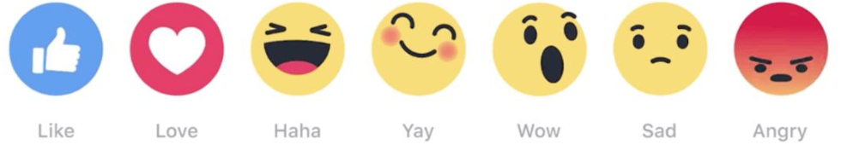




EmoTag1200 👍: Understanding the Association between Emojis 😄 and Emotions 😻
Abu Awal Md Shoeb and Gerard de Melo
EMNLP 2020
Notes:
Hi everyone. Welcome to our EMNLP presentation.
Our paper is about the connection between emojis and emotions, and I hope many of you can relate to this topic.
I’m Abu Shoeb from Rutgers University, New Brunswick, USA and my advisor is Gerard de Melo from HPI, University of Potsdam, Germany.
So let’s get started.

Slide 2


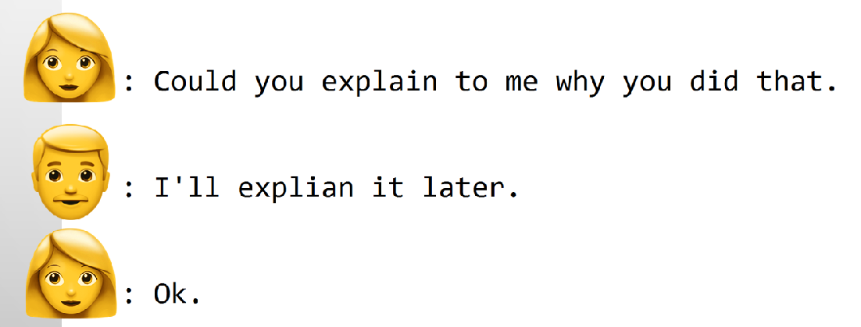
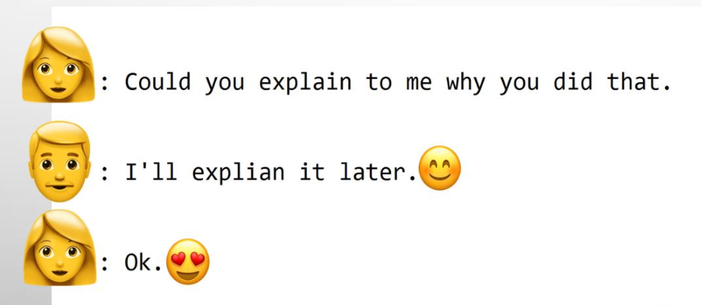
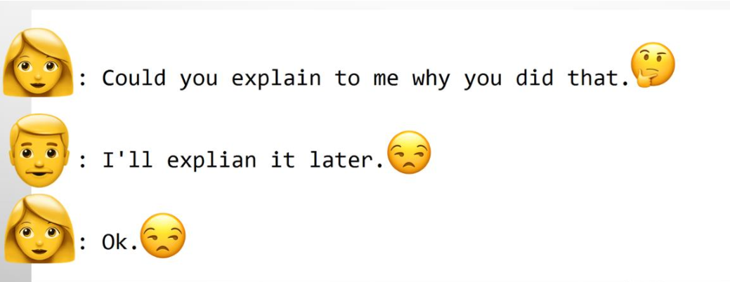
Plain Text vs ve Emojis vs ve Emojis
Source: Shatha Ali A Hakami, The Importance of Understanding Emoji : An Investigative Study, 2017
Notes:
In our work, we want to quantify how emoji correspond to particular emotions.
Let’s consider an example from personal messaging.
This image shows a conversation in plain text. It is somewhat neutral and we cannot really be sure of the associated emotions.
However, let’s look at the same conversation with emojis. As you can see, positive or negative emojis may change the tone of the conversation.
You can relate this to my presentation where I have facial expressions while delivering my talk. Emojis can play the same role here by conveying emotions in the conversation.

Slide 3
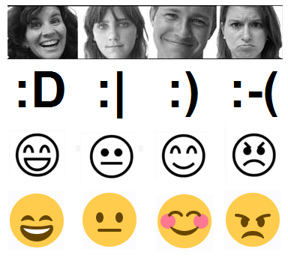
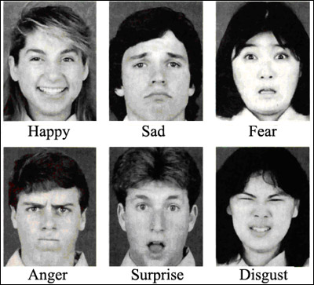
Emojis and Emotion
Emoji vs Facial Expression¹
Ekman's 6 Basic Emotions
1: Emoticons in mind: An event-related potential study by Churches et al. (2014)
Notes:
“Emoji” means picture character in Japanese and the word is not related to the word emotion. Still, there is a clear connection between emojis and emotions.
Studies show that when we look at a smiley face, the same parts of the brain are activated as when we look at a real human face. Facial expressions have also been the foundation of emotion theories such as Ekman’s 6 basic emotions.
Despite these connections, previous work has not studied in detail the connection between specific emojis and emotions. In our work, we try to fill this gap.

Slide 4
EmoTag 1200
1,200 emoji–emotion ratings
to better understand the association between emojis and emotions
👉 😊 😡 😳 🌹
0.25 0.92 1.00 0.5 0.72
Anticipation Joy Anger Fear Trust
Notes:
We created a new resource called EmoTag with 1,200 emoji-emotion pairs, annotated by humans who rated the strength of their association.
The name EmoTag indicates its usefulness in exploiting emojis for emotional tagging.

Slide 5
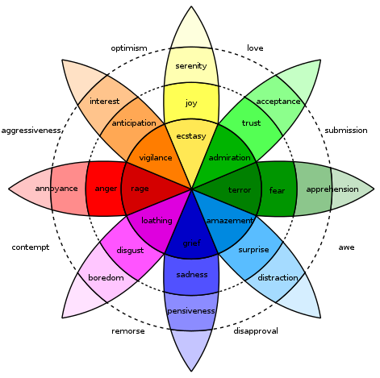
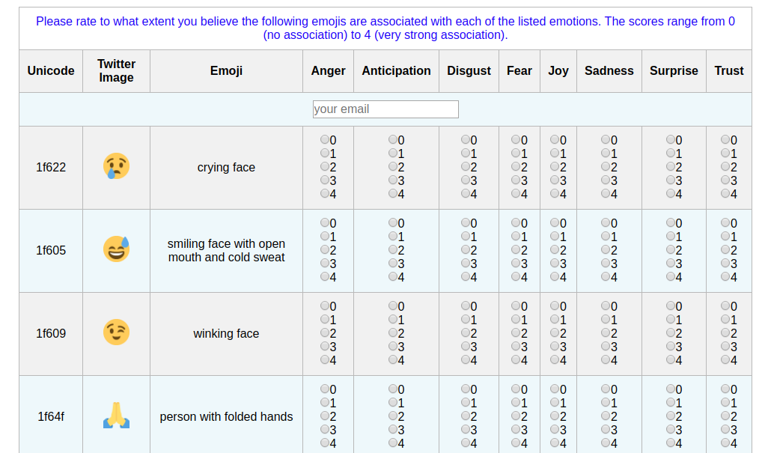
Annotation Task
8 Emotions
5 Association Levels (0-4)
Total 150 Popular Emojis
https://shoeb.info/emotag/experiment/
Plutchik's Wheel of Emotions
Notes:
The annotation experiment was designed to collect 8 emotion ratings for a set of 150 popular emojis. Their popularity was determined based on their frequency on the Twitter platform.
The 8 emotions are the basic ones in Plutchik’s Wheel of Emotions.
We can see here the Web interface that we designed for this annotation task. Raters were asked to describe the degree of association on a 5-point scale, which we later turned into scores between 0 and 1.

Slide 6
Annotation Process
Each final rating is an average of 9 human ratings
Consistent set of 9 human annotators
Native/near-native speakers of English, age 25–35
Extensive prior experience in using emojis for communication
Annotation Setup
Raters were asked to do one set of 25 emojis per day
The order of emojis was randomized for each rater
Notes:
Every association was rated by 9 annotators, and we used the average to determine the final rating for each emoji-emotion pair. We used a consistent set of human annotators and made sure that all of them are native or near-native speakers of English with extensive past experience of using emojis.
We also recommended them to rate no more than one set of 25 emojis per day to preserve the quality and stability of the ratings. Additionally, within each set, we randomized emojis so the order of emojis was not the same for different participants.

Slide 7
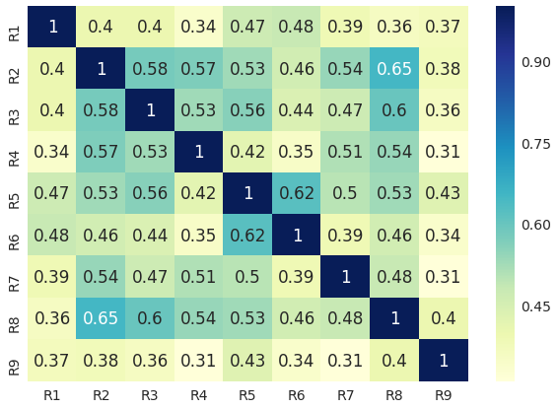
Overall Inter-Annotator Agreement
Notes:
After collecting all ratings, we first checked the inter-annotator agreement between pairs of human raters across the entire set of emoji-emotion ratings.
In this confusion matrix, R1 to R9 represents 9 raters. The table shows Pearson Correlation scores ranging from -1 to 1, where higher the number is higher the agreement between two raters.
For quality control, we checked whether there was any individual rater that disagreed substantially with all other raters. Fortunately, this was not the case and we decided not to eliminate data from any rater.

Slide 8
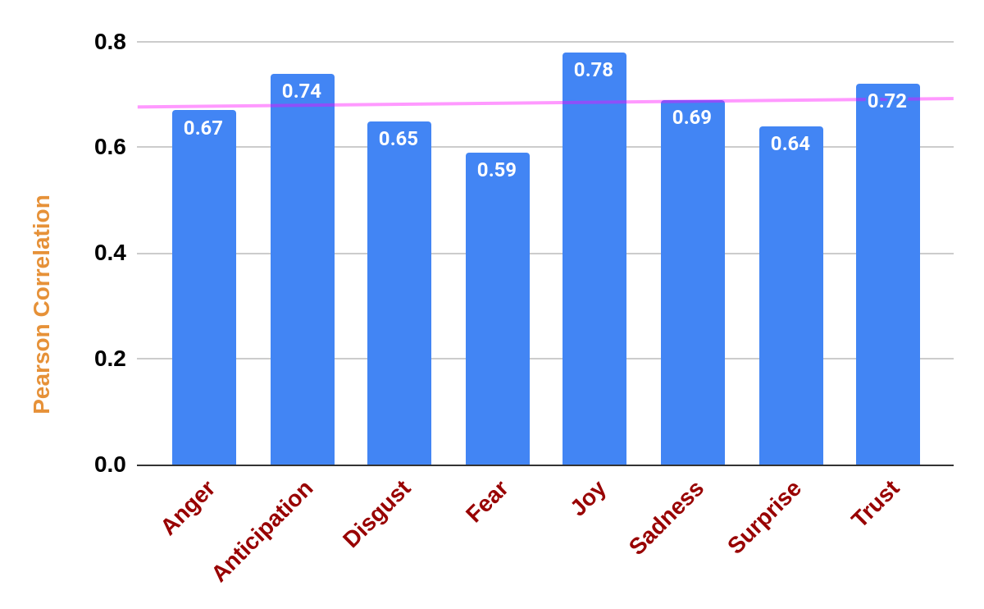
Correlation between Rater & Gold Scores
Notes:
In the previous slide, we looked into the overall agreement between raters. Now we are interested in investigating how the agreement works for different emotion classes.
We computed the average Pearson Correlation between individual raters and the mean scores separately for each emotion. We found that Joy, Anticipation, and Trust have a fairly high agreement, and Fear, Surprise, and Disgust have a slightly lower agreement.
The pink line represents the overall trend of agreement.

Slide 9
Prediction Experiments
Notes:
Now that we have baseline emotion scores for a set of emojis, we wanted to see if we can predict these scores by leveraging other existing resources.

Slide 10
Can You Predict Emotion?
To make it easy, a short list of emotions are given for a particular emoji.
👎 ( Disgust or Fear or Joy )
Disgust
🎂 ( Joy or Surprise or Trust )
Joy
🌹( Joy or Surprise or Trust )
Trust
Notes:
Before we jump into our experiments, I want you guys to participate in a small quiz!
Let’s say you are given some emojis, Thumbs Down, Birthday Cake, and Rose. Can you tell which of the emotions would have the highest association level for them?
I will pause for a moment, so that you can think about your answer.
Ok let’s do the first one. 3,2, 1 . . . so the first one is Disgust
3,2,1 … the second one is Joy
Let’s do the last one. 3,2,1 . . . and it’s Trust

Slide 11
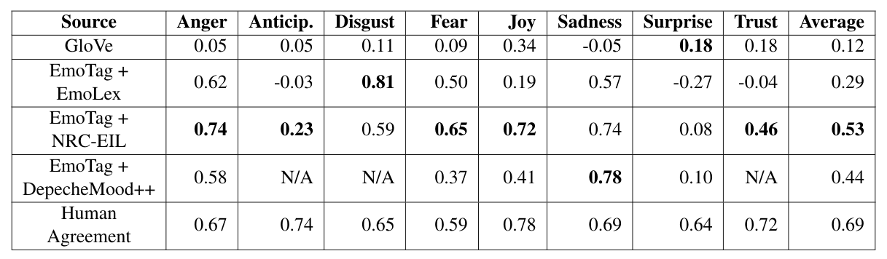
Comparison of Different Prediction Models
Pearson Correlation scores for all considered prediction methods. Bolded scores represent the highest correlation observed for the emotion in the respective column except for the human agreement score.
Notes:
So let’s look at our experimental results that we performed to compare automatic methods with the human-annotated scores. We considered different resources and compared them against the human ratings in terms of Pearson Correlation.
We first considered GloVe, which captures word similarity quite well but does not get very strong results for emoji-emotion associations.
Next, we evaluated different word emotion lexicons. In previous work, we created EmoTag interpretable word vectors that allow us to find related words for each emoji, using cosine similarities or co-occurrence frequencies. Then we look up the emotions for those related words. We find that this domain specific emoji embedding gives better emotion prediction than other vanilla embedding like Glove and Word2Vec.

Slide 12
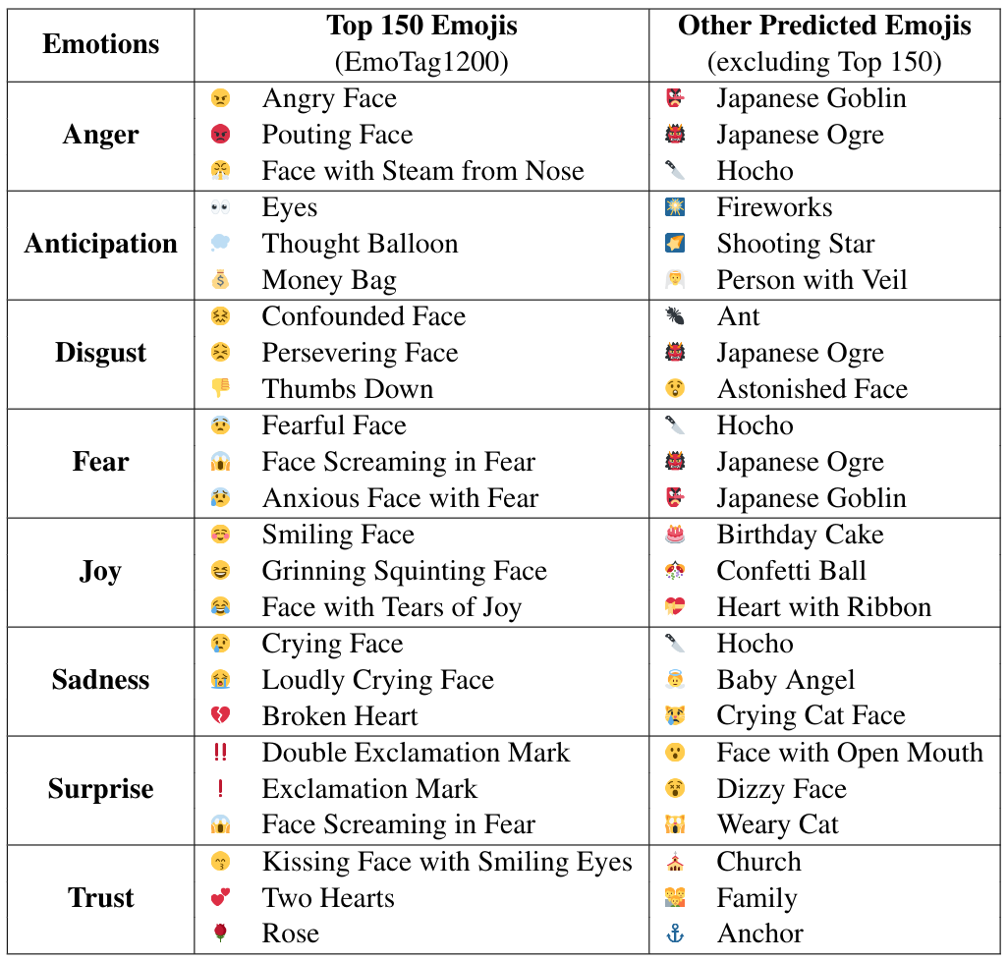
Top-Ranked Emotion Intensive Emojis
Notes:
So here is a glimpse of our top emotion intensive emojis. The second column is based on the annotation experiments and the last column shows our predicted emojis excluding the 150 emojis that were human-annotated.
Just so you guys know, we are going to release all resources including this result online and you should be able to access it soon.

Slide 13



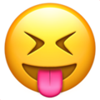
Conclusion: EmoTag1200
We created the first resource describing emoji–emotion pairs
We found that ratings can be predicted automatically based on emotion data
Potential Use Cases
Emotion & Sentiment Analysis
Consumer Behavior Analytics
Context Sensitive Emoji Recommendation
Opinion Mining & User Modeling
Notes:
In conclusion, we can say that this is the first resource for emoji-emotion pairs. Although we only used it for emoji emotion prediction, we believe it can be useful for Consumer Behavior Analytics, Emoji Recommendation, and User Modeling.

Slide 14


Thank You!
A Big Thanks to All Our Annotators
Contact - abu.shoeb@rutgers.edu
All resources can be found at http://emoji.nlproc.org
Available Downloads: EmoTag1200 || Emoji-Centric Tweets || EmoTag Vectors || Word–Emoji Co-Occurrences
Notes:
Thanks for your attention. We also sincerely thank our annotators who made this research possible.
Please also check out our website where we are making the EmoTag1200 dataset along with additional emoji resources available online. Feel free to contact us if you have additional questions or comments.
Thank you all for listening to our Virtual EMNLP talk. We look forward to receiving any questions or concerns you may have about this research. Thank you!

