Slide 1


(Project Review I)
Pune Vidyarthi Griha’s
College of Engineering & Shrikrushna S. Dhamankar Institute of Management, Nashik
Department of Artificial Intelligence & Data Science
TraceX
Intelligent Web Traffic Analysis and Threat Detection System
Presented by:
1. Atharva Bachhav
2. Vaishnavi Bhandare
3. Komal Godse
4. Upasana Wagh
Guided by: Prof. C. H. Patil

Slide 2

1. Introduction
The rapid growth of internet usage has increased the risk of phishing, malicious websites, and other web-based cyber threats.
Traditional security systems often depend on blacklists or previously detected threats, which may not identify newly created or evolving attacks.
TraceX – Intelligent Web Traffic Analysis and Threat Detection System is proposed as a cyber security browser extension.
It provides real-time website threat detection. The system analyzes URLs and website-related security features using a Random Forest Machine Learning model.
It integrates Google Safe Browsing, VirusTotal, and PhishTank for additional threat verification. The results are combined to generate a risk score.
Websites are classified as Safe, Suspicious, or Dangerous.
TraceX provides instant security alerts. It helps users make safer decisions while browsing the web.

Slide 3
2. Motivation
1
Increasing number of phishing and malicious websites.
2
Users may unknowingly visit fake websites designed to steal sensitive information.
3
Need for real-time website analysis while browsing.
4
Combining Machine Learning with multiple security services can provide additional threat information.
5
Traditional blacklist-based methods may not detect newly created threats.

Slide 4
3. Literature Survey
Sr. No | Year | Title & Authors | Objective | Algorithm | Result | Future Work
1 | 2026 | SafeNet: AI-Powered Browser Extension — Harika Vaka et al. | Detect phishing websites in real time. | Random Forest | 95.3% accuracy, 96.2% recall | Add Deep Learning & cross-platform support
2 | 2025 | AI and Cybersecurity — Adavelli et al. | Use AI to detect cyber threats. | AI / ML | AI helps detect and respond to threats. | Build real-time adaptive systems
3 | 2025 | AI in Network and Mobile Security — Singh & Kaunert | Improve security using AI. | AI / ML | AI helps automate threat detection. | Apply AI to browser security
4 | 2024 | Phishing URL Detection using ML & XAI — Pavani et al. | Detect phishing and explain predictions. | AI / ML | Better detection with explanations. | Add XAI to browser extensions

Slide 5
4. Objectives
01
02
Develop a real-time cyber security browser extension
Detect phishing and potentially malicious websites.
03
04
Extract important URL and website security features.
Use Random Forest Machine Learning for threat detection.
05
06
Integrate Google Safe Browsing, VirusTotal, and PhishTank.
Calculate a combined risk score.
07
08
Classify websites as Safe / Suspicious / Dangerous.
Provide instant security alerts to users.

Slide 6
5. Problem Statement
Phishing websites are continuously created and modified to deceive users.
Existing blacklist-based systems mainly identify already reported threats.
Newly created or unknown phishing websites may remain undetected.
Single detection methods may produce limited threat information.
Users need a system that can analyze websites in real time and clearly communicate the risk.
Therefore, TraceX aims to provide intelligent, multi-layered, and real-time web threat detection.
The TraceX Solution
TraceX addresses this by automatically capturing website information, extracting security features, applying ML detection, verifying URLs through multiple threat-intelligence APIs, calculating risk, and providing an immediate warning.

Slide 7
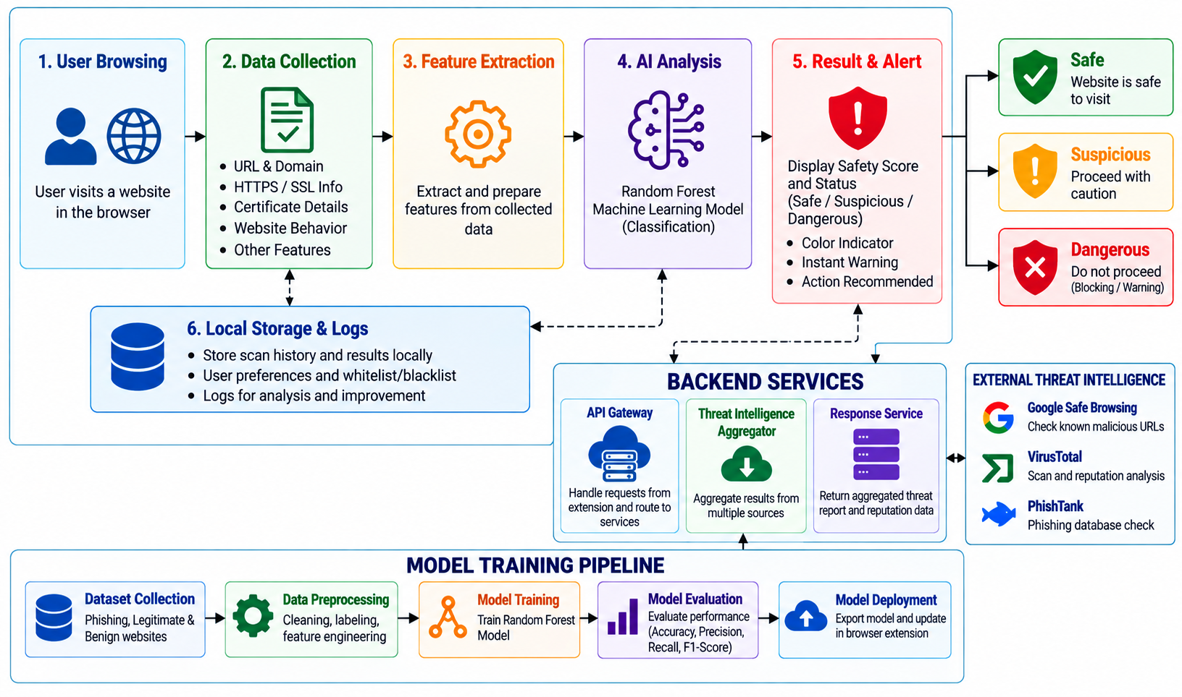
6. Proposed System

Slide 8
7. H/W & S/W Requirements
Software Requirement
Hardware
Browser: Google Chrome / Chromium
Extension: React, Tailwind CSS, JavaScript
Backend: Python, FastAPI
ML: Scikit-learn, Random Forest
Data: Pandas, NumPy
APIs: Google Safe Browsing, VirusTotal, PhishTank
Database: MongoDB
Development: VS Code , Git/GitHub
Laptop/Desktop
Dual-Core processor or higher
4 GB RAM minimum; 8 GB recommended
Internet connection

Slide 9
8. References
[1] Adavelli, S. R., Mittapelly, A. K., & Reddy Karri, N. (2025). AI and Cybersecurity: Advancements in Threat Detection and Prevention. Academic Guru Publishing House.
[2] Kiran, M. V. K., Rajendran, A., & Vasudevan, S. K. (2018). Phishing detection using RDF and random forests. International Arab Journal of Information Technology, 15(5), 817–824.
[3] Singh, B., & Kaunert, C. (2025). Fortifying the Digital World and Shielding Smart Infrastructures: AI-Enabled Malware and Threat. In Utilizing AI in Network and Mobile Security for Threat Detection and Prevention (pp. 1–22). IGI Global Scientific Publishing.
[4] Fazliani, S., Frangella, Z., & Udell, M. (2025). Enhancing Physics-Informed Neural Networks Through Feature Engineering. arXiv preprint arXiv:2502.07209
[5] Hu, Y., Zhang, Q., Zhu, H., Wang, B., Xiong, H., & Wang, H. (2025). Scalable intermediate-term earthquake forecasting with multimodal fusion neural networks. Scientific Reports, 15(1), 9748.

Slide 10
Thank you!

