Slide 1
CMCS
Contract Monthly Claim System
PROG6212 - Programming 2B
Portfolio of Evidence - Part 3
[Your Name] - [Student Number]

Slide 2
System Overview
What is CMCS?
A comprehensive web application for managing monthly claims submitted by independent contractor lecturers at educational institutions
4 User Roles
Complete Lifecycle
Secure & Automated
Lecturer, Coordinator, Manager, HR
Submit → Verify → Approve → Process
Sessions, encryption, auto-calc

Slide 3
Part 2 Feedback: Issue 1 - Role Separation
The Problem
Coordinator could both VERIFY and APPROVE claims - this violated separation of duties
The Solution
Created separate CoordinatorController and ManagerController
Coordinator: Submitted → Under Review
Manager: Under Review → Approved/Rejected
Clear separation of concerns

Slide 4
Part 2 Feedback: Issue 2 - File Encryption
The Problem
Uploaded documents were stored without encryption, creating a security vulnerability
The Solution
Implemented FileEncryptionService with AES-256 encryption
Files encrypted before saving to disk
Files automatically decrypted on retrieval
Secure key management in appsettings

Slide 5
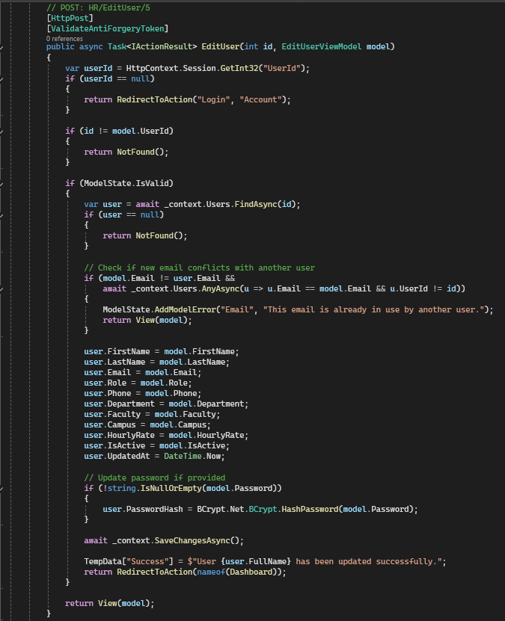
Code Example: HR Sets Hourly Rate
HRController - Edit User Method
What This Code Does
HR enters new hourly rate in Edit User form
Updates user.HourlyRate property
Saves changes to database with EF Core
Rate is now available for auto-calculation

Slide 6
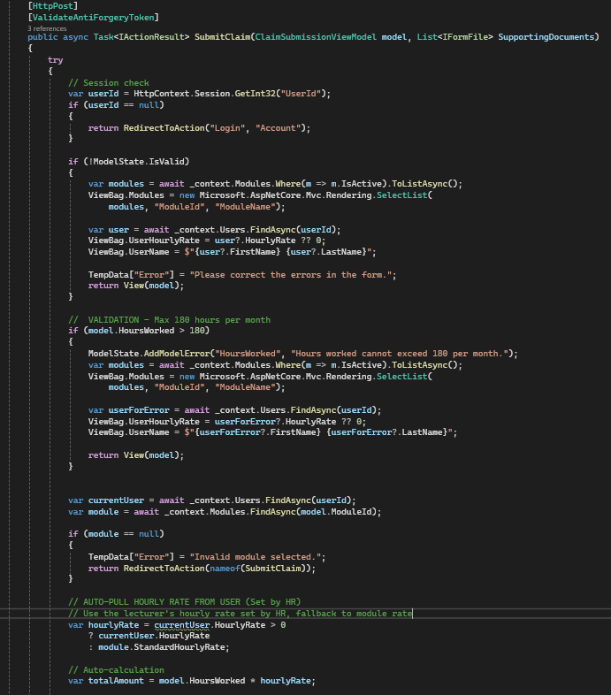
Code Example: Auto-Calculation
LecturerController - Submit Claim Method
Key Code Logic
Get current user's HourlyRate from session
TotalAmount = HoursWorked × HourlyRate
Lecturer only enters hours, system calculates
No manual calculation errors possible

Slide 7
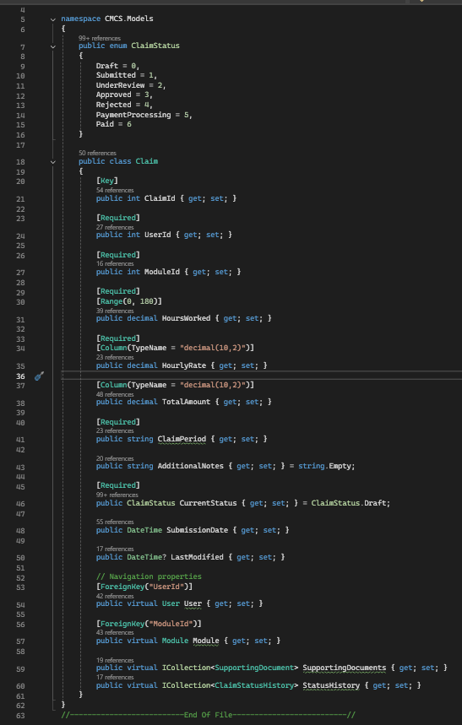
Code Example: 180-Hour Validation
Claim Model Validation
How Validation Works
Range attribute: HoursWorked must be 1-180
Server-side validation in controller
ModelState.IsValid checks before saving
Returns error message if validation fails

Slide 8
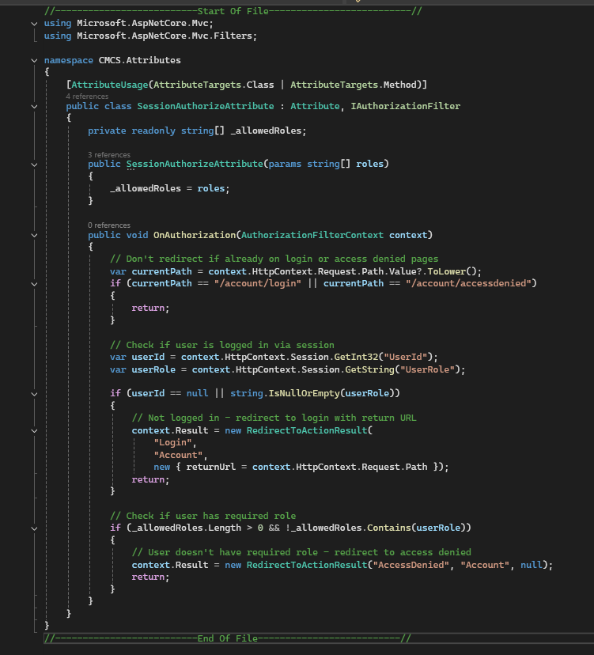
Code Example: Session Authorization
SessionAuthorizeAttribute Class
How It Protects Controllers
Checks if UserRole exists in session
Compares role with required role
Redirects to login if unauthorized
Applied to entire controllers with decorator

Slide 9
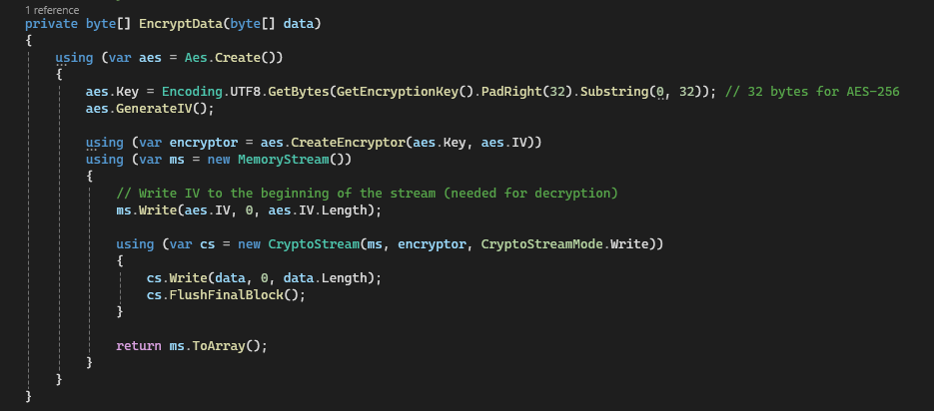
Code Example: File Encryption
FileEncryptionService Class
Encryption Process
Uses Aes.Create() for AES-256 algorithm
Generates encryption key and IV
CryptoStream encrypts file bytes
Returns encrypted byte array for storage

Slide 10
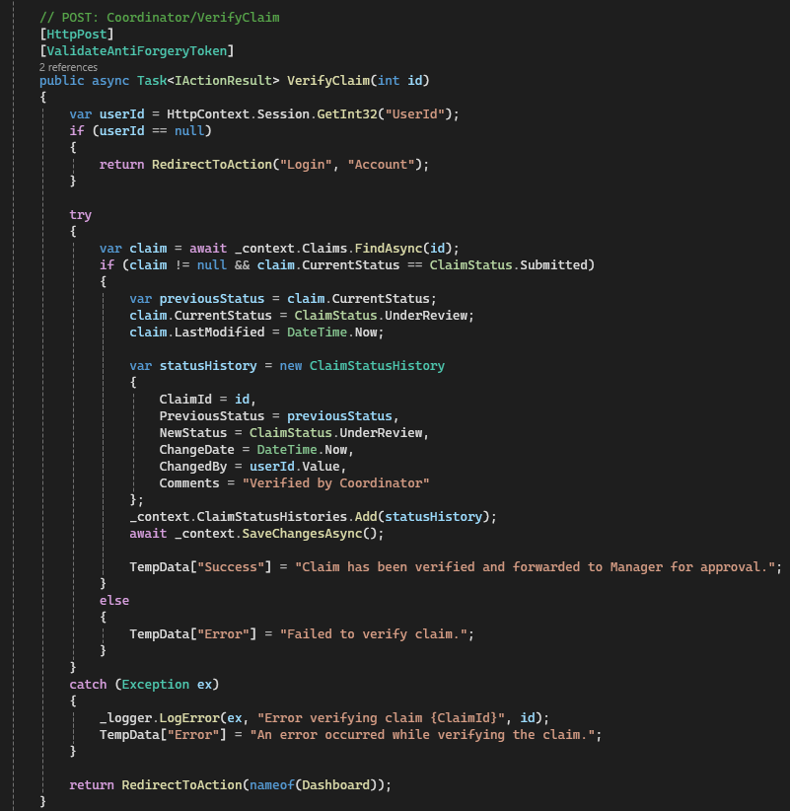
Code Example: Coordinator Verify Claim
CoordinatorController - Verify Method
Status Update Logic
Find claim by ID from database
Update Status to "UnderReview"
Create ClaimStatusHistory record
Save changes - claim moves to Manager

Slide 11
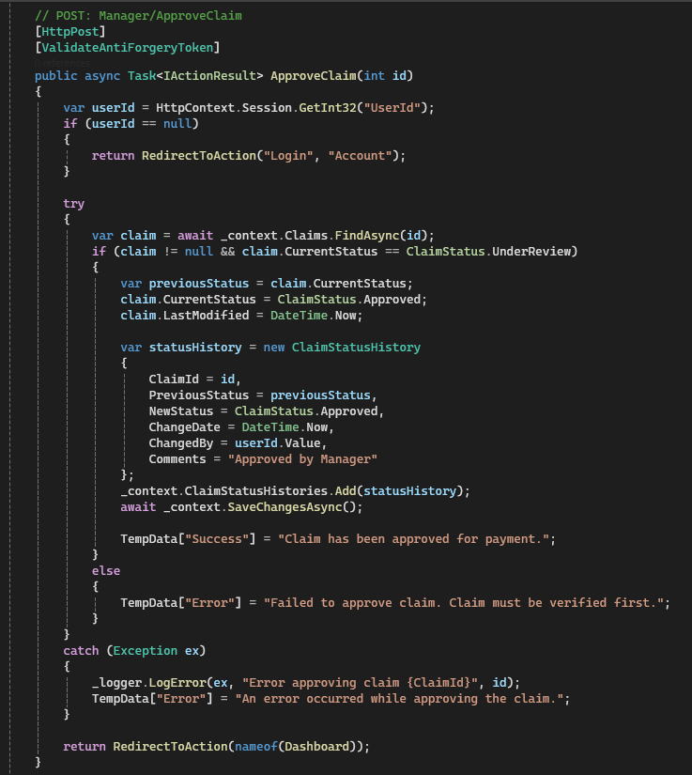
Code Example: Manager Approve Claim
ManagerController - Approve Method
Approval Logic
Check claim status is "UnderReview"
Update Status to "Approved"
Add audit trail entry
Claim ready for HR processing

Slide 12
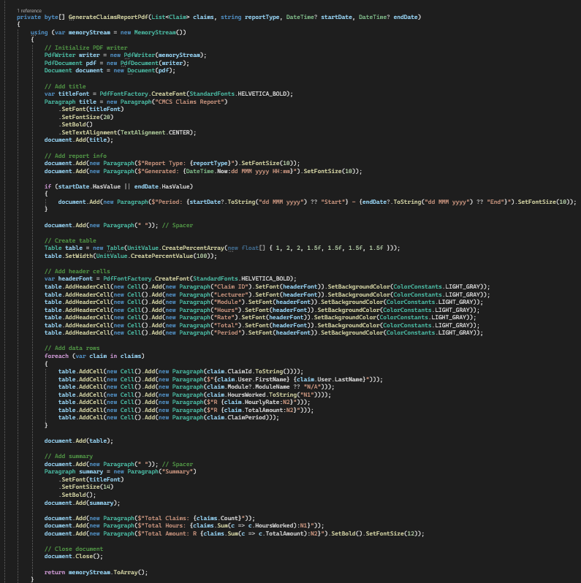
Code Example: HR Generate Report
ReportService - Generate PDF
Report Generation Steps
Query claims from database with LINQ
Create PdfWriter and PdfDocument
Add tables with claim data using iText7
Return PDF as byte array for download

Slide 13
Part 3: HR Management Features
User Management
Reporting
Add new users
Edit user information
Set hourly rates
Assign roles
Generate PDF reports
Generate invoices
Claims by period
Claims by status
No Registration Page
Only HR can add users to the system - requirement met

Slide 14
Part 3: Auto-Calculation Feature
How Auto-Calculation Works
1
HR sets hourly rate: R250.00 per hour
2
Lecturer enters hours: 80 hours worked
3
System calculates: 80 × R250 = R20,000
4
Validates: Must be ≤ 180 hours

Slide 15
Part 3: 180-Hour Validation
Validation Rules
Lecturers cannot claim more than 180 hours per month
✓ Valid
✓ Valid
✗ Invalid
80 hours
180 hours
200 hours
Claim accepted
Max allowed
Error shown
Client-side and server-side validation implemented

Slide 16
Security: Session-Based Authentication
Custom Authorization
SessionAuthorizeAttribute controls access to each controller
Each role has dedicated controller
Unauthorized access automatically redirected
Session stores: UserId, UserRole, HourlyRate
Lecturer
Coordinator
Manager
HR
LecturerController
CoordinatorController
ManagerController
HRController

Slide 17
Security: AES-256 File Encryption
FileEncryptionService
All uploaded documents are encrypted using AES-256 algorithm
Upload Process
Download Process
1. Lecturer uploads PDF
1. User requests file
2. File encrypted with AES-256
2. File decrypted automatically
3. Encrypted file saved to disk
3. Original PDF downloaded
Files protected at rest - even with disk access, files cannot be read

Slide 18
Complete Claim Workflow
Lecturer
→
Coordinator
→
Manager
→
HR
Submits
Verifies
Approves
Processes
Submitted
Under Review
Approved
Rejected
All changes tracked in ClaimStatusHistory for complete audit trail

Slide 19
Technology Stack
Backend
Features
ASP.NET Core 8.0 MVC
Entity Framework Core
SQL Server LocalDB
RESTful APIs
PDF generation (iText7)
File upload & encryption
Status tracking & history
Swagger API docs
Security
Database
Session authentication
BCrypt password hashing
AES-256 file encryption
Role-based authorization
Code-First approach
EF Core Migrations
Seeded test data
Audit trails

Slide 20
Bonus: RESTful API Integration
API Endpoints
Full Swagger documentation available for API automation
Claims API
Approvals API
HR API
POST /api/v1/claims/submit
POST /verify/{id}
POST /api/v1/hr/users
GET /api/v1/claims/{id}
POST /approve/{id}
GET /api/v1/hr/reports
GET /api/v1/claims/lecturer
POST /reject/{id}
GET /api/v1/hr/invoices

Slide 21
Thank You!
Complete Implementation
Part 2 feedback addressed ✓
Part 3 requirements met ✓
Project Highlights
Secure authentication & encryption
Auto-calculation & validation
Complete audit trails & APIs

