Slide 1
PROG6212 Summative Assignment
Fay-yaad Ahmed Parker
ST10434066
Group 1
BCAD2

Slide 2
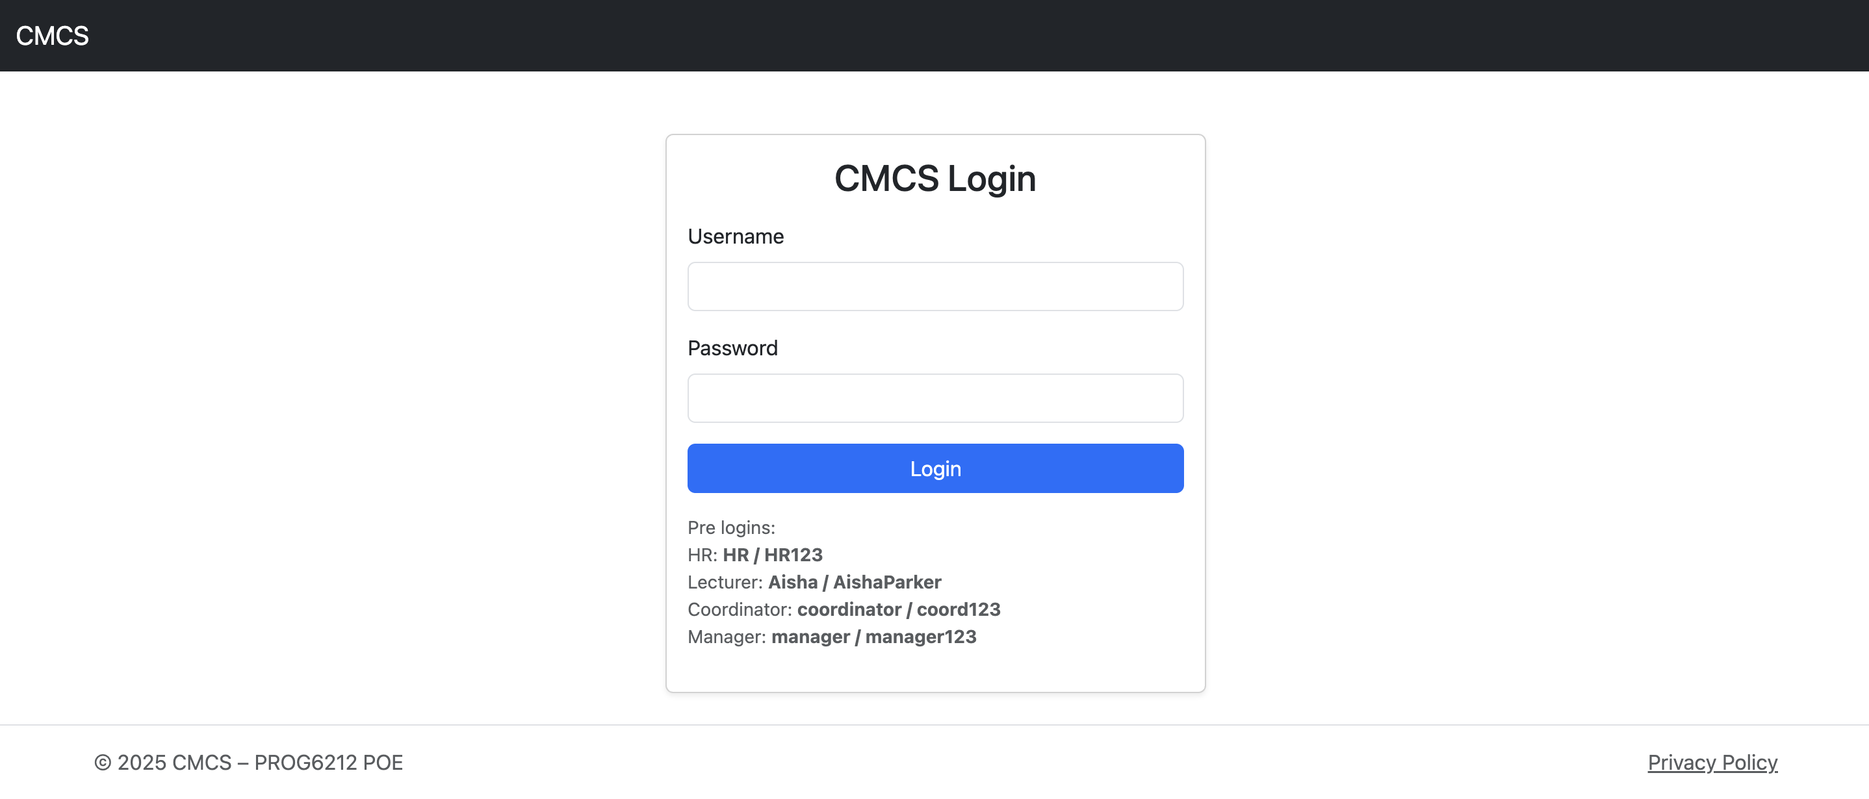
Contract Monthly Claim System
Tools used to develop this system
ASP.NET Core MVC
InMemory DB
Sessions
Micro APIs

Slide 3
Introduction
The contract Monthly Claim System streamlines and makes the process of lecturer claims much more efficient.
How it works:
Lecturers submit their monthly claims
Coordinators verify them
Managers approve them
HR finalizes the payment and generates a report.

Slide 4
Lecturer Feedback
Score 75%
Feedback – ‘Great effort. Well done’
Issues fixed for summative POE:
The UI looked rough, so I cleaned up the layout and navigation
Coordinator and Manager shared one screen, each have their own views now
Claims were approved too early. Added proper verification and flow.
Large files caused crashes, added file validation of sizes
Hourly rate was editable, now hourly rate is pulled from the DB, either by seeded lecturers or added by HR.
Commit messages were vague. I have now made better and more meaningful commit messages.

Slide 5
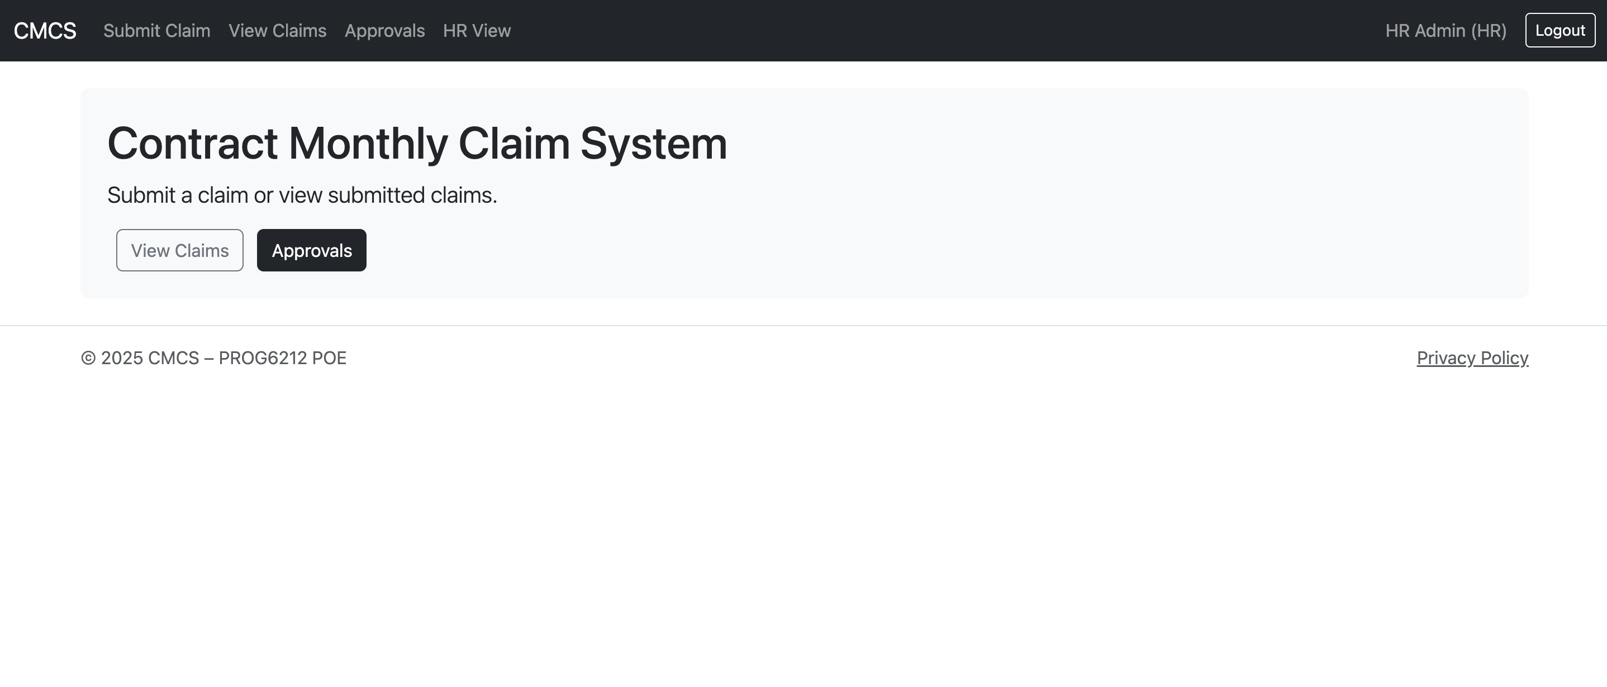
Technology Stack
ASP.NET Core MVC for structure
Entity Framework InMemory for in memory storage
Sessions for login and role management
Micro APIs for automation
LINQ to generate HR reports
Bootstrap 5 for styling
The stack keeps the system simple, easy to maintain and easy for demonstration purposes.

Slide 6
Login
Users log in with a username and password.
Sessions store the users role and id on successful login
This separates users and their roles, keeping everything clean and preventing unauthorised data access.
Passwords are hashed before being stored

Slide 7
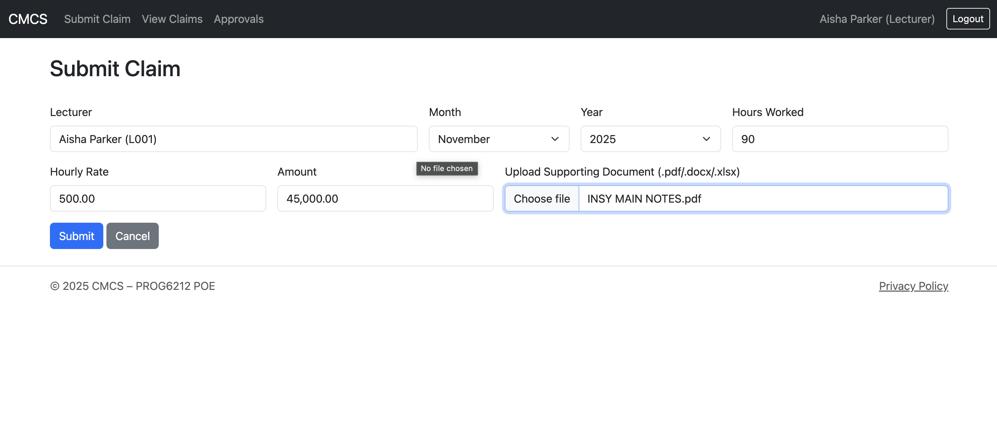
Lecturer Role
The role of a lecturer can :
Submit a claim
View all their past submissions
Upload supporting documents
View their claim status
The lecturer hourly rate is pulled from the database based off of seeding or HR implementation in the session.
The calculation is based off of hours X rate.
The lecturer role is the only role that can submit a claim
Lecturers cannot access HR screens or attend to claims and change their status.

Slide 8
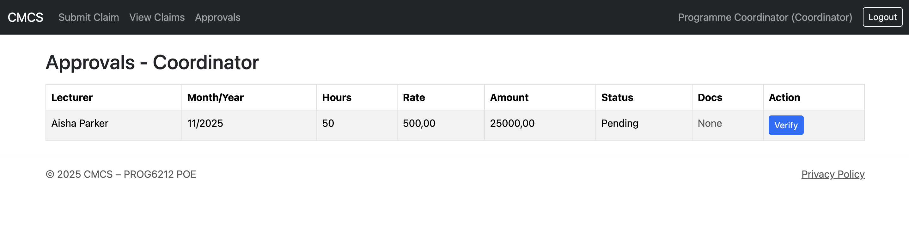
Coordinators Role
Coordinators can only see all pending claims
They can verify the claim but not approve it
This ensures the workflow stays correct before manager review.

Slide 9
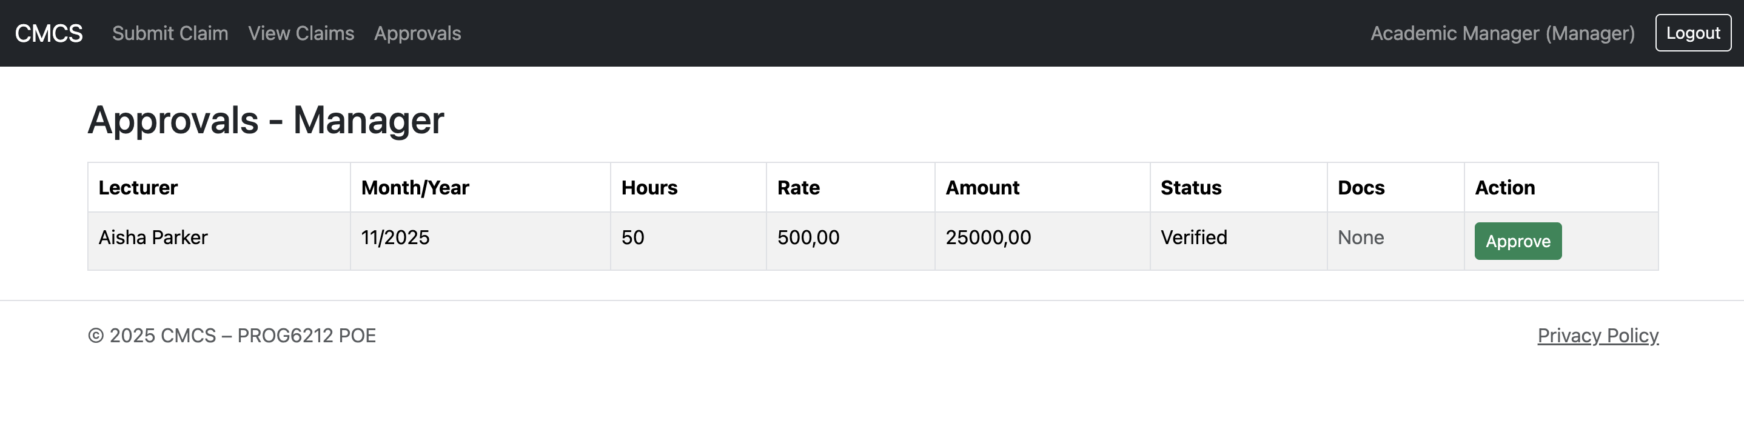
Manager Role
The manager role is able to only see verified claims. Once verified from the coordinator, the manager can then approve the claim.
Approved claims move to the HR for finalization and reporting.

Slide 10
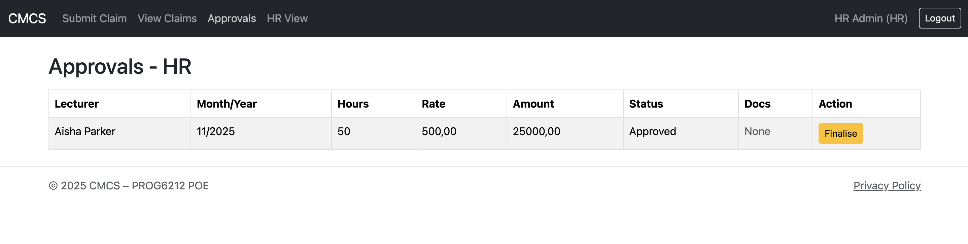
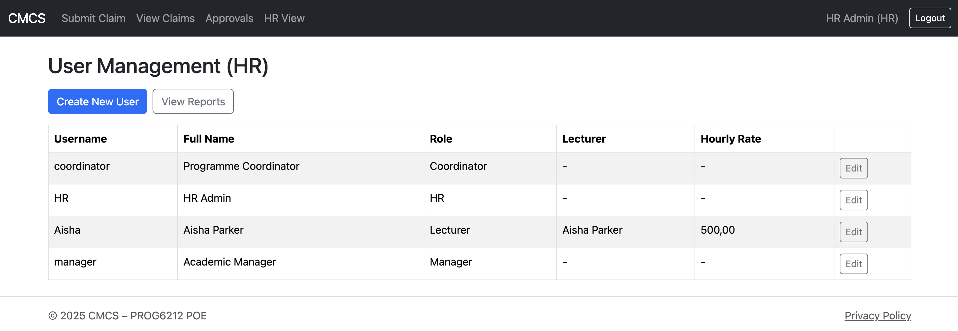
HR (The Super User)
This is the highest role level, the HR can:
Can create new users for any role
Edit passwords and hourly rate
They can generate monthly or yearly reports
HR essentially controls the entire operation of the system

Slide 11
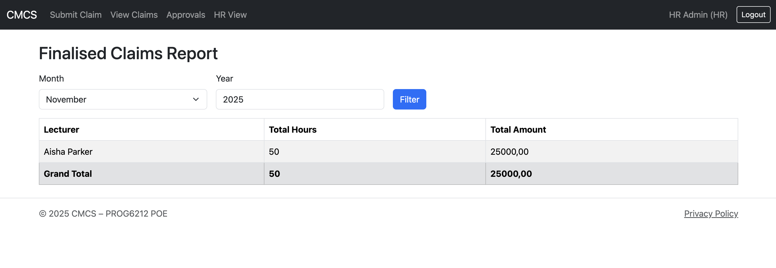
Reports
The only user role which can generate a linq report is the hr role.
The report can be broken down for any month or year.
The report shows the lecturer name, total hours, total claim amount .

Slide 12
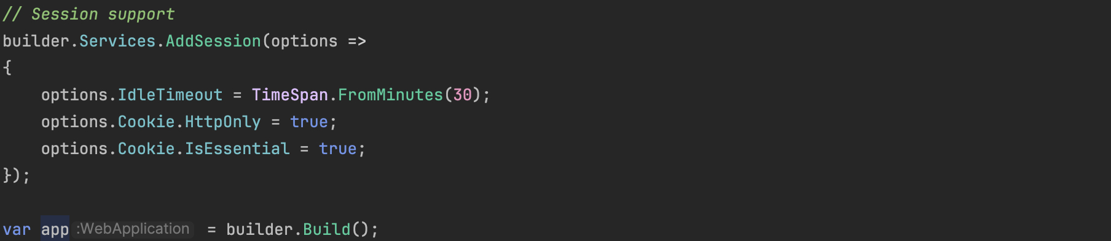
Sessions
What are sessions?
Sessions store bits of information after login. Such as the user id and fullname and especially the role.
This is important so the program knows who is logged in while we use the system.
Why sessions?
It is simple to use and extremely efficient to implement. Is it not heavy so build and run time do not time out.
It is an easy way to control access for every role. Works extremely well for this system.
How it helps.
The sessions ensures that all user roles are only allowed to access their relevant pages and able to do only allowed actions. Else they are redirected to a denied access page.

Slide 13
Conclusion
CMCS is now a fully working and operating claims system, ready for poe submission.
It follows the correct workflow and role based user actions, validates data properly and secures file upload.
The system is simple and provides all the functionality required for part 3 of the submission.
For more information on the actual code, refer to the github link and for a video demonstration, refer to the youtube link.
Github Link:
https://github.com/VCCT-PROG6212-2025-G1/ST10434066-CMCS-POE.git
Youtube Link:
https://youtu.be/vfKNtbmQx4I
Thank You!!!

