Slide 1
Part 3: Application Enhancement & Automation
Student Number: ST10440112
Module: PROG6212
November 2025

Slide 2
Agenda
1. Part 2 to Part 3 Changes Overview
2. Feedback Implementation Summary
3. Lecturer View - Claim Submission Automation
4. Coordinator & Manager View - Verification/Approval Workflow
5. HR View - User Management & Reporting
6. Session Management & Access Control
7. Document Encryption Security
8. Error Handling Improvements
9. Validation System
10. Live Demo / Key Screenshots
11. Conclusion

Slide 3
Part 2 to Part 3 - What Changed?
Part 2 Features (Existing)
- Basic claim submission
- Simple approval workflow
- Document uploads (no encryption)
- Limited error handling
Part 3 Enhancements (New)
- ASP.NET Core Identity authentication
- HR role with user management
- Automated hourly rate (HR-managed)
- Auto-calculation (Hours × Rate)
- Two-stage approval workflow (Coordinator → Manager)
- Invoice & report generation
- Session management & access control
- AES-256 document encryption
- Circuit breaker error handling
- Comprehensive validation

Slide 4
Feedback #1 - Two-Stage Approval Workflow

Slide 5
Feedback #1 - Two-Stage Approval Workflow
Problem
Needed better separation between verification and approval stages.
Solution Implemented
Pending → Coordinator Verifies → Verified
→ Manager Approves → Approved
Key Code (CoordinatorController.cs)
var pendingClaims = await _context.Claims
  .Where(c => c.ClaimStatus == "Pending")
  .Include(c => c.Lecturer)
  .ToListAsync();
Key Code (ManagerController.cs)
// Manager only sees Verified claims
var verifiedClaims = await _context.Claims
  .Where(c => c.ClaimStatus == "Verified")
  .Include(c => c.Lecturer)
  .ToListAsync();

Slide 6
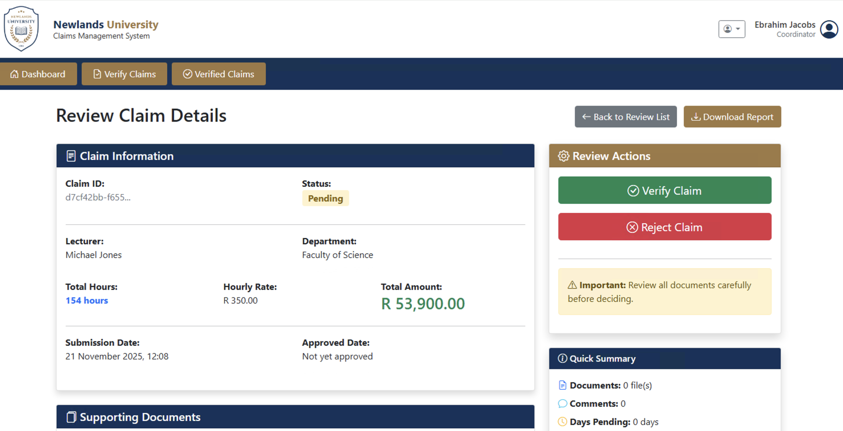
Feedback 1 Screenshot

Slide 7
Part 3 - Lecturer Claim Submission Automation
Problem
- Hourly rate was manually entered by lecturer (could be tampered)
Solution:
Auto-Fill Hourly Rate from HR Database
JavaScript Auto-Calculation (Create.cshtml)
$('#TotalHours').on('input', function() {
  var hours = parseFloat($(this).val()) || 0;
  var rate = parseFloat($('#HourlyRate').val()) || 0;
  var total = hours * rate;
  $('#calculatedAmount').text('R ' + total.toFixed(2));
});
Key Code (ClaimsController.cs)
var lecturer = await _context.Lecturers
.FirstOrDefaultAsync(l => l.Email == userEmail);
var model = new ClaimSubmissionViewModel
{
  HourlyRate = lecturer.HourlyRate, // Auto-filled, read-only
  TotalHours = 0
};

Slide 8
Feedback #2 - Lecturer Claim Submission Automation

