Slide 1
WEATHER APP
Where greatness begins

Slide 2
TABLE OF CONTENTS
01
02
03
04
Problem vs. Solution
Our Product
Challenges
Business Model
The problem is people need an app to view detailed information about the weather everyday.The solution is to create a Weather App
Our product isn’t anything revolutionary. It is simply s weather app that shows people the temperature and average temperature of the week
With the amount
of time given I would’ve liked to design my app further more
Work for the people

Slide 3
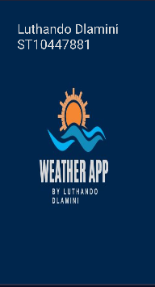
INTRODUCTION
Meet Us
I took inspiration from anime style when I was figuring out what I wanted my app to look like.
This project was all about design and creating a simple and easy to use weather app

Slide 4

OUR COMPANY
In this company we strive for excellency and greatness. As it says in our logo, we were born for greatness.
Dlamini LLC

Slide 5
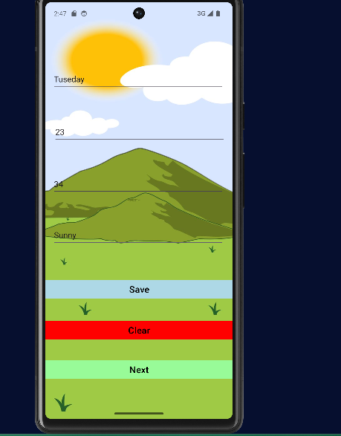
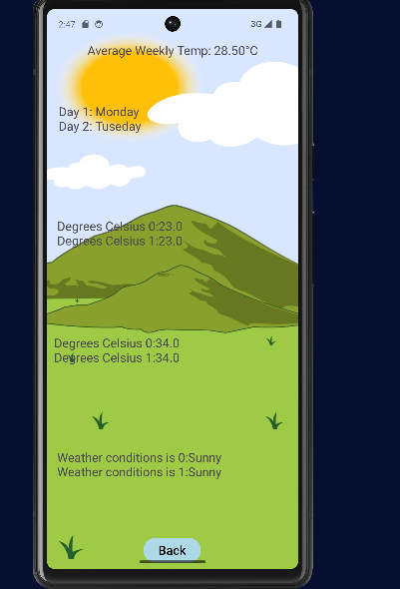
OUR TEAM
Screen 1/Splashscreen
Second Screen
Third screen
First screen
This is the second screen where the user can put indata
This screen is where the data gets displayed to the user

Slide 6
2nd screen VS 3rd Screen
Input data screen
Display screen
This is where the user inputs data so it’ll appear in the third screen
This is the third screen where the data will be shown

