Slide 1
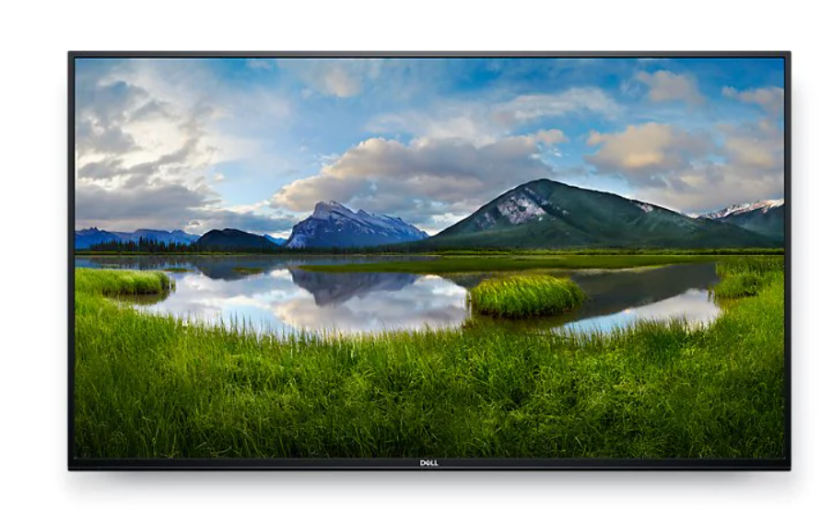
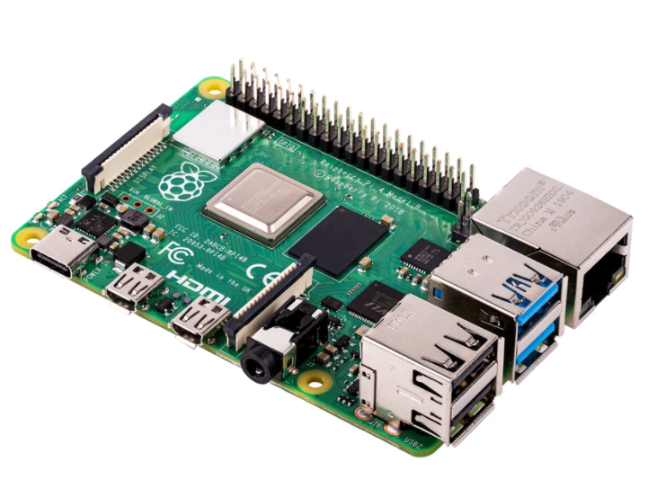

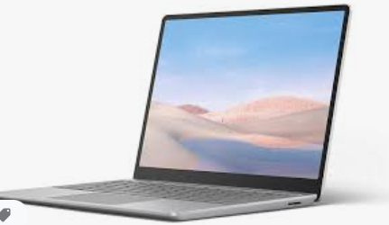
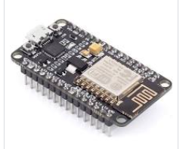
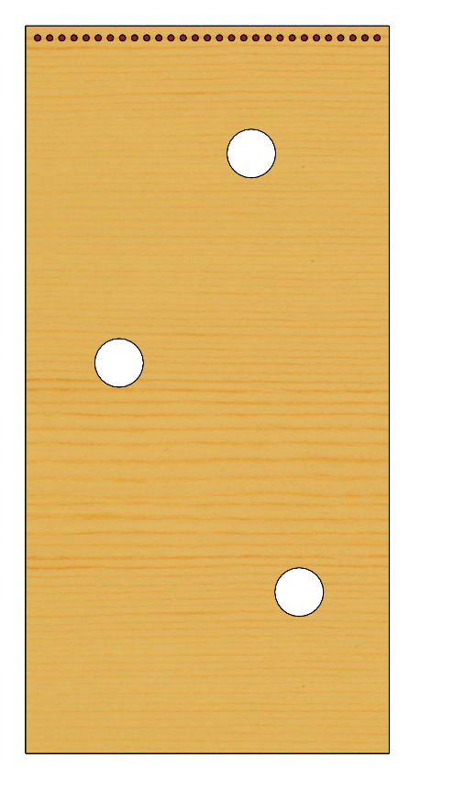
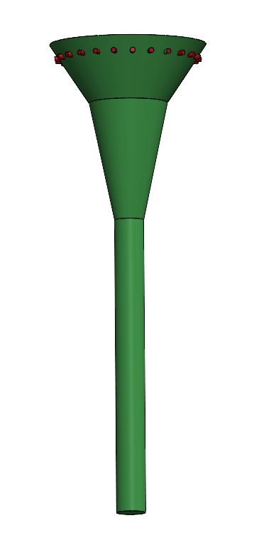
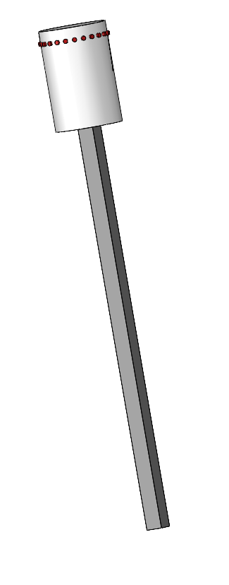
EPIC Robotz FMS System for the Fall 2021 Intramural Game
EPIC Robotz Internal Wired LAN
EPIC GAME SCORE
(Website)
T
Game Management (Website)
T
Main FMS Server
Provides Web site for game Admin,
And Score Board across wired LAN.
Also provides AP with ssid=epicfms
for communication with field elements.
Web Client for Audience Score Board
FMS Administrator
Field Elements:
Each Field Element has a ESP8266 wifi
Module for communication with the
Main FMS Server. The comm is across
a private LAN created by the server.
The server uses DHCP to assign IP
Addresses. The server then collects
Score counts from each ESP8266 in
real time, and sends commands
back to the ESP8266 to control the
NeoPixels on each game element.

