Slide 2
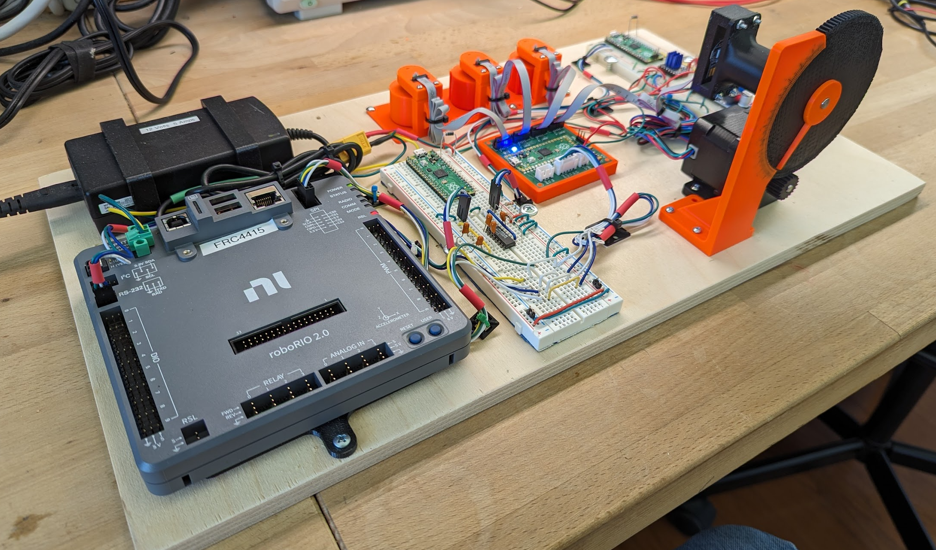
Mag4 Testing Board
3 Simulated Wheels, Hand Moved
Simulated Wheel
Moved with Stepper
Motor
12V Power
Supply
Stepper Motor
Circuit Board
Under Test
RoboRio
RS232 Interface
Circuit

