Slide 1
PWM Control Box
EPIC Robotz
Nov 2023

Slide 2
Purpose
Provide a way to manually control TALON based motors for prototyping.
Features
Super Simple to Use
Simply hook up CAN wires, turn it on, twist a knob.
Self Contained AA Batteries
that should last for over 50 hours of operation
Battery Monitor
Power LED blinks when batteries are weak
Direction LEDs confirm output

Slide 3
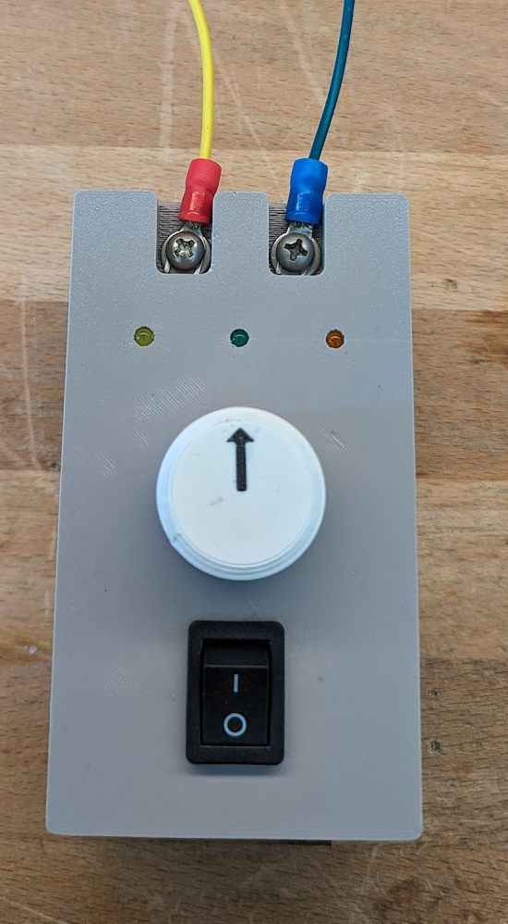
Usage Instructions
Pwm Output:
Connect Left to Yellow and
Right to Green
Power LED. Blinks when batteries are weak.
Reverse Direction LED. Blinks when slow, and
turns to solid on for high speed.
Forward Direction LED. Blinks when slow, and
turns to solid on for high speed.
Control Knob. Center is for motor neutral (“OFF”).
Turn left for reverse and right for forward.
There is a 10% deadband for neutral near the center.
Neutral is indicated by BOTH Direction LEDs being on.
On/Off switch. Turn off to save batteries.

Slide 4
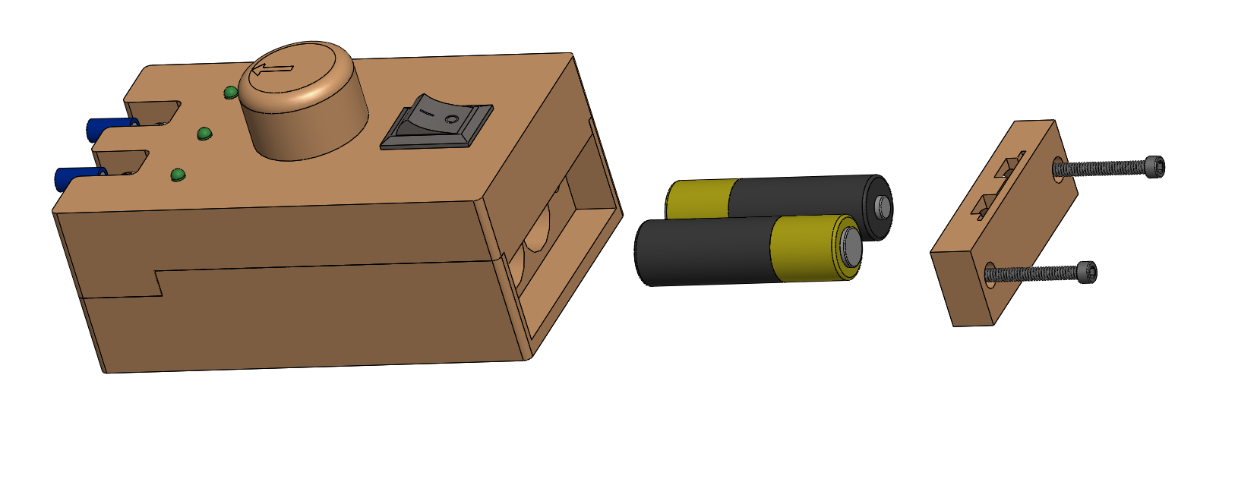
Replacing Batteries
Loosing the two #4 screws
to remove battery cover.
Remove old batteries and insert new
ones in the orientation shown.
Putting batteries in backwards WILL burn
out the microprocessor! Use the orientation shown.

Slide 5
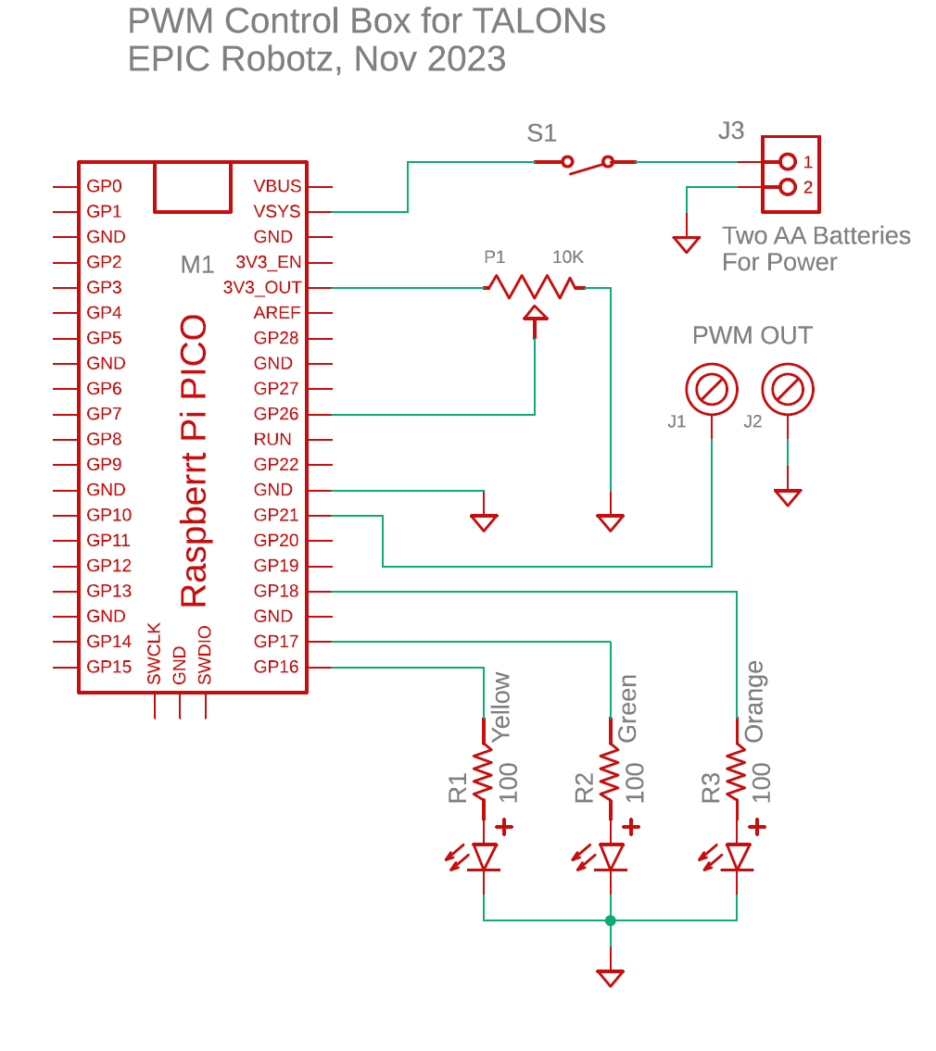
Schematic

Slide 6
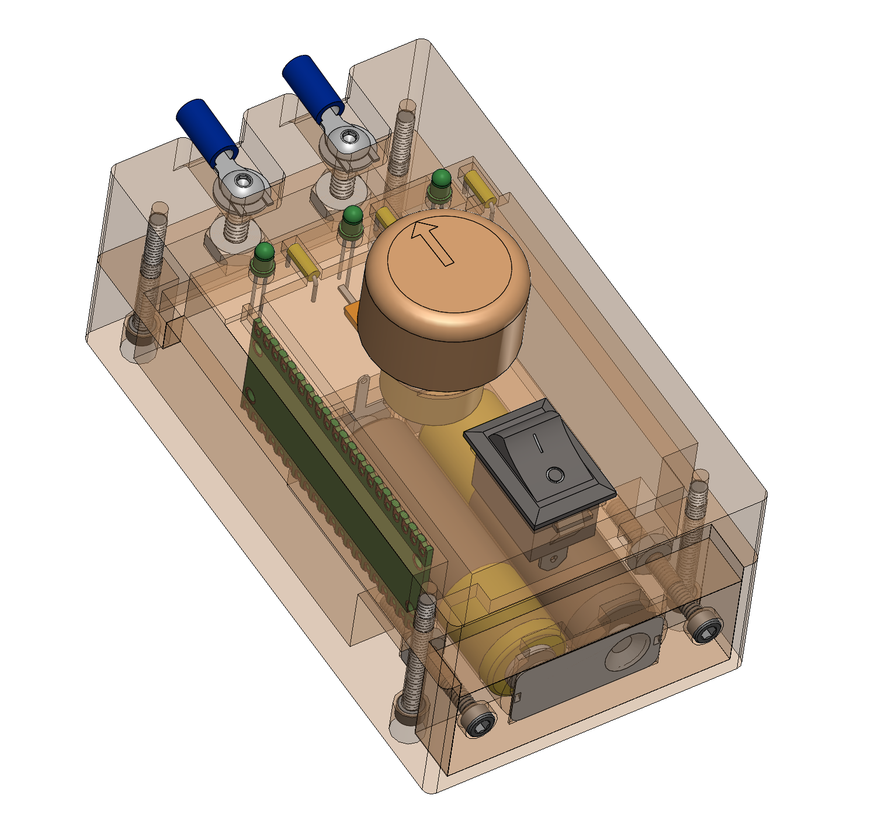
CAD Files
CAD files located in PDM Valut
Project: F23-CB

Slide 7
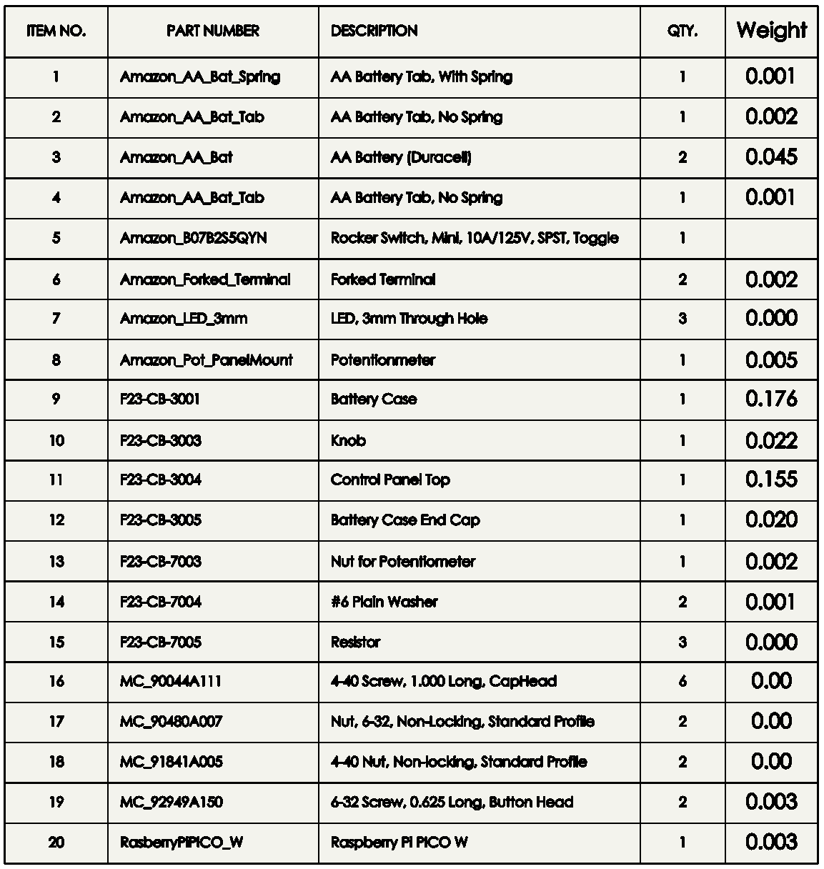
Bill of Materials

Slide 8
Software
Written in MicroPython
Source Code Located on Github: https://github.com/VCHSRobots/PwmControlBox
Firmware Image for Python on Raspberry Pi: RPI_PICO-20231005-v1.21.0.uf2

