Slide 1
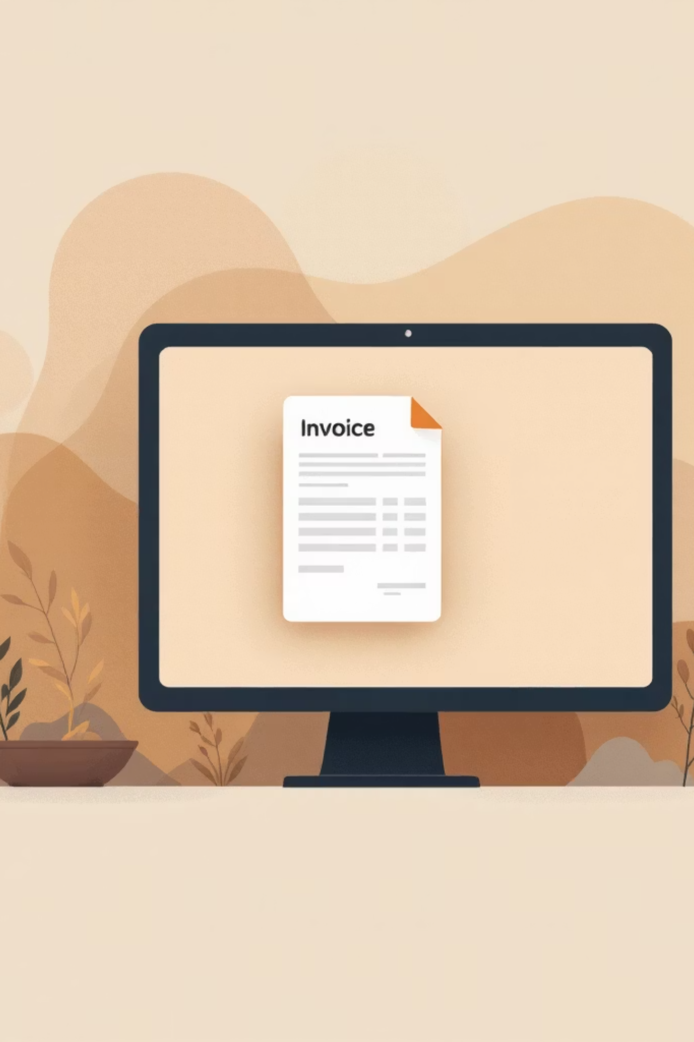

DCC Automation
AI
Intelligent Invoice Processing with Azure AI and SAP Integration
Suresh Prajapati - VCERP

Slide 2
Project Overview
DCC Automation streamlines invoice processing by combining Azure Document Intelligence for OCR extraction, Azure OpenAI for intelligent data interpretation, and OData API integration with SAP systems. The solution processes invoices through two distinct channels—manual upload via Fiori platform and automated email processing—ensuring flexibility and comprehensive coverage for enterprise invoice management.
Key Technologies
Azure Document Intelligence
Azure OpenAI
SAP OData API
Python 3.13.7
Flask API

Slide 3


Two Processing Pathways
Manual Upload
Users upload invoices directly through the Fiori platform interface. The Flask API processes each document sequentially using Azure Document Intelligence for OCR and OpenAI for data extraction.
Email Automation
Automatically reads emails from Azure Cloud, extracts invoice attachments, and processes them individually. Includes digital signature verification and QR code data extraction for enhanced accuracy.

Slide 4
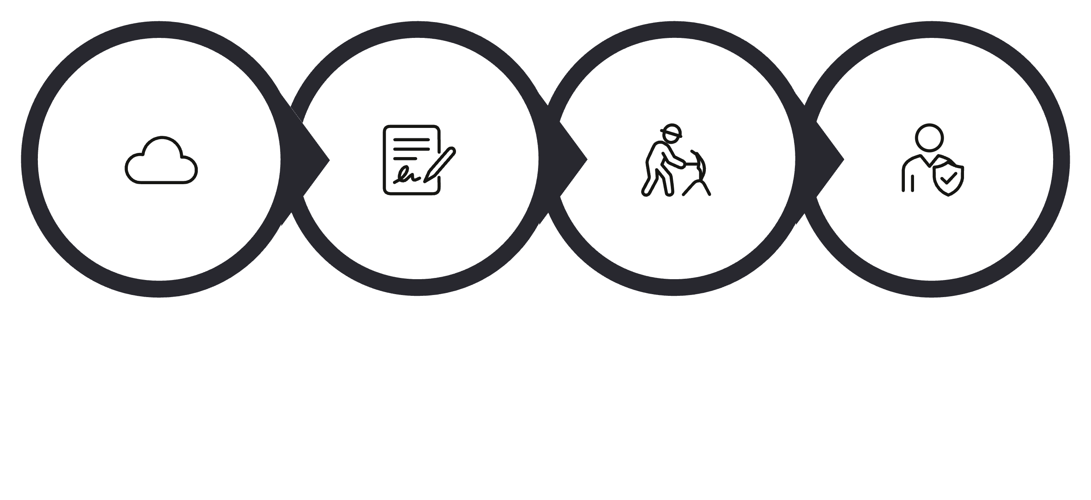




Processing Architecture
OpenAI Extract
Upload
Azure OCR
SAP OData
OCR & Extraction
Intelligent Processing
Azure Document Intelligence performs optical character recognition on invoice documents, extracting raw text and structured data elements including line items, totals, and vendor information.
Azure OpenAI interprets extracted data, identifying key fields and validating information. The AI models handle variations in invoice formats and languages while maintaining accuracy.

Slide 5



Configuration Management Platform
Dynamic Configuration
Scheduled Processing
Manage API keys, secret keys, and endpoint URLs through an intuitive interface. Changes apply immediately without server restart.
Define email processing intervals from 3 minutes to 1 hour. Flexible scheduling adapts to workload requirements.
Processing Logs
View complete processing history with success/failure status, timestamps, and error details for troubleshooting.

Slide 6
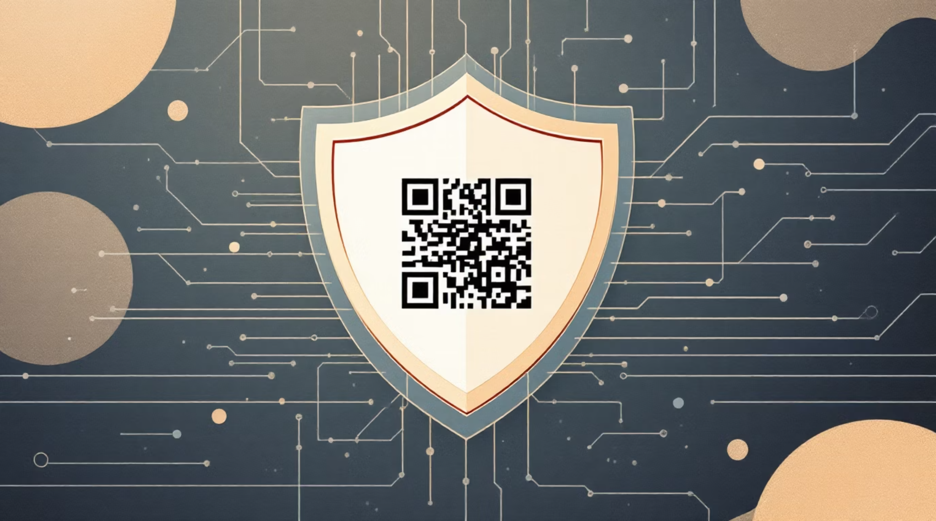

Security & Validation Features
Multi-Layer Verification
Digital signature validation ensures document authenticity
QR code data extraction provides trusted source information
Encrypted credential storage using login.ini and .env files
Server-side configuration management
Authentication: Platform uses static credentials from login.ini file for user authentication. API keys and service URLs are stored in .env configuration file.

Slide 7
Performance Parameters
30s
120s
100%
Minimum Processing Time
Maximum Processing Time
Single Processing
Smallest document size processing baseline
Connection timeout threshold for Azure services
Each email processed only once regardless of success/failure
Time Limits
Processing Notes
Processing time can be adjusted in the service file on the server side. Timeout errors occur if Azure services exceed 120 seconds.
Large invoice files take additional time to upload and process. Gunicorn server handles production workload efficiently.

Slide 8

Current Limitations
Single-Processing Constraint
Once an email is processed, the automation agent will not reprocess it—even if the initial attempt encountered errors. Manual intervention required for retry scenarios.
Timeout Configuration
Default 120-second timeout may not accommodate very large invoice files. Server configuration file adjustments required to increase processing window.
Static Credentials
Platform login credentials are statically stored in login.ini file. API keys and URLs defined in .env file require server access for updates.

Slide 9
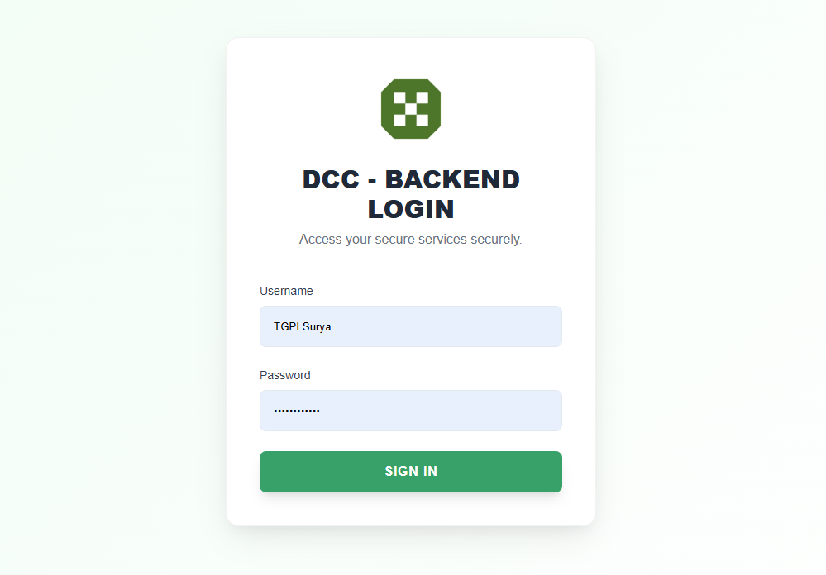
DCC Automation Login Screen

Slide 10
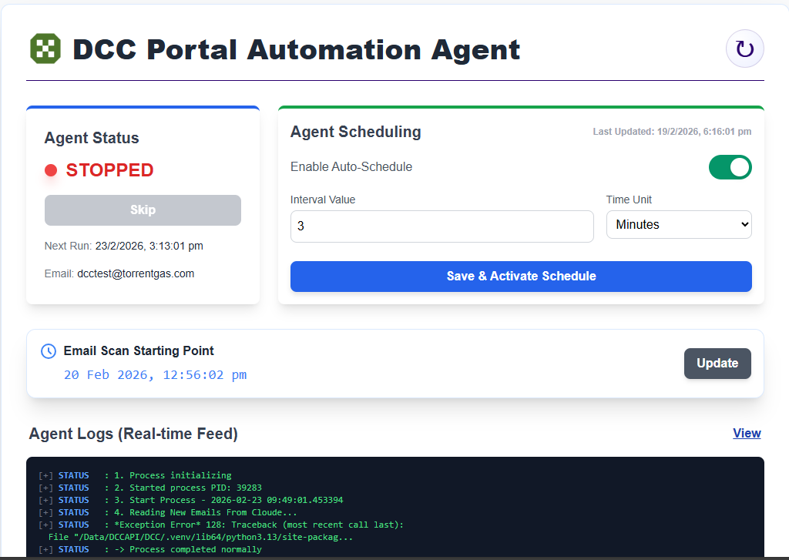
DCC Automation Control Screen

Slide 11
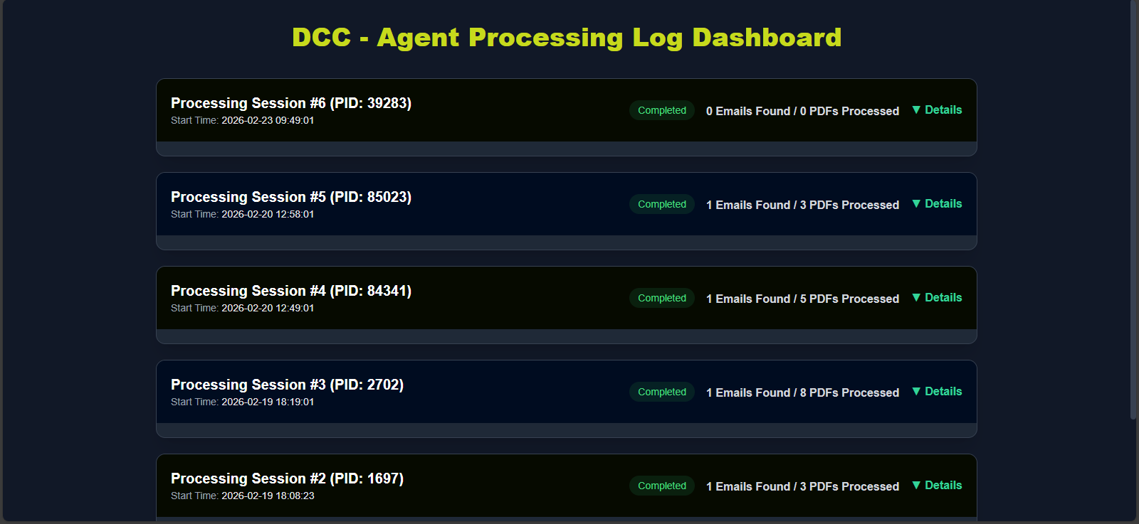
DCC Automation View Logs Screen

Slide 12
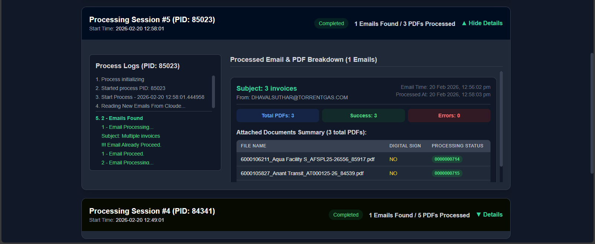
Processed Emails Logs

Slide 13
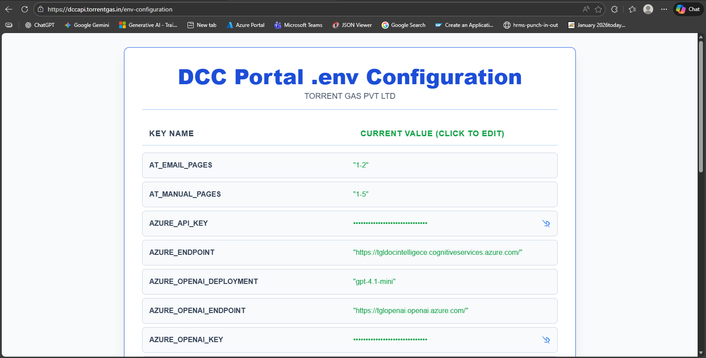
.env Configuration
URL: /env-configuration

Slide 14
Software Requirements:
Ensure the following packages are installed on the server:
Python 3.13.7
pip & virtualenv
Gunicorn
poppler-utils
libzbar0t64

Slide 15
Deployment Steps:
Step 1: Server Preparation
Install base dependencies:
sudo apt install python3.13 python3.13-venv python3-pip -y
apt-get download libzbar0
apt-get download poppler-utils
Step 2: Application Setup
Create the application directory:
sudo mkdir /dcc-portal
Step 3: Virtual Environment Setup
Navigate into the project directory /dcc-portal and run:
python3.13 -m venv .venv
source .venv/bin/activate
pip install -r requirements.txt

Slide 16
Deployment Steps:
Step 4: Environment Configuration
Create a .env file inside the project directory for sensitive configurations:
The .env file is included
Step 5: Gunicorn Configuration
Test Gunicorn:
gunicorn --workers 1 --timeout 120 --bind 127.0.0.1:7000 api:app

Slide 17
Deployment Steps:
Step 6: Systemd Service Configuration
Create the service file:
/etc/systemd/system/dcc-portal.service
Service File Content:
[Unit]
Description="DCC API Python"
After=network.target
[Service]
WorkingDirectory=/dcc-portal
Environment=PATH=$VIRTUAL_ENV/bin:$PATH
ExecStart=/dcc-portal/.venv/bin/gunicorn --workers 1 --timeout 120 --bind 127.0.0.1:7000 api:app
Restart=always
RestartSec=10
KillSignal=SIGINT
SyslogIdentifier=dcc-api-python
User=root
[Install]
WantedBy=multi-user.target
Enable & Start Service:
- sudo systemctl enable dcc-portal
- sudo systemctl start dcc-portal
- sudo systemctl status dcc-portal

Slide 18
.env File Content:
AZURE_API_KEY : here define the azure document intelligence api key
AZURE_ENDPOINT= define the azure resource end point
AZURE_OPENAI_ENDPOINT= define the azure open ai service end point
AZURE_OPENAI_KEY= define the secret key of azure open ai service
AZURE_OPENAI_DEPLOYMENT= here define the deployment name
CLIENT_SECRET= / CLIENT_ID = / TENANT_ID = >> define the all key for read the email from azure cloud
SCOPES = ["https://graph.microsoft.com/.default"]
SCOPES_URL = https://graph.microsoft.com/.default
AT_EMAIL_PAGES = here set the limit of page read from pdf like this “1-2” top 2 page read only from pdf but those pdf which process from email
AT_MANUAL_PAGES = here set the limit of page read from pdf like this “1-5” top 5 page read only from pdf but those pdf which uploaded manually from the portal
SAP_BASE_URL = here define the base url of Fiori app
SAP_CLIENT = define the client of sap application
SAP_USERNAME = / SAP_PASSWORD = define the sap application username and password
USER_ID = here define that email id from read the invoice like dcctest@torrentgas.com
IMAGE_EXTS=["jpeg","png","jpg"]
Z_TABLE_DATA_STORE_ENTETY_SET_NAME="ZFI_DCC_HEADERSet"
DMS_DOCUMENT_SAVE_ENTETY_SET_NAME="AttachmentSet"
GET_PAN_NUMBERS_ENTETY_SET_NAME="PanNo_DetailsSet"
GET_PO_NUMBERS_ENTETY_SET_NAME="PoCheckSet?$filter="

Slide 19
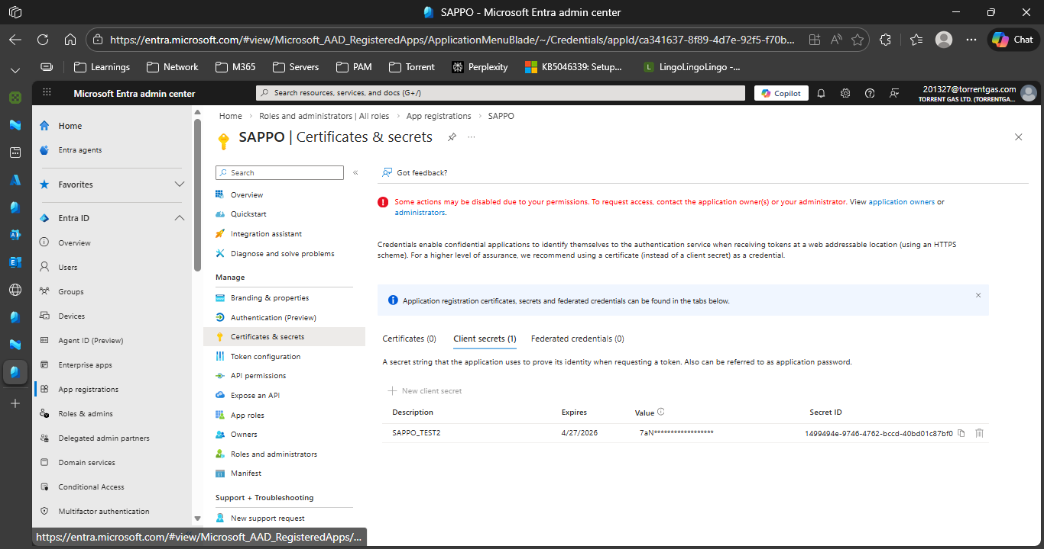
.env File Content:

Slide 20
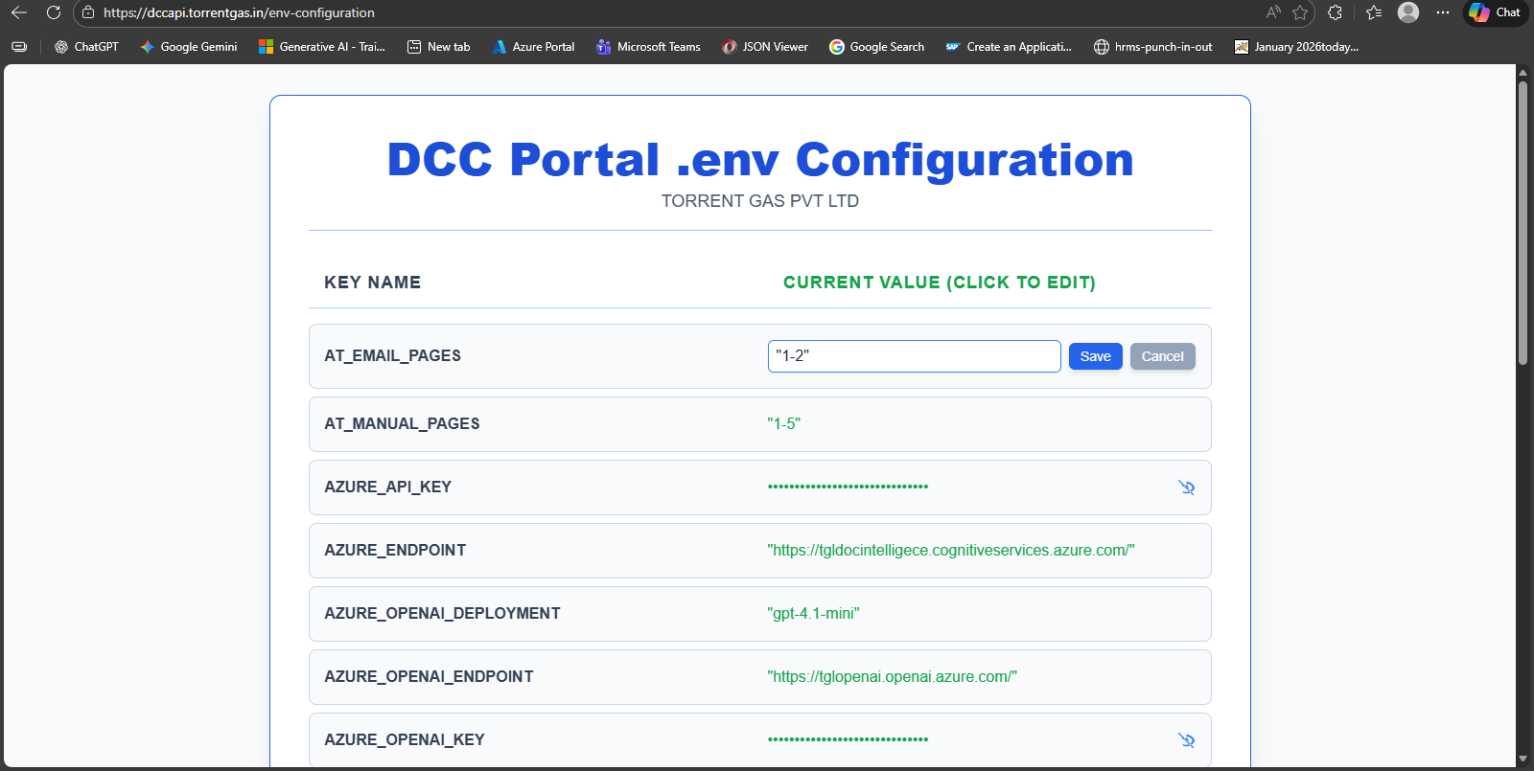
UPDATE .env File Content:
If any key expired or want to update the key value, using this url can do it /env-configuration

