Slide 1

ELC 2015
Security Architecture in the IoT Age
Stephen L Arnold
Principal Scientist, VCT Labs
Gentoo Linux Developer,
OpenEmbedded and LibreOffice contributor
http://www.vctlabs.com

Slide 2
Why do I need to worry about the security of cheesy little embedded devices?
Seriously?
  Stuxnet *
  Other recent/glaring examples of vulnerabilities being exploited in “enterprise” IT architectures
    (Sony, Anthem, etc)
Refresher
  Confidentiality, Integrity, and Availability =>
    Authentication – users, hosts, nodes
    Integrity – services, data
    Non-repudiation – more legal than technical?
    WRT digital security, the cryptological meaning and application of non-repudiation usually means:
      proof of both integrity and origin of data
      high assurance and genuine authentication
What's your risk?
* http://www.pbs.org/newshour/bb/science-july-dec10-computervirus_10-01/

Slide 3
What is all this about?
Where do you go for credible cybersecurity information?
  Vendors? Upstream docs? ISC2?
  ACM? IEEE?
  NIST? NSA? DoD?
Previous requirements and implementation guidance was scattered, duplicative, overlapping, conflicting...
Several factors have led to converge in all sectors, ie, federal govt, commercial, open source.
Although relatively recent, current cybersecurity guidance is now much more unified, standards-based, and integrated to fit within a modern risk management framework.

Slide 4
So where do we go?
A great place to get started is the Information Assurance Support Environment site, “your one-stop shop for cybersecurity information”:
  http://iase.disa.mil/index2.html
Help page, FAQs, acronym list, more:
  http://iase.disa.mil/help/index.html
Contains information and guidance documents, training materials, and guides/tools for everything from requirements to technical implementation to risk management and operations.

Slide 5
Risk Management Framework
Date: Mar 28, 2014 New - “Cybersecurity Guidance for DoD! - The new cybersecurity overarching guidance for DoD has been published. Included are two new DoD instructions”:
DoDI 8500.01, "Cybersecurity," replacing previous information assurance (IA) guidance.
  http://www.dtic.mil/whs/directives/corres/pdf/850001_2014.pdf
DoDI 8510.01, "Risk Management Framework (RMF) for DoD Information Technology (IT)," replacing the previous DIACAP guidance with an assessment and authorization (A&A) process.
  http://www.dtic.mil/whs/directives/corres/pdf/851001_2014.pdf
RMF Training Video Presentation: Cybersecurity and Risk Management Framework Implementation - Date: May 8, 2014
  http://iase.disa.mil/rmf/videos/rmf_v3.wmv
RMF Training Slide Presentations: Cybersecurity and the Risk Management Framework - Date: April 4, 2014
  http://iase.disa.mil/rmf/01_RMF_for_DoD_IT_v3.pptx
Risk Management Framework Implementation - Date: April 4, 2014
  http://iase.disa.mil/rmf/02_RMF_for_DoD_IT_Implementation_v4.pptx

Slide 6
Security Requirements Guides
Security Requirements Guides (SRGs)
  http://iase.disa.mil/srgs/index.html
Security Requirement Guide (SRG) - “A compilation of Control Correlation Identifiers (CCIs) grouped into more applicable, specific technology areas at various levels of technology and product specificity. An SRG provides DoD specificity to CCI requirements (organizationally defined parameters). An SRG is used by DISA FSO and vendor guide developers to build Security Technical Implementation Guides (STIGs). There are basically two types of SRGs. The first group are the four CORE SRGs which deal with Applications, Networking Devices, Operating Systems, and Policy. The second group are the Technology specific SRGs. A Technology specific SRG is a child of a CORE SRG. For example, the Database SRG was derived from the requirements in the Application SRG.”

Slide 7
SRGs - Current List
Security Requirements Guides
  http://iase.disa.mil/srgs/u_updated_srg_tim_overview.ppt
Application Server SRG
Database Security Requirements Guide (SRG)
Domain Name System (DNS) SRG
Firewall SRG
Intrusion Detection and Prevention System SRG
Mobile Applications SRG
Mobile Application Store SRG
Mobile Policy SRG
Network Device Management SRG (Draft)
Router SRG (Draft)
UNIX OS SRG
Web Server SRG

Slide 8
Control Correlation Identifier (CCI)
Control Correlation Identifier (CCI)
  http://iase.disa.mil/cci/index.html
“The Control Correlation Identifier (CCI) provides a standard identifier and description for each of the singular, actionable statements that comprise an IA control or IA best practice. CCI bridges the gap between high-level policy expressions and low-level technical implementations. CCI allows a security requirement that is expressed in a high-level policy framework to be decomposed and explicitly associated with the low-level security setting(s) that must be assessed to determine compliance with the objectives of that specific security control. This ability to trace security requirements from their origin (e.g., regulations, IA frameworks) to their low-level implementation allows organizations to readily demonstrate compliance to multiple IA compliance frameworks. CCI also provides a means to objectively rollup and compare related compliance assessment results across disparate technologies.”

Slide 9
CCI List (draft)
A draft version of the CCI List conforming to CCI version 2 is now available, containing CCIs derived from NIST SP 800-53.
  http://iase.disa.mil/cci/u_cci_list.zip
  http://iase.disa.mil/cci/u_draft_cci_specification_v2r0.2.zip
  http://iase.disa.mil/cci/u_cci_process_v1r0.1.pdf
  http://iase.disa.mil/cci/u_cci_comment_matrix.xls

Slide 10
Security Technical Implementation Guides (STIGs)
Security Technical Implementation Guides
  http://iase.disa.mil/stigs/index.html
“The Security Technical Implementation Guides (STIGs) and the NSA Guides are the configuration standards for DoD IA and IA-enabled devices/systems. Since 1998, DISA Field Security Operations (FSO) has played a critical role enhancing the security posture of DoD's security systems by providing the Security Technical Implementation Guides (STIGs). The STIGs contain technical guidance to "lock down" information systems/software that might otherwise be vulnerable to a malicious computer attack.”

Slide 11
STIG Documents
STIG Viewing Guide Quick Ref
  http://iase.disa.mil/stigs/downloads/pdf/u_stig_viewer_quick_reference_guide_v1.0.1.pdf
STIGs Master List (A to Z)
  http://iase.disa.mil/stigs/a-z.html
Automate everything:
Security Content Automation Protocol (SCAP) Content and Tools. Various SCAP benchmarks are available, but specific SCAP content is *PKI only
  http://iase.disa.mil/stigs/scap/index.html

Slide 12
Architecture Examples (frameworks, etc)
DoD / NATO / MOD, NASA, NIST
  http://en.wikipedia.org/wiki/Department_of_Defense_Architecture_Framework
  DoDAF, MODAF, other derivatives
OpenGroup
  http://en.wikipedia.org/wiki/The_Open_Group_Architecture_Framework
  TOGAF, ADML
  Model Driven Architecture
Archie
  http://archi.cetis.ac.uk/
  ArchieMate
CMM, EA, other guidance
  eg, http://www.sei.cmu.edu/architecture/
  http://www.enterprise-architecture.info/index.htm

Slide 13
Architecture Tools
Open Source Tools
  Essential Project
  Archie
  Eclipse
    EPF, EMF, GMT
    Polarsys, Capella, Kitalpha
  ArgoUML
    Supports DoDAF notation
Other tools
  IBM System Architect
  SEI Tools page

Slide 14
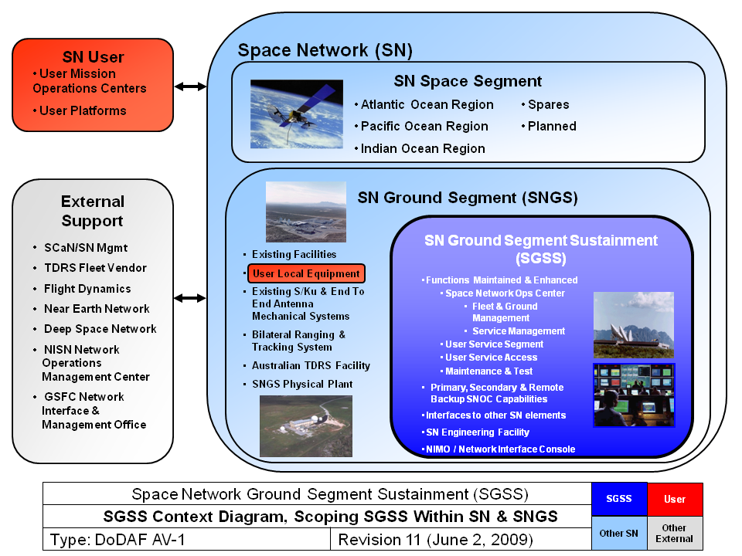
NASA

Slide 15
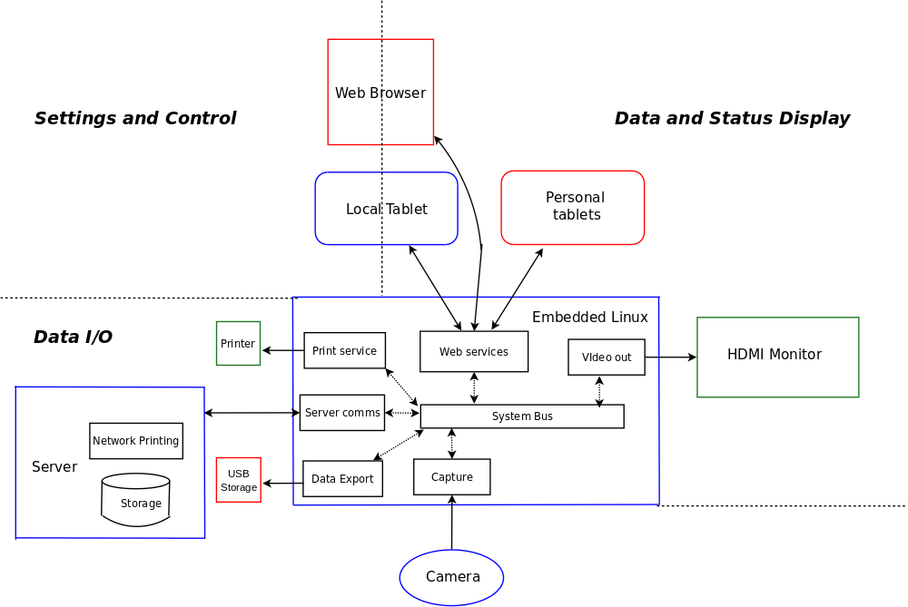
High-end Embedded Linux Camera (generic)

Slide 16
Questions?
Where next?
Assess your infrastructure
Understanding your architecture is key
  Classify business/mission-critical systems
  Categorize data sensitivity
  Define your operational environment
  Map requirements to controls
  Implement, Test, Verify
  Monitor operations, Collect & Analyze data
  Feedback lessons learned, Reassess risk
Integrate RMF with procurement / project management guidance and operations

Slide 17
This work is an original work by Stephen Arnold <sarnold@vctlabs.com>
<http://www.vctlabs.com>
Portions copyright 2015 Stephen L Arnold. Some rights reserved.
The Gentoo Linux logo is Copyright 2006 Gentoo Foundation, used with permission.
This work is licensed under the Creative Commons Attribution-NonCommercial-ShareAlike License. To view a copy of this license, visit <http://creativecommons.org/licenses/by-nc-sa/1.0> or send a letter to Creative Commons, 559 Nathan Abbott Way, Stanford, California 94305, USA.
Please contact Stephen Arnold <sarnold@vctlabs.com>
for commercial uses of this work.

