Slide 1
Learning to Program With Python – Part 1
Computers, Languages, and Tools: Saying “Hello”
Based on the book:
Snake Wrangling for Kids, Learning to Program with Python
by Jason R. Briggs
(Version 0.7.7-python2.7, modified by SJL)
Presented by
Steve Arnold, Principal Scientist VCT Labs
Stephanie Lockwood-Childs, President VCT Labs
(we are also open source Gentoo Linux / Yocto developers)

Slide 2
Computers and Languages
What is a computer?
  Abacus? Calculator? Watch? Phone? Tablet?
  Game Console? Laptop? Desktop? HAL 9000?
Languages
  Humans and Computers
  Binary language of moisture “vaporators”
  Number systems and representations
  Bits and bytes, text and binary
  Machine and Programming Languages
Computers and Intelligence
  Can animals think?
  Can computers think?

Slide 3
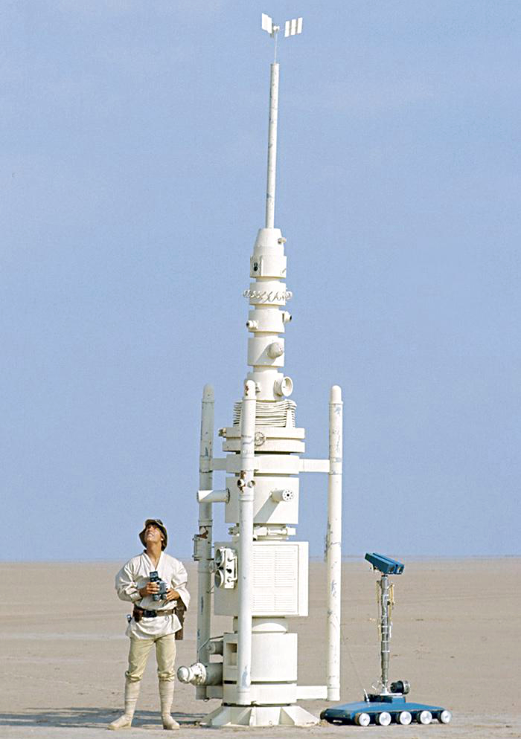
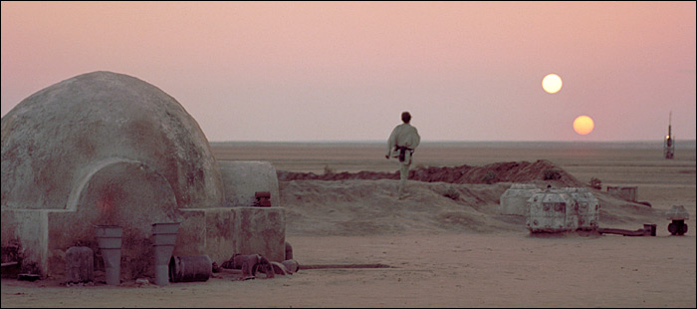
Moisture Vaporators

Slide 4

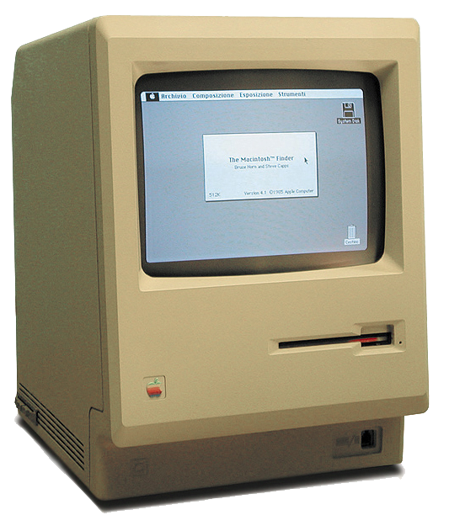
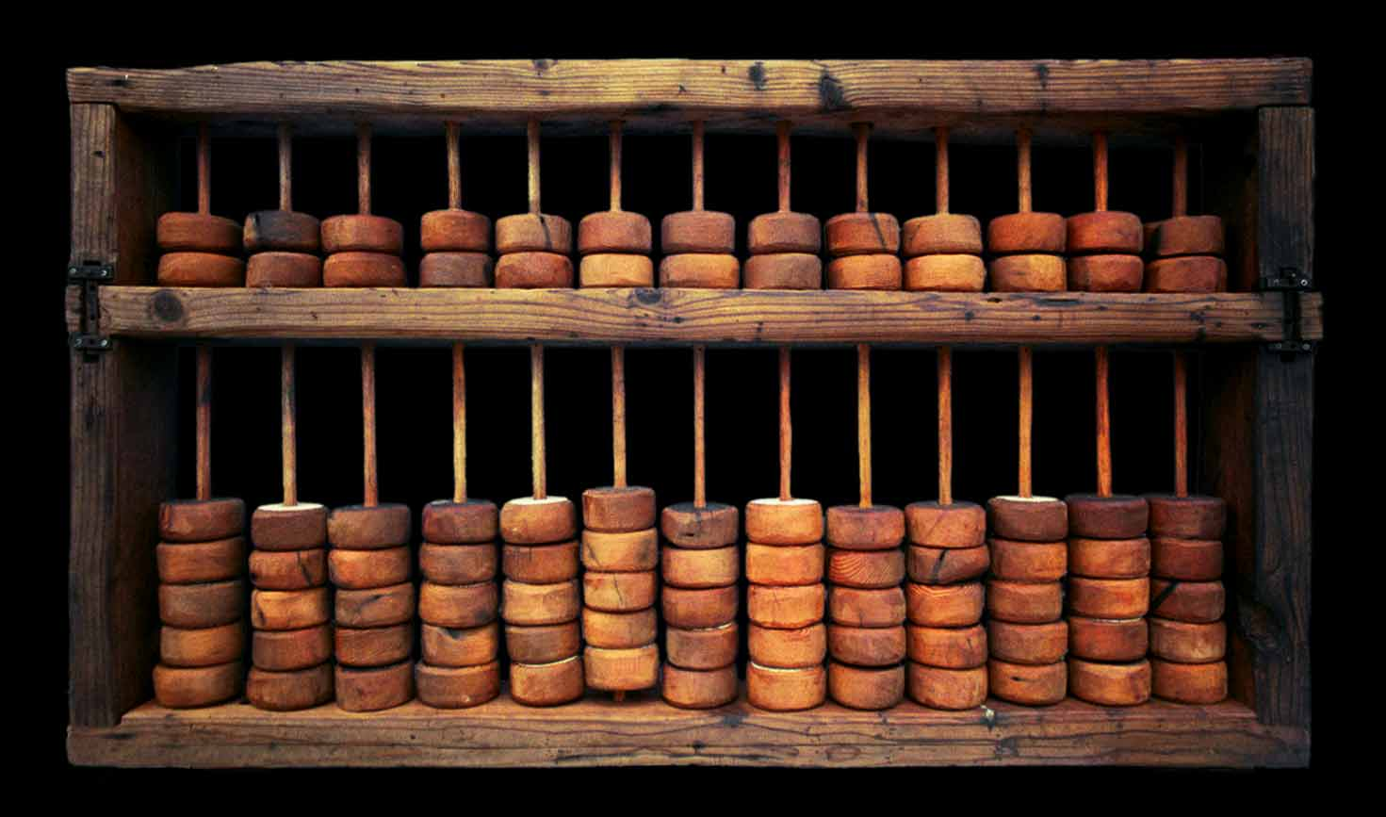
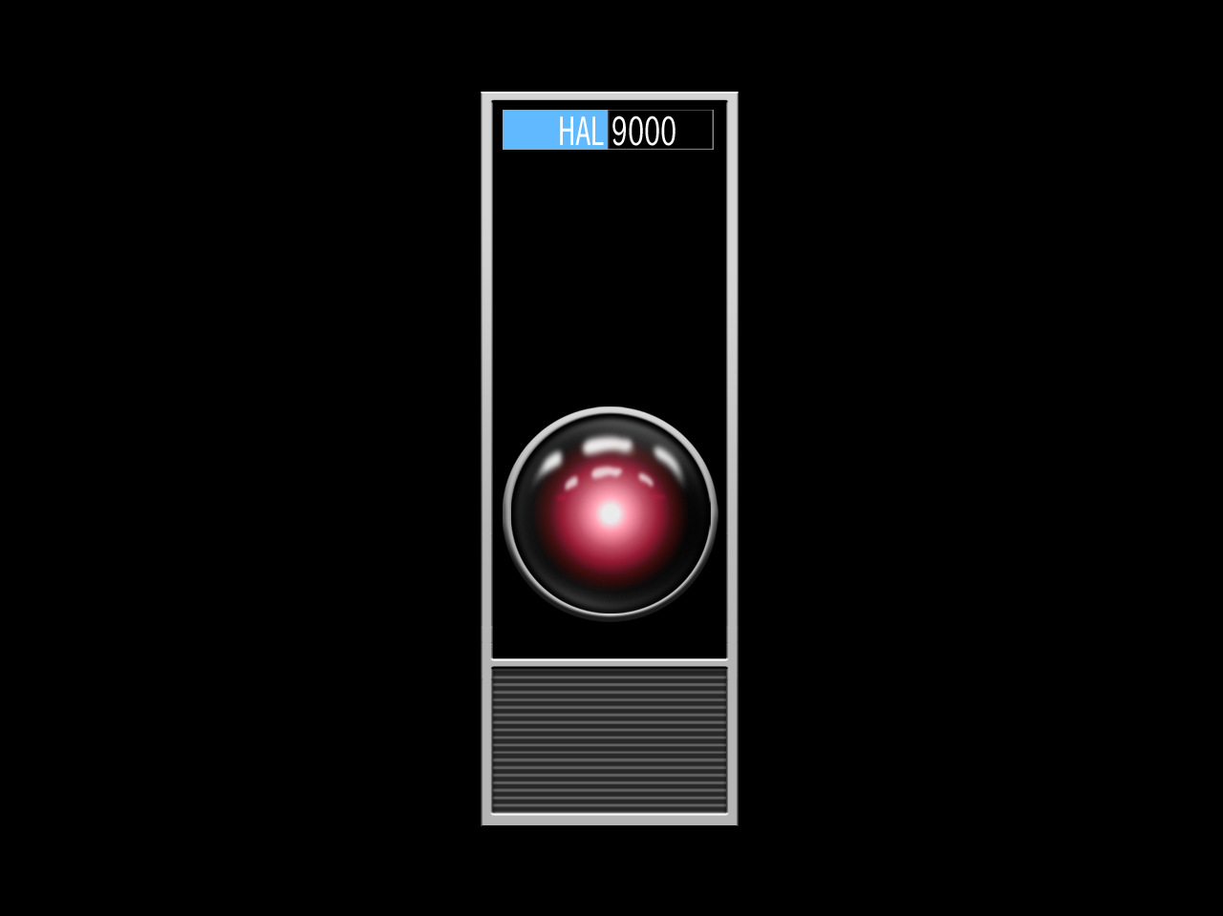
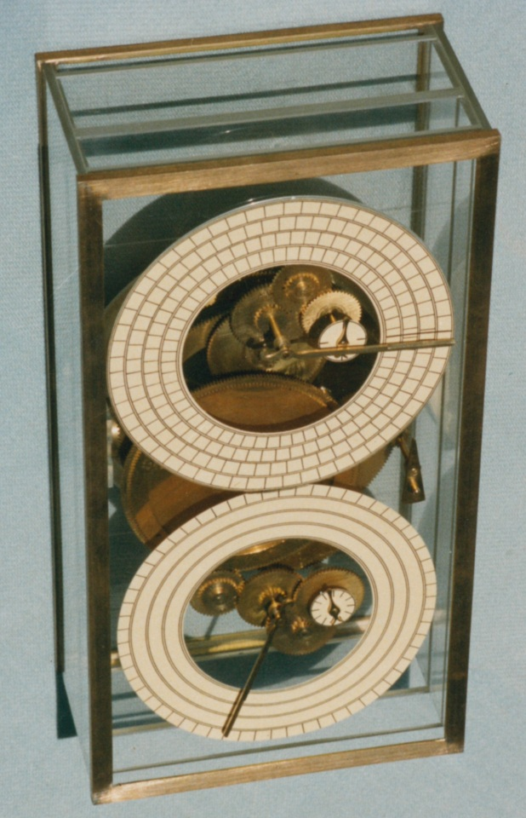
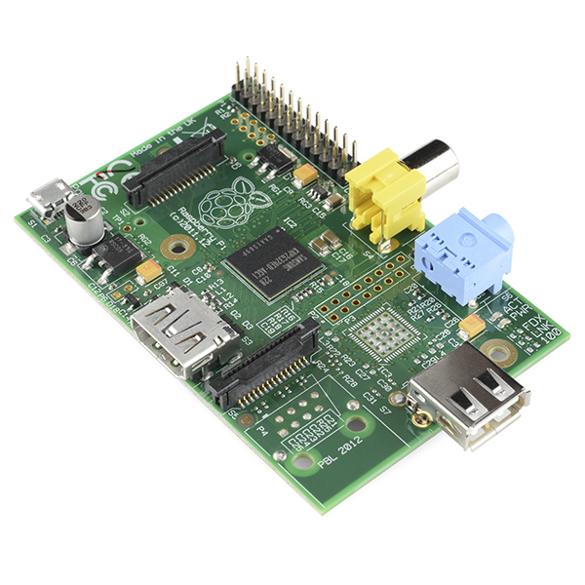
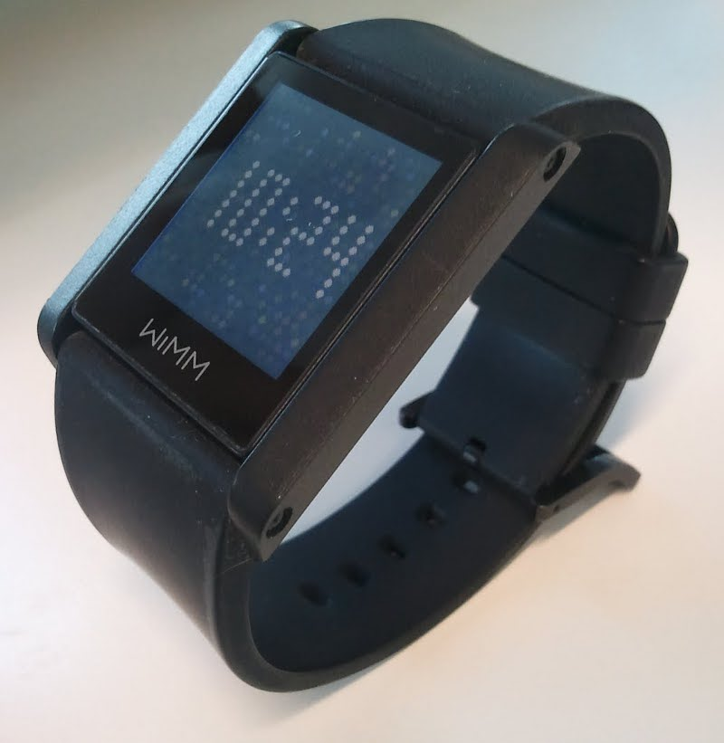
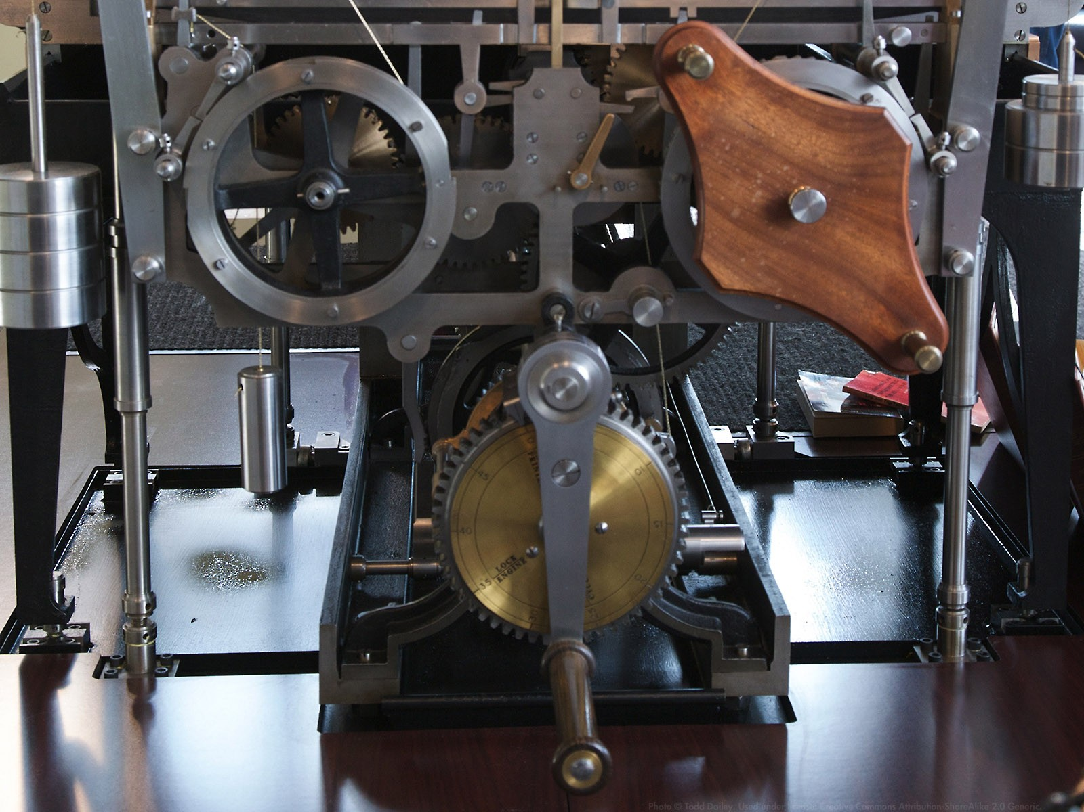
Which of these is a computer?

Slide 5
Computers and Languages cont.
Files and Encodings
  ASCII, Binary, Octal, Decimal, Hexadecimal
Computer Languages and “Flavors”
  Machine and Assembly Languages
    Processors and Architecture
  High Level Languages
    Compiled vs. Interpreted
    1st “modern” language: FORTRAN (1954)
    ALGOL, LISP (1958)
    Then A, B, C, D, C++, C#, perl, Java, SmallTalk
    COBOL, SNOBOL, ruby, lua, vala, scala, clojure...
  “Human” Programming Languages
    Ada (1st standard published 1983)
    Python (1st implementation 1989)

Slide 6
Programming Language Tools
The Language Files
  Compiler/interpreter, libraries, other components
  /us/lib/python/... (core python, site-packages, etc)
Programmer's Editor
  Text editor with special features for software development (not a word processor)
  Examples: gedit, nano, kate, gvim, emacs, nedit, scite
Shell / Terminal Emulator
  A place to type commands, like a DOS prompt only better (some shells are special, eg: python, pycrust)
  Open Terminal Emulator, type “python” then Ctrl-D
Integrated Development Environment (IDE)
  Like a fancy editor, with project interface, object browsing
  Examples: geany, code-blocks, eclipse, anjuta

Slide 7
Writing Your First Program in Python
Open Terminal Emulator (bash shell)
  At the “$” prompt, type:
$ python <enter>
  At the “>>>” prompt, type:
>>> print ("Hello, world!") <enter>
Hello, world!
Now write it as a Python program
  Open your editor and type:
print ("Hello, world!")
  Save the file as “hello.py”
  At the “$” prompt, type”
$ python hello.py
Congratulations, you just wrote a Python program!

Slide 8
What Does /. Say?
What programming language will earn you the best salary over time?
According to Burning Glass and a Brookings Institution economist, Ruby on Rails, Objective-C, and Python are all programming skills that will earn you more than $100,000 per year.
Tech-industry analyst firm RedMonk's list of most-used languages: Java/JavaScript PHP, Python, C#, and C++/Ruby
Python was the one programming language to appear on Dice's recent list of the fastest-growing tech skills
Python is a staple language in college-level computer-science courses, and has repeatedly topped the lists of popular programming languages as compiled by TIOBE Software and others.
http://developers.slashdot.org/story/14/12/03/177214/which-programming-language-pays-the-best-probably-python

Slide 9
This work is an original work by Stephen Arnold <stephen.arnold@acm.org>
<http://www.vctlabs.com>
Portions copyright 2014 Stephen L Arnold. Some rights reserved.
The Gentoo Linux logo is Copyright 2006 Gentoo Foundation, used with permission.
This work is licensed under the Creative Commons Attribution-NonCommercial-ShareAlike License. To view a copy of this license, visit <http://creativecommons.org/licenses/by-nc-sa/1.0> or send a letter to Creative Commons, 559 Nathan Abbott Way, Stanford, California 94305, USA.
Please contact Stephen Arnold <stephen.arnold@acm.org>
for commercial uses of this work.

