Slide 1
Learning to Program With Python – Part 1
Computers, Languages, and Tools: Saying “Hello”
Based on the book:
Snake Wrangling for Kids, Learning to Program with Python
by Jason R. Briggs
(Version 0.7.7-python2.7, modified by SJL)
Presented by
Steve Arnold*, Principal Scientist VCT Labs
Stephanie Lockwood-Childs*, President VCT Labs
Nick Lockwood, Senior Engineer, VCT Labs
(* also open source Gentoo Linux / Yocto developers)

Slide 2

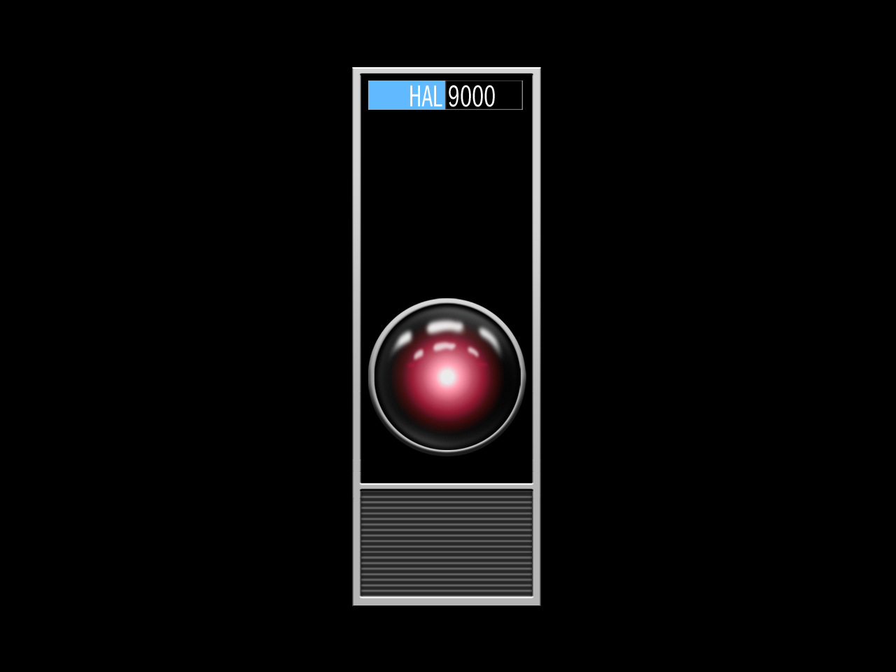
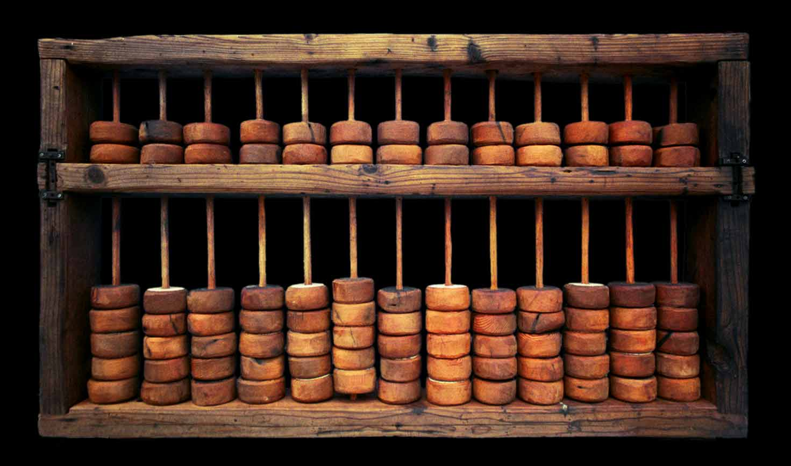
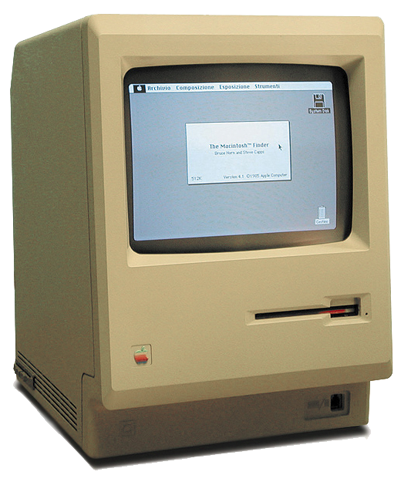
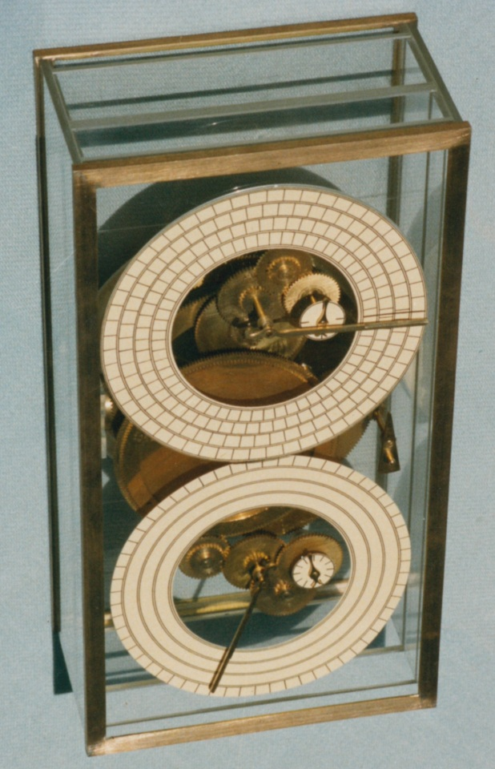
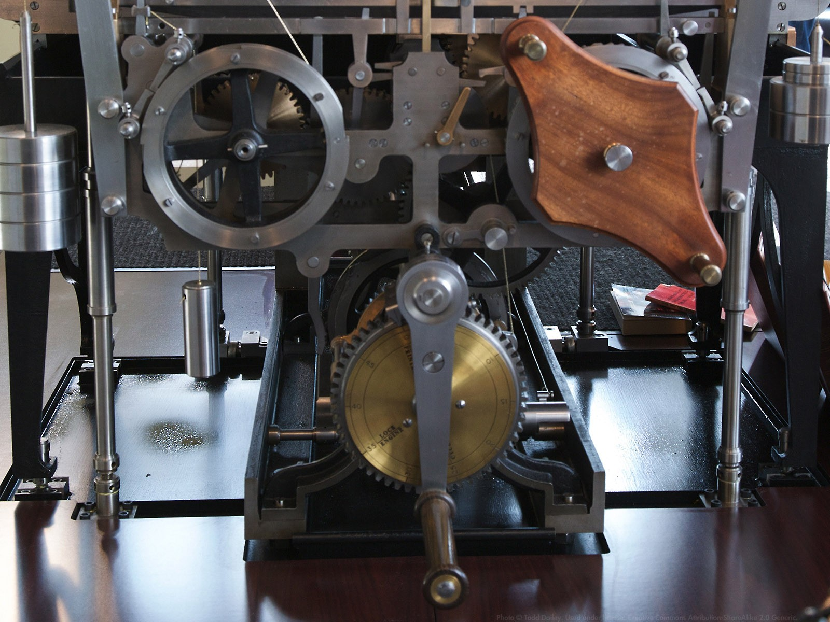
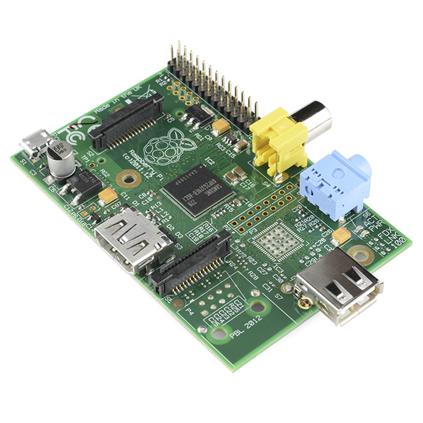
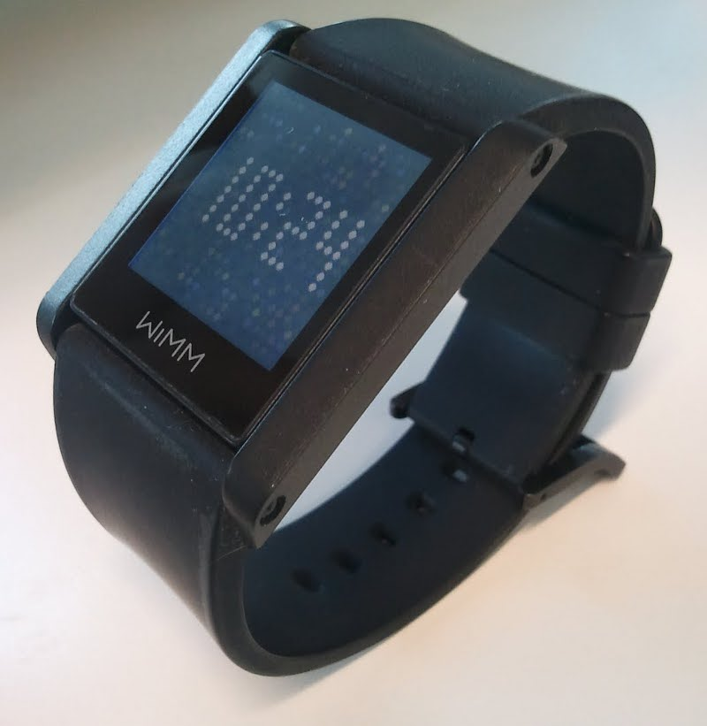
Which of these is a computer?

Slide 3
Can Computers 'Talk'?
  Computers and Languages
  Number systems and representations
  Bits and bytes,
  Text and binary
  Machine Languages
  Programming Languages

Slide 4
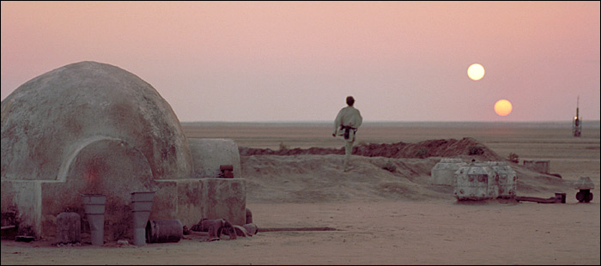
The Binary Language of Moisture Vaporators

Slide 5
Computers and Languages cont.
Machine and Assembly Languages
    Processors and Architecture
  High Level Languages
    Compilers and Interpreters
    FORTRAN
    ALGOL, LISP
    Then A, B, C, D, C++, C#, Perl, Java, etc
  “Human” Programming Languages
    Ada
    Python

Slide 6
Can Computers Think?
What do you think?
Are computers intelligent?

Slide 7
Programming Language Tools
The Language Files
  Compiler/interpreter, libraries, other components
Programmer's Editor
  Text editor with special features for software development (not a word processor!)

Slide 8
Programming Language Tools
Shell / Terminal Emulator
  A place to type commands
  Like a DOS prompt only better
  Special shells, eg: python, pycrust

Slide 9
Programming Language Tools
Integrated Development Environment (IDE)
  Like a fancy editor, with project interface, compilers
  Can provide useful language-sensitive features
  Can also require lots of system resources

Slide 10
Writing Your First Program in Python
Login and launch Terminal Emulator (bash shell)
At the “$” prompt, type:
$ python <enter>
At the “>>>” prompt, type:
>>> print ("Hello, world!") <enter>
You should see the following:
Hello, world!

Slide 11
Now, as a Python program
Open your editor and type:
print ("Hello, world!")
Save the file as “hello.py”
At the “$” prompt, type”
$ python hello.py
Congratulations, you just wrote a Python program!

Slide 12
This work is an original work by Stephen Arnold
<stephen.arnold@acm.org>
<http://www.vctlabs.com>
Portions copyright 2014 Stephen L Arnold. Some rights reserved.
The Gentoo Linux logo is Copyright 2006 Gentoo Foundation, used with permission.
This work is licensed under the Creative Commons Attribution-NonCommercial-ShareAlike License. To view a copy of this license, visit <http://creativecommons.org/licenses/by-nc-sa/1.0> or send a letter to Creative Commons, 559 Nathan Abbott Way, Stanford, California 94305, USA.
Please contact Stephen Arnold <stephen.arnold@acm.org>
for commercial uses of this work.

