Slide 1
Welcome to bol.com
What to expect from our Data Science interviews

Slide 2
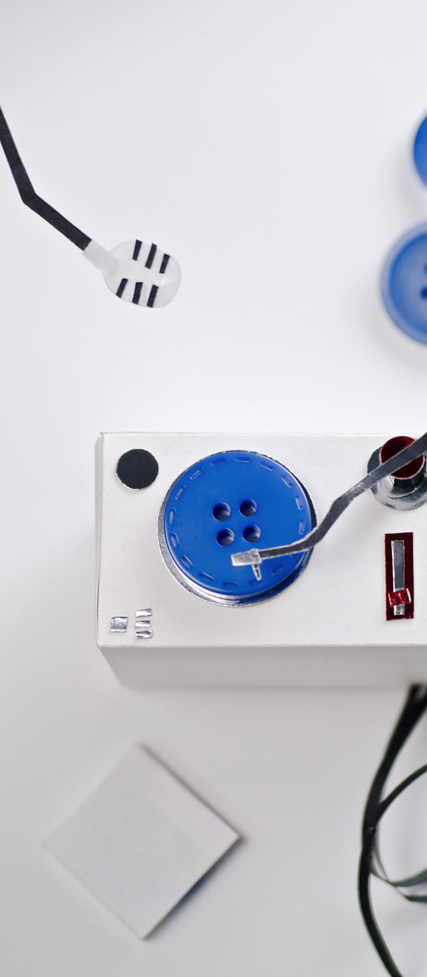
Our interviews
How to prepare?
First of all, a big thank you
There are many cool companies out there, so thank you for applying at bol.com. We are looking for enthusiastic people who love to work in the fast-paced, and somewhat chaotic world of online retail. Our interview process is a two-way conversation – for you to find out about life and work at bol.com, for us to see how you fit in.
What are we looking for?
The bol.com fit. We want people to feel enthusiastic about working at bol.com. Our employees are entrepreneurs in spirit, who do not hesitate to roll up their sleeves to achieve their goals and make our customers love us even more. You will find few guru’s here. We like to see the ‘humor’ in our work and are not afraid to make fun of ourselves. During the interview you can expect questions on your reflective ability. We love hearing examples of success and failures, especially in team settings.
Knowledgeable professionals. There are many roles you can fulfill within bol.com. During the interviews we will test the knowledge and experience you bring to a team that allows you to be successful in your role. However we are not only looking to fulfill a position. Things will change and so will your role. Be ready to talk about your ideas on future development.
Data-driven entrepreneurs. We are looking for people who take responsibility and chase an opportunity when they see one. We believe that autonomy is key for fast innovation but should always be supported by data. Be prepared to talk about situations where you achieved your goal in creative ways and made use of data to do so.
How to prepare
Make sure you read-up a bit on bol.com, what we stand for and our Plaza business model. We love to hear your thoughts on improving our store! Be ready to talk about your motivation for bol.com, the decision that brought you to our table and examples that show your skills and personality. Prepare some questions you have for us, so we can make sure we answer those. Most importantly, relax and be yourself. We are looking for a fit. It is perfectly fine if you cannot answer every question. Just be honest!
Tests (the HR assessment, a technical case and a business case to prepare at home) will be shared with you up front.

Slide 3
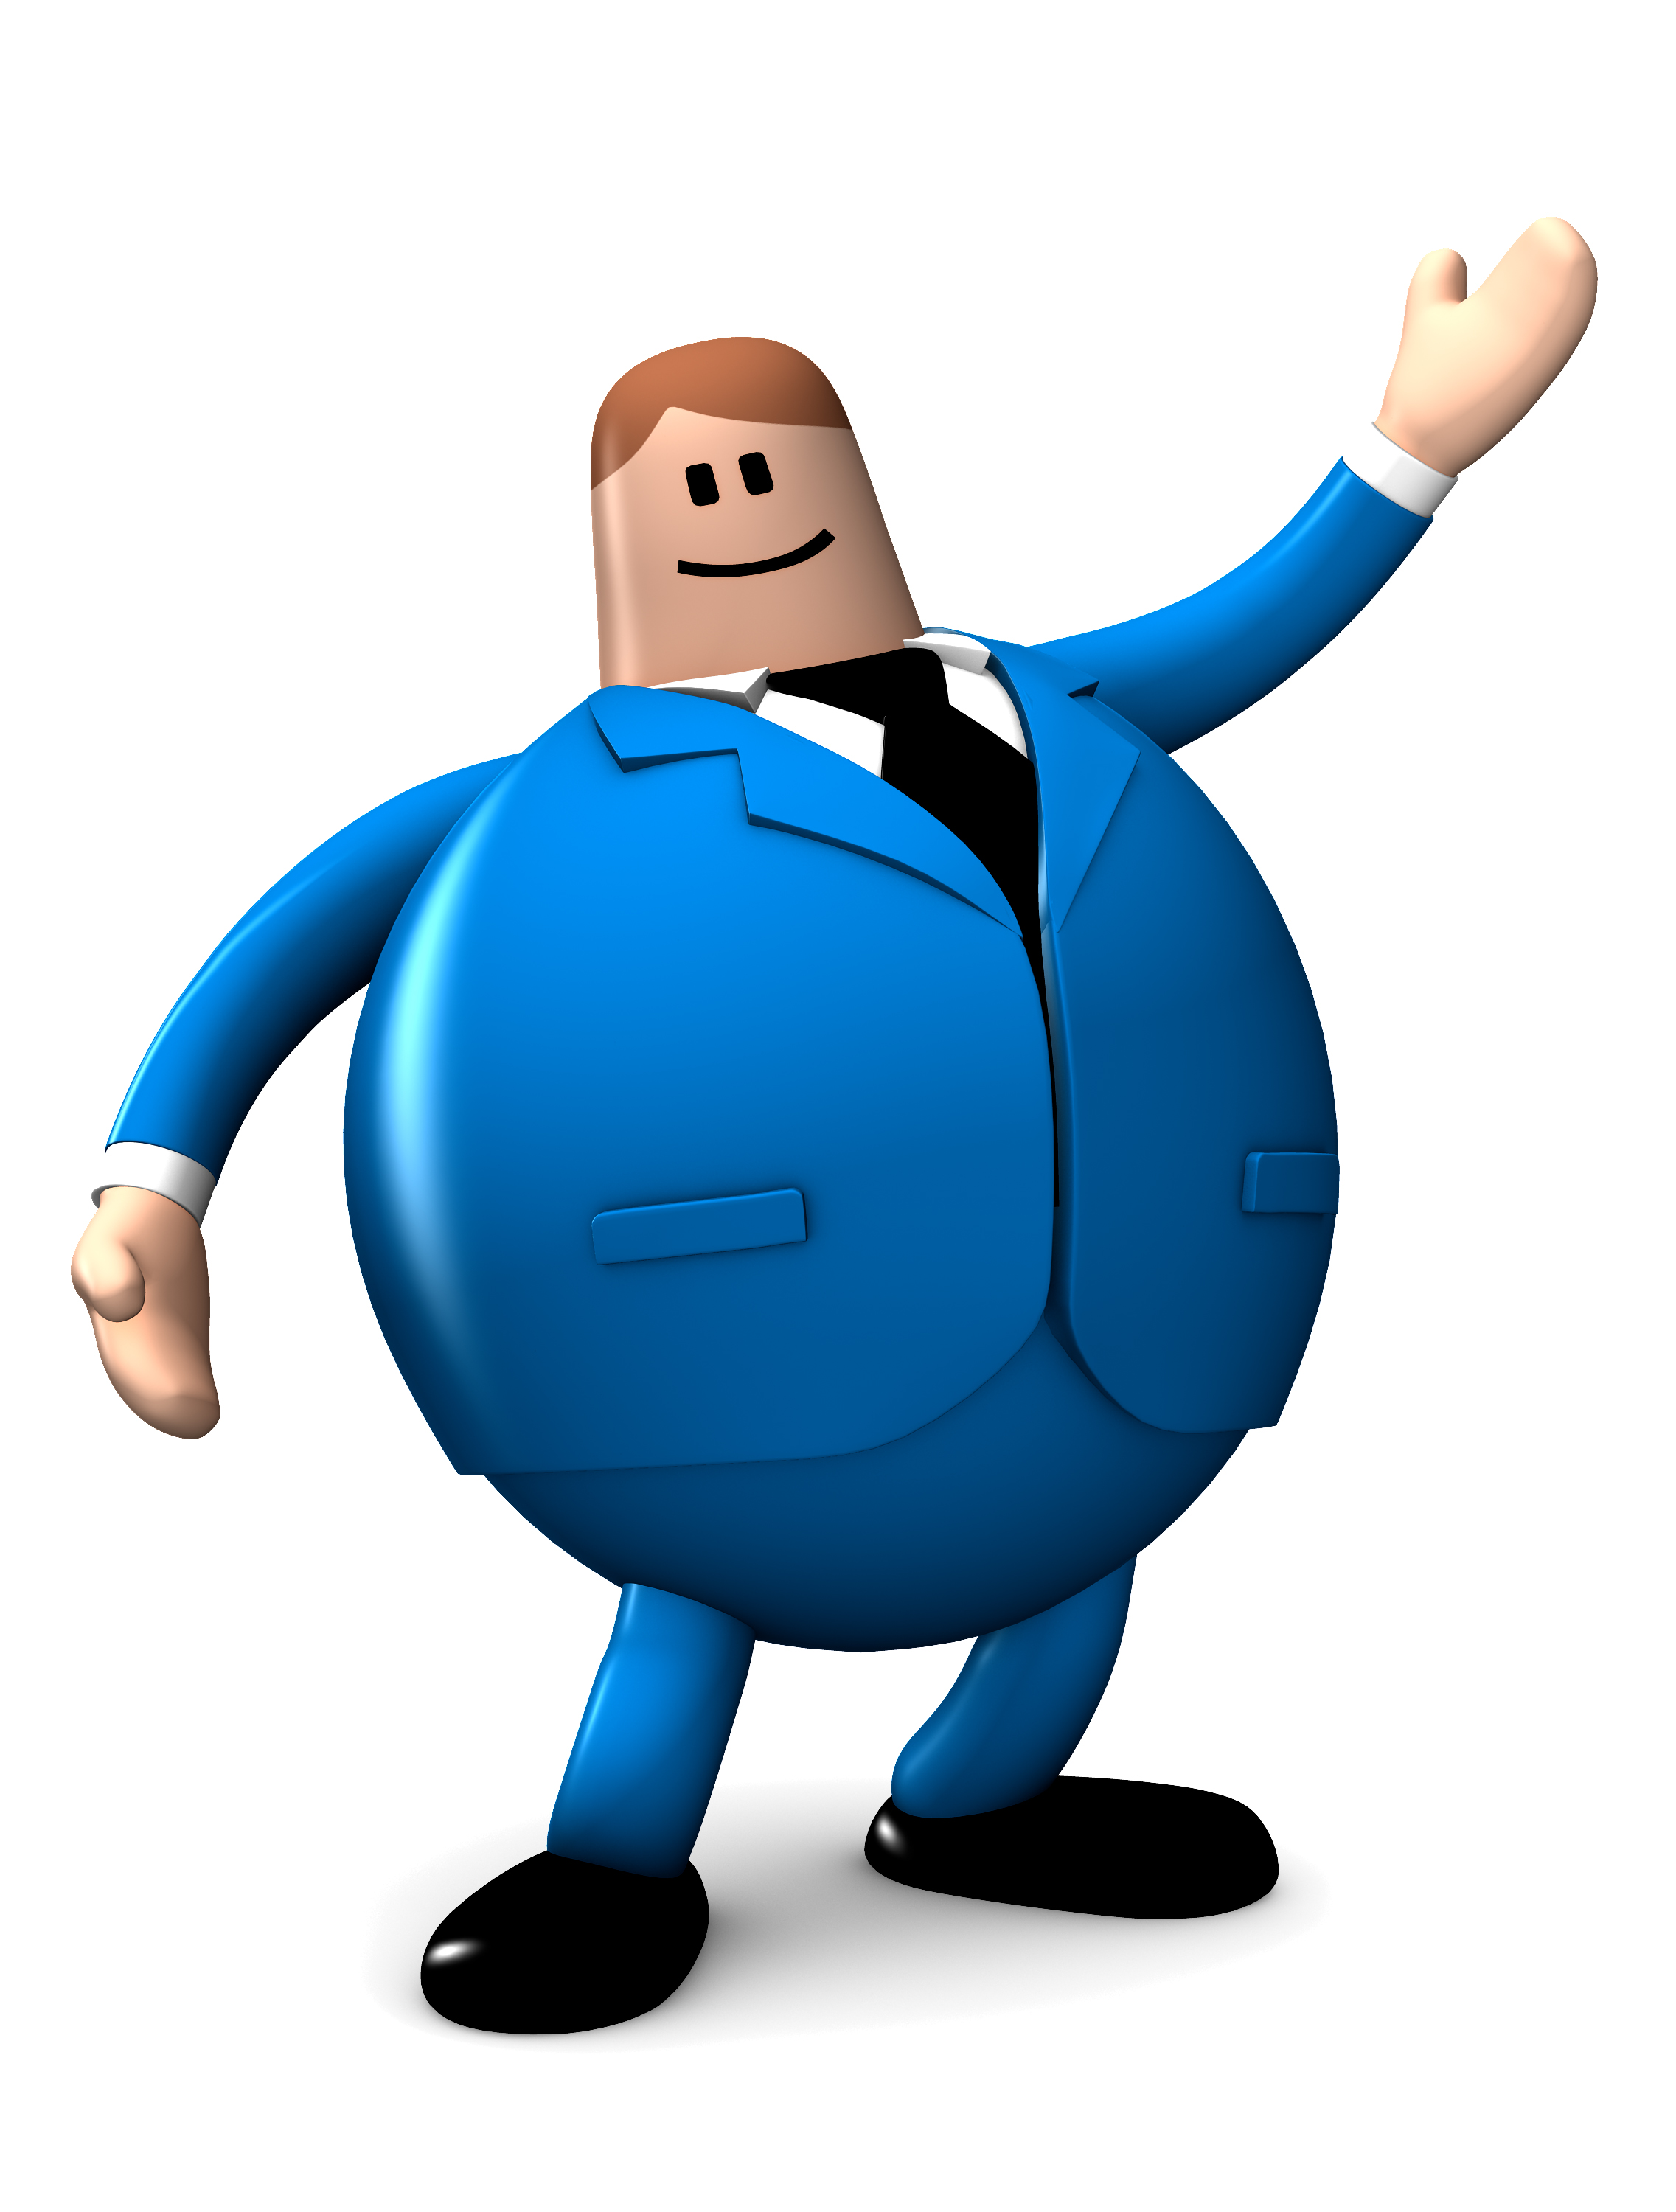





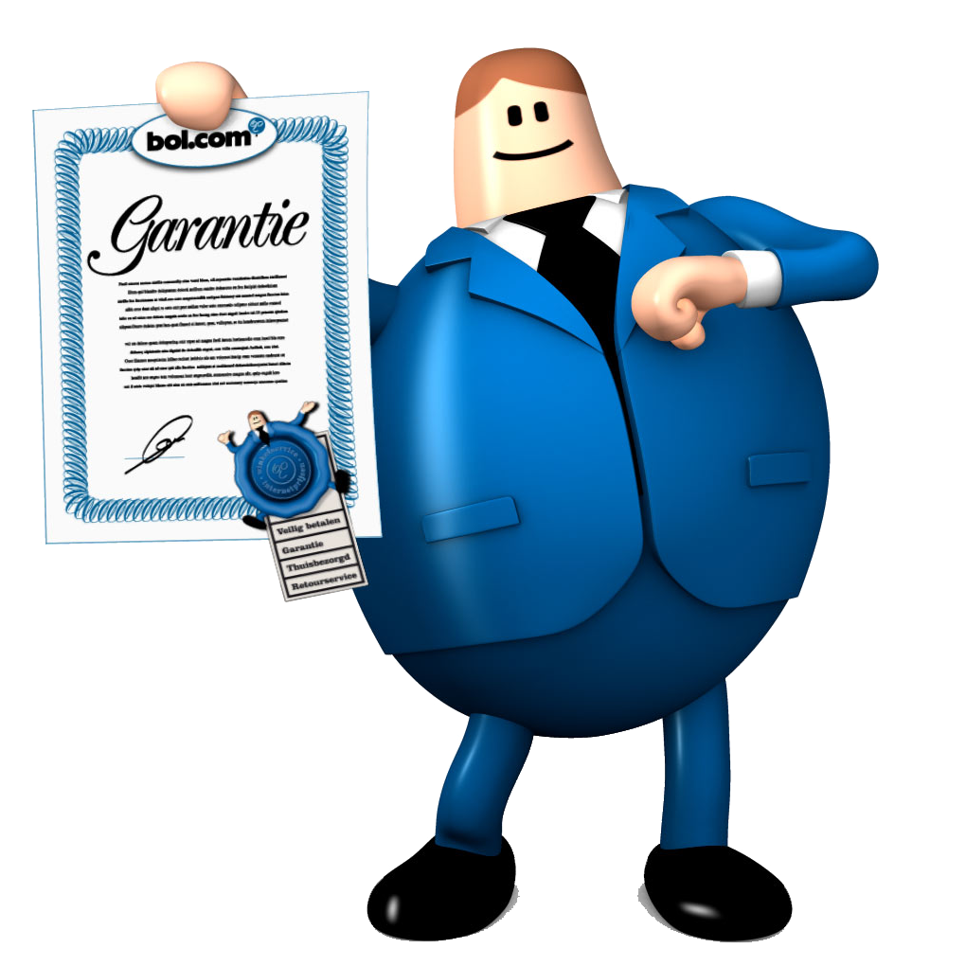
Our hiring process
What to expect?
For the interview process, we ask you to come to our office for about a day. During this day you will have multiple interviews in which you:
Meet and get to know bol.com colleagues
Share your experience, knowledge and skills
Share your ideas and enthusiasm
See if bol.com is a fit for you
Your day at bol.com will look like this:
You will be welcomed at the reception by your HR contact. You will have a conversation about your test outcome and the general HR package.
Then you head into the technical round. You will discuss both the technical & business case you prepared. This is a conversation about skill and knowledge.
Time for a break! You will have a relaxing coffee break or lunch with two bol.com colleagues. A great time to talk about life at bol.com, experience the atmosphere and our office.
After the break you will meet the next two colleagues. This conversation is all about personality and fit with the bol.com culture.
Then its time for a final interview with our Manager Data Science & Advanced Analytics to recap a bit of everything, explore some more and ask your final questions.
By the end of the day, you’ll know if we will make you an offer.
30 minutes
60 minutes
60 minutes
60 minutes
30 minutes

Slide 4
The technical case
Show your research capabilities
This technical case is meant to not only test your skills with data science tools, but more importantly to see how you think, understand and break down a business problem into practical, production-level data science.
There are no right answers, your approach is what counts.
Please do not spend an elaborate amount of time on completing it, is not necessary for our goals, and we do not want to use more of your time at this stage.
We would like you to talk us through the code and results of your solution, the Jupyter notebook that we supplied you with is a convenient way of doing this. But if you are more comfortable in using a different tool, that’s perfectly fine. Please make sure that we receive all of your code in a format that is readable in any text editor.
Pro tip: Getting technical details across in a meeting is challenging, so please think about the narrative of your research and present your case accordingly.

Slide 5
The business case
Applying data science at bol.com scale
Online retail is a tough nut to crack, but in essence it is simple: pull customers to your store, have as many of them buy as much as possible and then return as little as possible.
We would like you to show us how you would apply data science to benefit bol.com. We have only reserved 15 minutes for this of which you get at most 5 minutes to pitch your idea, the remaining time is saved for discussion. You can choose whether your solution is customer-facing or back-end driven, but please choose from one of the following areas:
Content: all information on products we have.
Personalisation: adapting or recommending for specific users.
Pricing: offering optimal prices.
Forecasting: adapting to future demands
Customer service: helping out in the best possible way
The core of your proposal should be about what to develop and what you think is the underlying business rationale. Please prepare 2 slides to explain the what and why to your interviewers.
Topics we might want to discuss are:
The exact place and purpose of your solution in the processes of bol.com
The outline of your model (data, features, optimization, validation).
Which success metrics you would use and how you would evaluate them against our real-world business goal.
How you turn it into a production-ready application, and whose help you need to achieve that.

Slide 6
Thanks!
See you @ bol.com ;-)

