Slide 1
Youtube Link
Link: https://youtu.be/R808vby5fZE

Slide 2
Conceptual Architecture of Bitcoin Core
Victor Coombes(Leader) (20vmwc@queensu.ca) - Architecture
Osamu Adun (19osa2@queensu.ca) - External Interfaces/Use Cases/Conclusion/Presentation
Anton Gudonis (19adg8@queensu.ca) - Architecture
Selena Kesidis (21smk13@queensu.ca) - External Interfaces/Use Cases/Conclusion/Presentation
Navin Pandey (17np1@queensu.ca) - Abstract/Intro
Kyle Verma (18kv10@queensu.ca) - Abstract/Intro

Slide 3
Overview
Introduction
Components of the Conceptual Architecture
Interactions in the Conceptual Architecture
External Interfaces
Use Cases
Conclusion

Slide 4
Introduction
This presentation aims to summarize the conceptual architecture of the Bitcoin Core application. It discusses how the various components interact to produce the complex network of nodes that allow for users to send and receive Bitcoin. The user can access their Bitcoin Core wallet, which stores their personal data. This data is then transferred using a blockchain system which ensures authenticity and security of all transactions. This is accomplished through a combination of components within the Bitcoin Core application that improve upon the preexisting structure of the Bitcoin process.

Slide 5
Components
App: The GUI that connects users with the Bitcoin network. Users are able to access and manage their Bitcoin wallets including sending and receiving Bitcoin.
RPC: The remote procedure call interface handles some Bitcoin transactions like creating new Bitcoin addresses, sending Bitcoin to other users, and accessing the status of the blockchain of Bitcoin.
Wallet: This component is how user’s access most of their individual information and manage their Bitcoin funds.
Storage Engine: The storage engine is responsible for retrieving blockchain
data and optimizing data storage.

Slide 6
Components cont.
Headers, Blocks, and Coins: Headers contain metadata for each block, blocks contain transaction data and are used to validate the integrity of the blockchain, and coins are the individual units of value transferred between Bitcoin addresses.
Validation Engine: The validation engine is used to verify each Bitcoin transaction and ensure the safety and authenticity of the transaction inputs.
Mempool: This is where the unconfirmed transactions are stored before they are included in a block.
Miner: The miner component is responsible for creating new blocks in the
blockchain and producing the newly minted bitcoins.

Slide 7
Components cont.
Connection Manager and Peer Discovery: These components are responsible for managing the connections and flow of data between the nodes in the Bitcoin network.
Peers and P2P Network: The peers and peer-to-peer network components are responsible for maintaining the decentralized network of Bitcoin nodes. They allow Bitcoin core to connect to other nodes and share blockchain data.

Slide 8
Interactions
App + RPC: The application provides the user interface that interacts with the RPC interface for the Bitcoin Core software.
App + Wallet: The Bitcoin Core application allows users to access and manage their wallets, storing private information.
Wallet + Storage Engine: The wallet relies on the storage engine to access blockchain data.
Storage Engine + Headers: The storage engine stores the header information
for each block in the blockchain.

Slide 9
Interactions cont.
Storage Engine + Blocks: The storage engine stores the complete transaction data for each block in the blockchain.
Storage Engine + Coins: The storage engine stores the complete information for each coin transferred between Bitcoin addresses.
Validation Engine + Blocks: The validation engine ensures that the blockchain data for each block is authentic and accurate.
Validation Engine + Coins: The validation engine verifies the validity of each coin.

Slide 10
Interactions cont.
Mempool + Validation Engine: The mempool component sends transactions to the validation engine for verification before they are included in a block.
Miner + Mempool: The miner selects transactions from the mempool component to create a new block for the blockchain.
Miner + Validation Engine: The miner component uses the validation engine to validate the information for the blocks before adding them to the blockchain.
Connection Manager + Peer Discovery: The connection manager uses the peer
discovery component to discover other nodes in the network.

Slide 11
Interactions cont.
Connection Manager + Peers: The connection manager component manages the connections to other peer nodes in the Bitcoin network.
Peers + P2P Network: The peers component allows the Bitcoin Core application to connect and share blockchain data with other nodes.

Slide 12
External Interfaces
Due to the peer-to-peer architecture present in Bitcoin Core, a lot of information is transferred to and from the system. Every Bitcoin transaction involves a transfer of information to another peer or node within the system. This transfer includes all the information of the blockchain and individual coins.

Slide 13
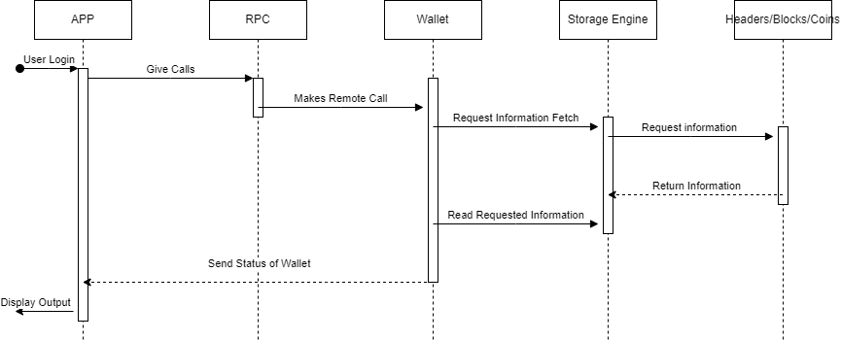
Use Case 1
A user wants to log in and access their wallet and view the information inside.

Slide 14
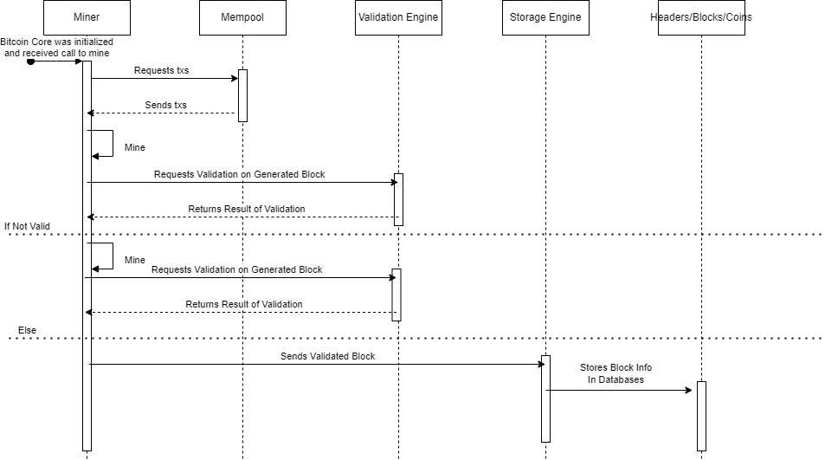
Use Case 2
A user wants to mine and mint a new Bitcoin.

Slide 15
Conclusion
Bitcoin Core uses a peer-to-peer architecture to function as a secure and safe virtual Bitcoin wallet. This is accomplished through multiple layers of architecture that allow for complete verification of every transaction of Bitcoin. Each element of the blockchain is verified and implemented such that the integrity of the transaction is maintained. We have gained a much deeper understanding of the Bitcoin Core system and Bitcoin transactions and wallets as a whole.

Slide 16
References
Bitcoin Core Website:
https://bitcoin.org/en/bitcoin-core/
What is Bitcoin Core? By River Financial: https://river.com/learn/what-is-bitcoin-core/#:~:text=Bitcoin%20Core%20is%20open%20source%20code.,versions%20of%20the%20Bitcoin%20software.
Review of Bitcoin Core wallet:
https://wallets.com/bitcoin-core-review/
Conceptual Architecture Reference:
https://cypherpunks-core.github.io/bitcoinbook/ch03.html
Bitcoin Architectural Overview:
https://dl.gi.de/bitstream/handle/20.500.12116/16570/DFN-Forum-Proceedings-001.pdf?sequence=1&isAllowed=y

