Slide 1
VEHICLE DETECTION AND COUNTING
GUIDE NAME: Mrs.M.SANGEETHA, M.Tech, Associate Professor
BATCH NUMBER: A17
DONE BY
ABITHA U (211419104004)
HARSHINI B (211419104098)

Slide 2
ABSTRACT
This project describes about the system to count the number of vehicles on roads and highways by using adaptive background subtraction.
Overall, system requires a video stream captured from static cameras installed on roads and highways .
The necessity of detecting and counting the vehicles is helpful for traffic surveillance.

Slide 3
INTRODUCTION
Our project describes the methodology used for video processing for traffic flow counting with real time videos using a programming language.
With the rapid development of intelligent video analysis, traffic monitoring has become a key technique for collecting information about traffic conditions.

Slide 4
LITERATURE SURVEY
Date of publication | Author name | Title of the paper | Methodology
01 July 2020 | Chenghuan Liu , Du Q. Huynh, Yuchao Sun, Mark Reynolds, Steve Atkinson | A Vision-Based Pipeline for Vehicle Counting, Speed Estimation, and Classification | It uses Convolutional Neural Network.

Slide 5
Date of publication | Author name | Title of the paper | Methodology
01 May 2019 | Zhe Dai, Huansheng Song, Xuan Wang, Yong Fang, Xu Yun,Zhaoyang Zhang, Huaiyu Li | Video-Based Vehicle Counting Framework | It uses YOLOV3 for detecting an object.

Slide 6
Date of publication | Author name | Title of the paper | Methodology
11 December 2017 | Hilal Tayara, Kim Gil Soo, Kil To Chong | Vehicle Detection and Counting in High-Resolution Aerial Images Using Convolutional Regression Neural Network | The method used is Convolutional Regression Neural Network

Slide 7
Date of publication | Author name | Title of the paper | Methodology
21 February 2019 | Wei Li, Hongliang Li, Qingbo Wu, Xiaoyu Chen, King Ngi Ngan | Simultaneously Detecting and Counting Dense Vehicles From Drone Images | It uses Drone based images.

Slide 8
Date of publication | Author name | Title of the paper | Methodology
22 February 2012 | Niluthpol Chowdhury Mithun, Nafi Ur Rashid, S. M. Mahbubur Rahman | Detection and Classification of Vehicles From Video Using Multiple Time-Spatial Images | It uses multiple time spatial images to detect vehicles.

Slide 9
PROBLEM STATEMENT
Current approaches of monitoring traffic include manual counting of vehicles, or counting vehicles using magnetic loops on the road. The main drawback of these approaches, is that it is not that much accurate. It is a challenging task due to many reasons such as, small size of the vehicles, different types and orientations. This technology is increasing the number of applications such as traffic control, traffic monitoring, traffic flow, security etc.

Slide 10
DEVELOPMENT ENVIRONMENT
HARDWARE REQUIREMENTS:
Cameras
System: i3
Hard disk: 500GB
RAM: 4GB
SOFTWARE REQUIREMENTS:
Operating System: Windows
Coding language: Python

Slide 11
SYSTEM DESIGN
INPUT VIDEO CLIP
BACKGROUND LEARNING
FOREGROUND EXTRACTION
VEHICLE COUNTING
VEHICLE DETECTION

Slide 12
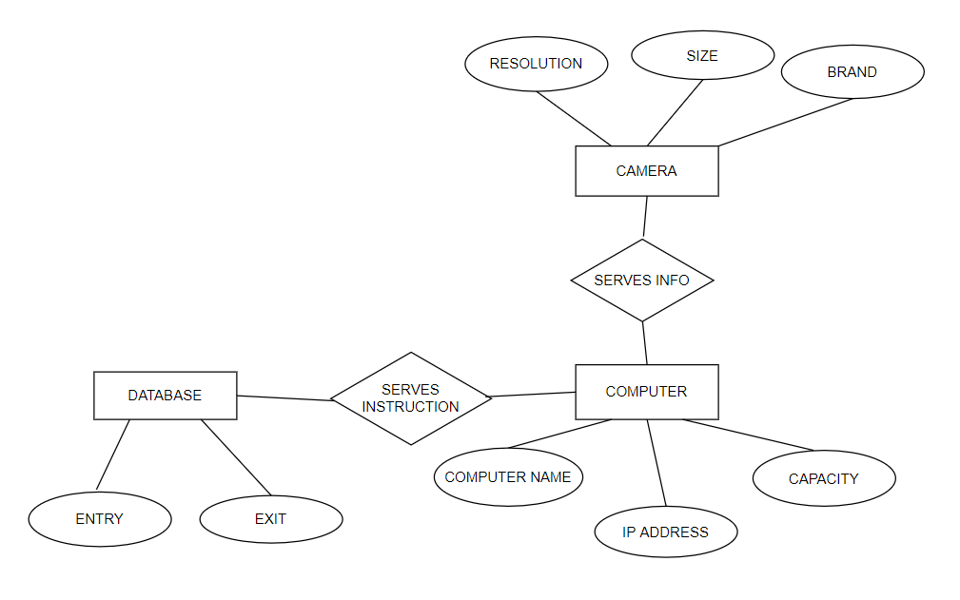
ER DIAGRAM

Slide 13
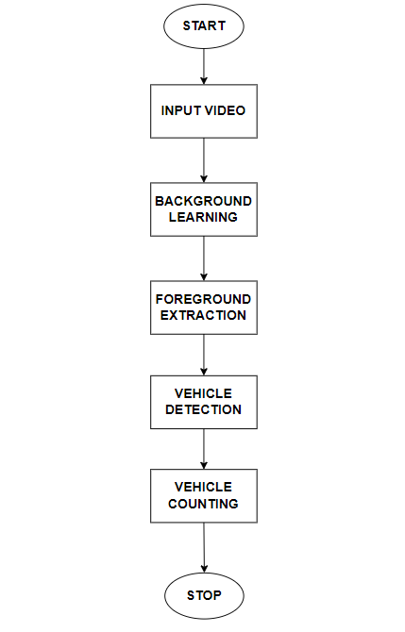
DATAFLOW DIAGRAM
USECASE DIAGRAM

Slide 14
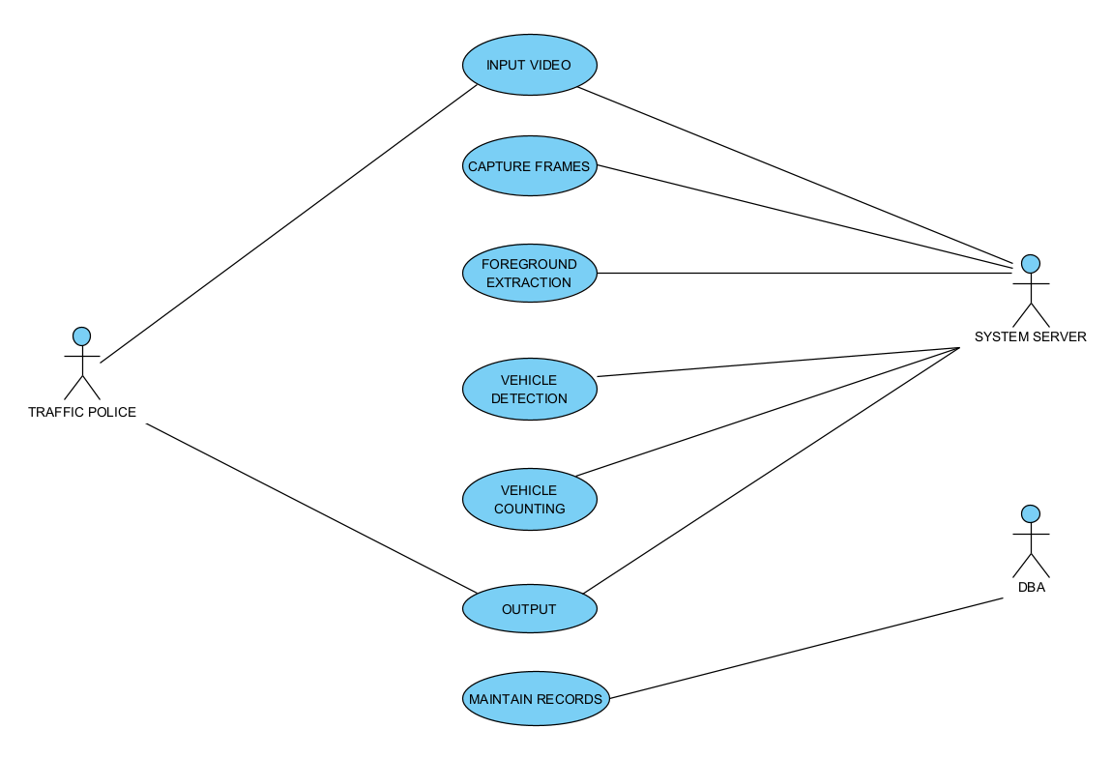
USECASE DIAGRAM

Slide 15
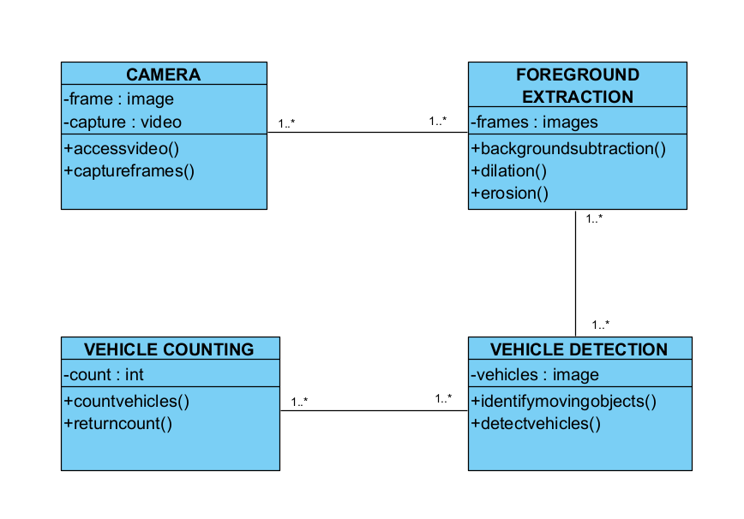
CLASS DIAGRAM

Slide 16
MODULES
Input Video
Background Learning
Foreground Extraction
Vehicle Detection
Vehicle Counting

Slide 17

MODULES DESCRIPTION
Input Video :
In this type of processing typically needs input data provided by the computer vision system and acting as a vision sensor and providing a high-level information. Then the video frames which are captured by the surveillance cameras are given as an input video for vehicle detection and counting.

Slide 18
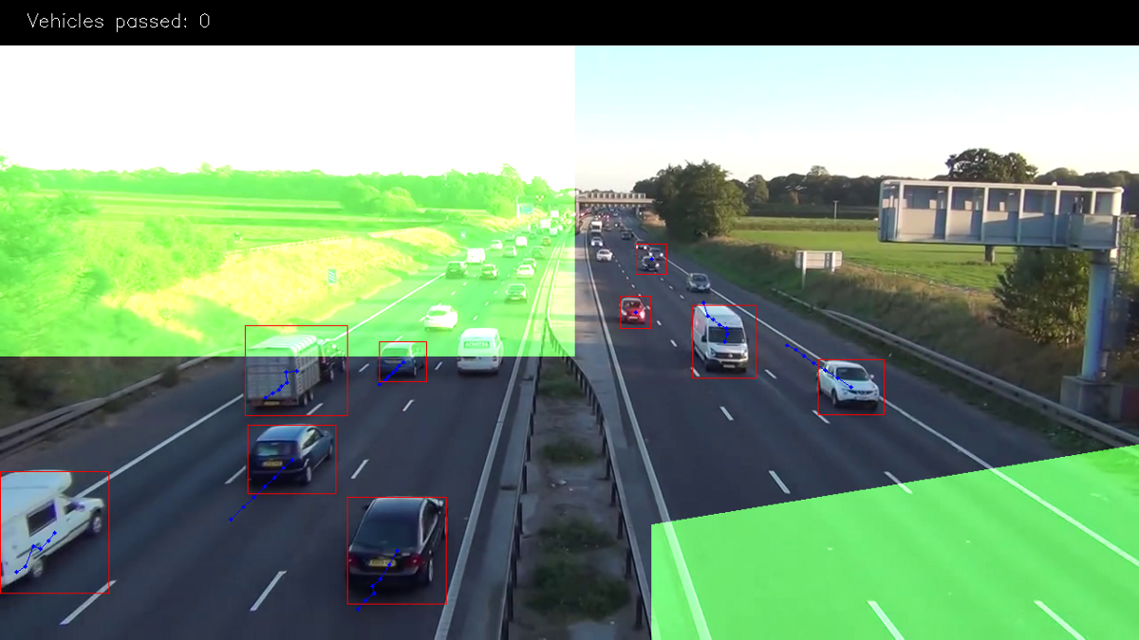
Background Learning :
In this module the main purpose is to learn about the background in a sense that how it is different from the foreground. Furthermore as proposed system works on a video feed, this module extracts the frames from it and learns about the background.

Slide 19
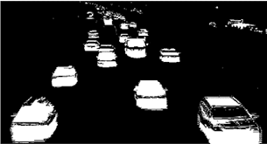
Foreground Extraction :
This module consists of three steps, background subtraction using GMM, image enhancement and foreground extraction. Background is subtracted so that foreground objects are visible. After background subtraction image enhancement techniques such as dilation and erosion are used to get proper contours of the foreground objects. The final result obtained from this module is the foreground.

Slide 20
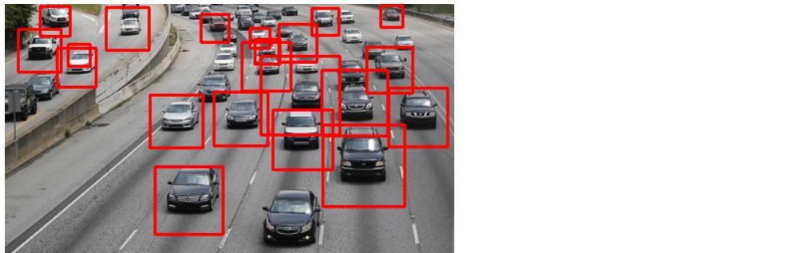
Vehicle Detection :
Vehicle detection is a technique used in computer vision and image processing. Multiple consecutive frames from a video are compared by various methods to determine if any moving object is detected. Moving objects detection has been used for wide range of applications like video surveillance, activity recognition, road condition monitoring, airport safety, monitoring of protection along marine border.

Slide 21
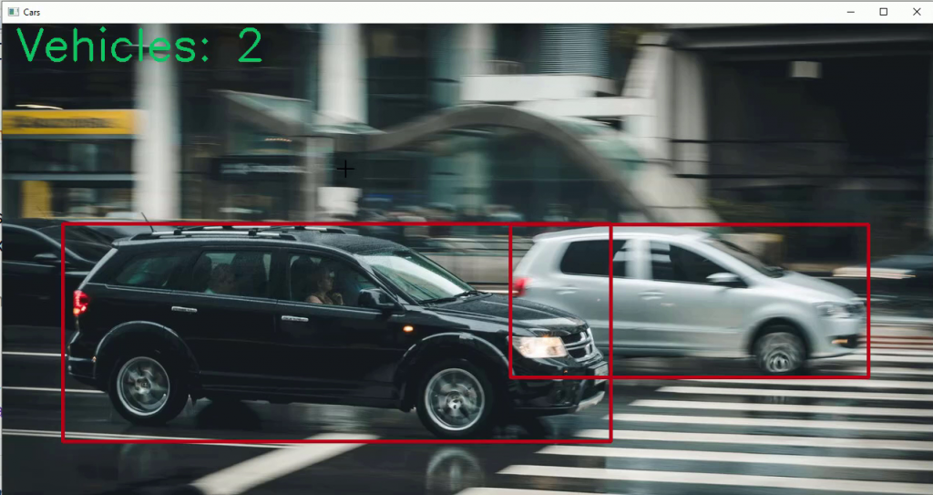
Vehicle Counting :
In counting step, a counter is used to store the sum value of them. It counts the vehicles which are passing in the specific direction. In this technique, counting is according to the number of moving vehicles detected in the detection zone.

Slide 22
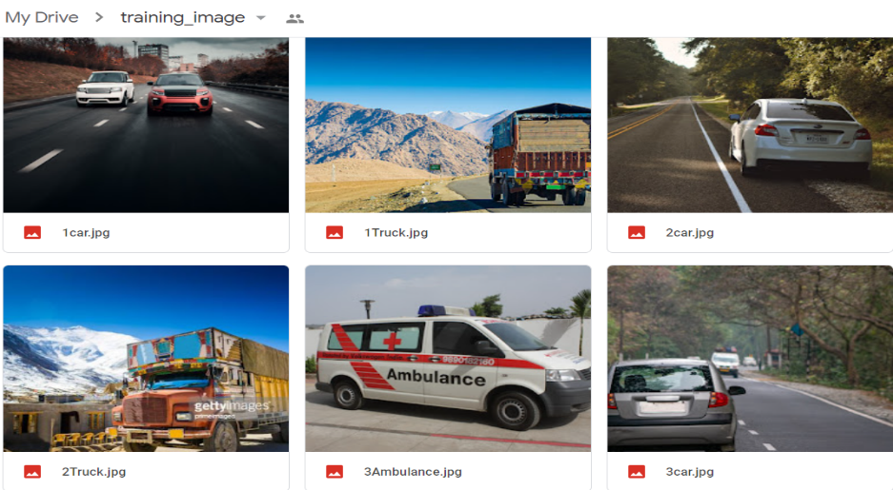
DATASET
This dataset was used in project for detecting vehicles in an video. This dataset contain 556 images for each class of vehicle. The classes in this dataset is:
Bus
Car
Truck
Ambulance
LINK:
https://drive.google.com/drive/folders/1U- 5jxcPBfNTsay9pCI5QnGY3ruG2MSqH

Slide 23
PERFORMANCE ANALYSIS
TEST CASE ID | TEST CASES | INPUT DESCRIPTION | EXPECTED OUTPUT | ACTUAL OUTPUT | TEST STATUS
1 | Upload video | The video is uploaded to detect and count vehicles | Video is successfully uploaded | Video successfully uploaded | PASS
2 | Background learning | To learn about the environment in the given video | Analyse the background | Successfully analysed background | PASS
3 | Foreground extraction | To extract the moving objects | The moving objects are extracted successfully | Objects extracted successfully | PASS
4 | Vehicle detection | To detect the moving vehicle | The vehicles are detected successfully | Vehicles detected successfully | PASS
5 | Vehicle counting | To count the vehicles that are detected | Return the count of the vehicles | Returned the count successfully | PASS

Slide 24
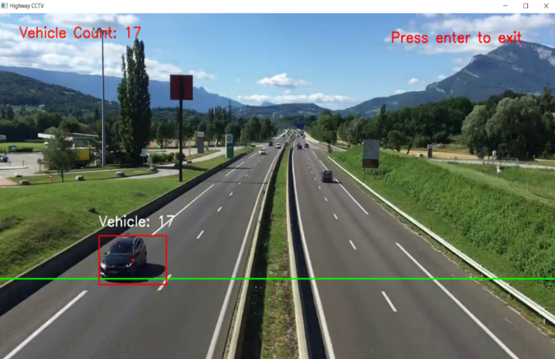
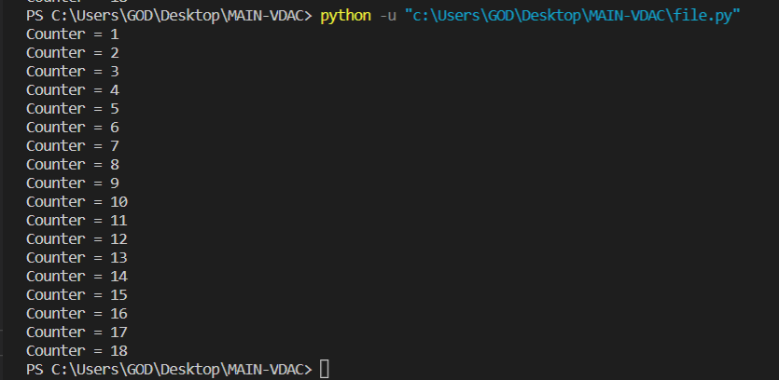
SCREENSHOTS

Slide 25
CONCLUSION
Therefore the proposed solution is implemented on python, using the OpenCV bindings. The traffic camera footages from variety of sources are in implementation. And it works with already captured videos. Our proposed method performs excellently in traffic jams and various conditions, such as sunny, cloudy, and rainy days.

Slide 26
REFERENCES
Chenghuan Liu , Du Q. Huynh, Yuchao Sun, Mark Reynolds, Steve Atkinson, A Vision-Based Pipeline for Vehicle Counting, Speed Estimation, and Classification, IEEE, 2020
Zhe Dai, Huansheng Song, Xuan Wang, Yong Fang, Xu Yun,Zhaoyang Zhang, Huaiyu Li, Video-Based Vehicle Counting Framework, IEEE, 2019

Slide 27
Hilal Tayara, Kim Gil Soo, Kil To Chong, Vehicle Detection and Counting in High-Resolution Aerial Images Using Convolutional Regression Neural Network, IEE, 2017
Wei Li, Hongliang Li, Qingbo Wu, Xiaoyu Chen, King Ngi Ngan, Simultaneously Detecting and Counting Dense Vehicles From Drone Images, IEEE, 2019.

Slide 28
THANK YOU!!!

