Slide 1
VEHICLE DETECTION AND COUNTING
GUIDE NAME: Mrs.M.SANGEETHA, M.Tech, Associate Professor
BATCH NUMBER: A17
DONE BY
ABITHA U (211419104004)
HARSHINI B (211419104098)

Slide 2
ABSTRACT
This project describes about the system to count the number of vehicles on roads and highways by using adaptive background subtraction.
Overall, system requires a video stream captured from static cameras installed on roads and highways .
The necessity of detecting and counting the vehicles is helpful for traffic surveillance.
The primary key features of the system are 1) Ability to count the vehicles 2) efficiency, to show that system would give the results with high perfection.

Slide 3
INTRODUCTION
Our project describes the methodology used for video processing for traffic flow counting with real time videos using a programming language.
With the rapid development of intelligent video analysis, traffic monitoring has become a key technique for collecting information about traffic conditions.
Using the traditional sensors such as loop detectors, ultrasonic sensors may cause damage to the road surface, the cost is also high.
Surveillance video cameras are commonly used sensors in the traffic monitoring, which can provide video stream for vehicle detection and counting.

Slide 4
LITERATURE SURVEY
Date of publication | Author name | Title of the paper | Abstract
01 July 2020 | Chenghuan Liu , Du Q. Huynh, Yuchao Sun, Mark Reynolds, Steve Atkinson | A Vision-Based Pipeline for Vehicle Counting, Speed Estimation, and Classification | In this paper, we demonstrate effective use of these older assets by applying computer vision techniques to extract traffic data from videos captured by legacy cameras. In our proposed vision-based pipeline, we adopt recent state-of-the-art object detectors and transfer-learning to detect vehicles, pedestrians, and cyclists from monocular videos.

Slide 5
Date of publication | Author name | Title of the paper | Abstract
01 May 2019 | Zhe Dai, Huansheng Song, Xuan Wang, Yong Fang, Xu Yun,Zhaoyang Zhang, Huaiyu Li | Video-Based Vehicle Counting Framework | This paper proposes a video-based vehicle counting framework using a three-component process of object detection, object tracking, and trajectory processing to obtain the traffic flow information.

Slide 6
Date of publication | Author name | Title of the paper | Abstract
11 December 2017 | Hilal Tayara, Kim Gil Soo, Kil To Chong | Vehicle Detection and Counting in High-Resolution Aerial Images Using Convolutional Regression Neural Network | This paper introduces an automated vehicle detection and counting system in aerial images. The proposed system utilizes convolution neural network to regress a vehicle spatial density map across the aerial image. It has been evaluated on two publicly available data sets, namely, Munich and Overhead Imagery Research Data Set.

Slide 7
Date of publication | Author name | Title of the paper | Abstract
21 February 2019 | Wei Li, Hongliang Li, Qingbo Wu, Xiaoyu Chen, King Ngi Ngan | Simultaneously Detecting and Counting Dense Vehicles From Drone Images | In this paper, it develops a unified framework to simultaneously detect and count vehicles from drone images.

Slide 8
Date of publication | Author name | Title of the paper | Abstract
22 February 2012 | Niluthpol Chowdhury Mithun, Nafi Ur Rashid, S. M. Mahbubur Rahman | Detection and Classification of Vehicles From Video Using Multiple Time-Spatial Images | In this paper, a novel detection and classification method is proposed using multiple time-spatial images (TSIs), each obtained from a virtual detection line on the frames of a video.

Slide 9
PROBLEM STATEMENT
Current approaches of monitoring traffic include manual counting of vehicles, or counting vehicles using magnetic loops on the road. The main drawback of these approaches, is that it is not that much accurate. It is a challenging task due to many reasons such as, small size of the vehicles, different types and orientations. This technology is increasing the number of applications such as traffic control, traffic monitoring, traffic flow, security etc. The estimated cost using this technology will be very less. Video and image processing has been used for traffic surveillance, analysis and monitoring of traffic conditions in many cities and urban areas

Slide 10
DEVELOPMENT ENVIRONMENT
HARDWARE REQUIREMENTS:
Cameras
System: i3
Hard disk: 500GB
RAM: 4GB
SOFTWARE REQUIREMENTS:
Operating System: Windows
Coding language: Python

Slide 11
SYSTEM DESIGN
INPUT VIDEO CLIP
BACKGROUND LEARNING
FOREGROUND EXTRACTION
VEHICLE COUNTING
VEHICLE DETECTION

Slide 12
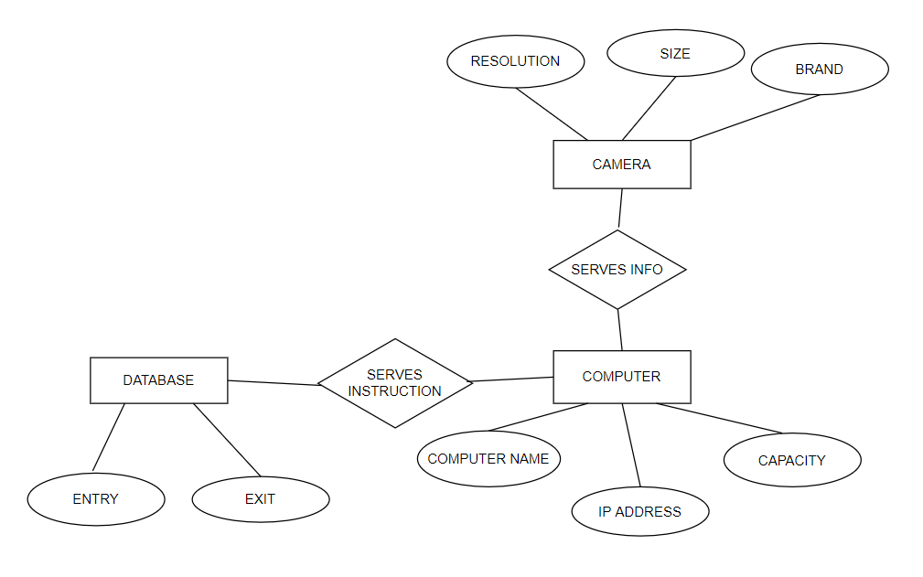
ER DIAGRAM

Slide 13
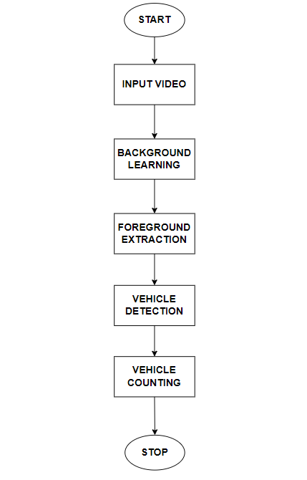
DATAFLOW DIAGRAM
USECASE DIAGRAM

Slide 14
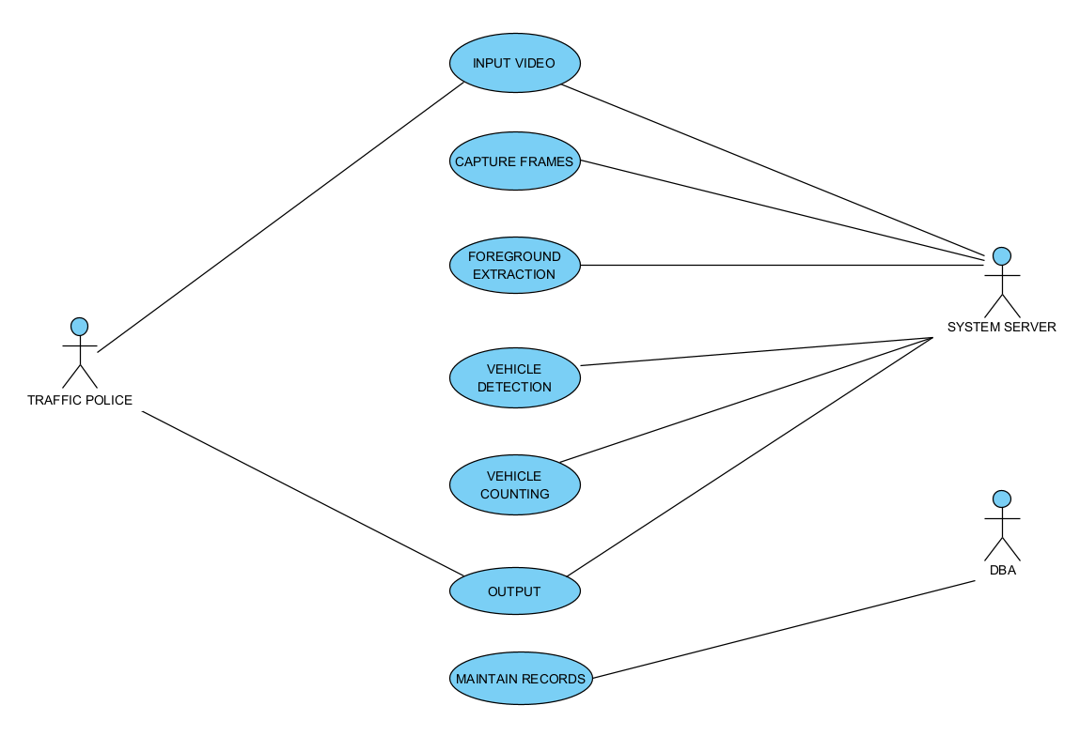
USECASE DIAGRAM

Slide 15
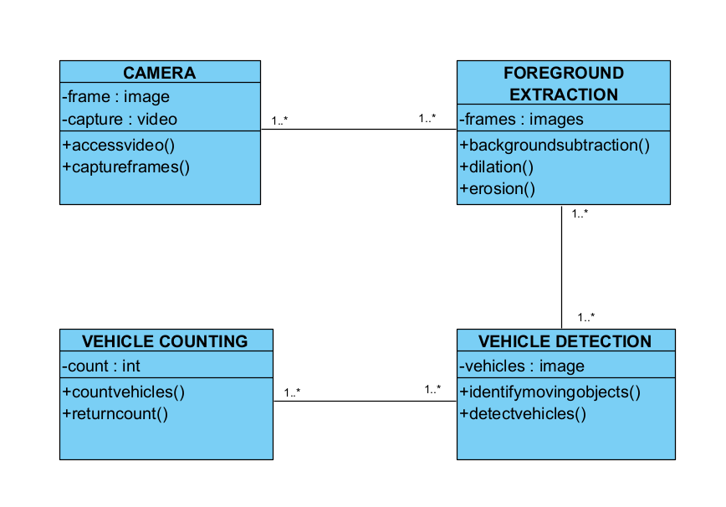
CLASS DIAGRAM

Slide 16
MODULES
Input Video
Background Learning
Foreground Extraction
Vehicle Detection
Vehicle Counting

Slide 17

MODULES DESCRIPTION
Input Video :
In this type of processing typically needs input data provided by the computer vision system and acting as a vision sensor and providing a high-level information. Then the video frames which are captured by the surveillance cameras are given as an input video for vehicle detection and counting.

Slide 18
Background Learning :
In this module the main purpose is to learn about the background in a sense that how it is different from the foreground. Furthermore as proposed system works on a video feed, this module extracts the frames from it and learns about the background. In a traffic scene captured with a static camera installed on the road side, the moving objects can be considered as the foreground and static objects as the background. Image processing algorithms are used to learn about the background using the above mentioned technique.

Slide 19
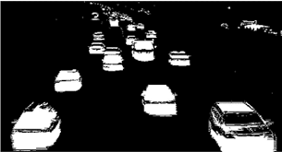
Foreground Extraction :
This module consists of three steps, background subtraction using GMM, image enhancement and foreground extraction. Background is subtracted so that foreground objects are visible. This is done usually by static pixels of static objects. After background subtraction image enhancement techniques such as dilation and erosion are used to get proper contours of the foreground objects. The final result obtained from this module is the foreground.

Slide 20
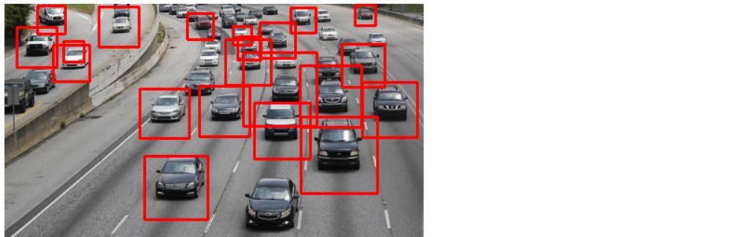
Vehicle Detection :
Vehicle detection is a technique used in computer vision and image processing. Multiple consecutive frames from a video are compared by various methods to determine if any moving object is detected. Moving objects detection has been used for wide range of applications like video surveillance, activity recognition, road condition monitoring, airport safety, monitoring of protection along marine border.

Slide 21
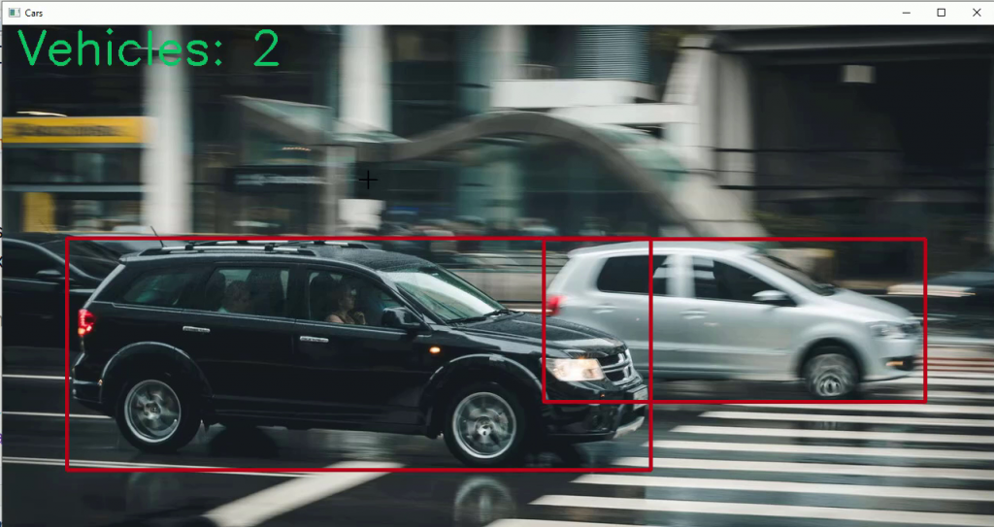
Vehicle Counting :
In counting step, a counter is used to store the sum value of them. A counter should count the vehicles which are passing in the specific direction. So, if any vehicle stops, move turn in any direction in detection zone which are not counted. In this technique, counting is according to the number of moving vehicles detected in the detection zone.

Slide 22
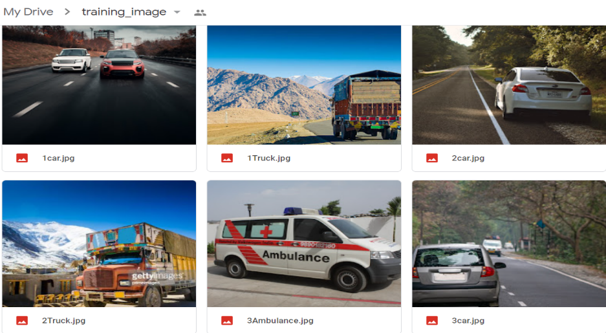
DATASET
This dataset was used in project for detecting vehicles in an video. This dataset contain 556 images for each class of vehicle. The classes in this dataset is:
Bus
Car
Truck
Ambulance
LINK:
https://drive.google.com/drive/folders/1U- 5jxcPBfNTsay9pCI5QnGY3ruG2MSqH

Slide 23
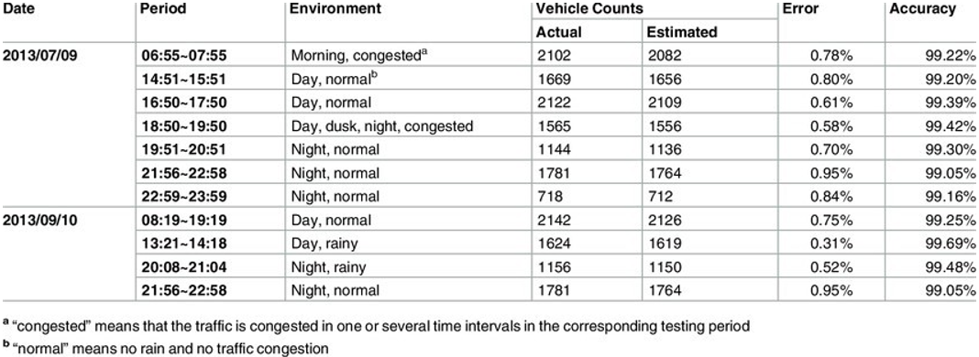
PERFORMANCE ANALYSIS

Slide 24
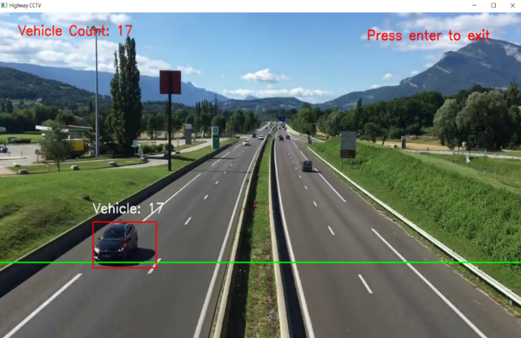
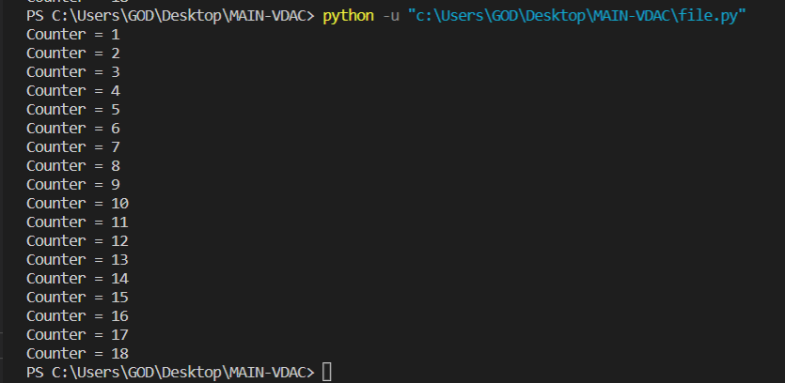
SCREENSHOTS

Slide 25
CONCLUSION
Therefore the proposed solution is implemented on python, using the OpenCV bindings. The traffic camera footages from variety of sources are in implementation. And it works with already captured videos. Our proposed method performs excellently in traffic jams and various conditions, such as sunny, cloudy, and rainy days.

Slide 26
REFERENCES
Chenghuan Liu , Du Q. Huynh, Yuchao Sun, Mark Reynolds, Steve Atkinson, A Vision-Based Pipeline for Vehicle Counting, Speed Estimation, and Classification, IEEE, 2020
Zhe Dai, Huansheng Song, Xuan Wang, Yong Fang, Xu Yun,Zhaoyang Zhang, Huaiyu Li, Video-Based Vehicle Counting Framework, IEEE, 2019

Slide 27
Hilal Tayara, Kim Gil Soo, Kil To Chong, Vehicle Detection and Counting in High-Resolution Aerial Images Using Convolutional Regression Neural Network, IEE, 2017
Wei Li, Hongliang Li, Qingbo Wu, Xiaoyu Chen, King Ngi Ngan, Simultaneously Detecting and Counting Dense Vehicles From Drone Images, IEEE, 2019

Slide 28
THANK YOU!!!

