Slide 1
GITFlow
Vũ Đức Thắng

Slide 2
I. What is GitFlow?
II. How it works
III. Conventions, Rules
IV. Demo

Slide 3
I. What is GitFlow?
Made by Vicent Driessen at nvie.
Git branching model – streamlining collaboration and scaling teams.
Give rules fow how to work with invidual branches by assigning specific roles and defining how they interact

Slide 4
II. How it works
Main/master
Hotfix
Release
Develop
Feature

Slide 5
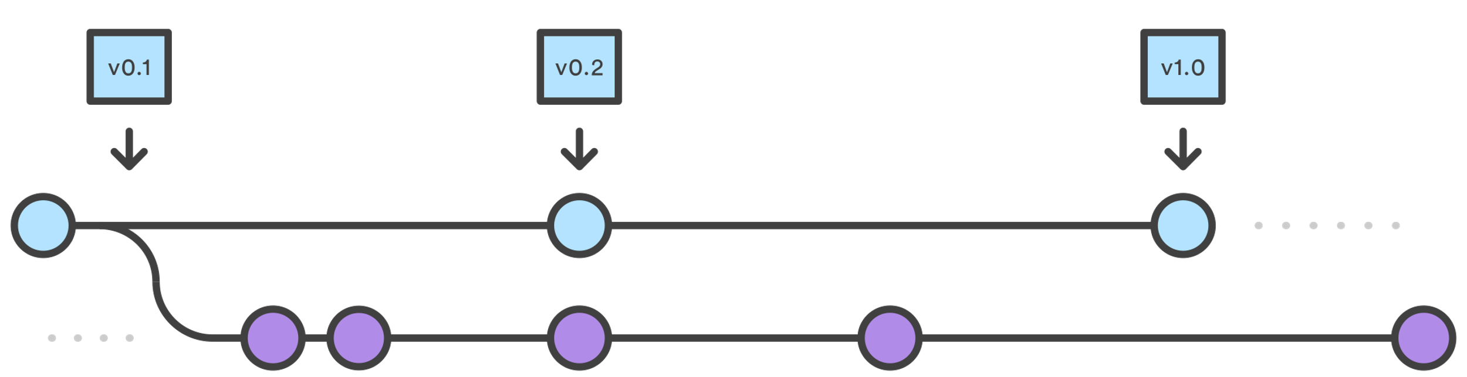
Main – Develop branches
Main/master
Develop
Main branch stores official release branch (tag version: v0.1, v0.2,…).
Develop branch serves as an interation branch for features.
Develop based on Main branch.

Slide 6
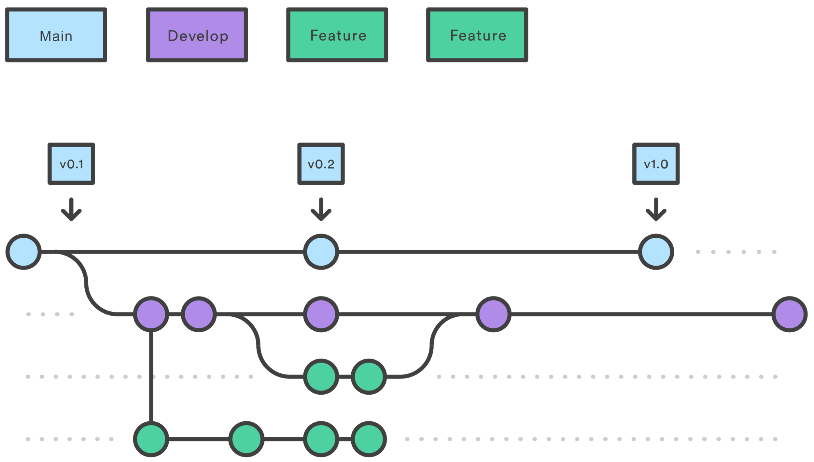
Feature branches
Main/master
Develop
Feature
Feature branches store functions/business in a sprint work (login, curd,…).
Feature base on Develop branch.
Feature never interact directly with Main branch.
When complete, create pull request/merge request to Develop branch.

Slide 7
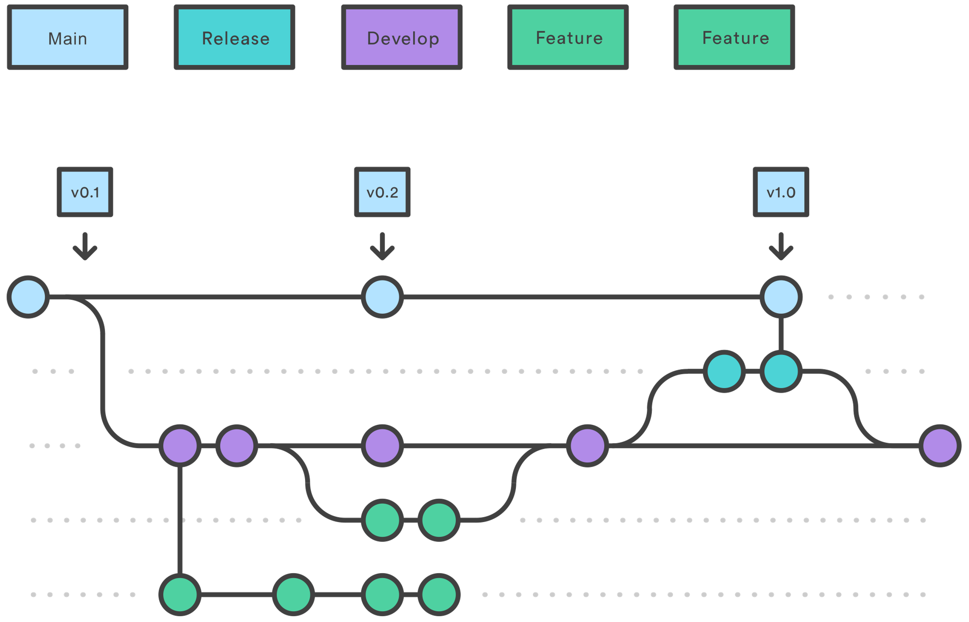
Release branches
Main/master
Release
Develop
Feature
When has enough features for release → Release branch is created.
Release branch only stores bug fixes, documentation generation, other config release.
When ready to ship Release branch merged into Main branch (tag version) and merged back to Develop branch.
Release branch based on Develop branch.

Slide 8
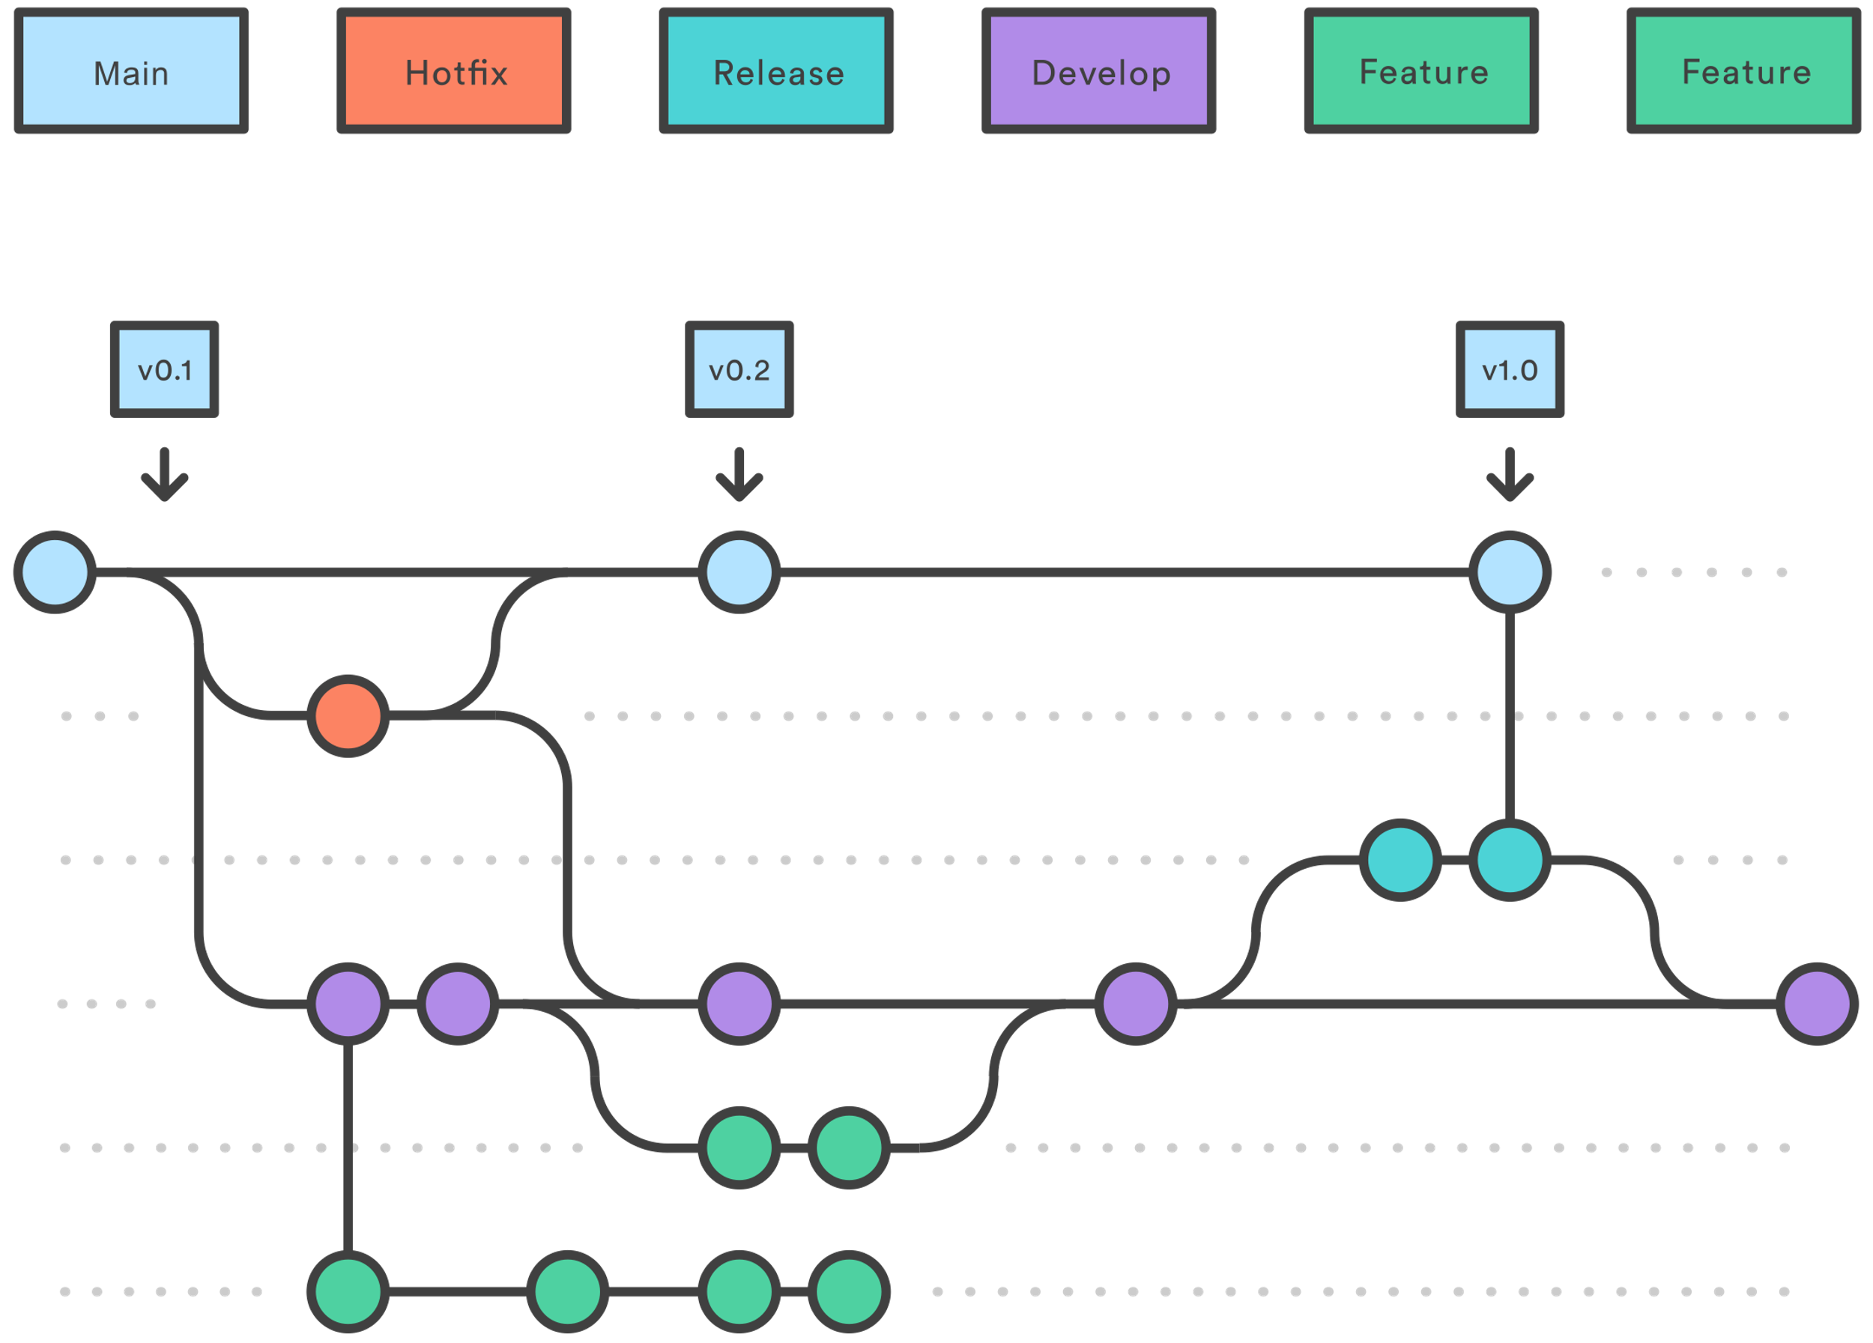
Hotfix branches
Main/master
Hotfix
Release
Develop
Feature
Hotfix branches are used to quickly path production releases.
Hotfix branch based on Main branch.
When fix is complete, Hotfix branch merged into Main branch (update tag version) and Develop (or current Release branch).

Slide 9
Overview
Main
v0.1
v0.1.1
Bugfix1
Hotfix/HF1
Bugfix 2
Release/v0.1
Develop
Feature/T1
Change must be merged
Back into feature branch
Stable and tested
Feature/T2

Slide 10
III. Conventions, Rules
Naming
Feature branches: feature/NameOfFeature (PascalCase - ExportCSVInvoice).
Release branches: release/NameOfRelease (PascalCase - Version3.1).
Hotfix branches: hotfix/NameOfHotfix (PascalCase - FixErrorLogin).
Tag Version (Main Develop)
Techlead/SA has permission to do that.
After complete a sprint or hotfix → must to be tagged version.
NameOfVersion’s format like: Version3.1.
PullRequest/MergeRequest
Every change between in each branch (main, develop, feature,…) must be created
pullrequest/merge request and review by Techlead/SA.
Role and Permission need configed to guaranteed GitFlow.

Slide 11
III. Conventions, Rules
Branch | Position | Create | Pull | Push | Accept pullrequest/merge request | TagVersion
Main | Dev
 | Techlead/SA | v | v | v | v | v
 | PM | v | v | v | v | v
Develop | Dev |  | v
 | Techlead/SA | v | v | v | v | v
 | PM | v | v | v | v | v

Slide 12
III. Conventions, Rules
Branch | Position | Create | Pull | Push | Accept pullrequest/merge request | TagVersion
Feature | Dev | v | v | v
 | Techlead/SA | v | v | v | v | v
 | PM | v | v | v | v | v
Release | Dev |  | v | v
 | Techlead/SA | v | v | v | v | v
 | PM | v | v | v | v | v

Slide 13
III. Conventions, Rules
Branch | Position | Create | Pull | Push | Accept pullrequest/merge request | TagVersion
Hotfix | Dev |  | v | v
 | Techlead/SA | v | v | v | v | v
 | PM | v | v | v | v | v

Slide 14
IV. DEMO

Slide 15
THANK YOU !
Vũ Đức Thắng

