Slide 1
GraphQL and GraphQL.NET
David stevenson

Slide 2
Why use GraphQL and GraphQL.NET?
The QL in GraphQL stands for Query Language
Clients are able to specify exactly the data that is needed.
Reduce bandwidth and Internet transmission costs for data retrieval. Eliminates over-fetching of data.
Reduce over-fetching and under-fetching of data.
Reduce number of (REST) end-points.
This improves performance for mobile clients.
GraphiQL (when integrated with your GraphQL.NET schema) allows interactive testing of queries.
Include / exclude directives allows easy inclusion / exclusion of data.

Slide 3
5 Reasons Not to Use GraphQL
REST can do much of what GraphQL does You could pass the fields that you need with REST: GET /books/1492030716?fields=title,pageCount Could use JSON Schemas or Odata.
GraphQL will make some tasks more complex
It’s easier to use a web cache with REST than with GraphQL. Caching at the Network level is easier with REST.
You could have performance issues with GraphQL queries. The N+1 Problem. With REST, you can fine-tune your (SQL) queries for each end-point.
The way GraphQL schemas work could be a problem
Notes:
https://blog.logrocket.com/5-reasons-you-shouldnt-be-using-graphql-61c7846e7ed3/ 1. You could pass the fields that you need with REST: GET /books/1492030716?fields=title,pageCount

Slide 4
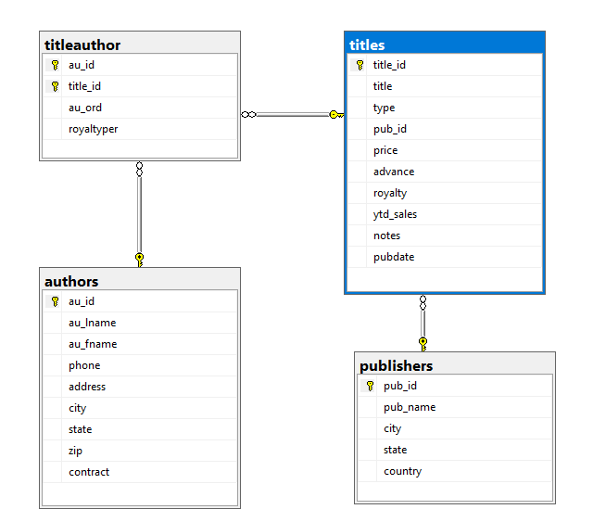
Pubs (Database) Schema

Slide 5
N+1 Problem Example
“The N + 1 problem occurs when an application gets data from the database, and then loops through the result of that data. That means we call to the database again and again and again. In total, the application will call the database once for every row returned by the first query (N) plus the original query ( + 1).”
Get All Authors, with each Author’s Titles, with each Title’s Publisher Problem: Get All Authors (1 Query), Titles for each Author (1 Query per Author) Publisher for each Title (1 Query per Title) A simple GraphQL query could result in hundreds or thousand of queries, where one query would be more efficient.
With Entity Framework, use an Include (eager loading), not Lazy Loading. Cache data for use in GraphQL.NET.
Notes:
https://www.brentozar.com/archive/2018/07/common-entity-framework-problems-n-1/

Slide 6
ASP.NET Core Middleware with GraphQL.NET
Request
Kestrel
Middleware
Middleware
ASP.NET Core Controller
Response

