Slide 1
STM32
LED, Button, PWM, Analog Input,
UART, FreeRTOS
Student Lab 1
18.10.2024

Slide 2

Basic Knowledge
  STM32CubeMX and STM32CubeIDE
  Both software are tools from STMicroelectronics (www.st.com)
  STM32CubeMX
  STM32CubeMX - STM32Cube initialization code generator – STMicroelectronics
  STM32CubeIDE
  STM32CubeIDE - Integrated Development Environment for STM32 - STMicroelectronics
You will need ST account to access these software

Slide 3
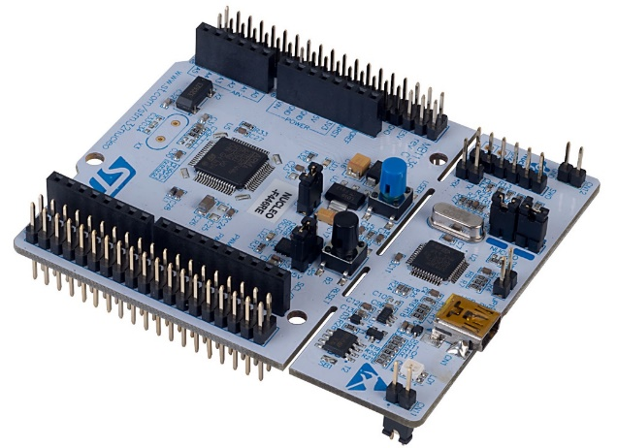
Basic Knowledge
  Development boards
  NUCLEO-G474RE from STMicroelectronics
NUCLEO-G474RE - STM32 Nucleo-64 development board with STM32G474RE MCU, supports Arduino and ST morpho connectivity – STMicroelectronics
with STM32G474RE MCU
STM32G474RE - Mainstream Arm Cortex-M4 MCU 170 MHz with 512 Kbytes of Flash memory, Math Accelerator, HR Timer, High Analog level integration - STMicroelectronics

Slide 4
Basic Knowledge
Microcontroller: STM32G474RE
- Core: ARM Cortex-M4
- Frequency: 170 MHz
- Architecture: 32-bit RISC
Memory:
- Flash Memory: 512 KB
- SRAM: 96 KB
Peripheral / Communication Interfaces:
- SPI: Dual mode QuadSPI interface,
- UART/USART: 5 channels, including USB
- LIN: LIN support via USART
- I2C: 4 interfaces
- ADC: 5 x 12-bit ADCs, up to 42 channels
- DAC: 12-bit DAC, 7 channels
- GPIO: Up to 107 pins
- Timers: 17 timers
- DMA: 16 streams, 16-bit data bus
Operating System Support:
- FreeRTOS: Supported
Debugging and Programming:
- On-board Debugger: STLINK-V3E debugger/programmer
- IDE Compatibility: STM32CubeIDE, Keil MDK-ARM, IAR
Embedded Workbench
Expansion connectors:
- Arduino Uno V3 Connectivity
- ST morpho headers
Additional Features:
- CRC Calculation Unit
- True Random Number Generator

Slide 5
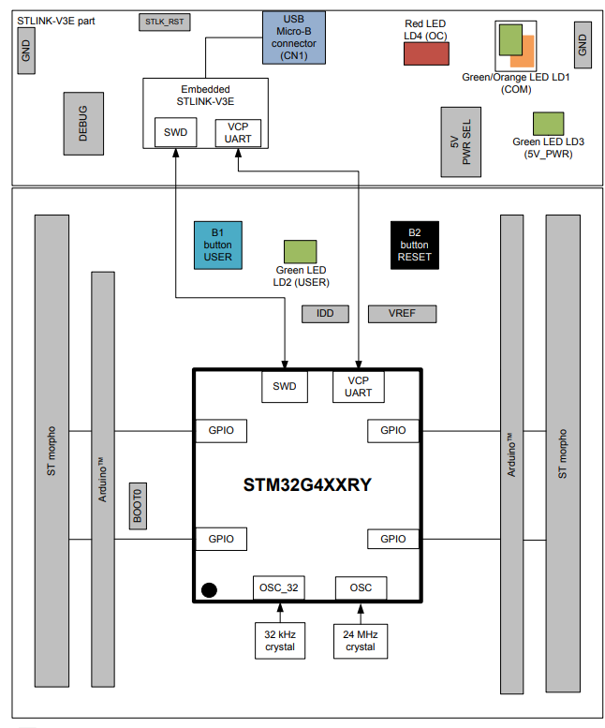
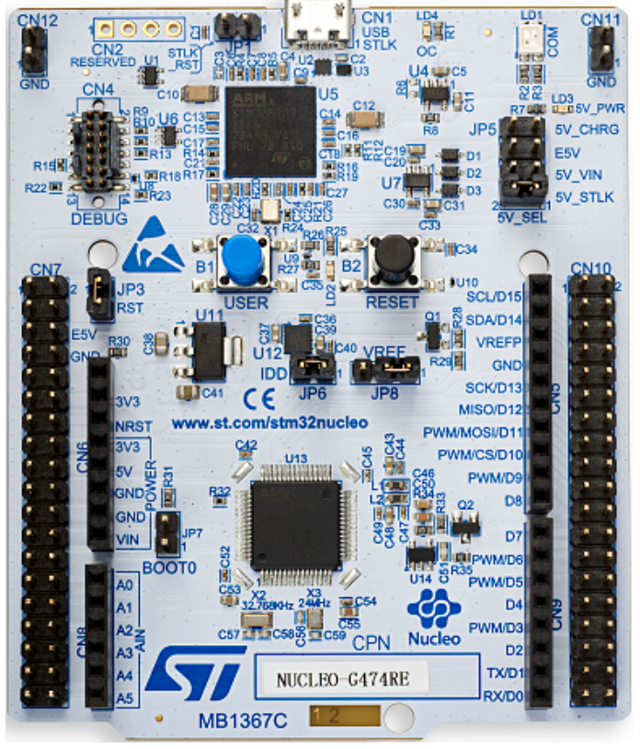
Basic Knowledge: Nucleo board
User Button B1
User LED LD2

Slide 6
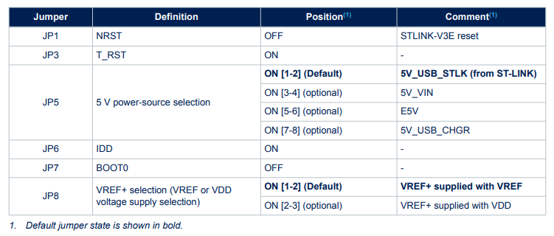
Basic Knowledge: Nucleo board
Check the default jumpers and leave them as default!

Slide 7
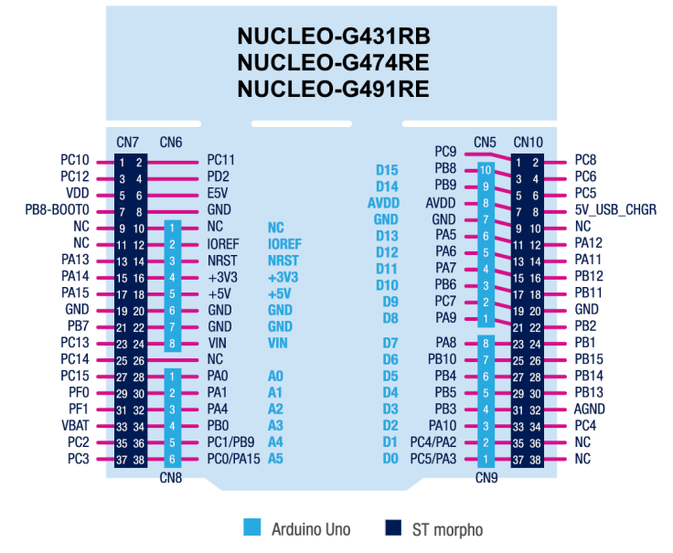
Basic Knowledge: Nucleo board

Slide 8
Lab1 content
Lab1a: LED and Button from NUCLEO (Demonstration code from NUCLEO board)
Lab1b:
- LED and Button
- PWM and FreeRTOS
- Exercise 1 (combine LED, button, and PWM)
Lab1c:
- Analog Input (ADC)
- Exercise 2 (read potentiometer)
Lab1d
- UART
- Exercise 3 (display potentiometer/PWM value)

Slide 9
Lab1a
LED and Button from NUCLEO
Notes:
F:\AEE\AEE2\BSW\BSW Goals\ST firmware\StudentLab2024\Lab1a\Lab1a_LED_Button

Slide 10
Lab1a: LED and Button from NUCLEO
In this lab, we will use the demonstration code that provided by NUCLEO board
We will learn how to open STM32CubeMX and generate code to STM32CubeIDE
We will learn to run the code in debug mode of STM32CubeIDE
Notes:
F:\AEE\AEE2\BSW\BSW Goals\ST firmware\StudentLab2024\Lab1a\Lab1a_LED_Button

Slide 11
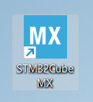
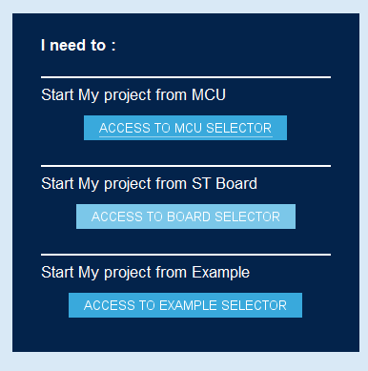
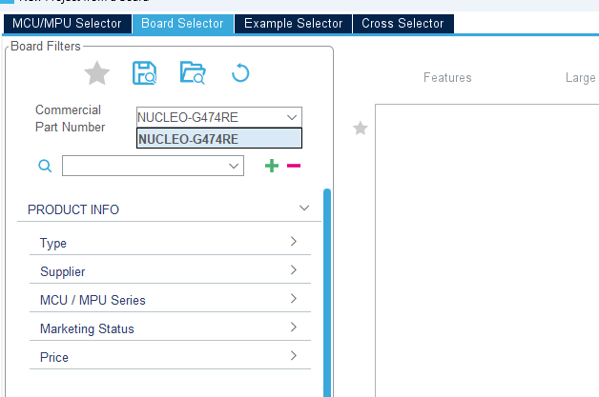
Lab1a: LED and Button from NUCLEO
Open STM32MCubeMX
Type
Click
Notes:
F:\AEE\AEE2\BSW\BSW Goals\ST firmware\StudentLab2024\Lab1a\Lab1a_LED_Button

Slide 12
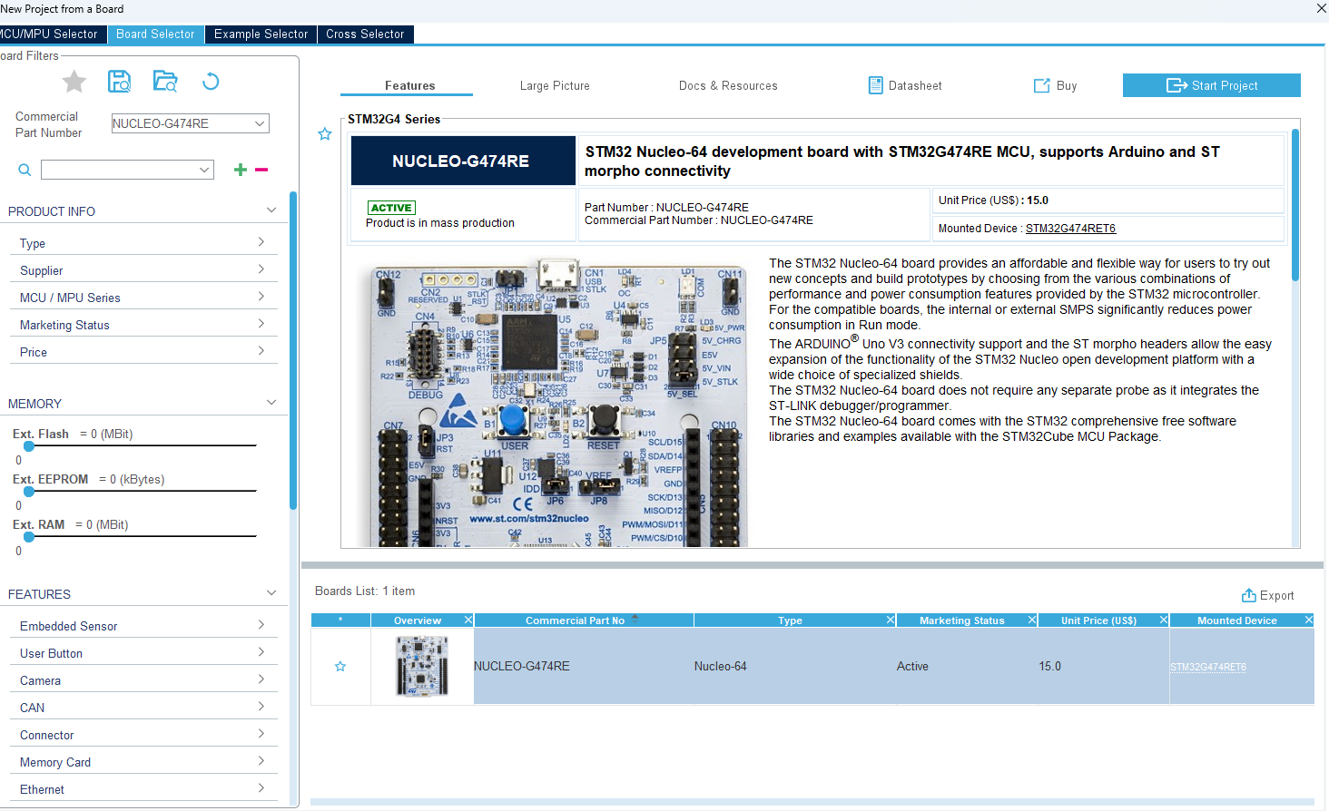
Lab1a: LED and Button from NUCLEO
Click
Choose
Notes:
F:\AEE\AEE2\BSW\BSW Goals\ST firmware\StudentLab2024\Lab1a\Lab1a_LED_Button

Slide 13
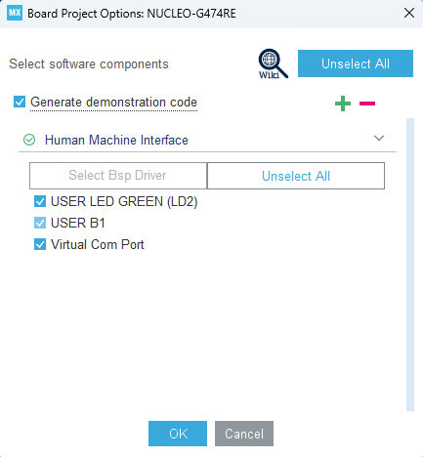
Lab1a: LED and Button from NUCLEO
Leave others as default and click
Notes:
F:\AEE\AEE2\BSW\BSW Goals\ST firmware\StudentLab2024\Lab1a\Lab1a_LED_Button

Slide 14
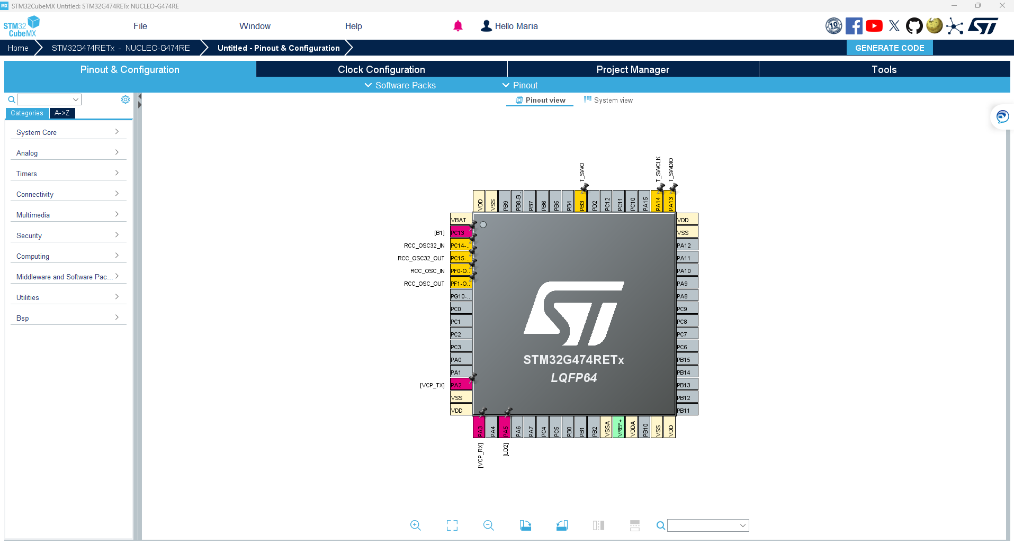
Lab1a: LED and Button from NUCLEO
Notes:
F:\AEE\AEE2\BSW\BSW Goals\ST firmware\StudentLab2024\Lab1a\Lab1a_LED_Button

Slide 15
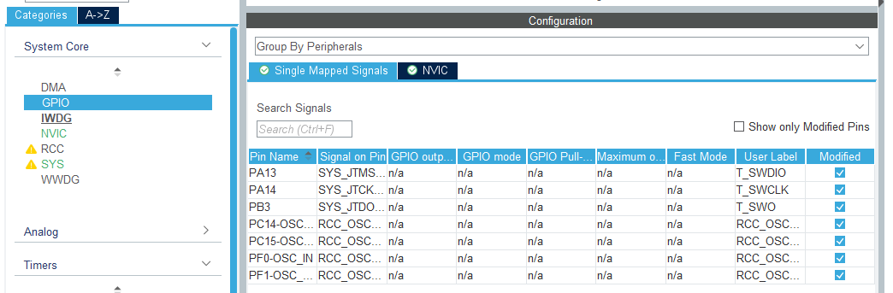
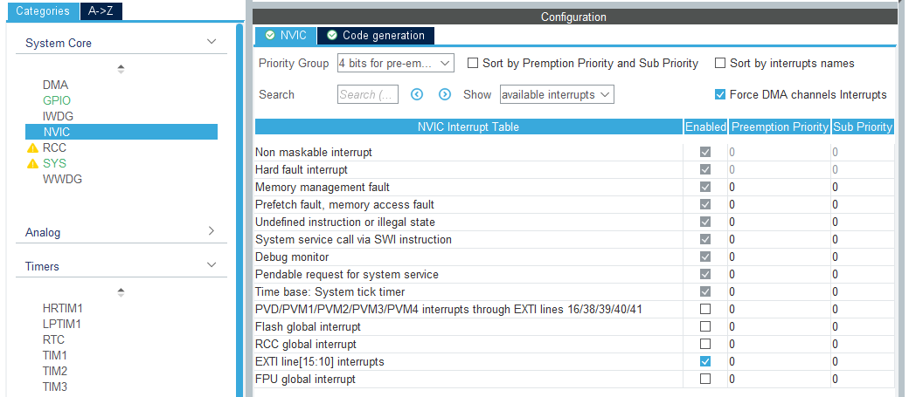
Lab1a: LED and Button from NUCLEO
Check Pinout & Configuration that made by Nucleo board
Notes:
F:\AEE\AEE2\BSW\BSW Goals\ST firmware\StudentLab2024\Lab1a\Lab1a_LED_Button

Slide 16
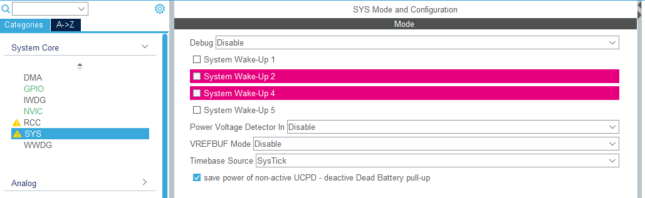
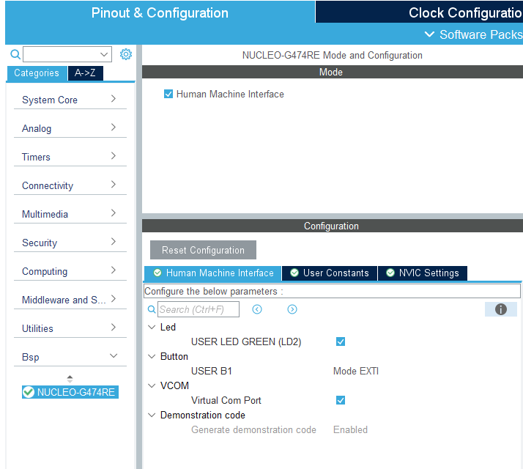
Lab1a: LED and Button from NUCLEO
Notes:
F:\AEE\AEE2\BSW\BSW Goals\ST firmware\StudentLab2024\Lab1a\Lab1a_LED_Button

Slide 17
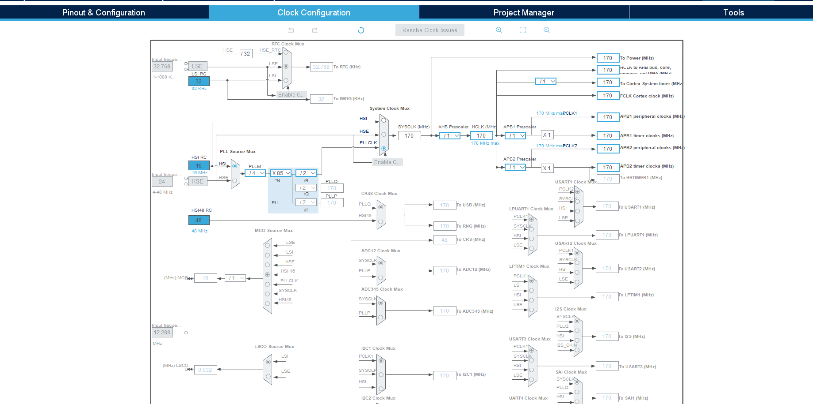
Lab1a: LED and Button from NUCLEO
Check Clock Configuration that made by Nucleo board
Leave everything as default
Notes:
F:\AEE\AEE2\BSW\BSW Goals\ST firmware\StudentLab2024\Lab1a\Lab1a_LED_Button

Slide 18
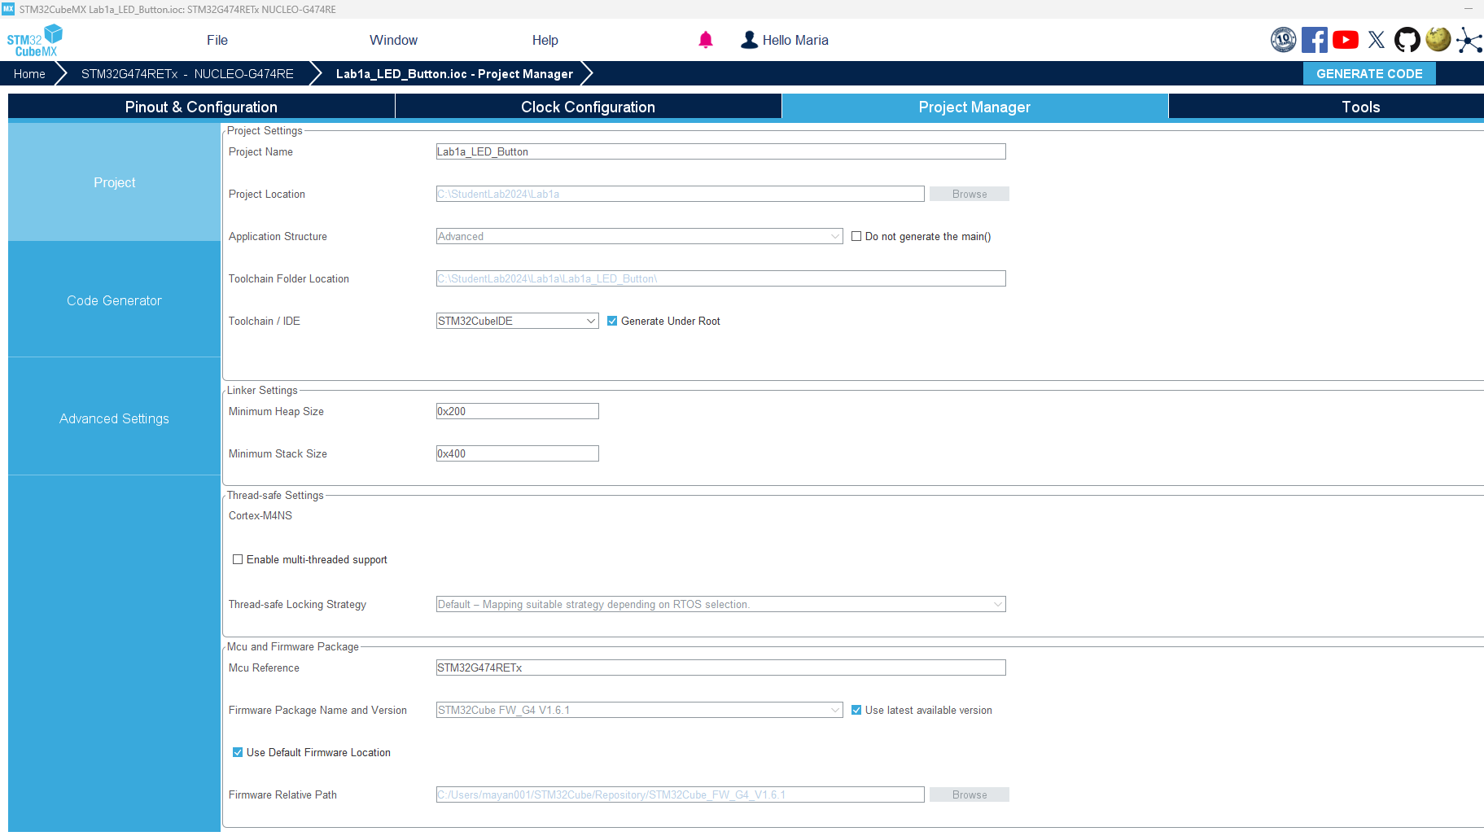
Lab1a: LED and Button from NUCLEO
Leave others as default
Notes:
F:\AEE\AEE2\BSW\BSW Goals\ST firmware\StudentLab2024\Lab1a\Lab1a_LED_Button

Slide 19
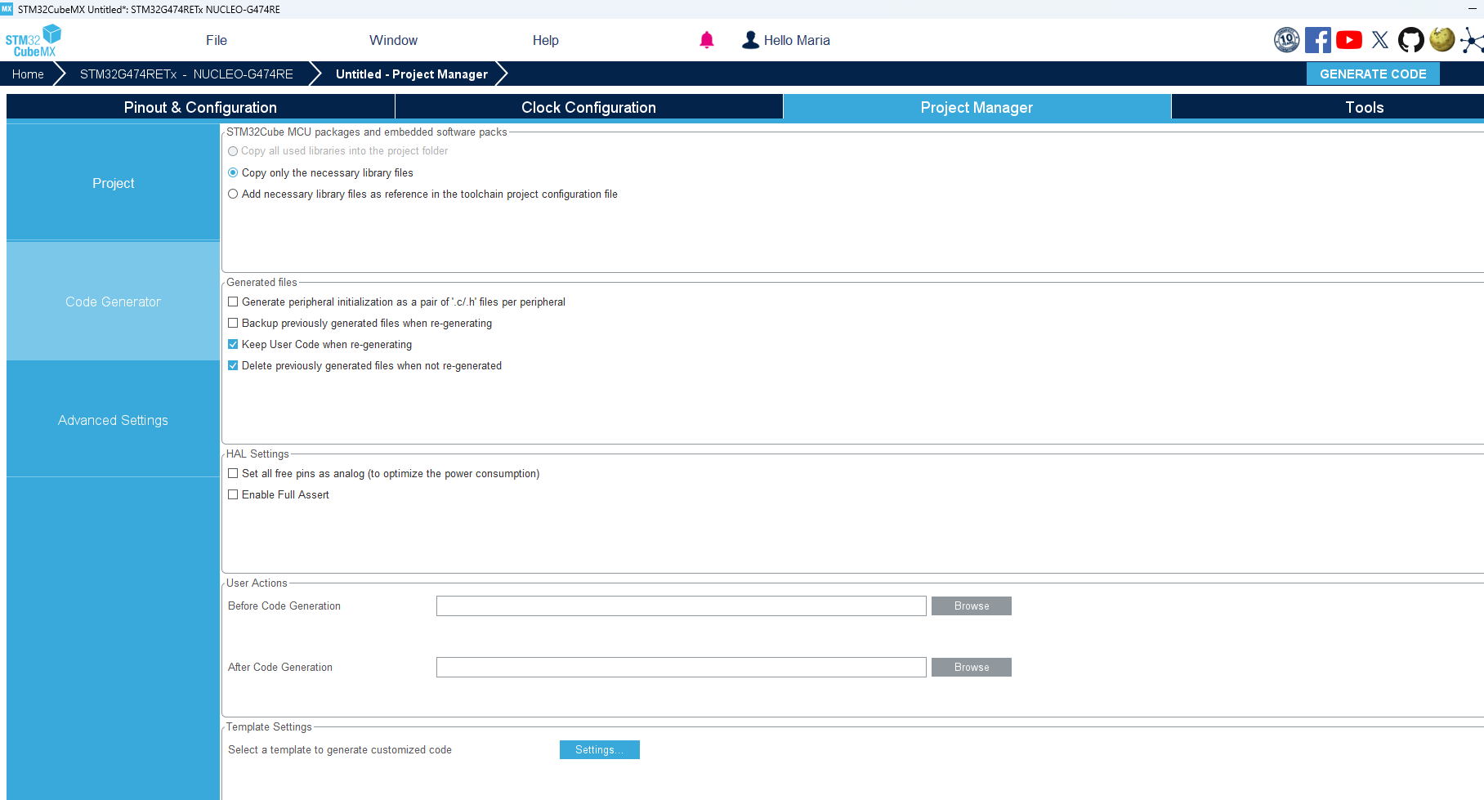
Lab1a: LED and Button from NUCLEO
Leave others as default and click
Notes:
F:\AEE\AEE2\BSW\BSW Goals\ST firmware\StudentLab2024\Lab1a\Lab1a_LED_Button

Slide 20
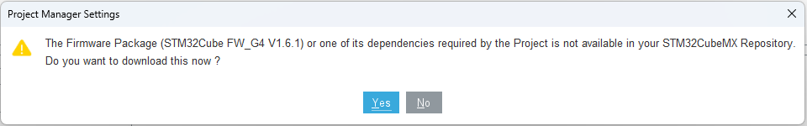
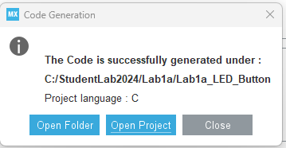
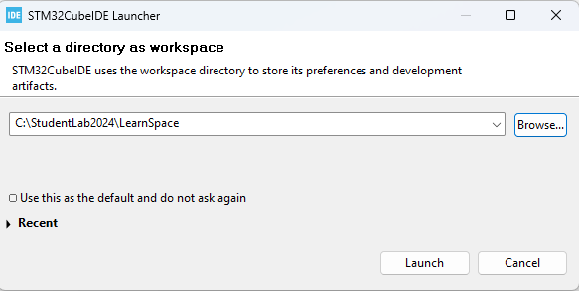
Lab1a: LED and Button from NUCLEO
Sometimes it will ask for downloading new package. Click Yes to continue
Click Open Project when this window appears
Choose or type workspace folder
Notes:
F:\AEE\AEE2\BSW\BSW Goals\ST firmware\StudentLab2024\Lab1a\Lab1a_LED_Button

Slide 21
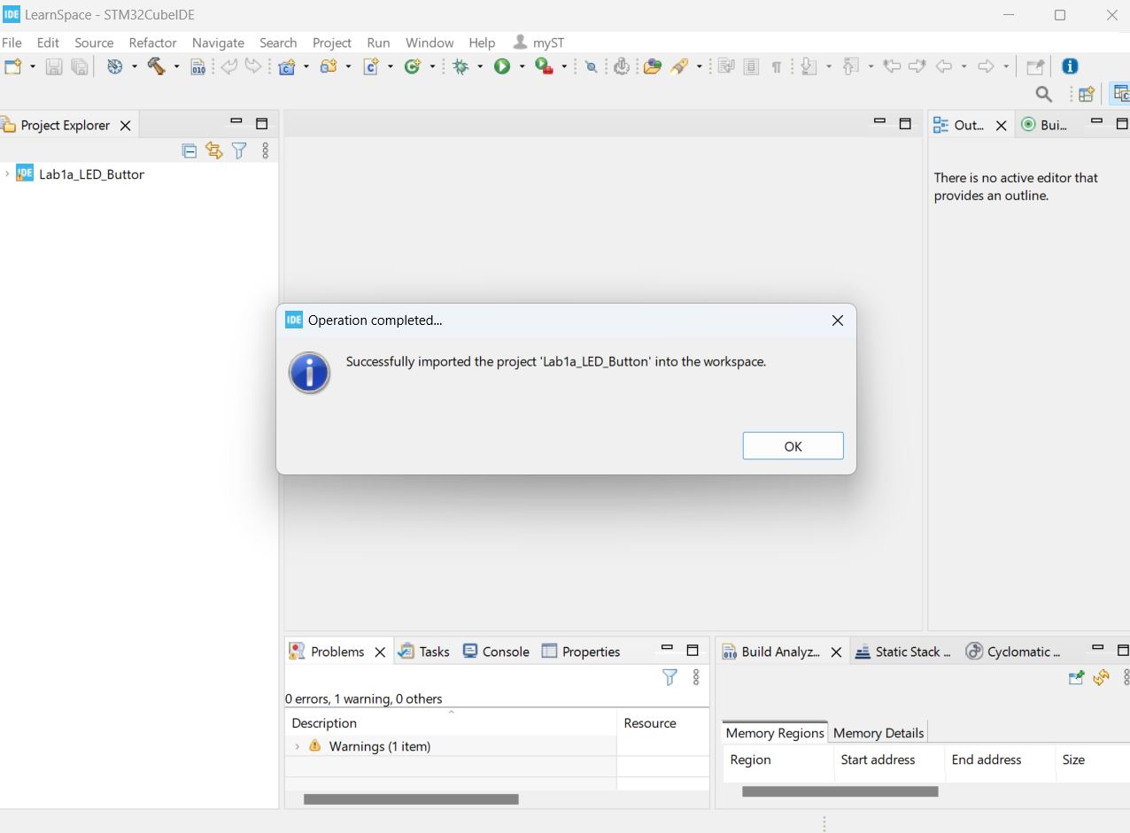
Lab1a: LED and Button from NUCLEO
The project will be opened in STM32CubeIDE
Notes:
F:\AEE\AEE2\BSW\BSW Goals\ST firmware\StudentLab2024\Lab1a\Lab1a_LED_Button

Slide 22
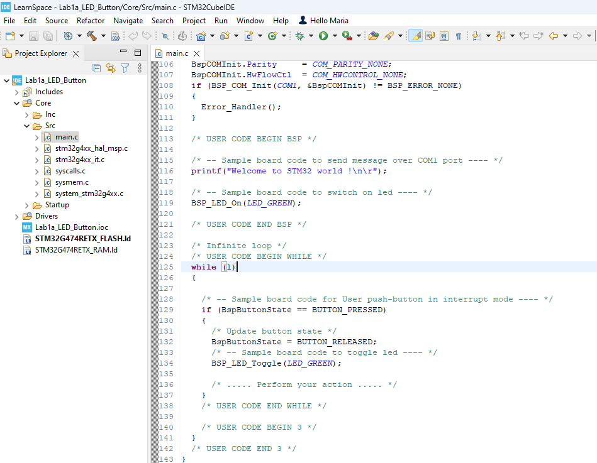
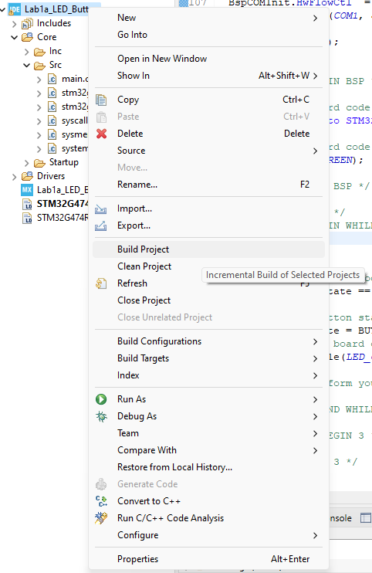
Lab1a: LED and Button from NUCLEO
Check main.c, double click to open
To build project:
  Right click on the project name and choose Built Project
Notes:
F:\AEE\AEE2\BSW\BSW Goals\ST firmware\StudentLab2024\Lab1a\Lab1a_LED_Button

Slide 23
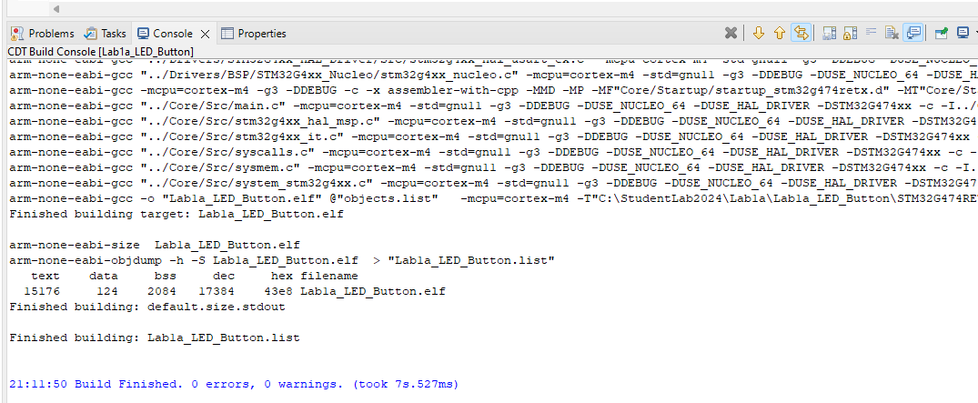
Lab1a: LED and Button from NUCLEO
From Console tab, it can be seen whether the project is built successfully or not
Notes:
F:\AEE\AEE2\BSW\BSW Goals\ST firmware\StudentLab2024\Lab1a\Lab1a_LED_Button

Slide 24
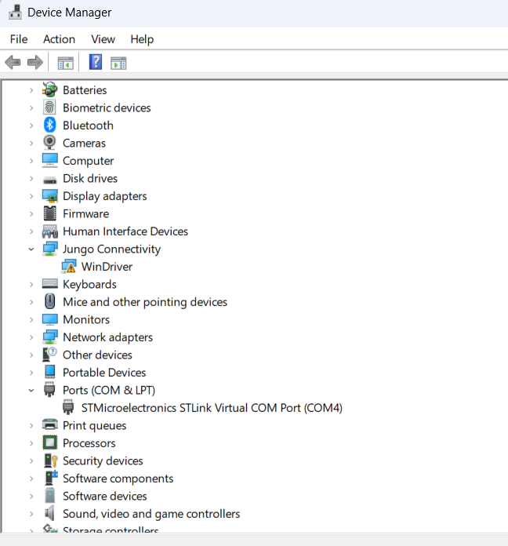
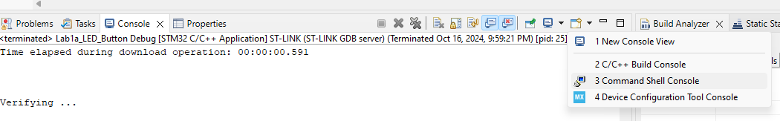
Lab1a: LED and Button from NUCLEO
To use serial print to monitor
Go to the Device Manager and check the STLink Virtual COM Port
From Console tab of STM32CubeIDE
Notes:
F:\AEE\AEE2\BSW\BSW Goals\ST firmware\StudentLab2024\Lab1a\Lab1a_LED_Button

Slide 25
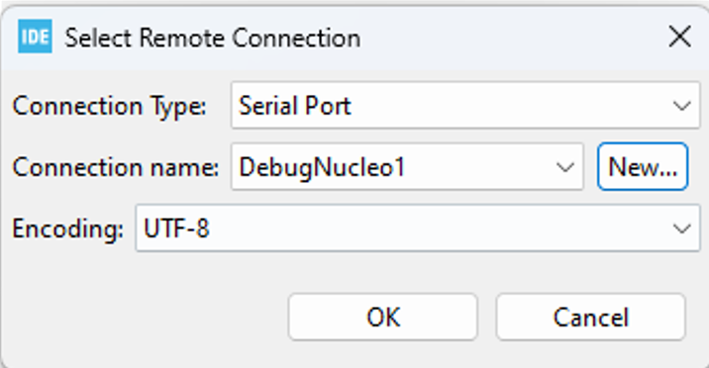
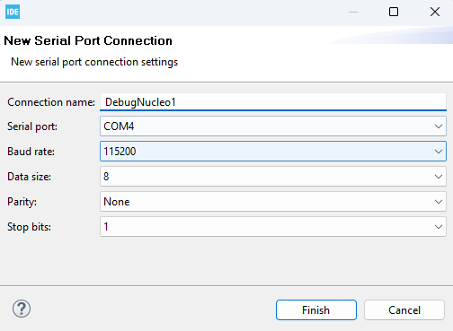
Put connection name and COM settings
Notes:
F:\AEE\AEE2\BSW\BSW Goals\ST firmware\StudentLab2024\Lab1a\Lab1a_LED_Button

Slide 26

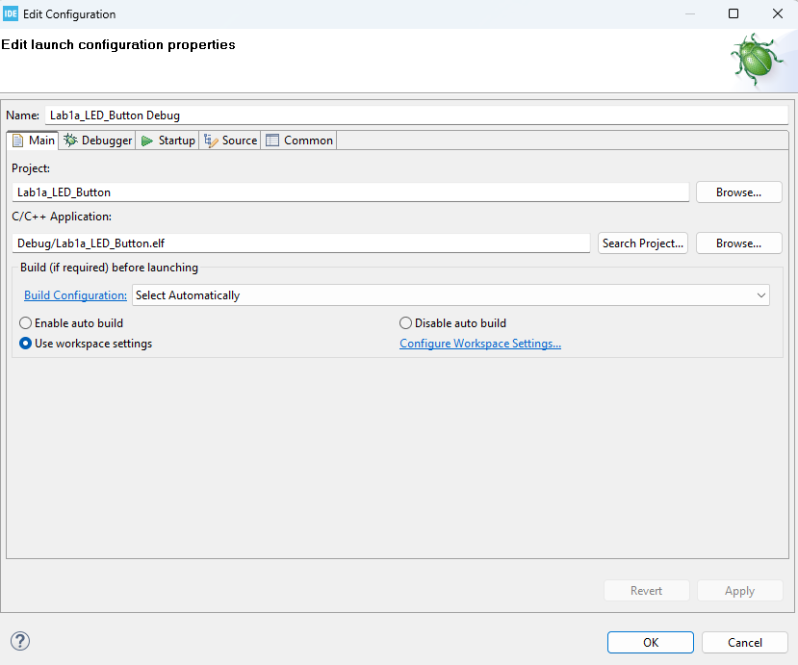
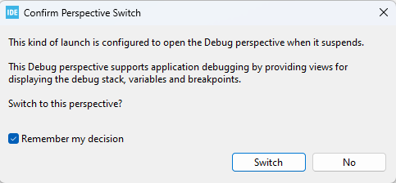
Lab1a: LED and Button from NUCLEO
Connect NUCLEO-G474RE to PC
Click Debug button
- Click Switch if this window appears
Leave everything as default and click
Notes:
F:\AEE\AEE2\BSW\BSW Goals\ST firmware\StudentLab2024\Lab1a\Lab1a_LED_Button

Slide 27
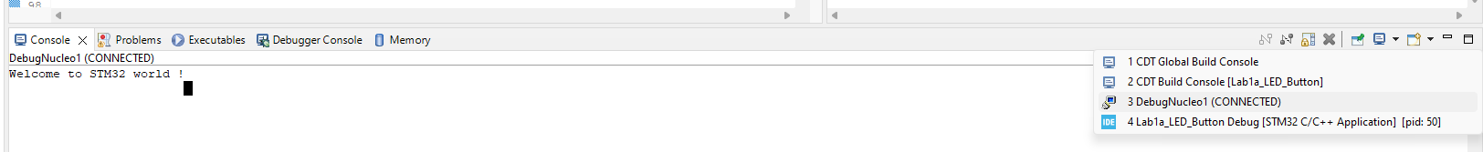
Choose the Console to monitor
Notes:
F:\AEE\AEE2\BSW\BSW Goals\ST firmware\StudentLab2024\Lab1a\Lab1a_LED_Button

Slide 28
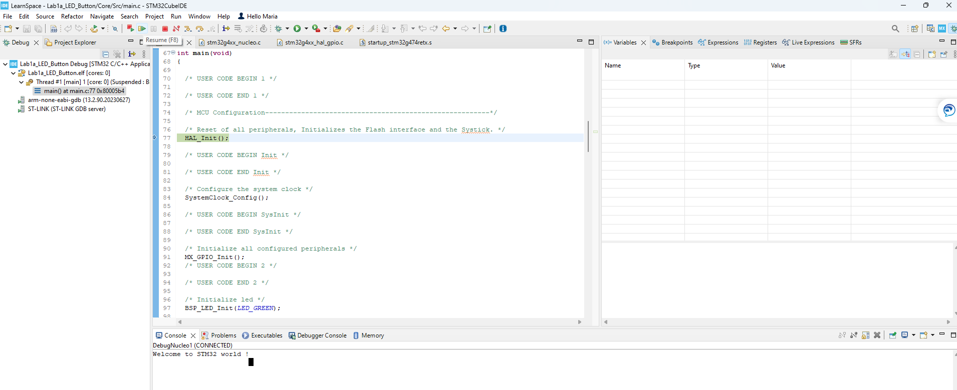
Lab1a: LED and Button from NUCLEO
Click Resume button to run the code
Notes:
F:\AEE\AEE2\BSW\BSW Goals\ST firmware\StudentLab2024\Lab1a\Lab1a_LED_Button

Slide 29
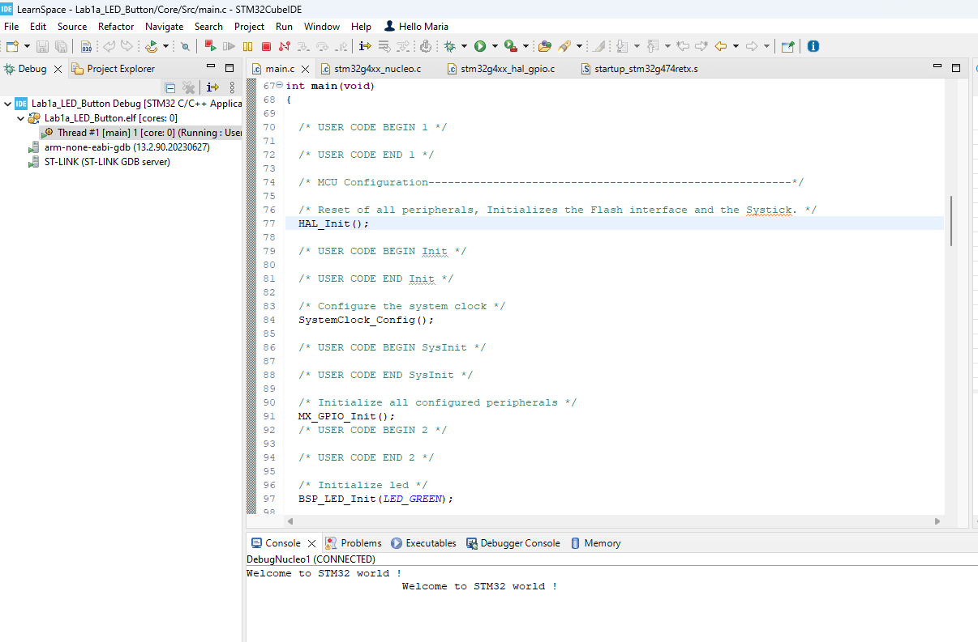
Lab1a: LED and Button from NUCLEO
Observe on NUCLEO board:
  LD2 must lit (ON, green LED) in the beginning
  Every pressing of B1 (blue button), LD2 will be toggled (ON to be OFF, or OFF to be ON)
Notes:
F:\AEE\AEE2\BSW\BSW Goals\ST firmware\StudentLab2024\Lab1a\Lab1a_LED_Button

Slide 30
Lab1b
LED and Button
Notes:
F:\AEE\AEE2\BSW\BSW Goals\ST firmware\StudentLab2024\Lab1b\Lab1b_LED_Button

Slide 31
Lab1b: LED and Button
In this lab, we will set LED and button in STM32CubeMX, not using NUCLEO board setting
We will get familiar with HAL functions for LED and button
We will still use LD2 (PA5) as LED (GPIO output)
We will still use B1 (PC13) as button (GPIO EXTI13)
Notes:
F:\AEE\AEE2\BSW\BSW Goals\ST firmware\StudentLab2024\Lab1b\Lab1b_LED_Button

Slide 32
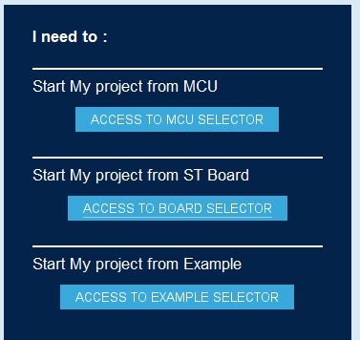
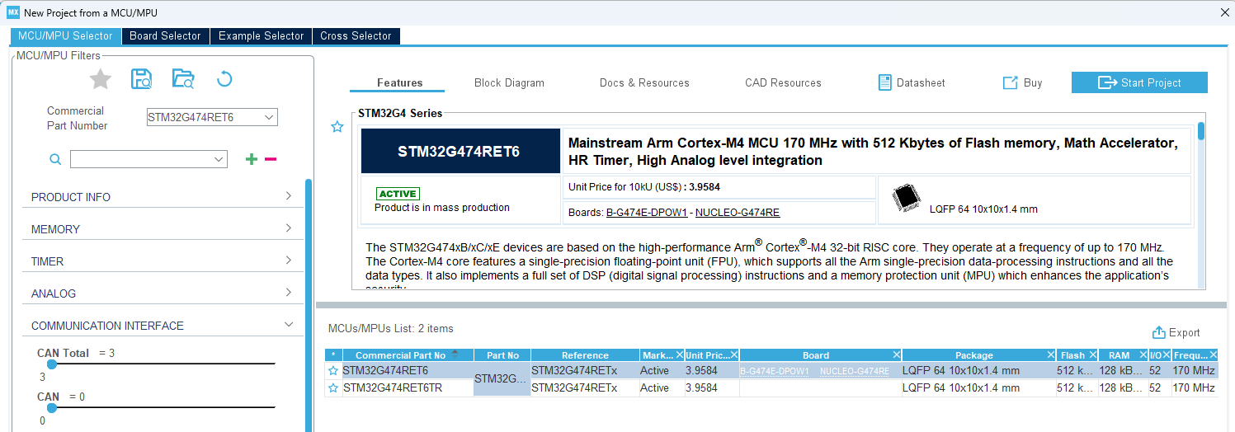
Lab1b: LED and Button
Open STM32MCubeMX
Click
Click
Notes:
F:\AEE\AEE2\BSW\BSW Goals\ST firmware\StudentLab2024\Lab1b\Lab1b_LED_Button

Slide 33
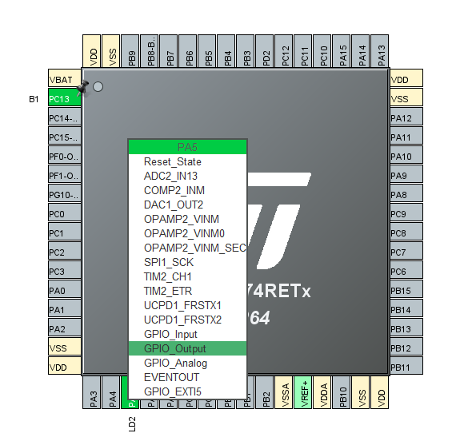
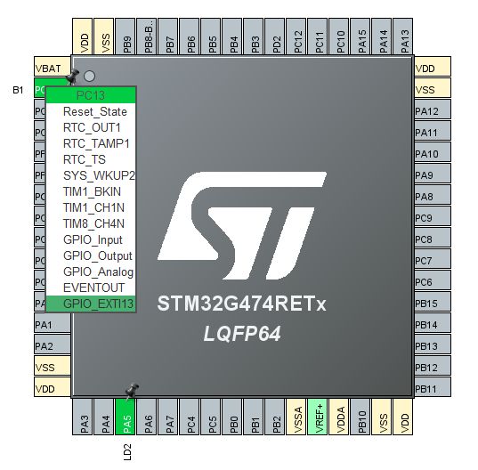
Lab1b: LED and Button
Notes:
F:\AEE\AEE2\BSW\BSW Goals\ST firmware\StudentLab2024\Lab1b\Lab1b_LED_Button

Slide 34
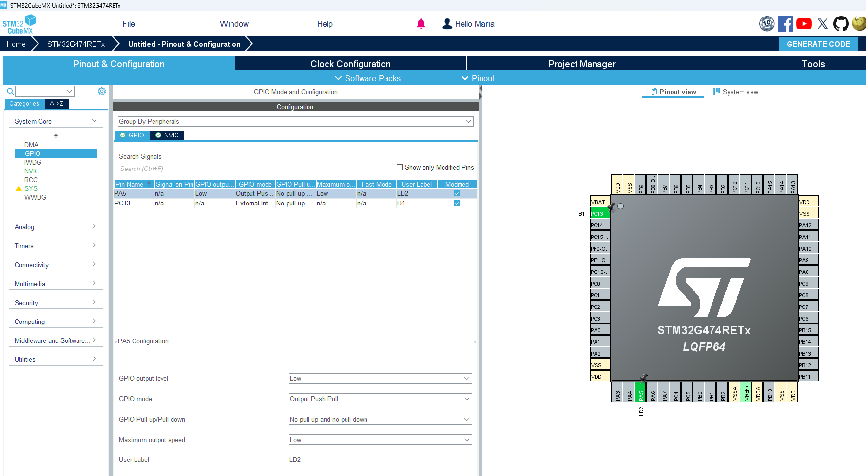
Lab1b: LED and Button
Notes:
F:\AEE\AEE2\BSW\BSW Goals\ST firmware\StudentLab2024\Lab1b\Lab1b_LED_Button

Slide 35
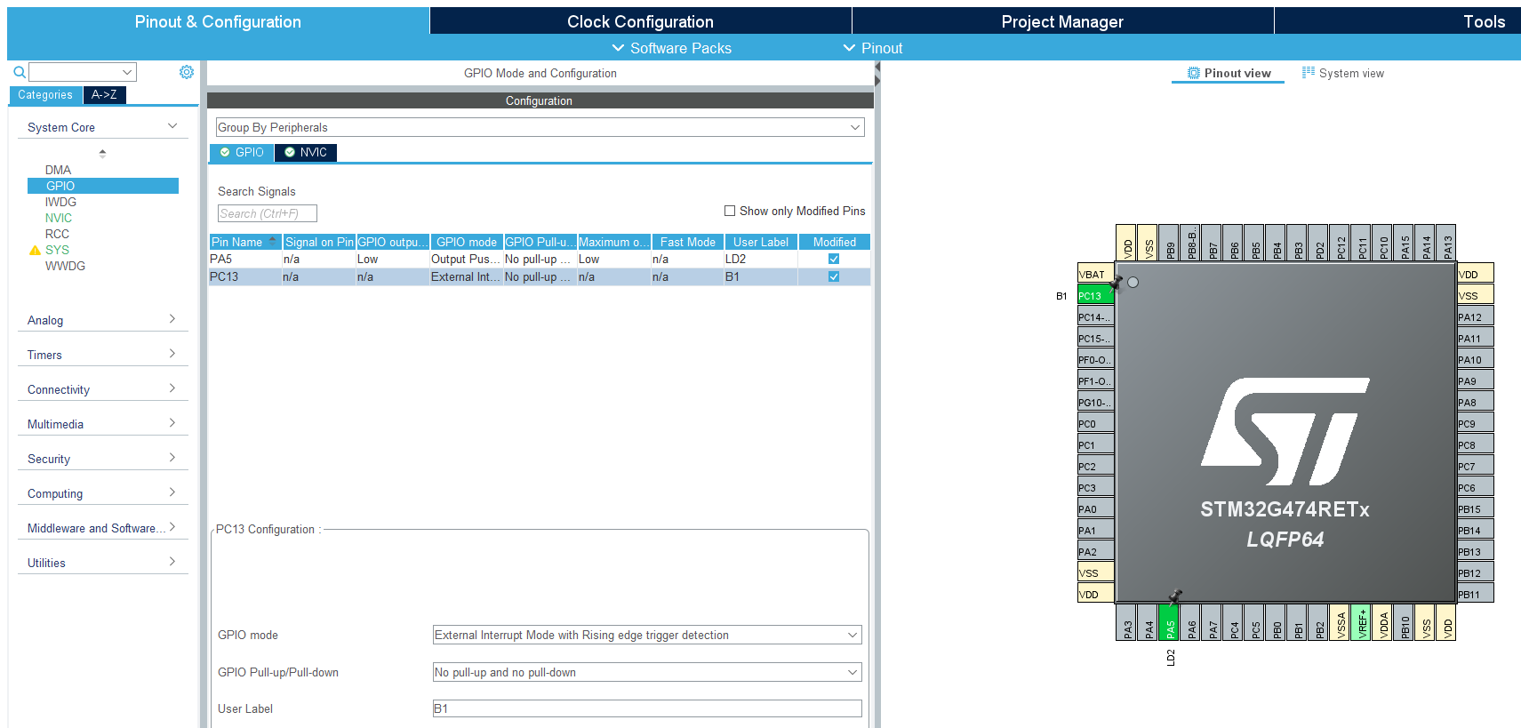
Lab1b: LED and Button
Notes:
F:\AEE\AEE2\BSW\BSW Goals\ST firmware\StudentLab2024\Lab1b\Lab1b_LED_Button

Slide 36
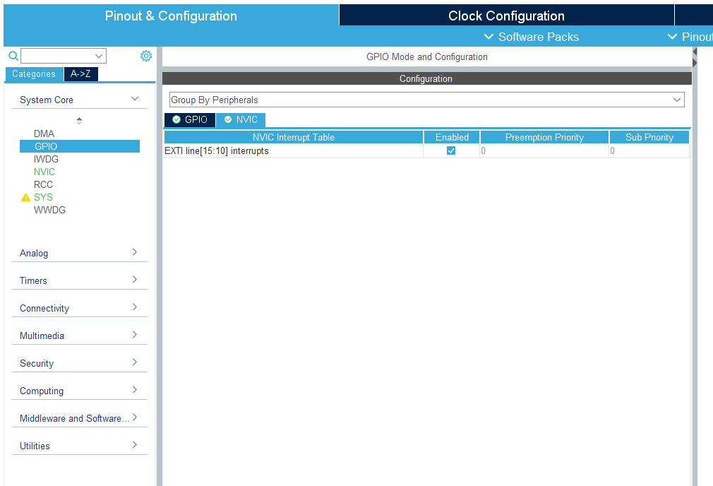
Lab1b: LED and Button
Notes:
F:\AEE\AEE2\BSW\BSW Goals\ST firmware\StudentLab2024\Lab1b\Lab1b_LED_Button

Slide 37
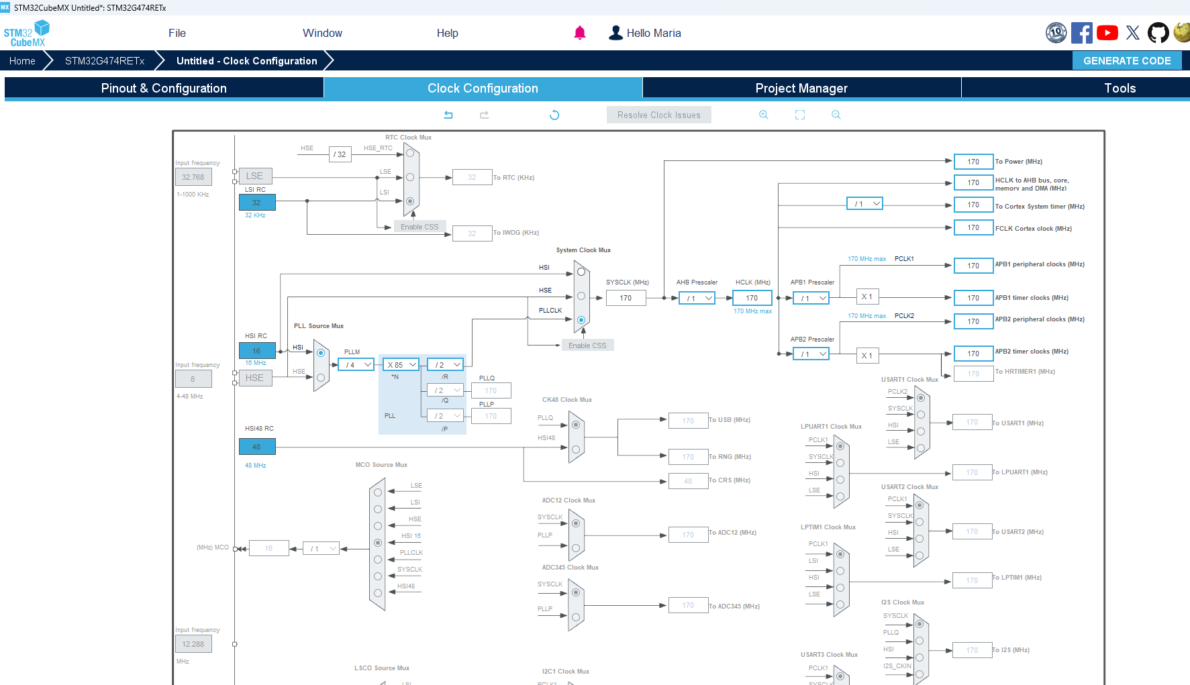
Lab1b: LED and Button
Fill with 170 and it will find the solution automatically
Notes:
F:\AEE\AEE2\BSW\BSW Goals\ST firmware\StudentLab2024\Lab1b\Lab1b_LED_Button

Slide 38
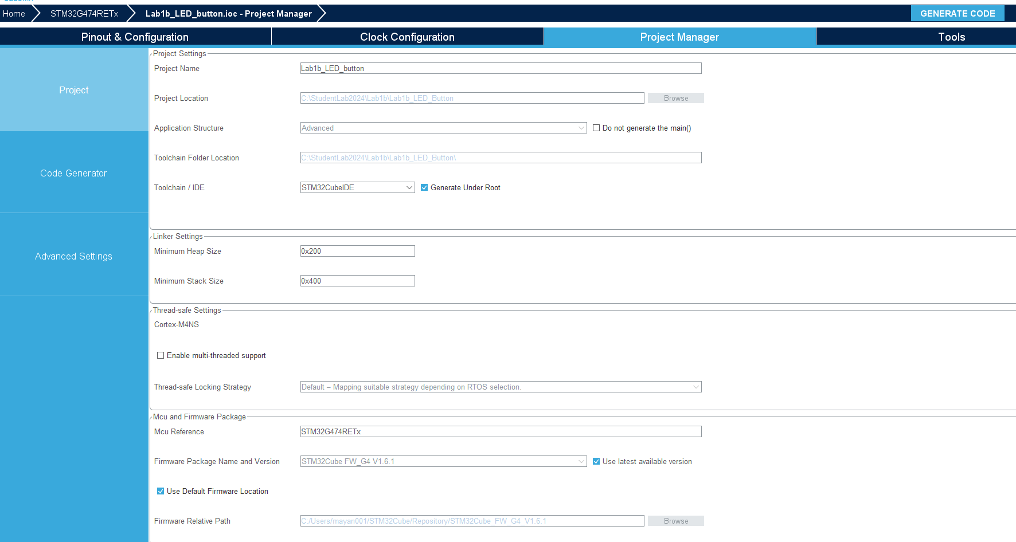
Lab1b: LED and Button
Notes:
F:\AEE\AEE2\BSW\BSW Goals\ST firmware\StudentLab2024\Lab1b\Lab1b_LED_Button

Slide 39
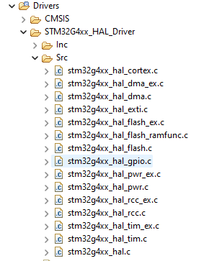
Lab1b: LED and Button
Our code must be put between:
/* USER CODE BEGIN XXXX */
and
/* USER CODE END XXXX */
HAL functions for GPIO can be found in file:
stm32g4xx_hal_gpio.c
Notes:
F:\AEE\AEE2\BSW\BSW Goals\ST firmware\StudentLab2024\Lab1b\Lab1b_LED_Button

Slide 40
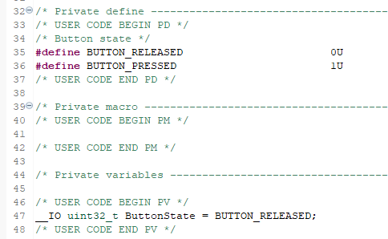
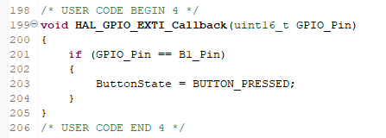

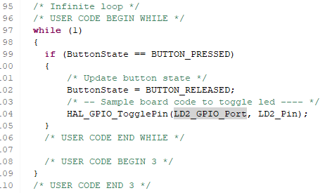
Lab1b: LED and Button
In main.c
Build and debug code
Observe:
  LD2 must lit (ON, green LED) in the beginning
  Every pressing of B1 (blue button), LD2 will be toggled (ON to be OFF, or OFF to be ON)
Notes:
F:\AEE\AEE2\BSW\BSW Goals\ST firmware\StudentLab2024\Lab1b\Lab1b_LED_Button

Slide 41
Lab1b
PWM and FreeRTOS
Notes:
F:\AEE\AEE2\BSW\BSW Goals\ST firmware\StudentLab2024\Lab1b\Lab1b_PWM_FreeRTOS1

Slide 42
Lab1b: PWM and FreeRTOS
In this lab, we will set LED controlled by PWM in STM32CubeMX
We will use PA5 as TIM2_CH1. Timer 2 channel 1 will be set as PWM generator.
  F (PWM) = F (Clock) / ((Prescaler+1) (Period+1))
  We will use: 170MHz / (169+1)(9999+1) = 100 Hz
We will still use B1 (PC13) as button (GPIO EXTI13)
We will use FreeRTOS based code
Clock Configuration tab will be the same as previous example
Notes:
F:\AEE\AEE2\BSW\BSW Goals\ST firmware\StudentLab2024\Lab1b\Lab1b_PWM_FreeRTOS1

Slide 43
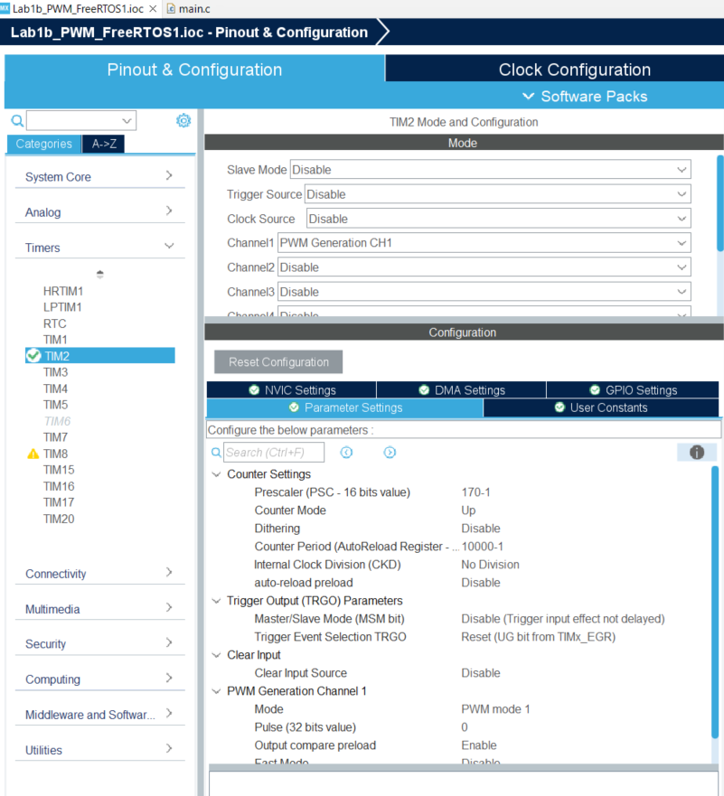
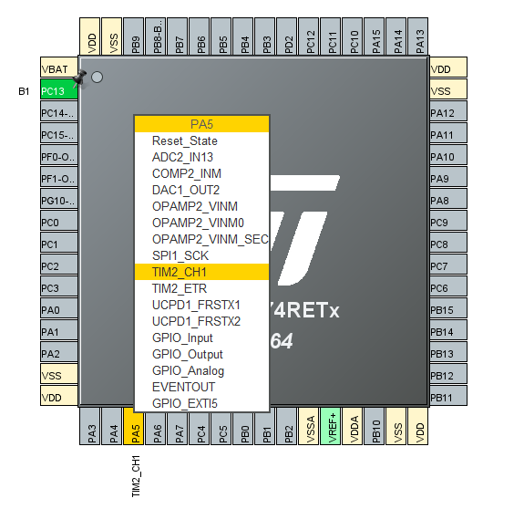
Lab1b: PWM and FreeRTOS
Notes:
F:\AEE\AEE2\BSW\BSW Goals\ST firmware\StudentLab2024\Lab1b\Lab1b_PWM_FreeRTOS1

Slide 44
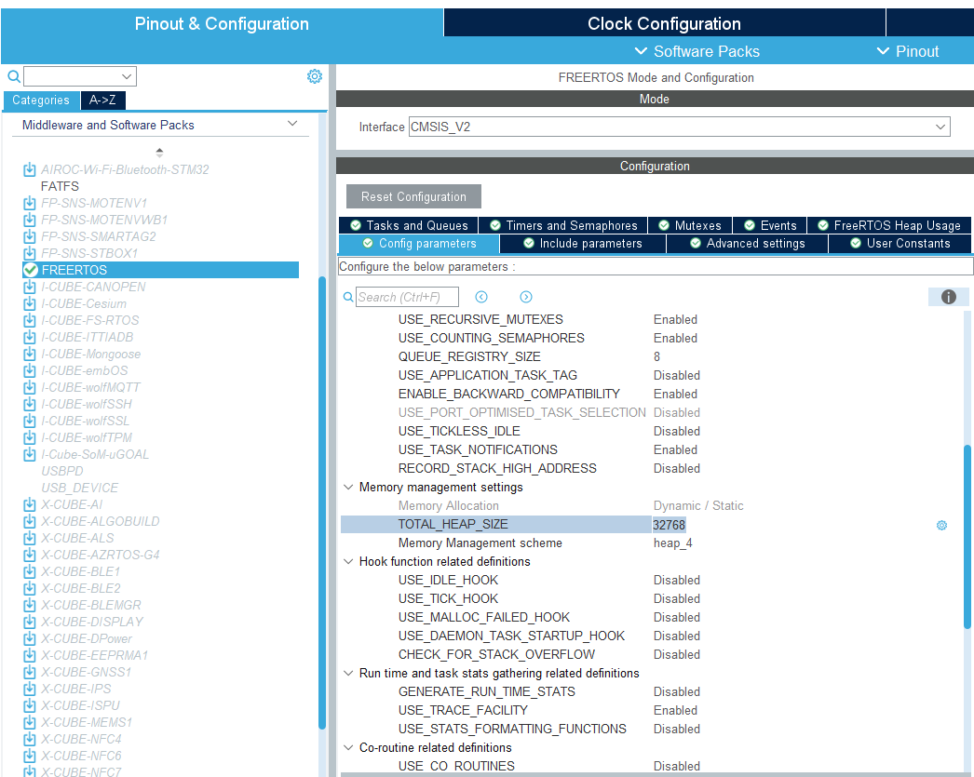

Lab1b: PWM and FreeRTOS
Notes:
F:\AEE\AEE2\BSW\BSW Goals\ST firmware\StudentLab2024\Lab1b\Lab1b_PWM_FreeRTOS1

Slide 45




Lab1b: PWM and FreeRTOS
Select Timebase Source other than SysTick
for FreeRTOS based code
Notes:
F:\AEE\AEE2\BSW\BSW Goals\ST firmware\StudentLab2024\Lab1b\Lab1b_PWM_FreeRTOS1

Slide 46





Lab1b: LED and PWM
LD2 will dim based on PWM value.
In main.c
Build and debug code
Observe:
  LD2 must dim repeatedly OFF to ON
Notes:
F:\AEE\AEE2\BSW\BSW Goals\ST firmware\StudentLab2024\Lab1b\Lab1b_PWM_FreeRTOS1

Slide 47

Lab1b: LED, Button, and PWM
Exercise 1
Modify the code: Use both tasks (Task1 and Task2)
Task1 : Once button B1 is pressed, LD2 brightness will increase (min to max in 1s).
Task2 : When the brightness reaches maximum, in next pressed button of B1, LD2 brightness will decrease (max to min in 1s).
And so on…
Notes:
F:\AEE\AEE2\BSW\BSW Goals\ST firmware\StudentLab2024\Lab1b\Lab1b_PWM_FreeRTOS_x

Slide 48
Lab1c
Analog Input (ADC)
Notes:
F:\AEE\AEE2\BSW\BSW Goals\ST firmware\StudentLab2024\Lab1c\Lab1c_ADC

Slide 49
Lab1c: Analog Input (ADC)
In this lab, we will set analog input pins.
  Analog input is converted to digital using ADC
  We use 12-bit ADC (ADC value is 0 - 4095)
We will use PC0 and PC3 as analog input.
We will read voltages from PC0 and PC3
(using ADC polling conversion)
We will use FreeRTOS based code, the same as previous example
Clock Configuration tab will also be the same as previous example
Notes:
F:\AEE\AEE2\BSW\BSW Goals\ST firmware\StudentLab2024\Lab1c\Lab1c_ADC

Slide 50


Lab1c: Analog Input (ADC)
Notes:
F:\AEE\AEE2\BSW\BSW Goals\ST firmware\StudentLab2024\Lab1c\Lab1c_ADC

Slide 51


Lab1c: Analog Input (ADC)
Notes:
F:\AEE\AEE2\BSW\BSW Goals\ST firmware\StudentLab2024\Lab1c\Lab1c_ADC

Slide 52


Lab1c: Analog Input (ADC)
Notes:
F:\AEE\AEE2\BSW\BSW Goals\ST firmware\StudentLab2024\Lab1c\Lab1c_ADC

Slide 53




Lab1c: Analog Input (ADC)
In main.c
Notes:
F:\AEE\AEE2\BSW\BSW Goals\ST firmware\StudentLab2024\Lab1c\Lab1c_ADC

Slide 54


Lab1c: Analog Input (ADC)
Build and debug code
Add adc_raw and adc_mV in Live Expression
Resume code and observe the values of adc_raw and adc_mV in Live Expression (yellow means the data is changed)
Notes:
F:\AEE\AEE2\BSW\BSW Goals\ST firmware\StudentLab2024\Lab1c\Lab1c_ADC

Slide 55

Lab1c: Analog Input (ADC)
Connect PC0 pin to GND and PC3 to +3V3
Observe the values of adc_raw and adc_mV in Live Expression
  adc_raw[0] must be 0 and adc_raw[1] must be 4095
  adc_mV[0] must be 0 and adc_mV[1] must be 3300
Notes:
F:\AEE\AEE2\BSW\BSW Goals\ST firmware\StudentLab2024\Lab1c\Lab1c_ADC

Slide 56

Lab1c: LED, PWM, and Analog Input
Exercise 2
Modify the code: Use both tasks (Task1 and Task2)
  Connect potentiometer to PC0
  Task1: Read the ADC value of PC0
  Task2: Use the ADC value (0 – 4095) as value of PWM duty cycle (0 – 100%), observe LD2 (dimming based on potentiometer control)
The MCU uses 3.3V as supply voltage (VDDA).
Be careful to not exceed the voltage to analog input pins.
Notes:
F:\AEE\AEE2\BSW\BSW Goals\ST firmware\StudentLab2024\Lab1c\Lab1c_ADC_x

Slide 57
Lab1d
UART
Notes:
F:\AEE\AEE2\BSW\BSW Goals\ST firmware\StudentLab2024\Lab1d\Lab1d_UART

Slide 58

Lab1d: UART
In this lab, we will set UART communication.
We will use PA2 and PA3 as UART TX-RX, with interrupt.
We will use FreeRTOS based code, the same as previous example
Clock Configuration tab will be the same as previous example
Notes:
F:\AEE\AEE2\BSW\BSW Goals\ST firmware\StudentLab2024\Lab1d\Lab1d_UART

Slide 59

Lab1d: UART
Notes:
F:\AEE\AEE2\BSW\BSW Goals\ST firmware\StudentLab2024\Lab1d\Lab1d_UART

Slide 60

Lab1d: UART
Notes:
F:\AEE\AEE2\BSW\BSW Goals\ST firmware\StudentLab2024\Lab1d\Lab1d_UART

Slide 61




Lab1d: UART
In main.c
The serial monitor will display the initial message
and then the characters that we type will be displayed every 10 typed characters.
Notes:
F:\AEE\AEE2\BSW\BSW Goals\ST firmware\StudentLab2024\Lab1d\Lab1d_UART

Slide 62
Lab1d: UART
To use serial print to monitor in STM32CubeIDE
Go to the Device Manager and check the STLink Virtual COM Port
From Console tab of STM32CubeIDE
Notes:
F:\AEE\AEE2\BSW\BSW Goals\ST firmware\StudentLab2024\Lab1d\Lab1d_UART

Slide 63


Lab1d: UART
Put connection name and COM settings
The COM setting must be the same with UART settings
Notes:
F:\AEE\AEE2\BSW\BSW Goals\ST firmware\StudentLab2024\Lab1d\Lab1d_UART

Slide 64

Lab1d: UART
- Build and debug code
Notes:
F:\AEE\AEE2\BSW\BSW Goals\ST firmware\StudentLab2024\Lab1d\Lab1d_UART

Slide 65

Lab1d: UART
- Click Resume
- Type any character
The serial monitor will display the characters after we type 10 characters
Notes:
F:\AEE\AEE2\BSW\BSW Goals\ST firmware\StudentLab2024\Lab1d\Lab1d_UART

Slide 66

Lab1d: UART
Notes:
F:\AEE\AEE2\BSW\BSW Goals\ST firmware\StudentLab2024\Lab1d\Lab1d_UART

Slide 67

Lab1d: UART
If the serial monitor connection is already created, for the next debugging process, we can directly choose the connection by selecting from the button below.
Notes:
F:\AEE\AEE2\BSW\BSW Goals\ST firmware\StudentLab2024\Lab1d\Lab1d_UART

Slide 68

Lab1d: UART
Exercise 3
Modify the code: Use both tasks (Task1 and Task2)
  Display the value from potentiometer as value of PWM duty cycle (0-100%) to UART
Notes:
F:\AEE\AEE2\BSW\BSW Goals\ST firmware\StudentLab2024\Lab1d\Lab1d_UART_x

Slide 69
Thank you and good luck!

