Slide 1

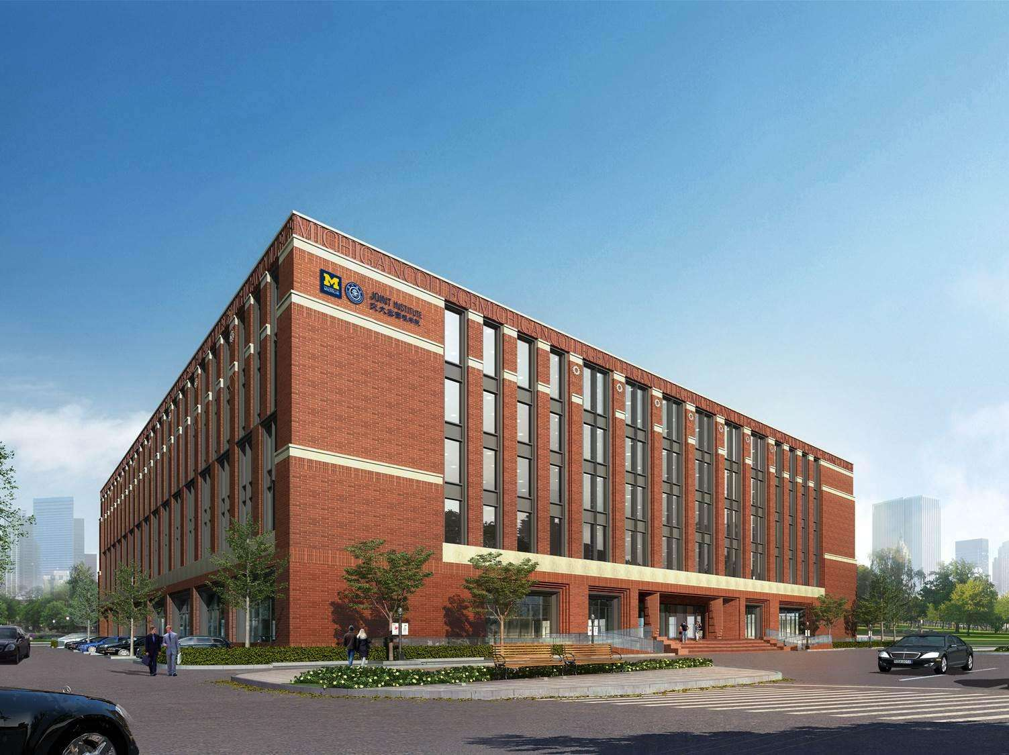
VE450
Capstone Project:
VMware#1-AR in Data Centers
Kick-off Meeting
Group 21
Shuyi Zhou Han Liying Jinglei Xie
Chenyun Tao Yaxin Chen
University of Michigan – Shanghai Jiao Tong University Joint Institute (UM-SJTU JI)

Slide 2
1
Member Introduction

Slide 3

Jinglei Xie （谢静蕾）
| Joint Institute

Slide 4
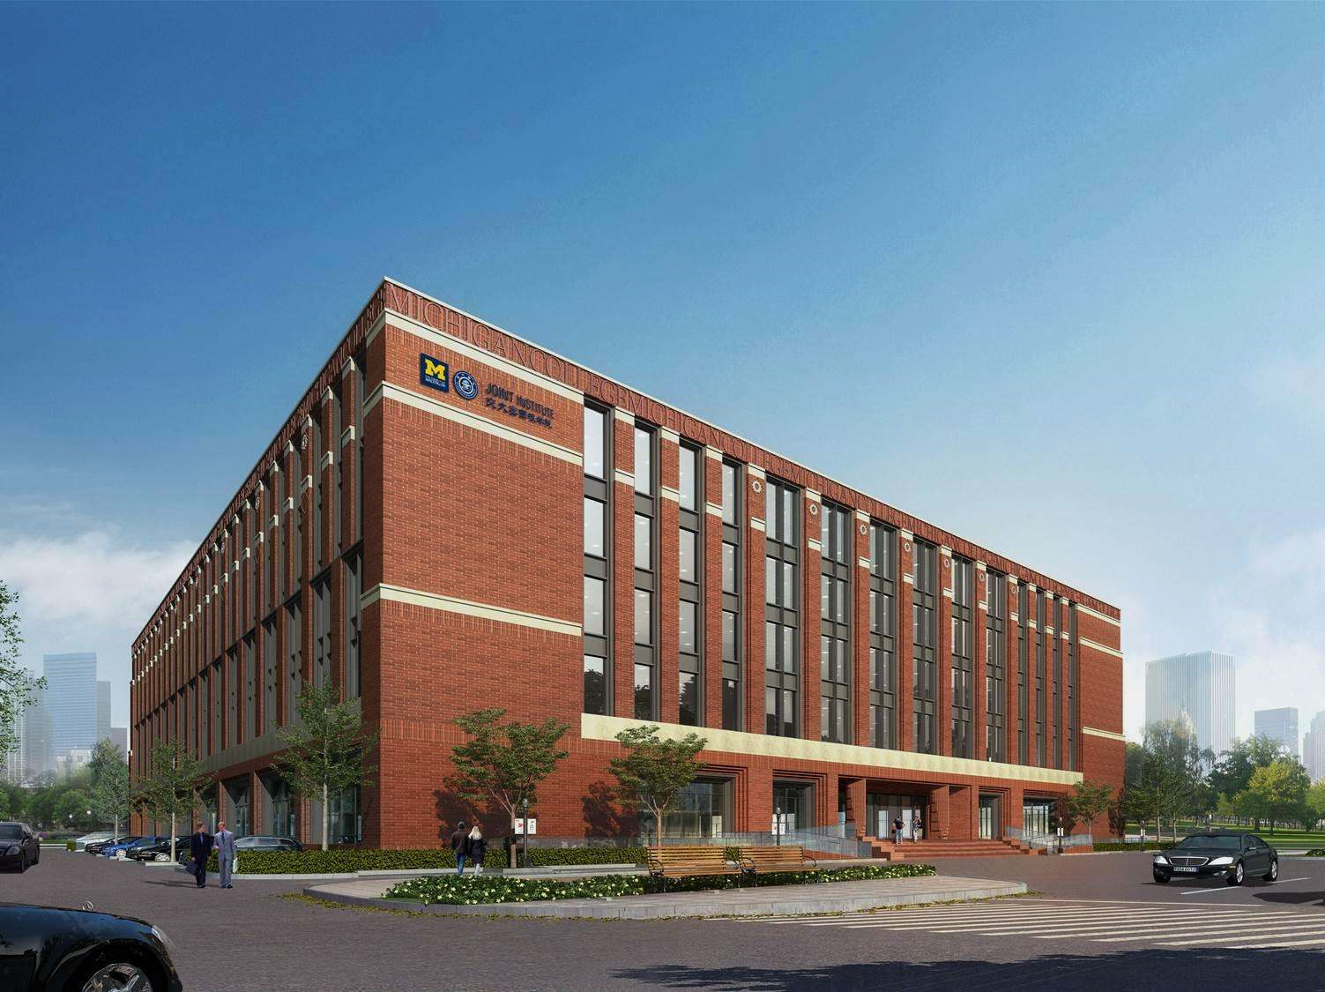
| Joint Institute
Thanks for your
attention

