Slide 1
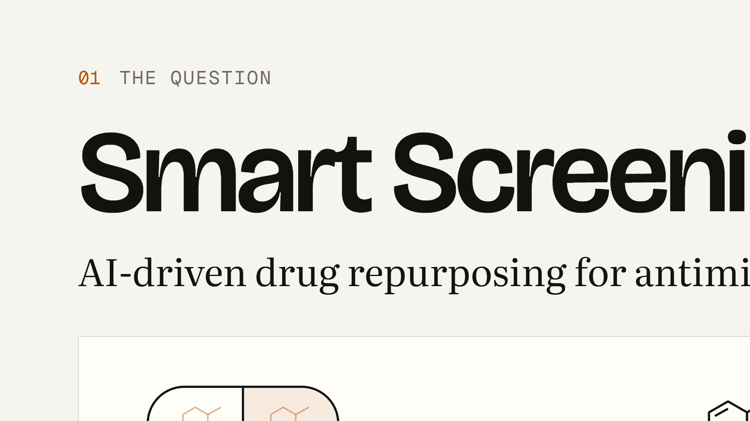
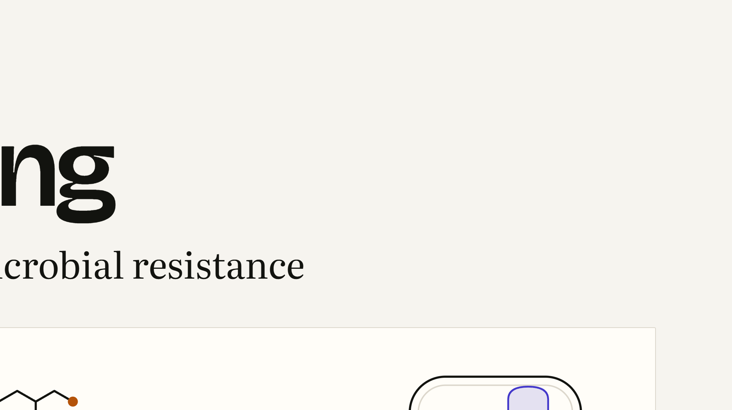
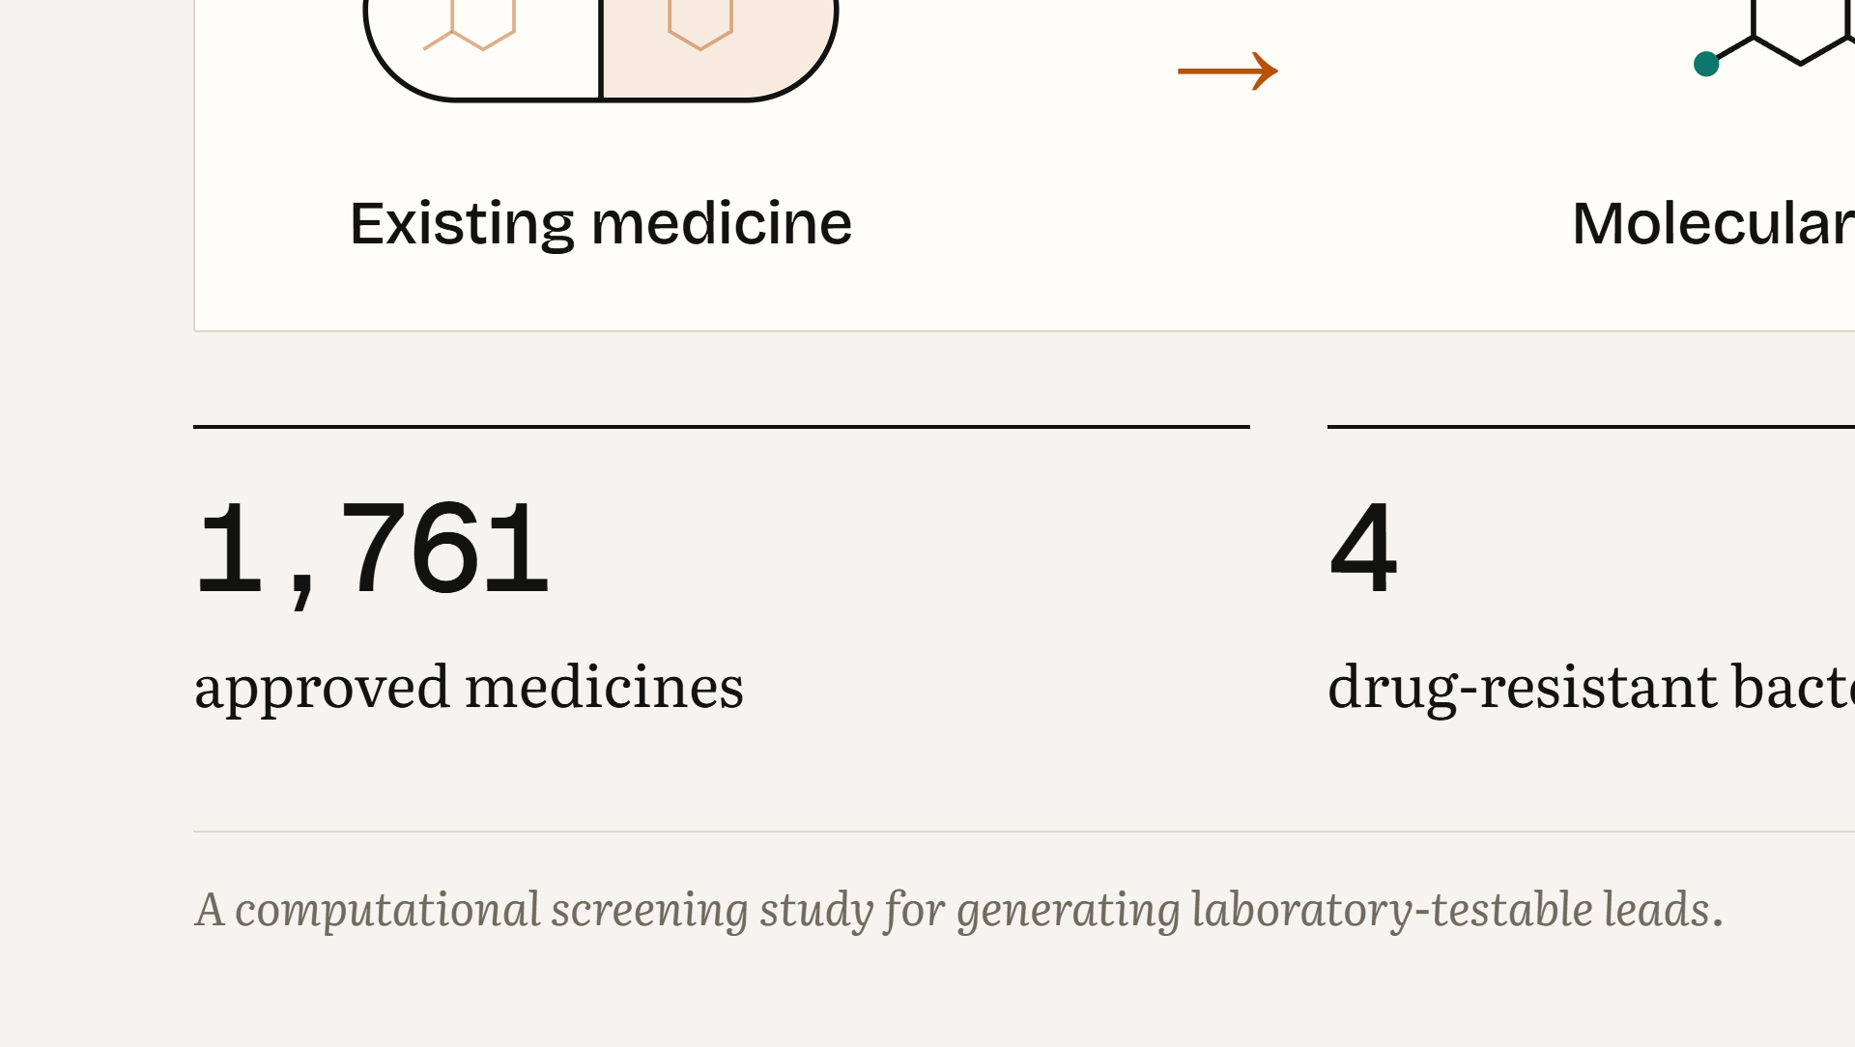
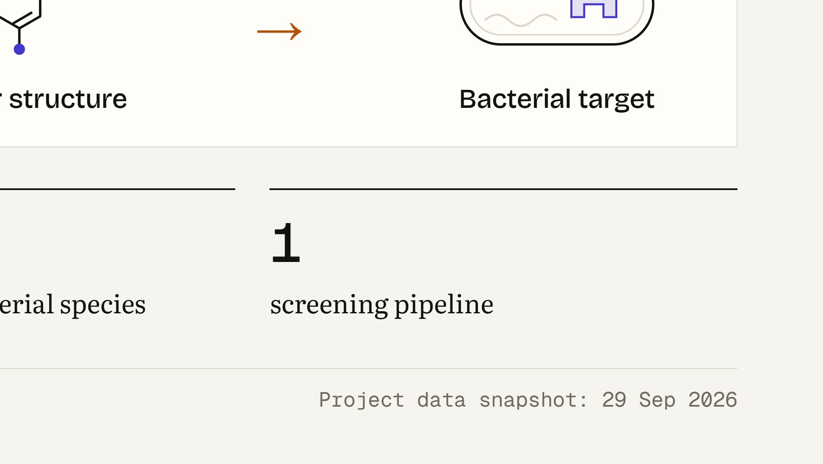
Notes:
WHAT THIS SLIDE MEANS: This is a computational screening study. We took medicines that already exist and asked a computer to estimate whether any of them might show antibacterial activity against four drug-resistant bacterial species. WHAT THE AUDIENCE SHOULD UNDERSTAND: The output of this project is a list of leads for laboratory testing. Nothing on these slides is a new treatment, and no patients or new wet-lab experiments were involved. The chain on screen reads left to right: an existing medicine, its molecular structure, and a bacterial target the structure might interact with. LIKELY STUDENT QUESTION: “So did you find a new antibiotic?” ANSWER: “No. We generated hypotheses. Each candidate still needs laboratory testing before anyone can say it has antibacterial activity, and much more before any clinical use.”

Slide 2
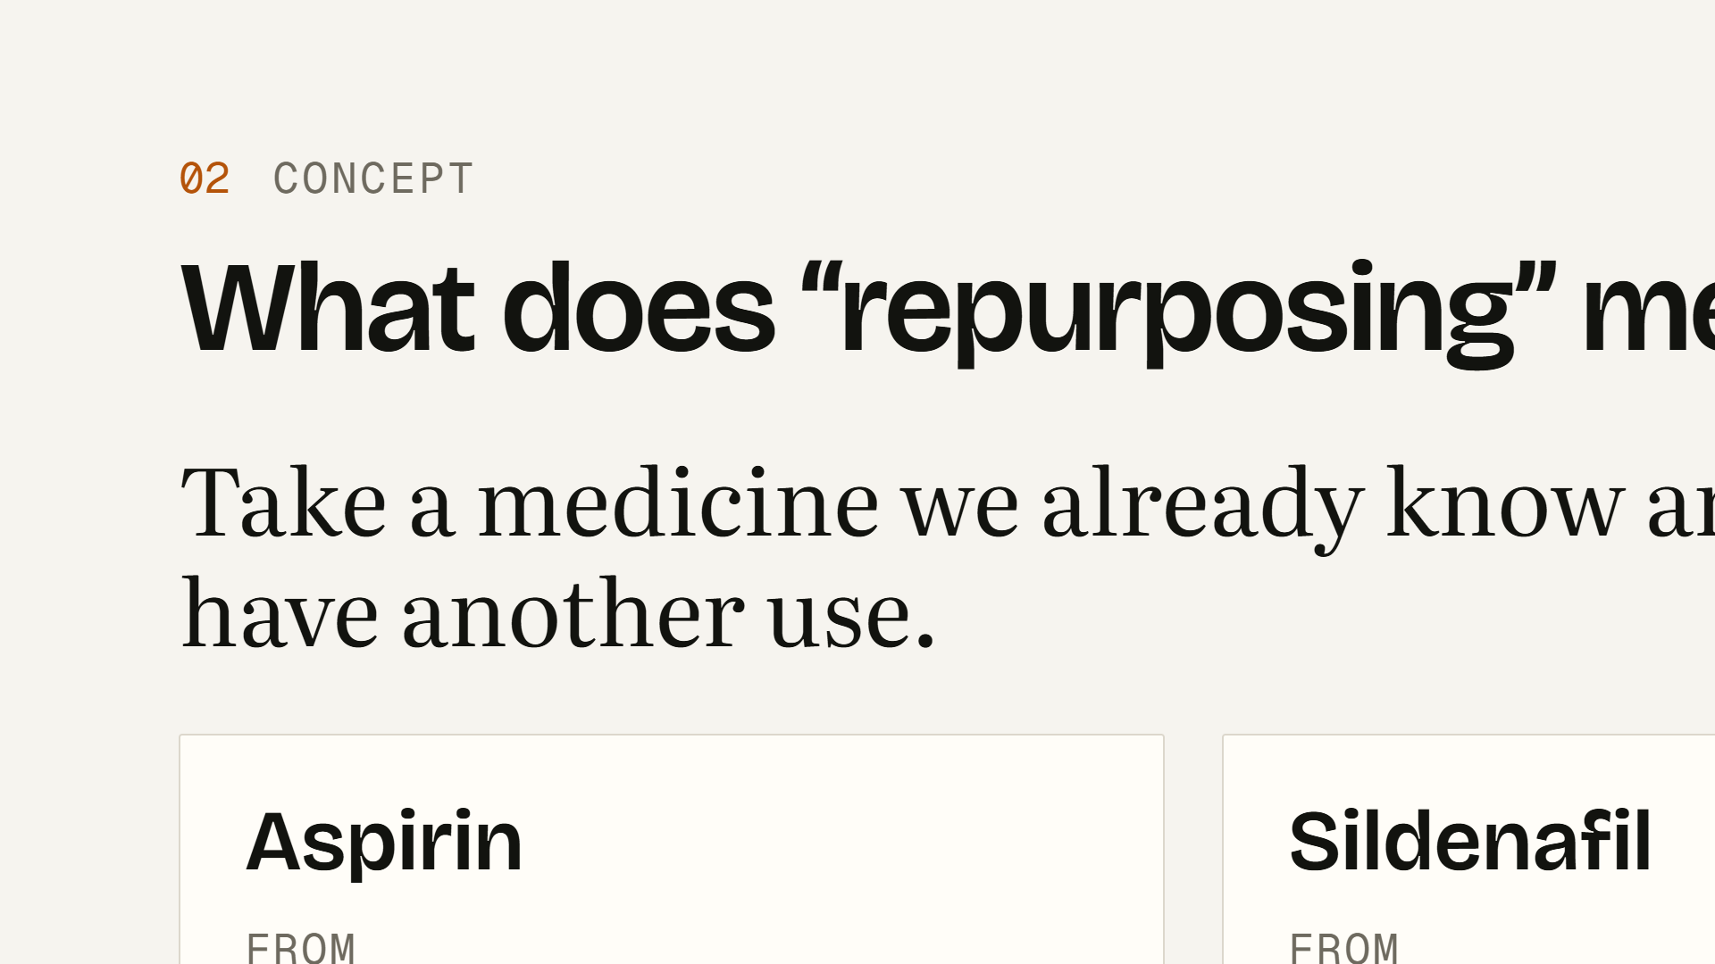
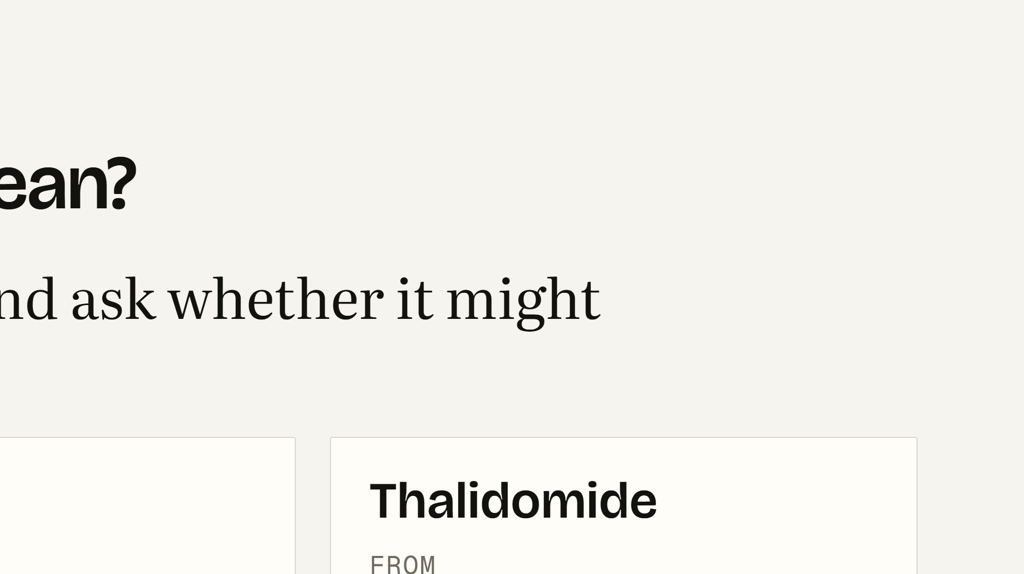
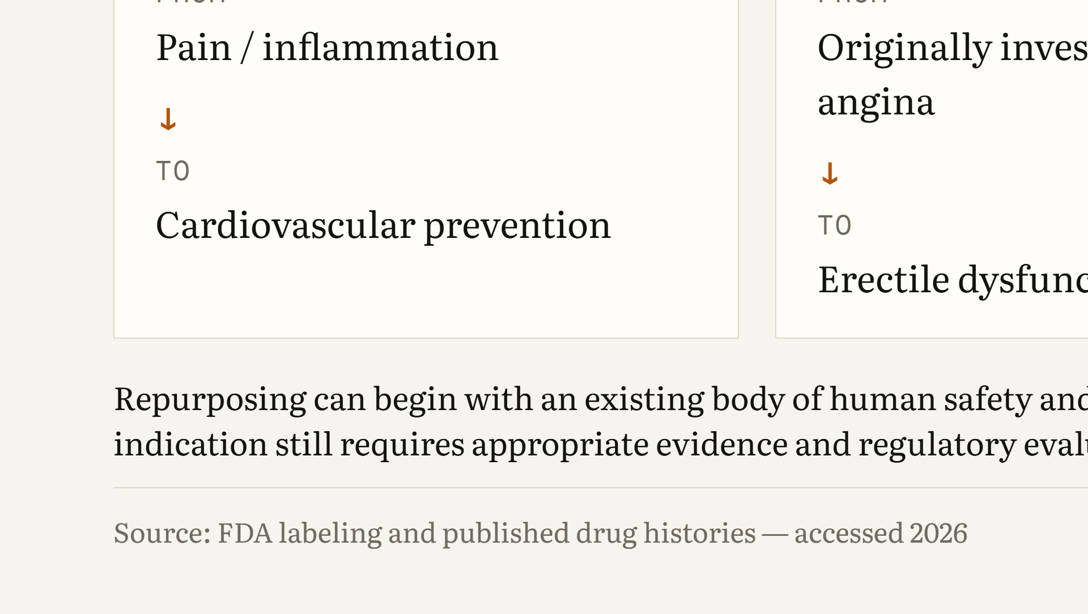
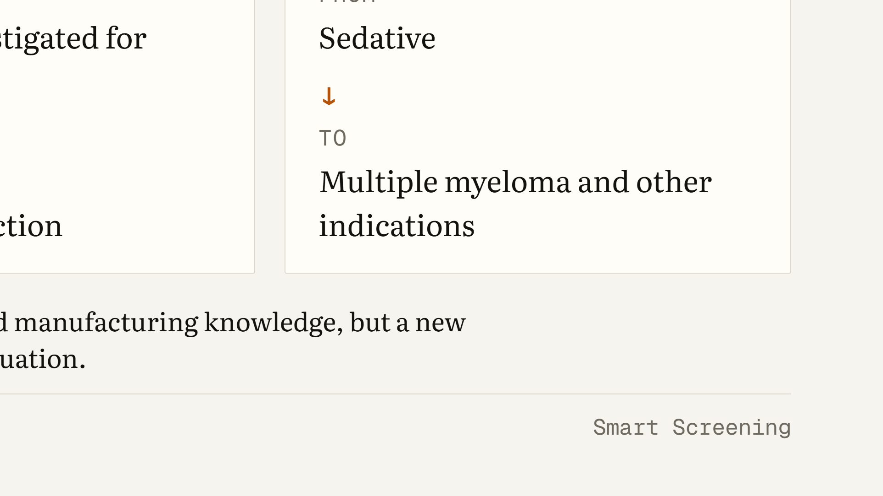
Notes:
WHAT THIS SLIDE MEANS: Drug repurposing means taking a medicine that already exists and asking whether it might be useful for a different condition. WHAT THE AUDIENCE SHOULD UNDERSTAND: You already know examples. Aspirin moved from pain and inflammation to cardiovascular prevention. Sildenafil was originally investigated for angina and became a treatment for erectile dysfunction. Thalidomide, a sedative with a tragic history, was later evaluated and approved for multiple myeloma and other indications under strict controls. The appeal is that repurposing can start from existing human safety and manufacturing knowledge. But every new indication still needs its own evidence and its own regulatory evaluation. Approval for one use is not approval for another. LIKELY STUDENT QUESTION: “If a drug is already approved, isn’t it automatically safe to use for something else?” ANSWER: “No. Dose, patient population, duration and route can all change. Thalidomide is the clearest reminder. A new indication needs new evidence.”

Slide 3
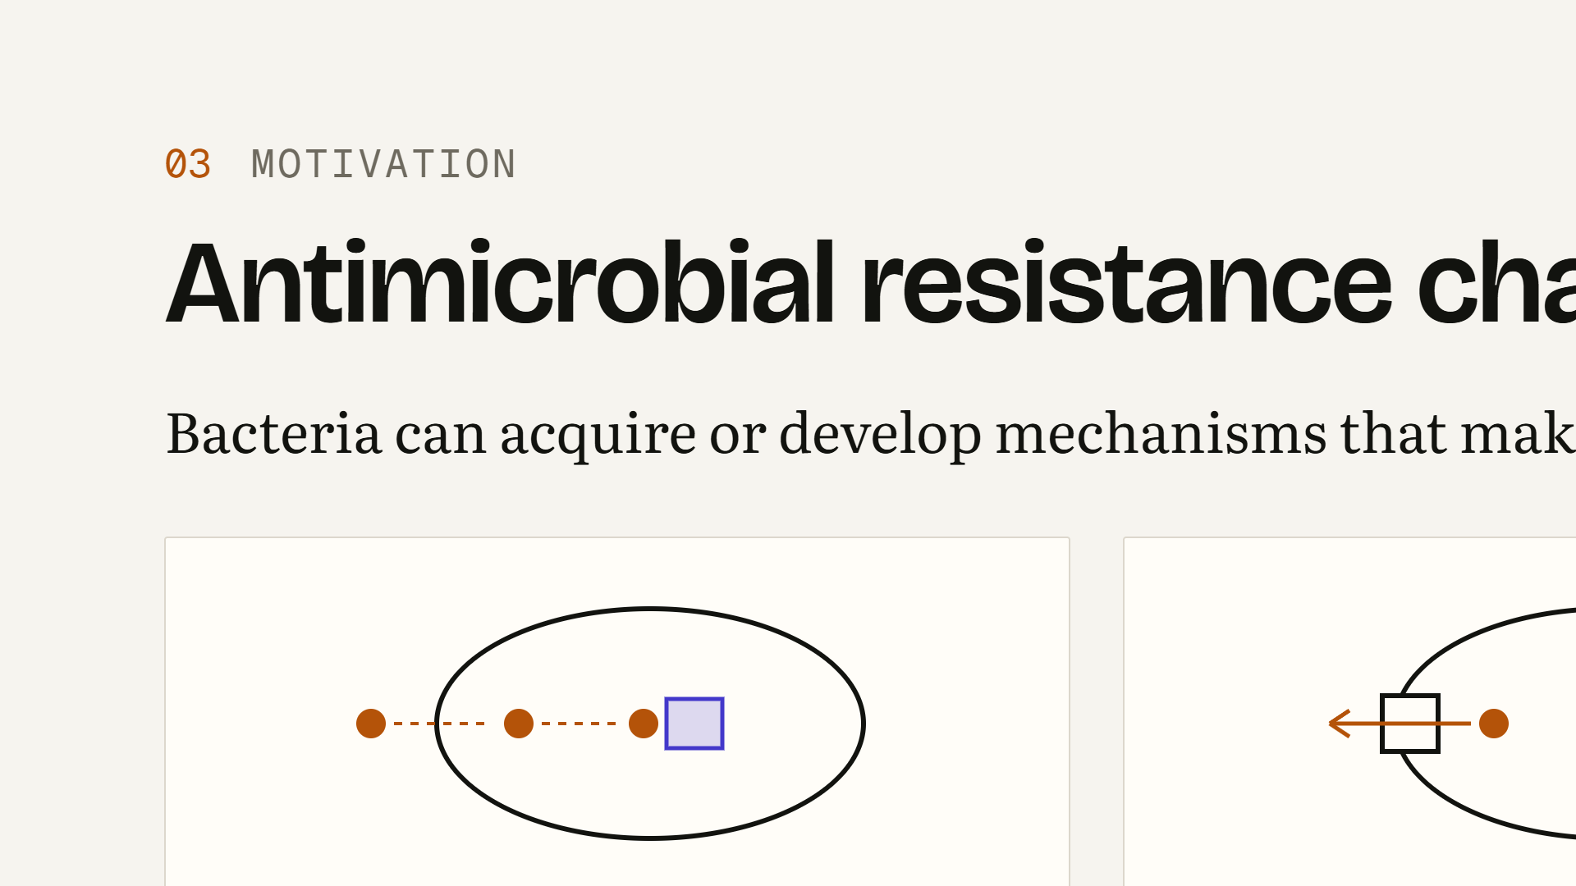
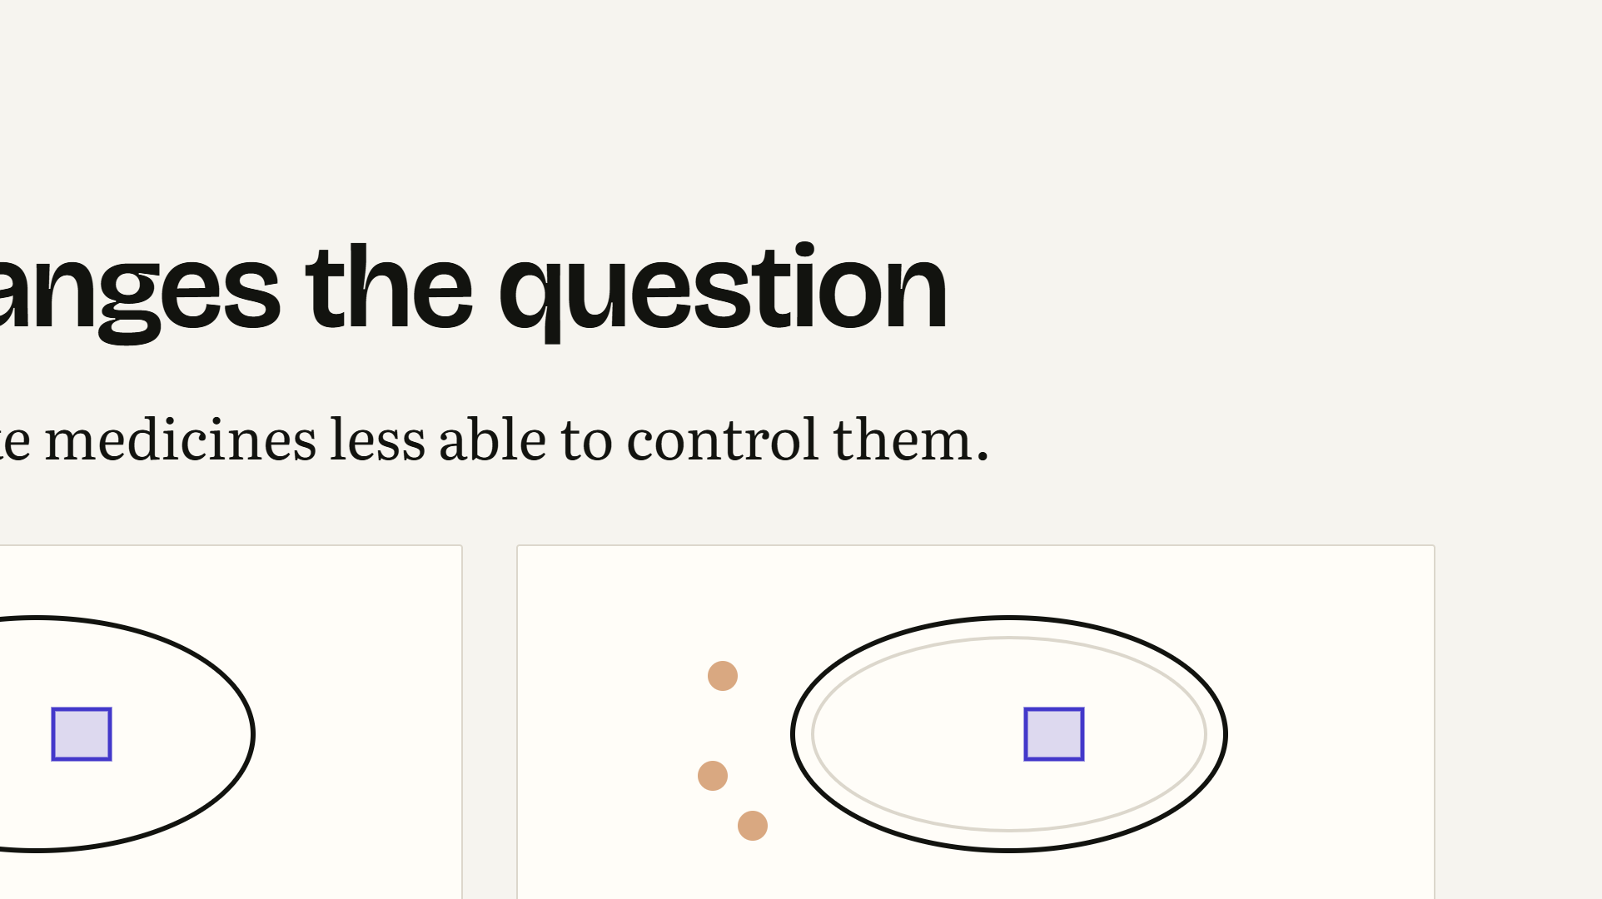
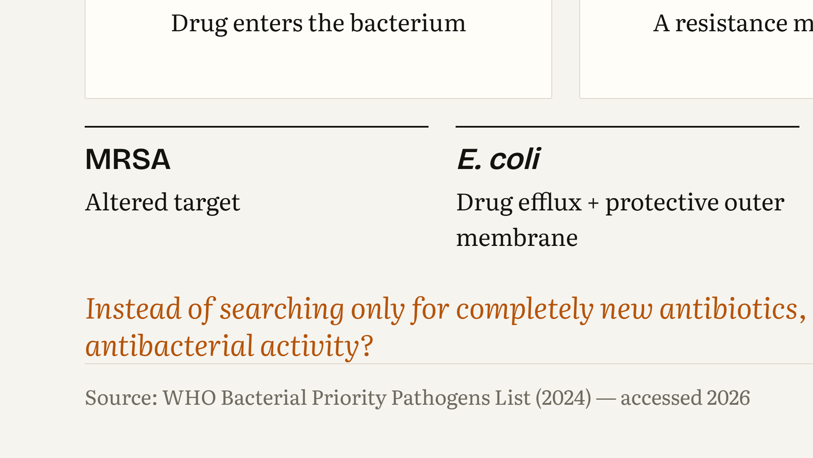
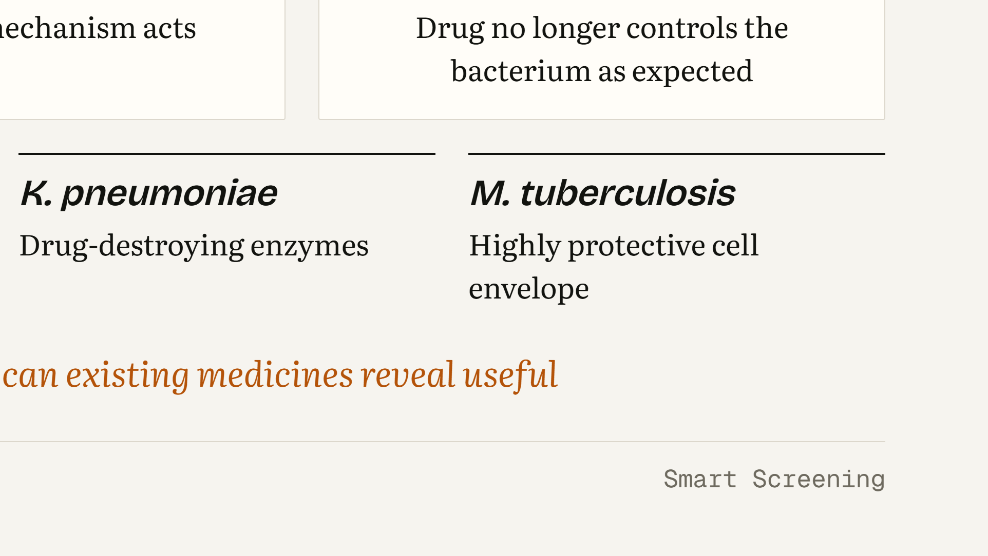
Notes:
WHAT THIS SLIDE MEANS: Antimicrobial resistance happens when bacteria acquire or develop mechanisms that make medicines less able to control them. WHAT THE AUDIENCE SHOULD UNDERSTAND: The three panels show the general idea: a drug normally enters and reaches its target; a resistance mechanism interferes; the drug no longer controls the bacterium as expected. The four examples each use a different strategy. MRSA has an altered target, PBP2a, so beta-lactams bind poorly. E. coli combines efflux pumps with a protective outer membrane. K. pneumoniae can produce drug-destroying enzymes such as carbapenemases. M. tuberculosis has a highly protective, waxy cell envelope. Because these problems differ, it makes sense to ask the question broadly: could some existing medicines show useful antibacterial activity? LIKELY STUDENT QUESTION: “Is resistance caused by the patient becoming resistant to the drug?” ANSWER: “No. The bacteria change, not the patient. Resistance is a property of the bacterial population.”

Slide 4
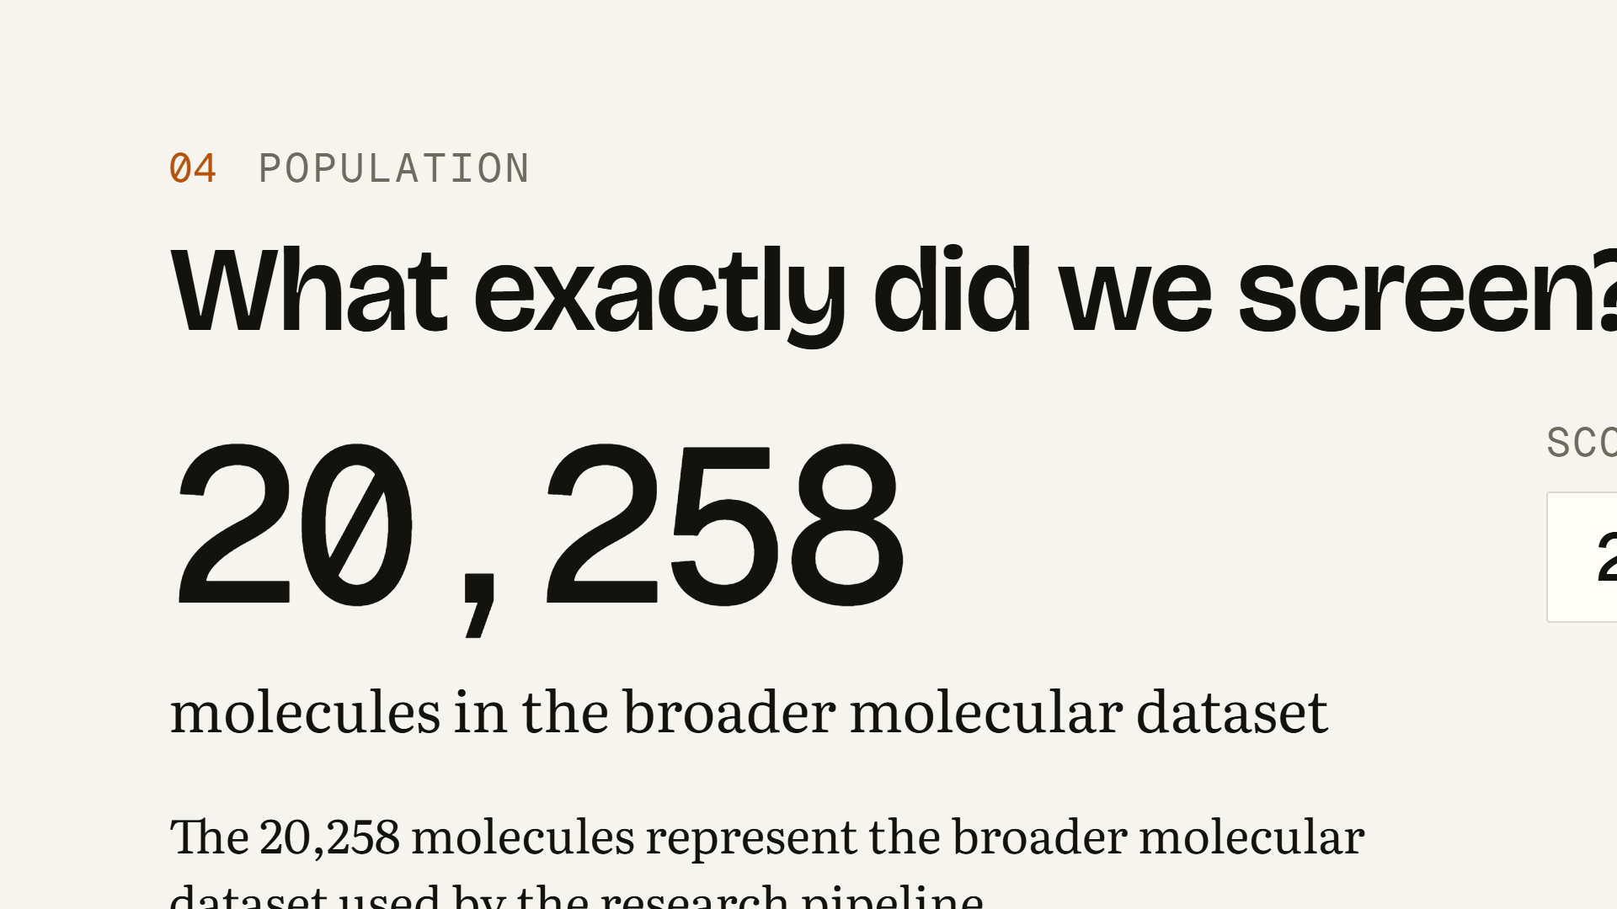
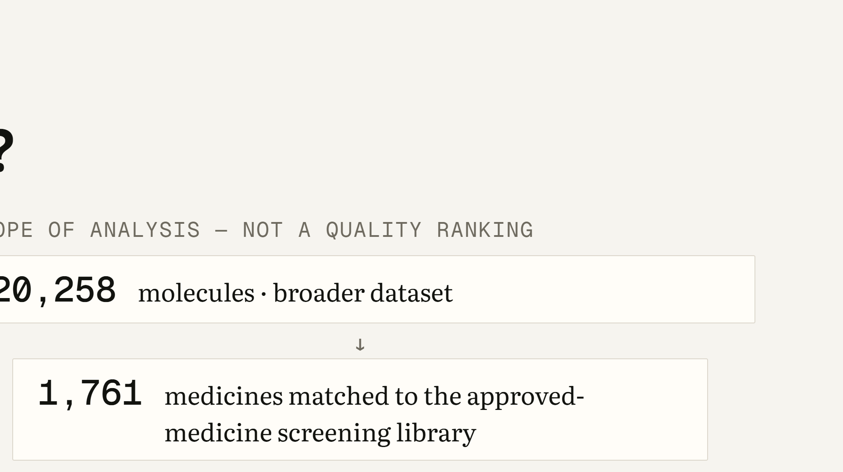
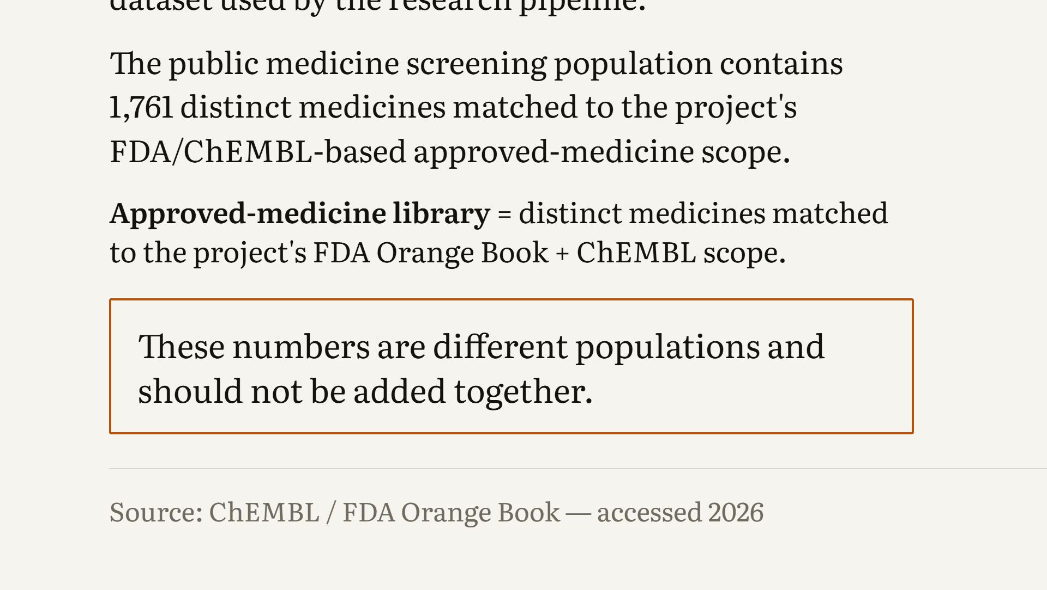
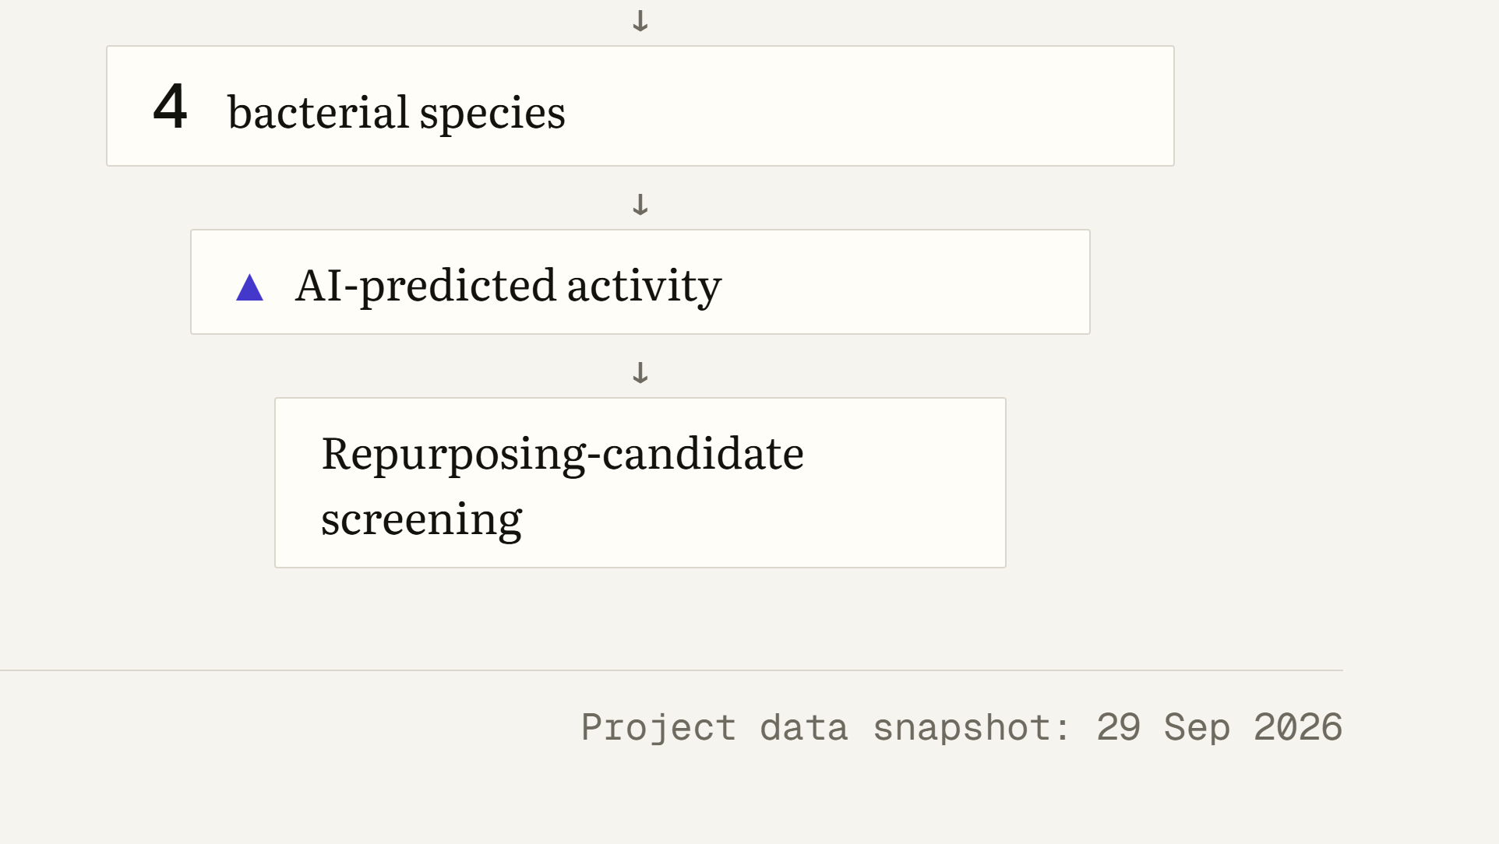
Notes:
WHAT THIS SLIDE MEANS: This slide defines exactly what was screened. WHAT THE AUDIENCE SHOULD UNDERSTAND: There are two different populations. The 20,258 molecules are the broader molecular dataset used by the research pipeline. The 1,761 are distinct medicines matched to the project’s FDA and ChEMBL-based approved-medicine scope; these are the medicines we actually screened. Do not add the two numbers together. The funnel on the right narrows the scope of the analysis step by step: molecules, then approved medicines, then four bacterial species, then AI-predicted activity, then candidate screening. It describes what we looked at, not how good anything is. LIKELY STUDENT QUESTION: “Why do you say 20,258 molecules but only screen 1,761 medicines?” ANSWER: “They are different populations. The larger set is the broader molecular data the pipeline works with. Only the 1,761 medicines matched to the approved-medicine library are part of the repurposing screen.”

Slide 5
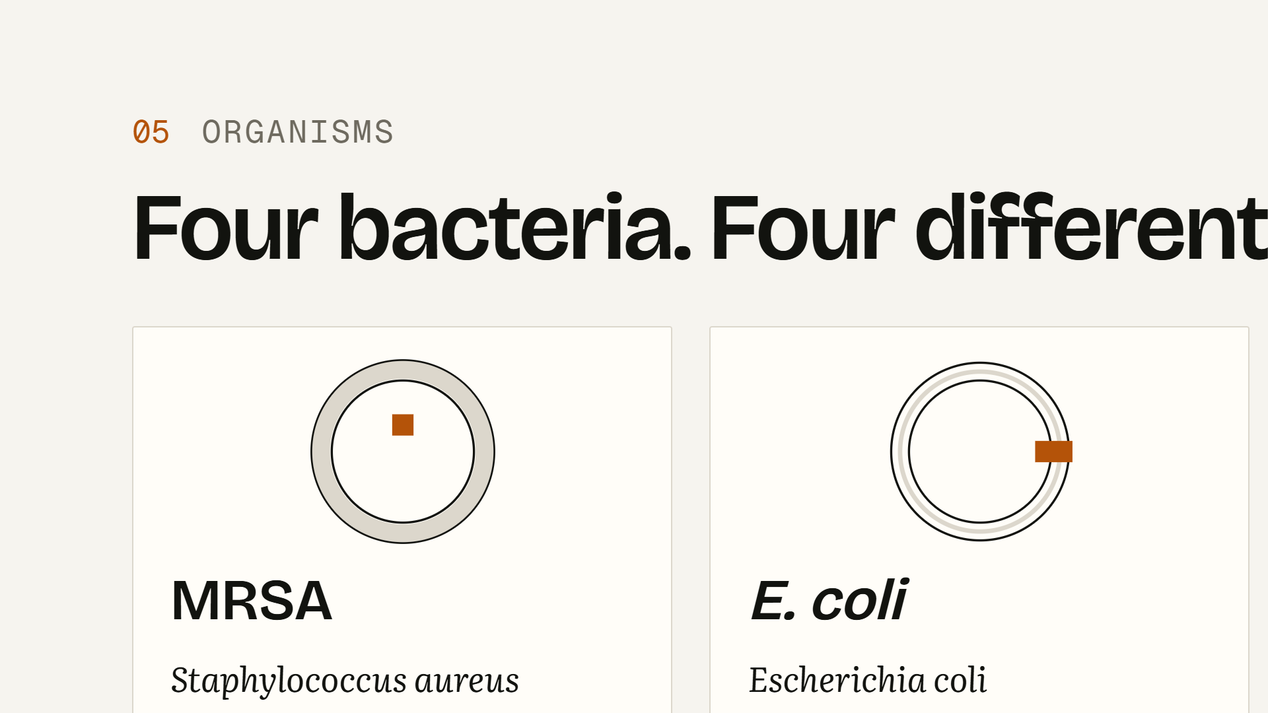
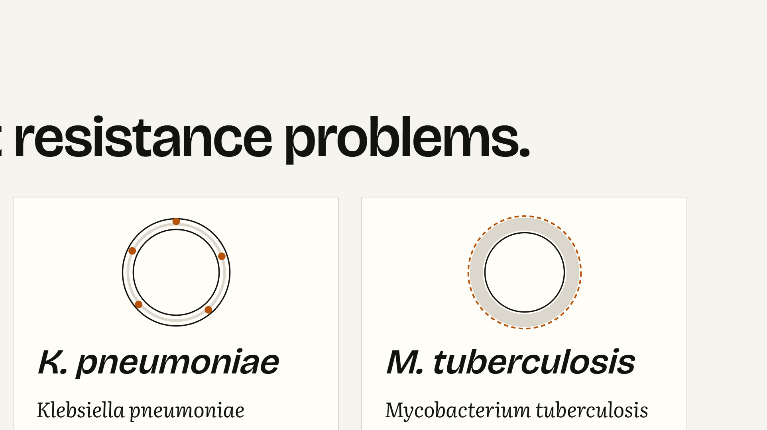
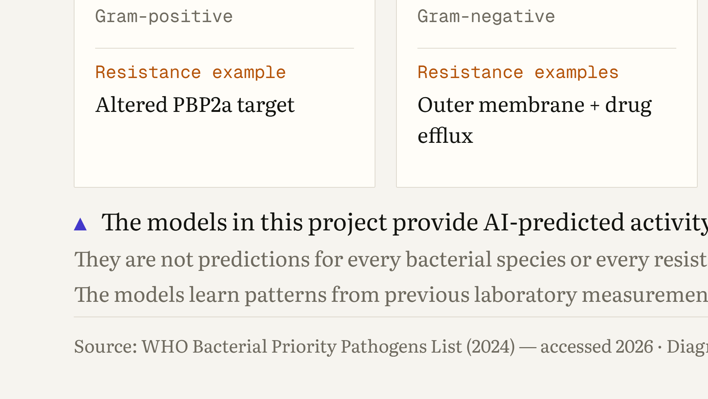
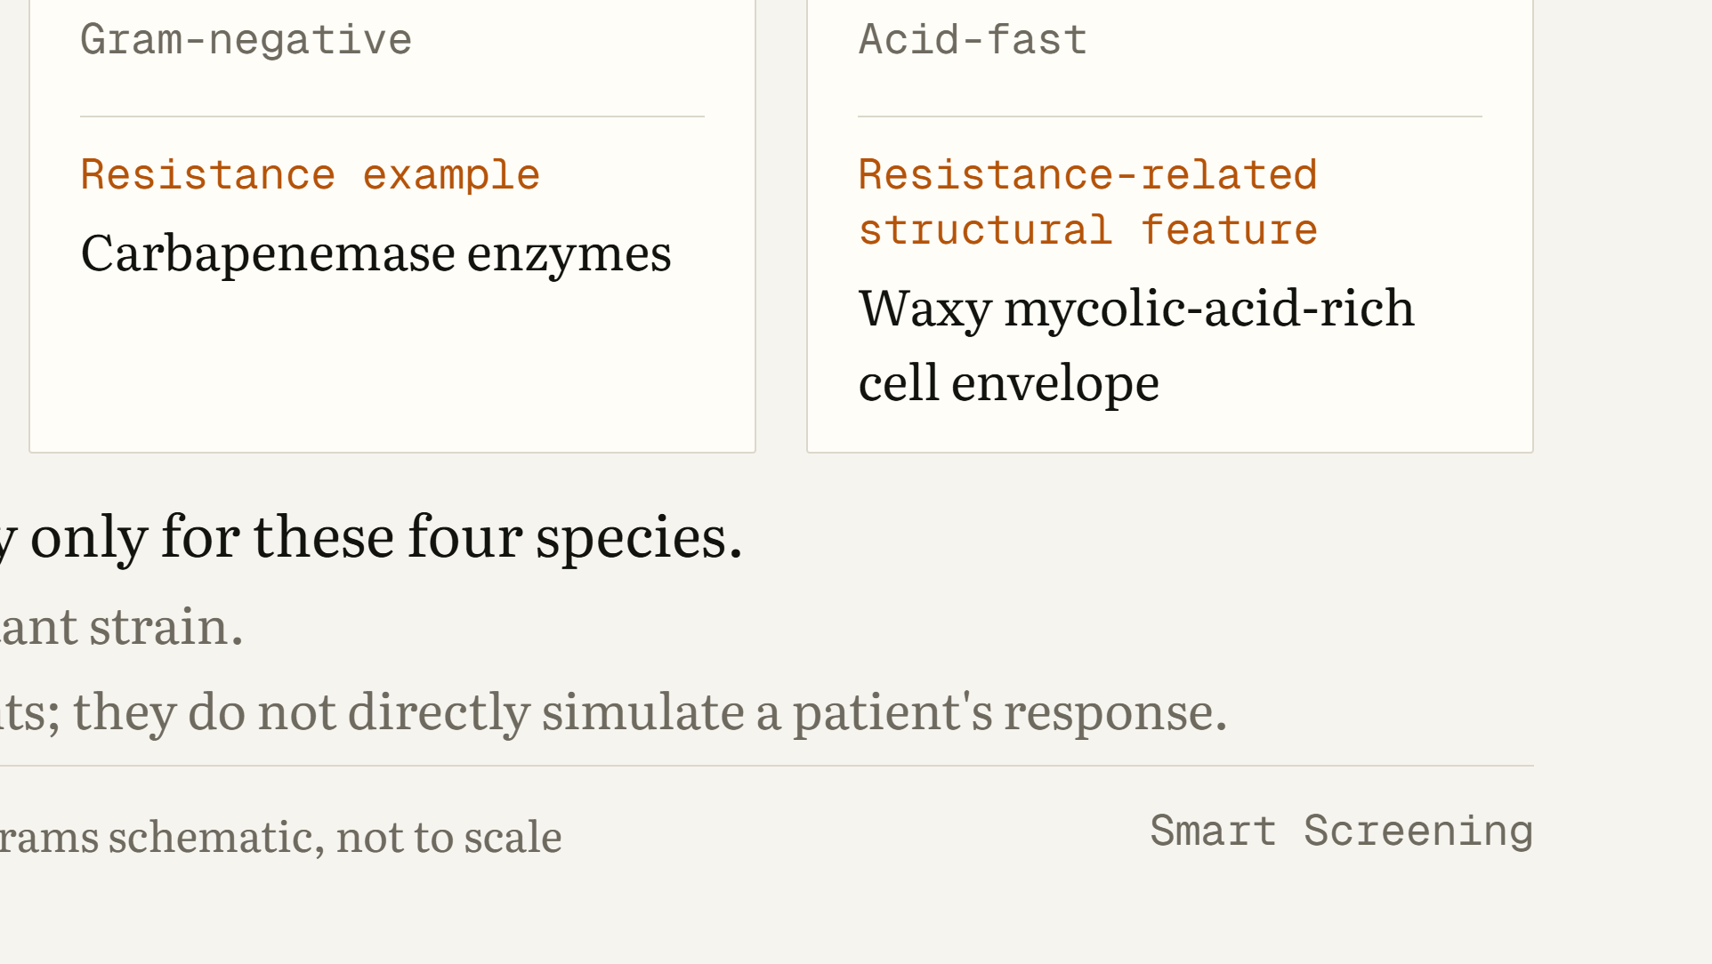
Notes:
WHAT THIS SLIDE MEANS: The project has models for exactly four bacterial species, and each poses a different resistance problem. WHAT THE AUDIENCE SHOULD UNDERSTAND: MRSA is Gram-positive; its altered PBP2a target reduces beta-lactam binding. E. coli and K. pneumoniae are Gram-negative; their outer membrane limits entry, E. coli also pumps drugs out, and K. pneumoniae can produce carbapenemase enzymes. M. tuberculosis is acid-fast, with a waxy, mycolic-acid-rich envelope. The orange marks in each diagram show where the resistance feature sits. The models provide AI-predicted activity only for these four species. They are not predictions for other bacteria, and they are not predictions for specific resistant strains. LIKELY STUDENT QUESTION: “If a medicine is predicted for MRSA, will it also work on other staphylococci or on streptococci?” ANSWER: “We cannot say. The model only covers these four species, and even then it estimates activity from laboratory-style data, not effect in a specific strain or patient.”

Slide 6
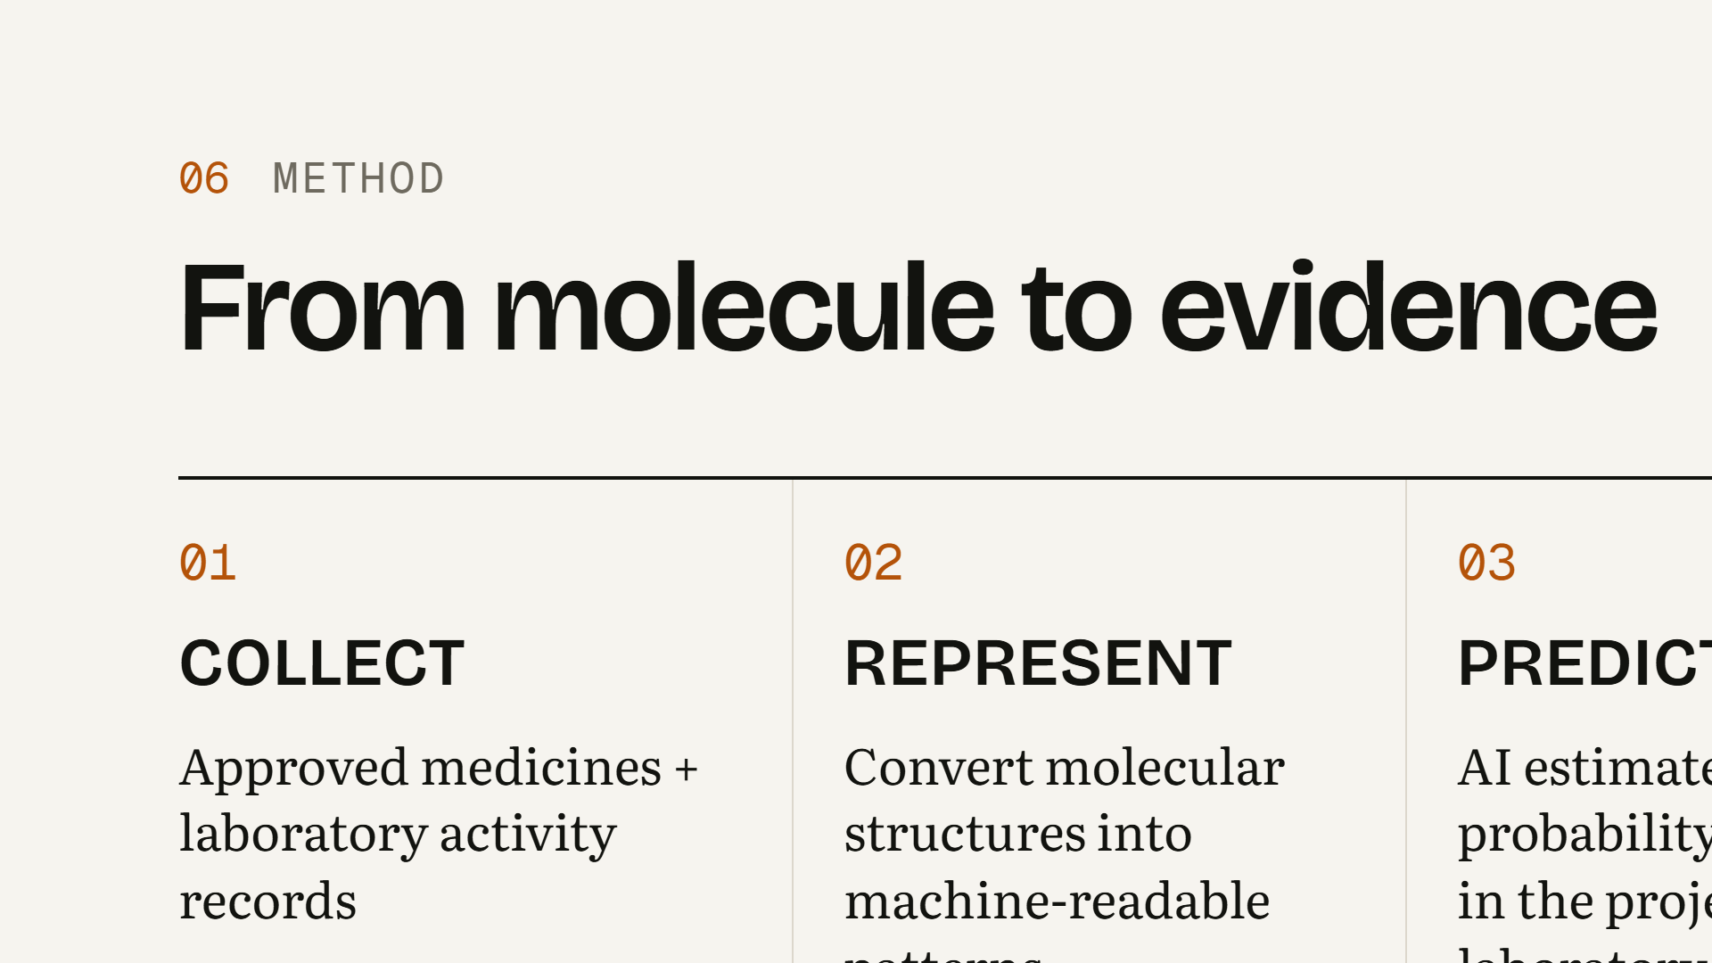
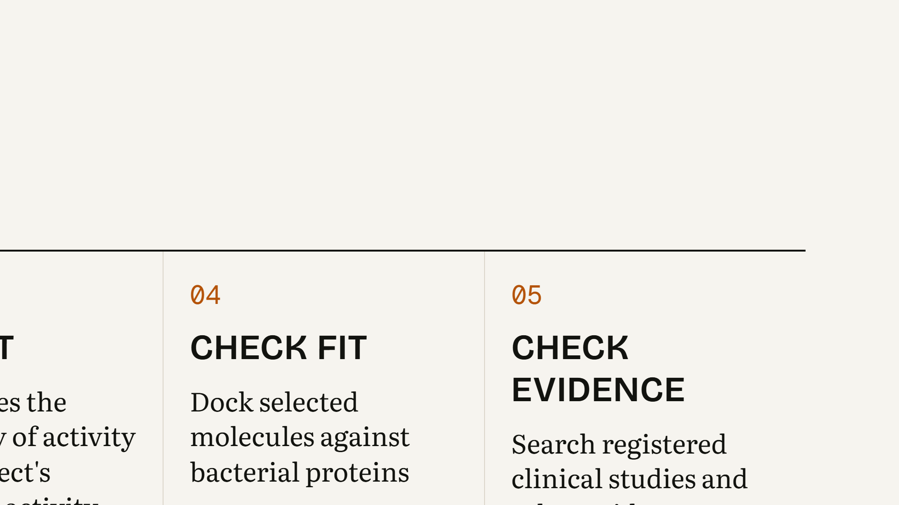
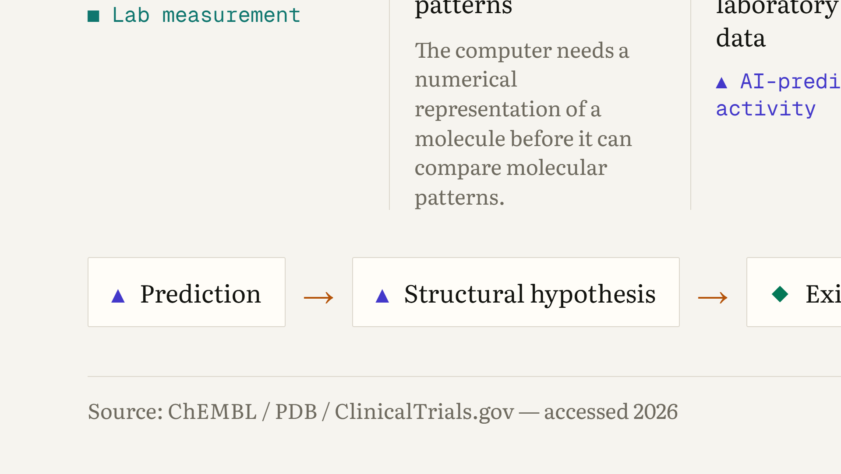
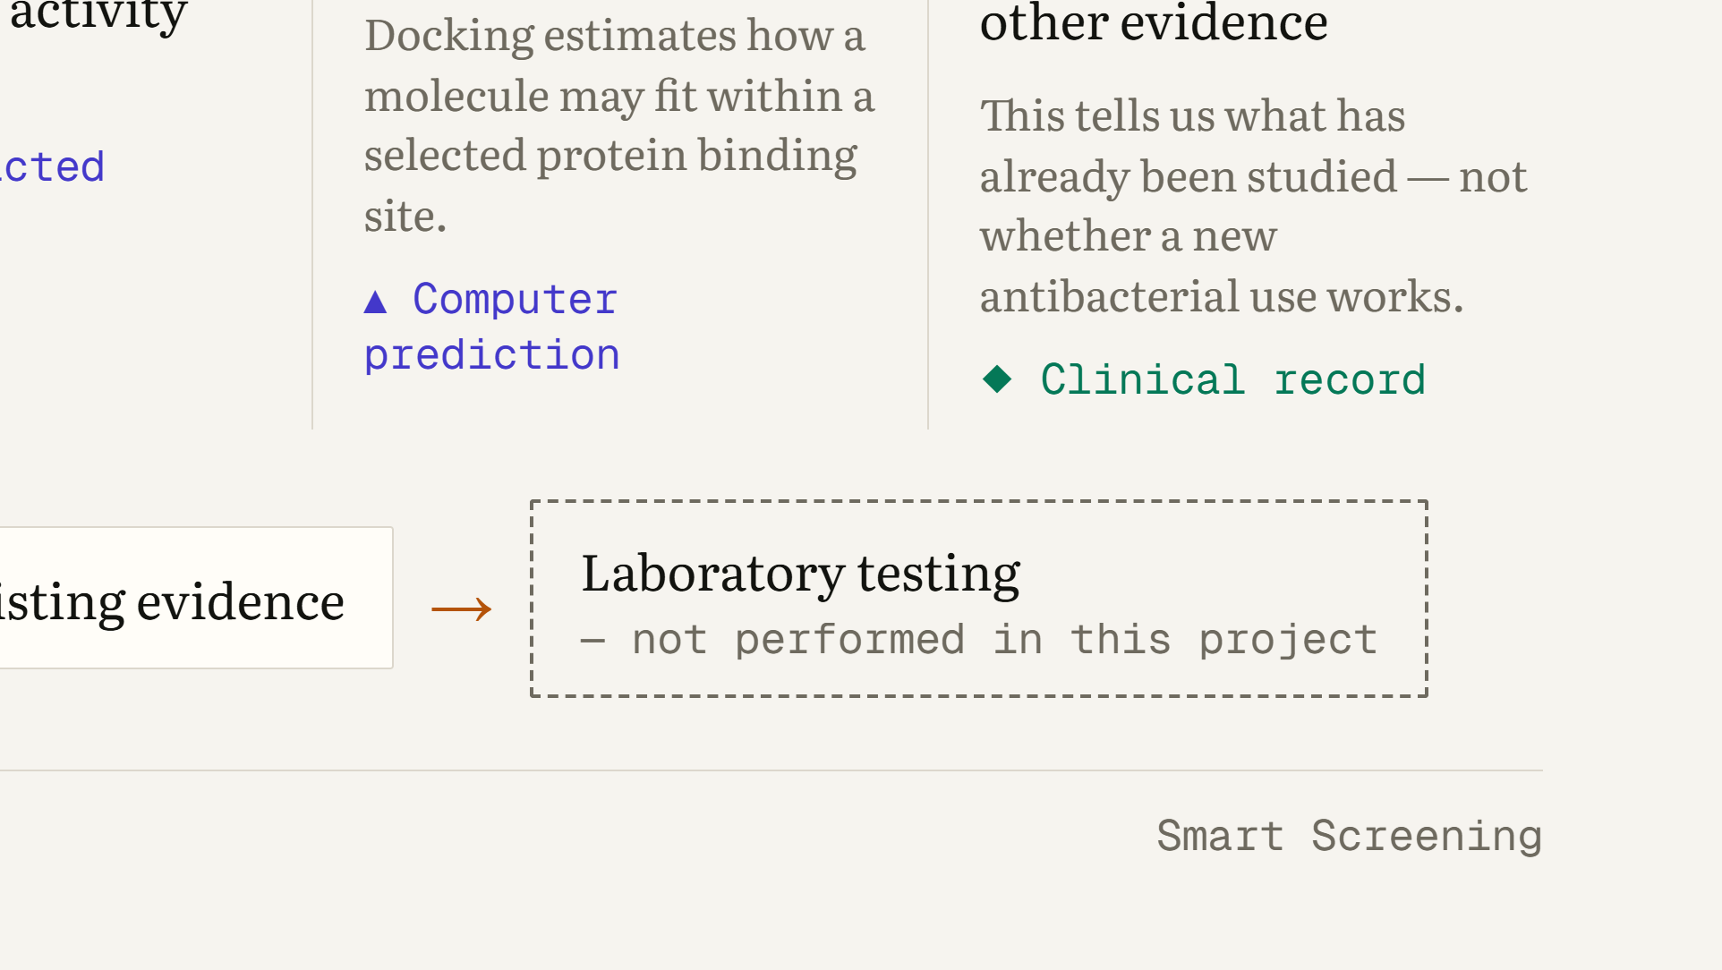
Notes:
WHAT THIS SLIDE MEANS: This is the screening pipeline in five steps. WHAT THE AUDIENCE SHOULD UNDERSTAND: First we collect approved medicines and previously recorded laboratory activity data. Second, each molecular structure is converted into a numerical pattern, often called a molecular fingerprint; think of it as a compact description of structural features that lets a computer compare molecules. Third, the AI model estimates the probability of activity, based on patterns learned from previous laboratory observations; that is a pattern, not a diagnosis. Fourth, for selected molecules we run docking, a computational model of how a molecule could fit into a protein site; it is not a laboratory binding experiment. Fifth, we search registered clinical studies to see what has already been studied. The bottom line shows where this leads: prediction, then structural hypothesis, then existing evidence, and only then laboratory testing, which this project has not done. LIKELY STUDENT QUESTION: “If all three computer steps agree, isn’t that enough?” ANSWER: “No. Agreement makes a candidate more interesting to test, but only experiments can show whether there is real antibacterial activity.”

Slide 7
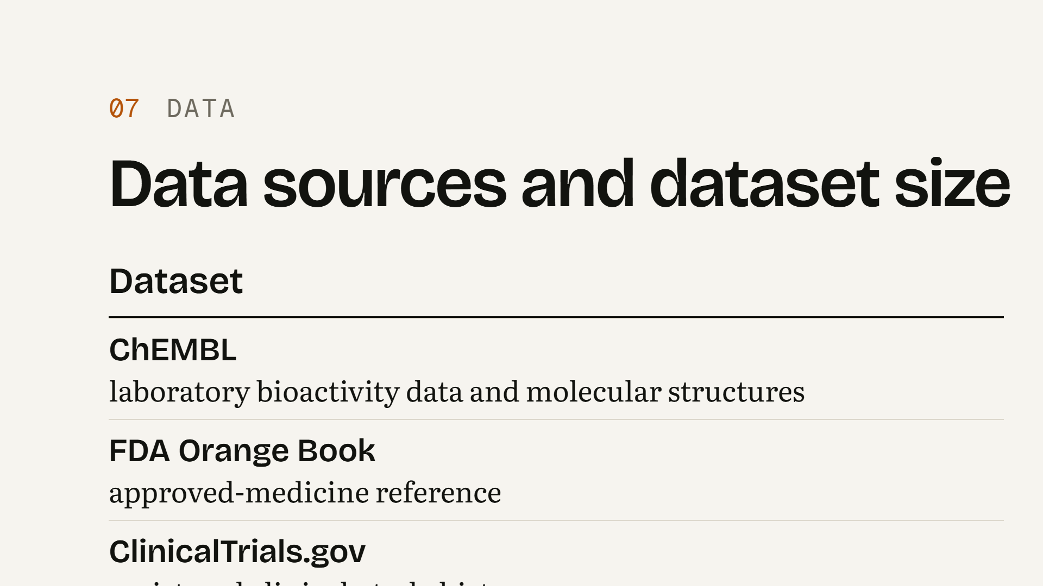
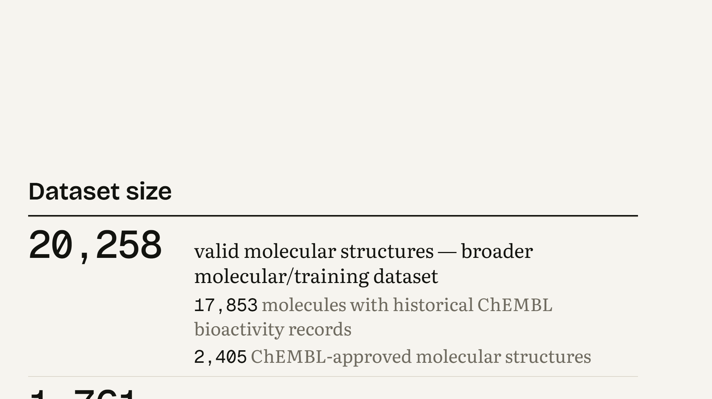
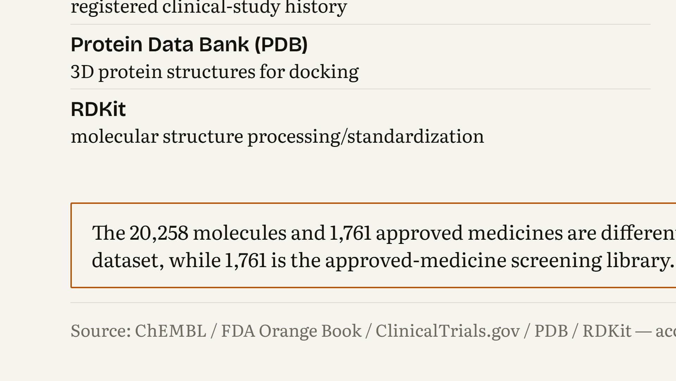
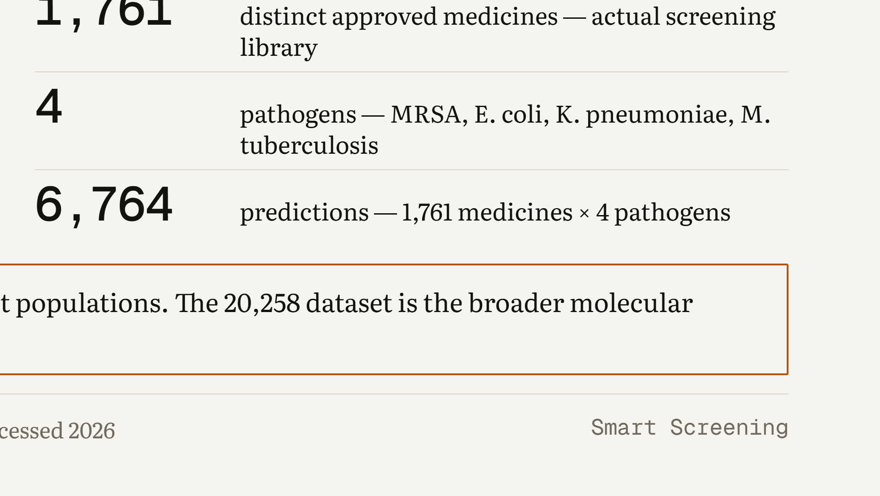
Notes:
WHAT THIS SLIDE MEANS: These are the data sources and tools behind the pipeline, and the size of each dataset. WHAT THE AUDIENCE SHOULD UNDERSTAND: ChEMBL supplies laboratory bioactivity records and molecular structures. The FDA Orange Book defines which medicines are approved. ClinicalTrials.gov gives the registered study history. The Protein Data Bank provides the 3D protein structures used for docking. RDKit is the software used to process and standardise molecular structures. On the right: 20,258 valid molecular structures form the broader training dataset; 1,761 distinct approved medicines form the actual screening library; 4 pathogens; and 6,764 predictions, which is 1,761 medicines times 4 pathogens. The 20,258 and 1,761 are different populations and should not be added together. LIKELY STUDENT QUESTION: “Why is the training set bigger than the screening library?” ANSWER: “The model learns from a broad set of molecules with recorded laboratory activity. We then apply it only to the approved medicines we want to screen.”

Slide 8
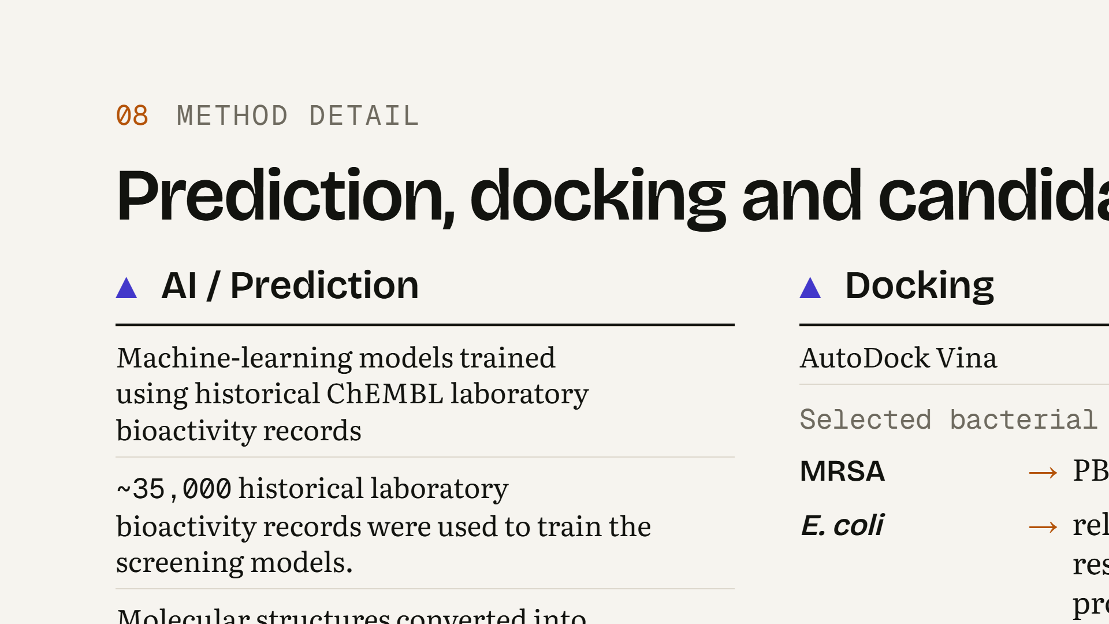
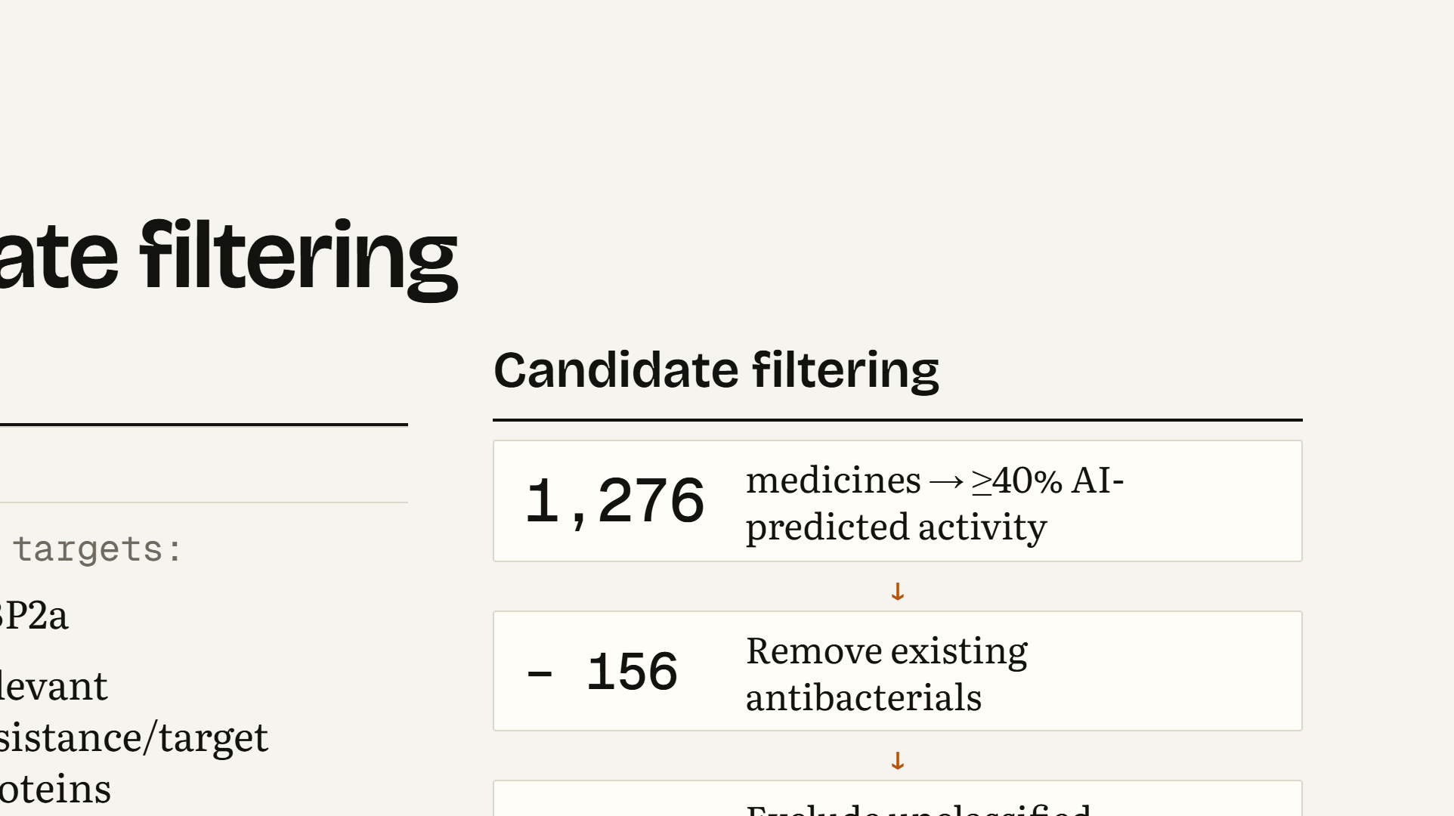
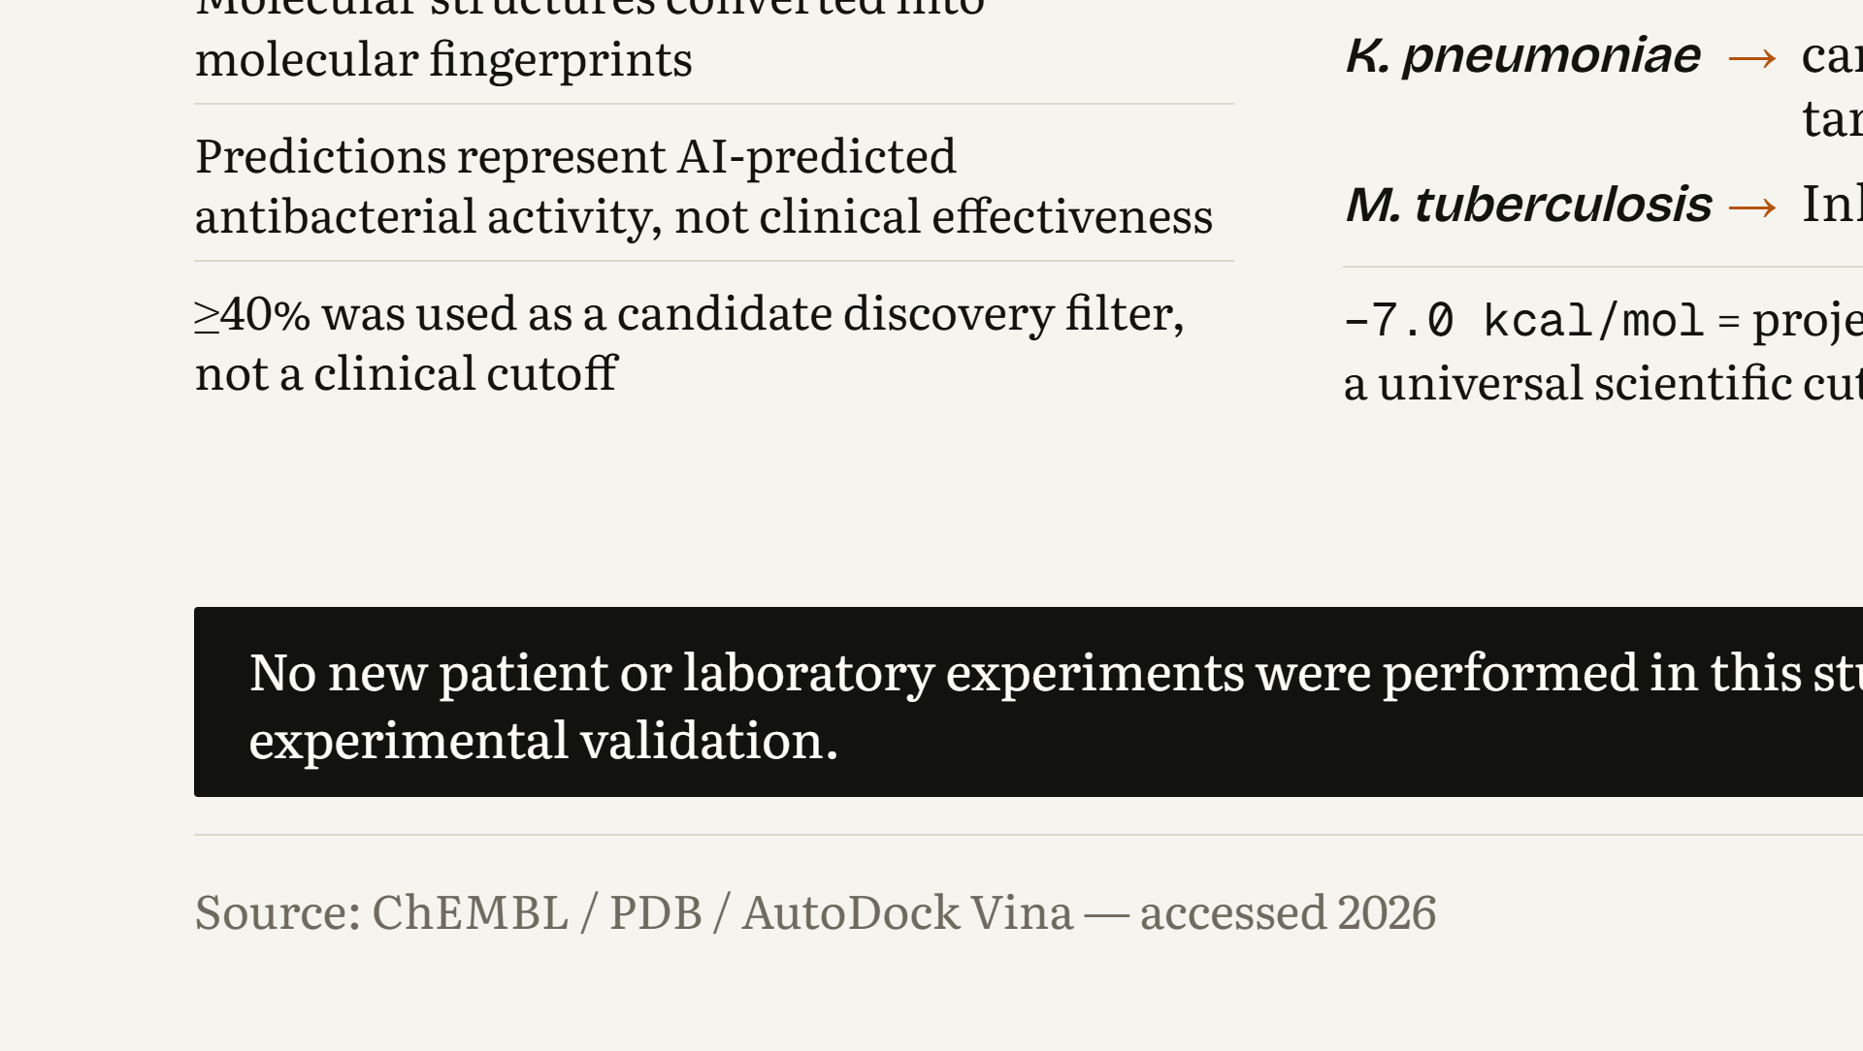
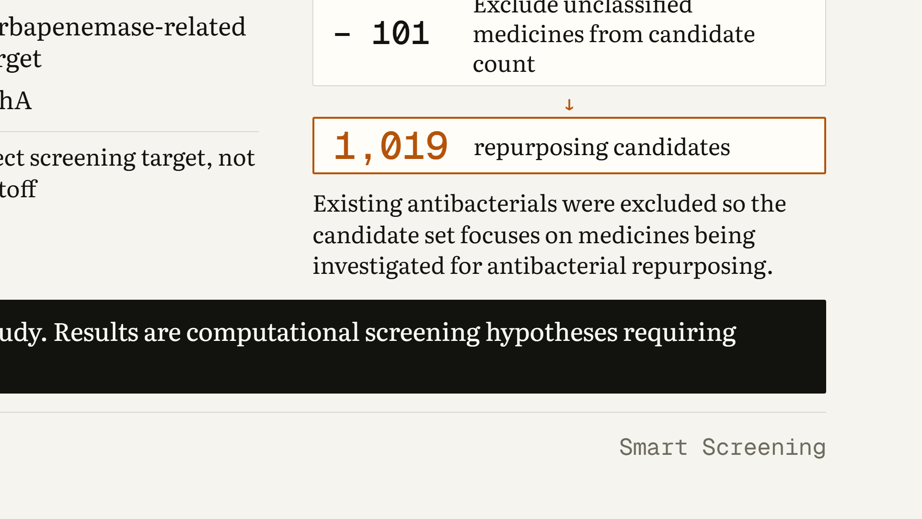
Notes:
WHAT THIS SLIDE MEANS: This is how predictions, docking and candidate filtering were done. WHAT THE AUDIENCE SHOULD UNDERSTAND: The machine-learning models learned from historical ChEMBL laboratory bioactivity records, using molecular fingerprints as the input. Their output is AI-predicted antibacterial activity, not clinical effectiveness, and the 40% level is a discovery filter, not a clinical cutoff. Docking used AutoDock Vina against one selected target per pathogen: PBP2a for MRSA, relevant resistance or target proteins for E. coli, a carbapenemase-related target for K. pneumoniae, and InhA for M. tuberculosis. The −7.0 kcal/mol value is this project’s screening target, not a universal scientific cutoff. Filtering: 1,276 medicines reached at least 40%; existing antibacterials were removed; unclassified medicines were excluded from the count; 1,019 repurposing candidates remain. No new patient or laboratory experiments were performed. LIKELY STUDENT QUESTION: “Why −7.0 and not another number?” ANSWER: “It is a practical screening target chosen for this project to prioritise molecules. Other studies use different values, and a docking score alone never proves binding.”

Slide 9
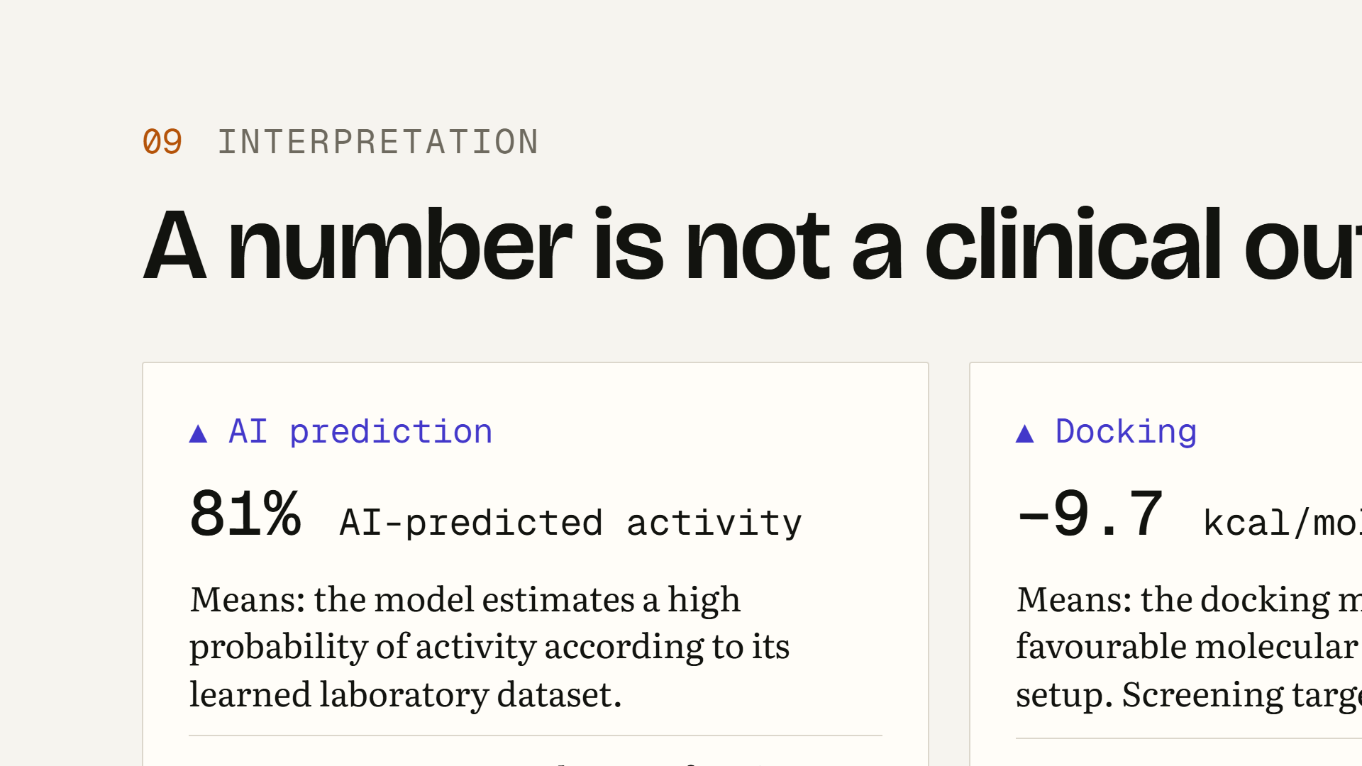
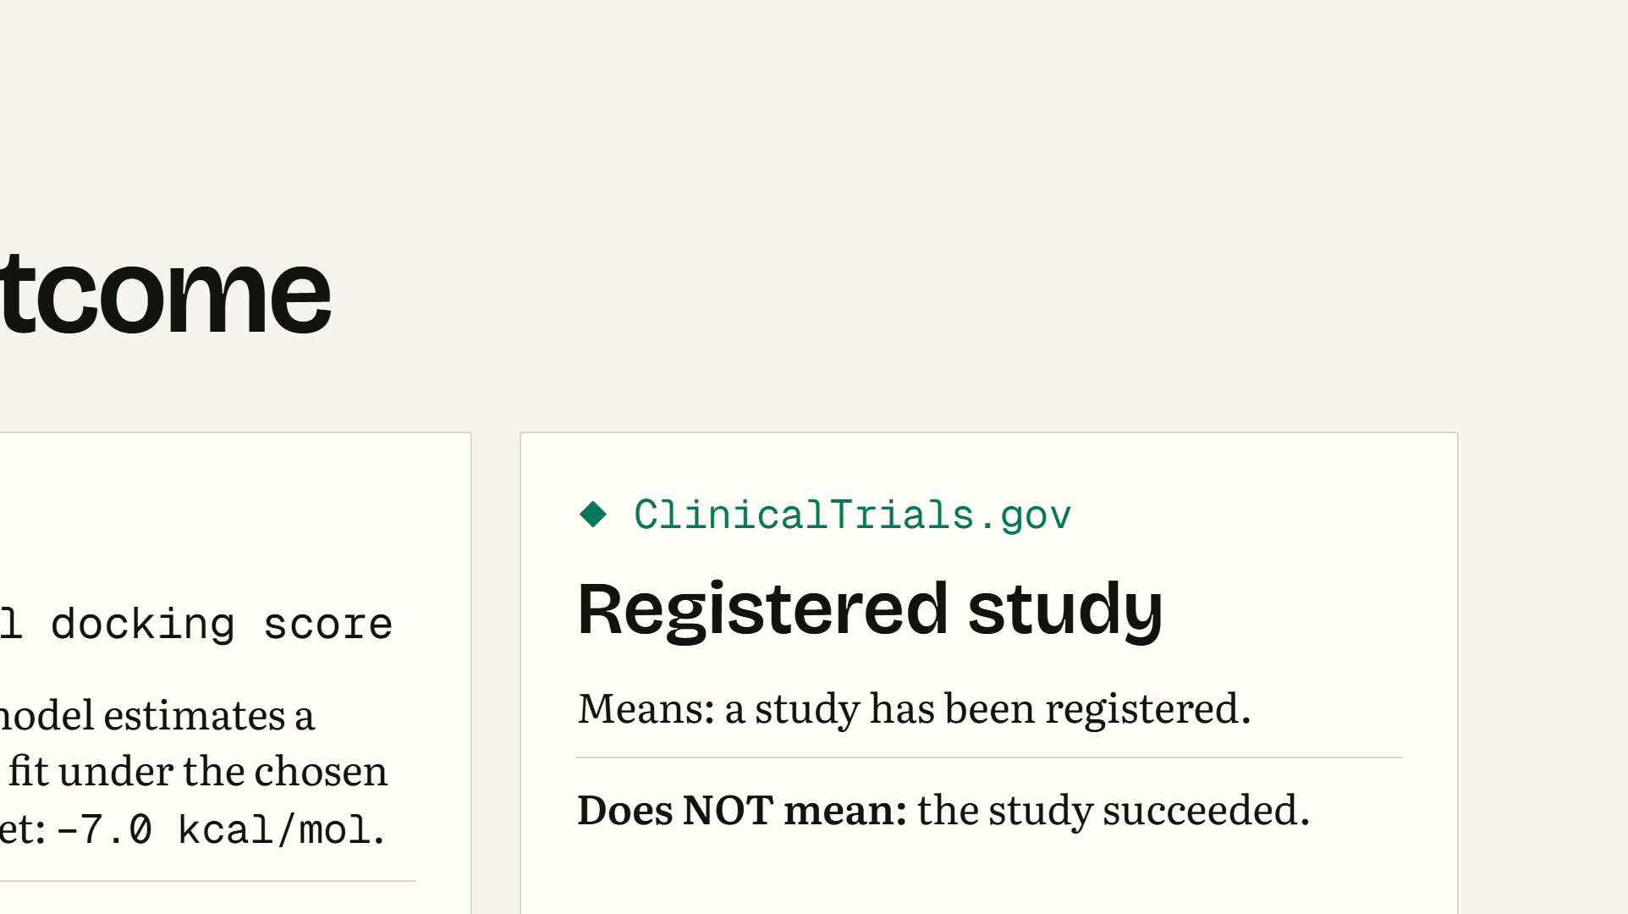
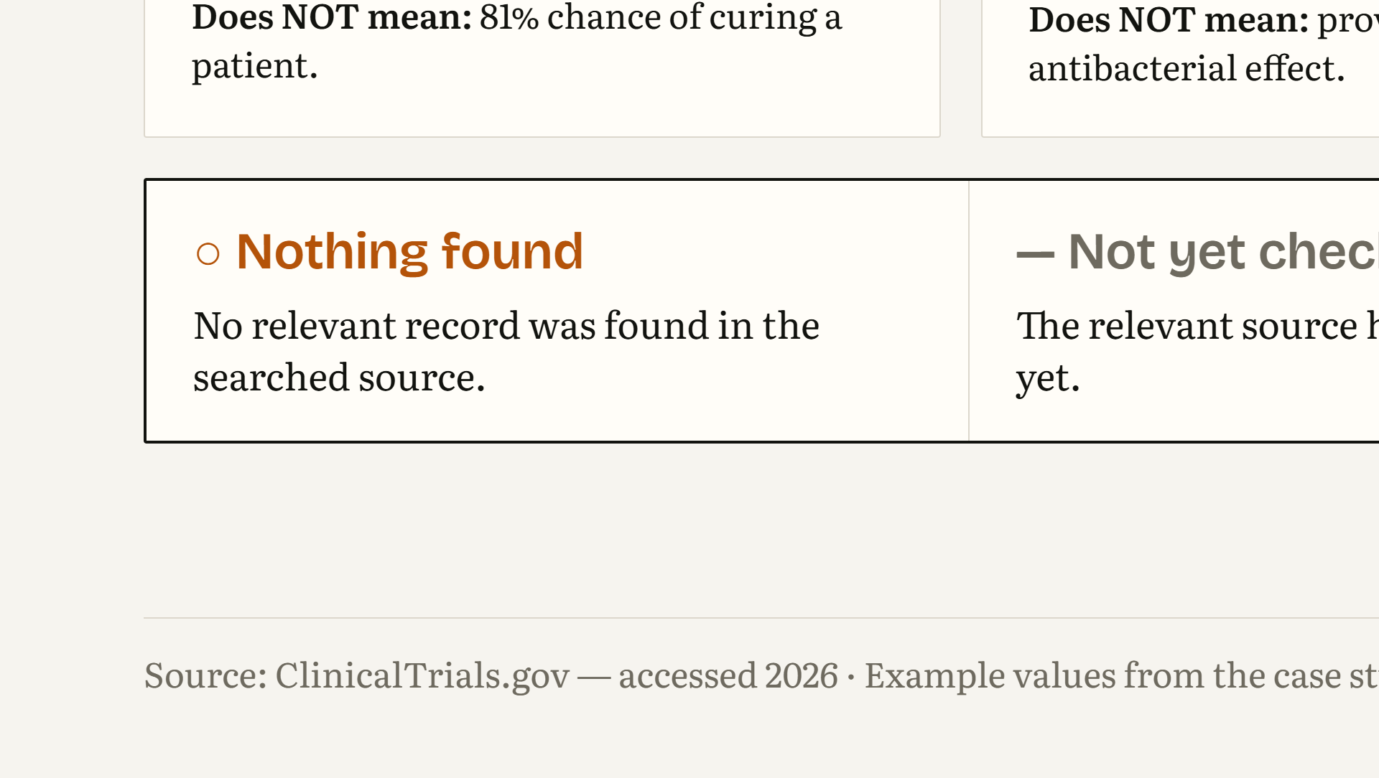
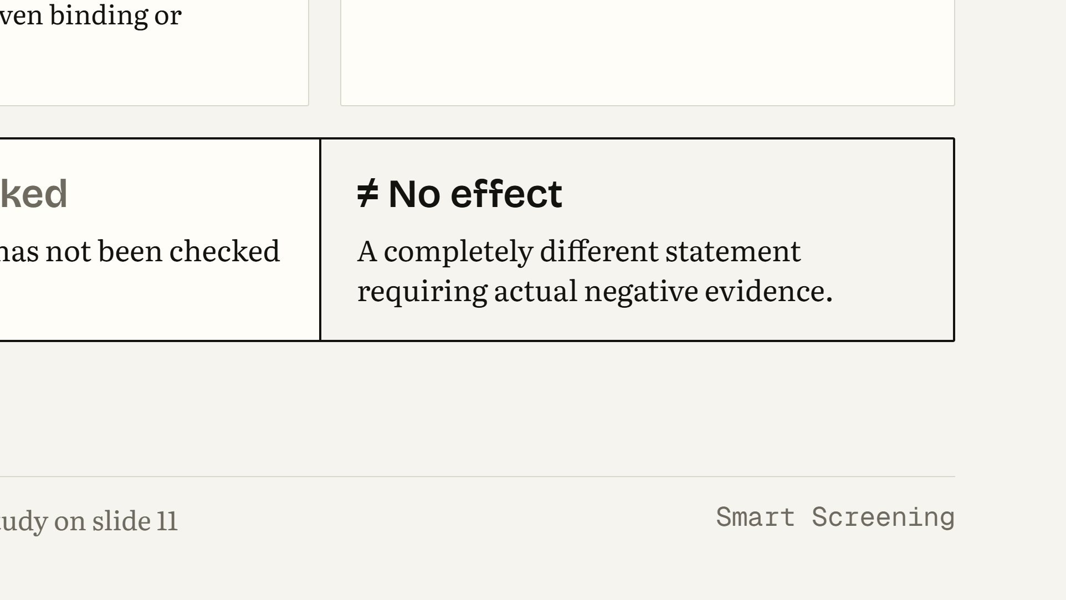
Notes:
WHAT THIS SLIDE MEANS: This is how to read every number in the project. WHAT THE AUDIENCE SHOULD UNDERSTAND: 81% AI-predicted activity means the model estimates a high probability of activity according to its learned laboratory dataset. It is not an 81% chance of curing a patient. A docking score of −9.7 kcal/mol means the docking model estimates a favourable molecular fit under the chosen setup. The project uses −7.0 kcal/mol as a screening target. It is not proof of binding or of antibacterial activity. A registered study on ClinicalTrials.gov means someone registered a study; it says nothing about whether it succeeded. Finally, the bottom row: ‘nothing found’ means we searched a source and found no relevant record. ‘Not yet checked’ means we have not searched that source. Neither of these means ‘no effect’, which is a completely different claim that needs actual negative evidence. LIKELY STUDENT QUESTION: “Does 81% mean there is an 81% chance the patient responds?” ANSWER: “No. It is an AI-predicted activity value learned from laboratory activity data. It is not a clinical response probability.”

Slide 10
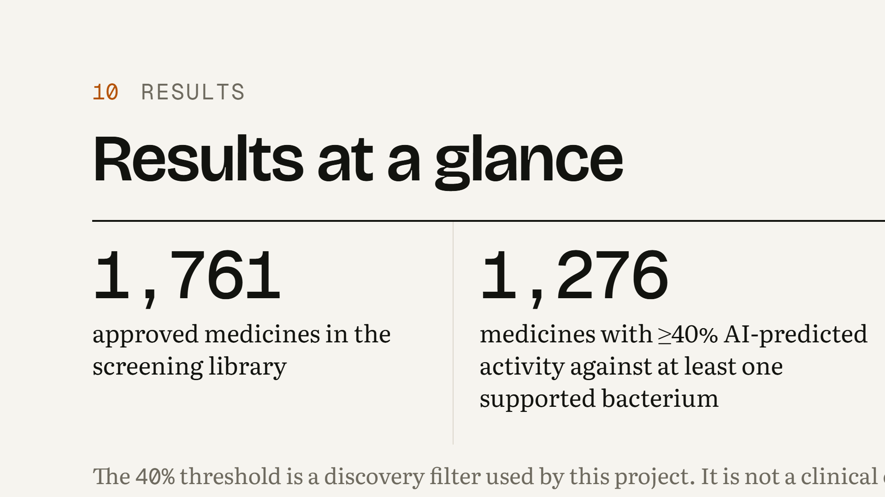
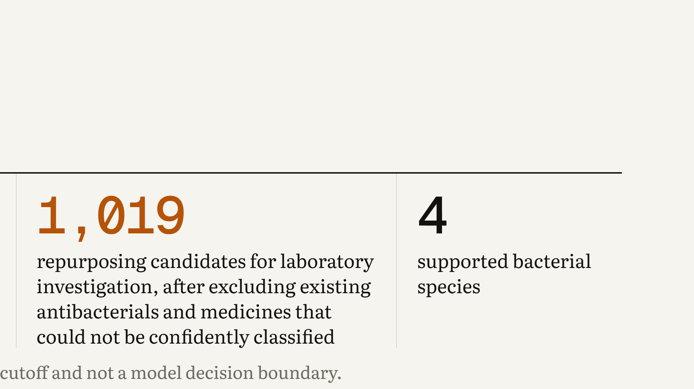
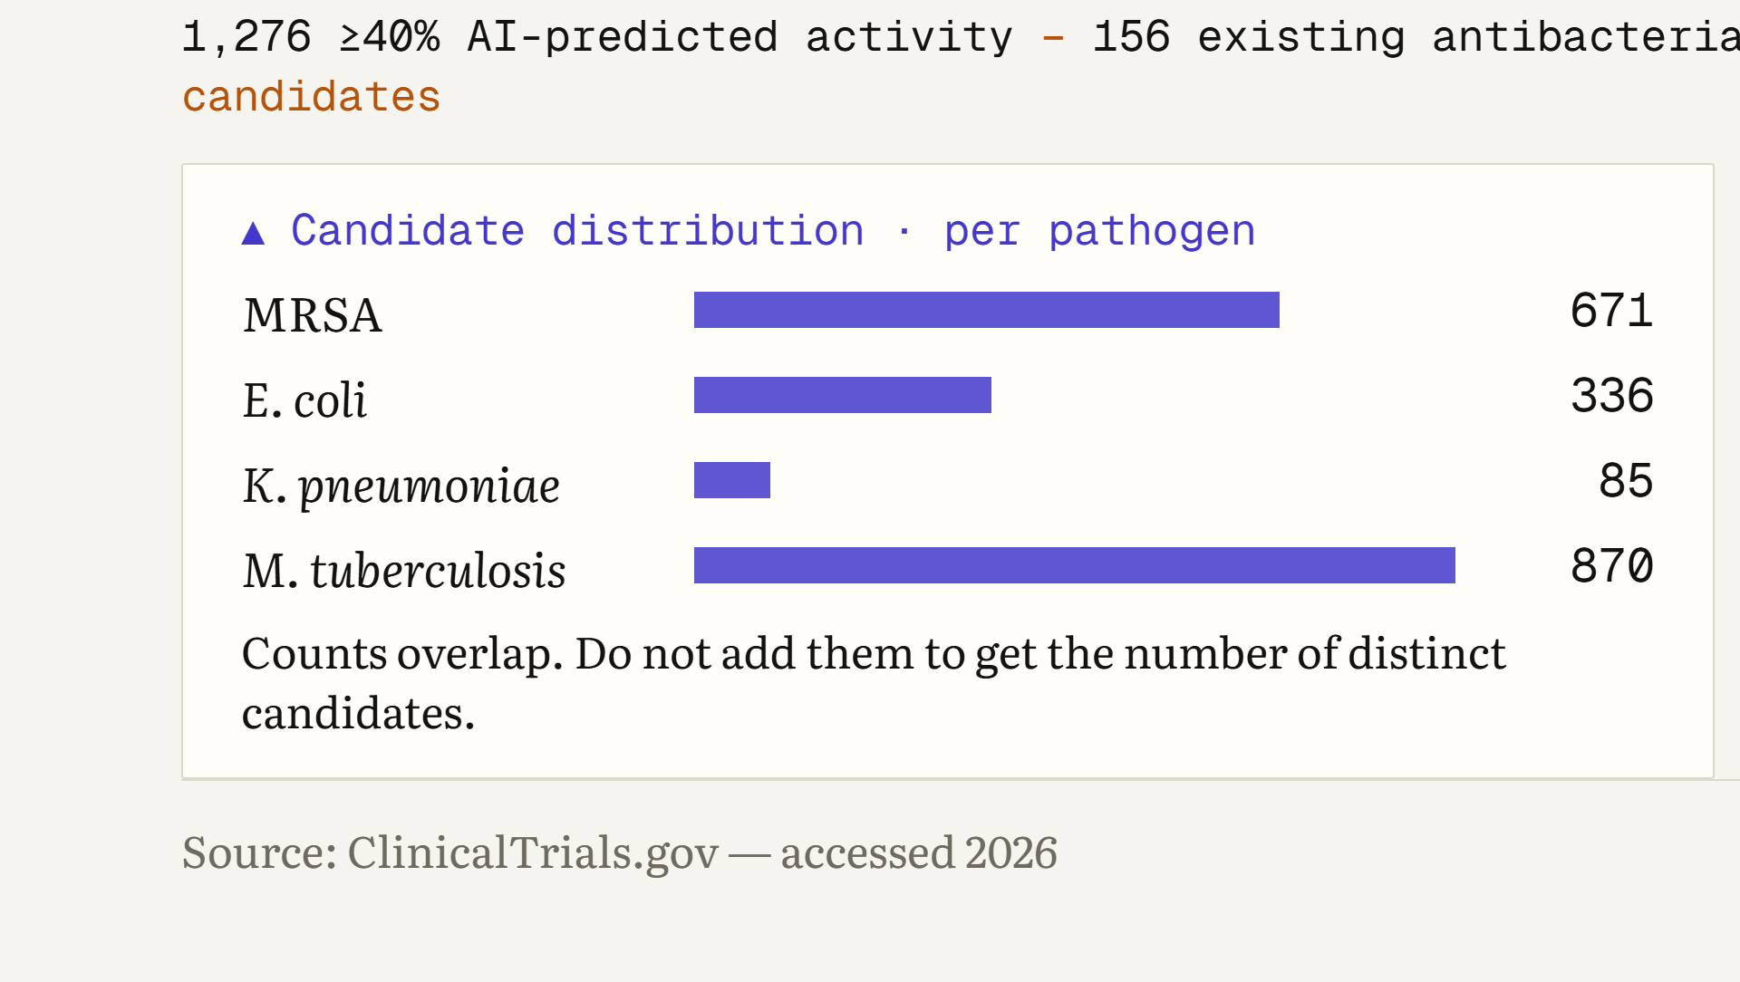
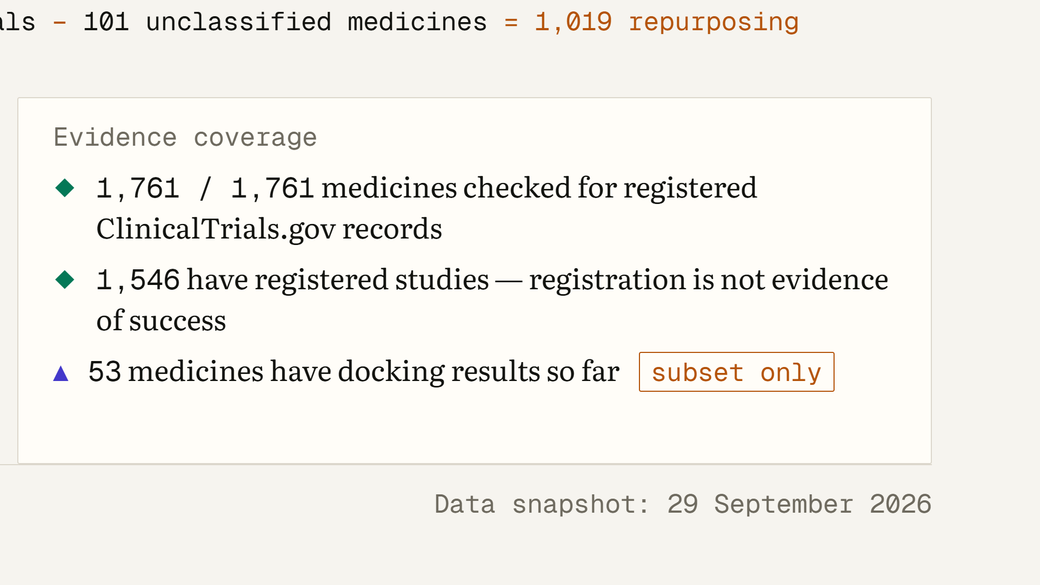
Notes:
WHAT THIS SLIDE MEANS: These are the project’s current numbers, from the 29 September 2026 data snapshot. WHAT THE AUDIENCE SHOULD UNDERSTAND: We screened 1,761 approved medicines. 1,276 of them reached at least 40% AI-predicted activity against at least one of the four bacteria. The 40% is a discovery filter chosen for this project; it is not a clinical cutoff and not the model’s decision boundary. After removing existing antibacterials and medicines that could not be confidently classified, 1,019 remain as repurposing candidates, meaning candidates for laboratory investigation, not 1,019 treatments. The per-pathogen counts overlap because one medicine can be a candidate for several species, so they do not add up to 1,019. All 1,761 medicines were checked for registered ClinicalTrials.gov records, and 1,546 have at least one registered study, for any reason. Docking has been run for only 53 medicines so far, a subset. LIKELY STUDENT QUESTION: “Why does MRSA plus E. coli plus K. pneumoniae plus TB add up to more than 1,019?” ANSWER: “Because the counts overlap. A medicine flagged for both MRSA and TB is counted in both bars but only once in the 1,019.”

Slide 11
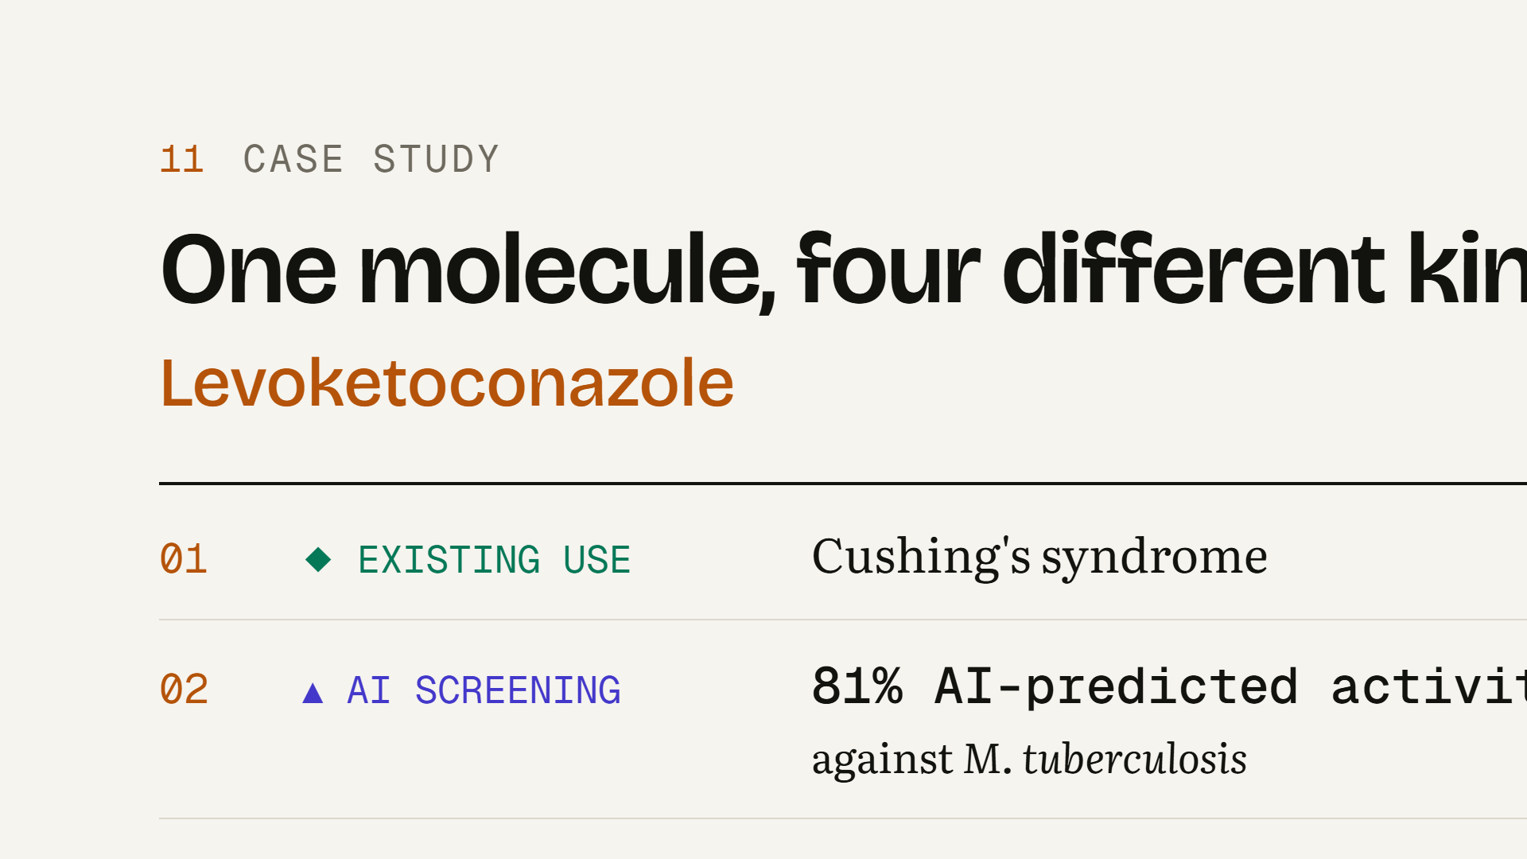
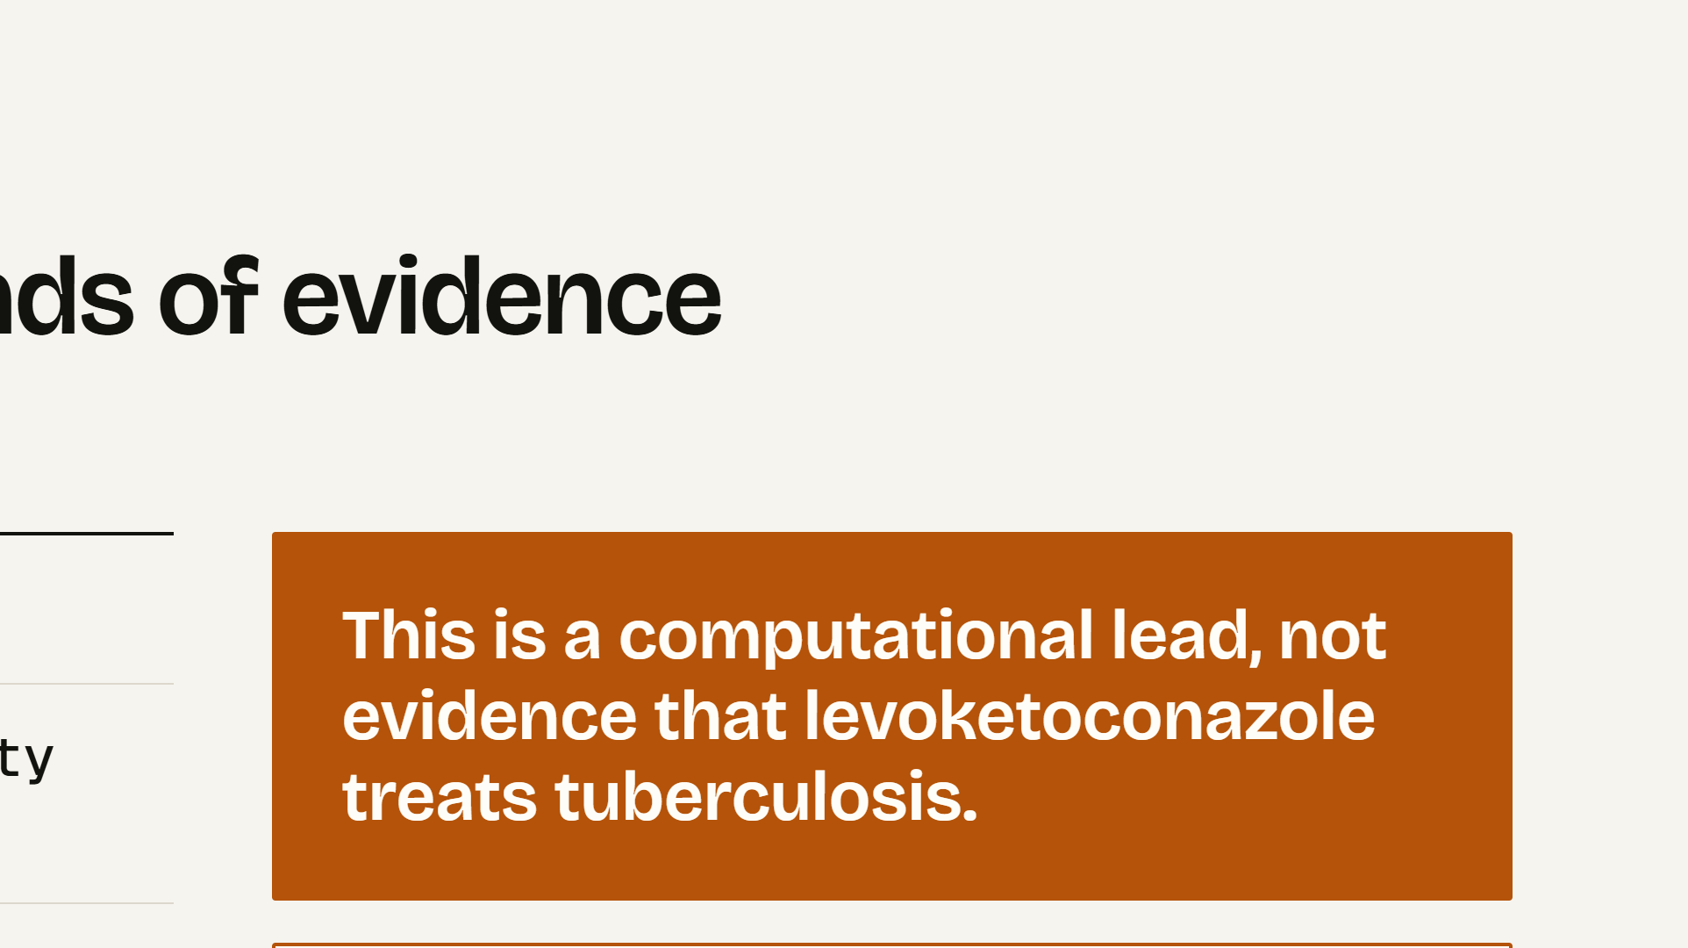
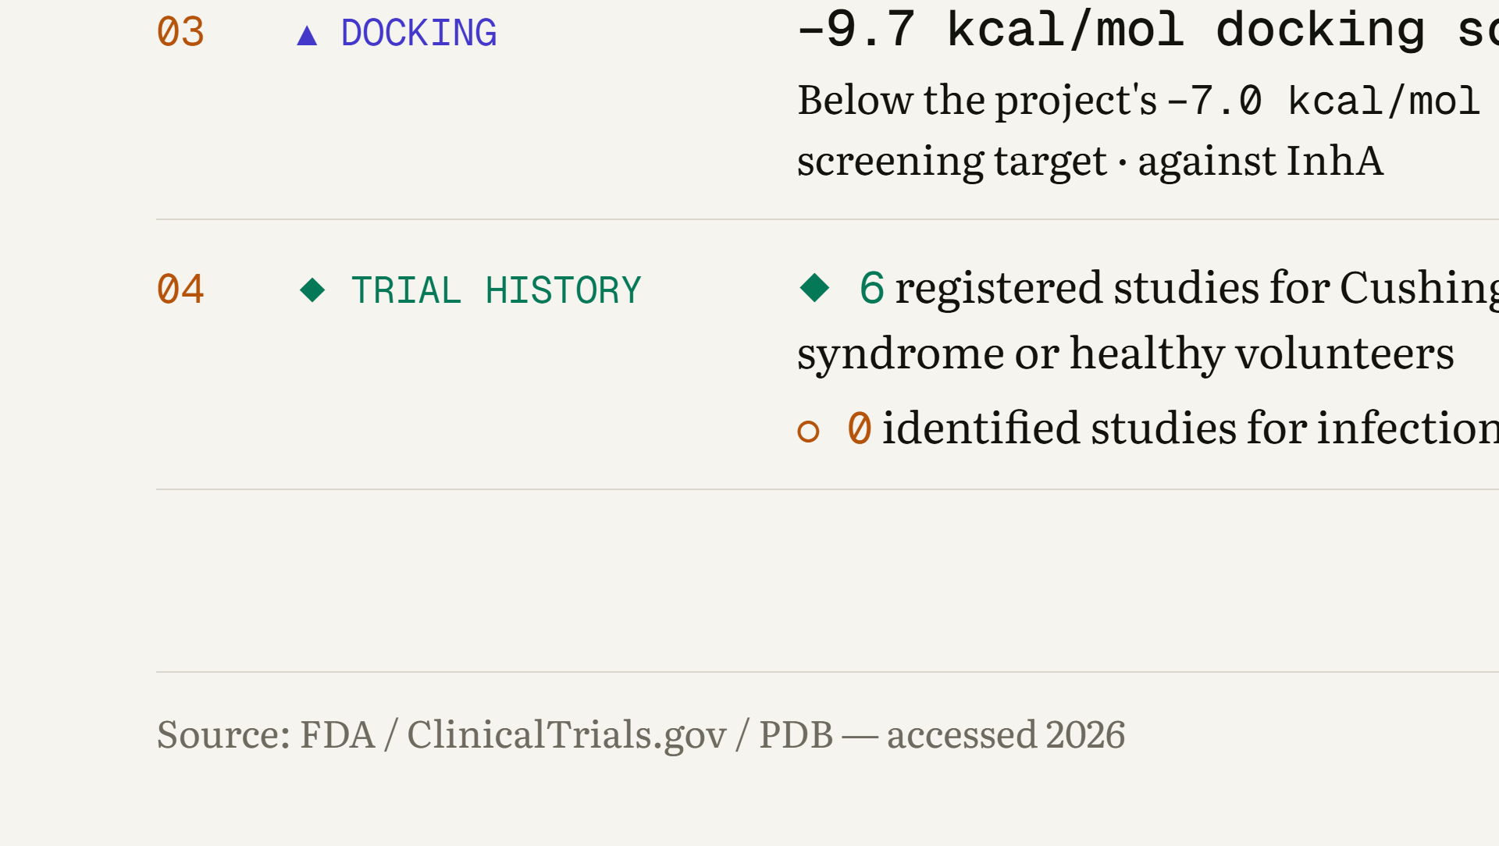
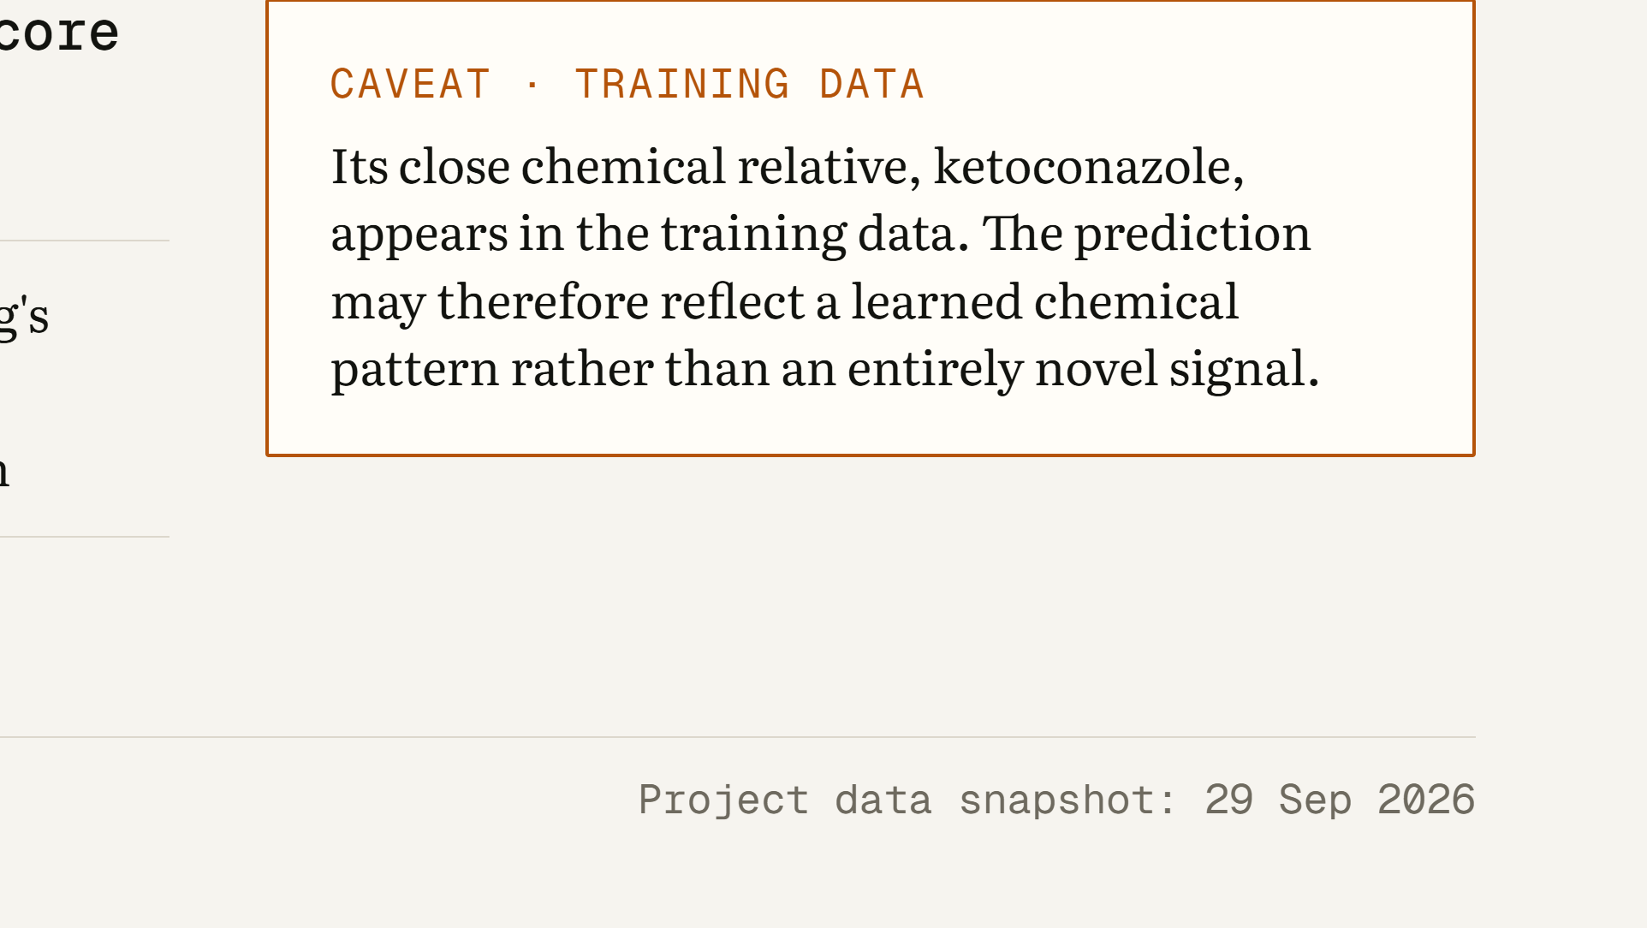
Notes:
WHAT THIS SLIDE MEANS: One example shows how the four kinds of evidence sit side by side for a single medicine. This is an example of hypothesis generation, not a highlighted result. WHAT THE AUDIENCE SHOULD UNDERSTAND: Levoketoconazole’s existing approved use is Cushing’s syndrome. The AI model gives it 81% AI-predicted activity against M. tuberculosis. Docking against the TB enzyme InhA gives −9.7 kcal/mol, which is below the project’s −7.0 kcal/mol screening target. Its trial history: 6 registered studies, all for Cushing’s syndrome or in healthy volunteers, and no identified studies for infection. So this is a computational lead, not evidence that it treats tuberculosis. There is also an important caveat: its close chemical relative ketoconazole appears in the training data, so the model may simply be recognising a familiar chemical pattern rather than detecting something new. LIKELY STUDENT QUESTION: “Since it is already approved, could doctors just try it for TB?” ANSWER: “No. There is no laboratory or clinical evidence for TB. The approved use, dose and safety profile relate to Cushing’s syndrome. The next step would be laboratory testing, not patients.”

Slide 12
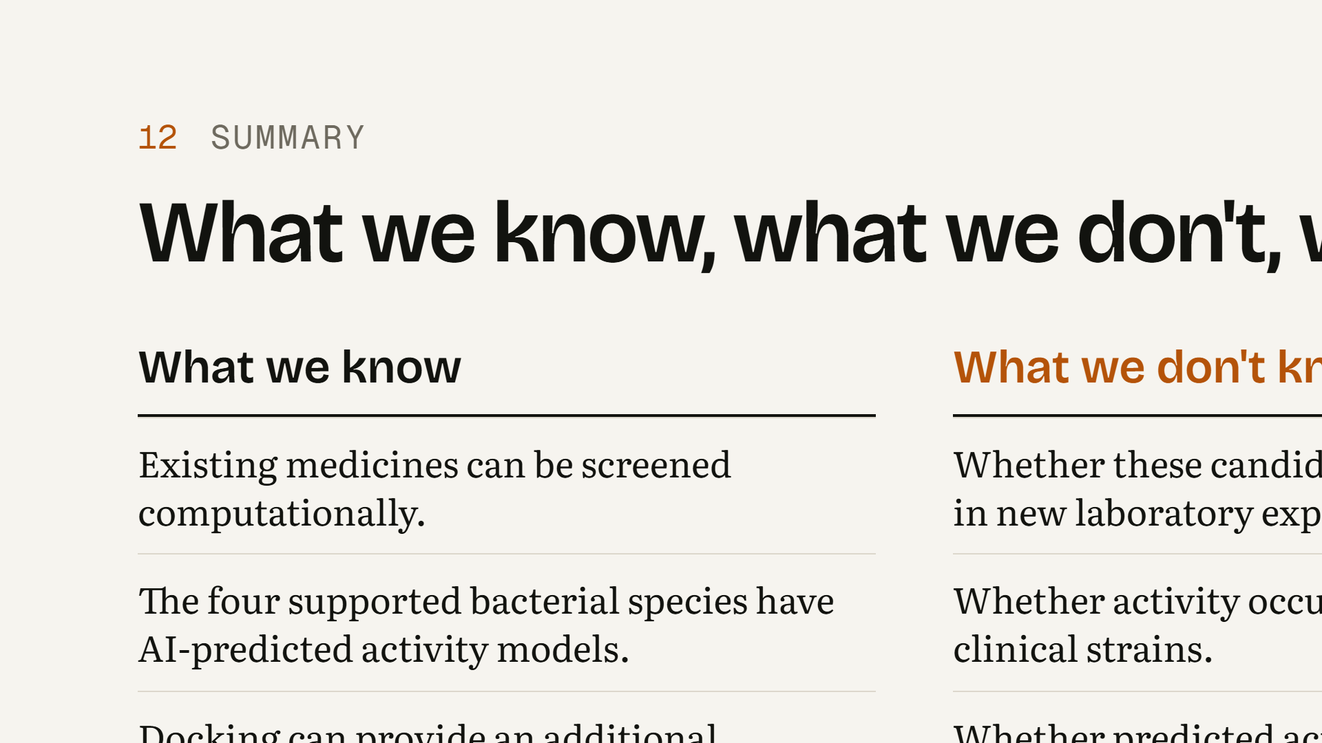
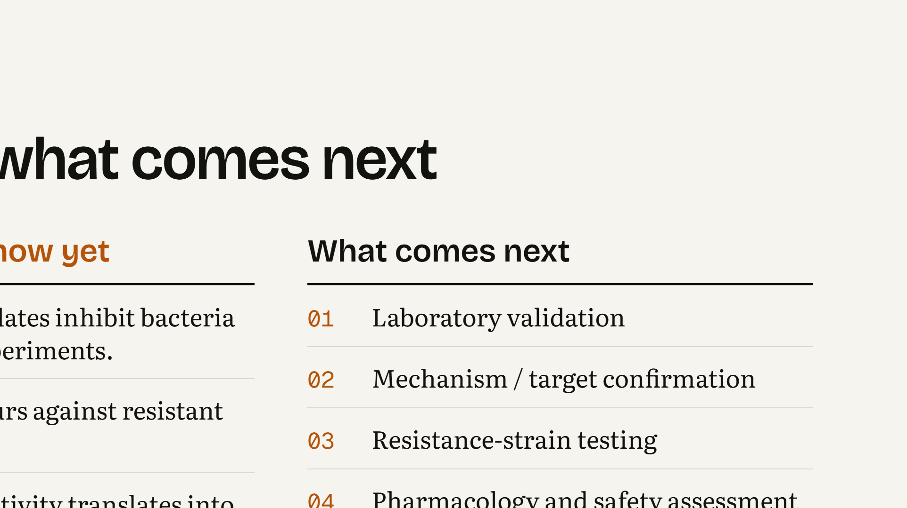
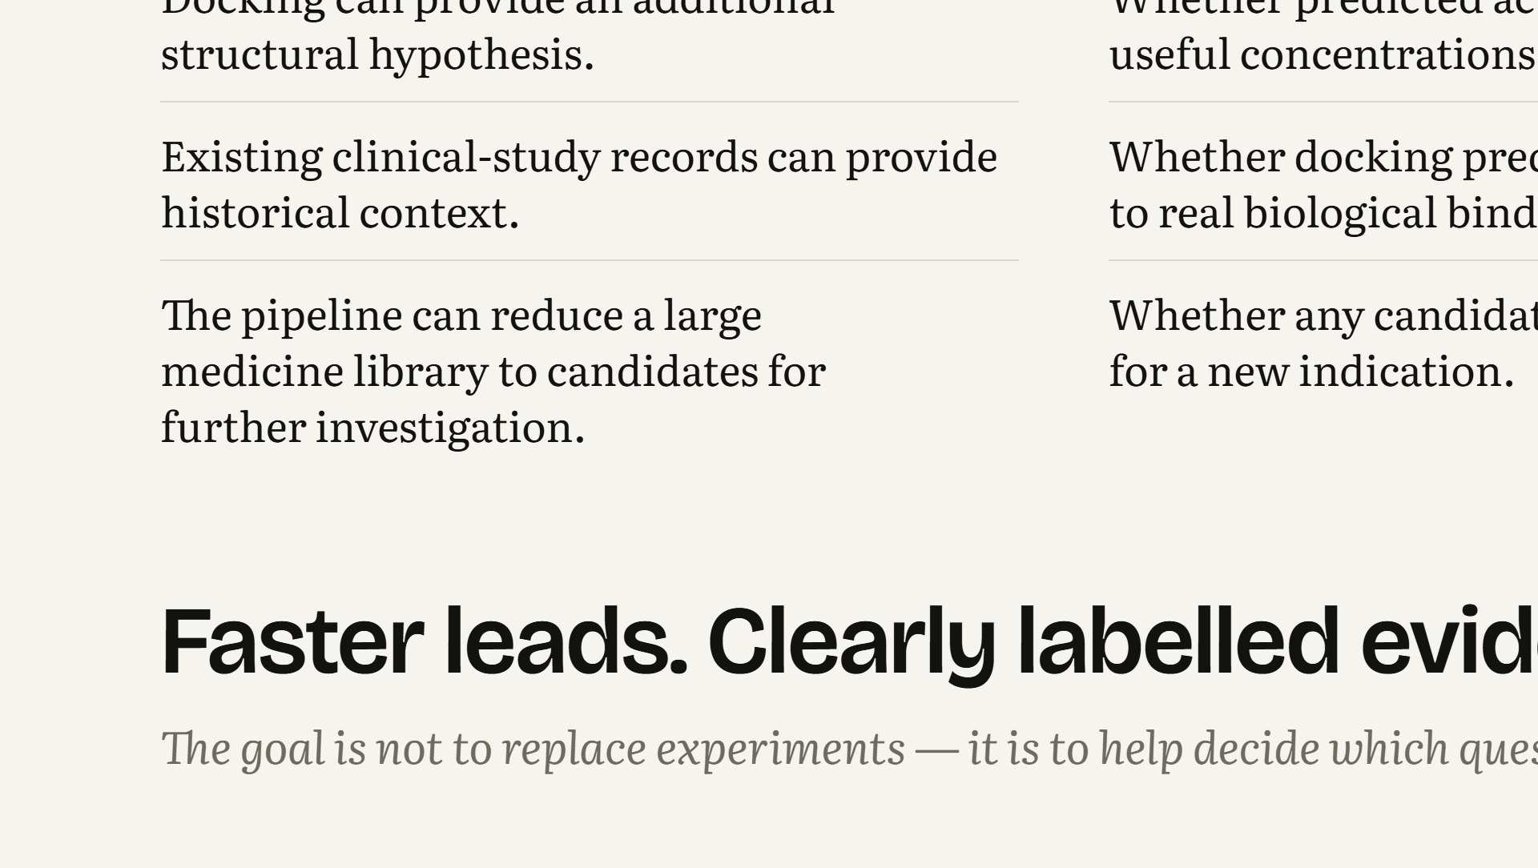
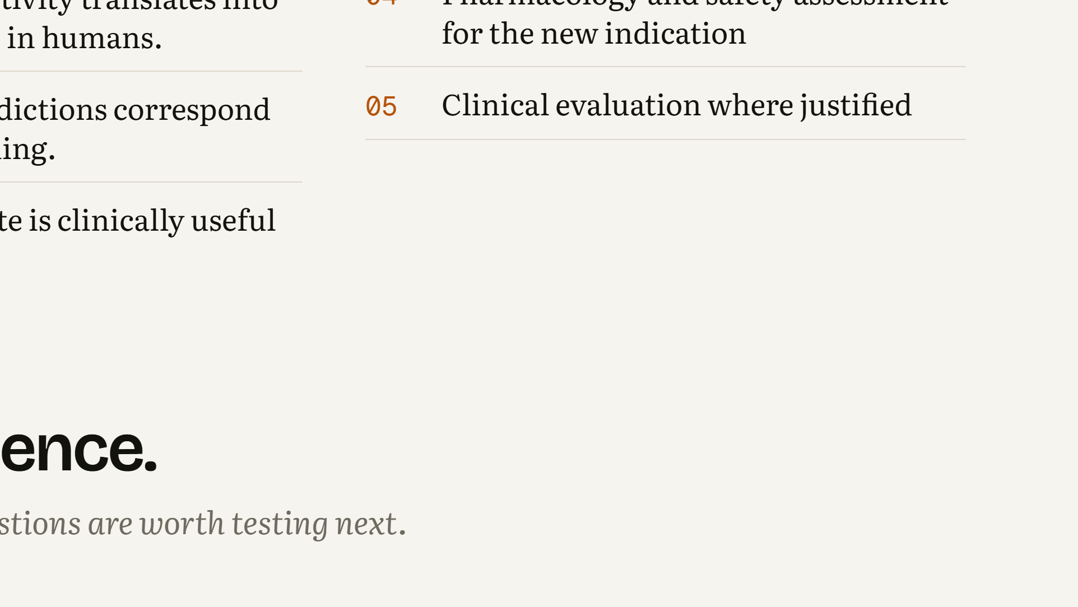
Notes:
WHAT THIS SLIDE MEANS: This summarises what the project can and cannot tell us. WHAT THE AUDIENCE SHOULD UNDERSTAND: We know that existing medicines can be screened computationally, that there are AI-predicted activity models for four species, that docking adds a structural hypothesis, that clinical-study records add historical context, and that the pipeline can narrow a large library to candidates worth investigating. We do not yet know whether any candidate inhibits bacteria in new experiments, whether activity holds against resistant clinical strains, whether useful concentrations are reachable in humans, whether docking reflects real binding, or whether any candidate is clinically useful. The path forward is laboratory validation, then mechanism and target confirmation, resistance-strain testing, pharmacology and safety assessment for the new indication, and clinical evaluation only where justified. LIKELY STUDENT QUESTION: “So how much time does this actually save?” ANSWER: “It does not skip any experimental step. It helps decide which medicines are worth testing first, so laboratory effort goes to clearly labelled computational leads instead of a library of 1,761 medicines.”

