Slide 1
Stress and strain
Chapter 4

Slide 2
Stress-strain-temperature relations
Chapter 5

Slide 3
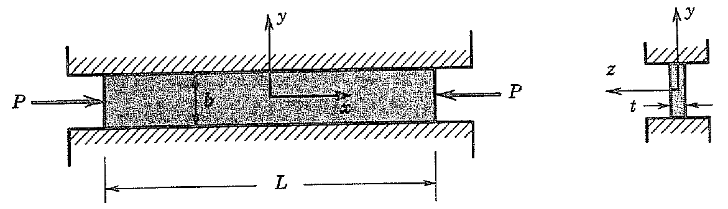
Problems
A long, thin plate of width b, thickness t, and length L is placed between two rigid walls a distance b apart and is acted on by an axial force P. Find the deflection of the plate parallel to the force P.
Assumptions:
No normal stress in z-direction.
Negligible or no friction at the walls

Slide 4
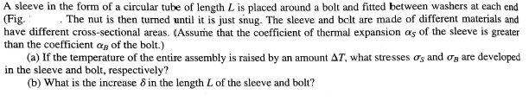

Slide 6
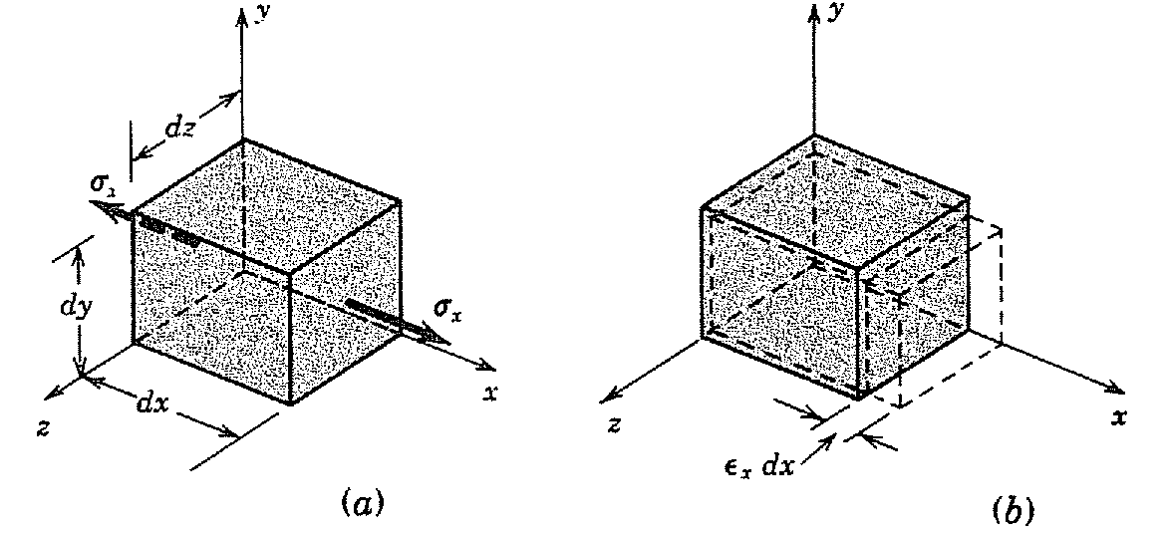
Strain energy in an elastic body

Slide 7
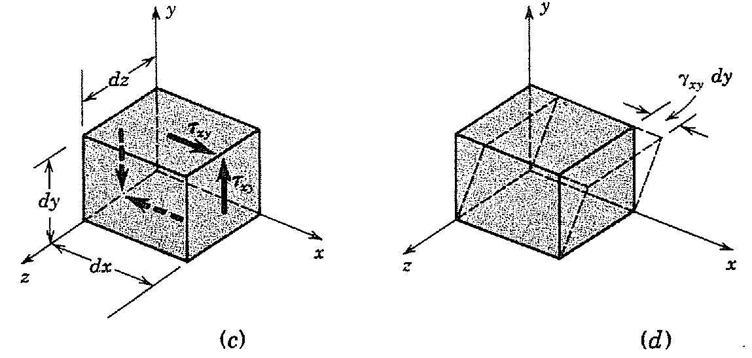

Slide 8
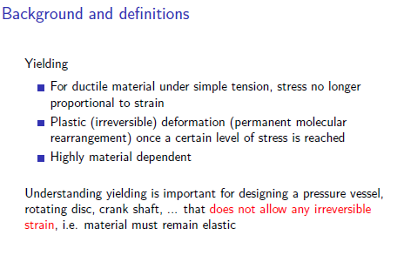

Slide 9
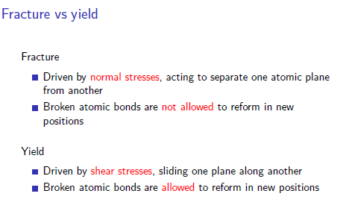

Slide 10
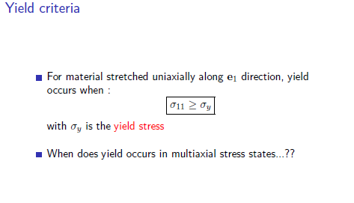

Slide 11


Slide 12
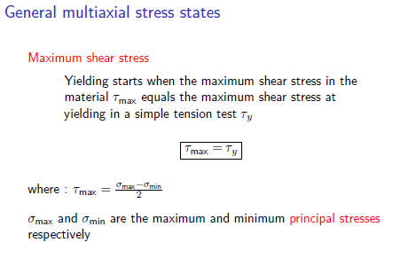

Slide 13
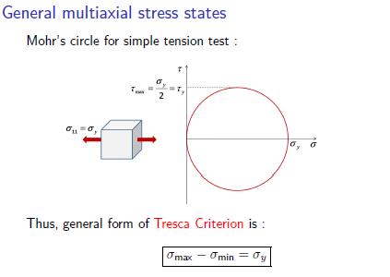

Slide 14
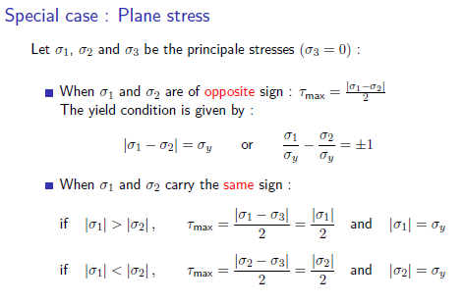

Slide 15
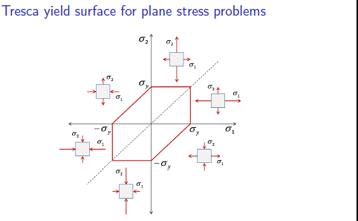

Slide 16
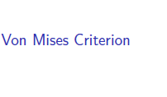

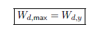

Slide 17

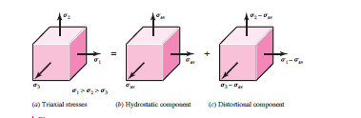


Slide 18
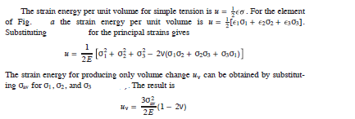


Substituting σav
Distortion energy is given by
-------1

Slide 19
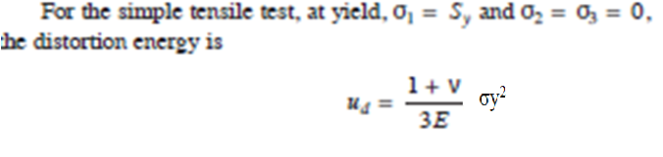
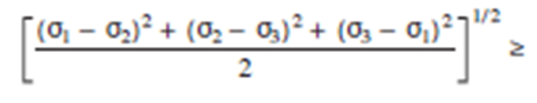
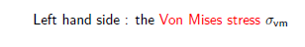
-------2
1=2 gives the yield criterian
σy
σy

Slide 20
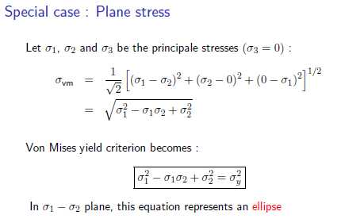

Slide 21
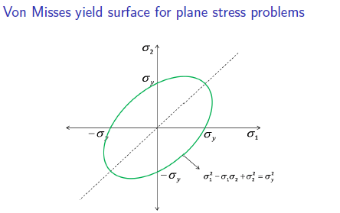

Slide 22
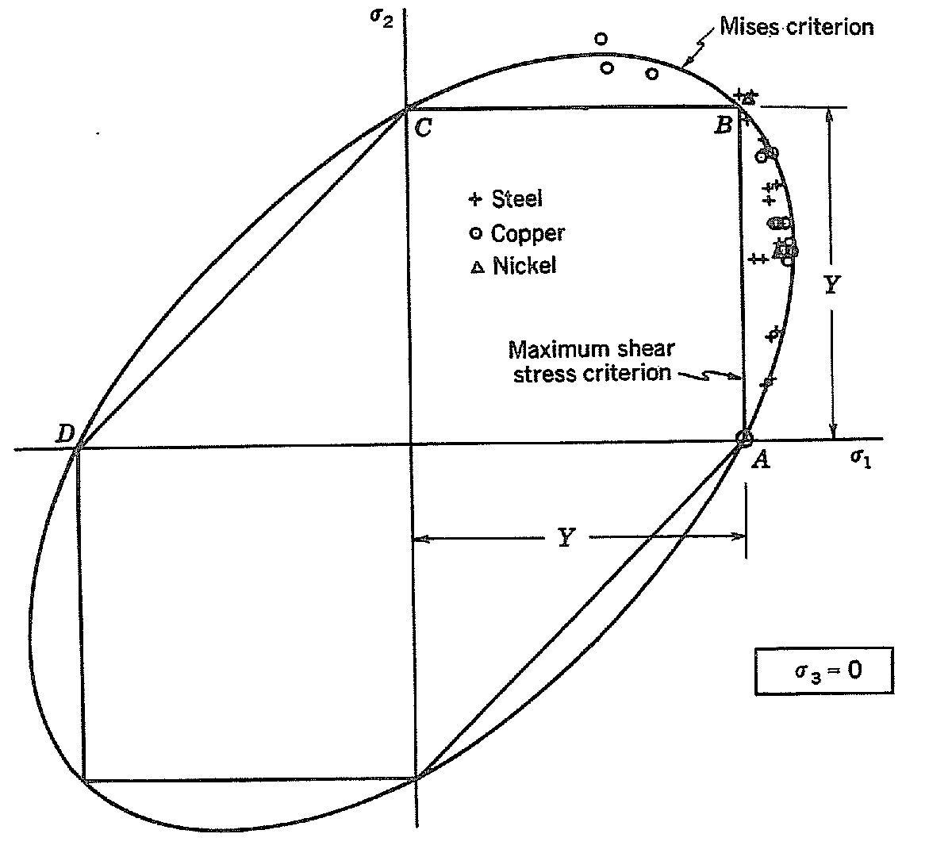

Slide 23
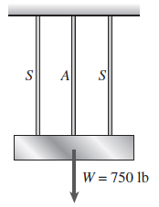
Problem
A rigid bar of weight W 750 lb hangs from three equally spaced wires, two of steel and one of aluminum. The diameter of the wires is . Before they were loaded, all three wires had the same length.
What temperature increase T in all three wires will result in the entire load being carried by the steel wires? (Assume E_{s}= 30x10⁶ psi, α_{s}=6.5x10⁻⁶/°F, and α_{a}=12x10⁻⁶/°F.)

Slide 24
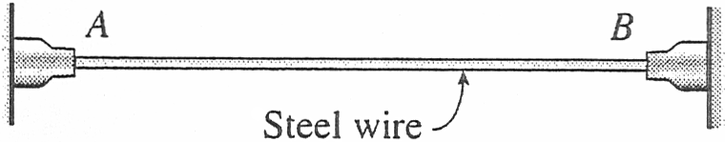
Problem
A steel wire AB is stretched between rigid supports. The initial pre-stress in the wire is 42 MPa when the temperature is 20°C.
(a) What is the stress in the wire when the temperature drops to 0°C?
(b) At what temperature T will the stress in the wire become zero?
(Assume α=14x10⁻⁶/°C and E=200 GPa.)

Slide 25
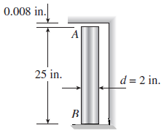
Problem
A copper bar AB of length 25 in. is placed in position at room temperature with a gap of 0.008 in. between end A and a rigid restraint (see figure).
(a) Calculate the axial compressive stress σ_{c} in the bar if the temperature rises 50°F. (For copper, use α=9.6x10⁻⁶/°F and E=16x10⁶ psi.)

Slide 26
The load on a bolt subjected to an axial pull of 15 kN together with a shear of 7.5 kN. Determine the diameter of the bolt according to
Tresca’s criterion
Mises yield criterion
In uniaxial tension, material yields at the stress of 95 N/mm² and poisson’s ratio is 0.3.

Slide 28
THANK YOU

